Slide 1
CEOS Chair 2019 priorities
Committee on Earth Observation Satellites
Pham Anh TUAN
Vietnam National Space Center
Vietnam Academy of Science and Technology
CEOS Plenary 2018
Agenda Item # 8.3
Brussels, Belgium
16 – 18 October 2018

Slide 2
CEOS Chair 2019
As 2019 CEOS Chair, VAST/VNSC will ensure the priorities and initiatives identified by the 2018 Chair (European Commission) and current SIT Chair (NOAA) are supported and further developed through 2019.
In addition, VAST/VNSC will pursue the following initiatives:

Slide 3
An Application Focused Initiative
Application Focused Initiative:
Priority #1:
Carbon Observations (forested regions)
Priority #2:
Observations for Agriculture (rice)

Slide 4
CEOS Chair 2019 Initiative
Seek to integrate a number of ongoing CEOS activities and data in support of the target applications for a targeted region (Mekong Delta is proposed)

Slide 5
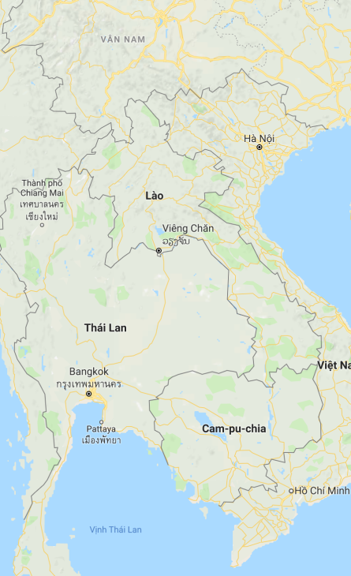
Proposed Initiative Summary
S-1 ARD
GEORice
CESBIO
ALOS ARD
CARD4L/LSI
NovaSAR ARD
ODC
Other ARD.. Landsat +
Mekong River Commission
SDCG
Forest Pilot (GFOI)
GA/CSIRO SARCube
VDC
(Vietnam DataCube)
2019 outcomes for VNSC & CEOS
Rice Pilot (GEOGLAM)
Long-term benefits
SEO
ARD pilots
SAR capacity building
CNES
AOGEOSS, Paris, SDGs
Infrastructure
Activities
Expected outcomes

Slide 6
Why?
Channel to pilot existing CEOS ambitions
Bring together various existing CEOS activities and pilots in support of an engaged user base.
Build a regional observatory to produce tangible outcomes with enduring benefits.
Contribute to CEOS and also build domestic capacity beyond the year.
Collaborative initiative that will demonstrate the utility of each component.
Most importantly demonstrate what can be achieved through integration.
Advances in:
FDA
Data Cube and algorithms
Data fusion – in particular multi-band SAR
Applications for societal benefit, SDG applications, etc.
Training and capacity building activities – in particular on SAR data processing and land applications

Slide 7
How can CEOS contribute?
Data (Analysis-Ready)
Algorithms
Pilot activities
Training and capacity building materials
Contact:
Dr. Vu Anh Tuan: vatuan@vnsc.org.vn
Dr. Lam Dao Nguyen: ldnguyen@vnsc.org.vn

Slide 8
Timeline

Slide 9
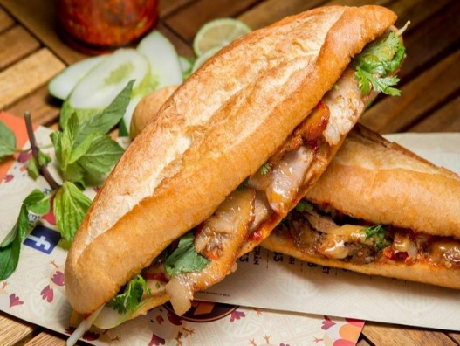
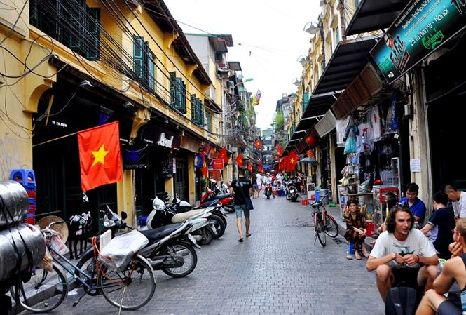
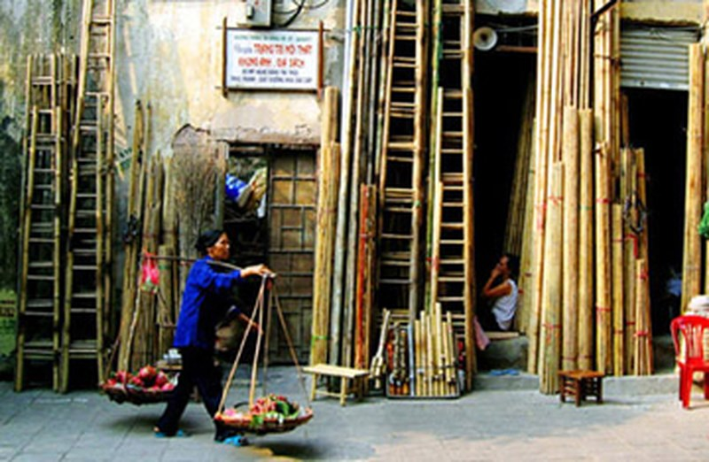
2019 CEOS Plenary
14th - 16th October 2019
WELCOME ALL OF YOU TO HANOI TO ATTEND CEOS PLENARY AND ENJOY….

Slide 10
Video

