Slide 1
Missions, Instruments, and Measurements (MIM) Database Report
Committee on Earth Observation Satellites
I. Petiteville, ESA
CEOS Plenary 2018
Agenda Item #1.7
Brussels, Belgium
17 – 18 October 2018

Slide 2
Overview
Activity
User stats
2018 survey and updates
Troubleshooting and feedback
Coming Improvements
Web app updates and fixes
API
Linkages
ECVI - how to progress collaboration
OSCAR – updated mapping

Slide 3
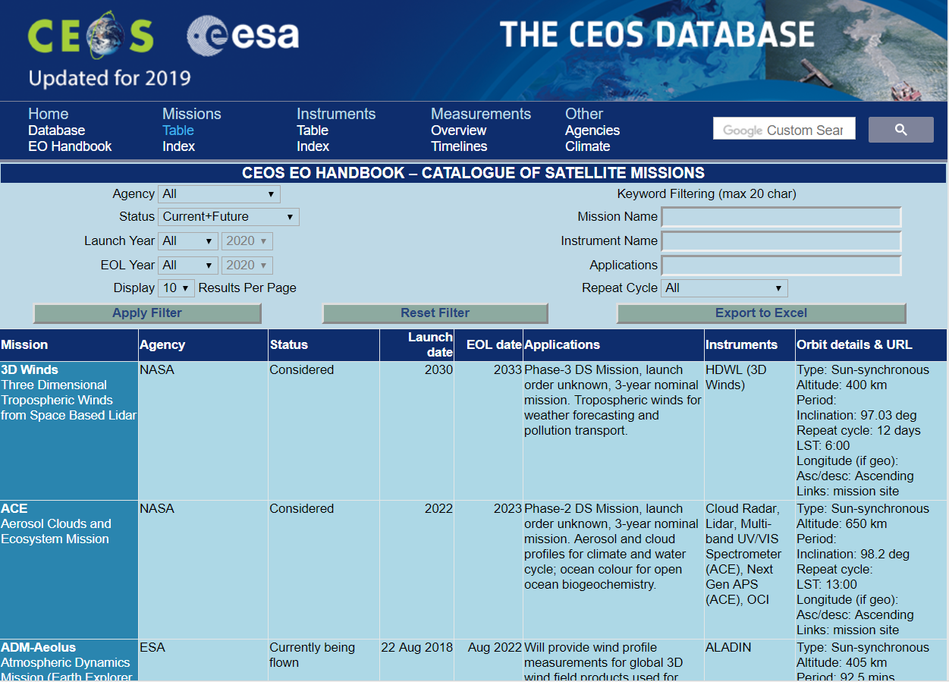
Activity
User stats database.eohandbook.com
150-300 users per week
8,000 - 10,000 per year
17% new users wrt 2017
Similar again for www.eohandbook.com
80-200 users per week
8,000 - 10,000 per year (higher with print edition)
12% new users wrt 2017
Total users
230 – 500 per week
16,000 – 20,000 per year

Slide 4
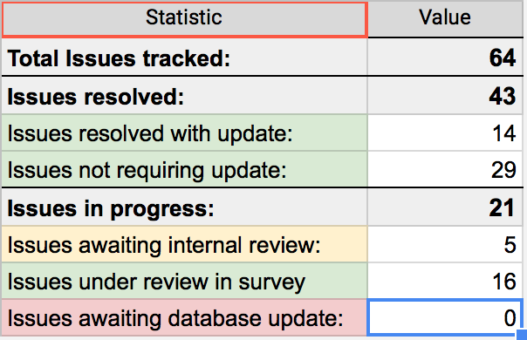
Survey and Updates
2018 survey status
33 Agencies engaged – CEOS + Met Agencies per earlier coordination
Updated database online
database.eohandbook.com
Troubleshooting and feedback
Triaged a table of 57 issues flagged by ECVI Team on both CEOS MIM and WMO OSCAR
Identified items to be checked in survey cycle (24), discussed (4), to change (7), or no change (22)

Slide 5
Improvements
Historical Missions 24 missions with instruments to be included in the database in this release
WMO OSCAR added 130 mappings (~37% increase) between the CEOS DB and OSCAR
Report an Issue link added to the website to enable self-reporting of data consistency questions
Waveband response curves DB tables added to capture waveband response for enhanced analysis capability
API currently being tested with SEO (future mission gap analysis), with broader test user release planned before end 2018

Slide 6
API Objective and Pilot Functionality
Enabling machine-to-machine access to the CEOS Database via an API
Enable the content to be leveraged by external developers
Pilot functionality: supporting gap analysis
[Beta Version Implemented] call by missionID to expose by JSON mission: status, launch and EOL date, mission instruments, agencies, and measurements
[Beta Version Implemented] call by instrumentID to expose by JSON instrument: type, resolution, waveband information, instrument missions, agencies, and measurements
[Remains to be Implemented] call by waveband (nm or GHz range; band name) to expose by JSON instruments with certain properties
Next Steps:
Beta test group to be expanded before end 2018 – NASA/SEO already tester
Demonstration for LSI-VC – possible element of LSI-VC gap analysis toolkit

Slide 7
ECV Inventory
Dialogue with WGClimate following CEOS SIT TW 2017 (Sept-Nov 2017)
Call and follow-up with technical team (Alexandra Nunes, Peter Albert)
Provided a full MS SQL copy of the CEOS DB in support of the ECVI gap analysis
SIT TW Side Meeting: Discussions of Way Forward Ongoing
CEOS MIM, WMO OSCAR and WGClimate representatives
Reciprocal copy of ECVI for CEOS DB Team to assess options
ECVI as a test user for the MIM API (initiate before end 2018)

Slide 8
Questions?

