Slide 1

CEOS Ad Hoc Working
Group for GEOGLAM Update
Committee on Earth Observation Satellites
Bradley Doorn, NASA
Philippe Maisongrande, CNES
Co-Chairs
CEOS Plenary 2018
Agenda Item 6.4
Brussels, Belgium
17 – 18 October 2018

Slide 2

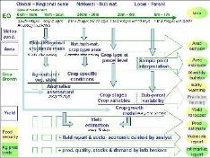
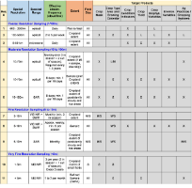
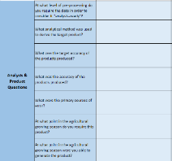


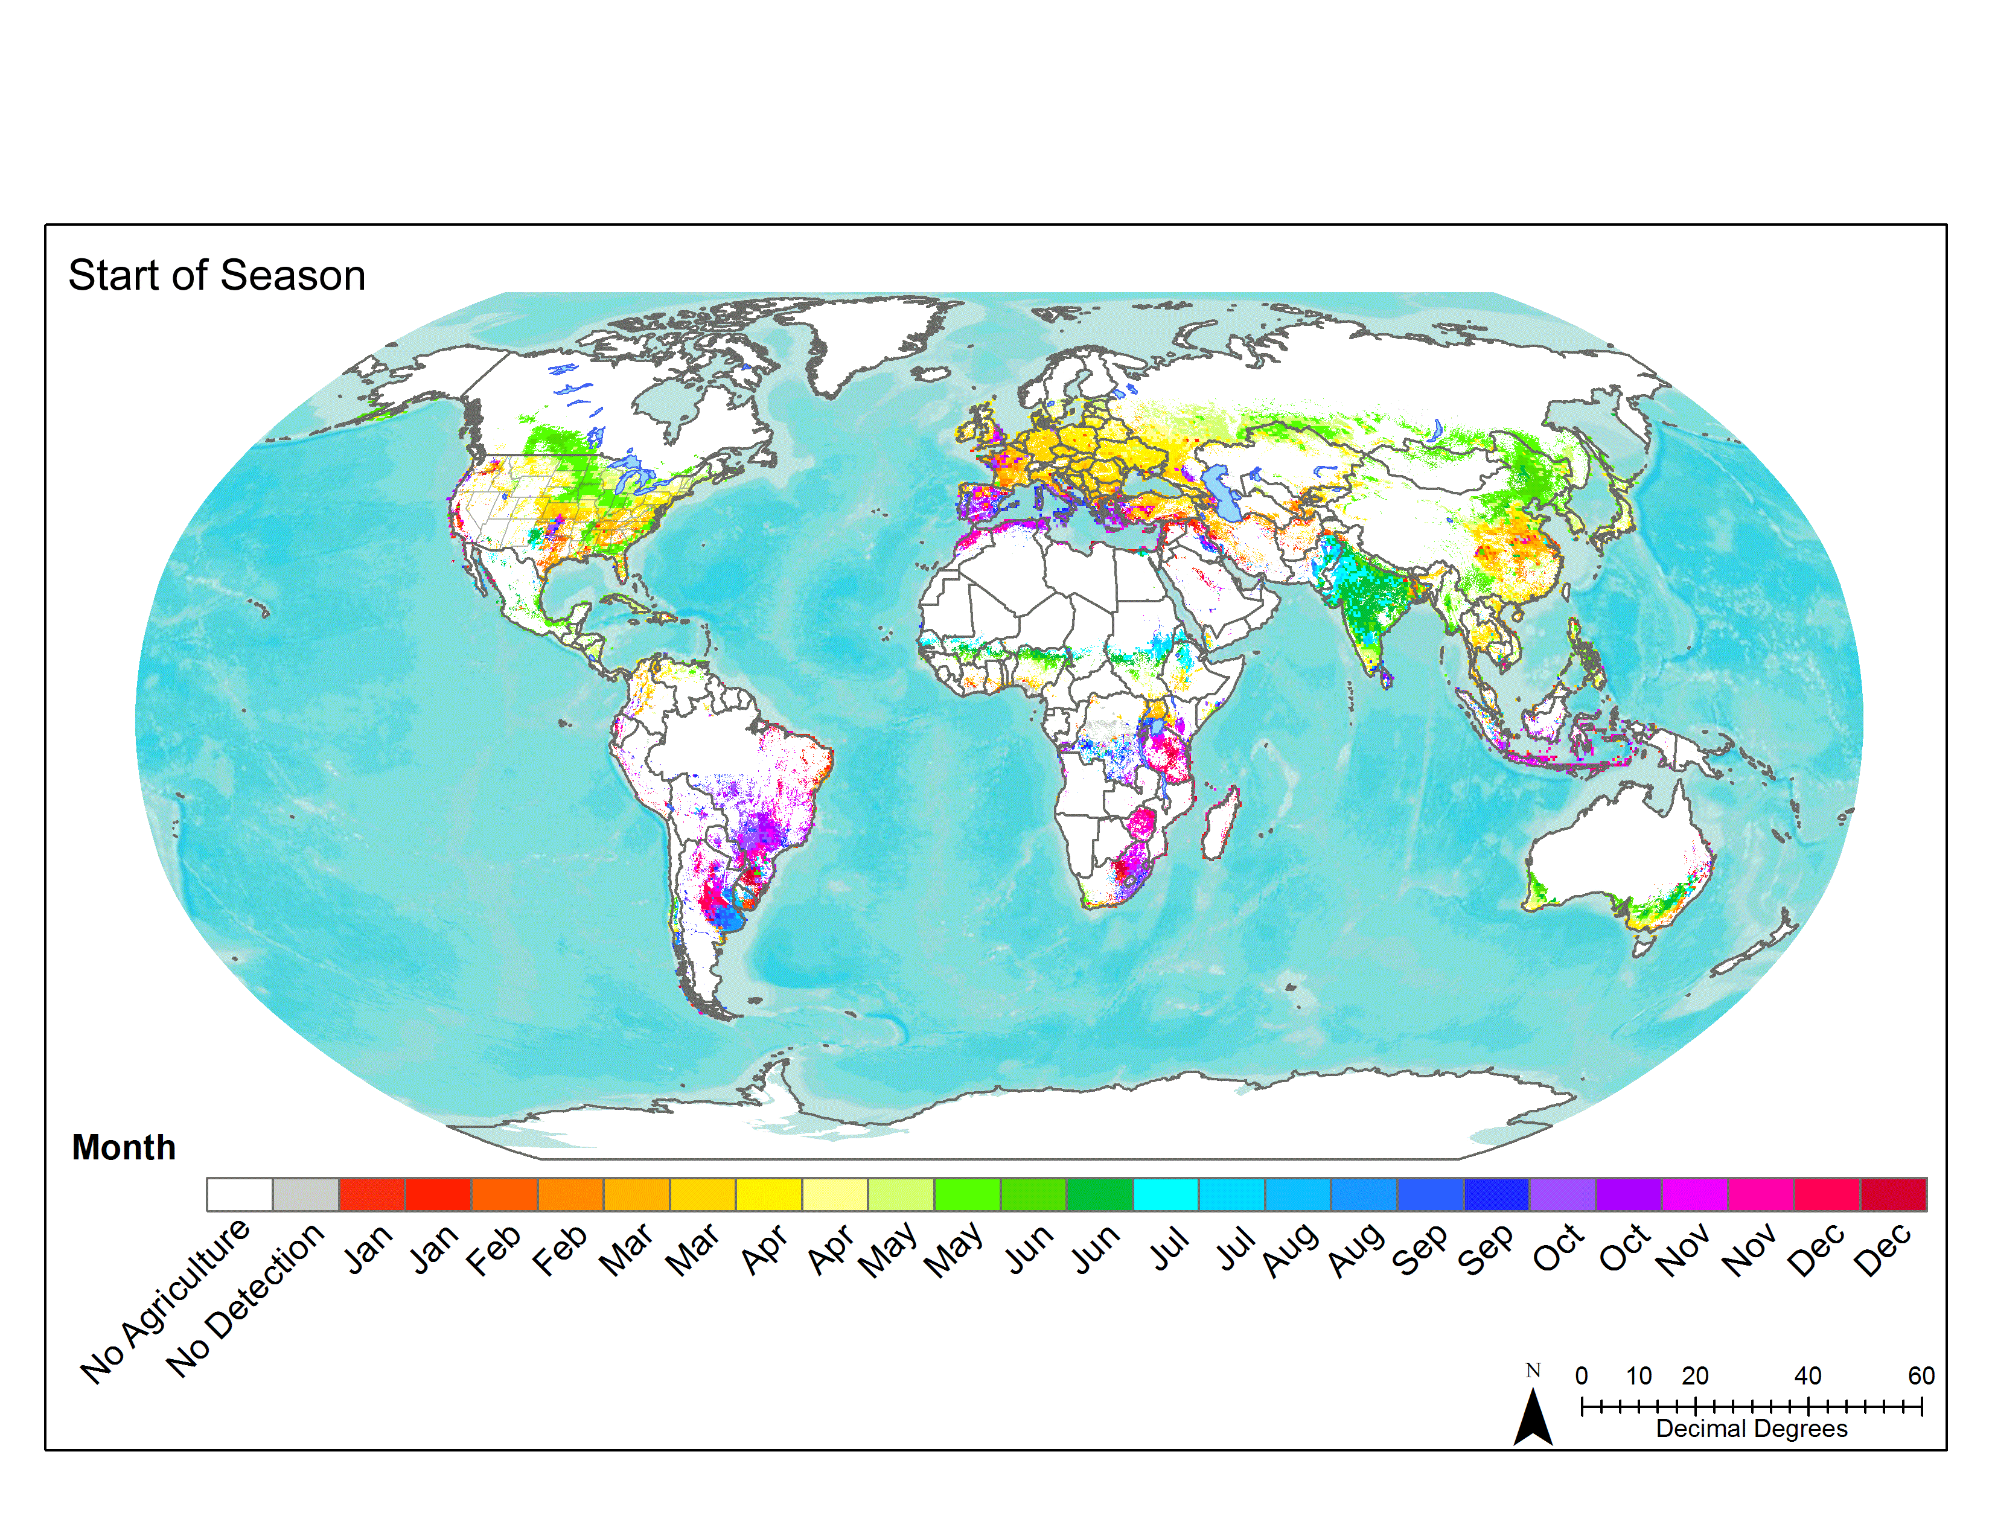
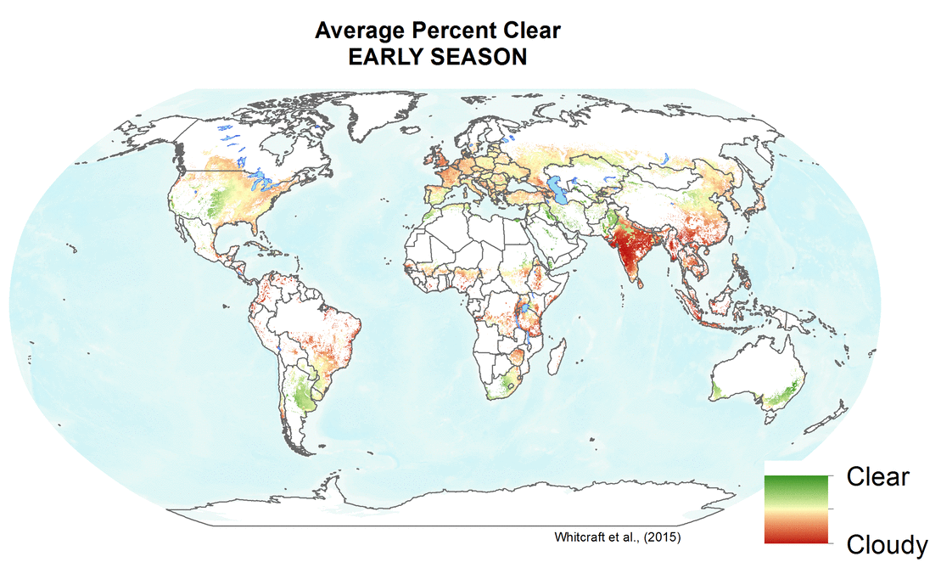
Requirements Summary: Timeline
2005-2010 Defourny Diagram
2012-2014 GEOGLAM Reqs v1
2016-2017
Reqs. v2
2017
Reqs. v2 process Update
2018
Finalize Reqs. v2
  Conceptual requirements
  Spatially explicit requirements by product/variable and by sensor type
  CEOS AHWG on GEOGLAM
  Question template to R&D sites
  New variables
  Minimum vs. preferred
  LSI-VC Coordination
  Discussion of R&D results, recognition of need for operational perspective
  State of use unknown
  LSI-VC Coordination
  Survey deployed
  National, Regional, and Global Users
  Platforms for Use
  LSI-VC Coordination

Slide 3
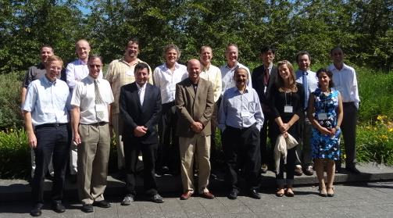
GEOGLAM Workshop on User Requirements
CSA
Montreal July 10-11, 2012
Original Req. Group
16 participants
Global Agriculture Monitoring Experts and Major Data Providers

Slide 4
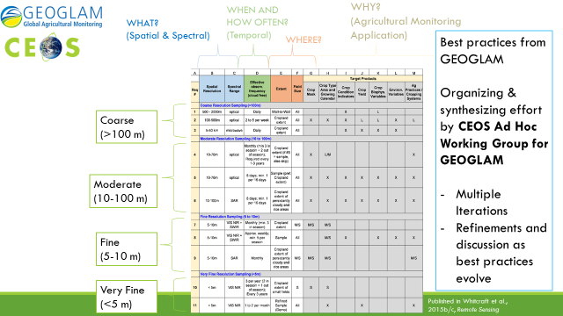
CEOS Ad Hoc Working Group worked with GEOGLAM to organize agriculture v1 information requirements (circa 2014-2015)

Slide 5
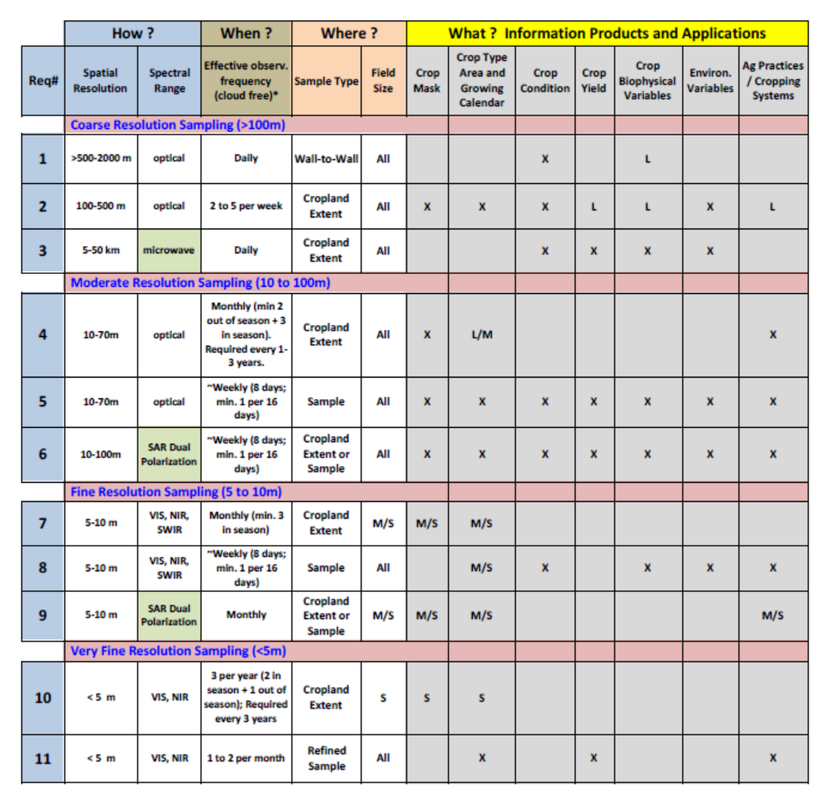
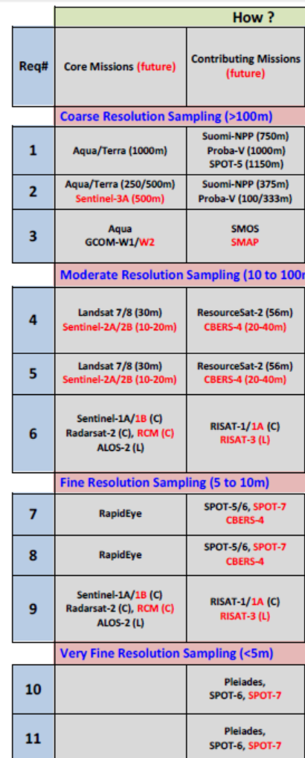
CEOS Ad Hoc Working Group identified candidate missions to meet v1 requirements (circa 2014-2015)

Slide 6
Requirements Version 2:
Sources of Information
Original Requirements Document (2012-2014)
Research and Global GEOGLAM activites:
  Crop Monitor
  JECAM & Asia-RiCE sites (2016)
GEOGLAM Requirements Survey (2017-2018)
  Survey responses were not sufficient to update requirements
  Extended the survey to more GEOGLAM users and planned a Workshop to finish requirements
Ispra-JRC Requirements Meeting (April 2018):
  Presentation Templates
  Collective Discussion + breakout groups
Sanya, China Meeting (September 2018) on ICT, Data Management, and Knowledge Hub
  Future concepts (e.g. Training, Best Practices)

Slide 7
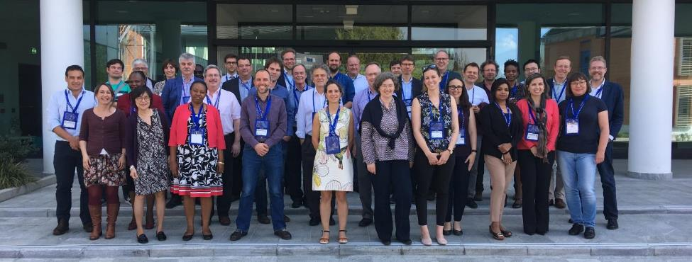
GEOGLAM Workshop on Operational User Reqs
EC JRC, DG GROW Support
Ispra 17-18 April 2018
The New Req. Group
40 participants
More diverse, greater numbers –
representative of growing community
priorities and visibility of EO in key decision making processes

Slide 8
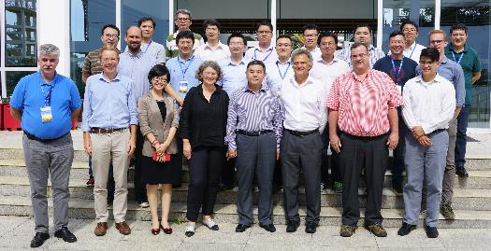
GEOGLAM Workshop on Cloud Computing and Knowledge Management
29-31 August 2018; Sanya, China (Host: RADI-CAS)
Cloud Computing is enabling big data analysis for agricultural monitoring
Increased volumes of accessible data in the cloud
Proliferation of tools
Increasing number of satellite-based products generated
Community requirement for guidance on best practices and coordinated data sharing.
Selected Workshop Outcomes:
Task Force established for coordinating cloud computing– focus on developing country capacity building
Community Algorithms and Tools to be shared via a GEOGLAM TEP (Thematic Exploitation Platform)
Document and report archives through Knowledge Management Hub (GEOGLAM Sec)
  GEOGLAM Best Practices documentation given priority (Fund being established at GEOSec)
Community Research Agenda in development (NASA Harvest with JECAM EC/Canada)

Slide 9
New Requirements Table
(2014-2018)
New issues beyond satellite observing
specifications:
In-situ Observations
Community Best Practices/Guidelines
Data Access
Training
other….
CEOS Response NLT October 2019
Notes:
Addendum Optical: 700-1400 nm (VIS NIR) + 1400-3000 nm (SWIR) + 8000-14000 nm (thermal)
Optimal bandwidths and channel locations to-be-articulated; 1900, 2000, 2100 broadly useful for soil classification (applications in precision management)
Passive Microwave: emphasis on continuity (SMAP, AMSR-E, SMOS, TRMM) SAR: C-band is highest priority, followed by X and L-band
** Field Sizes (indicated in gray section) X = All sizes S = < 1.5 ha M = 1.5 - 15 ha L = > 15 ha
*** General Guidance Latency: <2 days for most products and applications Pre-processing levels: all to a minimum of terrain-corrected surface reflectance Cirrus band must be included for atmospheric adjustment + bands for efficient cloud screening

Slide 10
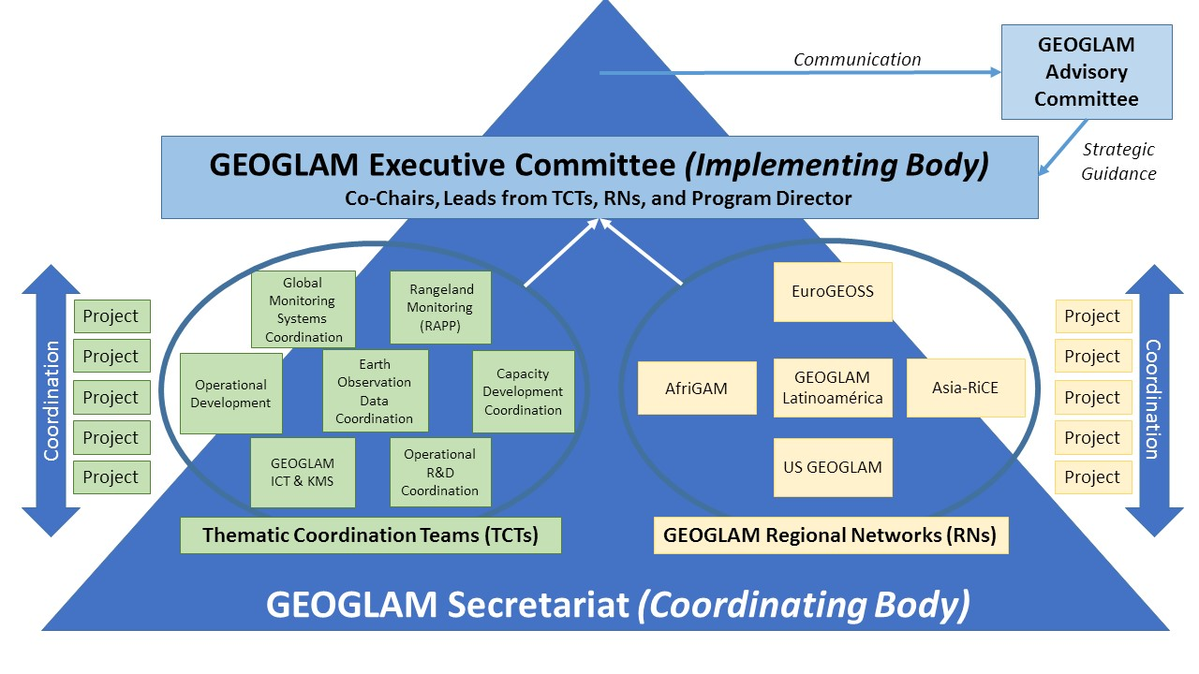
GEOGLAM Actions in Response to Growing Requirements:
EO Data Coordination and Management TCT
Establish an active EO Data Coordination and Management Thematic Coordination Team (TCT) – within GEOGLAM
Next Steps on ARD+ and EAVs
Access and Needs Assessment for
GEOGLAM users (NASA-2019)
Established
connection with CEOS

Slide 11

CEOS AHWG on GEOGLAM:
2018-2019 Work Plan
CEOS Strategic Response to GEOGLAM’s new requirements
  Initial feedback from AHWG to GEOGLAM:
    Add latency requirements and traceability/value of requirements,
    Review and provide feedback on CEOS “ARD+” plans, and
    Provide full description of GEOGLAM Essential Agriculture Variable (EAVs) concept
Plenary Decision: 1-year extension for CEOS AHWG on GEOGLAM
  CEOS Strategic Response to updated requirements and
  Options/Decision on future of CEOS support of GEOGLAM post-Plenary 2019

Slide 12

Timeline of Meetings, Actions, and Decisions on the question of the future of the
CEOS Ad Hoc Working Group on GEOGLAM
Sep-18 Oct-18 Nov-18 Dec-18 Jan-19 Feb-19 Mar-19 Apr-19 May-19 Jun-19 Jul-19 Aug-19 Sep-19 Oct-19
Telecon
Annual Meeting
CEOS Plenary
Core Group Meeting on Future Options
CEOS SIT
CEOS SIT TWS
CEOS Plenary
Meetings
Respond to Req. v.2 and Evaluate CEOS-Ag future Options
Present Update on Req. v.2 Response and Fut.
CEOS-Ag Options to SIT
Present Req. V.2 Response and Future CEOS-Ag Recome-ndations to SIT
Final Present-ation to Plenary
Actions
Develop Draft of Response to Req. v.2 and Develop Options for Future CEOS-Ag, including interactions with other groups in CEOS
Evaluate Req. v.2 Response and Future CEOS-Ag Options, with SIT comments.
Feedback from CEOS on GEOGLAM AHWG
Finite Set of Options Developed
SIT feedback on Req. v.2 Response and Future CEOS-Ag Options
SIT Assess Req. v.2 Resp. and recom-mend a CEOS-Ag Option
Approve Req. v.2 Resp. and Decision on CEOS-Ag Future
Decisions

Slide 13
Additional Information
More information on GEOGLAM activities
just Google – “GEOGLAM”
Near-term CEOS GEOGLAM AHWG output from
GEOGLAM AHWG side meeting:
Task/Responsibility List for CEOS agencies

