Slide 1

WGCV Report
Committee on Earth Observation Satellites
Kurt Thome (NASA)
Cindy Ong (CSIRO)
CEOS Plenary 2018
Agenda Item #6.1
Brussels, Belgium
17 – 18 October 2018

Slide 2
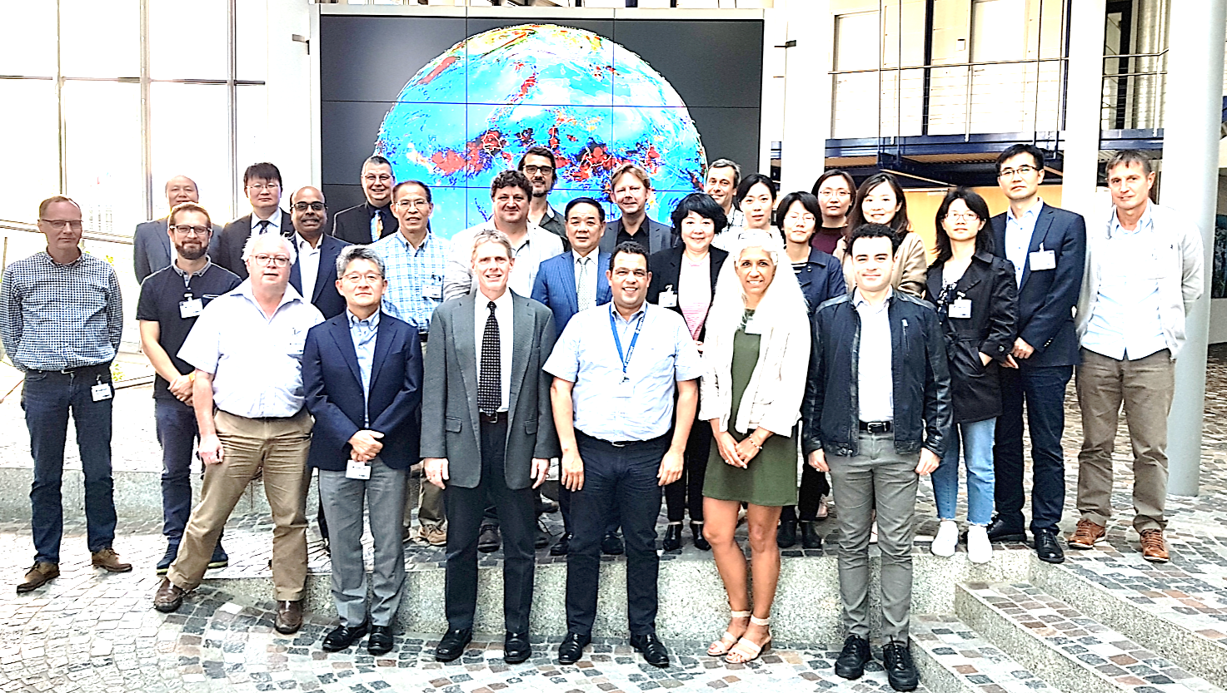
WGCV report
Key activities from 2018
  CEOS Work Plan Deliverables
  Highlighted with discussions related to ACIX, RADCALNET, Carbon, WGCV subgroups
  Interactions with other entities
Meetings / Workshops
Conclusion
WGCV-44 meeting hosted by EUMETSAT

Slide 3
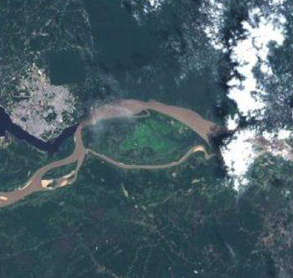
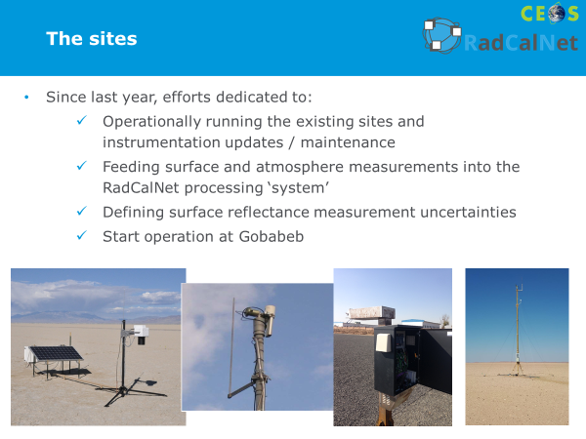
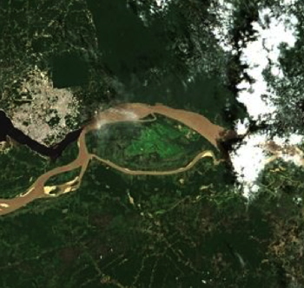
WGCV Achievements and Planned Outcomes
Recent major achievements
  ACIX (CV-13)
  RadCalNet (CV-9)
  Solar Irradiance Model (CV-16)
  LPV SuperSites (CV-12, CARB-19)
Improved reporting of achievements to ensure their utility to CEOS agencies
  CEOS WGCV website (completes CV-01)
  Other outreach methods
Near-term planned activities
  CARD4L assessment (CV-17)
  Joint WGISS activities
  GSICS Level 1 interoperability (CV-15)
  Carbon actions including GHGs (CV-18) and biomass (CV-19)

Slide 4
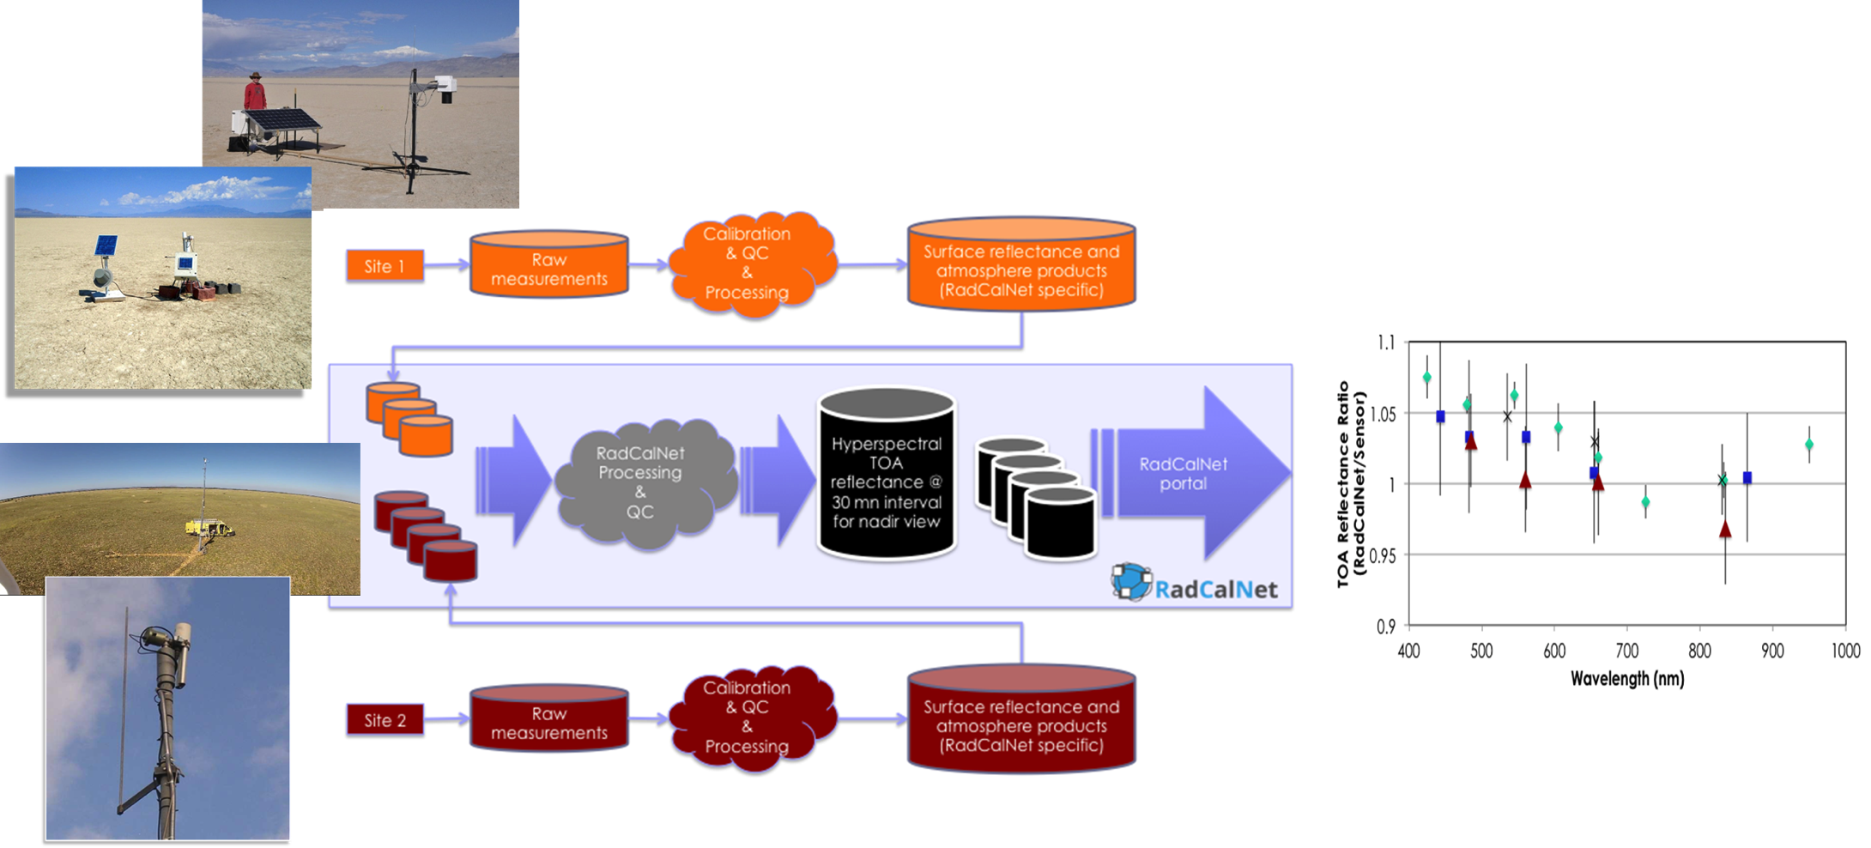
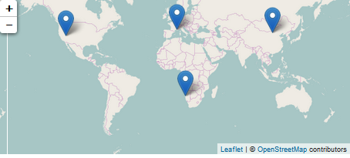
RadCalNet - Radiometric Calibration Network
  CV-9 (Radiometric Calibration Network (RADCALNET)) is complete
  Network of instrumented sites for radiometric calibration of optical sensors
  Opening of RadCalNet portal (https://www.radcalnet.org) on July 24, 2018
Method developed for admitting new sites

Slide 5
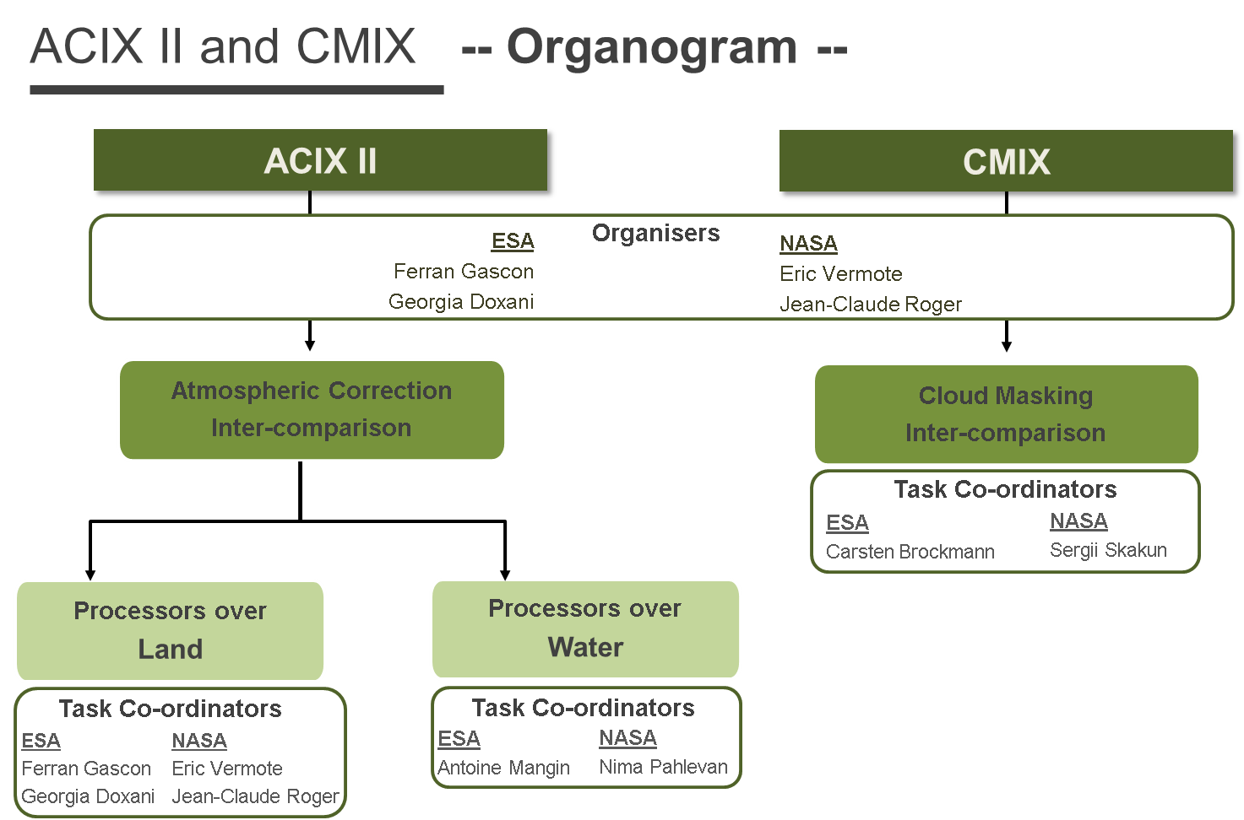
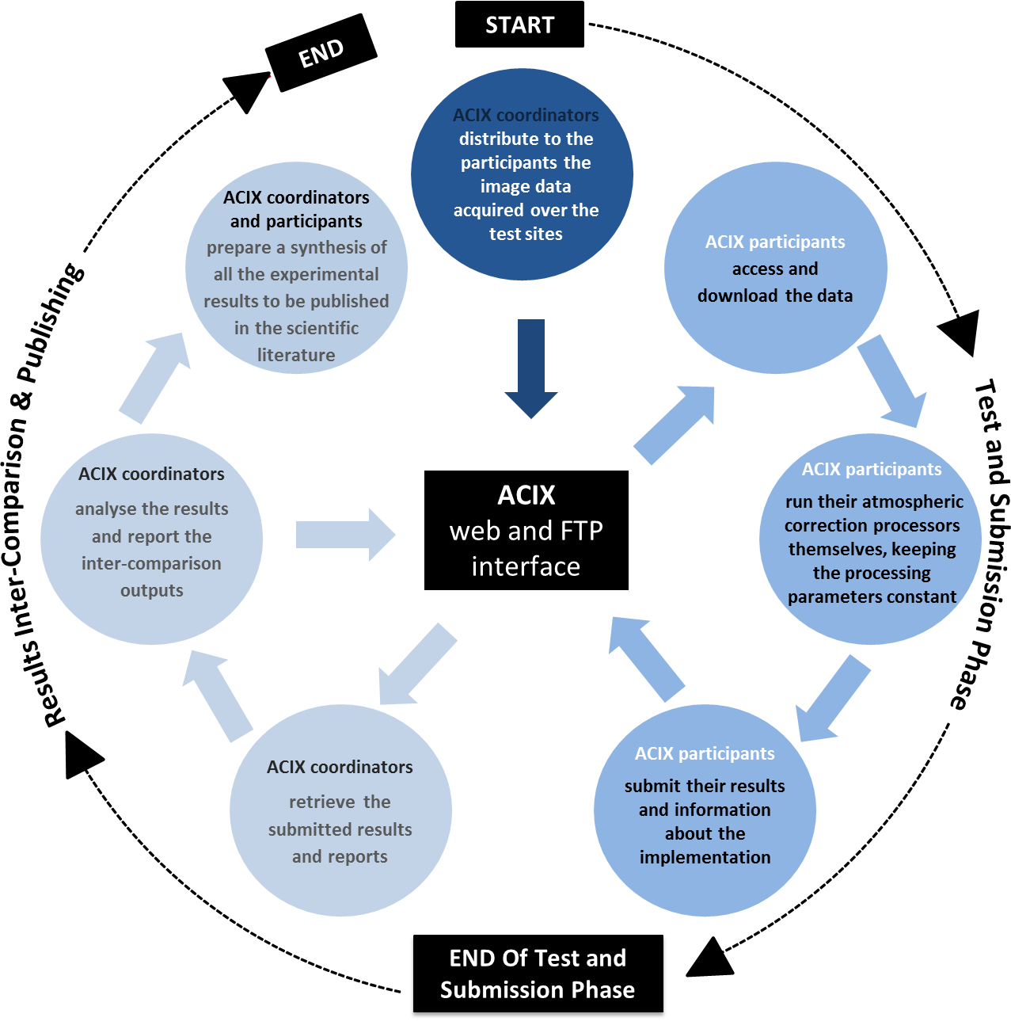
ACIX II and CMIX
CV-13: Intercomparison of atmospheric correction models is completed with summary report on Cal/Val portal
You are here for ACIX II
CV-14: Report on application of approaches for
cloud masking)
Deadline has been adjusted to Q2 2020
Based on ACIX example

Slide 6
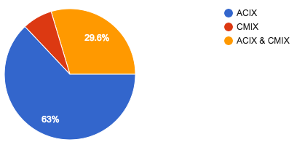
ACIX II and CMIX
Workshop for Cloud Mask Intercomparison Experiment (CMIX) and ACIX II scheduled for October 17-18 in Washington, DC, USA
ACIX II/CMIX workshop 17-18 October 2018
Results submission 15 March 2019
Analysis report May 2019
2nd ACIX II/CMIX workshop June 2019
ACIX II and CMIX Participants as of Sept. 1
7.4%
23 Atmospheric Correction and/or Cloud Masking Processors
7 Countries: France, Germany, UK, Belgium, USA, India, China
18 Space Agencies, Research Institutes, Universities, Companies

Slide 7
Solar Irradiance Spectrum
  CV-16: Report on outcomes from GSICS/CEOS reference Solar Spectrum evaluation is complete
  Solar spectral irradiance model can be found through the Cal/Val Portal website: http://calvalportal.ceos.org/events

Slide 8
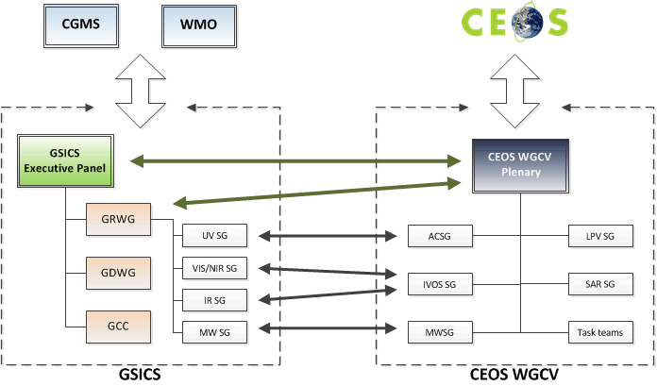
Interaction with other entities
Cooperation with GSICS
Identification of cooperation
priorities and concluded
(cf CV-03 and CV-15)
Cooperation on subgroup level &
working group level which includes
joint meetings of sub-groups
WGCV chair observer @ GSICS-EP
GRWG chair observer @ WGCV
Others
Interaction with IOCCG wrt Cal/Val ocean color
Participation on LSI VC telecons
Combined meeting with WGISS

Slide 9
Level 1 Interoperatibility
  CV-15: L1 top-of-atmosphere interoperability deadline has been changed from Q4 2017 to Q4 2019 based on outcomes from WGCV-44
  Rely on existing material across multiple GSICS and WGCV activities
  RadCalNet
  Solar irradiance spectrum
  Fiducial reference measurements
Mid-December telecon to develop activities for Q1 2019 with follow up at March IVOS Subgroup meeting
  FDA-12: Inventory of space data product formats used by CEOS agencies
    Related to L1 top-of-atmosphere interoperability
    Provide guidance on appropriate quality indicators to facilitate interoperability
    Joint telecon between WGISS and WGCV in Dec. 2018 covering data formats and interoperability; quality indicators in discovery metadata

Slide 10
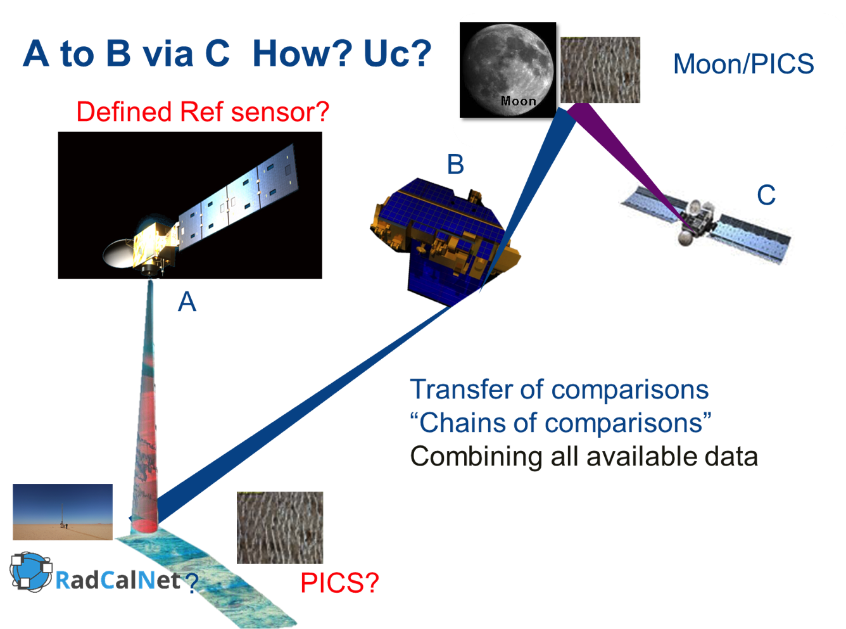
L1 top-of-atmosphere interoperability
  CV-15: L1 top-of-atmosphere interoperability deadline has been changed from Q4 2017 to Q4 2019 based on outcomes from WGCV-44
  Rely on existing material across multiple GSICS and WGCV activities
  RadCalNet
  Solar Irradiance Spectrum
  Fiducial reference measurements
  SI-traceability and good practices
Mid-December telecon will develop activities for Q1 2019 for follow up at March IVOS Subgroup meeting

Slide 11
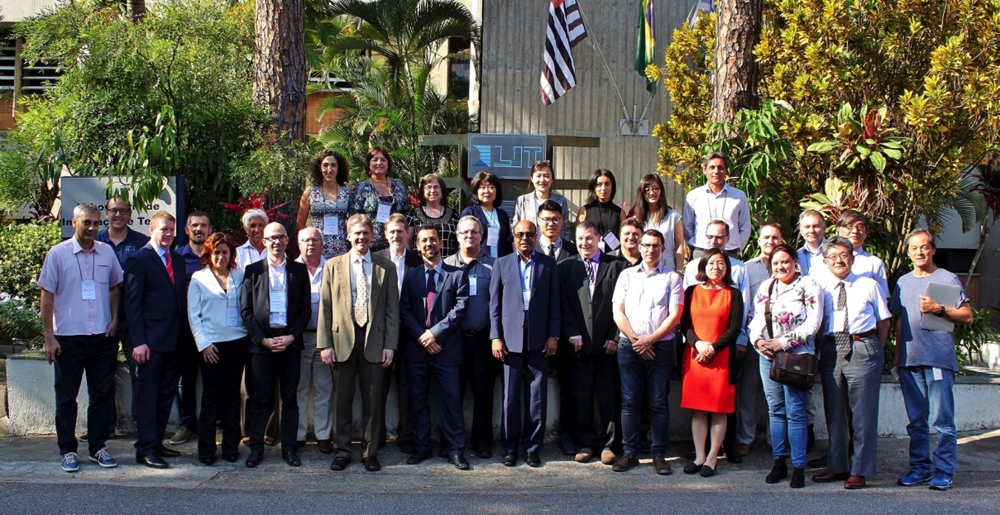
Synergies amongst teams
CV-14: Report on application of approaches for cloud masking will involve understanding impacts on CARD4L (LSI-VC)
CV-17: Surface reflectance validation also will prompt interactions on CARD4L
CV-18: Greenhouse gas reference standards for interoperability will lead to work with AC-VC
CV-19: Biomass validation protocols will involve WGClimate
Formalize those interactions already occurring at the subgroup levels
  Fiducial reference measurements (FRMs) for validation of surface temperature is a collaboration between WGCV IVOS/LPV and SST-VC
  Ocean Colour FRM comparisons for OCR-VC and IOCCG
WGCV-43 meeting hosted by
INPE and joint with
WGISS-45

Slide 12
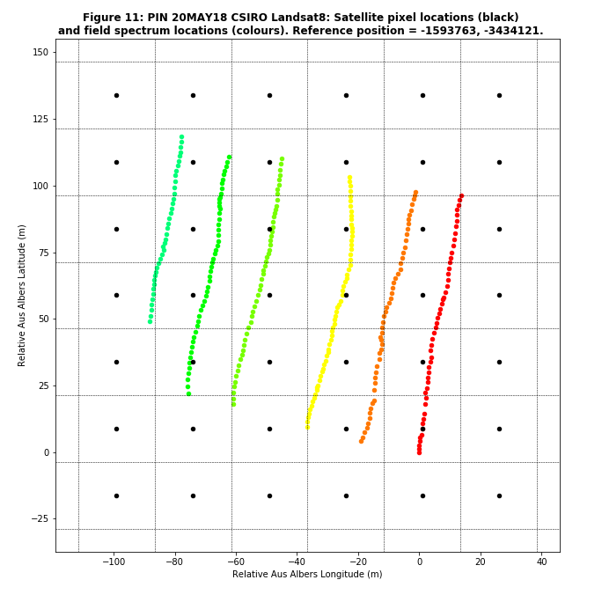
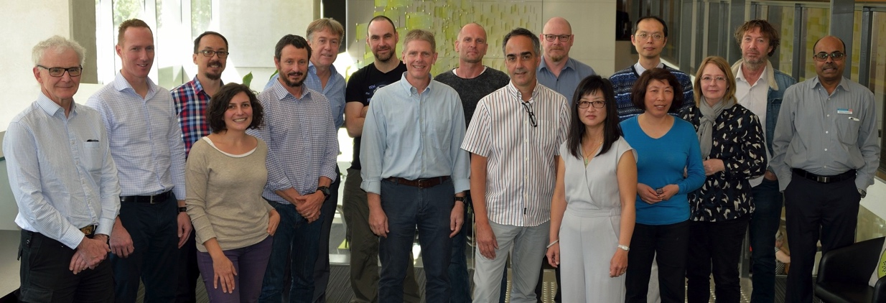
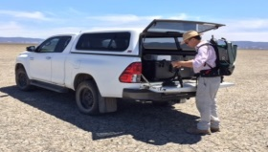
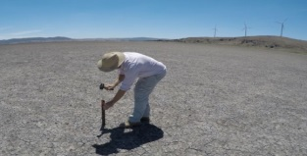
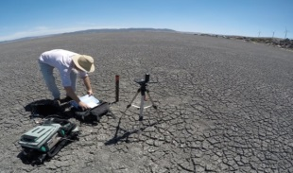
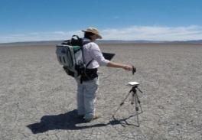
Surface reflectance validation
  CV-17: Continental scale surface reflectance validation
  Document being developed from results shown at WGCV-44 for approval at WGCV-45
  Leveraging activities of multiple agencies
  Results will have direct impacts on CARD4L as well as ACIX II
DEA Validation Workshop
Brisbane 16-17 August 2018

Slide 13
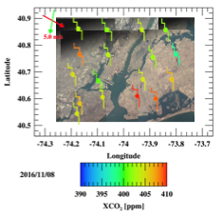
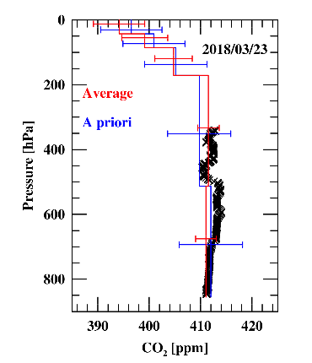
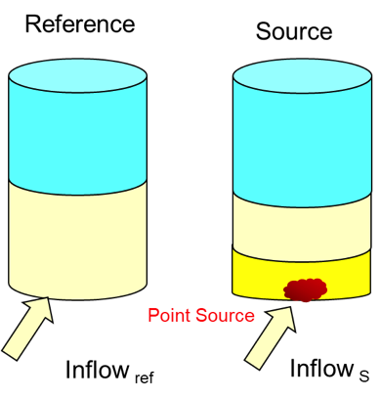
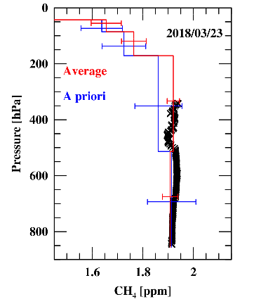
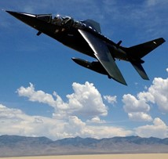
Greenhouse gas references
CV-18: Greenhouse gas reference standards for interoperability
Led by Atmospheric Composition Subgroup (ACSG)
Improvements/gaps in the (inter-)calibration of sensors (in cooperation with GSICS and across WGCV
Level-2 validation infrastructures (algorithm inter-comparisons, geographical/geophysical gaps for FRMs, etc.)
GOSAT target observations over NYC
GOSAT and NASA AJAX over RRV, NV
Coutesy of Iraci et al.

Slide 14
Biomass validation
CV-19 (Biomass validation protocols) is underway within the Land Product Validation Subgroup
Initial set of protocols planned by the end of 2018 and more formal documentation in 2019

Slide 15
Meetings
12/2018 25th SAR Subgroup Workshop hosted by CONAE
Buenos Aries, Argentina
3/2019 IVOS Subgroup will hold a meeting at CSIRO in
  Perth, Australia
6/2019 Workshop on state of the art for pre-flight calibration
  techniques (CV-3)
7/2019 WGCV-45 hosted by CSIRO in Perth, Australia

Slide 16
Conclusion
Work Plan progress is proceeding at a good pace
  All actions are proceeding
  Paths forward to completion are in place for all actions
WGCV interactions with other groups continues to provide challenges and progress
  Interactions with VCs and WGs are advancing WGCV activities
  Cross-cutting activities are creating new links between the subgroups
Attendance and participation by CEOS member agencies at the Working Group and Subgroup levels is strong

Slide 17
Endorsement items
Vice-Chair Nomination

Slide 18
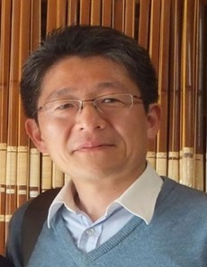
Endorsement Vice Chair Nomination
Working Group Vice Chair Nomination
Current Chair term terminates with CEOS plenary 32
Need of Vice Chair nomination
Candidate: Akihiko Kuze
GOSAT project team, JAXA
Greenhouse gases Observing Satellite (GOSAT) project for 15 years developing on-board instruments, calibrations and operation
Level 0-1 processing of GOSAT data and the GOSAT Level 1 products
CEOS WGCV recommends the nomination of Dr Kuze
Request for endorsement of Dr Kuze as incoming Vice-Chair 2018

Slide 19
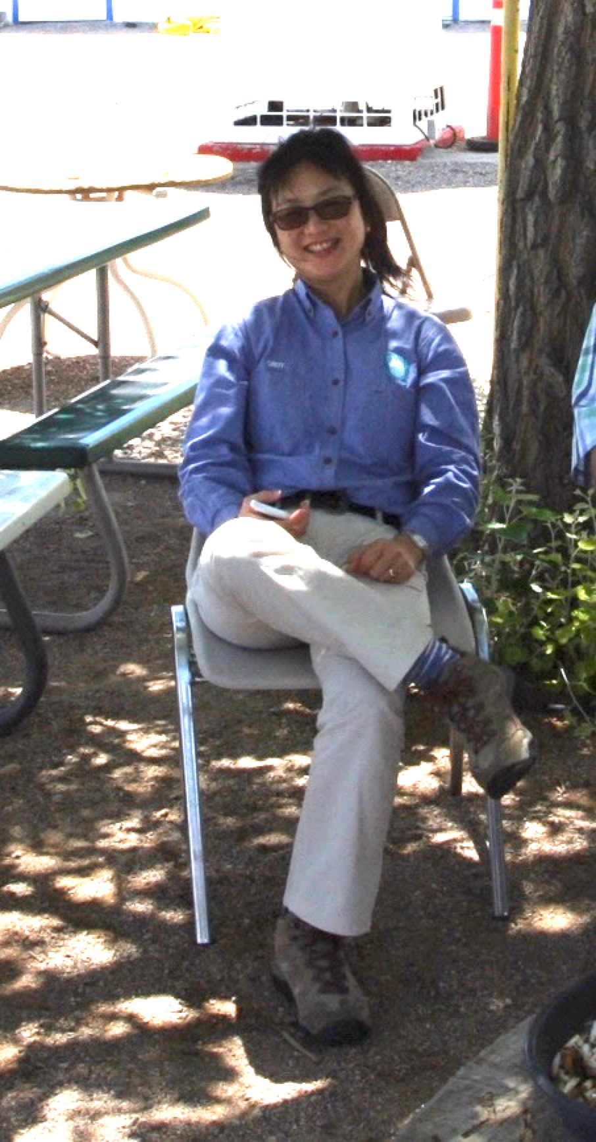
WGCV Chair Handover
New WGCV Chair
Cindy Ong –
Principal Research Scientist @ CSIRO
Expertise in ground-based and airborne-based
remote sensing (imagers & optical sensors)
Current research focus
  Greenhouse Gas detection including sensor development
  Quantification and monitoring of methane and other environmental impacts related to the onshore gas industry
  Calibration and validation of optical earth observation sensors

