Slide 1

Data Cubes and FDA
Pilot Status Report
Committee on Earth Observation Satellites
Brian Killough, NASA, CEOS SEO
CEOS Plenary 2018
Agenda Item 7.2
Brussels, Belgium
17 – 18 October 2018

Slide 2
Relevant CEOS Deliverables
AGRI-08: Vietnam Data Cube ... Now operational due to support from CSIRO. COMPLETE
AGRI-09: GEOGLAM Rangelands (RAPP) Data Cubes ... Demo in place in Kenya (with Livestock Institute). COMPLETE
CARB-18: Colombia Data Cube ... Now operational and being used as part of their forest monitoring workflow. COMPLETE
FDA-02: Collaborative Data Cube Development ... the initiative has made significant progress with support from several agencies. PROGRESSING
SDG-03: Contribution of EO to SDGs ... The Data Cube team is developing 3 algorithms to specifically address SDGs for demo at the GEO Plenary. PROGRESSING
VC-31: CARD4L Evaluation ... Data Cubes are routinely using ARD (based on CARD4L requirements) and providing feedback to LSI-VC on such use. PROGRESSING

Slide 3

What is ODC and CDC?
ODC = Open Data Cube (www.opendatacube.org)
Started by several “ODC Partner” organizations in Jan 2017 as an open source data management solution with a community of contributors and users.
The “ODC Partners” are ... GA, CSIRO, NASA-SEO, USGS, and
UK-Catapult. They meet monthly (via telecon) and have a detailed work plan.
The “ODC Steering Council” manages the technical development and open source code repository (https://github.com/opendatacube)
CDC = CEOS Data Cube
An ”extension” of the ODC goals to demonstrate data
cubes around the world and maximize the impact of
CEOS satellite data with a focus on developing countries
Focused on ARD, user needs, and global capacity building

Slide 4
49 countries in 20 months
9
6
34
Operational
Under Development
Under Review or Expressed Interest
Operational: Australia, Colombia, Switzerland, Taiwan, Kenya, Tanzania, Ghana, Sierra Leone, Senegal

Slide 5
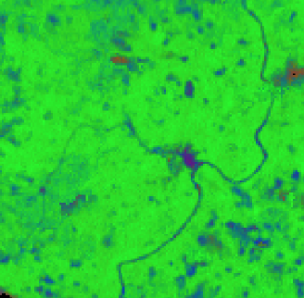
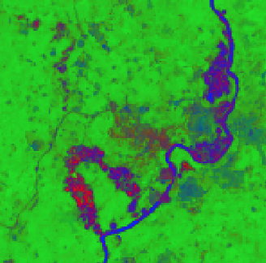
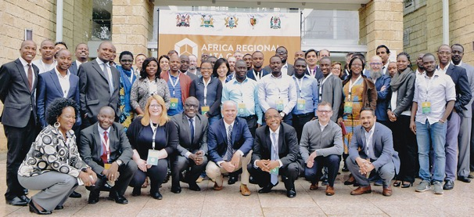
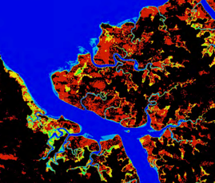
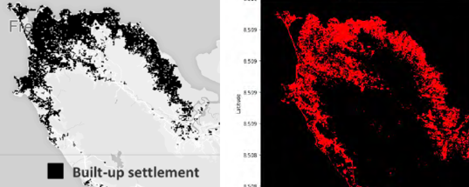
Africa Regional Data Cube
  Launched in May 2018 for 5 countries (Kenya, Tanzania, Sierra Leone, Senegal, Ghana). Initially based on Landsat ARD, with S1, S2 and ALOS coming soon!
  Supported by Amazon (donated cloud services) and GPSDD (training)
  Recent web-based remote training for Ghana (July 31), Tanzania (Aug 16, Oct 9-12), and Sierra Leone (Aug 24).
  Initial support has been focused on desired use-cases for each country.
  Kenya: Refugee camp expansion, deforestation and vegetation extent, livestock rangelands
  Tanzania: deforestation, mining, urbanization, agriculture
  Ghana: Illegal mining (on right)
  Sierra Leone: Flooding and urbanization (below)

Slide 6

Digital Earth Africa
A new Data Cube initiative ...
Digital Earth Africa is a new initiative undergoing planning to develop a full-continent EO program based on the Open Data Cube.
The effort is led by Stuart Minchen (Geoscience Australia) and Steven Ramage (GEO)
A new Steering Committee has been formed to serve as an advisory body to provide inputs and recommendations on institutional arrangements, stakeholder engagement and implementation plans.
The Steering Committee includes representatives from GA (lead), GEO, World Economic Forum (WEF), SANSA and CEOS.
Brian Killough (NASA SEO) is the CEOS representative on the Steering Committee. He has relevant experience with the Africa Regional Data Cube (ARDC) which is seen as a prototype to Digital Earth Africa. This role is active through the end of 2019 and is supported by NASA management.

Slide 7
Thoughts on ARD
Analysis Ready Data (ARD) is no longer a desire of global users, but is now becoming a requirement and an expectation.
The Data Cube pilots are an ideal way to prove the benefits of ARD, as every pilot is using ARD. Most global users (not scientists or commercial groups) DO NOT desire, or feel comfortable, making their own ARD, but want it provided.
There is a growing interest in radar data, but few users understand its benefits or know how to use this data. Data Cube pilots are a great place to demonstrate open source radar algorithms on ARD.
CEOS needs to make it easier for global users to get ARD. Pre-processing of data by satellite agencies or by “data aggregators” can allow ARD to be accessed by global users.

Slide 8
More Data Cube Use-Cases
Data Cubes with CEOS ARD are having a global impact ...
Switzerland is using their Data Cube to develop new snow detection algorithms and develop time series snow coverage maps.
UK-Rhea (commercial company) is using the Data Cube to develop a drought monitoring system for Uganda
UK-Catapult is leading the “Common Sensing Project” to monitor climate change resilience in the Pacific Islands using a Data Cube.
Taiwan is using the Data Cube to monitor forest and vegetation restoration in landslide areas.
Uruguay Is using the Data Cube to adjust their water sampling approach to coincide with satellite overpasses in order to improve water quality data in their reservoirs.
The Gates Foundation is using water extent time series data from the Lake Chad Data Cube to compare with their population density maps to strategically supply polio vaccines to small villages around the lake. Many of these villages become "isolated" during the rainy season and are only accessible for a small portion of the year.

Slide 9




More Data Exploitation Platforms
GEOSS Common Infrastructure (GCI) is a GEO foundational task to discover and access GEOSS datasets and services
ESA’s Thematic Exploitation Platforms (TEPs) utilize a theme-based collaborative virtual environment with EO data and tools.
The European Commission’s new Copernicus Data and Information Access Services (DIAS) platform will allow users efficient access to Sentinel data and computing resources. The ODC team (thru Geoscience Australia) is investigating options with several vendors to install the ODC technology on DIAS and run algorithms with Sentinel data.
Google Earth Engine ... The ODC team is working with Google to take advantage of their ARD datasets and COG formats. Integrating GEE community algorithms are next. Many users worry about the commercial dependency and lack of organized algorithms.

Slide 10
Plans for 2019
3rd Annual ODC Technical Meeting in Canberra, Australia in Feb 2019.
Support the new CEOS Chair (VNSC) initiatives promoting the use of CEOS ARD in the Mekong region and using the Open Data Cube.
Support training and capacity building for the Africa Regional Data Cube countries.
Work with the multi-agency Open Data Cube team to develop an end-to-end infrastructure release including an application library of algorithms. Continue to progress country prototypes and capture “lessons learned”.
Enhance the use of CEOS satellite data through future data architectures (e.g. DIAS, Open Data Cube) yielding improvements in time series analyses and solutions for developing countries.
Develop and test new user-driven Open Data Cube applications with high impact to global users. For example ... UN-SDGs (water extent, land change, urbanization), illegal mining, optical/radar interoperability and machine learning.

