Slide 1
Working Group on Information Systems and Services (WGISS)
Committee on Earth Observation Satellites
Mirko Albani, ESA, WGISS Chair
CEOS Plenary 2018
Agenda Item #5.2
Brussels, Belgium
17 – 18 October 2018

Slide 2
WGISS Scope
WGISS is a subsidiary body supporting CEOS
Promotes collaboration in the development of systems and services that manage and supply Earth Observation data;
Creates and demonstrates prototypes supporting CEOS and Group on Earth Observation (GEO) requirements;
Addresses the internal management of EO data, the creation of information systems and the delivery of interoperable services.
The activities and expertise of WGISS span the full range of the information life cycle from the requirements and metadata definition for the initial ingestion of satellite data into archives through to the incorporation of derived information into end-user applications.
Notes:
Recent advances in technology open the floor for new and innovative approaches for data exploitation and use and require an adaptation and evolution of the approaches, infrastructures and services provided by CEOS agencies. WGISS contribution and role in providing a forum for technical exchange and sharing, and for the definition and prototyping of common and interoperable approaches and architectures for data management and exploitation will become more and more central for CEOS agencies and for CEOS as a whole in support to the achievement of its objectives

Slide 3
Outline
Data Preservation and Stewardship
Data Discovery and Access
Interoperability and Use (including FDA)
Technology Exploration
Cooperation within and outside CEOS
CEOS 2018 – 2020 Work Plan Action Items

Slide 4
Data Preservation and Stewardship
WGISS accomplishes its Data Preservation and Curation efforts through the Data Stewardship Interest Group (DSIG)

Slide 5
Data Stewardship Best Practices Document Tree
EO Data Stewardship Cooperative Framework
Policy Documents
CEOS Agencies EO Space Data Sets
Applied to
Data Purge Alert Procedure & White Paper
Recommended / Reference
Individual organizations' policies (stewardship, access, ...)
Recommended for
application
Recommended /
Reference
Technical Documents
Reference Model for Data Stewardship
Glossary of Acronyms and Terms
General guidelines and best practices
Support
Preservation Workflow
EO Data Preservation Guidelines
Preserved Data
Set Content
Associated Knowledge Preservation
WGISS Maturity Matrix
Persistent Identifiers Best Practice
Guidelines and best practices on specific topics
Technical implementation procedures
EO Data Set Consolidation Process
…
Image Source: http://eastenders.wikia.com/wiki/File:Under-construction.png

Slide 6
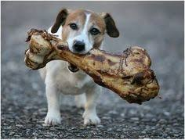
Discovery & Access
WGISS accomplishes its Data Discovery and Access efforts through the WGISS Connected Data Assets System Level Team (SLT)

Slide 7
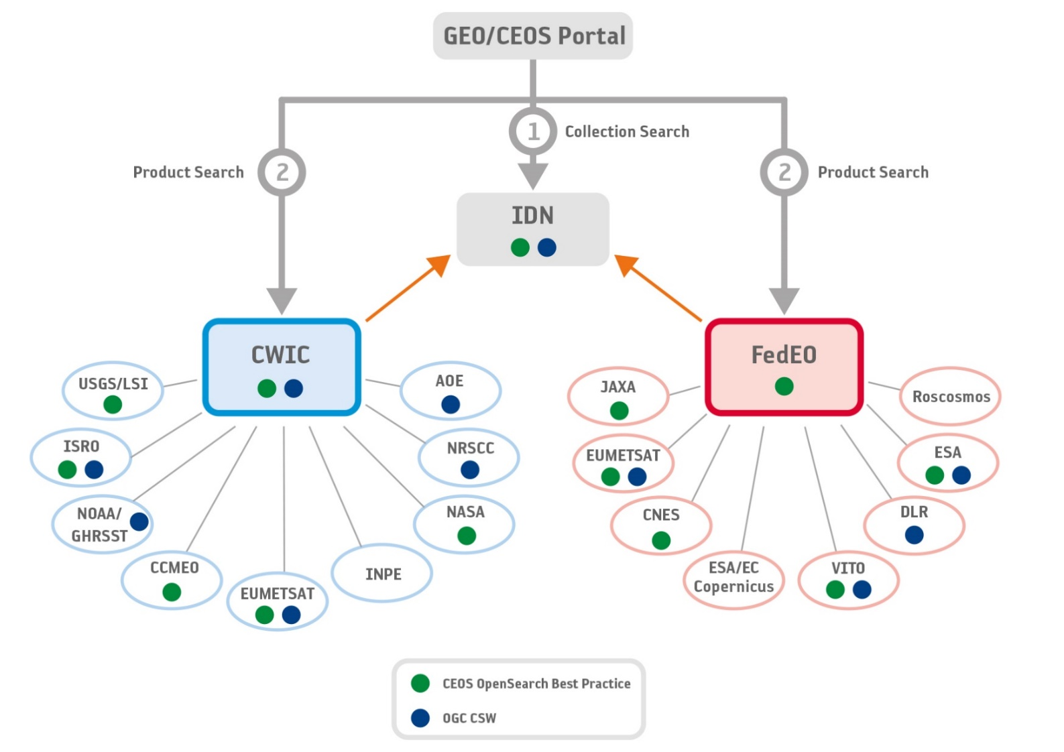
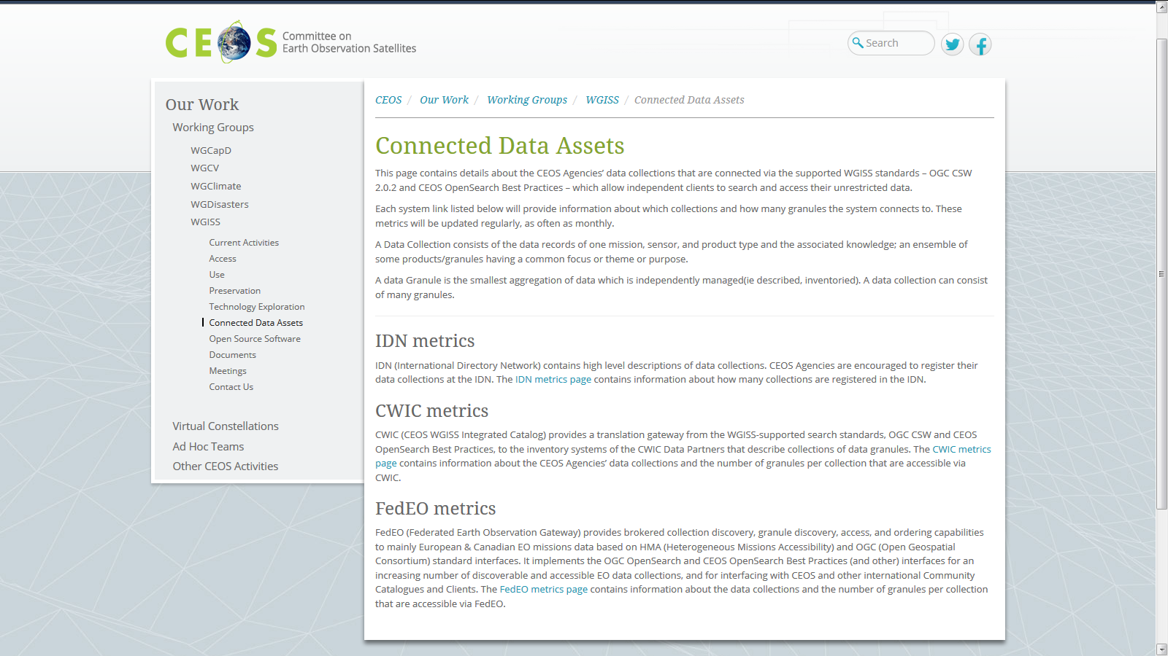
WGISS Connected Data Assets (CDA)
Relying on IDN/CWIC/FedEO components, provides a single entry point for external clients to discover and access CEOS agencies data
Search over 32,000 collections in the IDN
Access over 5000 collections with associated over 300+ million granules (granule search)
DATA-2: Full representation of CEOS Agency datasets in the IDN and accessibility via supported WGISS systems and standards

Slide 8
WGISS Connected Data Assets (CDA)
System Level Team (SLT) coordinates maintenance and operations.
Client Portals:
GEOSS Platform (GEO Portal)
AMERIGEOSS Portal
ESA EOPortal
CEOS COVE Tool
CEOS Carbon Portal
Being enlarged with new partners and continuously populated with additional data collections, for example:
ECVs/CDRs in coordination with WGClimate, COVERAGE Team, CEOS Carbon Team
ESA Heritage and Earth Explorer Missions (11 million granules)
NOAA One Stop (over 100 million granules)
National Remote Sensing Center of China (NRSCC) now active participant in WGISS CDA (35 millions granules)
(2017-2018)
Sent Provider DIF-9 to DIF-10 QA/Triage Reports.
May 1, 2018
Start migrating existing non-NASA EOSDIS DIF-9 records to DIF-10.
2019 (First quarter)
Plan to have all metadata records transition.
Example IDN: DIF-9 to DIF-10 Transition Schedule
DATA-8: Maintain and evolve WGISS Connected Data Assets Infrastructure and Systems
Notes:
WGISS Connected Data Assets Operational Systems (IDN, CWIC, FedEO):
Is maintained and operated in coordination among different agencies (System Level Team) and implements the OpenSearch Interoperability Best Practice defined in WGISS.
Provides a single entry point for GEO (GEOPortal) to discover and access CEOS agencies data.
Is being enlarged with new partners and continuously populated with additional Collections (e.g. ECVs/CDRs inventories from WGClimate).

Slide 9
ECVs/CDRs Discovery and Access through WGISS Systems
913 ECV/CDRs from ECV Inventory V2.0
CURRENT
FUTURE
417
496
DATA-9: ECVs/CDRs Discovery and Access through WGISS Systems
204 not in IDN
Progress and next steps
Providers and PoCs responsible of the 204 datasets not registered in IDN preliminarily contacted
First batch of datasets being addressed: will be registered by Q4 2018
Second batch will be addressed in coordination with WGClimate in the frame of ECV Inventory update to V3. Completion by Q4 2019
Notes:
Objective: facilitate discoverability and accessibility of ECV Products and space-born CDRs relevant for the CEOS Carbon Action via WGISS Interoperability Systems & Standards (FedEO/CWIC/IDN, OpenSearch).
Approach: start from results of WGClimate Questionnaire for ECV Inventory population; tailoring for Carbon Action and gaps identification wrt data records already discoverable/accessible through WGISS systems.
Additional Resources: support from WGClimate and experts for priorities setting; activities at data providers’ side to be carried out by relevant entities.
496 out of 913 considered (417 out of 913 not considered because future collections).
288 out of 496 registered in IDN with granule/product accessible via CWIC infrastructure
4 out of 496 registered in IDN with IDN granule/product accessible via CNES infrastructure
204 out of 496 not registered in IDN

Slide 10
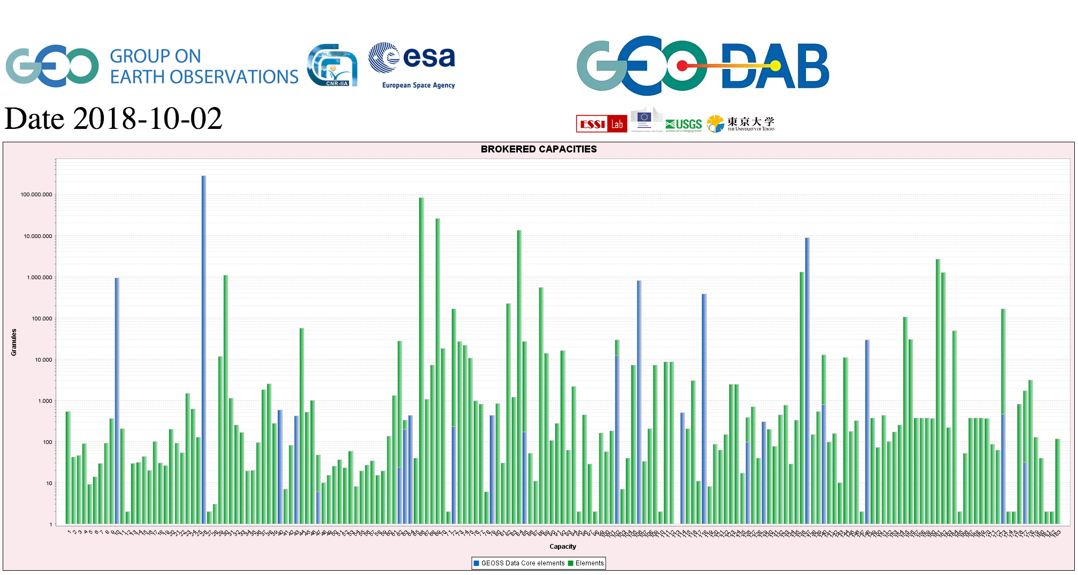
CEOS data in GEOSS
GEOSS PLATFORM DISCOVERABLE DATA PRODUCTS
CWIC
DATA-12: CEOS data holdings reported in GEO
FedEO

Slide 11
Support from data providers
Did you register your
data in the CEOS IDN ?

Slide 12
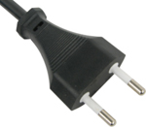
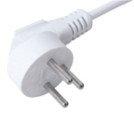
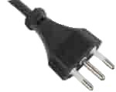
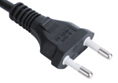
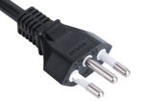
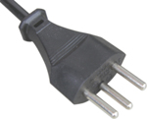
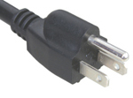
Interoperability and Use (including Future data Architectures)
WGISS accomplishes its interoperability and data use efforts through the Interoperability Interest Group.

Slide 13
Interoperability and Use
FDA Themes supported via WGISS
CEOS Analysis Ready Data (ARD)
Develop and provision CARD4L-compliant optical and/or SAR products
Examine ARD for ocean and atmosphere domains
Interoperable Free and Open Tools
Continue supporting the CEOS Data Cube (CDC) initiative
Demonstrate new technologies through ongoing support of ‘pilot projects’ and consideration of alternate candidate architectures
Data, Processing, and Architecture Interface Standards
Develop standards for pixel-level data discovery, access, and common analytical processing requests (e.g., cloud free mosaics of ARD) exploiting EO satellite data among various CEOS exploitation platforms
Analytical Processing Capabilities
Prototype portable web-based analytical processing APIs/Web Services that work across CEOS exploitation platforms in full computing environments for time series and other analysis
User Metrics
Develop a data use metrics framework through which agencies can contribute to how EO data is being used, rather than just downloaded data quantities
Block A: Analysis Ready Data, CARD4L and interoperable products
Block B: Agency roles in stimulating EO “use-environments”
BLOCK B
BLOCK C
Block C: Earth Observation Resources Analysis and User Metrics

Slide 14
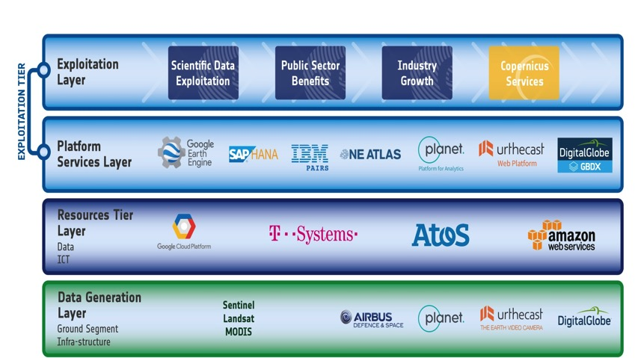
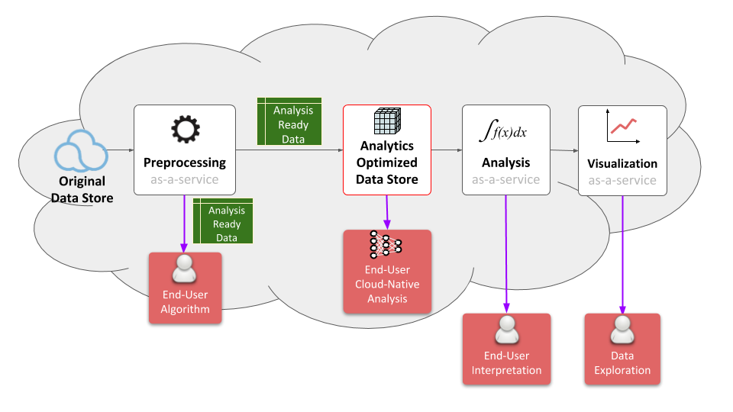
FDA Common Description
White Paper
FDA-8: Establish a common description of Future Data Architecture functional blocks and identify interfaces and interoperability approaches (WGISS supporting FDA AHT)
Multiple viewpoints into the evolving FDA landscape:
Enterprise, Information, Computation, Engineering, Technology
Building on WGISS Discovery and Access Infrastructure with a system wide view
Emphasis on what is changing: Analysis, Cloud, consumer EO
Notes:
WGISS is supporting the FDA ad-hoc team in the drafting of a white paper on to establish a common description of Future Data Architecture functional blocks and interfaces
There is large consensus that a common architectural model and terminology will:
facilitate interagency dialog
enable identification of interfaces
enable work on standardisation once interfaces identified
So we are working on a unified pretty diagram based on 5 viewpoints to convey all the necessary knowledge.
Building on WGISS Discovery and Access Infrastructure with a system wide view
Emphasis on what is changing: Analysis, Cloud, consumer EO
Technology and Engineering viewpoints link directly to the open source software and FDA inventory activities.

Slide 15
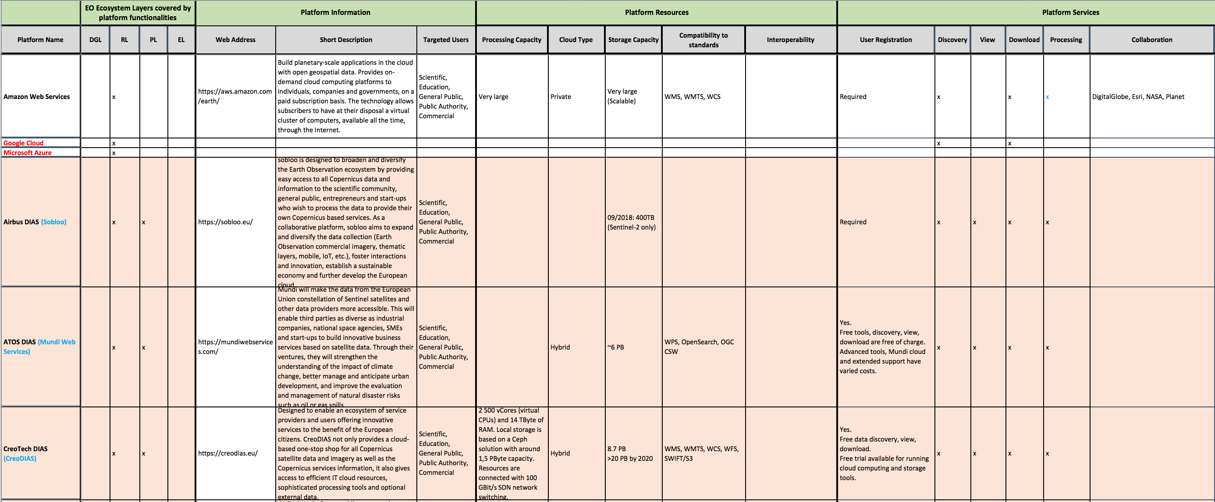
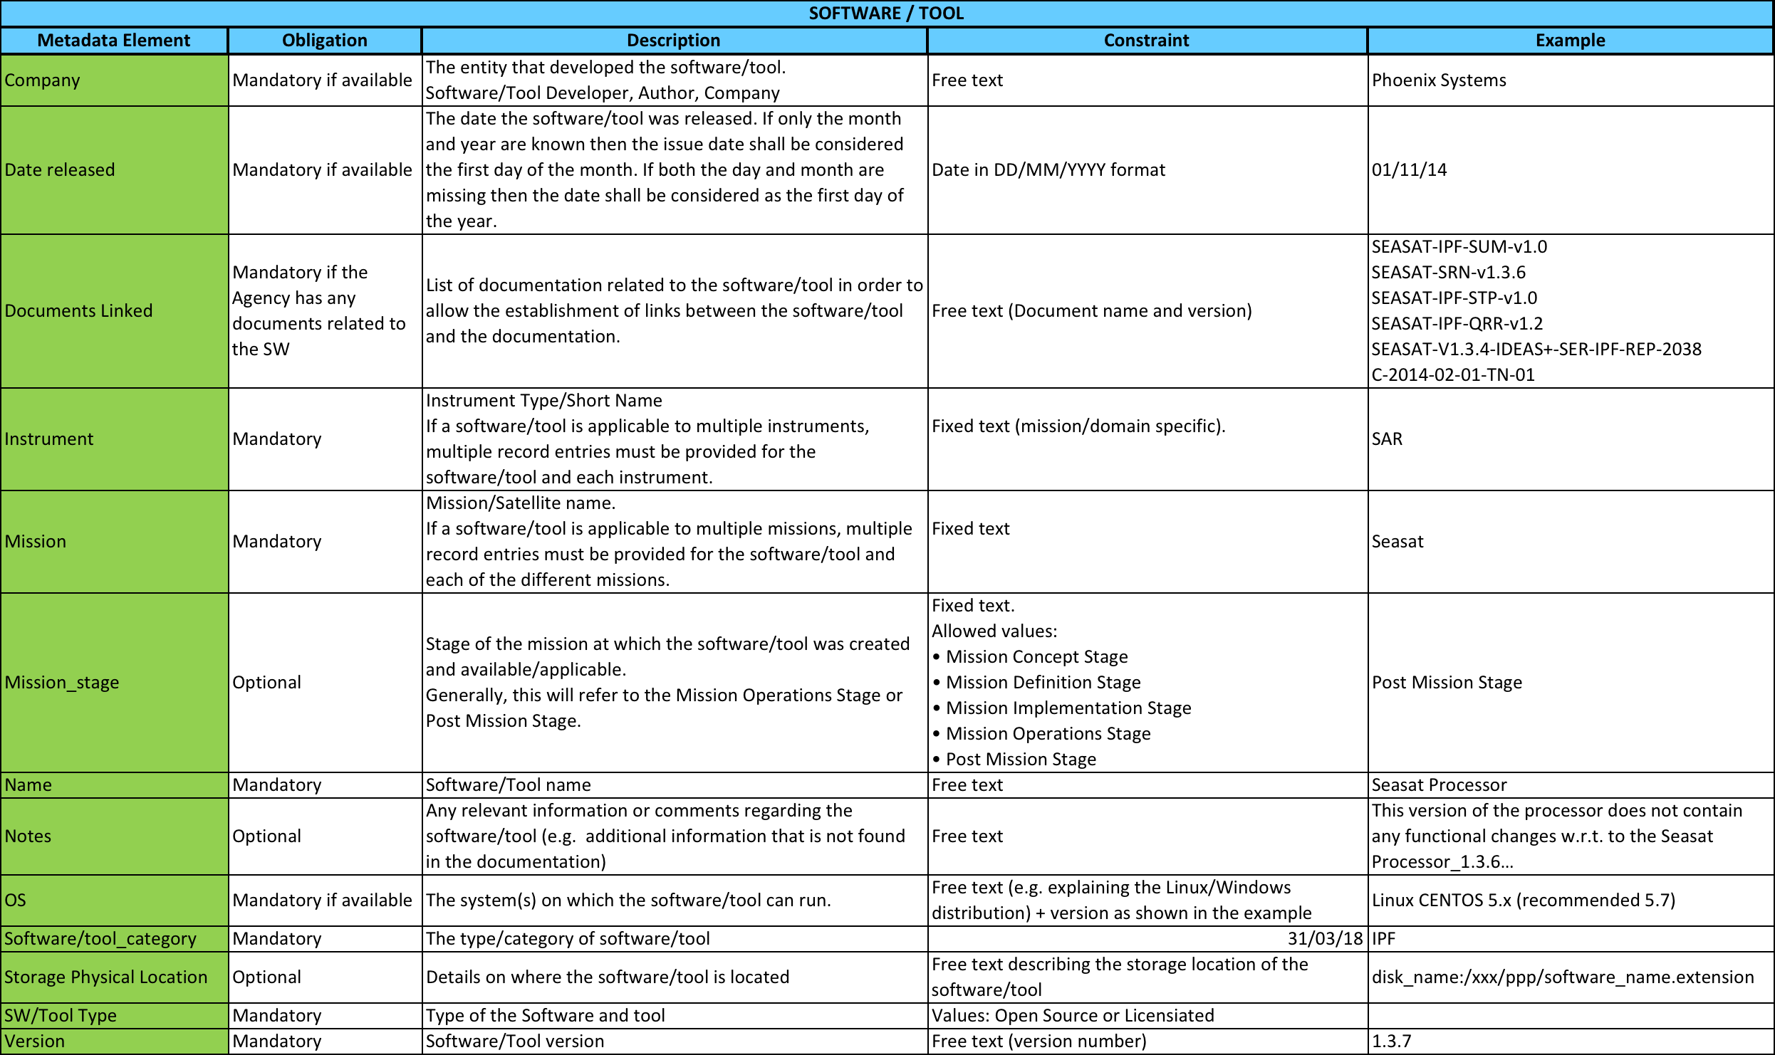
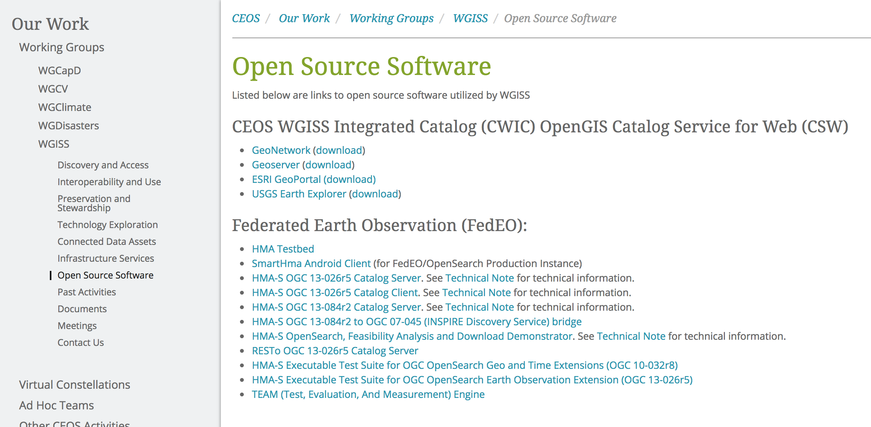
Inventories: 1) FDA Elements; 2) Open Source SW and Tools
FDA-9: Inventory and characterize existing FDAs operated by both public and private entities
Inventory of “EO use environments” to provide insight into the EO ecosystem: being filled-up with info collected from WGISS members
FDA-10: Inventory of CEOS agencies (Open Source) Software and Tools and implement a mechanism for discovery and access
Inventory and tracking tool to access identified CEOS agencies SW and tools for data use being finalised
Notes:
Consensus that an inventory of “EO use environments” is a useful exercise that will provide insight into the EO ecosystem
Template defined in coordination with FDA-AHT
Inventory being filled-up with information collected from different sources

Slide 16
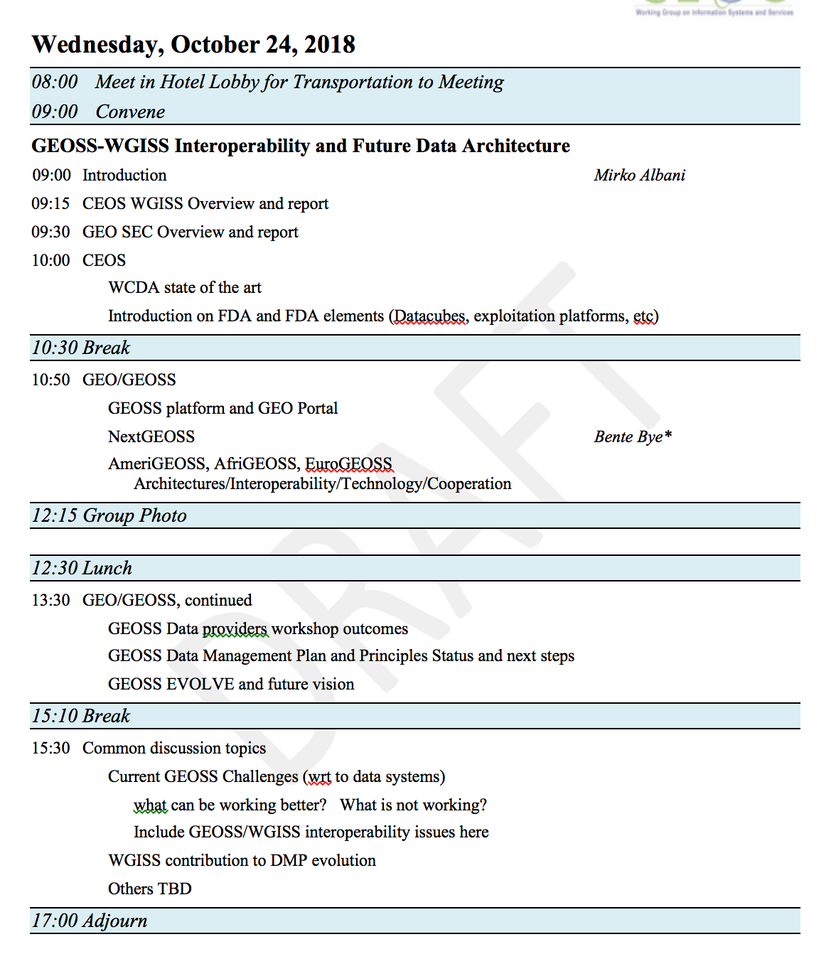
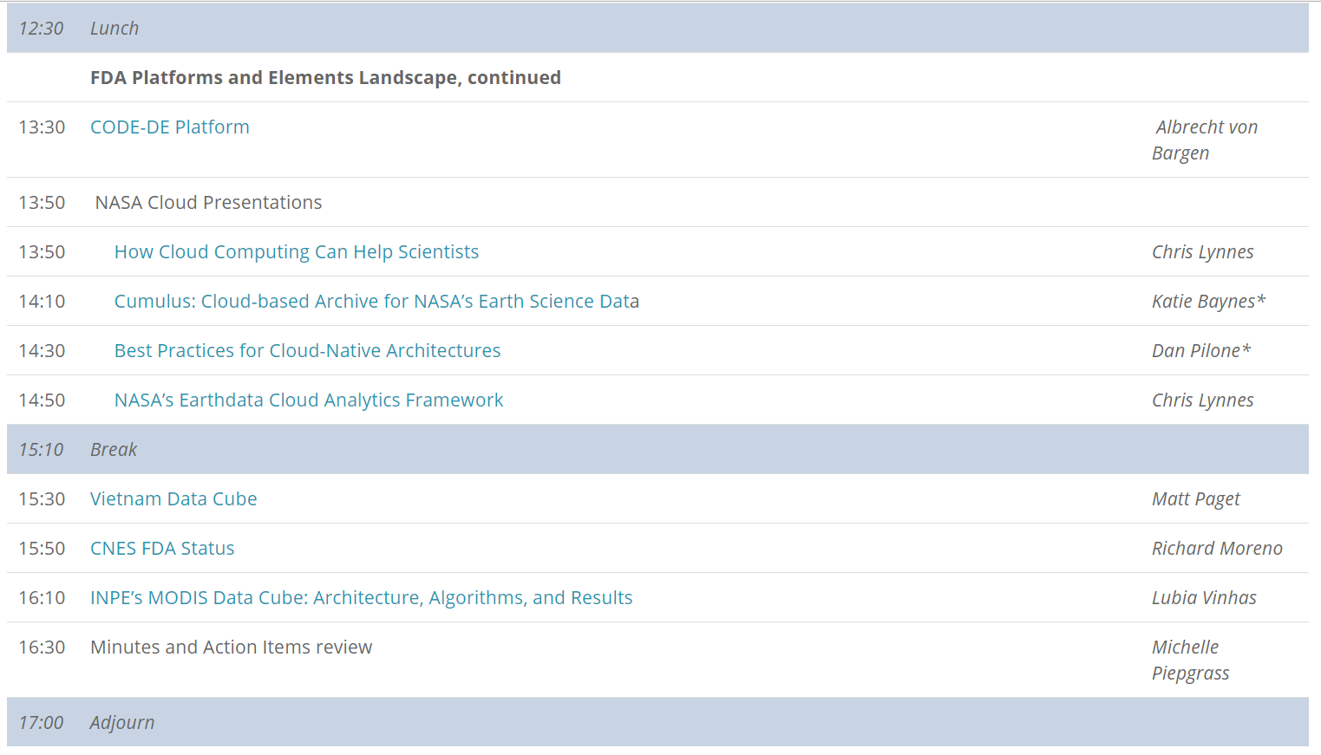
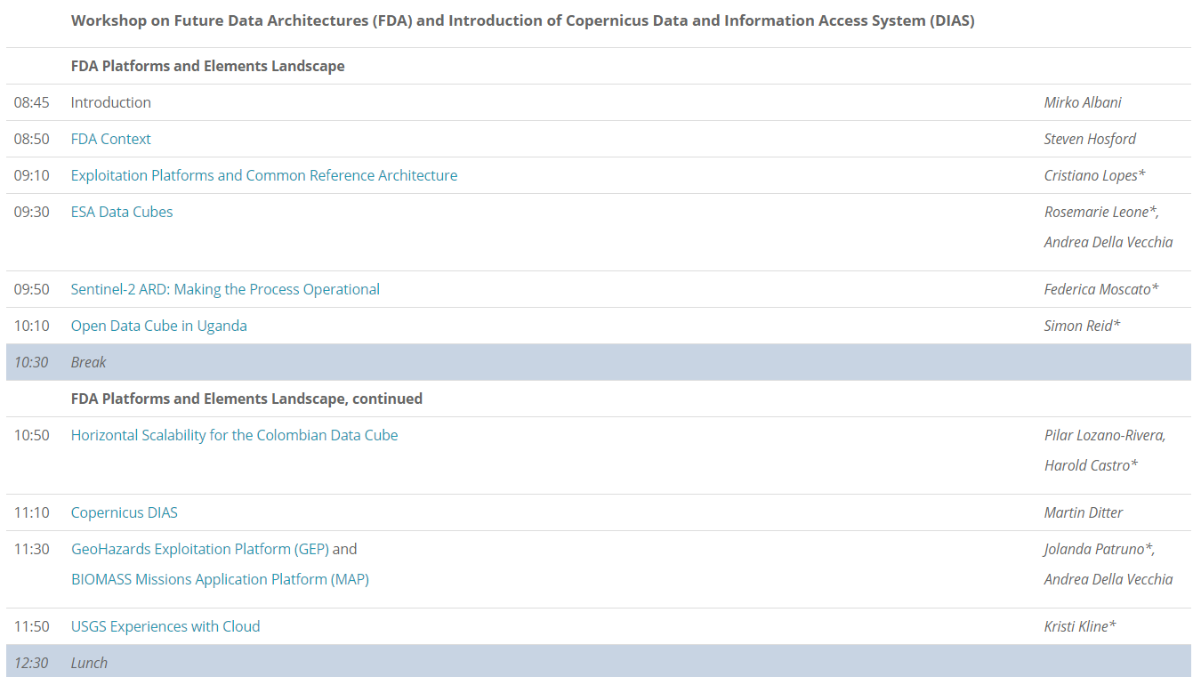
FDA Workshops
FDA-11: Organize sessions/workshops on FDA systems pilots and interoperability projects (with FDA AHT)
http://ceos.org/meetings/wgiss-45/

Slide 17
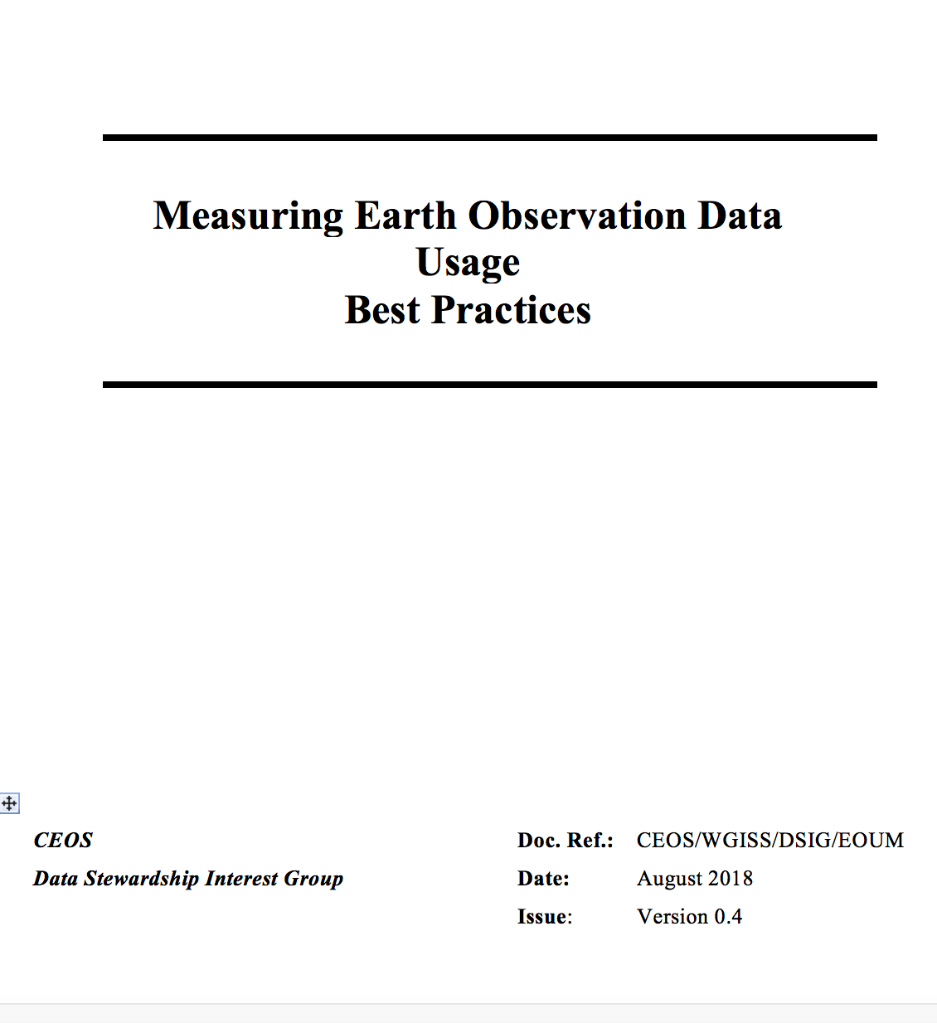
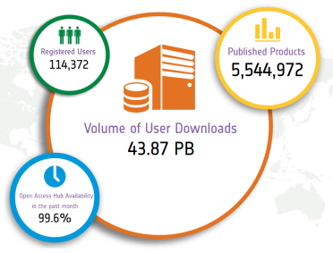
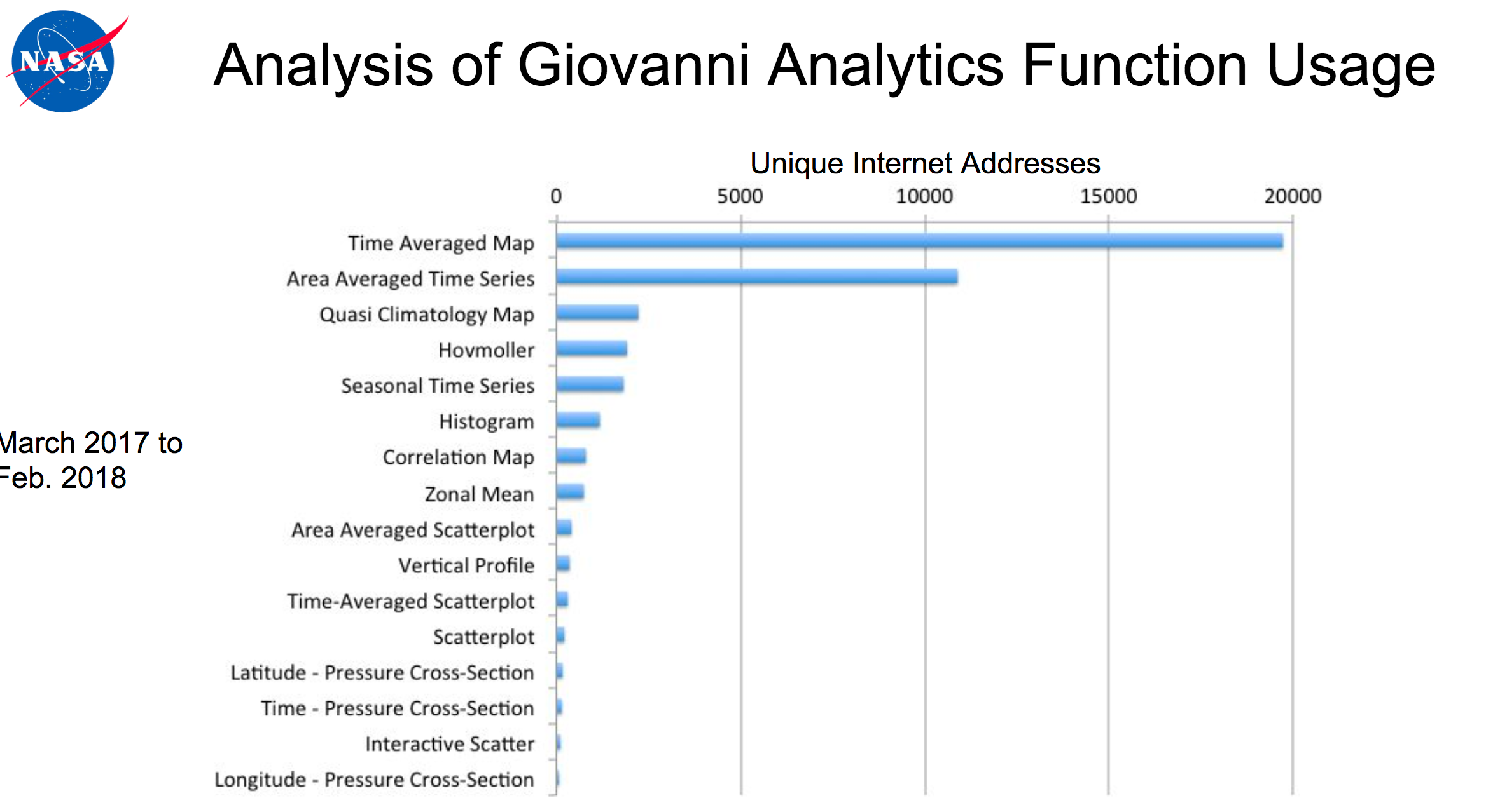
EO Data Usage Best Practice
FDA-13: Develop a User Metrics Best Practice
EO Data Offer Metrics
Web/Platform Metrics
User Engagement and Satisfaction Metrics
1-100
100-199
200-399
400-799
>800
Number of user projects
Notes:
USER METRICS CONCEPT OVERVIEW
Objectives and needs – Why
Data Usage Metrics Categories – Which
Data Usage Metrics Collection – When and How
USER METRICS DEFINITION
Assumptions
User Metrics Description
User Metrics Formatting
Earth Observation Data Offering Metrics
Web and Platform Metrics
User Engagement and Satisfaction Metrics
USER METRICS FROM THIRD PARTIES
ANNEX A – Examples of statistics and INDICATORS
ANNEX B - List of Software for Statistics and User Metrics generation

Slide 18
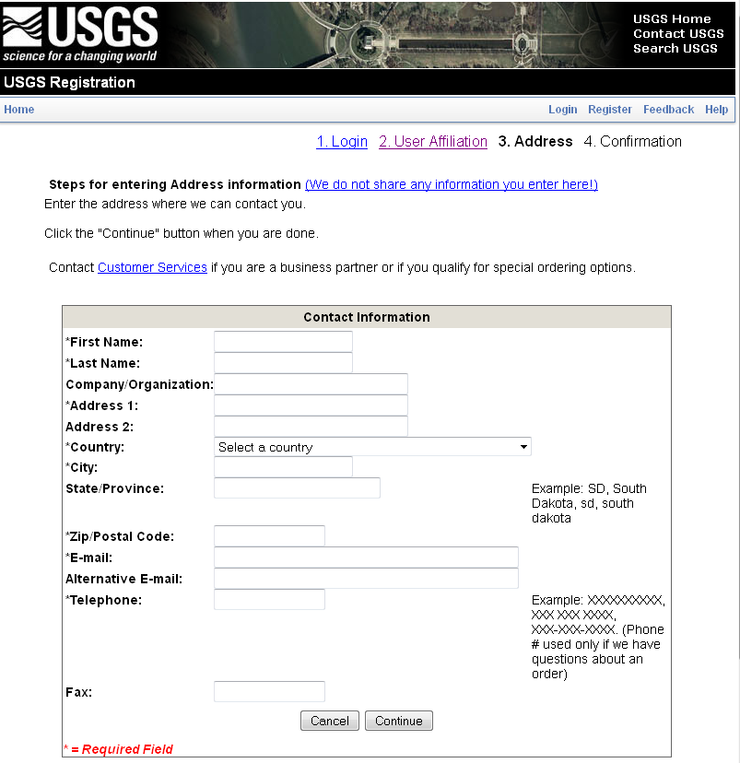
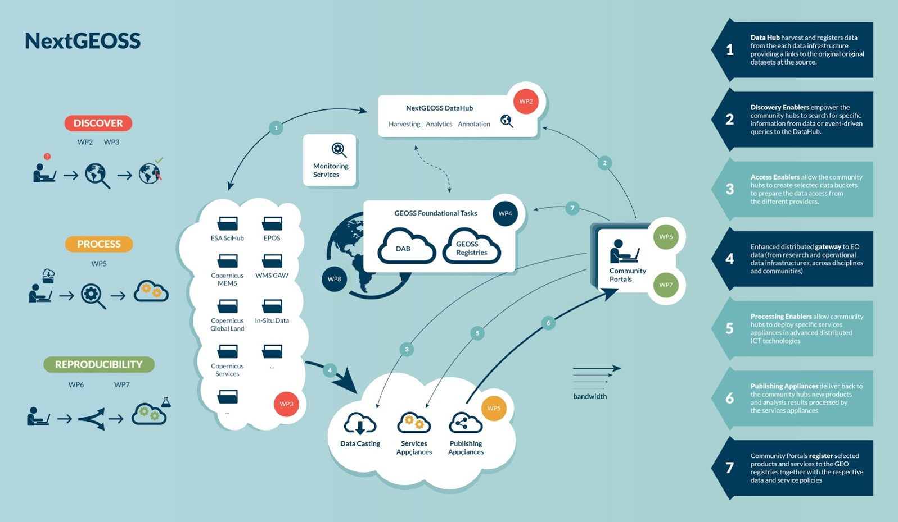
Federated Identity Management (SSO) White paper
DATA-14: Develop a White Paper on Single Sign-On (SSO) authentication

Slide 19
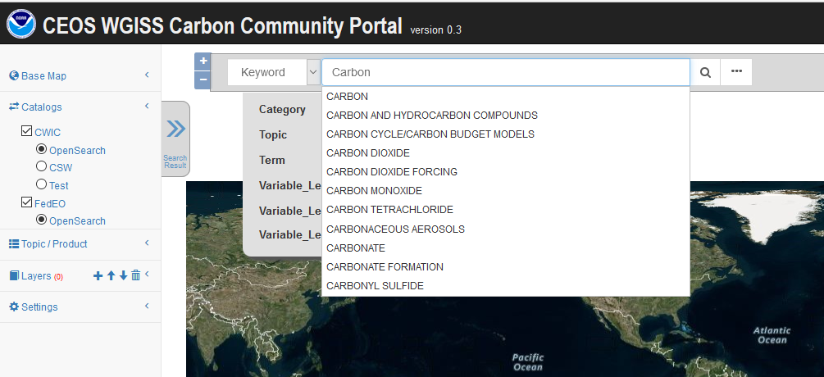
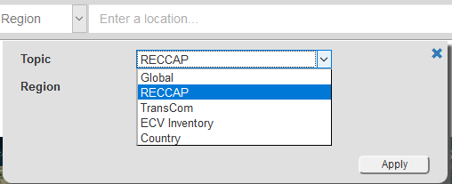
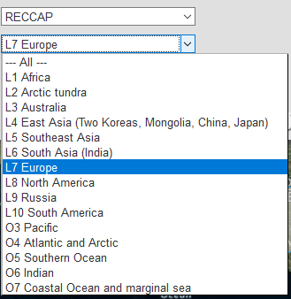
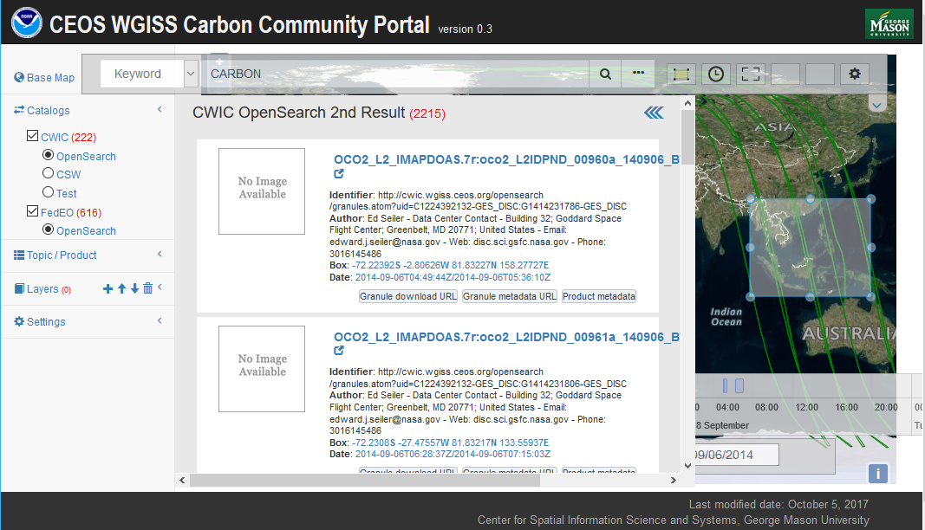
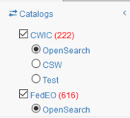
WGISS Carbon Community Portal
Special regions: Global, RECCAP, TransCom, Country Names, ECV Inventory)
Temporal Searches: support for time range and specific date
Pre-defined Carbon topics/datasets: (Atmospheric, Ecosystem, Ocean, Mixed-Theme)
Keywords (auto-completion with IDN Science Keywords)
Return records from both CWIC and FedEO
CARB-15: Carbon Data Portal prototype
Notes:
Objective: Implement a prototype carbon data portal to facilitate the discoverability and accessibility of ECV products and space-borne CDRs. The portal will seamlessly access data both in CWIC and FedEO to provide necessary data and services to the carbon science community of both CEOS and GEOSS.
Approach: prototype developed by WGISS in coordination with CEOS Carbon Team and WGClimate Carbon (requirements and use cases provision/validation).
Status: Several iterations held between WGISS and Carbon teams. Carbon Portal latest version (August 2018) with Carbon Team for review/feedback.
Next steps: 1) Improve discoverability of ECV/CDR key datasets for Carbon Community and functionalities based on received feedback; 2) Open-up portal to wider user community to gather additional feedback (target end October 2018).

Slide 20
Technology Exploration
The Technology Exploration interest group serves as a forum for exchange of technical information and lessons-learned experience about current and trending technologies, services and other WWW / Internet related software technologies.

Slide 21
Technology Activities
Past Technology Webinars
Relevancy Ranking of Data Search Results
Data Cubes for Large Scale Data Analytics
Burgeoning Role of Python for Earth Observation Data Analysis
The OGC Coverage Standards Suite: Introduction and Overview
Scrum and scale agile methods
Future Webinars being organised in cooperation with WGCapD: more end user oriented
Joint webinars and advertising with:
WGCapD
NextGEOSS
GEOSS Evolve
Federation of Earth Science Information Partners (ESIP)
http://ceos.org/ourwork/workinggroups/wgiss/technology-exploration/
DATA-11: Data and Technology Exploration webinars and workshops
FDA-5: Promote awareness of FDAs (support WGCapD)
Technology Session at WGISS#46 will address Artificial Intelligence, Machine Learning and other “disrupting” technologies
Notes:
Relevancy Ranking of Data Search Results
14th of March 2017
Stefano Nativi (GEOSS EVOLVE)
Chris Lynnes and James Norton (NASA)
Data Cubes for Large Scale Data Analytics
19th of June 2017
Rob Woodcock (CSIRO)
Brian Killough (CEOS SEO)
Burgeoning Role of Python for Earth Observation Data Analysis
22nd of August 2017
Syed Rizvi (Open Data Cube)
Rich Signell (USGS)
Alber Sanchez (INPE)
The OGC Coverage Standards Suite: Introduction and Overview
19th of January 2018
Dr Peter Baumann (Rasdaman)
Scrum and scale agile methods
31st of July 2018
Ms. Dana Shum (Raytheon NASA)

Slide 22
WGISS Cooperation

Slide 23
Cooperation with other groups
CEOS Carbon Team - Ongoing development of prototype Carbon Portal (CARB-15)
WGClimate - Ongoing review of ECV inventory to ensure CDRs access through WGISS Connected Data Assets Infrastructure (DATA-9)
WGDisasters – Opportunity identified: generic recovery observatory highlighted as possible cooperation area during WGDisasters meeting#10, to be further discussed.
WGCV – Ongoing around four different topics:
Data Formats and Interoperability in the framework of FDA
Quality Indicators in Discovery Metadata
CEOS Data Cubes and CEOS Test Sites Data Access in support of WGCV Activities
Standardization and Best Practices

Slide 24
Cooperation with other groups
Virtual Constellations – Opportunity identified: update the inventory of Virtual Constellations datasets and ensure discoverability/accessibility through WGISS Connected Data Assets infrastructure
WGCapD - Ongoing: WGISS Technology webinars and FDA events publicized through WGCapD, upcoming ones organised in cooperation (DATA-11 & FDA-5)
SEO - Ongoing: COVE tool harvesting metadata from WGISS Connected Data Assets Infrastructure
CGMS - Ongoing: Working Group (WG) IV Global Data Dissemination
ESIP - Ongoing: exchange of information and best practices on data stewardship
Notes:
WGISS best aligns with CGMS Working Group (WG) IV Global Data Dissemination. Many members of WGISS (e.g. NOAA, NASA EUMETSAT etc) are also members of CGMS. In the past, WGISS members have participated in WG IV to respond to CGMS action items. As an example, in response to CGMS action item # A44.03 (identify how far WGISS Interoperable standards were adopted), WGISS provided a list of CEOS agencies who have implemented CEOS Opensearch Best Practices: EUMETSAT, NASA, ESA, CNES, USGS, JAXA, ISRO (NRSC) and CCMEO.

Slide 25
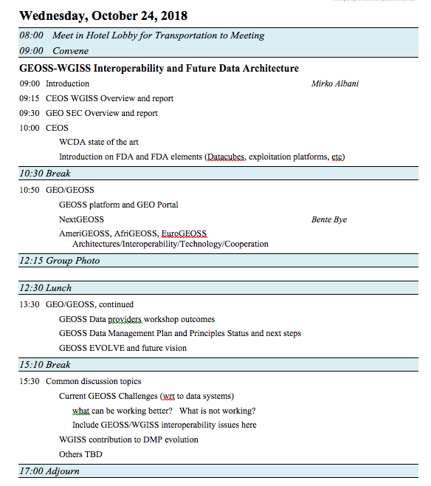
Cooperation with other groups
GEO - Ongoing:
GEOSS Platform accessing WGISS CDA infrastructure for CEOS agencies data discovery and access
WGISS contributing to GEOSS-EVOLVE initiative
Participation & support to GEOSS Data Providers
Workshops (e.g. “User Metrics” session, May 2018)
Contribution to CEOS booth at GEO Plenary
WGISS represented in NextGEOSS Advisory Board
and Working with NextGEOSS on federated
authentication technology solutions
Joint Workshop on GEOSS-WGISS
interoperability and FDA at WGISIS#43
and upcoming WGISS#46
WGISS representative will be proposed as
member of GEOSS Expert Advisory Group

Slide 26
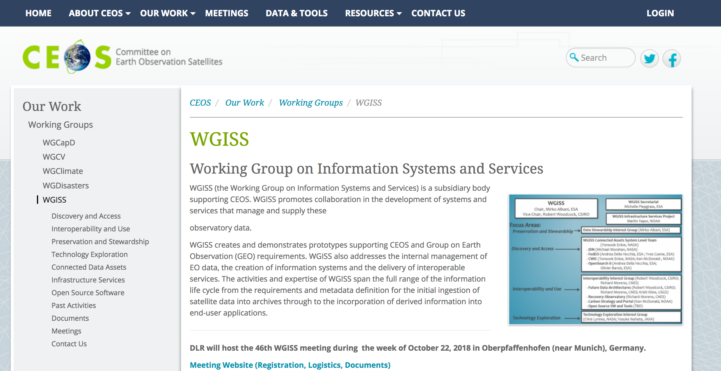
WGISS Information
http://ceos.org/ourwork/workinggroups/wgiss/

Slide 27
WGISS Health Status
Interagency coordination working well, good cooperation spirit
Healthy participation to meetings (average 20-25 people)
Some members attending all meetings (e.g. NASA, NOAA, USGS, CNES, ESA, CSIRO, JAXA, RADI, AOE CAS)
Others attending sporadically depending on meeting location and topics under discussion
Stable participation from all agencies would increase WGISS activities impact and capability to respond to CEOS 2018-20 Work Plan
Organization of targeted events during WGISS weeks proved to attract more participants (e.g. CEOS/GEO technical workshop, FDA sessions)
Promotional material being developed and actions being undertaken to enlarge engagement

Slide 28
Vice Chair Nomination
WGISS Vice Chair Nomination for the period October 2019 – October 21

Slide 29
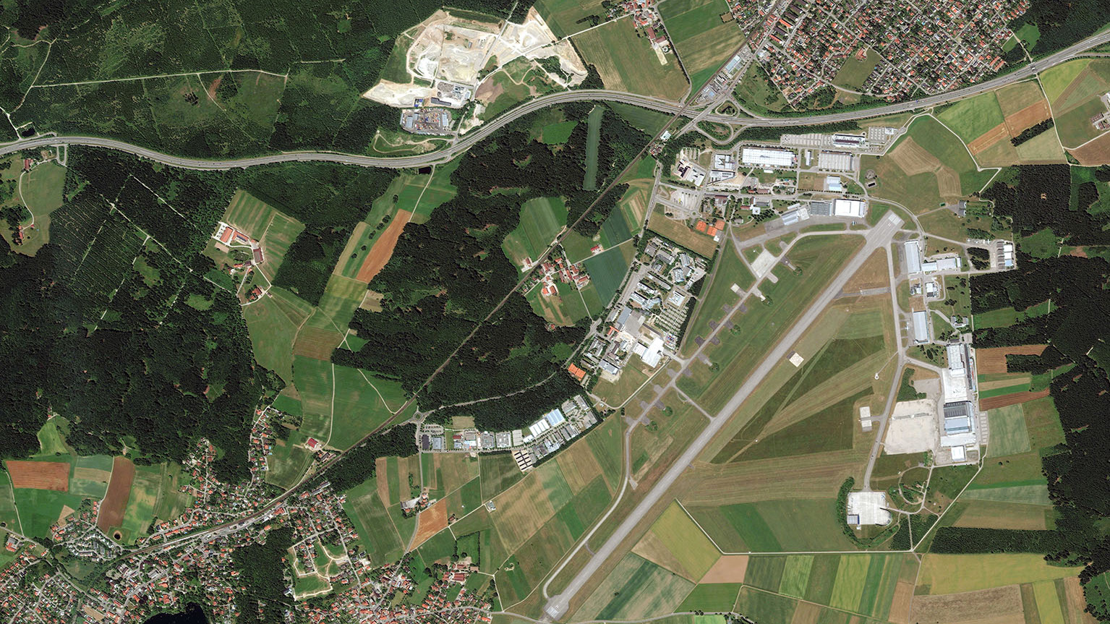
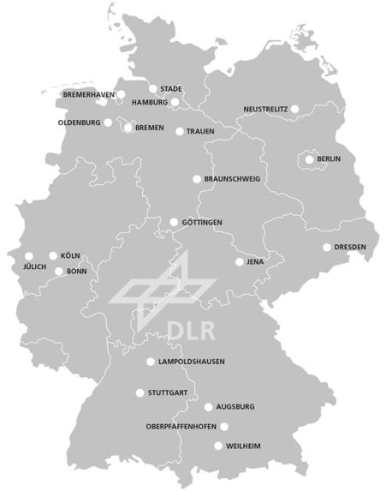
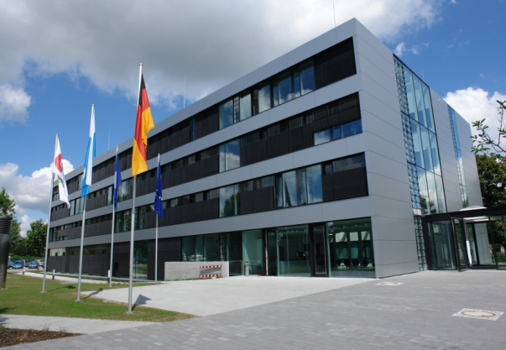
Upcoming Meetings
WGISS#46 hosted by DLR - Oberpfaffenhofen, Germany (22-25 October 2018)
CEOS/GEO FDA and Interoperability Workshop
WGISS#47 – March/April 2019, hosted by NOAA
DLR-Oberpfaffenhofen
near Munich, Germany
Munich 30 km →
Oberpfaffenhofen
DLR Earth Observation Center

Slide 30
Contact:
Mirko.Albani@esa.int

