Slide 1
Vision for WMO Integrated Global Observing System (WIGOS) in 2040
Context, purpose, scope, and current status
Fernando Belda and Lars Peter Riishojgaard
WMO Secretariat

Slide 2
What is the WMO Integrated Global Observing System (WIGOS)?
WMO foundational activity addressing the observing needs of the weather, climate, water and environmental services of its Members
A framework for integrating all WMO observing systems and WMO contributions to co-sponsored observing systems under a common regulatory and management framework
Overall purpose: Provide a solid and well-documented observational basis for all services in the areas of weather, climate and water, acquired in a manner that is as cost-efficient as possible
WIGOS homepage

Slide 3
WMO Application Areas supported by WIGOS
Global numerical weather prediction
High-resolution numerical weather prediction
Nowcasting and very short range forecasting
Seasonal and inter-annual forecasting
Aeronautical meteorology
Forecasting atmospheric composition
Monitoring atmospheric composition
Atmospheric composition for urban applications
Ocean applications
Agricultural meteorology
Hydrology
Climate monitoring
Climate applications
Space weather

Slide 4
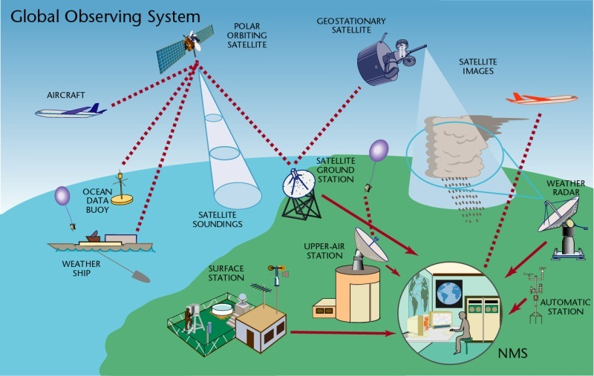
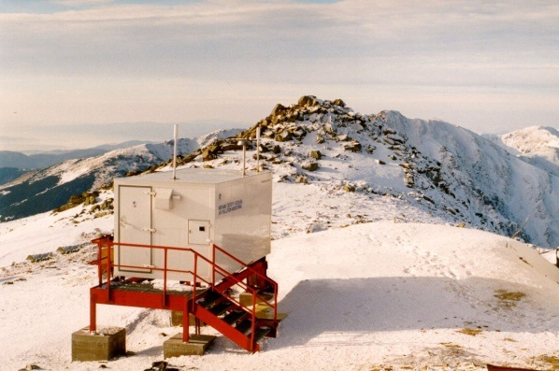
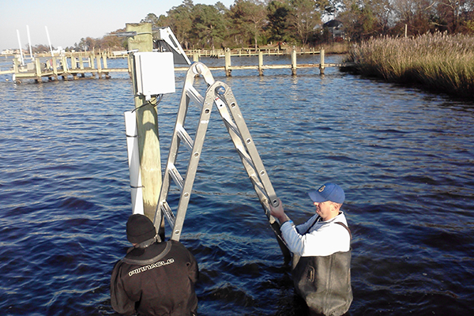
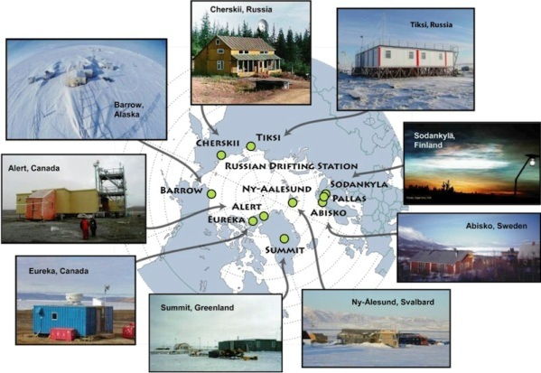
WIGOS Components
(by discipline)
Global Observing System (WWW/GOS)
Observing component of Global Atmospheric Watch (GAW)
WMO Hydrological Observations (including WHYCOS)
Observing component of Global Cryosphere Watch (GCW)

Slide 5
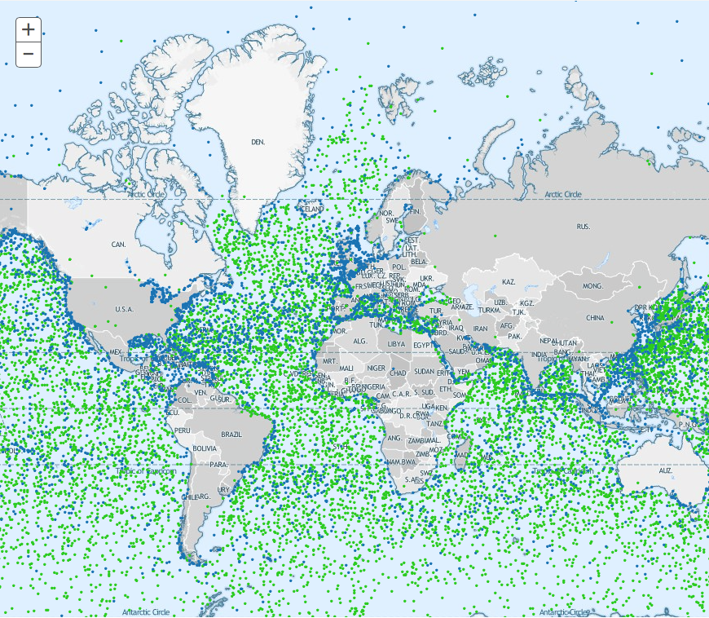
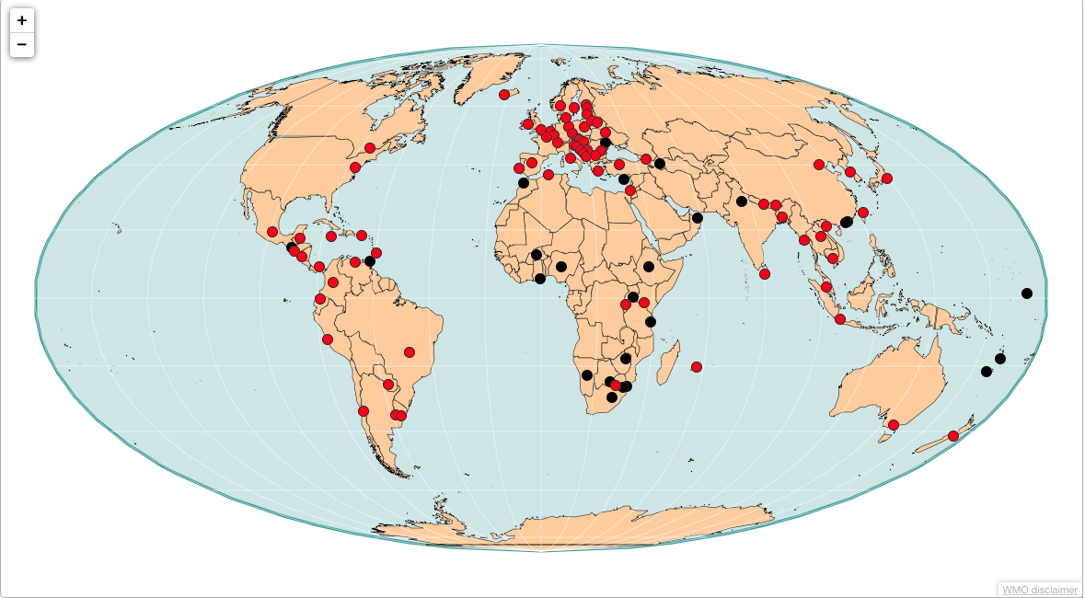
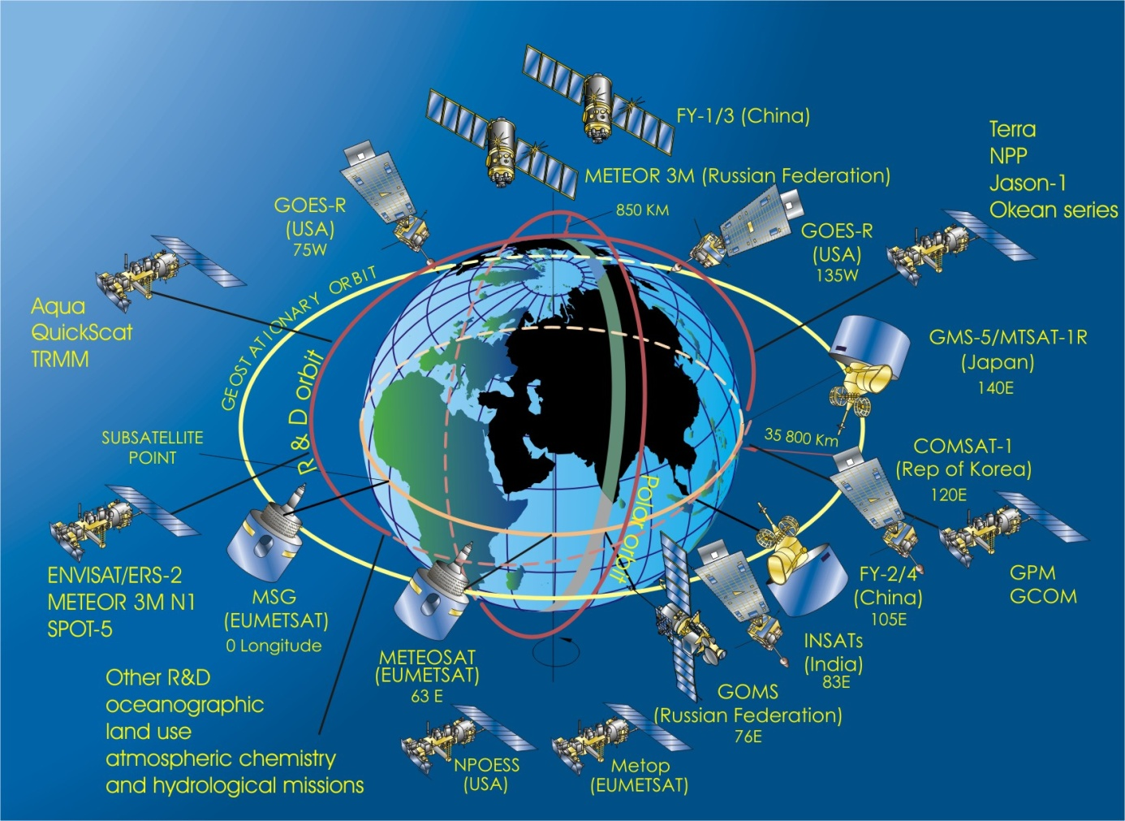
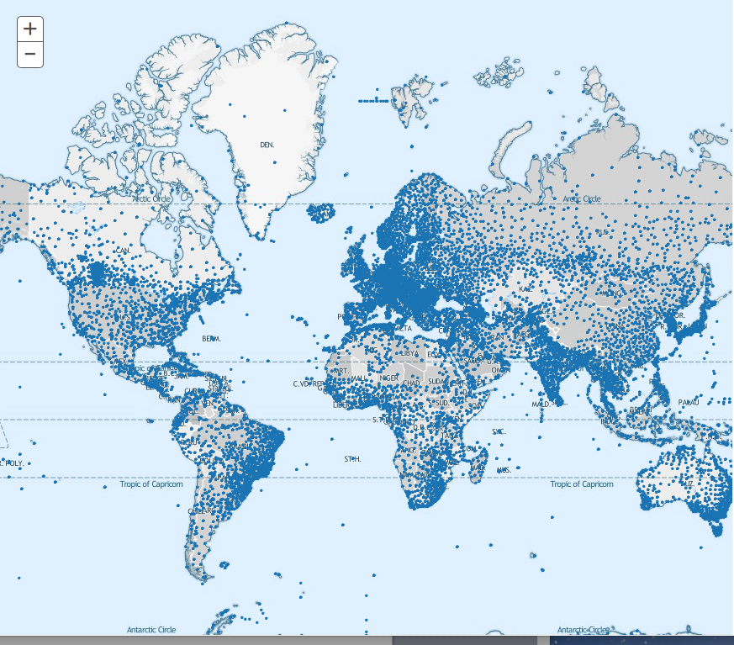
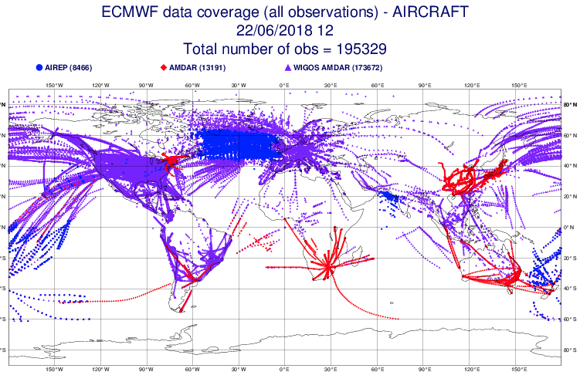
WIGOS Components
(by operator)

Slide 6
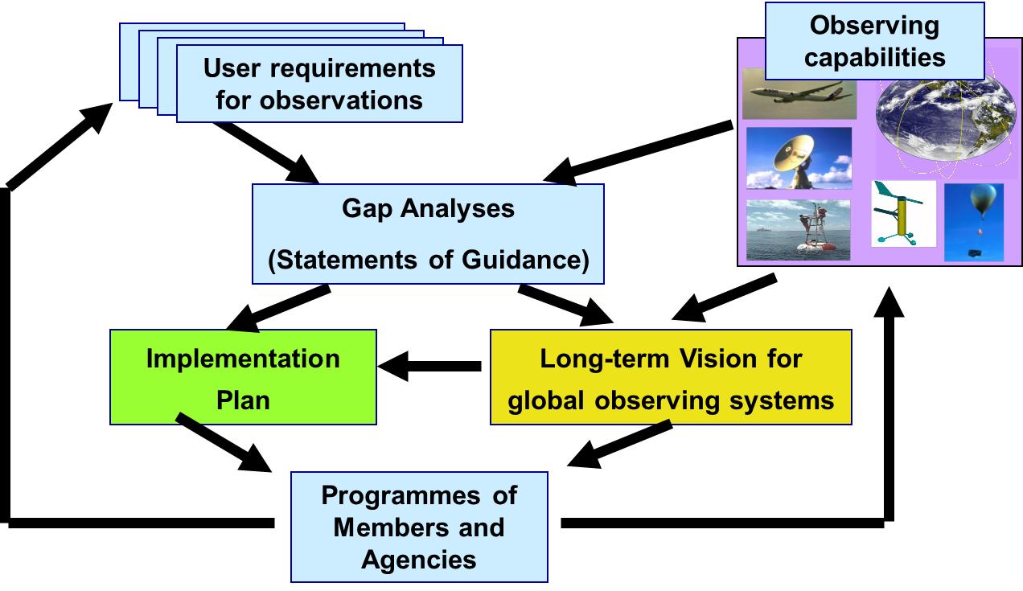
Rolling Review of Requirements (RRR)
WMO Congress: All WMO and WMO co-sponsored observing systems shall use the RRR to design networks, plan evolution and assess performance.
The RRR is the process used by WMO to collect, vet and record user requirements for all WMO application areas and match them against observational capabilities
Rolling Review of Requirements

Slide 7
Why a Vision for WIGOS in 2040?
To serve as reference for WMO Members and other observing system operators, providing context and expected boundary conditions relevant for observing system developments
To inform long-term planning of satellite agencies about expected evolution of WMO user requirements
This drives the 2040 timeline; current 2025 Vision too near-term
To inform planning efforts of users of observations (NHMSs, NWP centers, …) regarding systems development and required computing and communication capabilities

Slide 8
A few of the key drivers behind new Vision
External to the NMHSs:
Climate change; new requirements for information on all time scales;
Support for Paris Agreement, SDGs, Sendai Framework, …;
New application areas, renewed emphasis on existing application areas
Demographic changes (urbanization, mass migration, …);
Increasing overall demand for meteorological information
Internal to the world of meteorology:
Evolving technical capabilities (sensing, telecommunication, computing);
Move toward integrated earth system modeling:
Increasing recognition of economic value of meteorological information;
Private sector increasingly interested in owning and operating observing systems rather than in selling hardware.

Slide 9
Timeline
Timeline
17th World Meteorological Congress (2015) requested ICG-WIGOS to develop a “Vision for WIGOS in 2040” and submit for approval at next session in 2019;
Expert team meetings and user consultation workshops held in 2015-16 leading to the development of draft “Visions” for space- and surface-based components, respectively;
Draft material presented and discussed in various contexts (WMO constituent bodies, CGMS-44, 45, GEO-XIV,…);
First draft of an integrated document presented to ICG-WIGOS in January 2018;
Submitted to CGMS-46 as WMO-WP-01
Endorsed for finalization and submission to the 18th World Meteorological Congress in 2019 by WMO Executive Council in June 2018.

Slide 10
Timeline
CGMS Involvement in Vision Development
CGMS-43 (Boulder, May 2015): In anticipation of discussions to take place at WMO Congress-17, WMO briefed Plenary on the rationale for the new “Vision”; this action was taken in response to a report from ET-SAT in 2014;
CGMS-44 (Biot, June 2016): WMO (ET/SAT) briefed Plenary on initial development of “Vision for Space-based Components of WIGOS in 2040”;
CGMS-45 (Jeju, June 2017): WMO provided briefing on development of “Vision for Surface-based Components of WIGOS in 2040” and plans for an integrated Vision document; CGMS agencies invited to comment;
CGMS-46 (Bengaluru, June 2018): First draft of integrated “Vision for WIGOS in 2040” presented as WMO-WP-01.

Slide 11
Document Structure
Chapter I; Context, purpose, scope
Why a new vision, what are the main drivers of change; what does the concept of “integration” in WIGOS entail;
Chapter II; Space-based WIGOS components
Trends in Requirements and Capabilities; text and tables introducing the four tiers of space-based systems contributing to WIGOS;
Chapter III; Surface-based WIGOS components
Trends and issues (technology, requirements, private sector involvement, commoditization of sensors, processing, communication, …); tables of available and emerging technologies.

Slide 12
Chapter II (Space-based WIGOS Components)
The Vision describes a four-tier constellation:
Backbone system with specified orbital configuration and measurement approaches
Basis for Members’ commitments, should respond to the vital data needs; similar to the current CGMS baseline with addition of newly mature capabilities
Backbone system with open orbit configuration and flexibility to optimize the implementation
Basis for open contributions of WMO Members, responding to target data goals
Operational pathfinders, and technology and science demonstrators
Responding to R&D needs
Additional capabilities
contributed by WMO Members and third parties including governmental, academic or commercial initiatives

Slide 13
WIGOS Vision, CGMS Baseline, WIGOS Gap Analysis and CGMS Risk Assessment
Vision for WIGOS (Chapter II, Tier I);
(Idealized) user view of CGMS Baseline
Gap analysis (WMO); e.g. due to missing Tier I components;
four-year cycle
CGMS Baseline (see WG-III Report);
system committed to by CGMS Members;
will be included in the Manual on WIGOS
Risk assessment (CGMS), e.g. due to on-orbit or launch failures, budgets; annually
Space-based component of WIGOS;
system actually operating/will be operating

Slide 14
Next steps
On June 22 WMO Executive Council endorsed Vision development as part of its WIGOS deliberations and recommended submitting document in its final form to Congress-18 in 2019;
Final round of consultation taking place now (October/November 2018), prior to translation into all WMO languages and dissemination to all Members for review in preparation for Congress;
Consultations include all WMO technical commissions and program areas, (GCOS and GCW), CGMS, CEOS, …

Slide 15
GHG Missions and the Vision for WIGOS in 2040
The Vision for WIGOS 2040 should also include reference to the planned GHG missions that are expected to be deployed in the coming years, and well within the 2040 timeframe
The recently finalized CEOS AC/VC GHG Team Whitepaper on “A constellation architecture for monitoring carbon dioxide and methane from space” should provide helpful input
CEOS is kindly requested to provide guidance to WMO how the findings of the Whitepaper could be best integrated into the Vision document, and in particular, be reflected in the tier table
WMO would be grateful to receive this input at the earliest possible opportunity, ideally before the end of October 2018

Slide 16
Thank you very much for your attention
WMO Secretariat

