Slide 1
Update on KMA Space Program
Committee on Earth Observation Satellites
Geun-Hyeok Ryu
Korea Meteorological Administration
CEOS Plenary 2018
Agenda Item 4.3
Brussels, Belgium
17 – 18 October 2018

Slide 2
Launch of GK-2A
GK2A is scheduled to be launched in 05:30 ~ 06:30 5th December 2018
AMI (Resolution) |  | ABI | AHI
1 blue | 0.47 (1km) | 0.47 | 0.46
2 green | 0.511 (1km) |  | 0.51
3 red | 0.64 (0.5km) | 0.64 | 0.64
4 | 0.856 (1km) | 0.865 | 0.86
5 | 1.38 (2km) | 1.378
6 | 1.61 (2km) | 1.61 | 1.6
 |  | 2.25 | 2.3
7 | 3.830 (2km) | 3.90 | 3.9
8 | 6.241 (2km) | 6.185 | 6.2
9 | 6.952 (2km) | 6.95 | 7.0
10 | 7.344 (2km) | 7.34 | 7.3
11 | 8.592 (2km) | 8.50 | 8.6
12 | 9.625 (2km) | 9.61 | 9.6
13 | 10.403 (2lkm) | 10.35 | 10.4
14 | 11.212 (2km) | 11.2 | 11.2
15 | 12.364 (2km) | 12.3 | 12.3
16 | 13.31 (2km) | 13.3 | 13.3
Bus design and review
Module integration
System Integration
Launch/IOT/OPS
2013
2014
2015
2016
2017
2018
2019
Kick-off
SRR
PDR
CDR
TRR
Test
AMI PSR
Launch
System
Req. analyss
Preliminary
Design
Critical
Design
payload
test
AIT
Prep. Launch
IOT, Ops

Slide 3
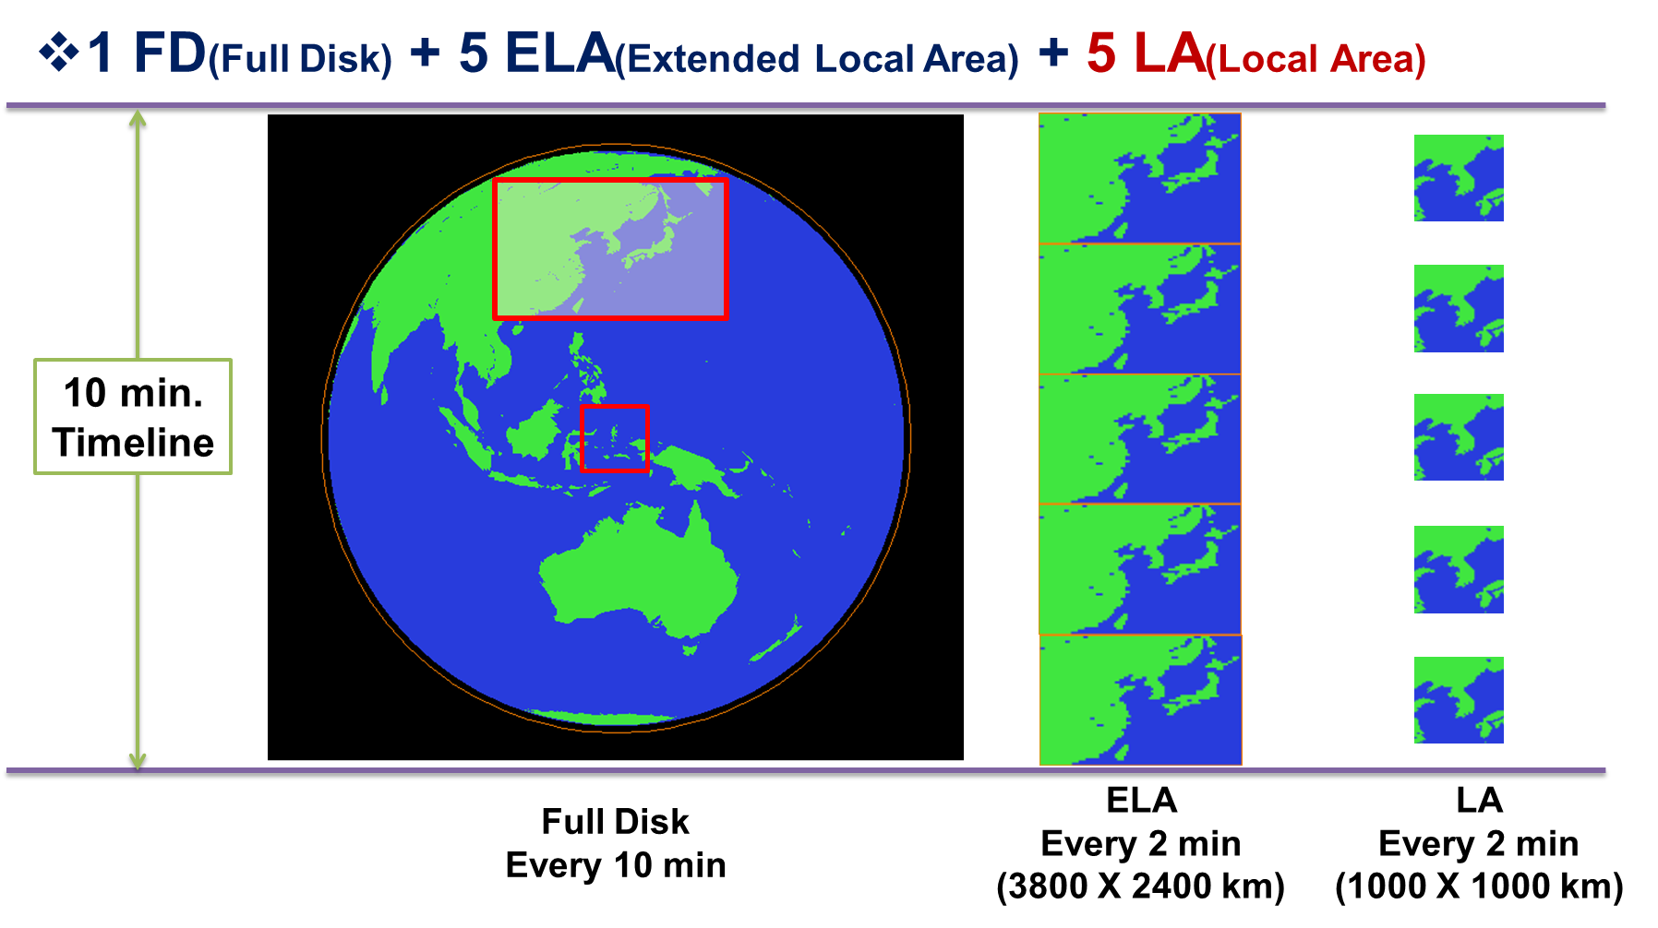
Observation Area and Schedule
1 FD + 5 ELA + 5 LA : 10 min
Full Disk (FD)
Extended Local Area (ELA) : 3800 X 2400 km (EW X NS)
Local Area (LA) 1000 X 1000 km

Slide 4
GK-2A 10-minute Timeline
KMA will operate 3 different observation areas with 10-min schedule
FD : Full Disk
ELA : Extended Local Area centered Korean Peninsular
LA : Target Area which can observe any area by user request
The official request of target area observations by global users
over the Asian Pacific region (RA II and RA V) will be available
The first priority is the disasters monitoring over Korean Peninsular,
such as typhoon, wild fire etc
Global users submit official request form defining specific measurement area via designated web page (or email)
Decision will be made before disseminating images via designated web page

Slide 5
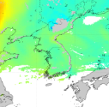
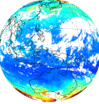
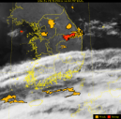
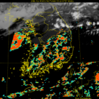
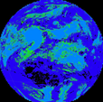
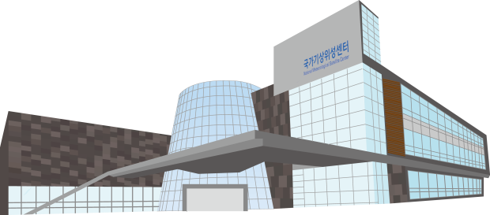
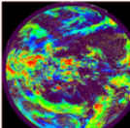
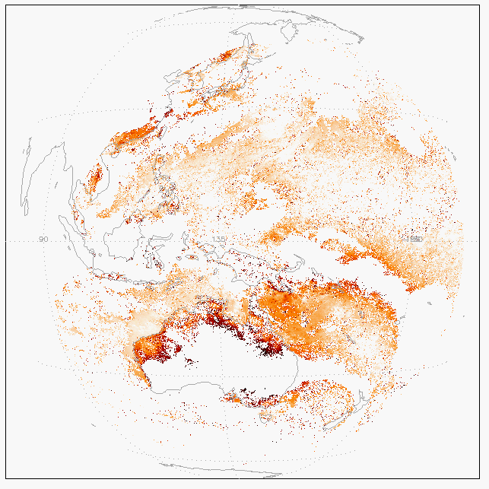
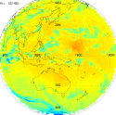
GK-2A/AMI Geophysical Products
Primary Products
Vertical
Moisture
Profile
Vertical
Temperature
Profile
Atmospheric
Motion
Vector
Convective Initiation
Cloud Detection
Instability Index
Total Ozone
Fog
Rainfall Rate
Sea Surface
Temperature
Cloud Phase
Land Surface
Temperature
Cloud Top Height
Cloud Top
Pressure
Snow Cover
Sea Ice Cover
Aerosol
Detection
Asian
Dust
Detection
Volcanic
Ash
Detection,
Height &
Mass
Aerosol
Optical
Depth
Asian
Dust
Optical
Depth
Radiance
Cloud Top
Temperature
Snow Depth
Ocean Current
Cloud Type
Cloud Amount
Cloud Optical Depth
Cloud Effective Radius
Cloud Liquid Water Path
Cloud Ice Water Path
Cloud Layer/Height
Probability of Rainfall
Rainfall Potential
Aerosol Particle Size
Visibility
Absorbed SW Radiation (SFC)
Downward SW Radiation (SFC)
Reflected SW Radiation (TOA)
Downward LW Radiation (SFC)
Upward LW Radiation (SFC)
Upward LW Radiation (TOA)
Aircraft Icing
Secondary Products
Fire Detection
Vegetation Index
Vegetation Green Fraction
Surface Emissivity
Surface Albedo
Overshooting Top Detection
SO2 Detection
Total Precipitable Water
Clear Sky Turbulence

Slide 6
Non Meteorological Application
Focus on NMA products such as dust and ocean/land surface parameters
With coming era of GK-2A, significantly expand NMA by adopting the various and additional products for monitoring fire and flood
NMA products | Current (COMS) | Future (GK-2A)
Dust | Aerosol Index AOD | Aerosol Detection(Aerosol Type) AOD, Aerosol Peak Height Surface-level Aerosol Concentration
Ocean environment monitoring | SST Sea Ice | SST, Sea Surface Current, Sea Ice SST Anomaly, Ocean Front, Ocean Eddy Upwelling Age, Vessel Icing
Land surface properties and Hydrology | evapotranspiration LST | Soil Moisture, Evapotranspiration Surface Albedo, Surface Emissivity LST, NDVI, Drought Index
Forest fire |  | Fire Detection Fire Potential Fire Radiative Power Fire Fraction of Burned Area
Flood |  | Flood RGB image

Slide 7
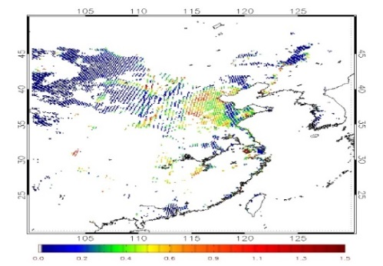
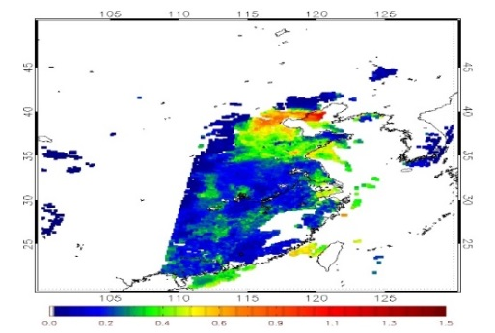
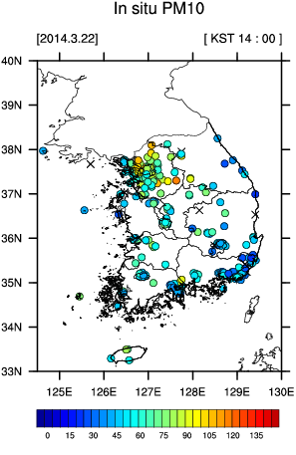
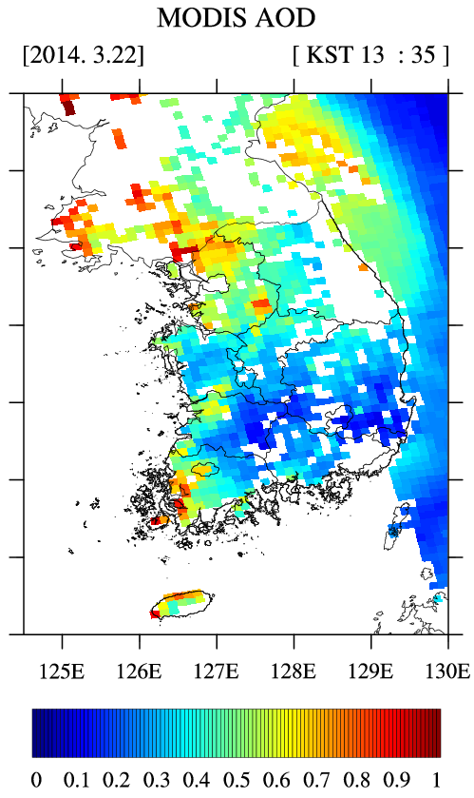
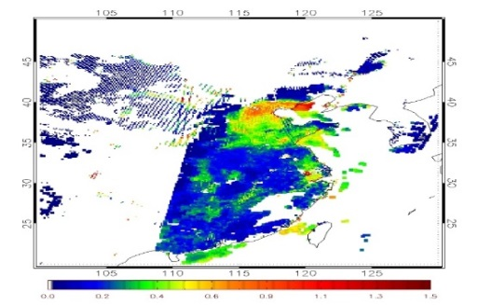
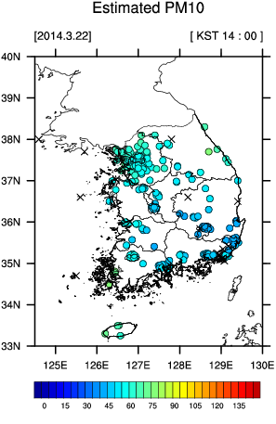
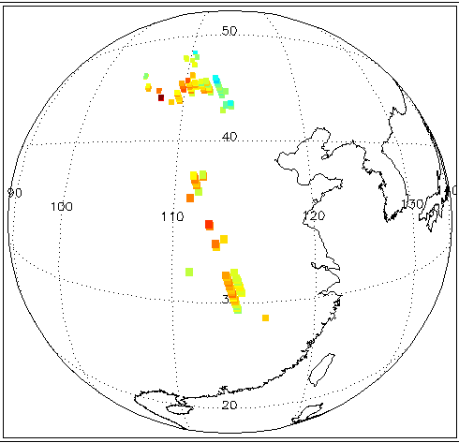
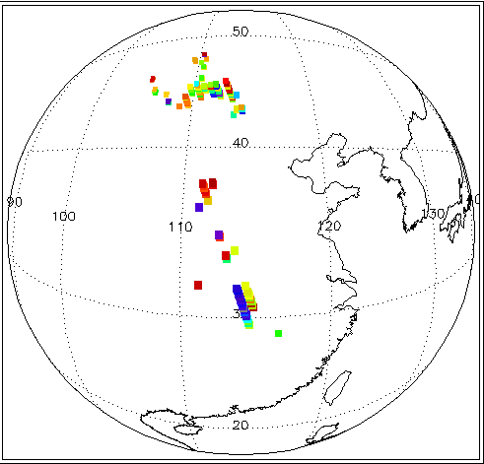
Application: Dust height & dust at surface
AOD Fusion
Aerosol Concentration at surface
MODIS <10km>20070109
SeaWiFs <10km>20070109
PM10 & AOD matching
AODcombine Process
${AOD}_{combine}$= $\left\{\begin{aligned}AODMODIS \\ AODSeaWiFs \\ (AODMODIS+{AOD}_{SeaWiFs})/2 \\ no value\end{aligned}\right.$
Estimated PM10
Aerosol Peak Height
O4 AMF from OMI
LUT Matching
Retrieved Dust peak Height
MLR model
AOD(Cloud Screening), PBLH, f(RH), Surface wind
O4 VCD
SZA
VZA
RAA
Reflectance
AOD

Slide 8
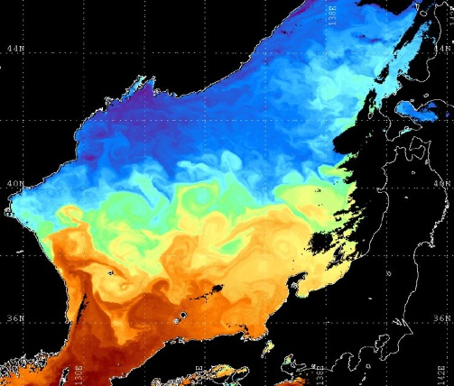
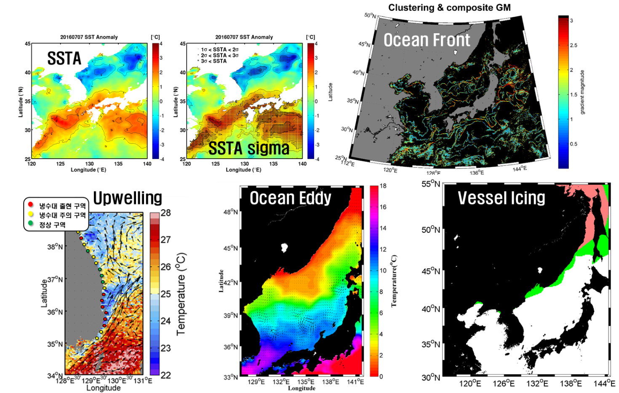
Application: Ocean
Ocean environment monitoring parameters; sea surface temperature and SST anomaly, sea surface current, ocean front, upwelling age, oceanic eddy, and vessel icing together with sea surface temperature and sea surface current.
SST
Sea Surface Current

Slide 9
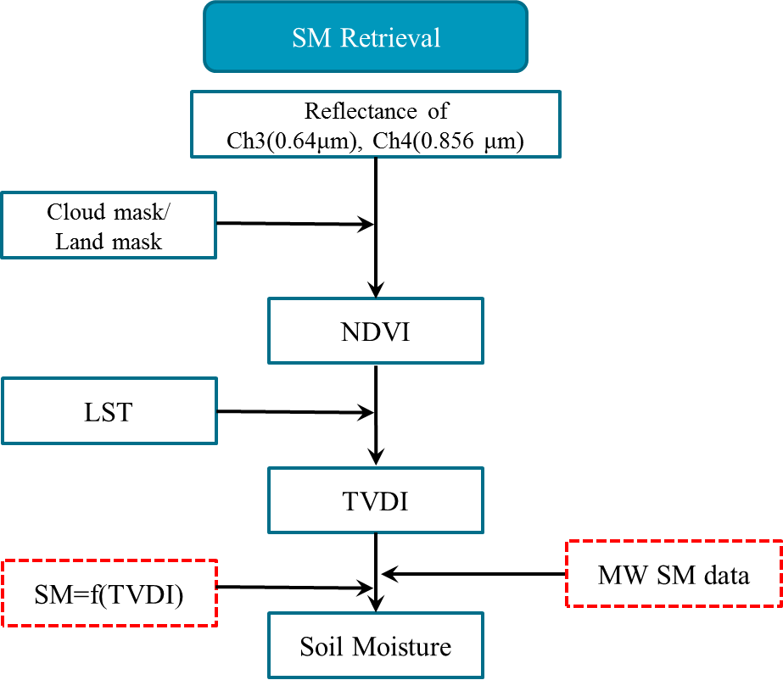
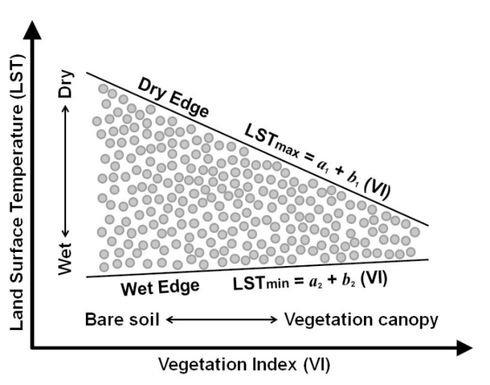
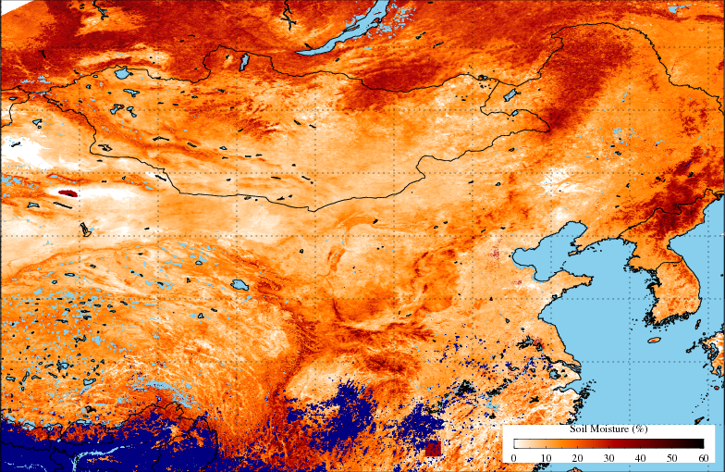
Application: Surface property/Soil moisture
Soil moisture
Relationship between TVDI and SM
TVDI : 0 (saturated soil) ~ 1(dry soil )
* TVDI: Temperature-Vegetation Dryness Index
$$TVDI=\frac{(LST−{LST}_{day_min})}{({LST}_{day_max}−{LST}_{day_min})}$$
LST_{max}= a₁ + b₁ (NDVI)
LST_{min} = a₂ + b₂ (NDVI)
LST = a+b NDVI
(an empirical formula: a, b is determined from observation data)
TVDI-based Soil Moisture (%)

Slide 10
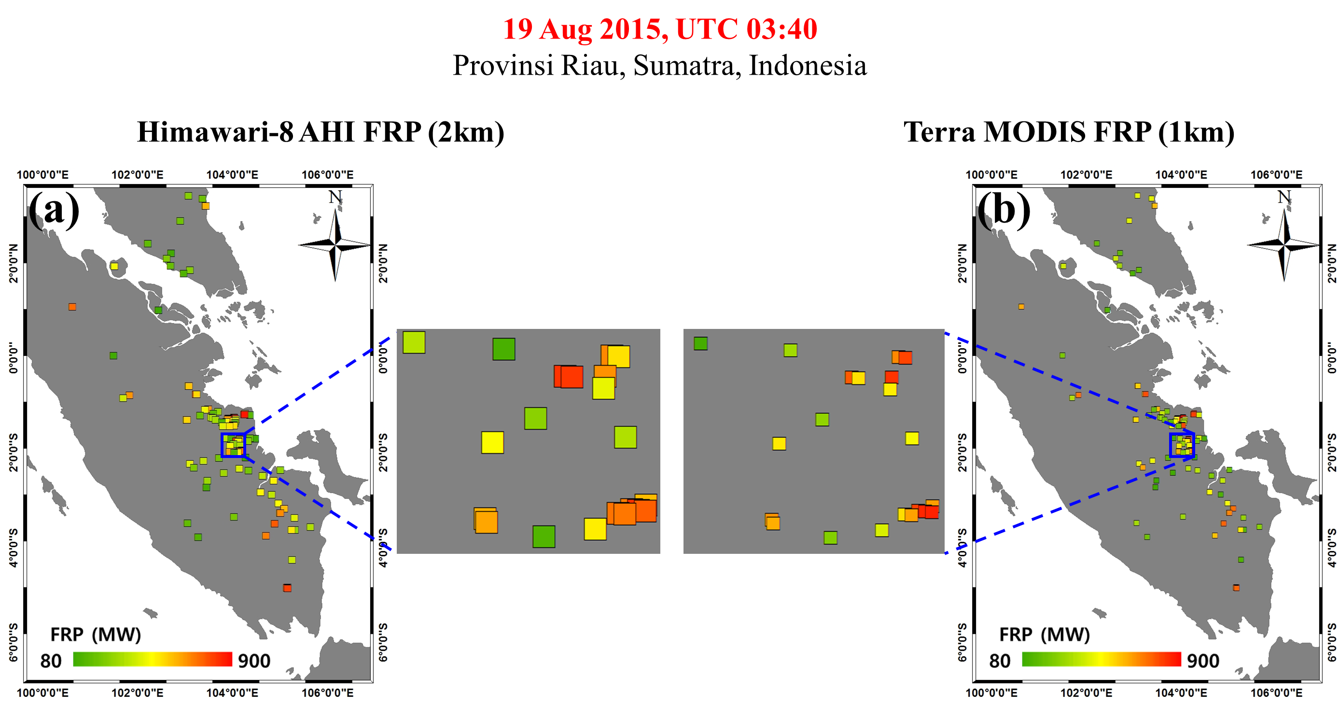
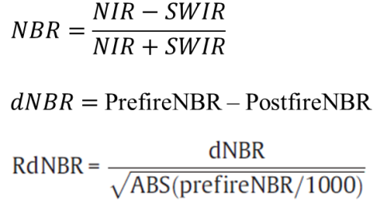
Application: Forest fire monitoring
Wildfire potential
Development of four meteorology-based indices and two surface dryness indices
- FFDI(Forest Fire Danger Index), FFMC(Fine Fuel Moisture Code), HI(Haines Index), MNI(Modified Nesterov Index)
- NDDI (Normalized Difference Drought Index), TVDI (Temperature Vegetation Dryness Index)
Fire Radiative Power
Fire Burned Area
using Sentinal-2 data
$$FRP= \left(\frac{σε_{f}}{c ∙ε_{f,MIR}}\right)L_{f,MIR}$$

Slide 11
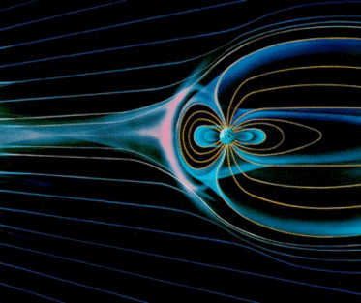
Global network of Space Weather monitoring
KSEM of GK2A could cover eastern local times for the space weather monitoring at geostationary orbits
Compression (dayside)
GK-2A
GOES-West
Solar Wind Variation
(Bz, V, n)
GK-2A: 128º E
EDRS-C : 31º E
GOES-East : 75º W
GOES-West: 135º W
GOES-East
EDRS-C
Field Stretching (night side)
Space Weather Data Processing Subsystem for L1 and L2 retrieval
FTP, Web
Data Receiving
and
Pre-processing
Data Processing
system
Data Analysis
system
Public
service
LV1
LV2
LV1 : Reconstructed, Processed instrument data at full resolution, time-referenced anotated with ancillary
information including calibration coefficients and georeferencing parameters applied
LV2 : Product retrieved using additional algorithm or model with LV1 data

Slide 12
Data Service Plan : GK-2A
Via GK-2A broadcast (< 3 minutes data latency)
Broadcast all 16 channels data (UHRIT, full resolution) of meteorological observations
Maintain L/HRIT broadcast corresponding to COMS five channels
Via Landline
Real-time cloud service similar to HimawariCloud will be implemented (< 5 min data latency)
GK-2A data also will be available in DCPC-NMSC (http://dcpc.nmsc.kma.go.kr)
L1 Data Format
netCDF4(for each channels), with GSICS information
L2 Data Format
netCDF4(for each products)
L1 Data Header Structure
General Information
Output Information
Pixel File Information
Projection Information
Star Measurement Information
INR Characteristics Information
Image Geometry Quality Information using Star Measurements
Registered Image Information
Quality Area Image Information

Slide 13
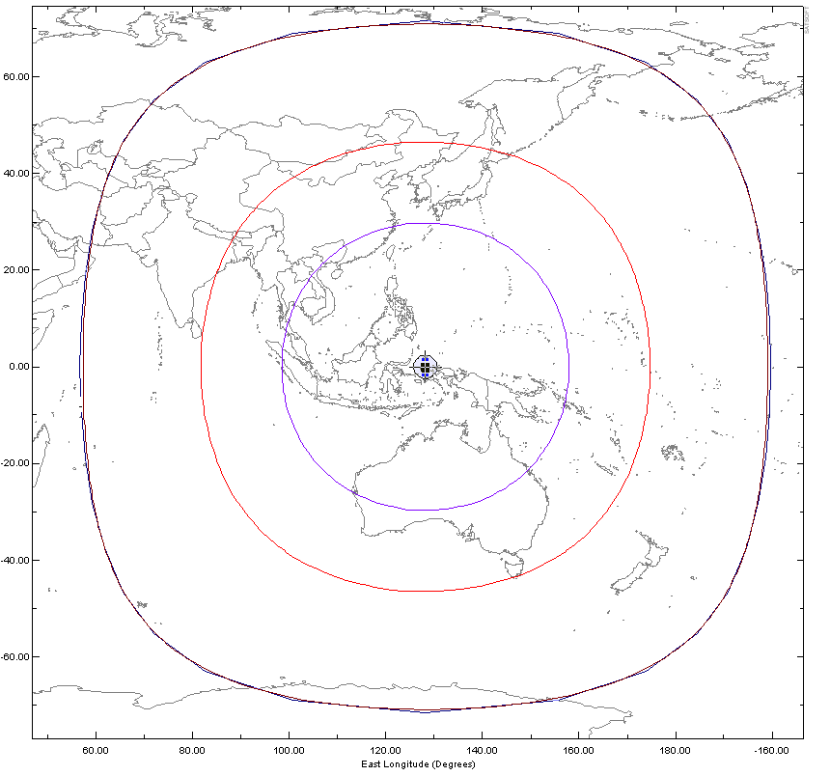
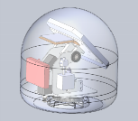
Data Service Plan : LDUS System Development(Under detail design)
LDUS
AMI 16ch data will be serviced by CCSDS formatted UHRIT Telemetry on DVB-S2 Broadcasting Standard
Service Area is same as COMS (El > 10°) but required antenna diameter depends on the rain degradation margin.
SDUS
LRIT service is redesigned for using on a ship mounting with an 2 axis tracking antenna.
Minimized SDR(Software Defined Radio) Receiver
Contents will be satellite images, weather fax, etc.
Rain Loss Margin(99.99%) : ITU-R 837-5
A
C
ADC
Mini PC
A
Area1(-1dB, EL=55°)
SDR
Receiver
E
5.5m
3.7m
SDUS System
E
K
N
Area2(-2dB, EL=37°)
MDUS
Downscaled 5ch data(TBC) will be serviced by COMS compatible HRIT telemetry.
Compact SDR(Software Defined Radio) Receiver built in Receiving Server
6.5m
M
N
P
4.5m
Area3(-3dB, EL=10°)
N
3.5m
F
K
[UHRIT Service Area and Rain rate Map by ITU-R]
A

Slide 14
Thank you!
geunhyeokryu@korea.kr

