Slide 1
THE RUSSIAN SPACE REMOTE SENSING SYSTEMS
Committee on Earth Observation Satellites
The State Space Corporation ROSCOSMOS
CEOS Plenary 2018
Agenda Item 4.3
Brussels, Belgium
17 – 18 October 2018

Slide 2
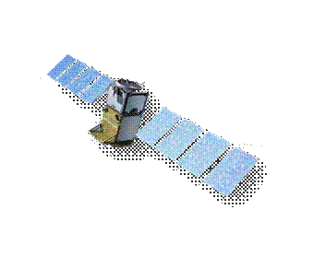
The Russian Earth Observation Satellite Constellation
Meteor-M2.2
Meteor-M2.3
Meteor-M2.4
Meteor-M2.5
Meteor-M2.6
Hydrometeorology
Meteor-M1
Meteor-M2
Arctica-M1
Arctica-M2
Arctica-M3
Arctica-M4
Arctica-M5
Elektro-L2
Elektro-L3
Elektro-L4
Elektro-L5
2018
2019
2020
2021
2022
2023
2024
2025
Resurs-P1
Resurs-P2
Resurs-P3
Kanopus-V3
Resurs-P4
Resurs-P5
Resurs-PM1
Resurs-PM2
Resurs-PM3
Resurs-PM4
NATURAL RESOURCES
Kanopus-V-IK
Kanopus-V4
Kanopus-V1
Obzor-R1
Obzor-R2
Kanopus-V5
Kanopus-V6
Kondor-FKA1
Kondor-FKA2
Kondor-FKA-M
Total
8
13
16
20
18
19
19
17
MS (visible and IR) data
SAR data
Planned launches – December 2018

Slide 3
THE RUSSIAN EO SENSORS
Spacecraft | Resurs-DK (archive only) | Meteor-М |  |  | Kanopus-V and Kanopus-V-IK |  |  | Resurs-P
Characteristics
Launch date | 15.06.2006 | 18.09.2009 15.10.2014 |  |  | 22.07.2012 14.07.2017 01.02.2018 5…7 years |  |  | 25.06.2013 26.12.2014 13.03.2016
Life time | 3 years | 5…7 years |  |  |  |  |  | 5 years
Swath width, km | 28.3 / 16 | KMSS |  | MSU-MR | PSS | MSS | MSU-IK-SRM | Geoton | SHMSA-VR
 |  | MSU-100 | MSU-50
 |  | 900 | 450 | 2800 | 23 | 20 | 2000 | 38 | 97
Space resolution, m: panchromatic band multispectral band | 1 / up to 3 2 - 3 / 3 - 5 | - 60 | - 120 | - 1000 | 2.5 - | - 12.5 | 200 | better than 1 2-3 | 12 23.8
Spectral bands | 3 / 1 | 3 | 3 | 6 | 1 | 4 | 2 | 7 | 6
Revisit time, days | - | 2 |  |  | 4 |  |  | 3 - 4

Slide 4
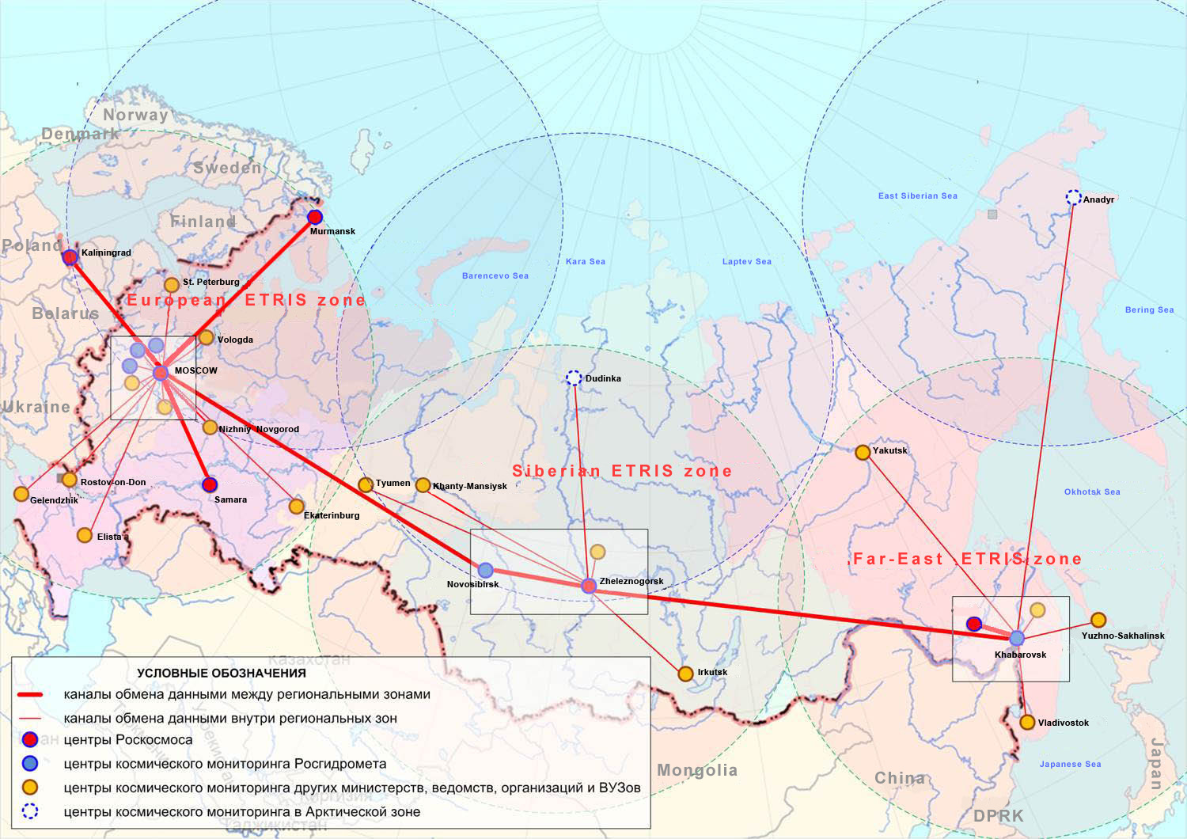
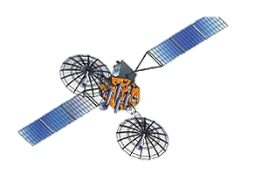
INTEGRATED GEOGRAPHICALLY DISTRIBUTED INFORMATION SYSTEM OF EARTH REMOTE SENSING
Luch-5A
Luch-5B
Data communication channels between regional zones
Data communication channels within zones
Space monitoring centers of ROSCOSMOS
Space monitoring centers of ROSHYDROMET
Space monitoring centers of other authorities (organizations)
Space monitoring centers in the Arctic Region
IN PROGRESS

Slide 5
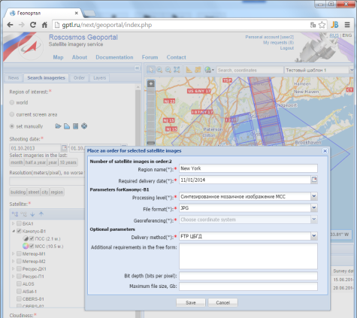
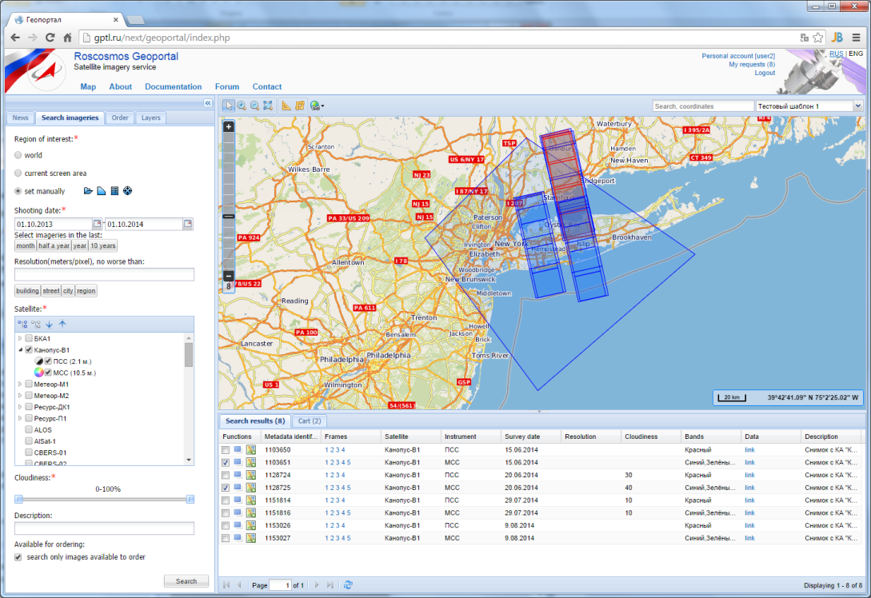
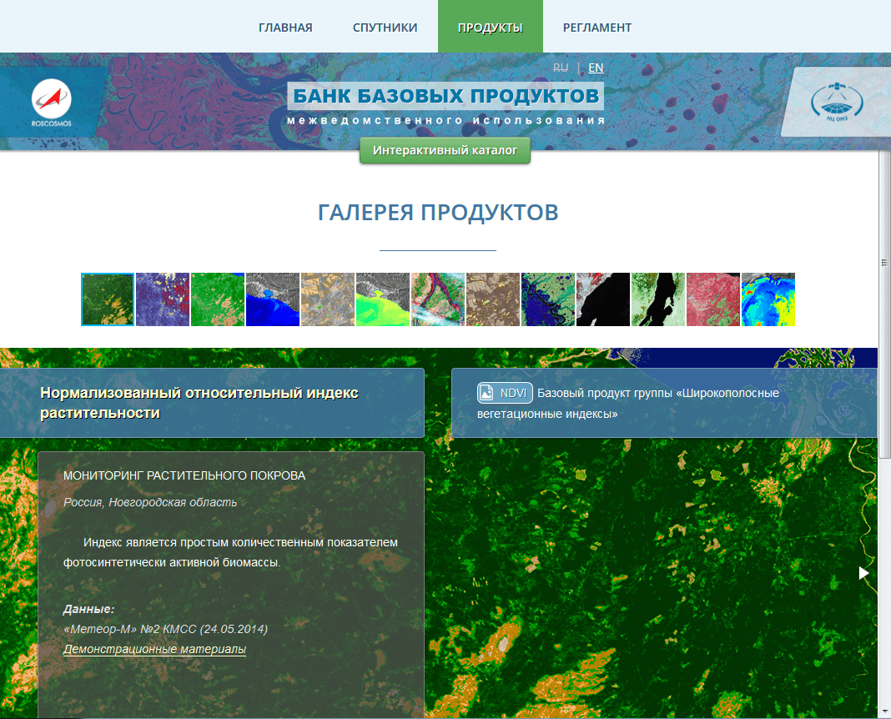
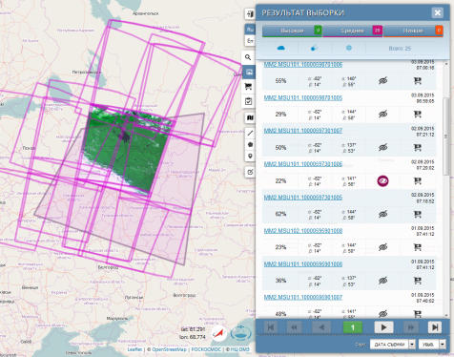
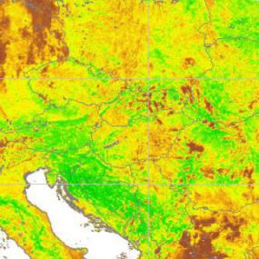
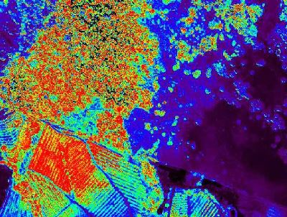
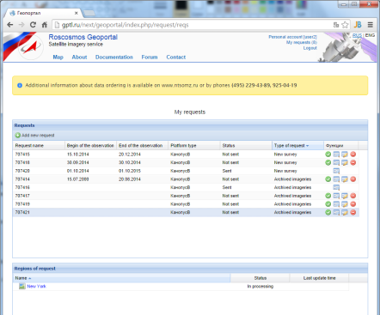
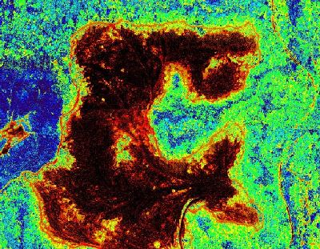
GEOINFORMATION SERVICES
Online data request
Automated data processing to pre-set levels according to user request
Access to Russian and foreign remote sensing data
Specialized maps for end-users
Access to remote sensing data catalog
API for users

Slide 6
«Digital earth» Concept
TECHNICAL IMPLEMENTATION
Web-service of online access
Integration into systems and services of users
Mobile apps
INFO BASIS
THEMATIC SERVICES
Multilayer basic complete coverage with EO data
Agriculture
«Cloud» core of a unified info space of EO data and products
Forestry
Spatial data
Infrastructure
Mineral resources
User data
Ecology
TECHNICAL SUPPORT
Data Processing Center
Basic Geoinformation Platform
Billing system

Slide 7
INFRASTRUCTURE OF THE “DIGITAL EARTH” SERVICES
В2G
В2B
В2C
Centralized control of informational resources;
Source data for creation and swift update of complete coverage;
Flow formation of base products;
Creation of thematic products in 10 main socio-economic spheres;
Complex ‘space’ services
Personified geoservices of data analysis and decision making
Info resources of the ground EO infrastructure
Multi-scale complete coverage of various resolution (global to super-detailed);
Basic and advanced solutions for mass and specialized users;
Unified space for reception of services by federal and commercial users;
Online billing and document workflow;
Mobile setting up for new thematic tasks
«Cloud» core

Slide 8
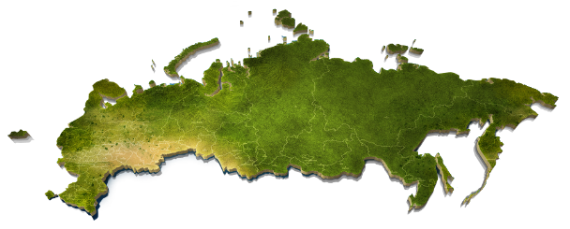
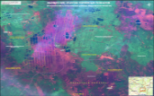
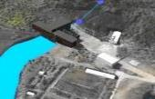
«DIGITAL EARTH» PRODUCTS
CADASTER MAINTENANCE
FLOOD MAPPING
CARTOGRAPHY
FIRE MAPPING
REGIONAL DEVELOPMENT PLANNING
INDUSTRIAL DISASTERS
GEOLOGICAL PROSPECTING
LAND USAGE

Slide 9
THE FEDERAL EO DATA FUND
The Federal Law
stipulates the creation of federal EO data fund
determines the purpose and contents of this fund
establishes general terms for provision of data and its copies form the fund.
Creation of the Federal EO data fund is intended for organization of effective usage of EO data received from spacecraft created at the expense of federal budget, at the expense of private and juridical entities with no connection to federal spacecraft and purchased at the expense of the federal budget, as well as optimization of federal budget expenses in case of such data purchase.
This law will help ROSCOSMOS to better provide Russian archived EO data.

Slide 10
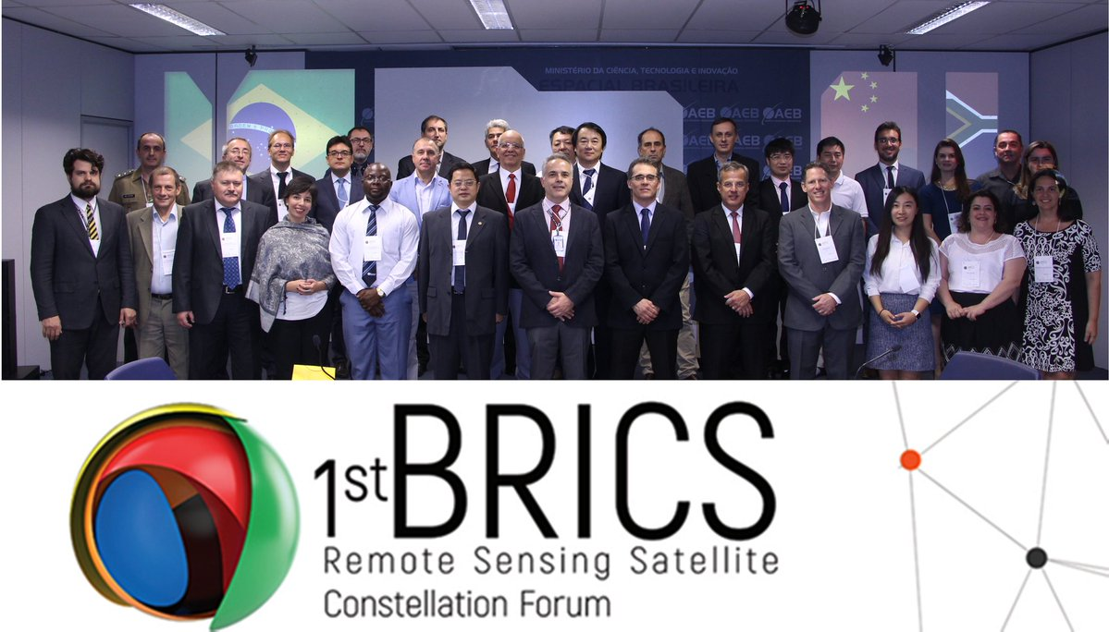
United EO constellation of BRICS countries
State Space Corporation ‘Roscosmos’ jointly with Brazil, India, China and South African Republic commenced the United BRICS EO Constellation project within the frame of multilateral cooperation in the sphere of peaceful usage of space.
The decision to create such united constellation was made within the frame of the meeting of BRICS representatives in Brazil on Sept 18-20, 2017.

Slide 11
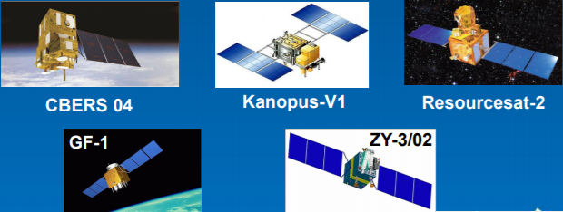
BRICS CONSTELLATION
The task of this constellation is application of EO data for peaceful purposes and strengthening of international cooperation in the space sphere in order to respond to global climate changes, to protect the environment, to forecast and prevent disasters as well as their consequences mitigation, and to solve other global tasks with modern space technologies.

Slide 12
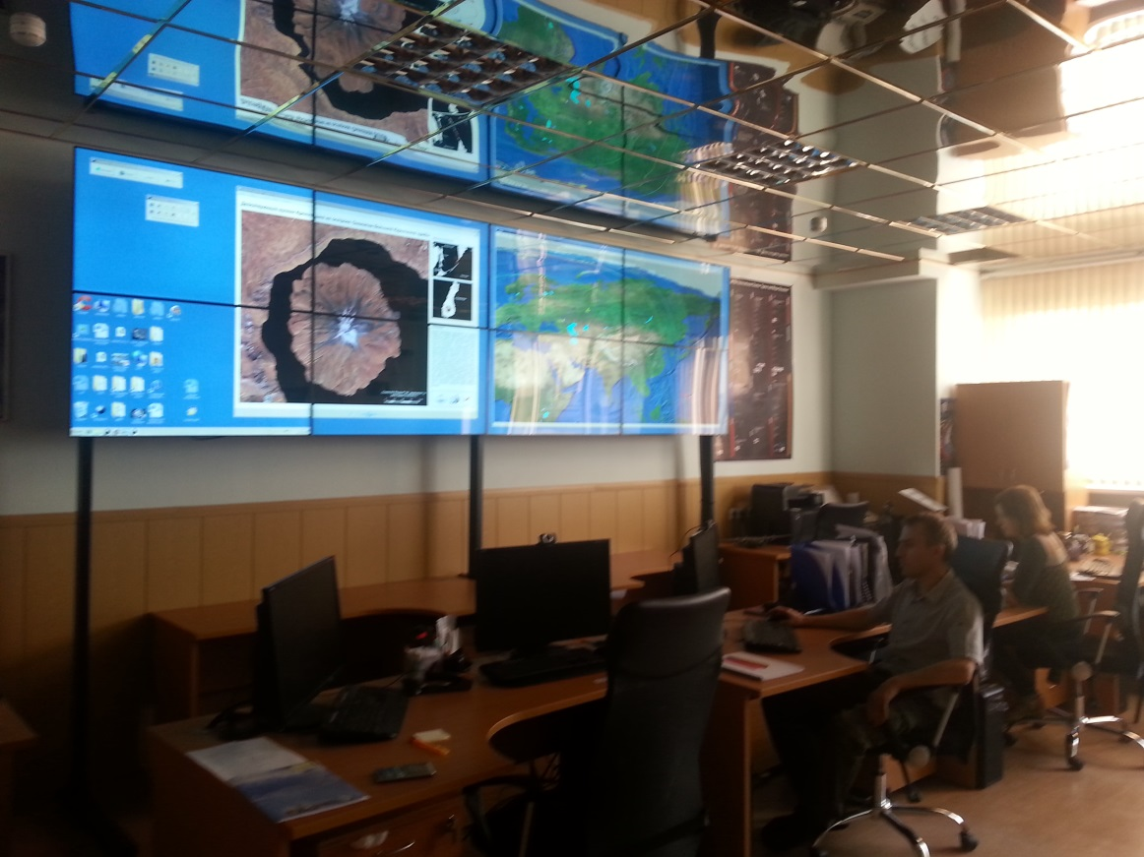
ROSCOSMOS IN INTERNATIONAL CHARTER ON SPACE AND MAJOR DISASTERS
On August 28, 2013
ROSCOSMOS joined the International Charter on Space and Major Disasters.
Research Center for Earth Operative Monitoring was assigned as the ROSCOSMOS’ Operator in the Charter.
A specialized hard- and software system was deployed and a division responsible for the Charter activity support in Russia was established at the basis of Research Center for Earth Operative Monitoring
The activation of the International Charter on Space and Major Disaster mechanism enables the implementation of international resources of multi-purpose space facilities (more than 40 satellites) in crisis and emergency situations including usage for the benefit of member nations.

Slide 13
ROSCOSMOS IN INTERNATIONAL SOCIETIES
ROSCOSMOS plans to work with the international Society for Digital Earth (ISDE)
ROSCOSMOS works with the International Society for Photogrammetry and Remote Sensing (ISPRS)

Slide 14
ROSCOMOS IN CEOS WORKING GROUPS
Working group | Engagement
WGISS | Participation
WGCV | Participation
WG CapD | Monitoring
WG Disasters | Participation
WG Climate | Monitoring

Slide 15
ROSCOMOS IN CEOS WORKING GROUPS
ROSCOSMOS is a member of WGCV, WGISS and WG Disasters
ROSCOSMOS provides the latest information on Russian satellites to update the CEOS
MIM Database
ROSCOSMOS hosted the following international events:
CEOS meetings:
WGCV-33, Moscow, May 2011
WGISS-38, Moscow, September 2014
Other events:
ASEAN RS data training, Moscow, March 2015
13th GEO Plenary and Exhibition, Saint-Petersburg, November 2016, (in partnership with Roshydromet)
36th meeting of the International Charter on Space and Major Disasters, Moscow, October 2016
AOMSUC-8, Vladivostok, October 2017 (in partnership with Roshydromet)
Planned:
CGMS-47, Sochi, May 2019 (in partnership with Roshydromet)
42d meeting of the International Charter on Space and Major Disasters,
Saint-Petersburg/Sochi (TBD), October 2019

Slide 16
ROSCOSMOS IN CEOS PROJECTS
CEOS WG Disaters
In 2017 the representatives of WG Disasters received more than 123 thousand sq. km of Russian EO data in the frame of flood monitoring over the territory of Australia, Albania, Venezuela, Vietnam, Haiti, Columbia, Madagascar and Panama.
Integration with CWIC
ROSCOSMOS’s geo-information services catalogs were connected in test mode to the CEOS WGISS Integrated Catalog (CWIC)

