Slide 1

Update on EUMETSAT
Committee on Earth Observation Satellites
CEOS Plenary 2018
Agenda Item # 4.3
Brussels, Belgium
17 October 2018

Slide 2
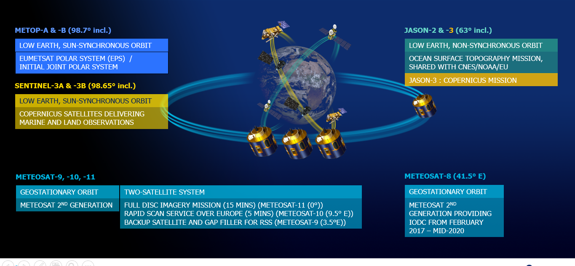
Current EUMETSAT system
10 satellites in orbit

Slide 3

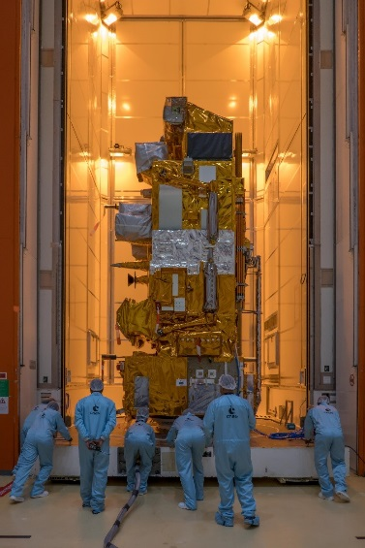
Preparation for the launch of Metop-C with ESA, CNES and NOAA

Slide 4
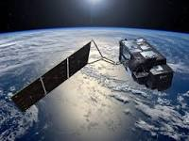
Commissioning of Sentinel-3B
Commissioning ongoing in tandem flight configuration
  Increasing EUMETSAT role in flight operations/commanding
  Instrument Mid-Term Reviews confirmed good quality of products
Planned next steps
  17 October: In Orbit Commissioning Review, release of Level 1 products
  17 Oct-24 Nov: manoeuvre for 140° separation started, planned to end on 24.11, flight operations handover
  End of January 2019: RORR after release of Level 2 products

Slide 5
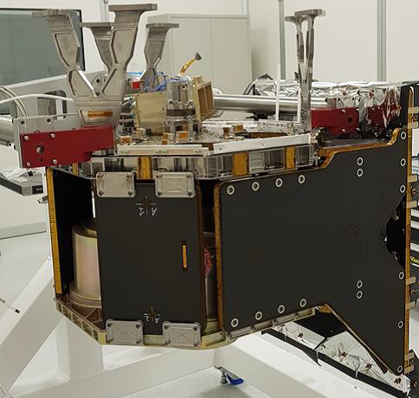
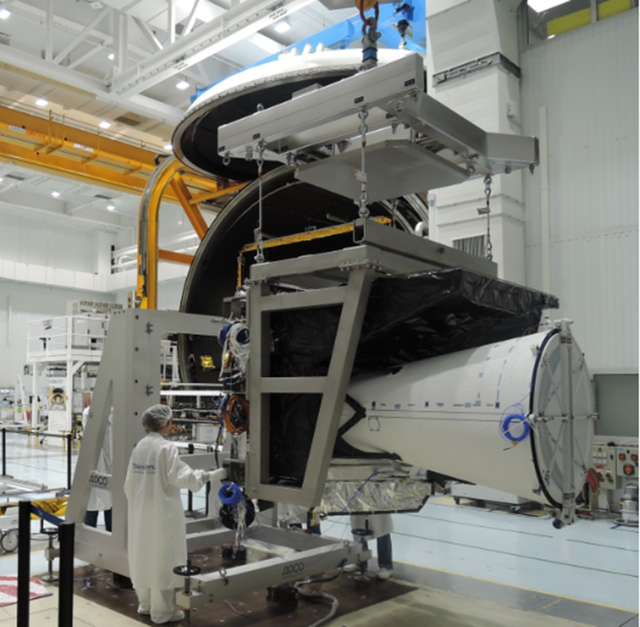
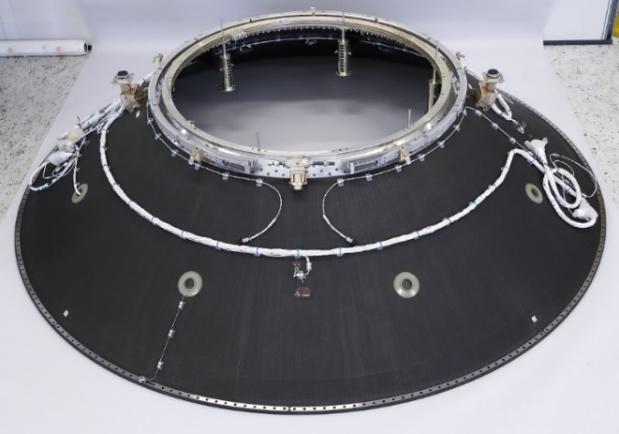
MTG Space Segment
FCI Structural and Thermal Model (STM)
Picture TAS
LI Structural Model (SM) in final integration
Picture Leonardo
Launcher adapter for MTG-I after its qualification
Picture RUAG

Slide 6
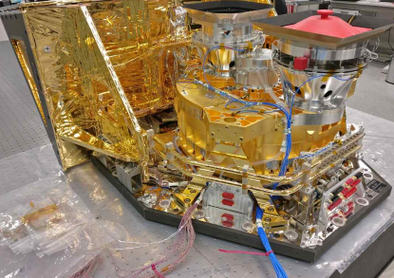
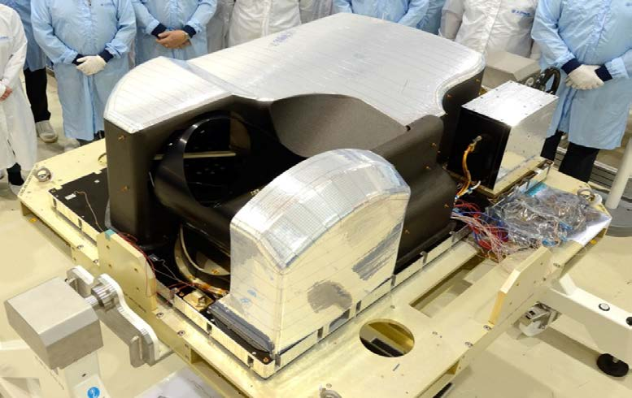
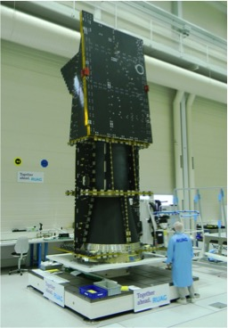
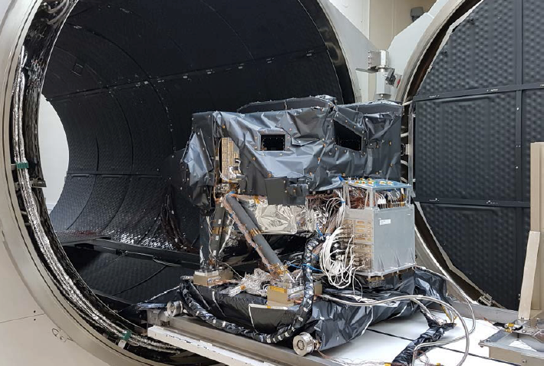
EPS-SG Space Segment with ESA, CNES, DLR and NOAA
Satellite structure STM
3MI STM
MWS STM
MWS STM
Sentinel-5 STM
(Photos courtesy ESA)

Slide 7
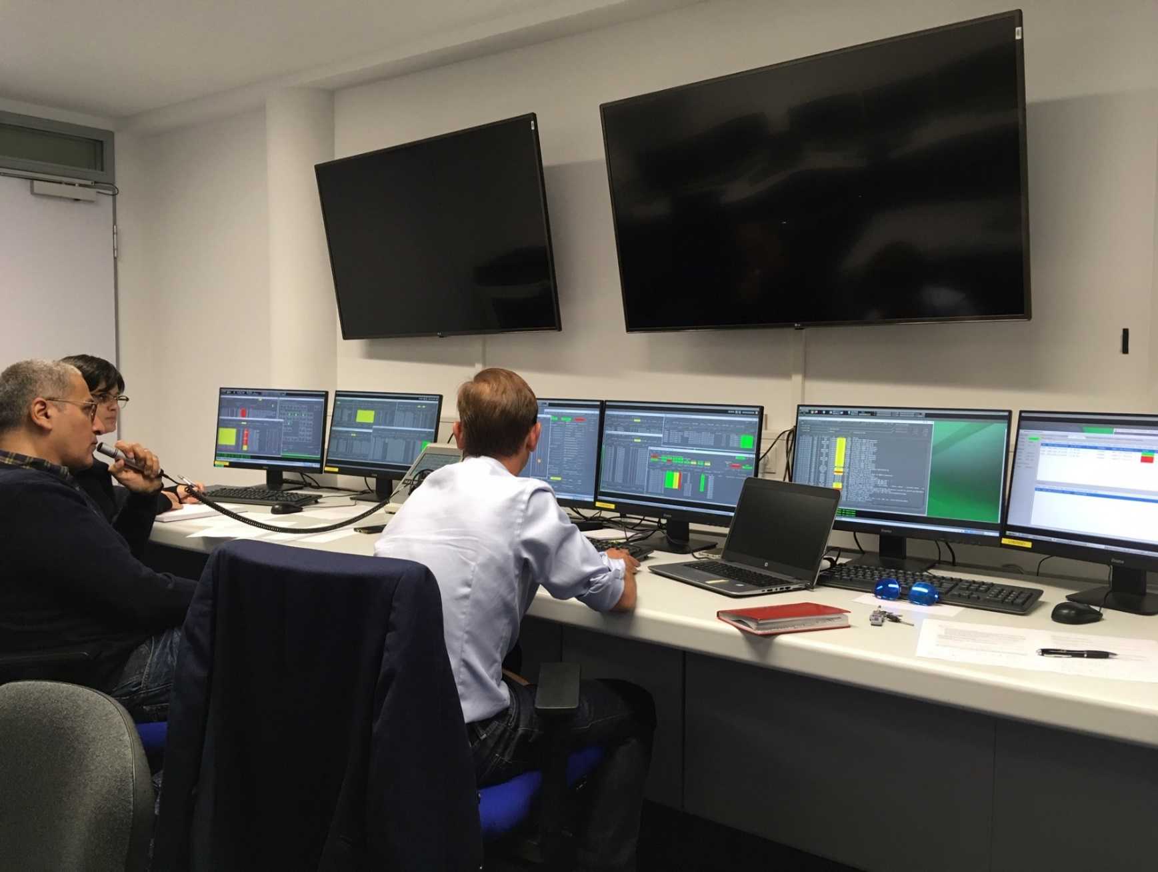
Jason-CS / Sentinel-6 with ESA, EC, NASA and NOAA
First command sent to satellite test bench on 8 October

Slide 8


Data Access and
EUMETSAT Pathfinders
EXTENDED USER VALIDATION PHASE FOR PATHFINDERS
Member State
NMHSs feedback
EUMETSAT
Feedback
analysis/
response
Extended
Validation
Phase
Pilot
Phases
Initial Validation
Phase
Workshop
(March)
Readiness
Review (May)
August
Report
(October)
February
STG-AFG
(May)
C91
(July)

Slide 9
Data Access
WEkEO : Copernicus DIAS
EUMETSAT, ECMWF and MERCATOR OCEAN International have joined their experience and skills to build up WEkEO

Slide 10




What’s Else ?
2.0

