Slide 1
Updates of Chinese EO satellites
Songmei Zhang, Jinlong Fan, Wei Wan
National Remote Sensing Center of China (NRSCC)
National Satellite Meteorological Center (NSMC)
China Centre For Resources Satellite Data And Application (CRESDA)
2018 CEOS Plenary
Agenda Item 4.3
Brussels, Belgium
16 – 18 October 2018

Slide 2
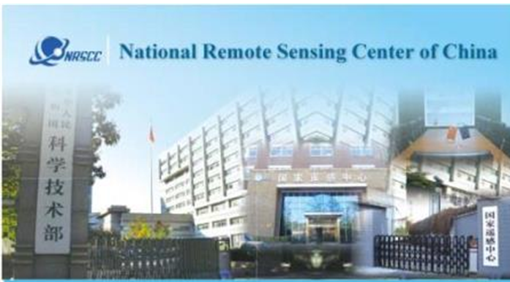

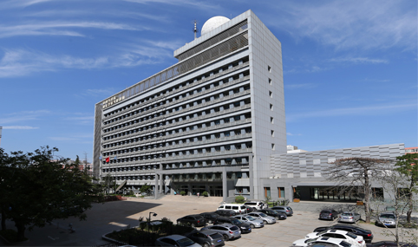
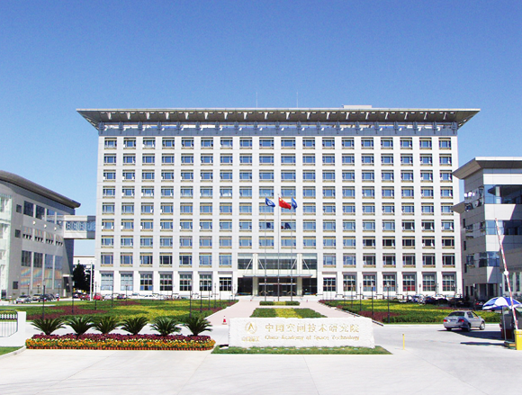
Chinese Agencies Participating CEOS
National Remote Sensing Center of China(NRSCC)
  An authorized organization of Ministry of Science and Technology (MOST), to deal with Earth observation related affairs
  Takes charge of secretariat affairs of China for GEO
China Centre For Resources Satellite Data And Application(CRESDA)
  In charge of receiving, processing, archiving and distributing CBERS, HJ, GF, Commercial Satellite Plan: SuperView
National Satellite Meteorological Center(NSMC)
  One of the operational centers of China Meteorological Administration and is tasked to support national-wide weather forecasts, climate research, and natural disaster monitoring with space-based Earth observation data and derived products.
Chinese Academy of Space Technology(CAST)
  One of the world-class spacecraft designers and manufacturers, providing full range of integrated space-ground system solutions for global customers

Slide 3
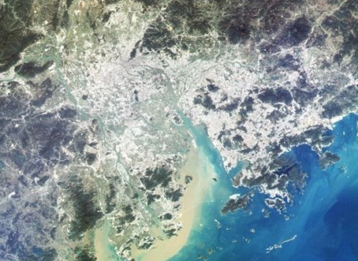
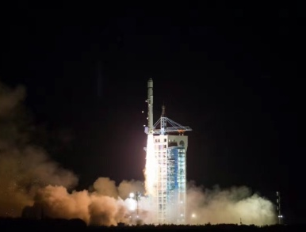
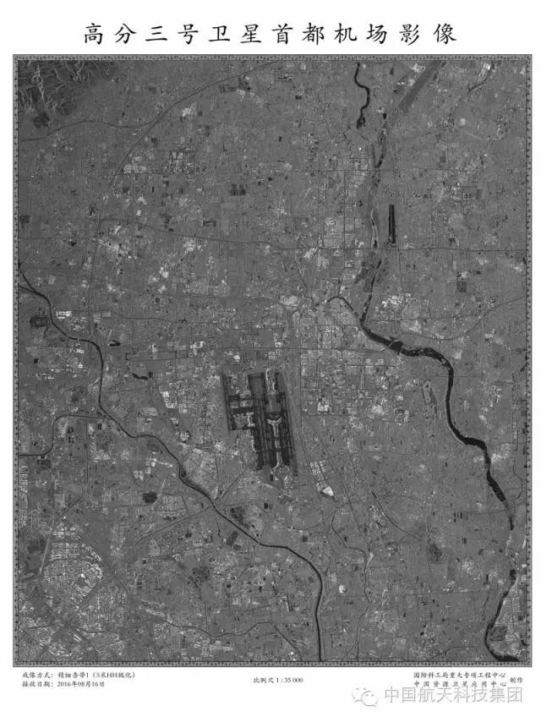
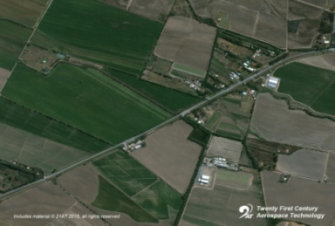
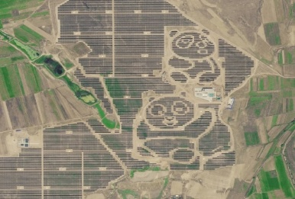
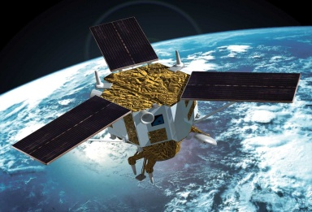
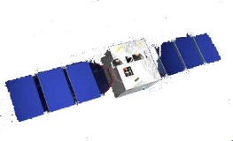

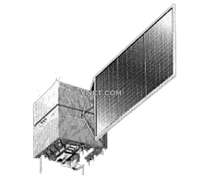
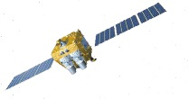
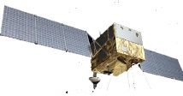
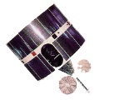
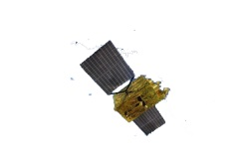

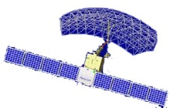
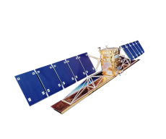

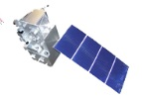
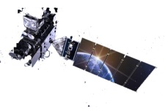
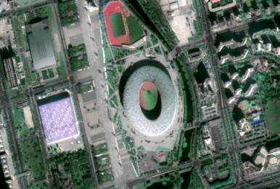
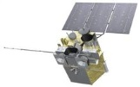
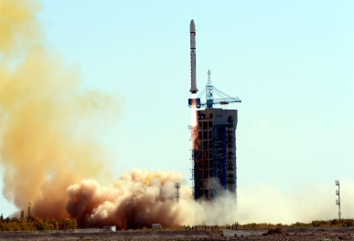


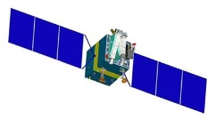
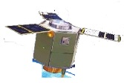


Launched Satellite
7 satellite series formed
Earth Resources
Comm. & Broadcast
Disaster Mitigation
Meteorological Satellite
Navigation & Positioning
Ocean Satellite
Scientific Experiment
Already Launched
To Be Launched
To Be Planned
FY-1
HY-1A/1B
GF-1
CEBERS
-01/02/02B/02C
FY-2
GF-2
GF-7
Land Resource Satellite
FY-3
HY-2A
GF-3
HJ-1C
GF-4
CFOSAT
HJ-1A/1B
TanSat
Metro and Ocean
Satellite
FY-4
Jilin
HY-2B/C/D
ZY-3
CEBERS-04
Seismo-Electromagnetic
Satellite
High Resolution Earth Observation System

Slide 4
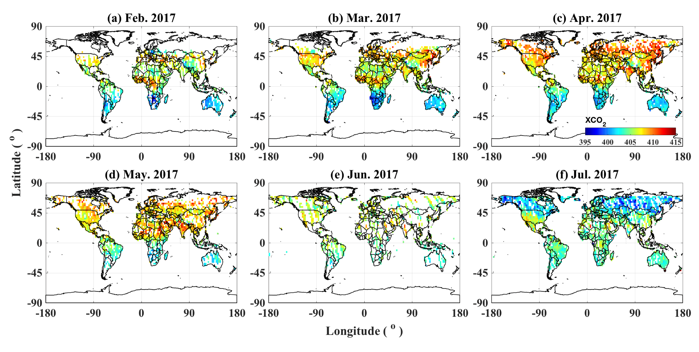

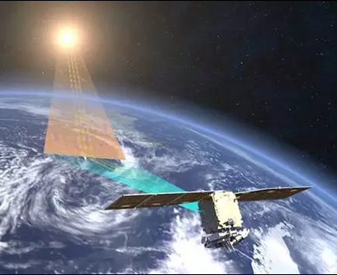
Recently Launched Satellite
TanSat
  First global CO₂ monitoring satellite of China
  Launched on Dec. 22nd, 2016
  Data is available through China GEOSS-DSNet ( the China National Earth Observation Data Sharing Platform) www.chinageoss.org/en/index.html
XCO2 over land
Yi Liu et al., 2018

Slide 5
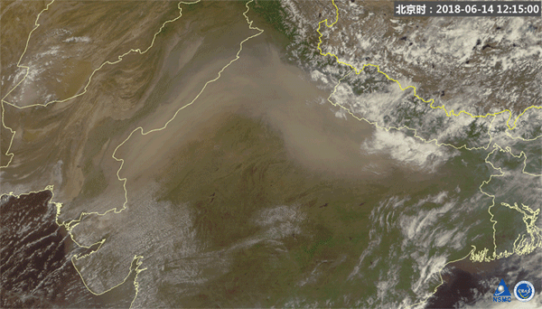
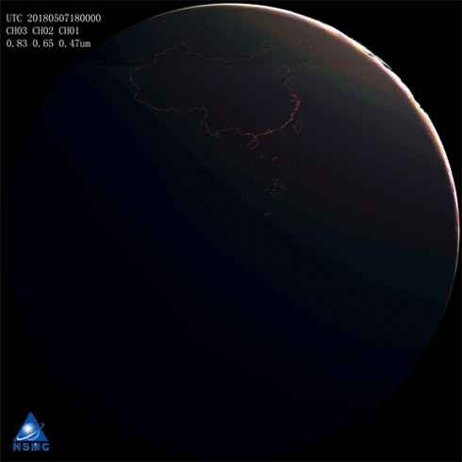
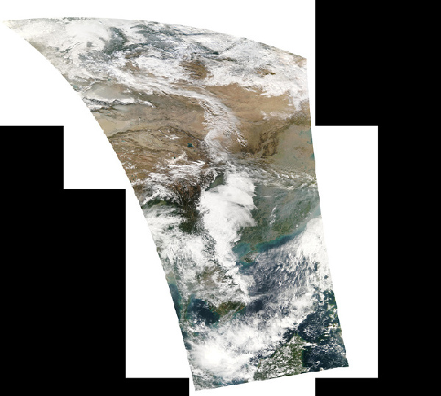
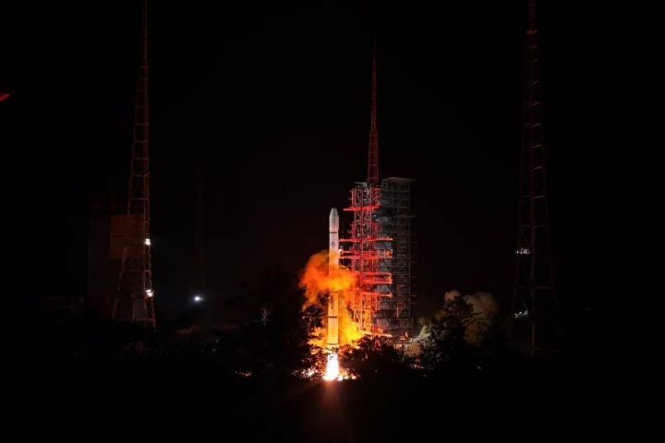
Recently Launched Satellite
FY-4A
  Launched on Dec. 11th, 2016
  Put in operational since May 1, 2018
  A new generation of geostationary meteorological satellite
  Can monitor the vertical structure of atmosphere
FY-3D
  Launched on Nov. 15th, 2017
  In testing stage at present
  Substantial contribution to ocean and ice monitoring, climate monitoring, atmospheric chemistry and space weather
FY-2H
  Launched on Jun. 5th, 2018
  The last of the first generation Chinese meteorological geostationary satellite was successfully and will be serving the road and belt countries when it turns to the operational stage.

Slide 6
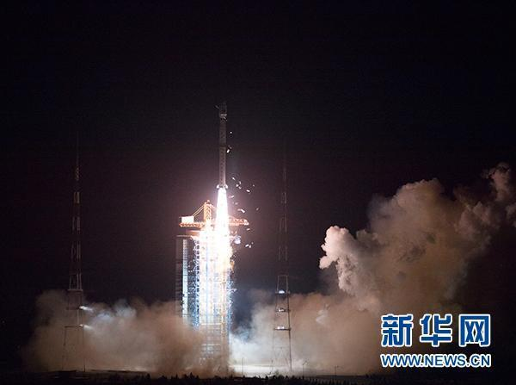
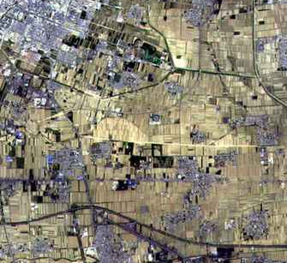
Recently Launched Satellite
GF-3
  C-band multi-polarization SAR radar satellite with 1m resolution
  Launched on Aug. 10th, 2016
GF-4
  50m resolution geostationary satellite
  Launched on Dec. 29th, 2015
GF-5
  High spectral resolution satellite - 230 bands
  Launched on May. 9th, 2018
  Can be used for greenhouse gas monitoring
GF-6
  2m for panchromatic band and 8/16m for multispectral band
  Launched on Jun. 6nd, 2018
  2 more red edge bands compared with GF-1 and 2, specially used for agriculture monitoring

Slide 7
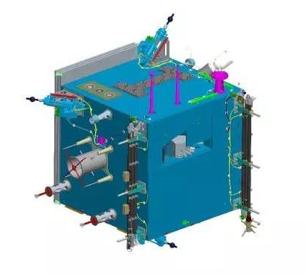
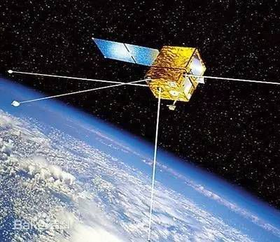
Recently Launched Satellite
ZhangHeng-1 (CSES)
Spacecraft:
First China Seismo-Electromagnetic Sat, scientific mission dedicated to study seismic event, named after Zhang Heng, an ancient astronomer in Han Dynasty
Launched on Feb. 2, 2018
Launch weight: 700KG
Orbit: sun synchronous
Orbit altitude: 507KM
Descending node time: 14:00 LT
Design life: over 5 years
Instruments:
8 payloads, including search-coil magnetometer (SCM), electric field detector (EFD), high precision magnetometer (HPM), GNSS occultation receiver (GOR), plasma analyzer package (PAP), langmuir probe (LAP), high energetic particle package (HEPP) and detector (HEPD), and tri-band beacon (TBB), among which HEPD is provided by Italian Space Agency

Slide 8
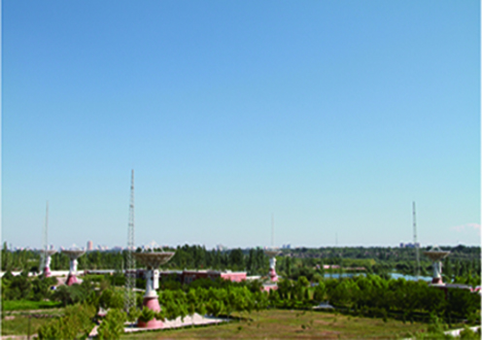


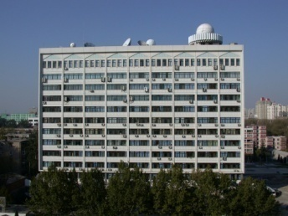
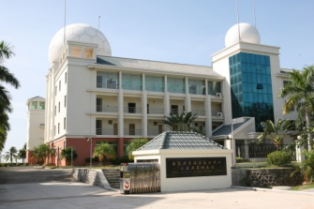
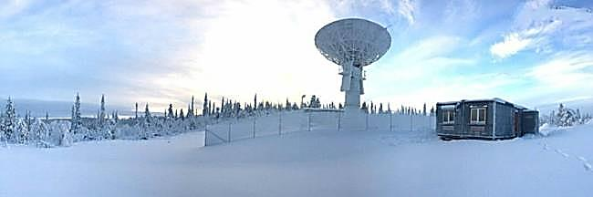
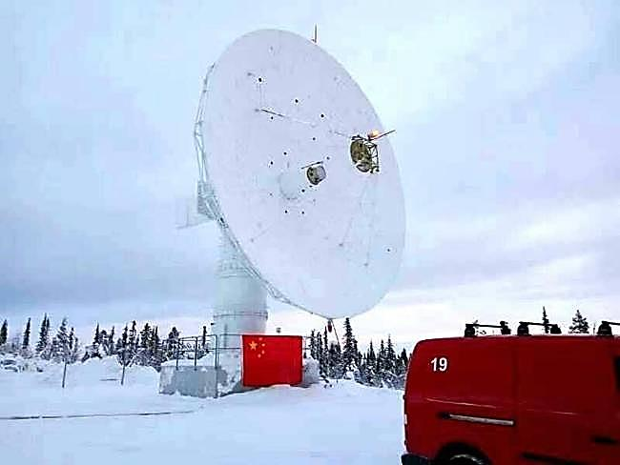
Ground Segments
China has established a national data receiving network for land observing satellites with the capacity to receive real-time data covering whole territory of China and neighboring countries and regions.
Kashi Station
Sanya Station
Miyun Station
Beijing Station
Mudanjiang
China Remote Sensing Satellite North Polar Ground Station
Put into trial operation on Dec. 15th, 2016.
Greatly enhanced the data receiving capabilities of Chinese satellites.

Slide 9
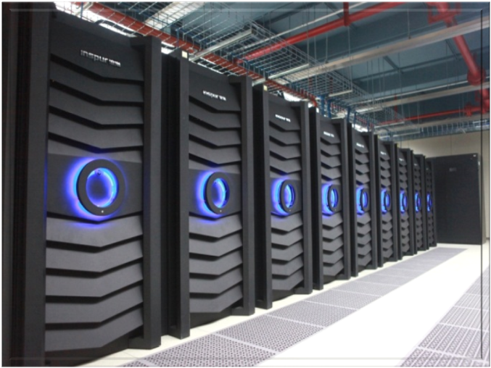
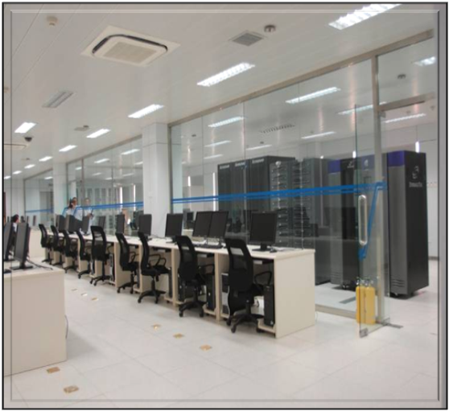
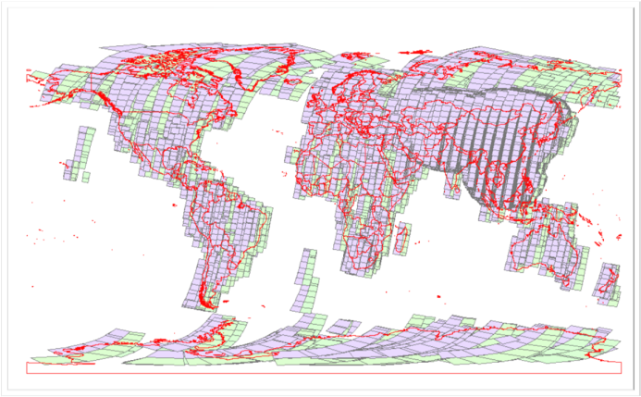
Data Archive
12 PB on-line storage ; 7×24 automatically operation.
Thousands of servers ; Calculate ability：110 trillion times.
Low Spatial≥30m
20m≥Medium Spatial＞2m
2m≥High Spatial
100%
82%
51%

Slide 10
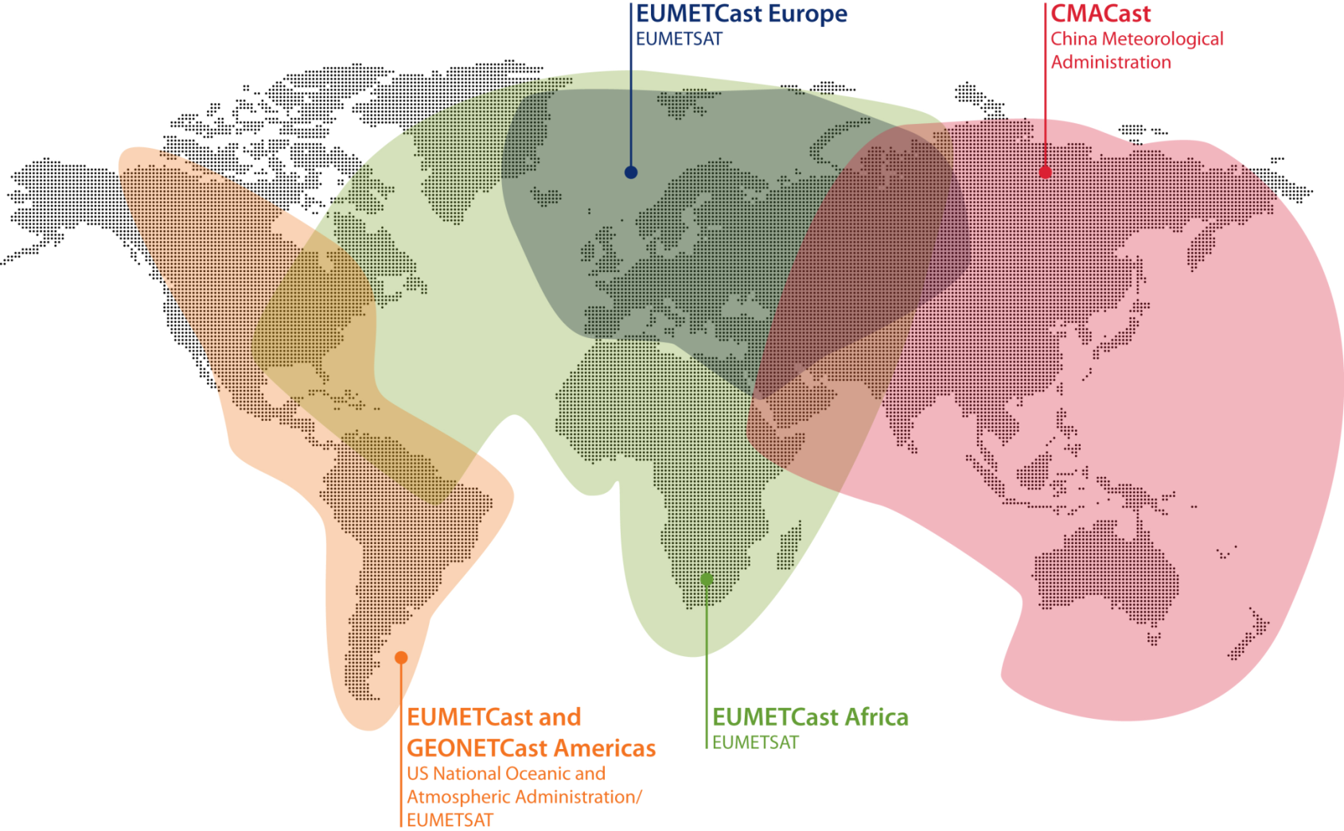
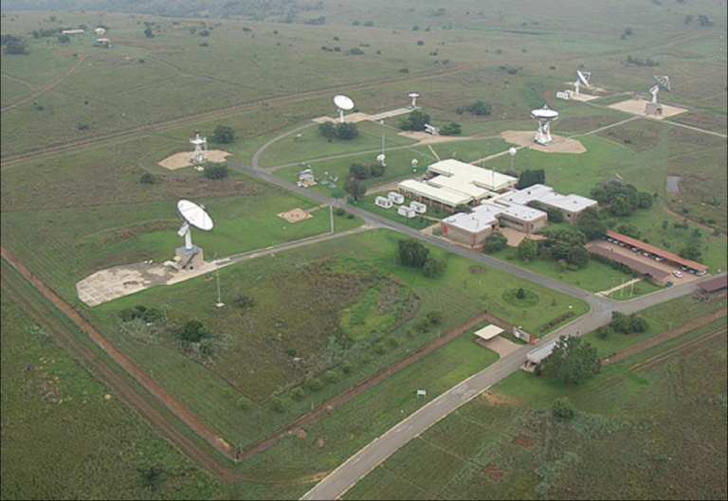
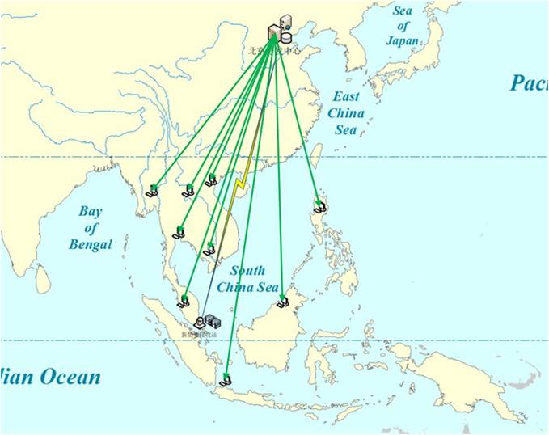
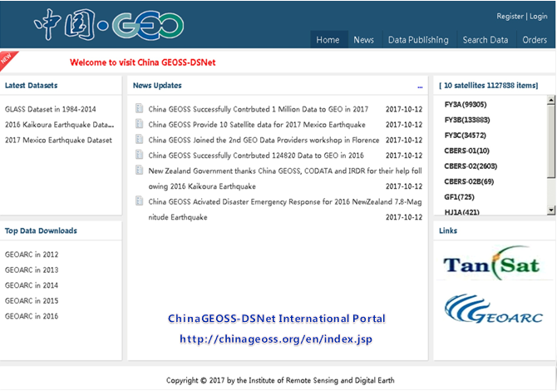
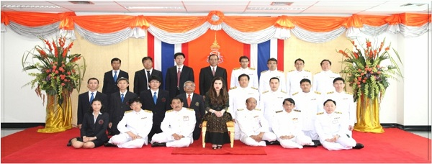
Data Distribution
CBERS Series Satellite Ground Receiving Station in South Africa
China - ASEAN Remote Sensing Satellite Data Sharing Service Platform
CMACast
A data broadcasting service system. It distributes the ground data, satellite data and model products to users in quasi real time.
Thailand Princess Chulaphorn Remote Sensing Satellite Ground Station
China GEOSS-DSNet Portal
A China National Earth Observation Data Sharing Platform. The English version was released in October, 2017 at GEO-XIV Plenary in Washington D.C., USA.
  www.chinageoss.org/en/index.html

Slide 11
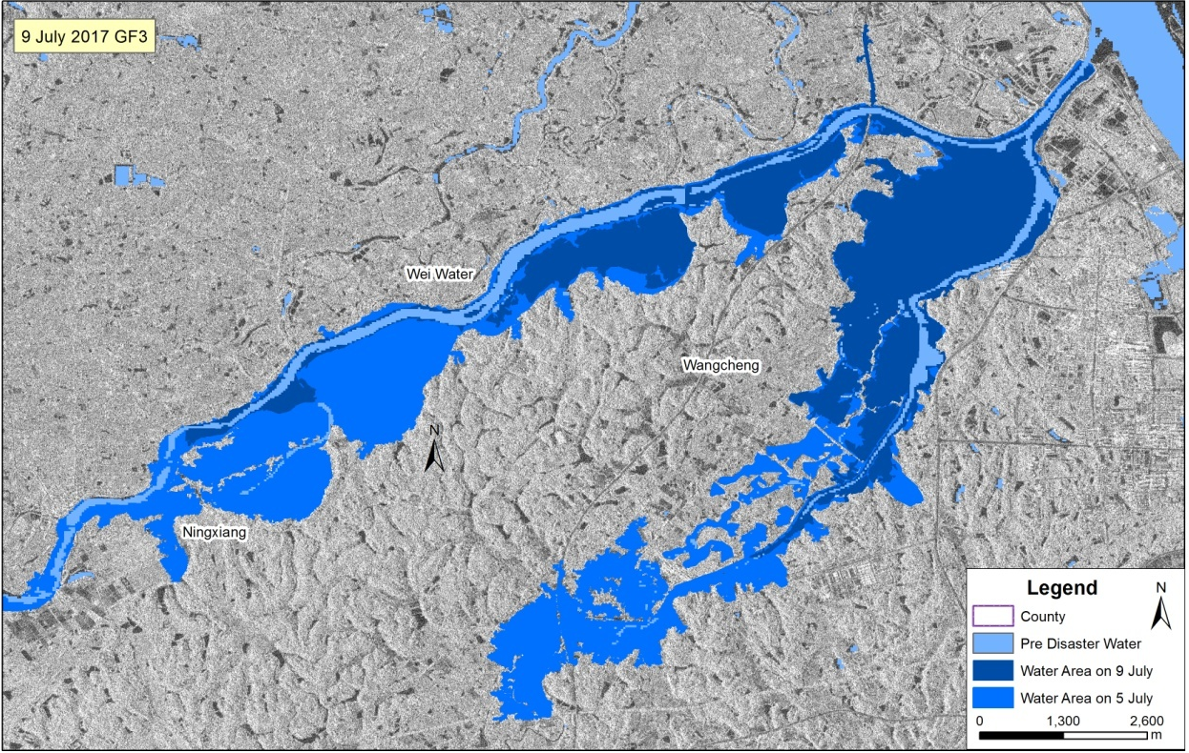
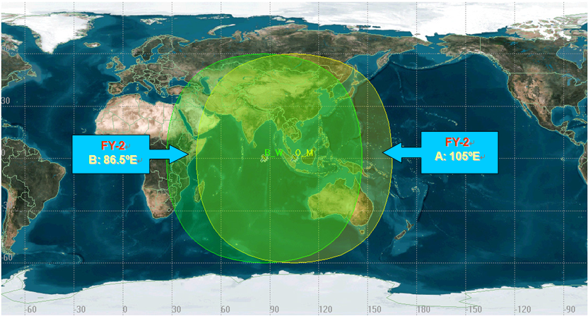
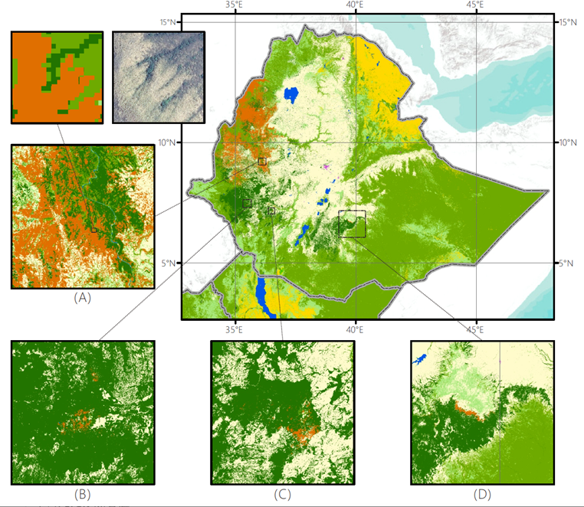



Data Applications
The FY geostationary ground system
Bamboo mapping of Ethiopia, Kenya and Uganda for the year 2016 using multi-tempral Landsat imagery
To support domestic and international disaster risk reduction, by using the network of the high-resolution satellites in China, the efficiency of disaster relief has been greatly enhanced.
The CMA weather service relies heavily on cloud images coming from two Fengyun geostationary spacecrafts, providing forecasters the measurements everyday.
China Remote Sensing Network Project - GlobeLand30
The result is promising for further land-cover management, modelling and climate change studies. Overall accuracy of the global landcover mapping is 73% at 30m spatial resolution, which is better than previous land cover mapping for 2010.
Real-time monitoring of forest fires in Inner Mongolia by using GF-4 satellite

Slide 12

International Cooperation
Participation in CEOS Work

Slide 13











Participation in CEOS Work
Participation in WGCV
Four demonstration sites:
  Baotou site (China, AOE)
  La Crau site (France, CNES)
  Railroad Valley Playa site (USA, NASA)
  Gobabeb (Namibia, ESA)
WorldView-2
WorldView-3
Resurs-P
GF-1
GJ01-A/MUX（Baotou Site）
DOVE
RapidEye
Sentinel-2A
ZY-3
GJ01-A/MUX(RVP, US)
Participation in WGDisasters
China Pilot – Region of Interest
Landsat-8 OLI, 22/04/2015
Visually Interpreted Landslides
Automatically Detected Landslides

Slide 14



Participation in CEOS Work
Data sharing with CEOS WGISS
  China GEOSS-DSNet Portal has already connected with most civil Chinese satellite data centers www.chinageoss.org/en/index.html
  Agreement has been made between CEOS WGISS and NRSCC to share data catalog with each other to promote EO data sharing through this portal;
  Preliminary test has been conducted to guarantee the accessibility of the data catalog.

Slide 15







Participation in CEOS Work
China GEOSS DSNet
  A Chinese platform to provide data for application on environment and ecological protection, disaster mitigation, earth science research at regional and global scale.
  Provided satellite imageries after severe disasters to the affected countries for damage assessment and efficient use of scare resources. Such as dam collapse in Laos, Cyclone Gita, and earthquake in Indonesia.

Slide 16




















International Cooperation
China GEOSS DSNet

Slide 17




International Cooperation
MOST-ESA Dragon Project
EO data exploitation of ESA, ESA Third Party Missions, Copernicus Sentinels & Chinese EO missions
14 symposiums and training courses have been successfully held
The recently held symposium in Xi’an attracted nearly 300 researchers from China and Europe
Next training course will be held in Shenzhen Nov.

Slide 18
Plans and Strategy in relation to CEOS
China is willing to expend the participation in CEOS related work to promote the application of remote sensing technology
Hope that the CEOS working groups will attract more Chinese institutions and experts, such as WGDisasters, WGClimate, and so on
Hope that CEOS will carry out some workshops and training courses on data standardization and quality control in China to promote the understanding of Chinese researchers

Slide 19



Thanks for your attention !

