Slide 1

JAXA Earth Observation Program
Committee on Earth Observation Satellites
Naoto Matsuura, Senior Chief Officer for Satellite Applications
Japan Aerospace Exploration Agency (JAXA)
CEOS Plenary 2018
Agenda Item 4.3
Brussels, Belgium
17 – 18 October 2018

Slide 2
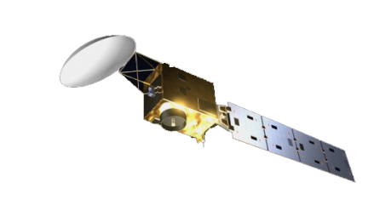
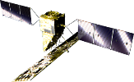
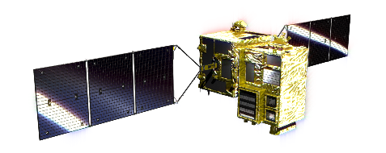
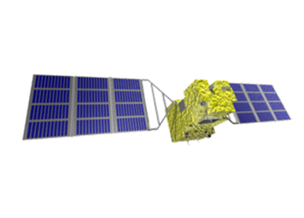
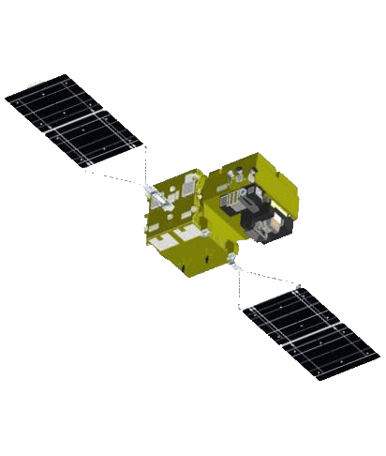
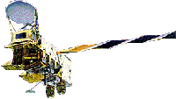


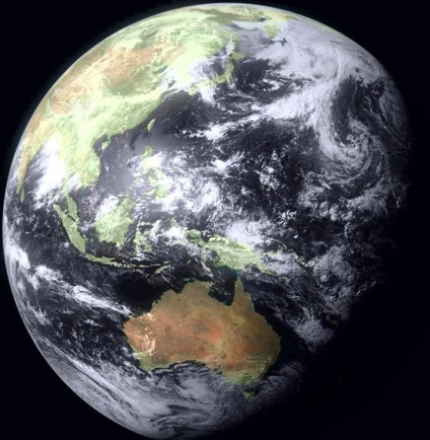
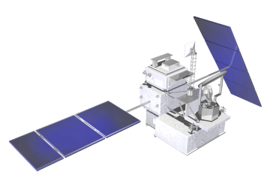
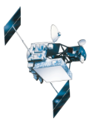
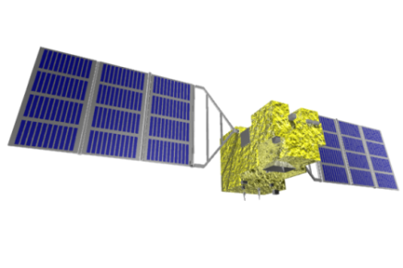
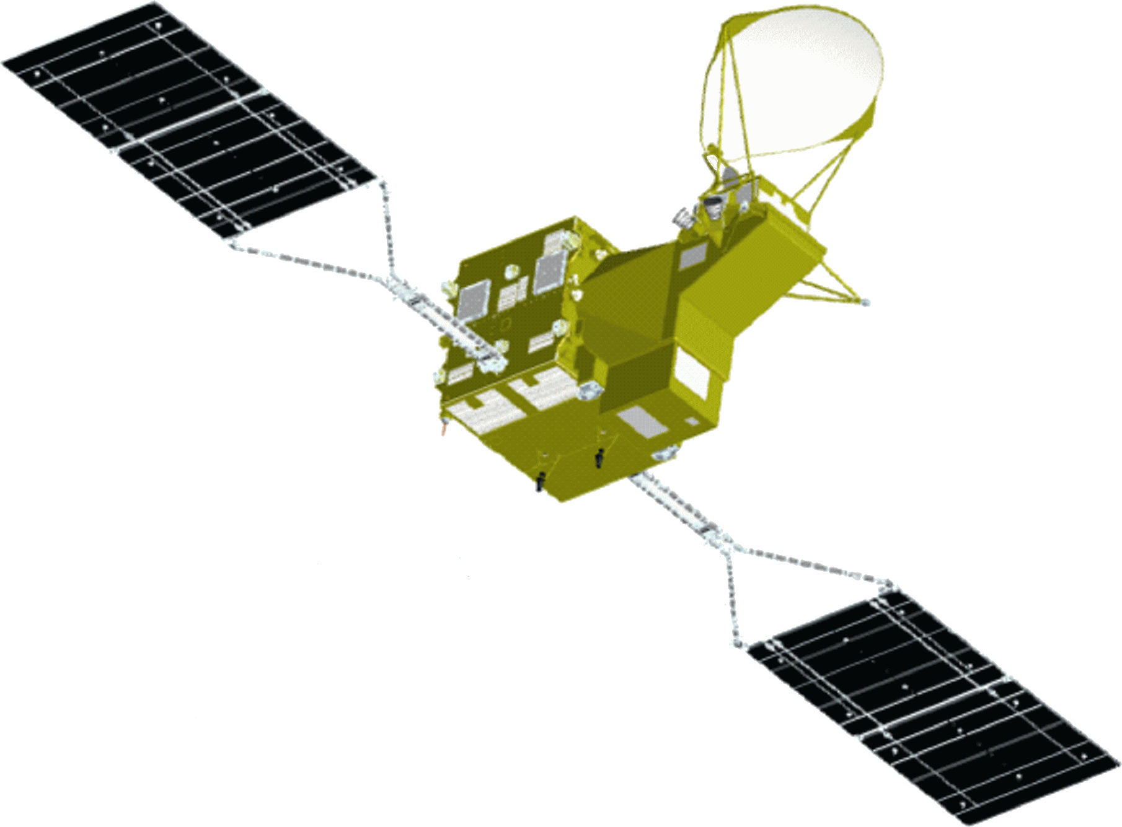
JAXA’s Past, Current and Future Satellite/Sensor Activities
Advanced Radar Satellite
Earth CARE/CPR
Advanced Optical Satellite
(JFY 2020)
GOSAT-2
(JFY 2020)
GCOM-C
(JFY 2018)
(JFY 2017)
ALOS-2
(CY 2014)
GPM/DPR
Aqua/AMSR-E
DAICHI (ALOS)
(CY 2014)
(CY 2002)
(CY 2006)
ADEOS/ADEOS-Ⅱ
(CY 1996/CY 2002)
TRMM/PR
JERS-1
MOS-1/MOS-1b
(CY 1997)
(CY 1992)
(CY 1987/ CY 1990)
SHIZUKU
(GCOM-W)
IBUKI (GOSAT)
(CY 2012)
(CY 2009)

Slide 3
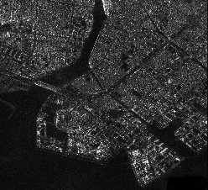
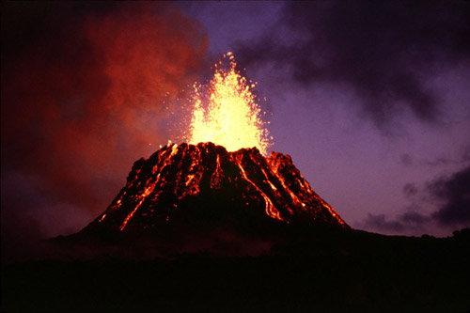

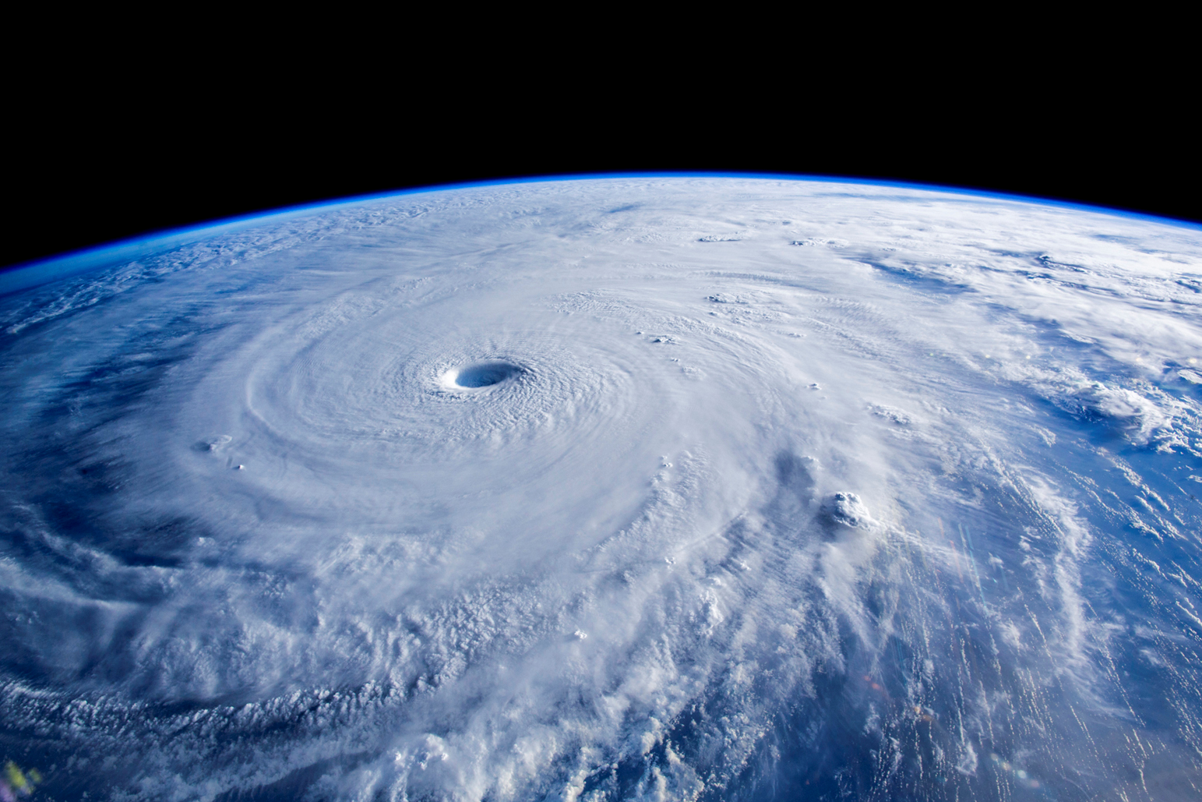
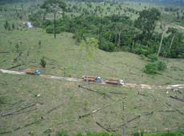
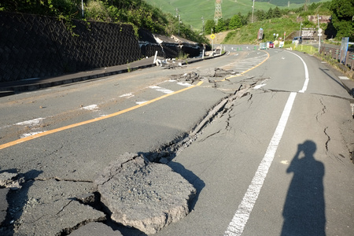

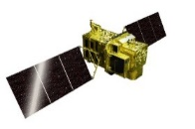
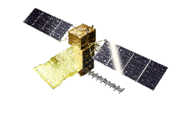
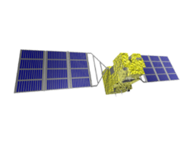
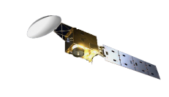

JAXA’s Earth Observation Programs
National Security
Disaster Risks Management
Climate Change
High Resolution
Observing Satellites
Global Observing
Satellites
ALOS Series Missions
GOSAT, GCOM-W and GCOM-C Series Missions;
GPM and EarthCARE
Challenges: Continuity and sustainability of earth observation data
⇒ JAXA proposes series of missions under the following conditions.
Establishment of an institutional framework to assure continuity of data provision.
Cost-reduction of satellite development and operations.
Research and development of innovative sensor technologies.

Slide 4
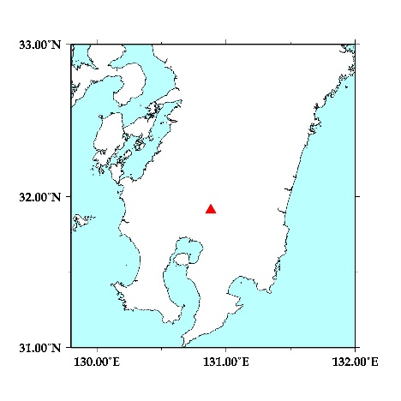
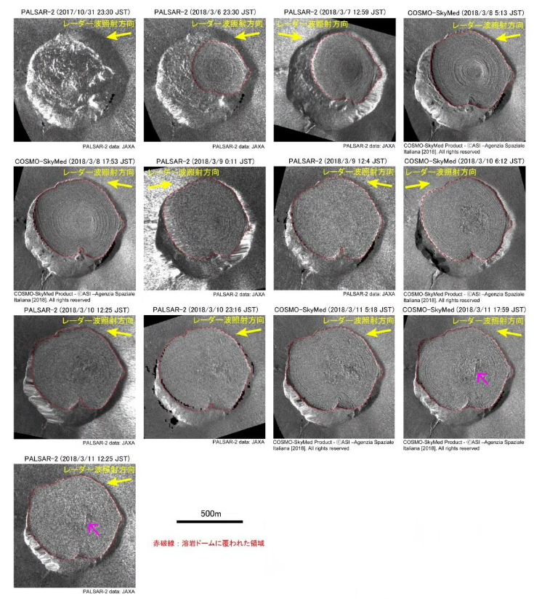
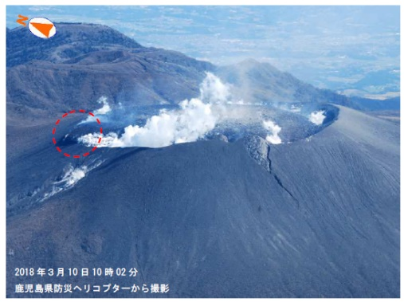
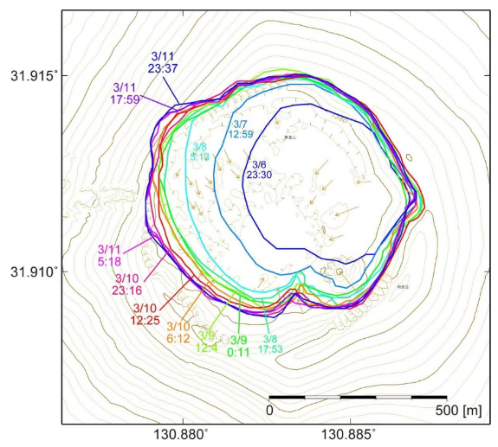
Disaster
Monitoring Eruption of Shinmoedake (Mt. Kirishima) in Kyushu, Japan
Kyushu, Japan
Shinmoedake (Mt. Kirishima) in Kyushu, Japan erupted on March 1,2018.
ALOS-2 and COSMO-SkyMed performed emergency observations 8 times each in March.
Observation data acquired by ALOS-2 and COSMO-SkyMed detected growth of the lava dome and the lava movement:
  Utilized for Government of Japan to monitor up-to-date status of Shinmoedake, such as growth of the lava dome and the lava flow.
Shinmoedake
Growth of the lava dome:
Changes in the outline estimated from SAR data
Eruption of Shinmoedake
(March 10, 2018)
* Reported by the Japan Meteorological Agency (JMA) and the Coordinating Committee for Prediction of Volcanic Eruptions (CCPVE)
(March 13, 2018)

Slide 5
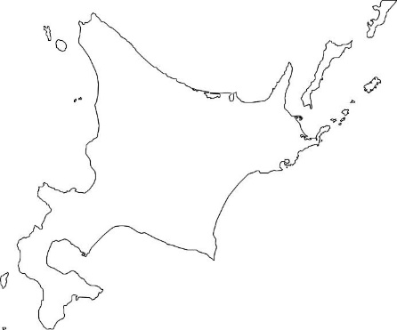
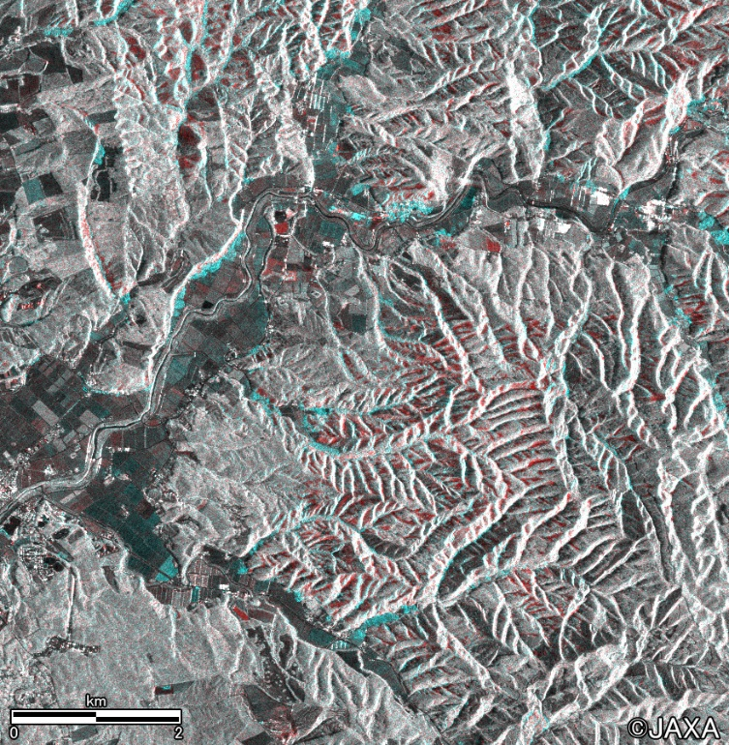
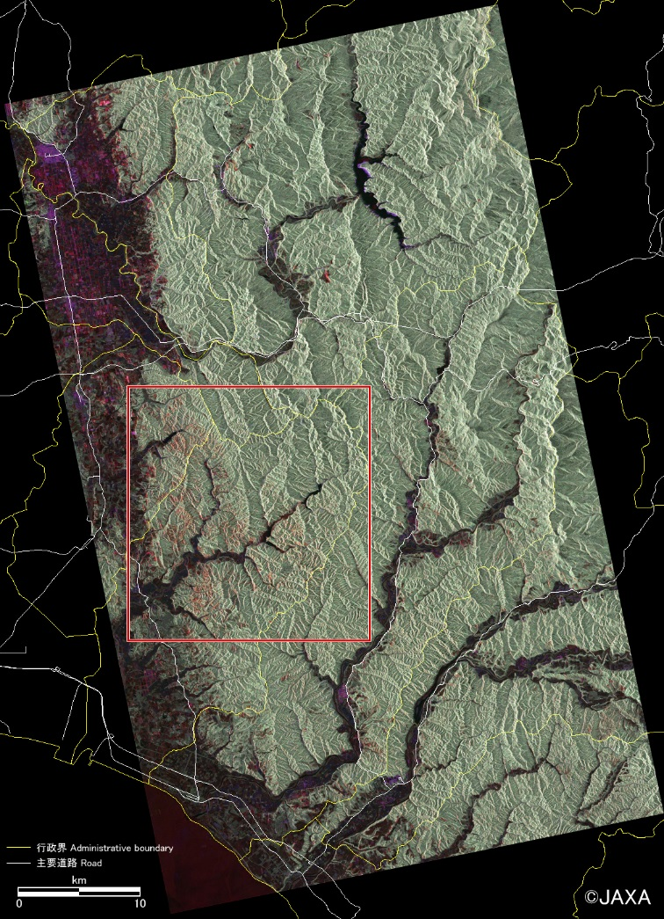
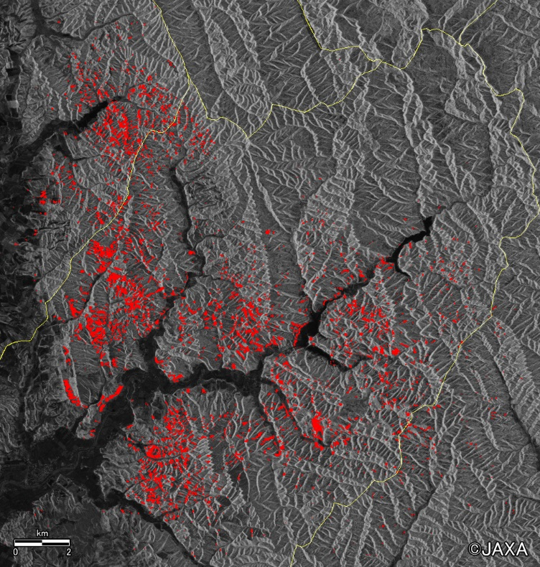
Disaster
Earthquake and Landslide
at Iburi Area in Hokkaido, Japan
Landslide areas derived by ALOS-2
Left: Polarimetric color-composite image / Observed at 23:19, Sep. 8, 2018 (R:G:B = HH+VV:HV:HH-VV)
Right: Landslide areas indicated in red / Detected by the left image
Hokkaido, Japan
Iburi
Color-composite image from two observation data in the same condition
Blue: After disaster at 11:41 Sep. 6, 2018
Red: Before disaster on Aug. 23, 2018
Land slide areas are shown in red color.

Slide 6
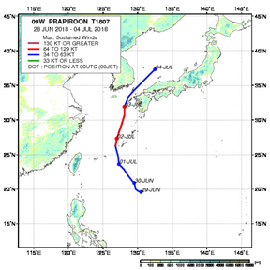
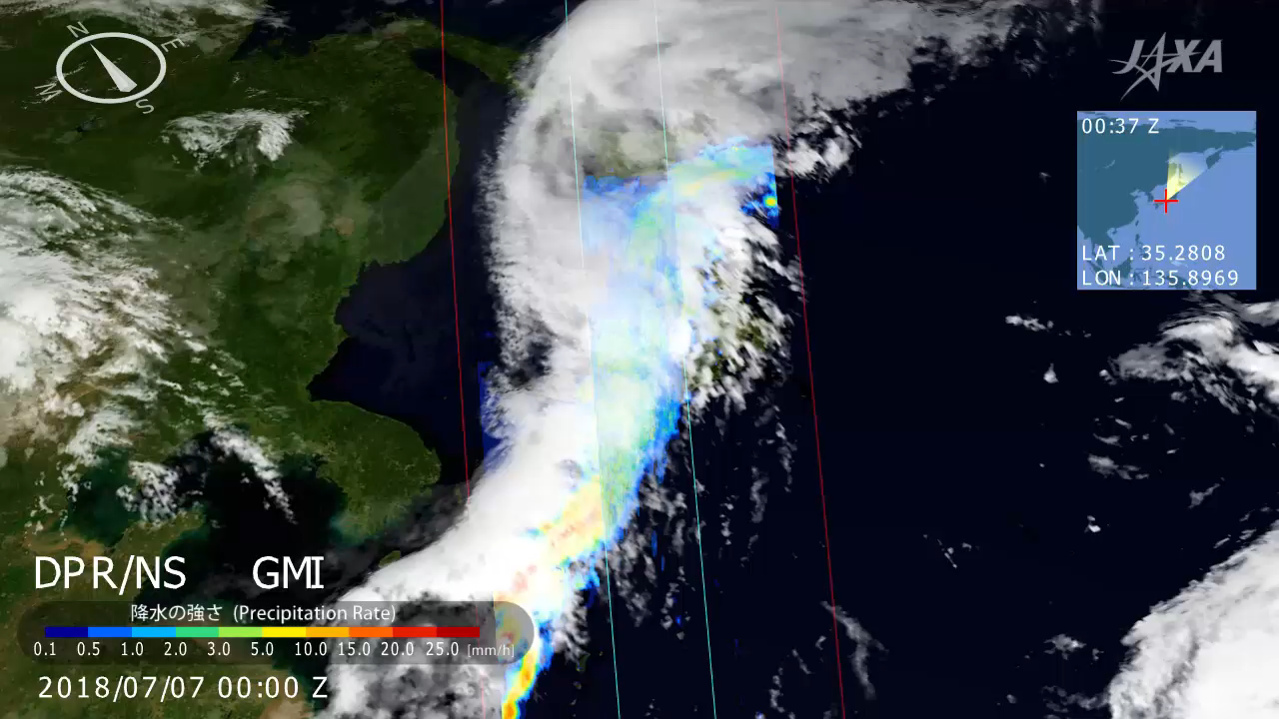
Disaster
Measuring 3D structure of heavy rain
caused by Baiu rain front over Japan
Baiu rain front measured by Dual-frequency Precipitation Radar (DPR) onboard GPM satellite

Slide 7
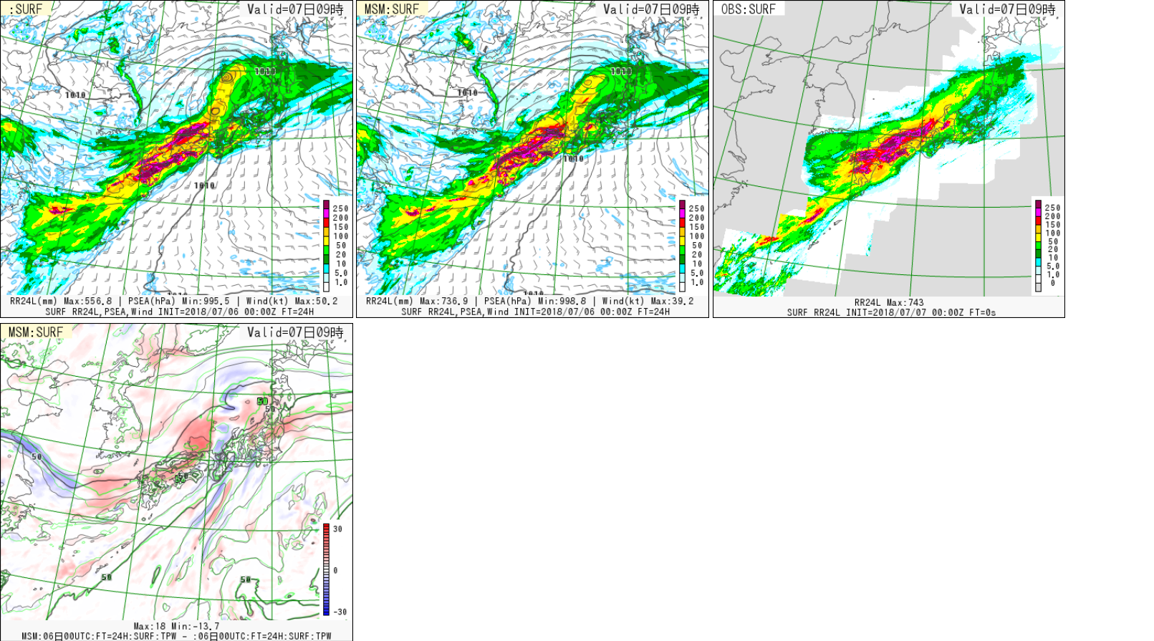
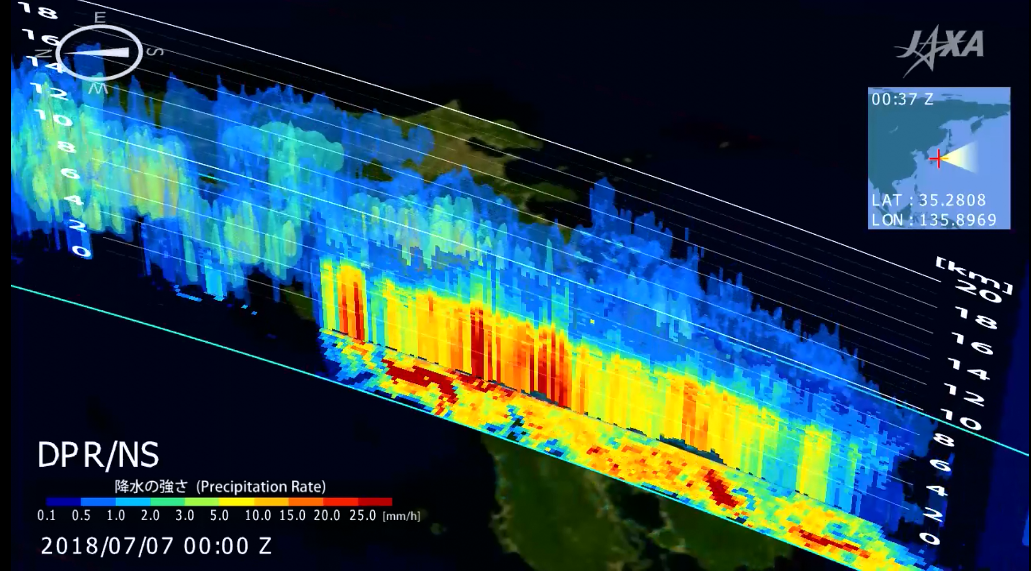
Disaster
Contribution to operational Meso-scale
Numerical Weather Prediction System
Figures show the case study for heavy rainfall in July 2018, causing serious damage in western part of Japan.
Precipitation forecast was similar to the actual precipitation when DPR data was assimilated.
without DPR
with DPR
Ground observation
© Japan Meteorological Agency
24h forecasts of precipitation (00UTC 7th July 2018)
GPM/DPR 3D precipitation on 00UTC 7th July 2018.
Assimilation of GPM/DPR improved the prediction of rainfall location in meso-scale, which is important for disaster prevention.
The DPR 3-dimensional information which cannot be detected by microwave radiometer is essential factor for rainfall forecasting as well as disaster prevention.

Slide 8
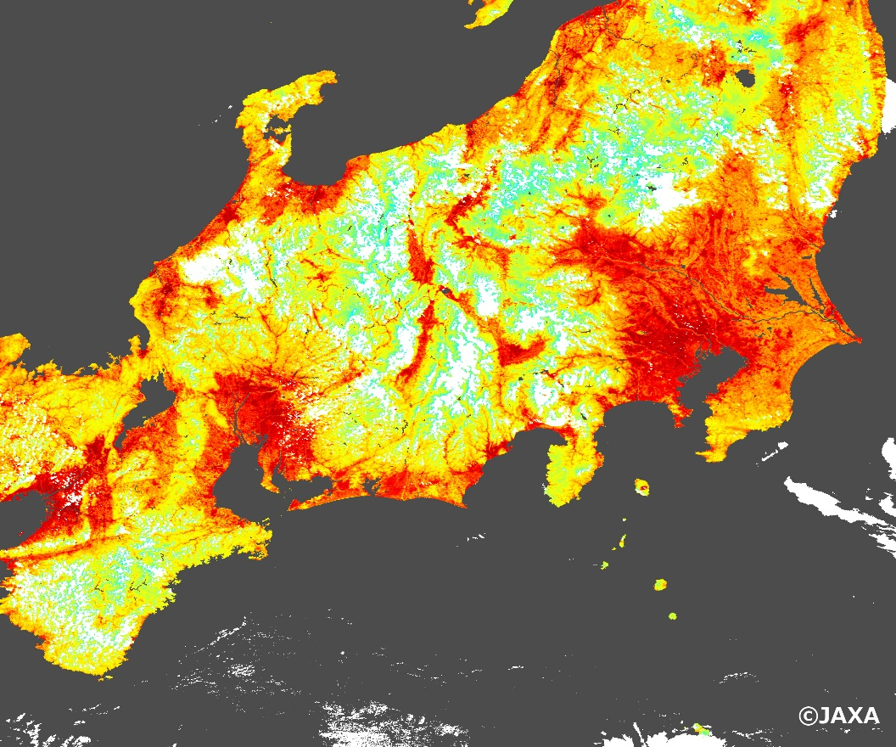
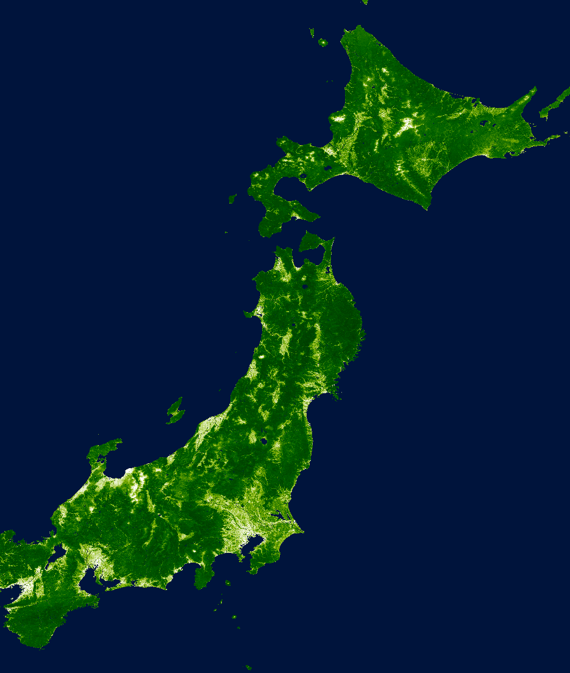
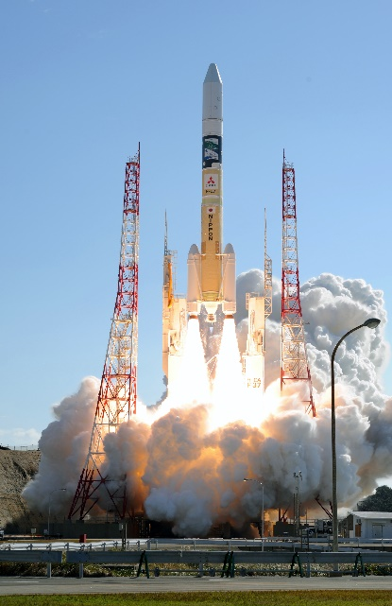
Climate Change
GCOM-C/SGLI
Acquired Images
◀ Surface temperatures of intense heat in central Japan (August 1, 2018)
Successful Launch of GCOM-C
(December 23, 2017)
Vegetation distribution of Japan ▶

Slide 9
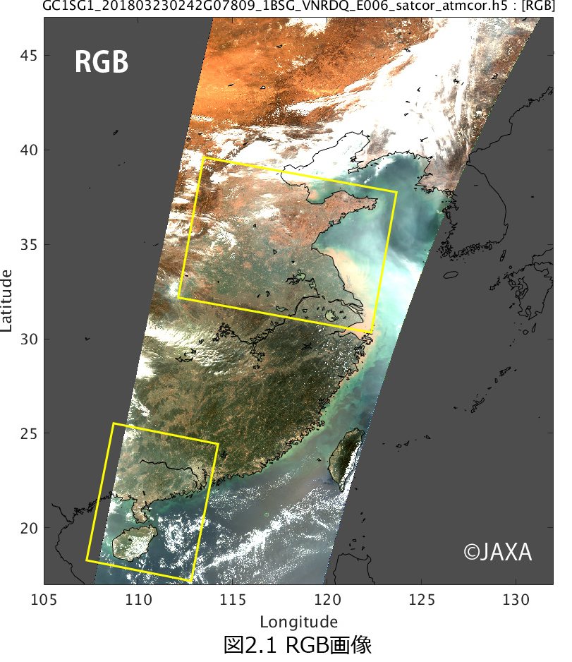
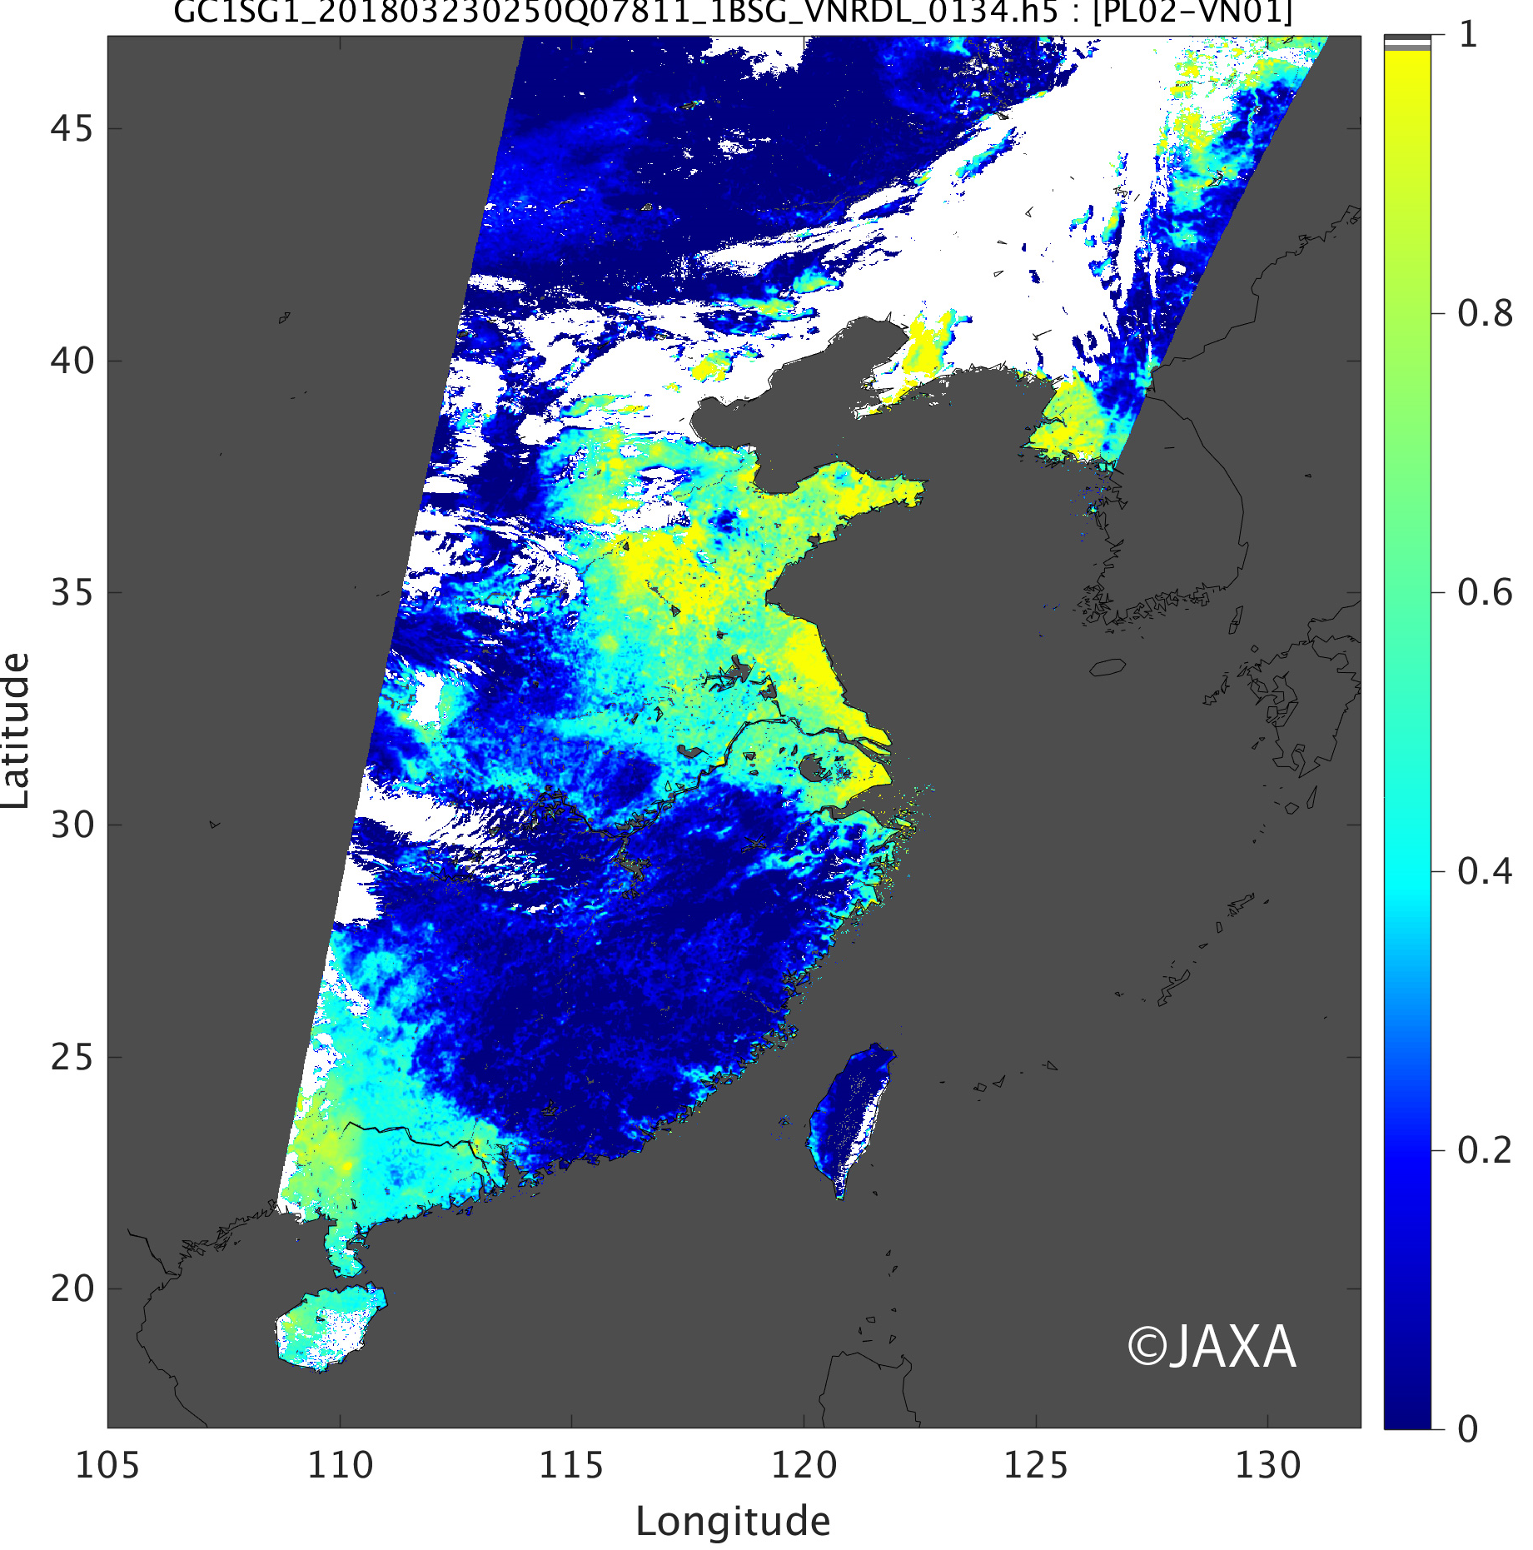
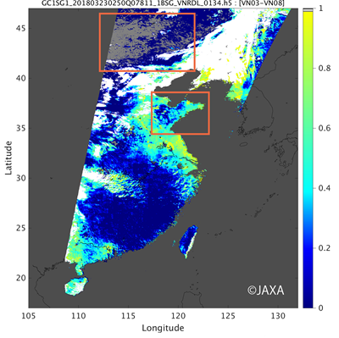
Climate Change
GCOM-C/SGLI Acquired Images
SGLI polarimetry and near-ultraviolet bands will improve aerosol estimation over the land
        Polarimetry: sensitive to aerosols with small particle size, therefore will contribute to monitoring of anthropogenic air pollutants
Near-ultraviolet band: will improve estimation of absorptive (carbonaceous) aerosol from human activities, slash-and-burn fires and forest fires.
◀Optical thickness of aerosol estimated by SGLI polarization and near-ultraviolet band
(March 23, 2018)
▼Optical thickness of aerosol estimated
by blue and red band (a traditional method)
Orange rectangles shows large error areas
due to the bright land surface

Slide 10
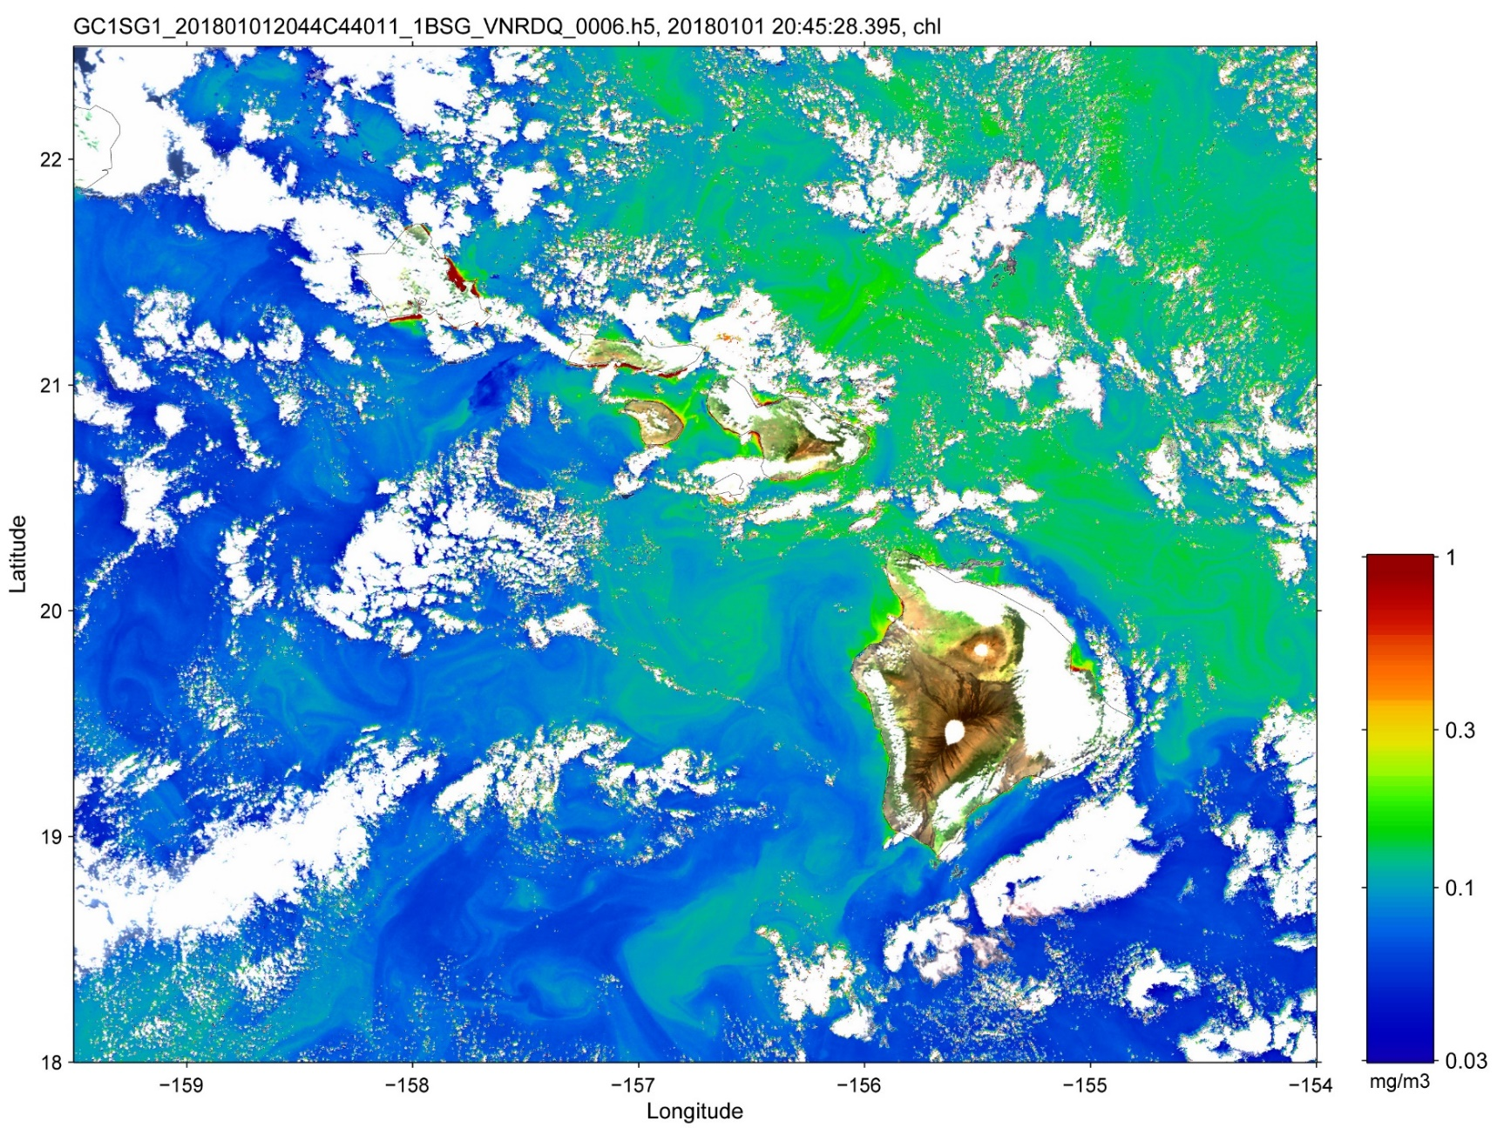
Climate Change
GCOM-C/SGLI acquired images
The Hawaiian Islands (250-m Chlorophyll-a concentration)
250m
380nm
Polarization
Multi-angles
MOBY
20.82N
157.19W
Chlorophyll-a concentration on 1 Jan 2018 (not validated)
10

Slide 11
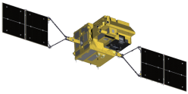
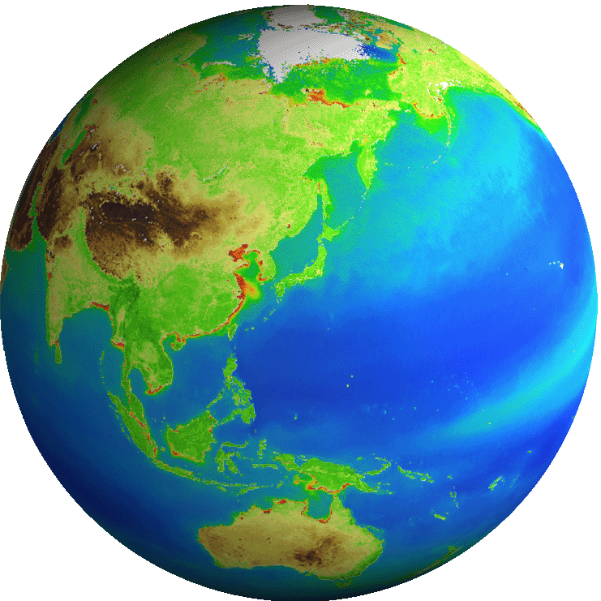
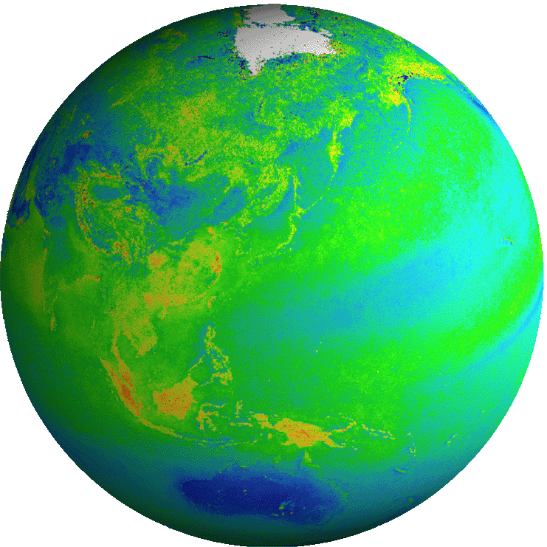
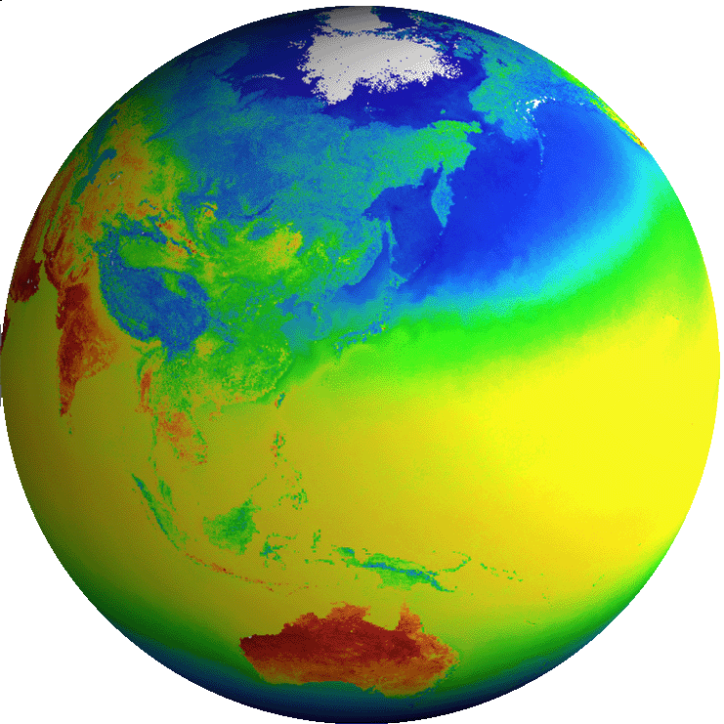

Climate Change
GCOM-C/SGLI: Observation Products
Common
Radiance | TOA radiance (including system geometric correction)
All standard products (L1, L2, L3) will be distributed by the internet (scheduled for release to the public in December 2018)
Free for both science and commercial purposes
Land
Reflectance | Precise geometric correction
 | Atmospheric corrected reflectance
Vegetation and carbon cycle | Vegetation index
 | Above-ground biomass
 | Vegetation roughness index
 | Shadow index
 | Fraction of Absorbed Photosynthetically available radiation
 | Leaf area index
Temp. | Surface temperature
Application | Land net primary production
 | Water stress trend
 | Fire detection index
 | Land cover type
 | Land surface albedo
Atmosphere
Cloud | Cloud flag/Classification
 | Classified cloud fraction
 | Cloud top temp/height
 | Water cloud optical thickness /effective radius
 | Ice cloud optical thickness
 | Water cloud geometrical thickness
Aerosol | Aerosol over the ocean
 | Land aerosol by near ultra violet
 | Aerosol by Polarization
Radiation budget | Long-wave radiation flux
 | Short-wave radiation flux
Ocean
Ocean color | Normalized water leaving radiance
 | Atmospheric correction parameter
 | Photosynthetically available radiation
 | Euphotic zone depth
In-water | Chlorophyll-a conc.
 | Suspended solid conc.
 | Colored dissolved organic matter
In-water | Inherent optical properties
Temp. | Sea surface temp.
Application | Ocean net primary productivity
 | Phytoplankton functional type
 | Redtide
 | multi sensor merged ocean color
 | multi sensor merged SST
Cryosphere
Distribution | Snow and Ice covered area
 | Okhotsk sea-ice distribution
 | Snow and ice classification
 | Snow covered area in forest and mountain
Surface properties | Snow and ice surface Temperature
 | Snow grain size of shallow layer
 | Snow grain size of subsurface layer
 | Snow grain size of top layer
 | Snow and ice albedo
 | Snow impurity
 | Ice sheet surface roughness
Boundary | Ice sheet boundary monitoring
ECV
ECV
ECV
ECV
ECV
ECV
ECV
ECV
ECV
ECV
ECV
ECV
ECV
ECV
Blue: standard products
Red: research products

Slide 12
Climate Change
Essential Climate Variables measured
by GCOM-C & W, GPM/DPR, GOSAT
Measured by GCOM-C
Measured by GCOM-W
Measured by GPM/DPR
Measured by GOSAT
Atmospheric
Terrestrial
Oceanic
Surface | Upper-air | Composition
Air temperature | Temperature | Carbon dioxide
Wind speed & direction | Wind speed & direction | Methane
Water vapour | Water vapour | & other long-lived GHGs *
Pressure | Cloud properties | Ozone & Aerosol
Precipitation | Earth radiation budget (including solar irradiance) | supported by their precursors **
Surface radiation budget
Surface | Sub-surface
Sea-surface temperature | Temperature
Sea-surface salinity | Salinity
Sea level | Current
Sea state | Nutrients
Sea ice
Surface current
Ocean colour
CO2 partial pressure | CO2 partial pressure
Ocean acidity | Ocean acidity
Phytoplankton
 | Oxygen
 | Tracers
River discharge
Water use
Groundwater
Lakes
Snow cover
Glaciers and ice caps
Ice sheets
Permafrost
Albedo
Land cover (including vegetation type
Fraction of absorbed photosynthetically active radiation (FAPR)
Leaf area index (LAI)
Above-ground biomass
Soil carbon
Fire disturbance
Soil moisture
* including N2O, CFCs, HCFCs, SF6, PFCs
** in particular NO2, SO2, HCHO, CO
Total Essential Climate Variables (ECVs) (ECVs largely dependent on satellite observations identified by CEOS and GCOS are shown in bold.) | 50
ECVs measured by GCOM-C&W, GPM/DPR and GOSAT | 23

Slide 13
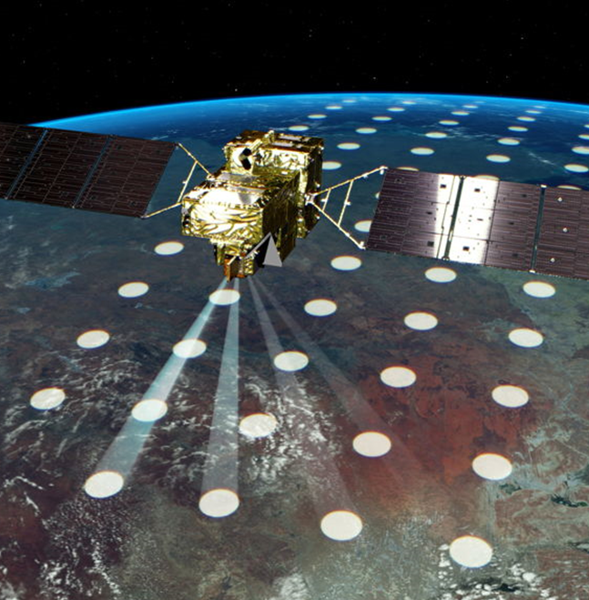
Climate Change
Greenhouse Gases Observing Satellite -2
Scheduled Launch Date: October 29, 2018 (JST)
Main Objectives Providing data that helps to create and release reliable emission inventories of CO2 due to human activities. Contributing to the Paris Agreement that requires the Parties to submit their annual greenhouse gas emission data.
A cooperative project among JAXA, NIES and MOE.
 | TANSO-FTS-2 | TANSO-CAI-2 Forward/Backward
Wavelength | 0.75-0.77 μm 1.56-1.69 μm 1.92-2.39 μm 5.5-8.4 μm 8.4-14.3 μm | 343 nm 443 nm 674 nm 869 nm 1.63 μm* | 380 nm 550 nm 674 nm 869 nm 1.63 μm*
Spatial Resolution | 9.7 km | 460 m 920 m*
Pointing Range/ Swath Width | (CT)±35 deg (AT)±40 deg | 1008 km 938 km*
Major Characteristics Altitude: Approx. 666 km Local sun time at descending node: 13:00 Mission Instruments: Greenhouse gases observation sensor (TANSO-FTS-2) Cloud-aerosol sensor (TANSO-CAI-2)

Slide 14
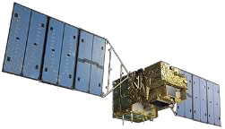
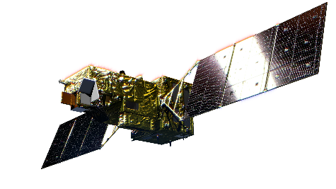
Climate Change
Upgrade from GOSAT to GOSAT-2
 | GOSAT | GOSAT-2
Concentration Measurement Precision | 4 ppm (CO2) 34 ppb (CH4) per 3 months at 1,000km mesh (land | 0.5 ppm (CO2) 5 ppb (CH4) per 1 month at 500 km mesh (land) at 2,000 km mesh (ocean)
Estimation Accuracy of Flux | Reduce the annual estimation error to half compared with the existing estimation error -sub-continental scale | Estimate the monthly net fluxes with the accuracy of ±100% at 1,000 km mesh (land) at 4,000 km mesh (ocean) (>±0.2GtC/area/year)
Estimation of Anthropogenic Emission | --------- | Examine the feasibility of the estimation of the anthropogenic emission with the observation of CO which is the correlated matter
Monitoring Aerosols in the Atmosphere | --------- | Calculate the optical thickness of the aerosols at 550nm and 1.6μm with 0.1 accuracy (for estimation of the moving state of the PM2.5)
Improvement
Improvement
New
New
14

Slide 15
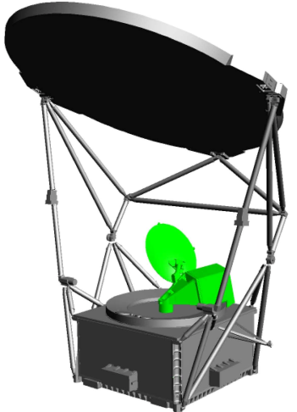
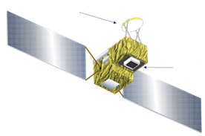
AMSR-2 Follow-on Mission
Climate Change
Status of AMSR-2 Follow-on Mission:
  AMSR2 follow-on mission has been in pre-project phase since September 1, 2018.
    Mission Definition Reviews (MDR): April to June 2018
    Project Preparation Review: July 2018
  The new satellite will be a joint mission of GCOM-W/AMSR2 follow-on sensor and GOSAT-2/TANSO-2 successor sensor (advanced spectrometer to monitor greenhouse gases).
    Orbit definition is currently under negotiation.
Specification of AMSR2 Follow-on Sensor:
  Almost equivalent sensor specification to the current AMSR-2 (antenna size, channels)
  Additional higher frequency channels of 166 & 183 GHz for snowfall retrievals
  New products: snowfall, TPW over land, high-resolution SST, all-weather sea surface wind speed & high-resolution sea ice concentration
  Near-real-time data distribution capability
AMSR-2 Successor Sensor
TANSO-2
Successor Sensor
Image of AMSR-2 Successor Sensor
Onboard GOSAT-3
Image of AMSR-2 Successor Sensor

Slide 16



Japan’s Earth Observation Schedule
Japanese Fiscal Year
2016 | 2017 | 2018 | 2019 | 2020 | 2021 | 2022 | 2023 | 2024 | 2025 | 2026 | 2027 | 2028 | 2029 | 2030
National Security
Disaster
ALOS-2/PALSAR-2
ALOS-4 (SAR)
Land Monitoring
ALOS-4 Follow-on
ALOS-3
(Optical)
ALOS-3 Follow-on
Climate
Change
GCOM-W/AMSR-2
AMSR-2’s Successor Sensor
Water Cycle
Precipitation
GPM/DPR
Vegetation,
Aerosol
GCOM-C/SGLI
EarthCARE/CPR
Clouds
GOSAT/FTS
Greenhouse
Gases
GOSAT-2/FTS-2
GOSAT-3

Slide 17
Missions for Contributing to National Security & Disaster Risks Management
JAXA’s Proposal for Future EO Missions
SAR | Propose ALOS-6 for continuous observation by L-band SAR with wider swath width and higher resolution.
Optical (LEO) | Propose ALOS-5 for continuous observation to respond to high resolution optical data needs.
SLATS (follow-on) | Advancement of instruments for the super low altitude (small optical sensors, SAR and infrared sensors, Lidar). Coordinated operations of a post-SLATS constellation systems to enable data acquisition of target areas in a timely manner, taking advantage of SLATS capability of moving to a recurrent orbit on which satellites can observe a particular target point every day at the same time.
Optical (GEO) | Development of a large optical sensor (visible and near infrared) for a geo-stationary satellite and establish a satellite system to enable time and consecutive observation and data provision of target areas for disaster related and national security use.
NEW

Slide 18
Missions for Monitoring Climate Change
JAXA’s Proposal for Future EO Missions
GHG | Propose to launch GOSAT-4 in the late 2020s for continuous observation by GOSAT series sensors.
Precipitation/Ocean | Propose to launch AMSR-4 in the late 2020s for continuous observation by AMSR series sensors, in consideration of its importance to operational users, i.e. meteorological operations, fisheries and sea ice monitoring.
Cloud/ Vegetation/ Ocean | Propose to launch SGLI-2 in the late 2020s for continuous observation by SGLI series sensors, in consideration of potential operational applications, i.e. agricultural management, fisheries and national security.
Precipitation | Taking into consideration of NASA’s study of EO Decadal Survey, start a joint study with NASA for requirements and architecture to articulate the future mission. Based on the results of the NASA-JAXA joint study, phase-up to a mission will be determined.
Cloud/Wind | Necessity of successor missions will be determined based on research and application results of EarthCARE/CPR.
Forest Cover | Propose a new mission for tree crown height measurement, Multi-footprint Observation LIdar (MOLI) and to start its development in JFY 2019 timeframe. MOLI will be attached to the Exposed Facility of Japanese Experiment Module “Kibo” of the International Space Station.
NEW

