Slide 1
Agency update: CNES
Committee on Earth Observation Satellites
Juliette Lambin, CNES
CEOS Plenary 2018
Agenda Item 4.3
Brussels, Belgium
17 – 18 October 2018

Slide 2
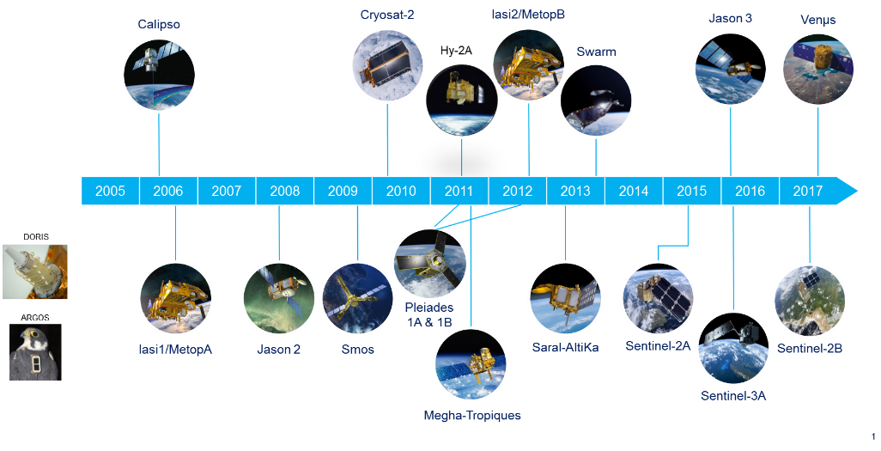
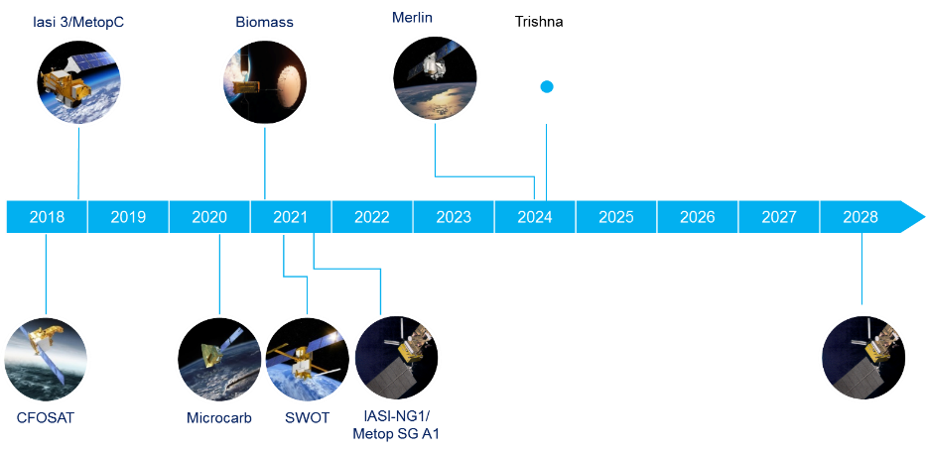
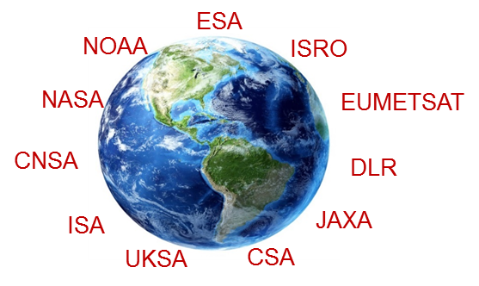
CNES EO Missions
In operation
3 main families:
Optical HR/THR
Altimetry/radar
Atmosphere sounding
Being developped

Slide 3
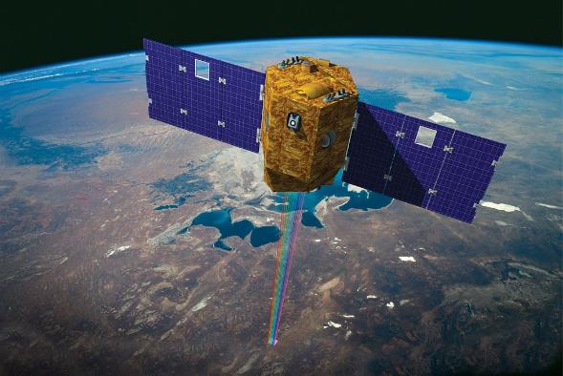
Venµs, one year
ISA/CNES cooperation
> one year in operations
2 day revisit
Data available via www.theia-land.fr

Slide 4
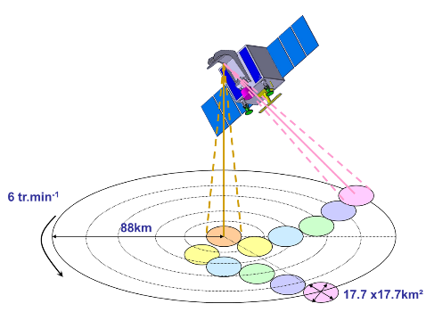
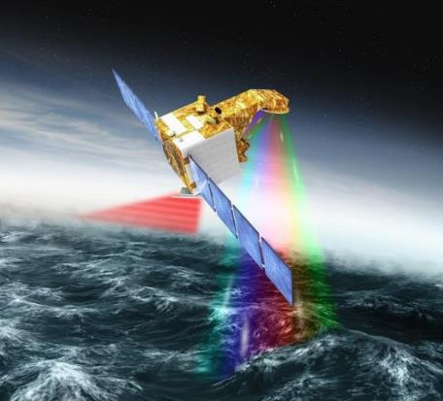
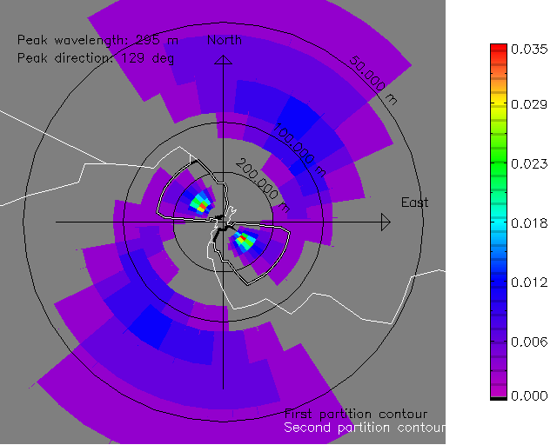
Coming (very) soon: CFOSAT
CFOSAT: China France Oceanography SATellite
Two payloads:
SWIM: wave scatterometer
SCAT: wind scatterometer
Orbit
Altitude = 519 km
SSO (13 days repeat cycle)
Mission : 3 years duration
Launch schedule Oct 29th
Call for proposals to set up an international science team on going (oceano@cnes.fr)

Slide 5
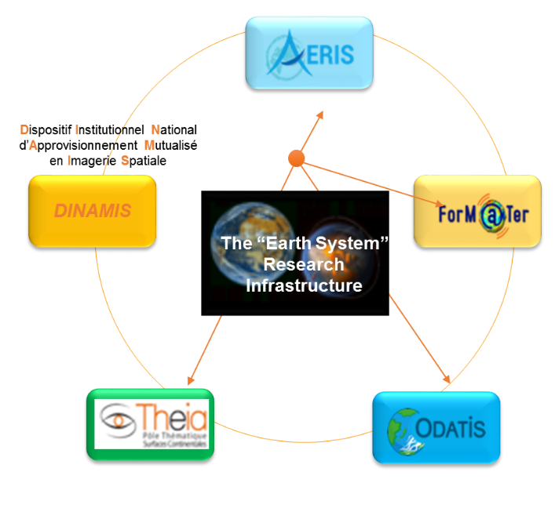
“Earth System” Research Infrastructure
Integrated “Earth System” studies
Four data and service hubs: AERIS, Form@Ter, THEIA and ODATIS.
Promote integrated and interdisciplinary research
Implement the new National Institutional Scheme for Pooling the Supply of Space Imagery (DINAMIS), develop shared access and support users.
Multi-source, multi-sensor data enabling multi-scale spatial, spectral and temporal uses
Combining satellite-based, in situ and modelling data
Interdisciplinarity
The mission of the Earth System infrastructure is:
to serve the scientific communities, public authorities and innovation stakeholders.
to develop European and international partnerships.
34 research institutions partnering
CNES main contributor

Slide 6
2018 – 2019 « Work plan »
Phases 0, A studies:
MESCAL (cloud/aerosol lidar) with NASA
C3IEL with ISA
Support to SKIM ESA/EE9 proposal
WISA wide swath altimetry concept for operational mission
Nanomagsat (magnetic field)
ULID: SMOS-next proof of concept
…
Science prospective seminar:
Will be held in Oct 2019
Preparatory work: large scale science community consultation, dedicated working groups…
Will provide Science (EO and space science) orientation for future CNES programs and activities
Space Climate Observatory
Cf dedicated presentation

Slide 7
Presenter Guidance
Presenters should name their files using the following convention:
AgendaItemNumber_LastName_Subject_Version.pptx (e.g., 1.5_Holloway_Communications_v2.pptx)
Reporting to support discussion or decision is encouraged, but historical context and detailed reporting should be provided as pre-meeting reading material or in background slides.
Materials should explicitly highlight the decisions, endorsements, outcomes, or actions you are seeking at Plenary. The more explicit you are with the required actions, the better. i.e., do feel free to propose draft action text for consideration – it may be revised, but will help with the efficient preparation of the Plenary actions record.
Materials should be sent to matthew@symbioscomms.com and Luc@plusci.be
Documents for endorsement: no later than Wednesday October 3rd
Presentations: no later than Wednesday October 10th

