Slide 1


RADARSAT Constellation Mission Update
Committee on Earth Observation Satellites
Canadian Space Agency
CEOS Plenary 2018
Agenda Item #4.3
Brussels, Belgium
17 – 18 October 2018

Slide 2
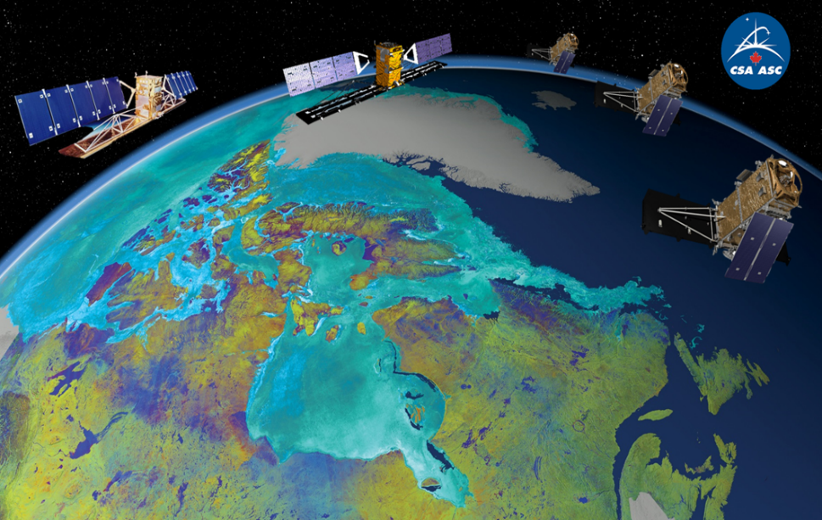
The RADARSAT Constellation Mission is the evolution of the RADARSAT program
Ensures data continuity and improves system reliability.
Responds to the increasing needs of the Government of Canada for SAR-C data to support operations and the timely delivery of products and services to Canadians.
Receivers for AIS transmissions will allow improved detection and tracking of vessels.
Space Segment delivered
Ground Segment on track for mission operations
Scheduled to launch in
February 2019
Government-owned mission, tailored to respond to the Canadian Government needs in 3 main areas:
  Maritime surveillance
  Disaster management
  Ecosystem monitoring

Slide 3
Evolution of RADARSAT data
usage by Government of Canada
50x
from R1 to RCM
Images
5x
from R1 to R2
GoC user departments currently forecast that they will use approximately 250,000 RCM images per year.

Slide 4
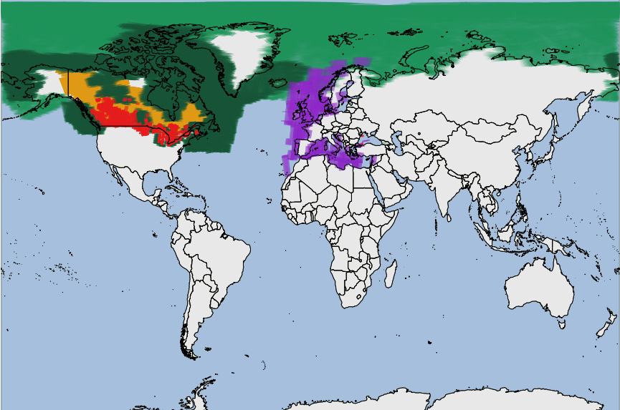
RCM Expected Coverage
Start of Routine Mission Phase - Q3 2019
Med. Res. 50m
Average Daily
Med. Res. 50m Every 3 day
Med. Res. 50m* Monthly
Med. Res. 16m/30m* Weekly to Monthly
Ship Detection Mode
Weekly
*Note: Coverage requirements over the Canadian land mass are under review and will be finalized prior to the start of routine operations.
Domestic and global coverages exclusively for defence and security are not shown.
4
Notes:
This graphic represents the expected coverage from RCM at the start of the Routine Operations mission phase in Q3 2019.
Coverage shown makes abstraction of Access Control conditions.
Coverage for High and Very High resolution beam modes are not shown. These are expected to be acquired mostly in an ad-hoc fashion over small areas of interest over Canada and internationally.
Domestic and global coverages that are exclusively for defence and security are not shown.

Slide 5
RCM SAR-C Data Policy and Access in Brief
The Canadian legal framework of the Remote Sensing Space Systems Act dictates the need for operating licenses for RCM
This has implications in terms of ability to open data access
Acquisition
Acquisition plans over large areas, using various imaging modes and coverage frequencies
Access and Distribution
Registration is required to access data, data latency ≤ 24hrs
Additional vetting criteria will be used to provide “better-than-public” access to data
Ownership of RCM SAR data remains with the Gov of Canada
Intellectual property rights to Value Added Products (VAPs) remain with the creator
Use of the RCM SAR data shall be in accordance with the applicable End User License Agreement
No commercial tasking (only Government of Canada will task the satellites)
No commercial data distribution
Ownership and Use

Slide 6
More on Canadian Government’s Data Access
RADARSAT-1
Government of Canada is working towards opening up R1 archives
First phase: commitment to release the data products residing in the Canadian archives and to make them available to the general public by March 2019 (approx. 37,000 images over Canada)
Data is not subject to the Canadian government’s Remote Sensing Space Systems Act regulating data access
RADARSAT-2
Data is owned by MDA and is subject to the Canadian government’s Remote Sensing Space Systems Act regulating data access
Archives of GoC processed data is accessible to GoC users only
Data is available commercially or provided for activations of International Charter Space and Major Disaster
RCM AIS Data
Managed by National Defence, access to products limited to the GoC Departments and defence partners

Slide 7
ADDITIONAL INFORMATION

Slide 8



The RADARSAT Program
 | RADARSAT-1 (1995-2013) | RADARSAT-2 (2007 - ) | RCM (2018)
# of satellite | 1 | 1 | 3
Mass | 2750 kg | 2300 kg | 1430 kg
Exact revisit | 24 day | 24 day | 4 day (12 / sat)
SAR time / orbit | 28 min | 28 min | 15 min / sat
Antenna size | 15 m | 15 m | 6.75 m
Polarization | HH | HH, VV, HV, VH | HH, VV, HV, VH, Compact Pol.
Look direction | Right | Right or Left | Right

Slide 9
RADARSAT Program Evolution
 | RADARSAT-1 (1995-2013) | RADARSAT-2 (2007- ) | RCM (2019 planned)
Policy Driver | To better manage navigation through Canada’s ice infested waters | Data continuity and expectation that SatCom and optical data commercialization trends applies to RADAR. | First and foremost national interest Radar imagery still mostly for government use and open data policy international trend.
Technological driver | Develop a niche for SAR | Enhanced system capabilities | Improved revisit time over resolution Small satellite platform capability
Commercialisa-tion | A private company established to commercialise the data | MDA has exclusive rights to market data worldwide. Government’s contribution is a data pre purchase | No commercial distribution
Procurement | Traditional Government procurement followed by a Government operation | Public, Private Partnership with MDA | Traditional government procurement and government operations
Implementation | Government owned and operated. In partnership with NASA and NOAA in exchange of imagery. | Government and MDA invested in the construction of the system and MDA owns and operates it | Government owns and operates. Defense provides AIS tracking system
Data Access | Commercial purchase except NASA/NOAA (partners); provisions for International Charter for major disaster | All commercial purchases; provisions for International Charter for major disaster | Intent is to make data available, accessible, and affordable to the broadest extent possible

Slide 10
RADARSAT Data Access
 | RADARSAT-1 | RADARSAT-2 | RCM
Ownership and operations | Gov. of Canada owned & operated | MDA owned & operated under RSSSA | Gov. of Canada owned & operated under RSSSA
Ordering and Distribution | Gov. of Canada order desk and MDA for other users; data delivered mostly on CDs until 2008 | Gov. of Canada order desk and MDA for other users; | Gov. of Canada order desk Gov. of Canada data needs expected to consume all SAR imaging capacity
Archives | No archival of processed data before 2008. Planning to make archived data available | Archive of GoC processed data accessible to GoC users only | Archive of Gov. of Canada processed data at NRCan accessible to various types of users. Exact scope of data availability is subject to the definition of access controls imposed by the RSSSA and operating license
Access International Partners | Commercial purchase except NASA/NOAA (partners); provisions for International Charter for major disaster | All commercial purchases; provisions for International Charter for major disaster | Intent is to make RCM data available, accessible, and affordable to the broadest extent possible
Open Data Access | None | None | Intent is to make the SAR data acquired by the government available in their originally ordered processed formats, at no cost, subject to legislation, regulations and policies as well as within technical capabilities
Acquisition Strategy | On demand request + Background mission | On demand request + Background mission | Recurrent acquisition plan (Std. Coverage) + occasional Ad-hoc request

