Slide 1
USGS Status
Jenn Lacey, USGS EROS
2018 CEOS Plenary
Agenda Item 4.3
Brussels, Belgium
16 – 18 October 2018

Slide 2
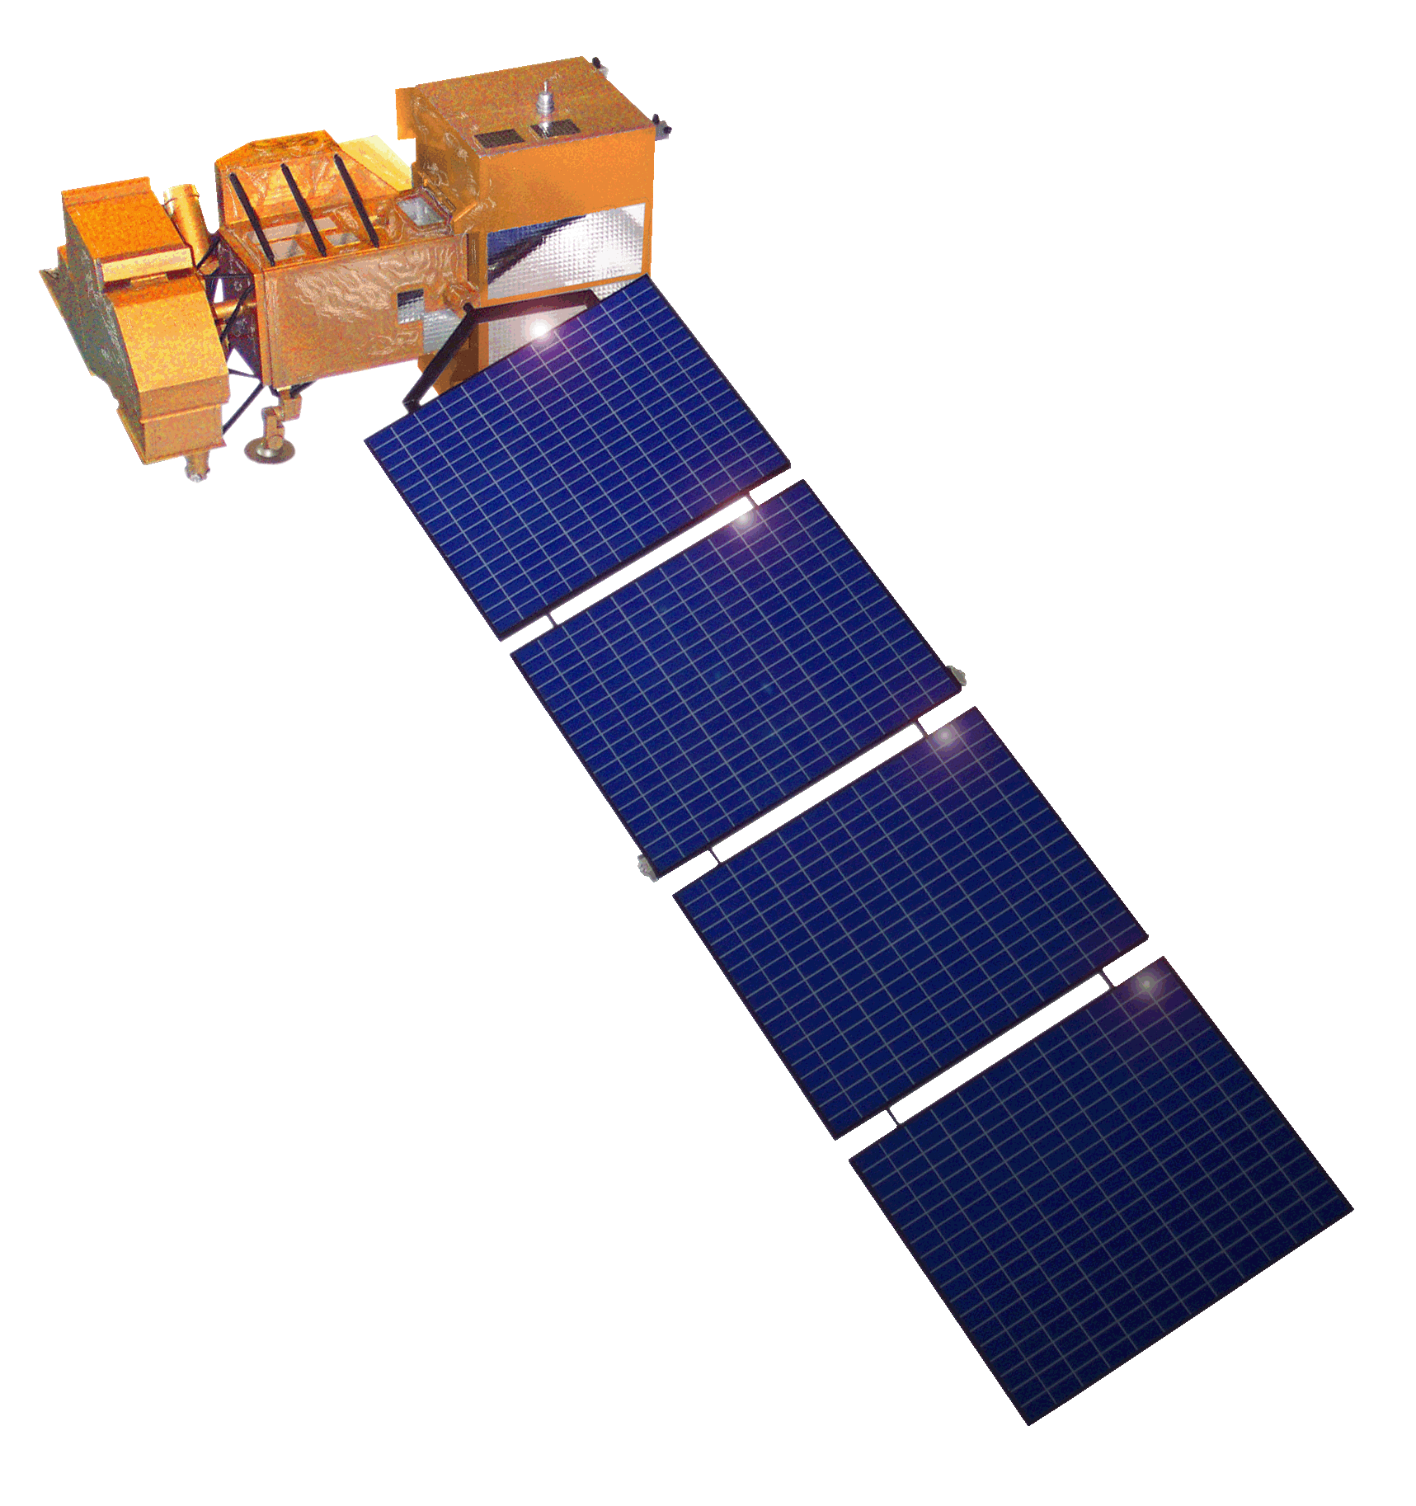
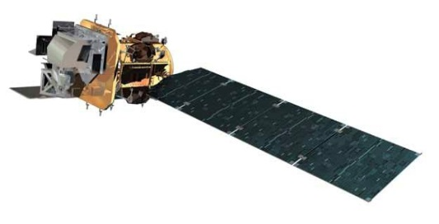
Landsat Operational Mission Status
Landsat 7
Acquiring ~470 scenes/day through a continental acquisition strategy
On-orbit observatory performance continues to be outstanding
13 active international ground stations
Finalized end of mission planning to extend L7 science operations to overlap with L9
  Assumes December 2020 L9 launch readiness date
  Science mission life-cycle potential extends to July 2021
  Decommissioning will follow L9 launch or end of science mission operations, whichever comes first
Landsat 8
Acquiring ~740 scenes/day with continental acquisition strategy
On-orbit observatory performance continues to be outstanding
21 active international ground stations and growing
Enhanced Landsat Ground Network (LGN) robustness and reliability through use of international partnerships
Flight Operations now performed under USGS contract for combined mission operation and Landsat Multi-satellite Operations Center (LMOC) development

Slide 3
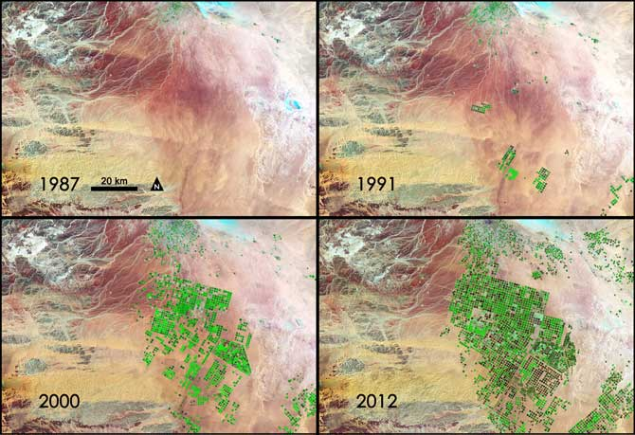
Landsat 9 Mission Overview
  Mission Objectives
Provide continuity in multi-decadal Landsat land surface observations to study, predict, and understand the consequences of land surface dynamics
  Core Component of Sustainable Land Imaging program
  Mission Parameters
Single Satellite, Mission Category 1, Risk Class B
  5-year design life after on-orbit checkout
  At least 10 years of consumables
Sun-synchronous orbit, 705 km at equator, 98°inclination
16-day global land revisit
Partnership: NASA & USGS
  NASA: Flight segment & checkout
  USGS: Ground system and operations
Category 3 Launch Vehicle
Launch: Management Agreement - December 2020
Agency Baseline Commitment – November 2021
  Mission Team
NASA Goddard Space Flight Center (GSFC)
USGS Earth Resources Observation & Science (EROS) Center
NASA Kennedy Space Center (KSC)
Instruments
Operational Land Imager 2 (OLI-2; Ball Aerospace)
    Reflective-band push-broom imager (15-30m res)
    9 spectral bands at 15 - 30m resolution
    Retrieves data on surface properties, land cover, and vegetation condition
Thermal Infrared Sensor 2 (TIRS-2; NASA GSFC)
  Thermal infrared (TIR) push-broom imager
  2 TIR bands at 100m resolution
  Retrieves surface temperature, supporting agricultural and climate applications, including monitoring evapotranspiration
Spacecraft (S/C) & Observatory Integration & Test (I&T)
Northrop Grumman Innovation Systems (NGIS), formerly Orbital ATK (OA)
Launch Services
United Launch Alliance (ULA) Atlas V 401
Mission Operations Center (MOC) and Mission Operations
General Dynamics Mission Systems (GDMS)
Increase in pivot irrigation in Saudi Arabia from 1987 to 2012 as recorded by Landsat. The increase in irrigated land correlates with declining groundwater levels measured from GRACE (courtesy M. Rodell, GSFC)

Slide 4
Landsat Data Policy Study for 2018
Landsat Advisory Group (LAG) Task topic title: “Considerations of cost sharing models for Landsat data”
DOI leadership is seeking to better understand economic and data policy considerations and impacts in relation to user needs, as well as the potential for public-private partnering (“P3”), with respect to various cost sharing models for Landsat data.
The “fee recovery” issue has been looked into as recently as 2012 by the LAG—that paper can be found online at the NGAC website.
This represents a good opportunity to inform current leadership on a number of Landsat data policy issues, in particular, the interplay with ESA’s adoption of a free and open policy for Sentinel.
USGS position is to support an objective investigation by the LAG.
Feedback and information: Email account (Landsatdatapolicy@usgs.gov) and FAQ section on EE website.

Slide 5
Sustainable Land Imaging (SLI) Architecture Study Team (AST)
NASA/DOI/USGS SLI AST kicked off a study for the design and implementation approach of a spaceborne system to provide global, continuous Landsat-quality multispectral and thermal infrared measurements for approximately a fifteen-year period starting in 2026
Oversight provided by the NASA Associate Administrator for Science and the DOI Assistant Secretary for Water and Science
AST-2019 will inform NASA and DOI/USGS acquisition strategies on options for both the space and ground segments, potential contributions from international partners and commercial Earth Observation data suppliers, and business model alternatives
Ground System a major driver for AST-2019 (and USGS)
Recommendation report to be delivered in August 2019

Slide 6
Collection 2 Definition Summary
Level-1 Products
Level-1 products will only undergo minor changes to preserve capabilities for users relying on our current Level-1 offerings
  Angle bands (solar and sensor viewing zenith and azimuth) are being added to assist users who want to generate their own TOA reflectance and brightness temperature bands
  Minor metadata enhancements and consistency changes
Other processing changes
  Updated geometric registration base (Sentinel-2 Global Reference Image (GRI))
  Improvements to precision modeling process to allow more products to process to Level-1TP
  Algorithm to detect Internal Calibrator (IC) shutter intrusion events and flag them in metadata
  Minor bug fixes and Cal/Val enhancements

Slide 7
Collection 2 Definition Summary
Level-2 Products
Level-2 products will be processed from all Level-1 inputs (Tier 1 or Tier 2) that meet the Solar Zenith Angle (SZA) constraint and that have required auxiliary data
  LEDAPS (L4-7) and LaSRC (L8-9)) being integrated into the current processing system flows
  Auxiliary bands associated with Surface Temperature (ST) processing will be included with the product
  Including both L7 bands 6H and 6L
Updated, consistent Quality Band specification for both Level-1 and Level-2 products
Landsat Collection 2 Level-2 product offering (SR/ST) to be global and CARD4L-compliant
  Coordinating interoperability efforts with ESA (Landsat/Sentinel-2)
  Targeting production in September 2019

Slide 8
Questions

Slide 9
Landsat 9 Status
Joint development between NASA and USGS (same as Landsat 8)
  NASA responsible for space and launch segment, mission success through handover
  USGS responsible for ground segment and on-orbit operations after handover
Landsat 9 is a rebuild of Landsat 8 with targeted upgrades
  Upgrade to fully Class B (TIRS was a Class C instrument on Landsat 8)
  TIRS-2 address on-orbit issues with Landsat 8 TIRS (stray light and position encoder)
  Ground System upgraded to multi-mission capabilities (Landsat 9 development takes priority)
Overall mission making excellent progress
  Launch vehicle contract awarded in October 2017 to United Launch Alliance (ULA)
  Key Decision Point C was on December 6, 2017
  Ground System Critical Design Review planned in September 2018
  OLI-2 and TIRS-2 instruments in fabrication and on-track for mid-2019 delivery to the spacecraft
On-track for launch in December 2020 with transition-to-operations in March 2021

Slide 10
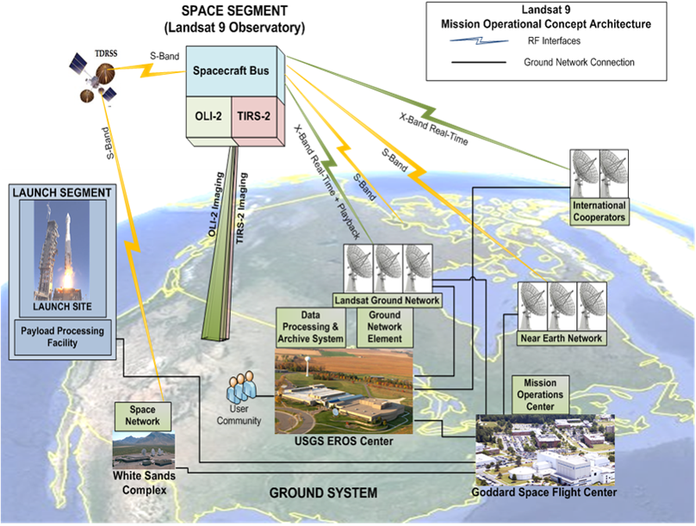
Landsat 9 Mission Architecture

Slide 11
Landsat 9 Ground System Architecture

Slide 12
Active Landsat Ground Stations https://landsat.usgs.gov/igs-network
13 Active L7 Stations 21 Active L8 Stations

Slide 13
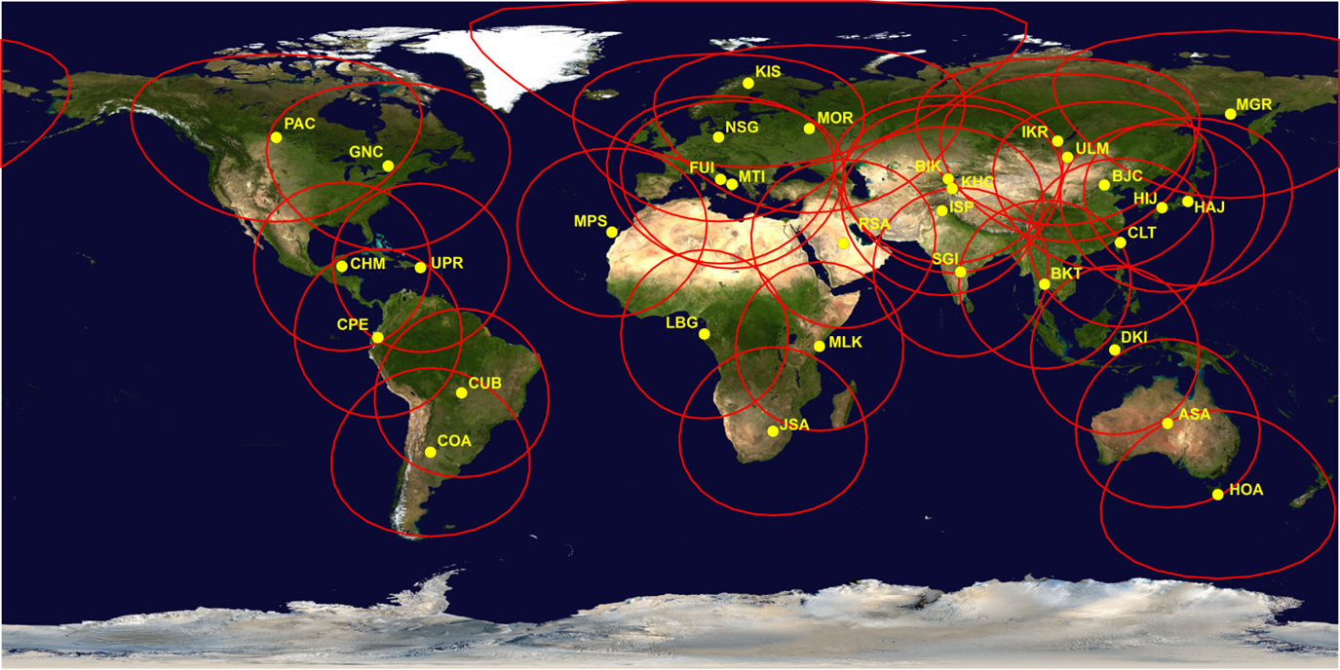
Landsat Global Archive Consolidation (LGAC)
Historical Landsat Ground Stations
* Does not include Landsat Ground Network (LGN) stations

Slide 14
