Slide 1
2018 CEOS Plenary
17 October 2018
Brussels, Belgium
Session 4: Agency and Partner Updates
Luc St-Pierre
Chief, Space Applications Section
United Nations Office for Outer Space Affairs

Slide 2
United Nations Office for Outer Space Affairs (UNOOSA)
Vision
Bringing the benefits of space to humankind
Mission Statement
The core business of the Office is to promote
International Cooperation
in the peaceful uses of outer space to achieve sustainable development goals

Slide 3
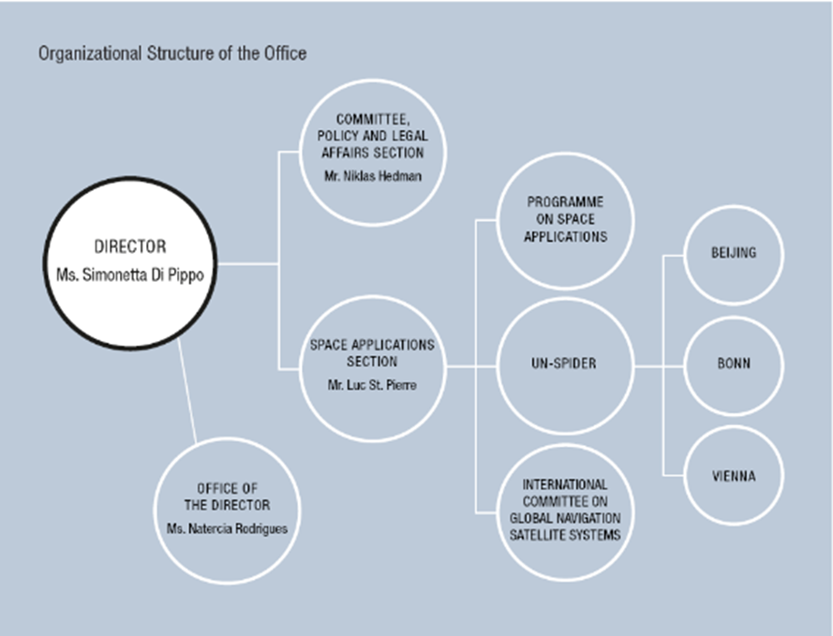
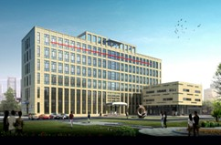
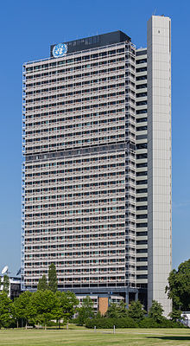
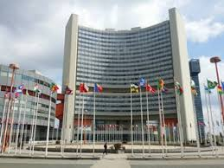
UNOOSA Organizational Structure
Notes:
The Office for Outer Space Affairs, which was initially set up in New York in 1958 as a small unit to support deliberations of the Committee on the Peaceful Uses of Outer Space, has in the 60 years of its existence exercised a unique and broad mandate that was just presented.
To deal with the full spectrum of space activities, the Office is organized in the structure that is depicted here.

Slide 4



Our Work
Main programmes and platforms
  Secretariat to COPUOS
  Works with MS, IGOs, NGOs (space-related)
  Programme on Space Applications
  UN-wide coordination - UN-Space
  UN Register of Space Objects
  UN-SPIDER
  International Committee on Global Navigation Satellite Systems (ICG)
  Space Mission Planning Advisory Group (SMPAG)…
  More info: www.unoosa.org
Notes:
As you see here, among its other responsibilities,
the Office discharges mandates on behalf of the Secretary-General pertaining to the United Nations treaties and principles on outer space,
in particular the Office is entrusted with maintaining the United Nations Register on Objects launched into Outer Space
This registry is the only treaty-based transparency and confidence-building instrument that contains information on such objects since 1957. I will present the registry in a subsequent session next Thursday.

Slide 5
Space Applications Section 2018
GNSS training course at the Asian Institute of Technology | Thailand
UN/Pakistan/PSIPW International Conference on Space Technology for Water Resources Management | Pakistan
UN/Argentina Workshop on the applications of global navigation satellite systems | Argentina
UN/Brazil Symposium on Basic Space Technology | Brazil
United Nations/Austria Symposium on Space for the Sustainable Development Goals | Austria
26th Workshop Space Technology for Socio-Economic Benefits: “Industry, Innovation and Infrastructure for Development (3Is4D)” | Germany
High Level Forum 2018 | Germany
UN Expert Meeting on Human Space Technology | Austria
Follow-up activity to Technical Advisory Mission | Sri Lanka
Follow-up activity to Technical Advisory Mission | Sri Lanka
Technical Advisory Mission | Zimbabwe
AMCDRR | Mongolia
International Conference/Expert meeting on Disaster Risk Reduction | China
International Training Programme in Earth observation for disaster risk reduction | China
Follow-up activity to Technical Advisory Mission | Viet Nam
Emergency mapping procedural guidelines for SAARC countries | India
UNOOSA/DLR/BMWi International Conference | Germany
Training on the use of the UN-SPIDER Knowledge Portal | Ghana

Slide 6
Space Applications Section 2019
Dark and Quiet Skies | Chile
UN/Jordan Workshop on Space Exploration | Jordan
UN/Romania Conference on Space Technology for Sustainable Agriculture and Precision Farming | Romania
UN/China Workshop on Space and SDGs | China
UN/IAF Workshop, tbc | United States of America
UN/xxx Workshop on Human Space Technology | tbc
UN/ICTP Workshop on International Space Weather Initiative (ISWI) | Italy
2019 High Level Forum
UN/Fiji Workshop on Global Navigation Satellite Systems | tbc
UN/Austria Symposium, tbc (25th anniversary of UN/Austria) | Austria
…
…

Slide 7


Sustainable Goal 17 – Partnership for the Goals
Target 17.6
Enhance North-South, South-South and triangular regional and international cooperation on and access to science, technology and innovation and enhance knowledge sharing on mutually agreed terms, including through improved coordination among existing mechanisms, in particular at the United Nations level, and through a global technology facilitation mechanism
“Partnerships with the private sector will facilitate global engagement …bringing together Governments, the private sector, civil society, and the United Nations system.”
UNOOSA intends to capitalize on technological and innovative skills of the private sector to benefit developing countries and to deliver the Access to Space initiative to address all 17 SDGs.
Target 17.9
Enhance international support for implementing effective and targeted capacity-building in developing countries to support national plans to implement all the sustainable development goals, including through North-South, South-South and triangular cooperation
Notes:
UNOOSA is a small UN Office with limited resources. Therefore, it needs to capitalize on technological and innovative skills of its partners. In this sense, the public/private sector partnerships play a crucial role to benefit developing countries directly at the national level through Access to Space initiatives.
KiboCube providing free deployments every year from the Japanese ISS Kibo module, and CMSA Space Station that will provide flight experiment and space application opportunities on board China's space station are excellent examples to the achievements of the Access to Space Initiative.

Slide 8

Notes:
UNISPACE+50 was a unique event since most of the work has been done in the preparatory period 2015-2017, when the Committee on the Peaceful Uses of Outer Space (COPUOS) launched this process to arrive in June this year to a UNISPACE+50 draft resolution entitled "Fiftieth anniversary of the first United Nations Conference on the Exploration and Peaceful Uses of Outer Space: space as a driver of sustainable development" (document A/AC.105/L.313).

Slide 9
UNISPACE+50
UNISPACE+50 included a symposium, a COPUOS High- level segment, side events, and a week-long exhibition.
The symposium panels gave stakeholders the opportunity to take note and discuss various relevant issues in the areas of Space and Civil Society, Space and Industries, Space and Women and Space and Youth
COPUOS high level segment allowed Member States to articulate their views on relevant space issues and commit to the development of “Space2030” Agenda
Major step for global space governance and towards the successful fulfilment of SDG targets and Space2030
400 Participants at the Symposium, 800 Participants at the High-level Segment
HIGHLIGHTS
30+ or high ranking representatives of Space Agencies attended
UNOOSA signed
several agreements with governments, space agencies and private companies
Live in-flight call with astronauts on the International Space Station
Notes:
The vision and actions contained in the agreed text of the UNISPACE+50 draft resolution to continue to develop the "Space2030" agenda and its implementation plan will set the course for strengthening the contribution of space activities and space tools to achieving internationally agreed development goals.
To this end the working groups formed by the member states to develop the Space2030 Agenda will focus their efforts around four main pillars (NEXT SLIDE)

Slide 10
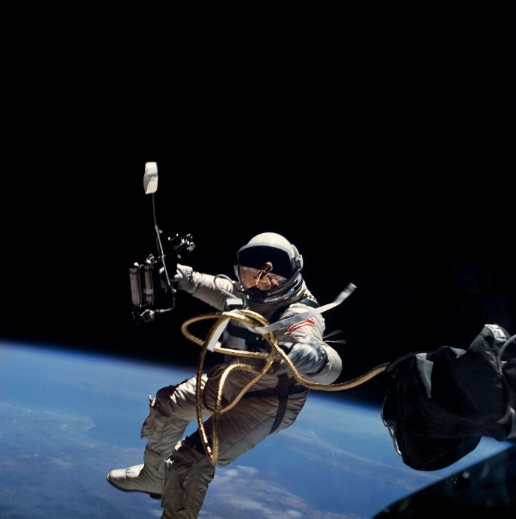
“Space 2030”: Four Pillars
Space Society: Refers to a society that carries out its core functions while making optimal use of space based technologies, applications and services
Space Accessibility: Equal and non-discriminatory access to outer space for all, regardless of a country’s scientific, technological and economic development
Space Diplomacy: Cooperation among nations in using space technologies and applications to address common challenges facing humanity to build constructive, knowledge-based partnerships.
Space Economy: Touches on topics including: space technologies and infrastructure, increasing awareness on the benefits of space economy for global sustainable development, addressing the economic rationale for space activities and potential for the cooperation of private and public entities.

Slide 11
Working Group on Capacity Building an Data Democracy
For Endorsement by the 2018 CEOS Plenary
TRAINING CALENDAR IMPLEMENTATION PLAN
CEOS WG Disasters
Recovery Observatory
GEO-DARMA

