Slide 1

NASA Overview
Committee on Earth Observation Satellites
NASA – Earth Science Division
CEOS Plenary 2018
Agenda Item # 4.3
Brussels, Belgium
17 – 18 October 2018

Slide 2


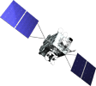


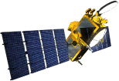


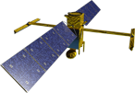


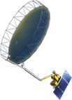




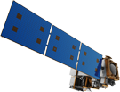


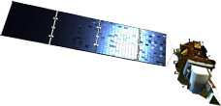

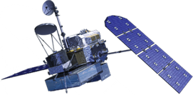

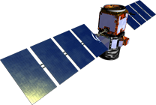

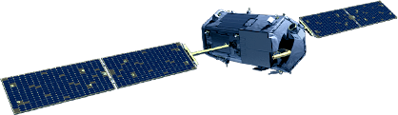
NASA Earth Science
Missions: Present through 2023
(no DS new starts or future
Venture Class shown)
PREFIRE (2) (TBD)
(Pre)Formulation
[PACE (2022)]
Implementation
GeoCARB (~2021)
Primary Ops
TROPICS (6) (~2021)
Extended Ops
MAIA (~2021)
Landsat 9 (2020)
Sentinel-6A/B (2020, 2025)
ISS Instruments
LIS (2020), SAGE III (2020)
TSIS-1 (2018), ECOSTRESS (2018), OCO-3 (2019), GEDI (2019)
[CLARREO-PF (2020)], EMIT (TBD)
NI-SAR (2021)
SWOT (2021)
TEMPO (~2021)
InVEST/CubeSats
RAVAN (2016)
IceCube (2017)
MiRaTA (2017)
HARP (2018)
TEMPEST-D (2018)
RainCube (2018)
CubeRRT (2018)
CIRiS (2018*)
CSIM (2018)
* Target date,
not yet manifested
GRACE-FO (2) (2023)
ICESat-2 (2022)
NISTAR, EPIC
(DSCOVR / NOAA)
(2019)
CYGNSS (8) (2019)
JPSS-2 Instruments
OMPS-Limb (2019)
Suomi NPP (NOAA) (>2022)
SMAP
(>2022)
Landsat 7
(USGS) (~2022)
QuikSCAT (2018)
SORCE,
TCTE (NOAA) (2018)
Terra (>2021)
Landsat 8
(USGS) (>2022)
Aqua (>2022)
CloudSat (~2018)
GPM (>2022)
CALIPSO (>2022)
Aura (>2022)
OCO-2 (>2022)
OSTM/Jason-2 (NOAA) (>2022)
02.21.18
Notes:
Fleet - Earth Science Division - Missions (with color key; editable)
Jan. 16, 2018: Reformatted, includes all missions, dates and cube sats
Dec. 15, 2015
Credit: NASA/J. Mottar
------------------------------
SLIDE INFO
CORRECTION DENNING PER RIVERA Feb 18, 2016
Changed misspelling of “Sentinal” to “Sentinel”
UPDATE DENNING PER FREILICH DECISIONS FEB 12, 2016
Changed OCO-3 to Formulation color and moved lower in list
Changed RBI to Formulation color
Changed GEDI to Implementation color and moved to line above it
Added TSIS-2 in Formulation color
UPDATE DENNING PER FREILICH DECISIONS FEB 4, 2016
Changed “Altimetry FO (Formulation in FY16) to “Sentinal-6A/B”
On Landsat 9, removed comma and TIRFF
Change I was going to make – “NISTAR, EPIC (NOAA’s DSCOVR) to green primary ops was already corrected
Dec. 15, 2015 – Updated: TEMPO changed to Implementation phase; NISTAR, EPIC changed to Primary Ops phase; ; OCO-3 and ECOSTRESS changed to Implementation phase; Aquarius removed; slide now fully editable. JMottar
May 18, 2015 – Added to SMD Multimedia Library.
May 18, 2015 – Updated the outdated 2014 version: TRMM was removed; NISTAR, EPIC (NOAA's DSCOVR) were added; SMAP icon was updated; moon at top left was removed; color key moved to top left.-JMottar
ID: I-EA-15-0040 (image)
ID: SL-EA-15-0068 (slide)

Slide 3


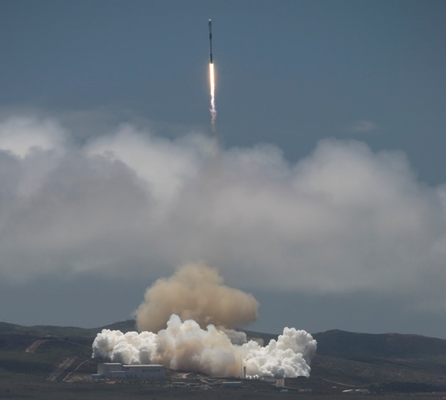
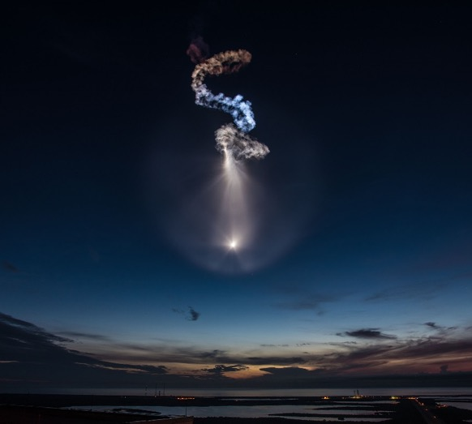
Recent and Near-Term Planned ESD Launches (1 of 2)
TSIS-1: DEC 15, 2017
GRACE-FO: May 22, 2018
ECOSTRESS: June 29, 2018
The Total and Spectral Solar Irradiance Sensor (TSIS-1) will measure the total amount of sunlight that falls on Earth, and how that light is distributed among the ultraviolet, visible and infrared wavelengths.
TSIS-1
GRACE-FO
Obtain high resolution global models of Earth's gravity field, including how it varies over time
ECOSTRESS
Provide insight into plant-water dynamics & how ecosystems change with climate via high spatiotemporal resolution thermal infrared radiometer measurements of evapotranspiration (ET)

Slide 4

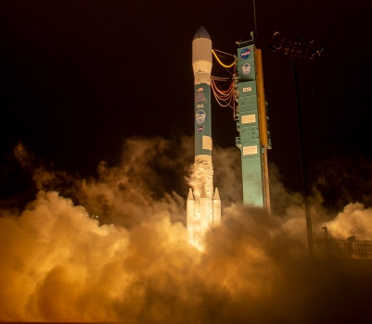
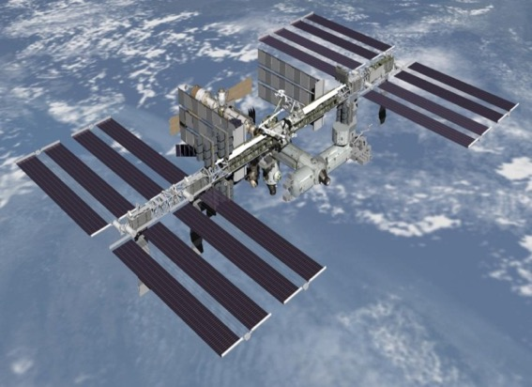

Recent and Near-Term Planned ESD Launches (2 of 2)
ICESat-2: Sep 15, 2018
GEDI
OCO-3
November 2018
February 2019
ICESat-2
Quantify polar ice-sheet contributions to sea-level change & measure vegetation canopy height as a basis for estimating large-scale biomass and biomass change
GEDI
Characterize the effects of changing climate and land use on ecosystem structure and dynamics, providing the first global, high-resolution observations of forest vertical structure
OCO-3
Investigate important questions about the distribution of carbon dioxide on Earth as it relates to growing urban populations and changing patterns of fossil fuel combustion.

Slide 5
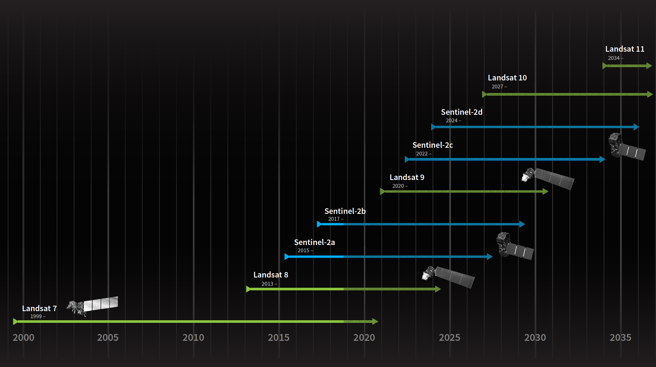
“Sustainable Land Imaging” – Moderate Resolution, Multi-Spectral
NASA, USGS, ESA, EC/Copernicus
CEOS LSI VC

Slide 6
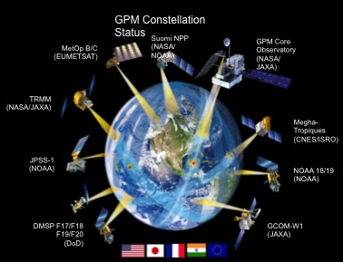
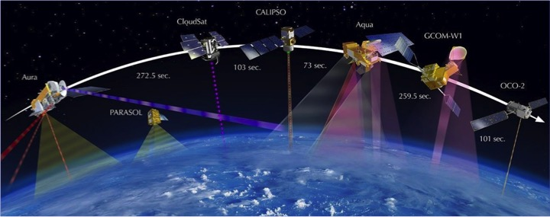
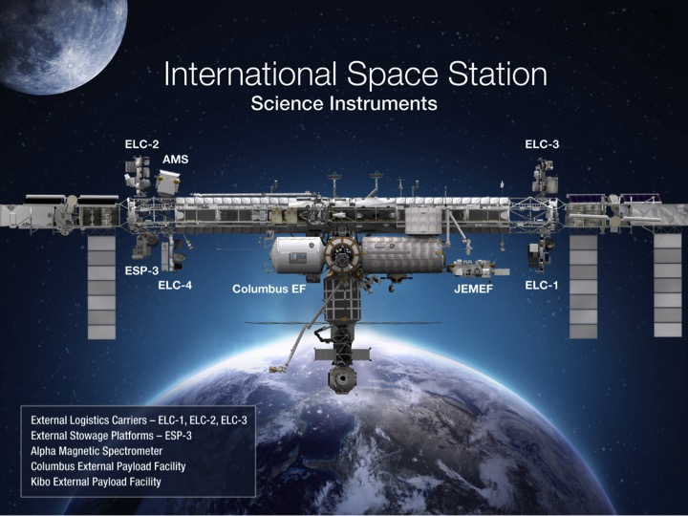
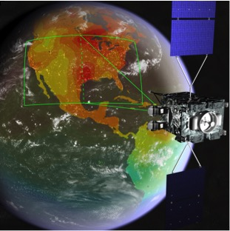
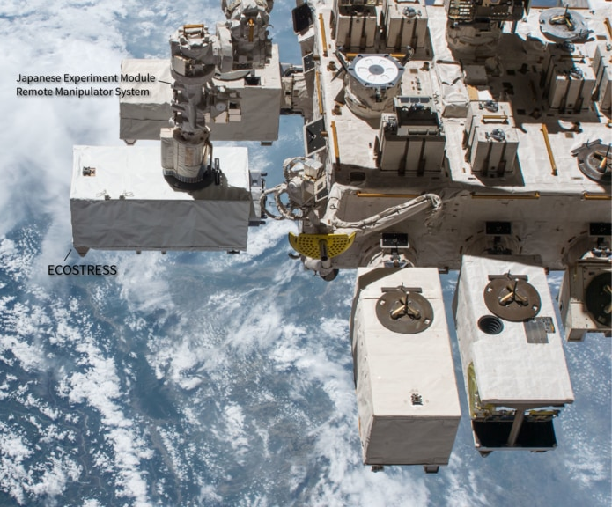
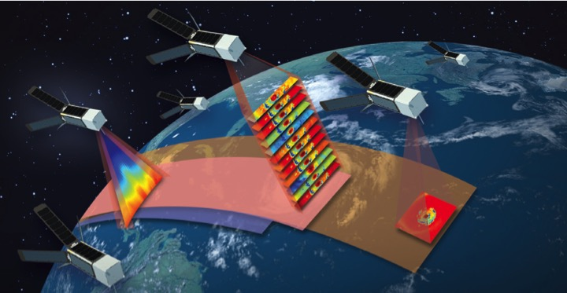
NASA Observing System INNOVATIONS

Slide 7
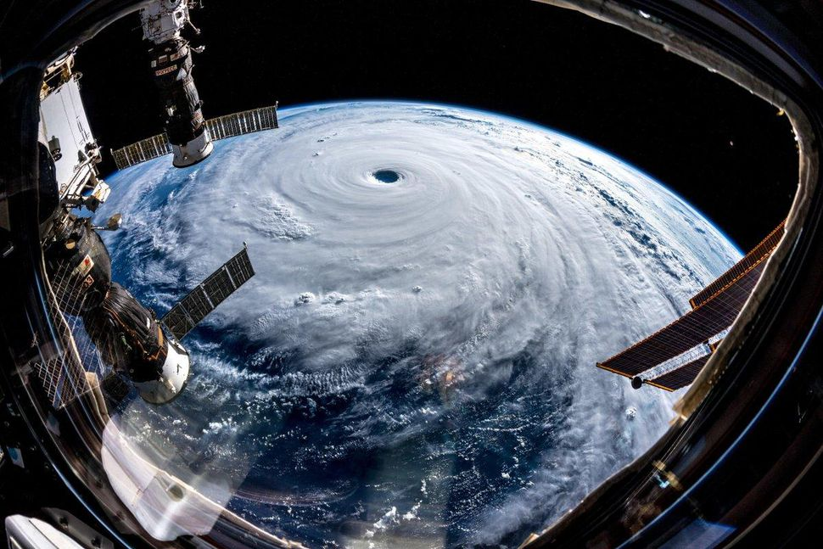
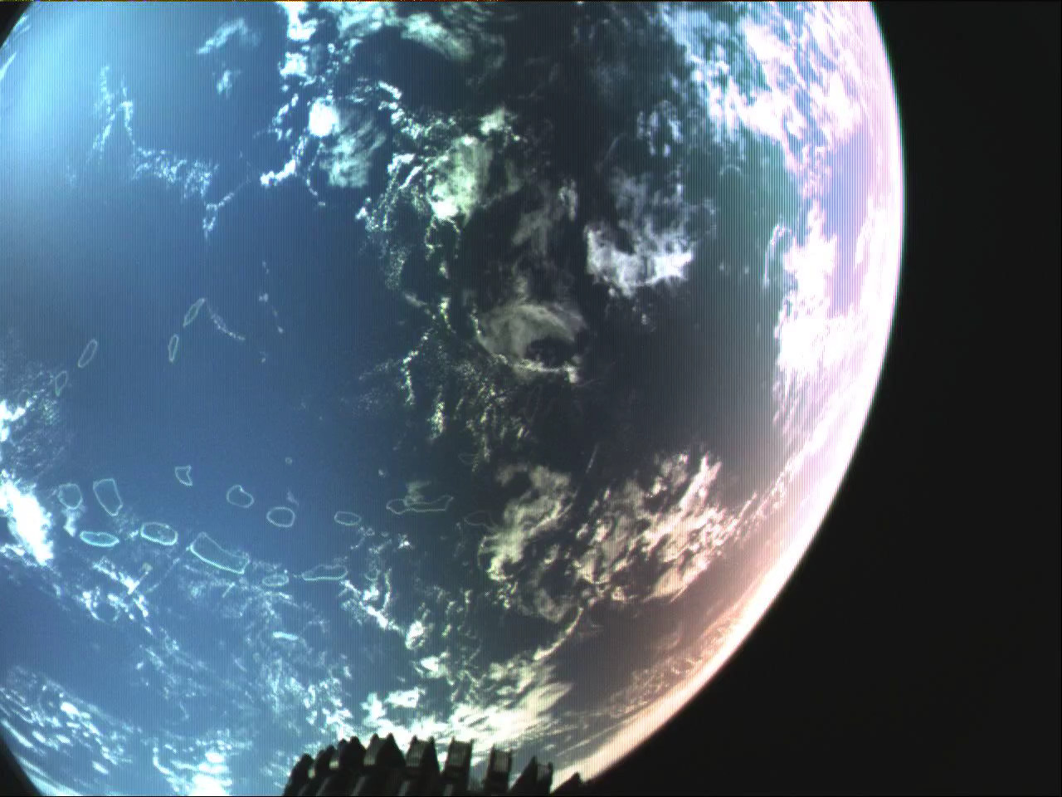
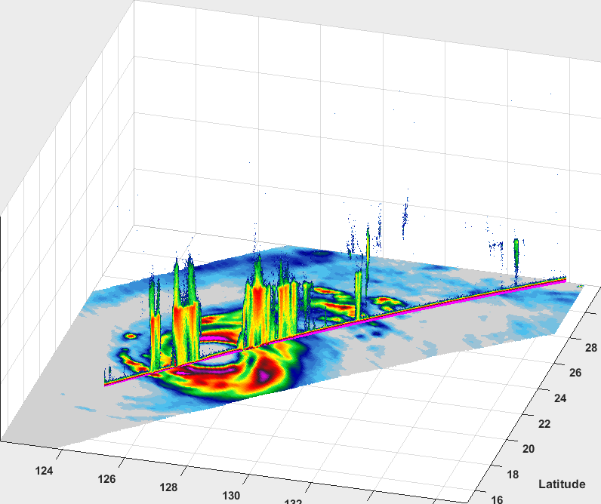
TEMPEST-D and RainCube
RainCube
0.5m mesh
antenna
deploy
September 28, 2018, TEMPEST-D and RainCube overflew Typhoon Trami < 5 minutes apart
RainCube nadir Ka-band reflectivity shown overlaid on TEMPEST-D 165 GHz brightness temperature illustrating complementary nature of these sensors in constellation for observing precipitation
Trami observed shortly after it had weakened from Cat 5 to Cat 2

Slide 8
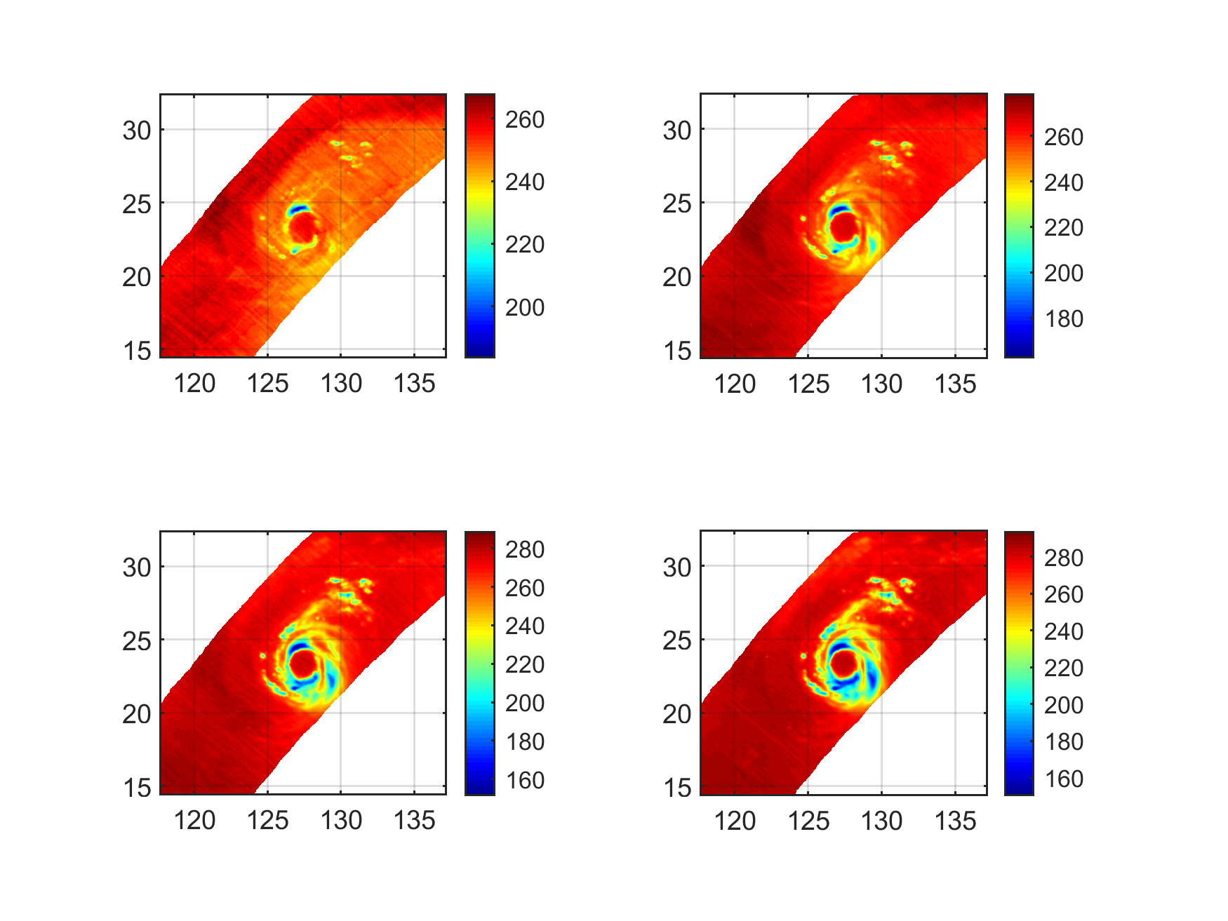
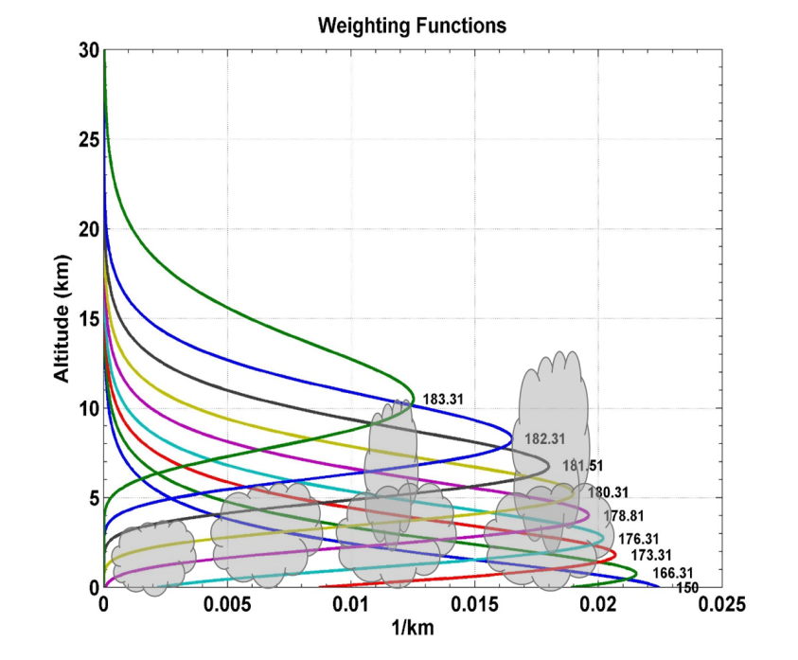
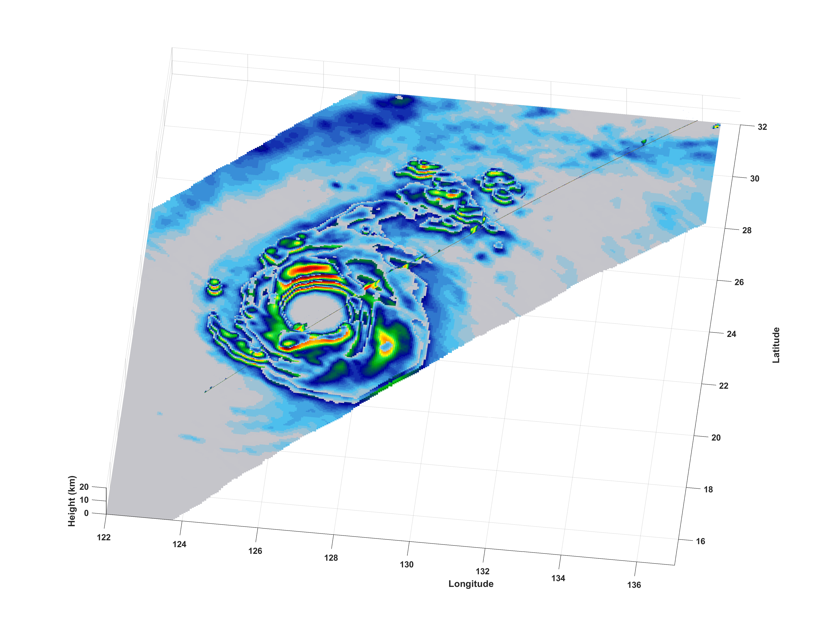
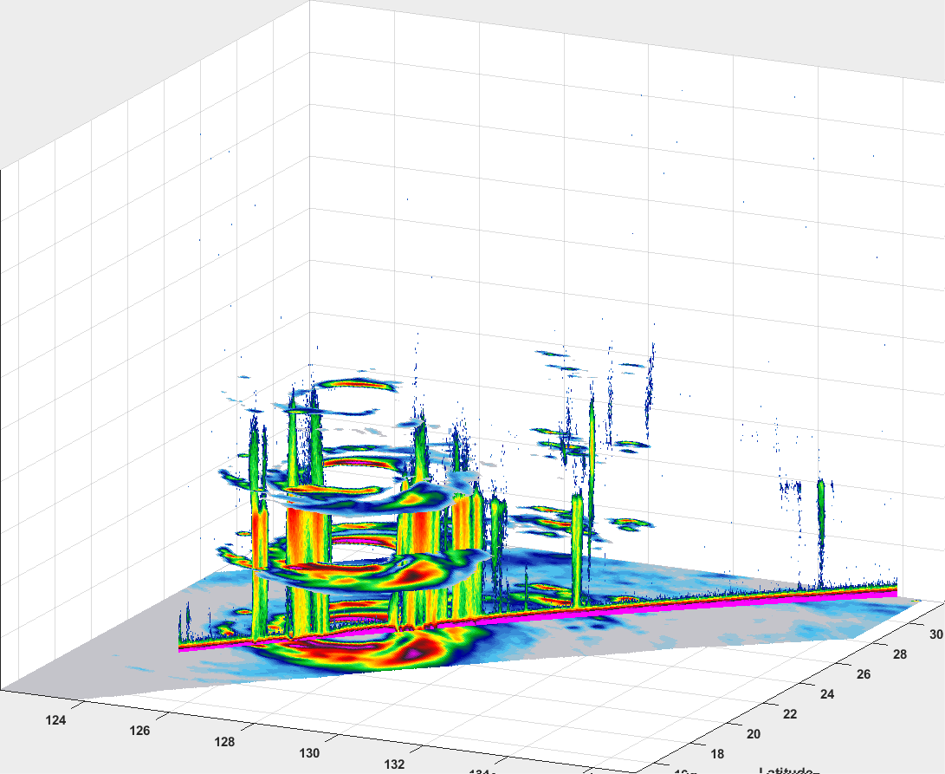
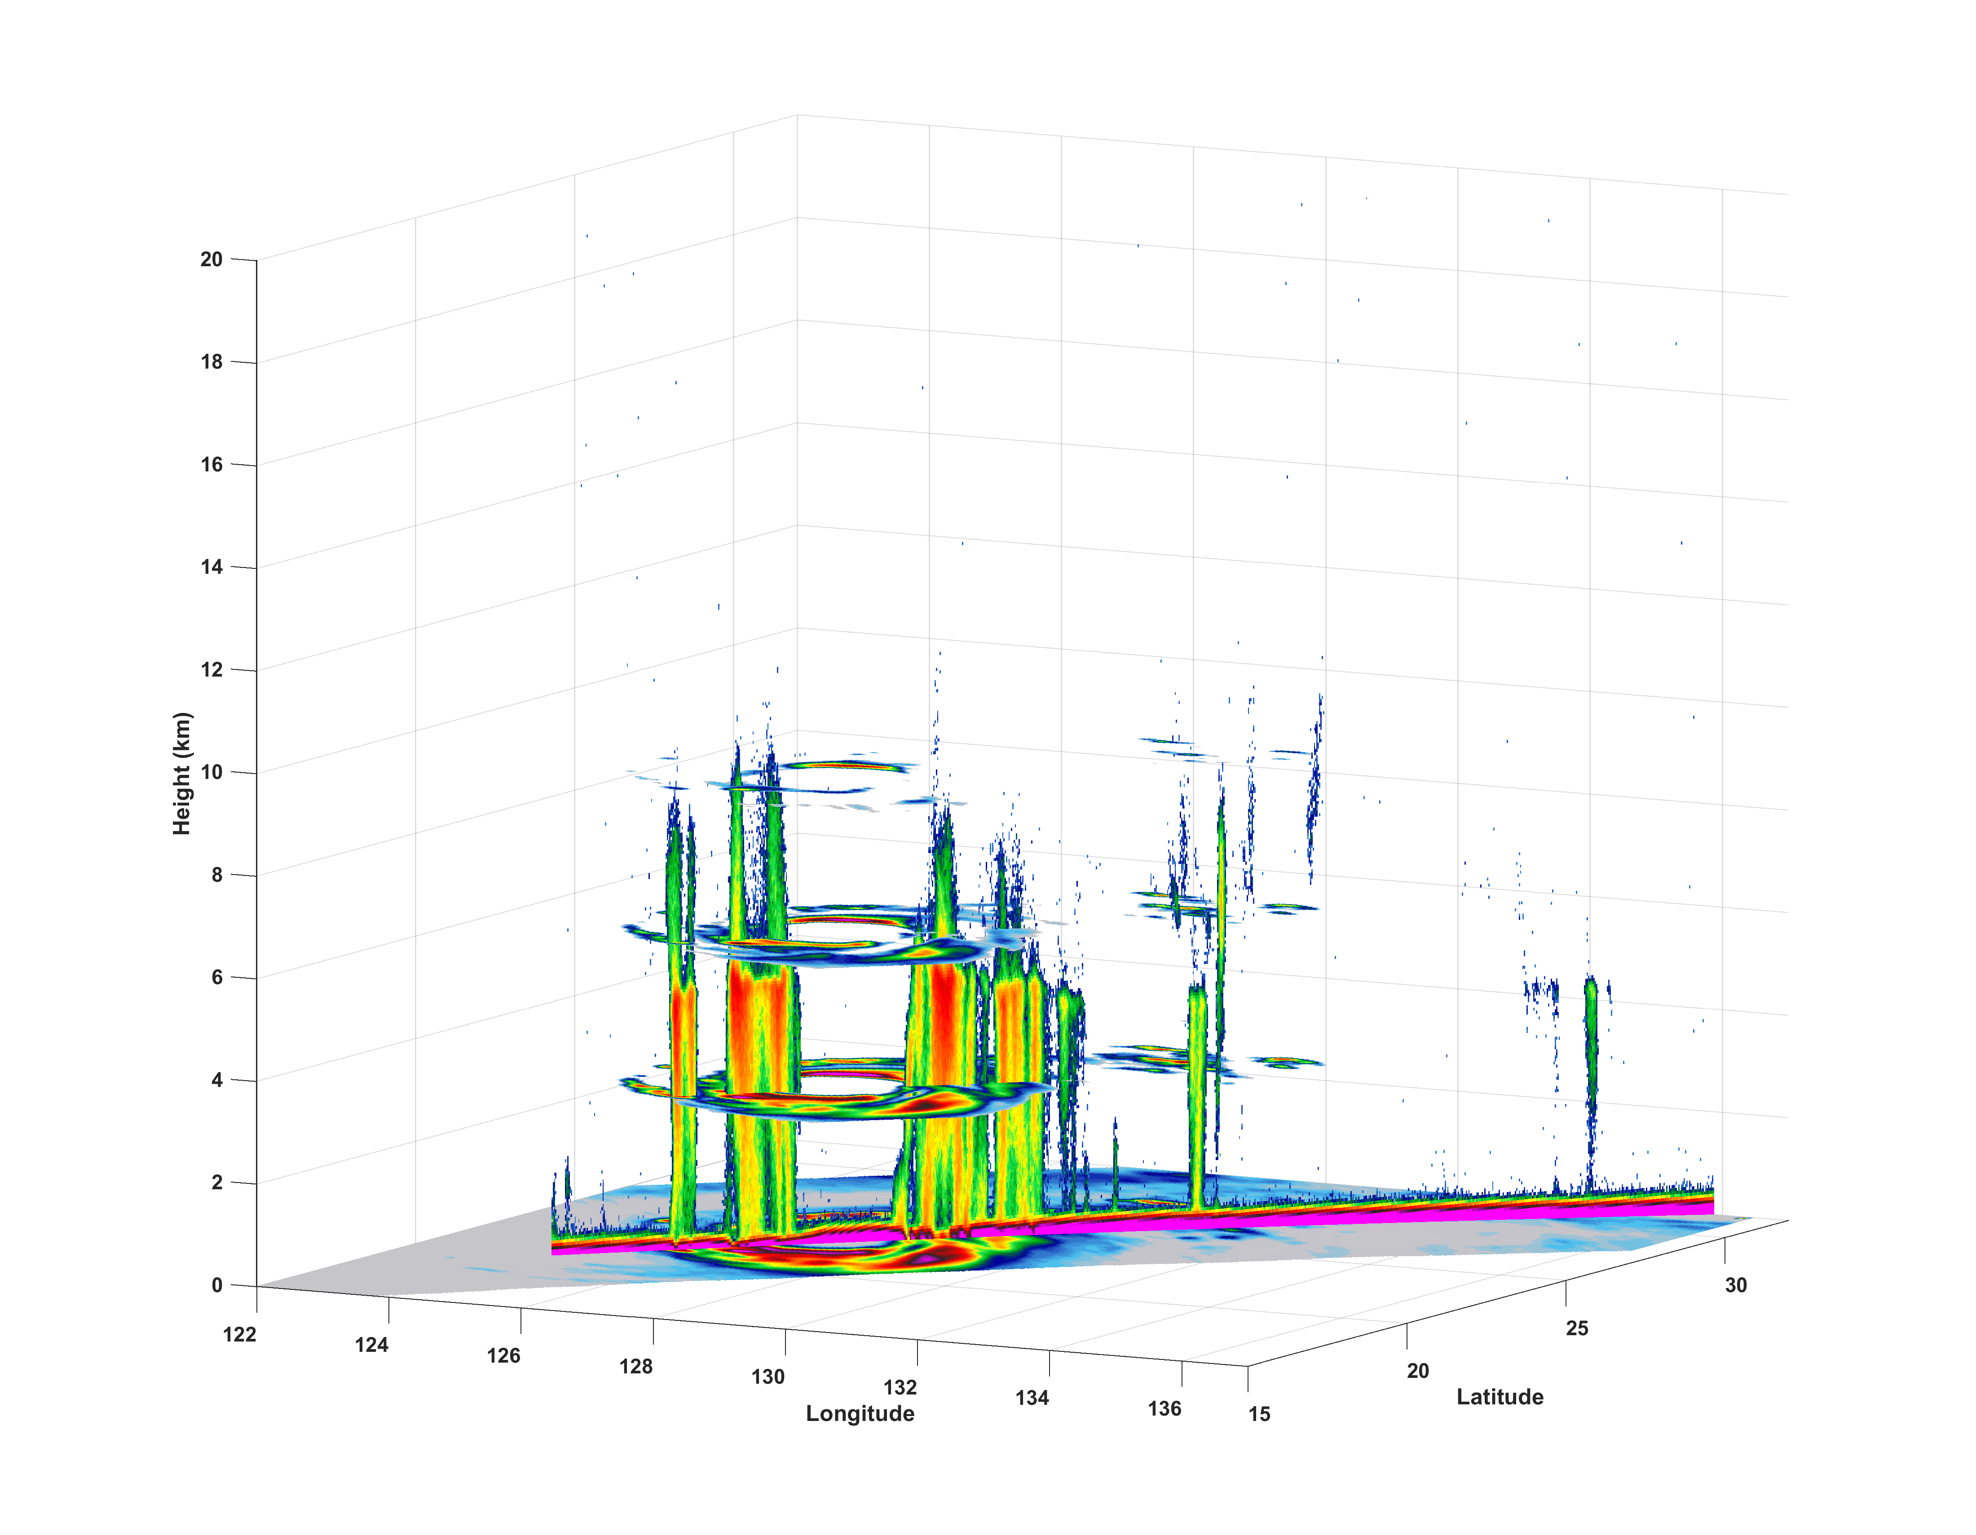
TEMPEST-D Sounding Channels provide 4 levels of vertical resolution to “slice” precipitation and compare with RainCube profile
Latitude
182 GHz
180 GHz
Longitude
176 GHz
165 GHz
Similar asymmetry observed in depth of eyewall convection between TEMPEST-D and RainCube (strongest on west side and to the south)

