Slide 1
Update on ESA Earth Observation Programmes
Josef Aschbacher, ESA
Director of Earth Observation Programmes
2018 CEOS Plenary
Agenda Item X.X
Brussels, Belgium
16 – 18 October 2018

Slide 2
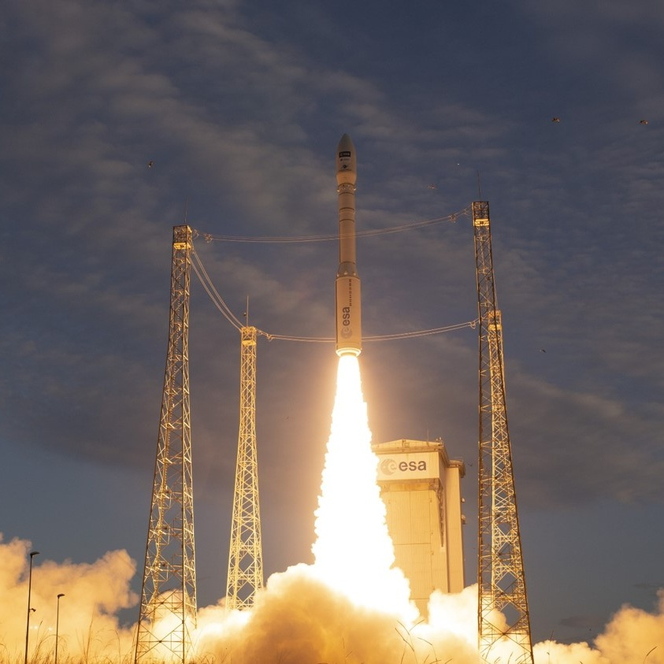
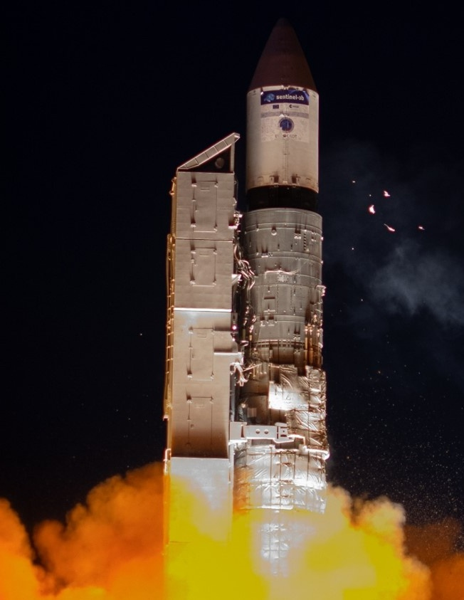

Sentinel-3B Launch
Aeolus Launch
Plesetzk
25 April 2018
Kourou
22 August 2018
MetOp-C Launch (planned)
Kourou
6 November 2016
Notes:
Sentinel-3B
The seventh Sentinel, Sentinel-3B, has been launched from Plesetzk on 25 April to form the third Sentinel pair in orbit together with its twin satellite Sentinel-3A. Following a perfect launch, an excellent separation from Breeze and a prompt signal acquisition from Kiruna, Sentinel-3B keeps performing very well in orbit.
Aeolus
First wind LIDAR– NWP impact
Laser switched on successfully!
Ingestion into NWP from early 2019

Slide 3
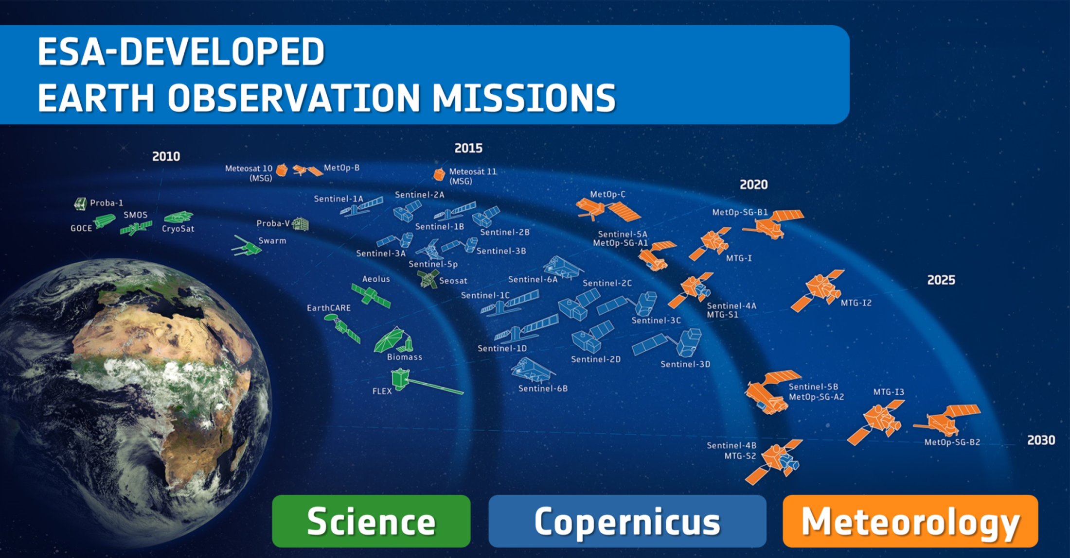
Satellites
26 under development
14 in operation
Notes:
D/EOP has three main lines of activities: Earth Science, Copernicus and Meteorology
Since the latest launch of Sentinel-5P on 13 Oct. 2017, we have 26 satellites in development and 13 satellites in operation.

Slide 4
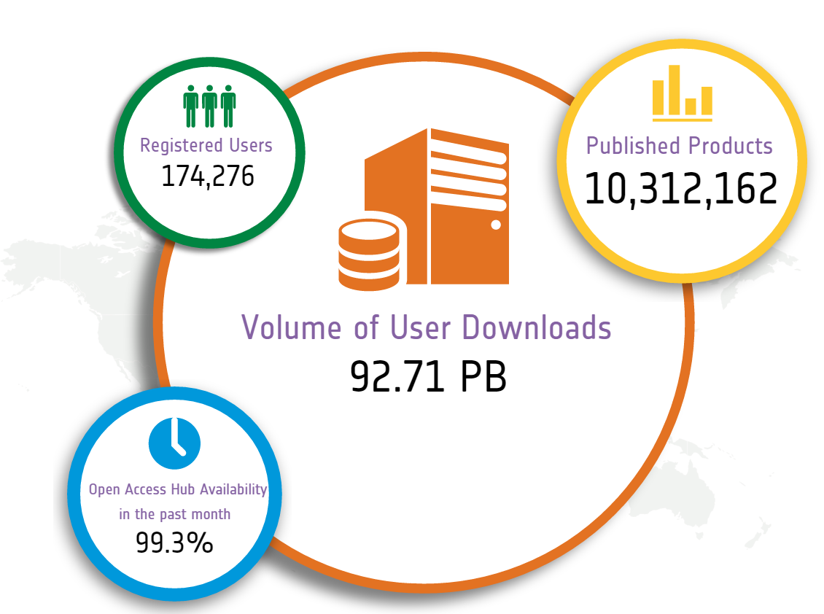

Sentinel Open Access Data Hub
Statistics on
9 Oct. 2018
scihub.copernicus.eu

Slide 5
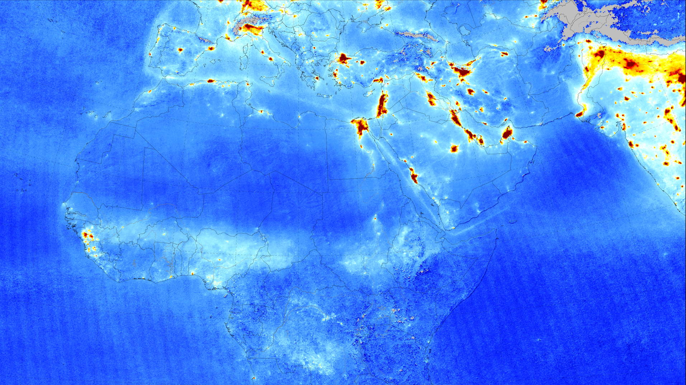
Nitrogen Dioxide from Sentinel-5P
April 2018 average
© KNMI / NSO
Notes:
Sentinel-5P tropospheric nitrogen dioxide measurements over Europe, Africa, Middle East, and India from April 2018 (averaged) are shown here.
Air pollution emitted by big cities and shipping lanes is clearly visible.
Launched in October 2017, Sentinel-5P is part of a fleet of satellites central to Copernicus, Europe’s environmental monitoring programme.
With a resolution of up to 7 x 3.5 km, Sentinel-5P’s Tropomi instrument can detect air pollution over individual cities.
Tropomi also has the capacity to locate where pollutants are being emitted, effectively identifying pollution hotspots.

Slide 6
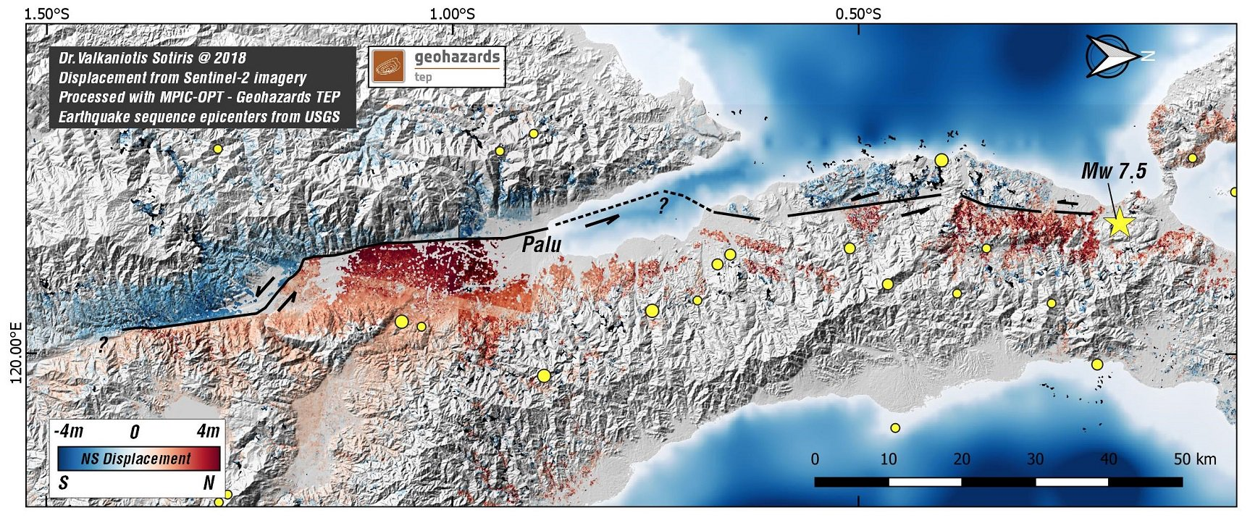
Palu Earthquake
Based upon Sentinel-2 data - October 2018
Notes:
This image / map based upon Sentinel-2 data show the horizontal displacement around the town of Palu, on the Indonesian Island of Sulawesi
The displacement is a result from the Earthquake that hit the island on 2 October 2018
The red areas on the map, below the black fault line, have shifted northwards (right is north on this map)
The blue areas, above the black line, have shifted southwards, at some parts up to 4 meters
The resulting energy of this shifting land caused a tsunami that killed thousands of people and destructed many parts of the coastline towns and villages of the island
The map is a product of the TEP geohazards

Slide 7
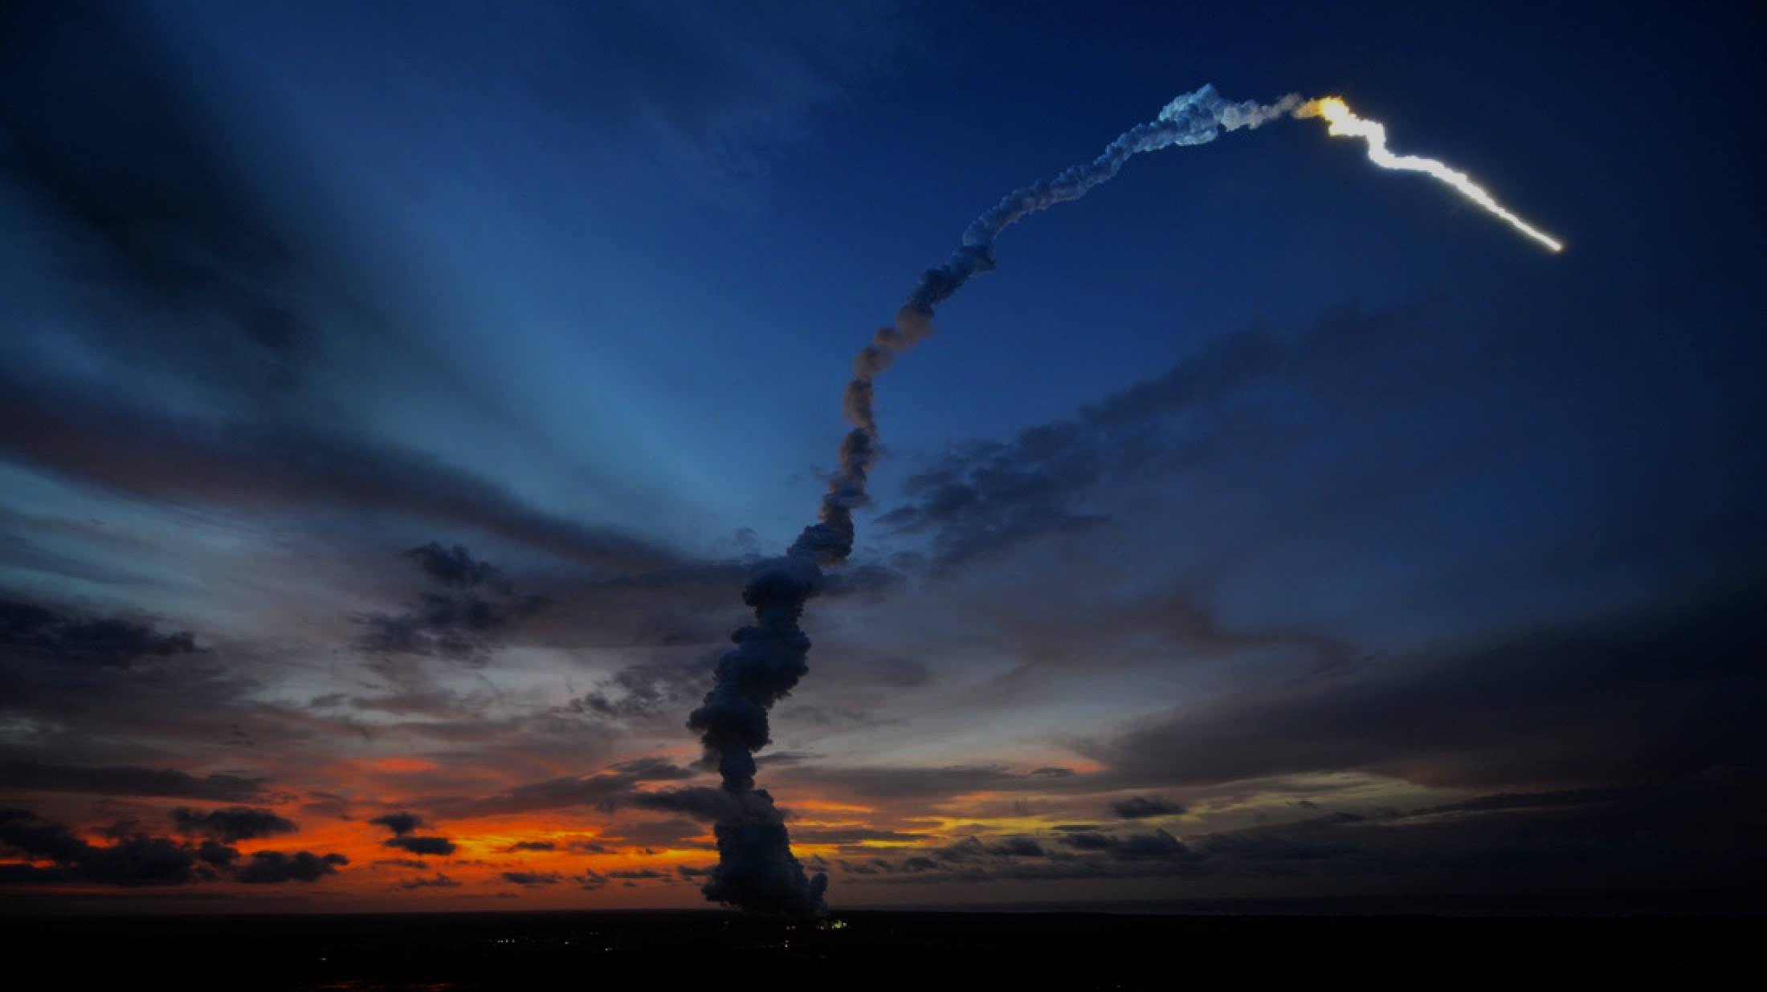
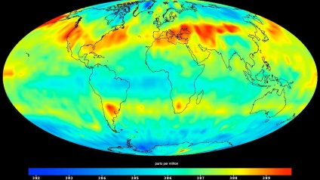
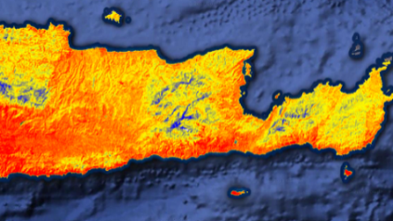
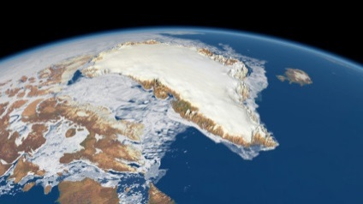
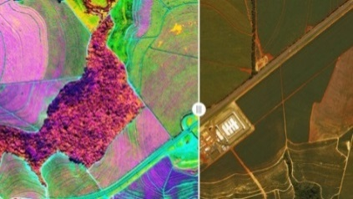
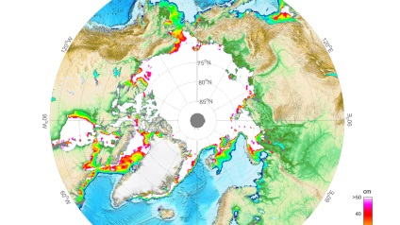
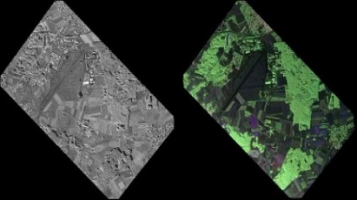
Operational EO: Copernicus 2.0
6 High Priority Candidate Missions
 | Anthropogenic CO₂ Imaging Spectrometer |  | High Resolution Surface Temp.
 | Polar Ice & Snow Topography |  | Hyperspectral Imaging
 | Passive Microwave Imaging |  | L-band SAR
 | Monitor causes of Climate Change (CO₂ emissions) |  | Agriculture & Water Productivity
 | Monitor effects of Climate Change (Arctic/Polar ice volume) |  | Food Security, Soil & Minerals, Forestry, Biodiversity
 | Sea Ice Conc. & SST (Arctic sit. awareness) |  | Soil Moisture, Vegetation & Ground Motion
Notes:
Kick-Off & Progress
Potential Sentinel expansion system study activities initiated
End-to-end performance simulation campaigns
Scientific studies in support of mission requirements definition
Pre-developments of most critical technologies.
Copernicus Long Term Scenario
20 new spacecraft
6 new mission domains: CO₂ imaging spectrometry, thermal / hyperspectral / microwave imaging, etc.
Integration of NewSpace and national mission data
Sophisticated, operational data access
Cost Estimate for Space: 8 Bn Euro (EU MFF + ESA CM)
CM19 proposal: 1,4 bn Euro (+0,6 bn at CM22/25)

Slide 8

New EO Challenges and Trends
From 20 to 80 EO satellite Launches per Year worldwide
Copernicus revolutionises EO
Daily EO dataflow in TB
Archives entering PB era
New Players and Innovation Approaches in EO
Non-space players
AI, IoT, HAPS, nanosat etc.
Notes:
The rough increased launch figure refers to all EO missions with a mass >50 kg, excluding meteo, and is based upon the Euroconsult data of 2017. The transition is occurring right now: roughly between 2015 and 2020.
For Copernicus alone, the daily data generated is approximately 15TB, and the daily data circulated 150TB. As this dataflow increases and accumulated in the archives, the total data stored in the ESA archive is entering the PB era. In 2018 +- 20 TB of EO data is stored, by 2026, this figures will have increased five-fold as it surpassed the 100 PB mark.

Slide 9
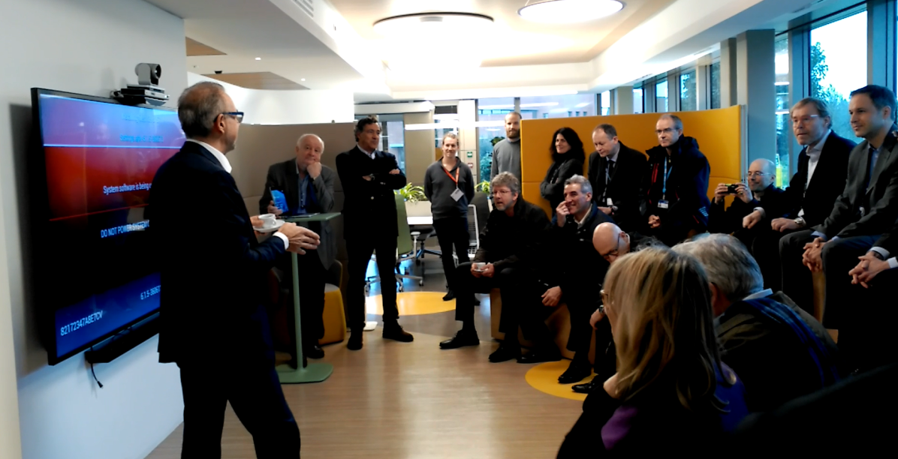


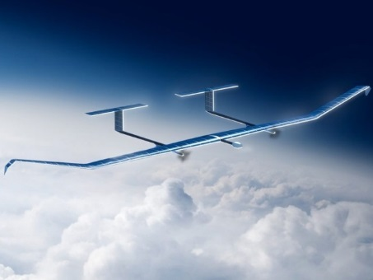
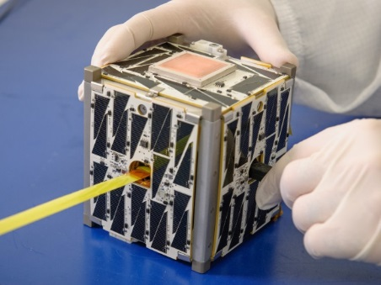
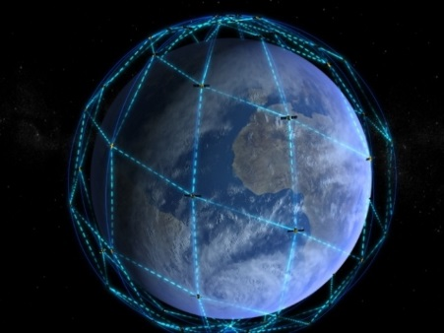

Φ-lab as Catalyst
“Introducing disruptive innovation into European EO”
HAPS
NanoSats
Mega-constellations
AI for EO

Slide 10
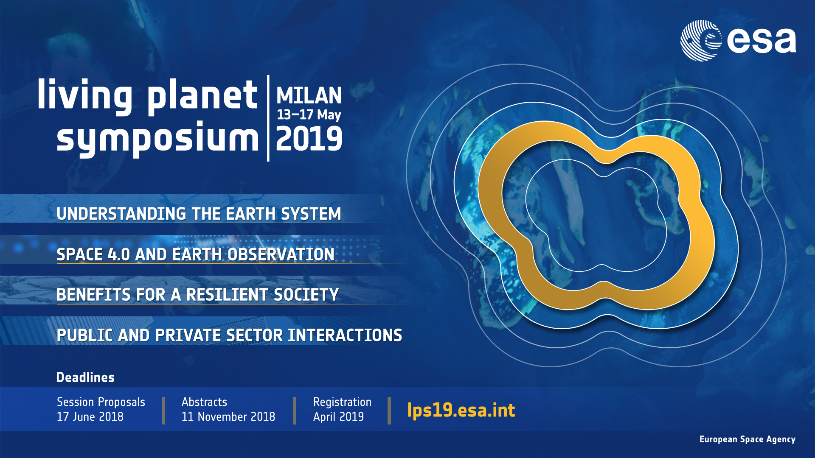

Slide 11
Thank you for your attention!
www.esa.int
@AschbacherJosef

