Slide 1
Update on ESA Earth Observation Programmes
Josef Aschbacher, ESA
Director of Earth Observation Programmes
2018 CEOS Plenary
Agenda Item X.X
Brussels, Belgium
16 – 18 October 2018

Slide 2
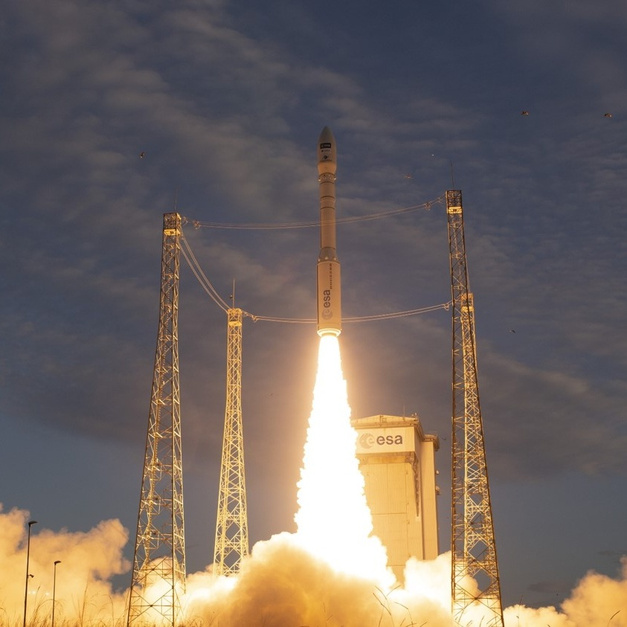
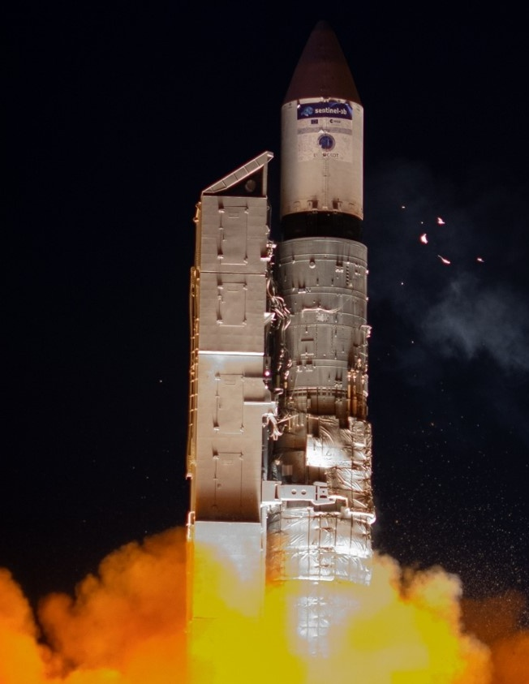
Sentinel-3B Launch
Aeolus Launch
Plesetzk
25 April 2018
Kourou
22 August 2018
MetOp-C Launch (planned)
Kourou
6 November 2016
Notes:
Sentinel-3B
The seventh Sentinel, Sentinel-3B, has been launched from Plesetzk on 25 April to form the third Sentinel pair in orbit together with its twin satellite Sentinel-3A. Following a perfect launch, an excellent separation from Breeze and a prompt signal acquisition from Kiruna, Sentinel-3B keeps performing very well in orbit.
Aeolus
First wind LIDAR– NWP impact
Laser switched on successfully!
Ingestion into NWP from early 2019

Slide 3
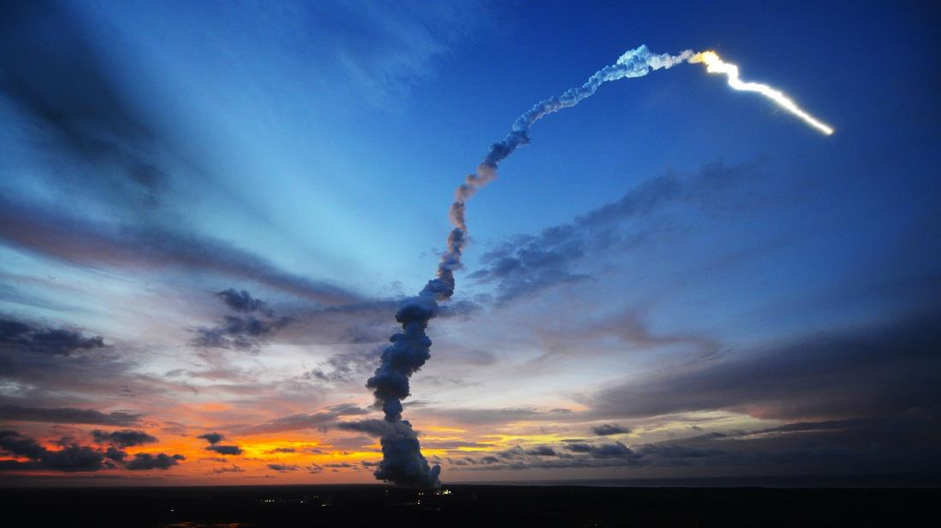
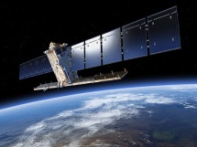
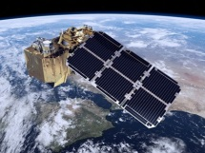
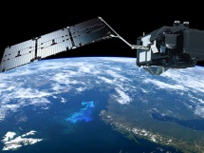
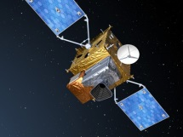
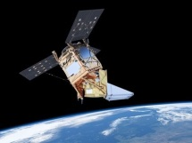
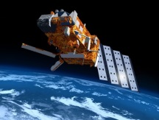
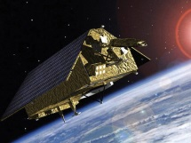
Sentinel Status
S-1
S-2
S-3
S-4
S-5P
S-5
S-6
Radar
High Res. Optical
Medium Res. Optical & Altimetry
Atmospheric Chemistry (GEO)
Atmospheric Chemistry (LEO)
Atmospheric Chemistry (LEO)
Altimetry
A
3 Apr. 2014
A
23 Jun. 2015
A
16 Feb. 2016
A
2022
A
13 Oct. 2017
A
2021
A
2020
B
25 Apr. 2016
B
6 Mar. 2017
B
25 Apr. 2018
B
2027
B
2027
B
2025
C
2022/23
C
2022/23
C
2023
C
> 2027
D
> 2022/23
D
> 2022/23
D
> 2023
Notes:
Green = launched
Blue = under development / to be developed

Slide 4
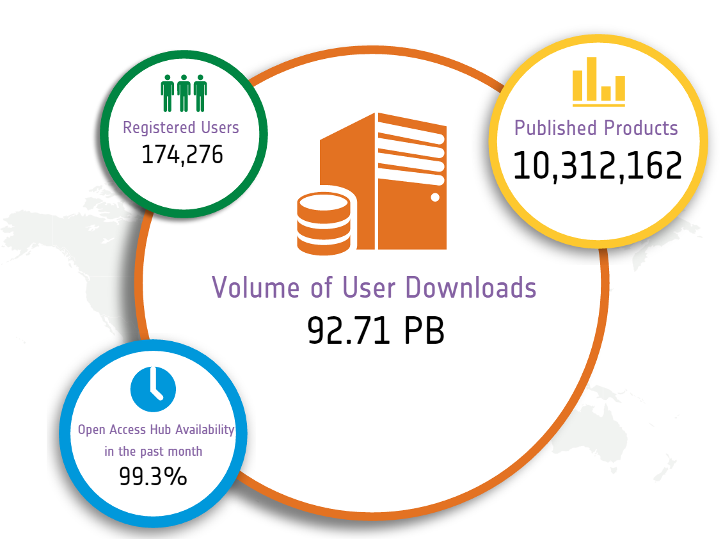
Sentinel Open Access Data Hub
Statistics on
9 Oct. 2018
scihub.copernicus.eu

Slide 5
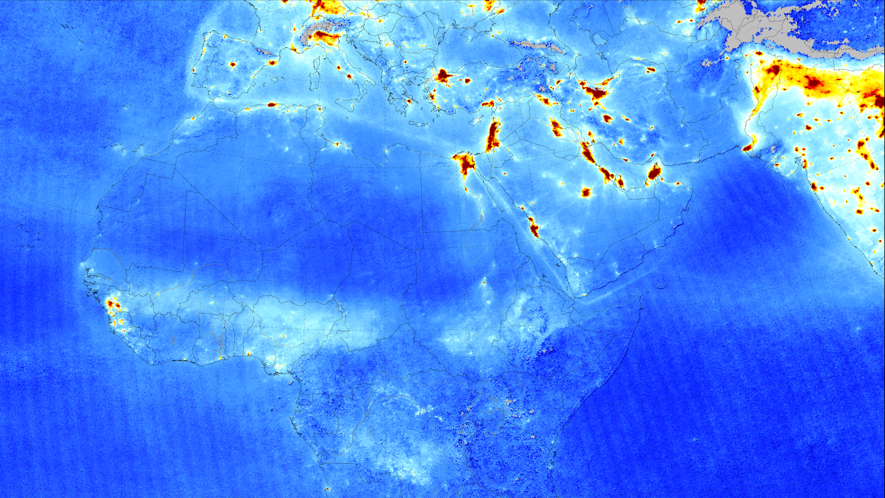
Nitrogen Dioxide from Sentinel-5P
April 2018 average
© KNMI / NSO
Notes:
Sentinel-5P tropospheric nitrogen dioxide measurements over Europe, Africa, Middle East, and India from April 2018 (averaged) are shown here.
Air pollution emitted by big cities and shipping lanes is clearly visible.
Launched in October 2017, Sentinel-5P is part of a fleet of satellites central to Copernicus, Europe’s environmental monitoring programme.
With a resolution of up to 7 x 3.5 km, Sentinel-5P’s Tropomi instrument can detect air pollution over individual cities.
Tropomi also has the capacity to locate where pollutants are being emitted, effectively identifying pollution hotspots.

Slide 6
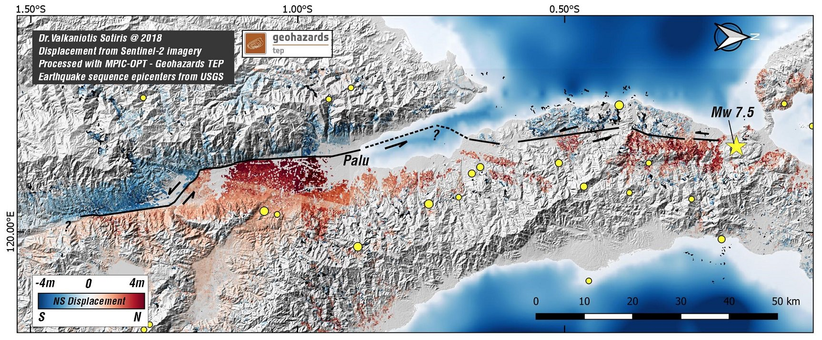
Palu Earthquake
Based upon Sentinel-2 data - October 2018
Notes:
This image / map based upon Sentinel-2 data show the horizontal displacement around the town of Palu, on the Indonesian Island of Sulawesi
The displacement is a result from the Earthquake that hit the island on 2 October 2018
The red areas on the map, below the black fault line, have shifted northwards (right is north on this map)
The blue areas, above the black line, have shifted southwards, at some parts up to 4 meters
The resulting energy of this shifting land caused a tsunami that killed thousands of people and destructed many parts of the coastline towns and villages of the island
The map is a product of the TEP geohazards

Slide 7
Antarctica Ice Melting Impact
Ice Loss (billion tonnes per year)
 | 1990s | 2010s
West-Antarctic | 53±29 | 159±26
Antarctic Peninsula | 7±13 | 33±16
© Nature June 2018

Slide 8
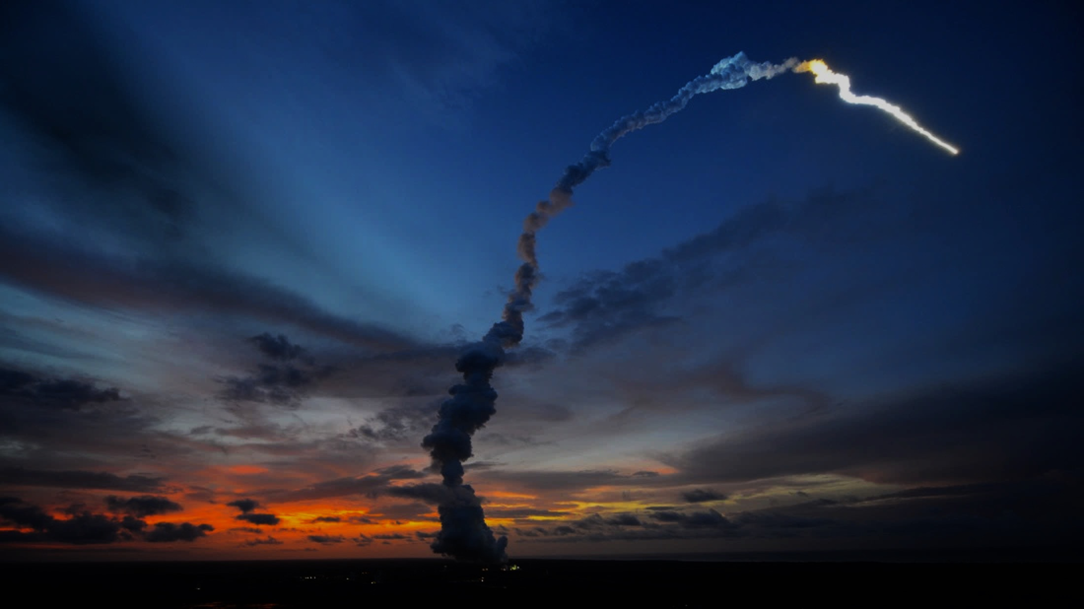
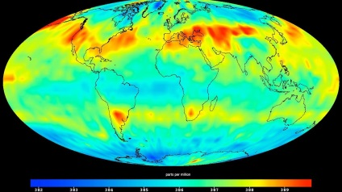
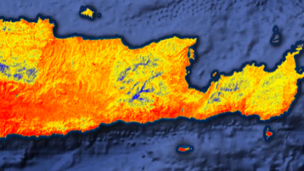
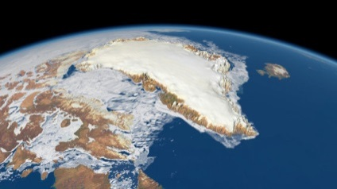
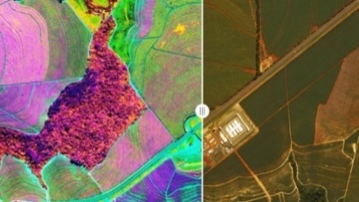
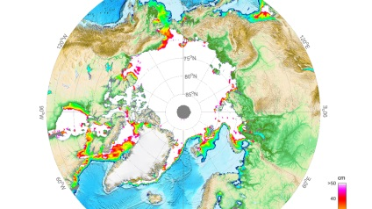
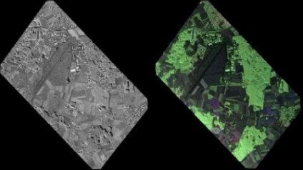
Operational EO: Copernicus 2.0
6 High Priority Candidate Missions
 | Anthropogenic CO₂ Imaging Spectrometer |  | High Resolution Surface Temp.
 | Polar Ice & Snow Topography |  | Hyperspectral Imaging
 | Passive Microwave Imaging |  | L-band SAR
 | Monitor causes of Climate Change (CO₂ emissions) |  | Agriculture & Water Productivity
 | Monitor effects of Climate Change (Arctic/Polar ice volume) |  | Food Security, Soil & Minerals, Forestry, Biodiversity
 | Sea Ice Conc. & SST (Arctic sit. awareness) |  | Soil Moisture, Vegetation & Ground Motion
Notes:
Kick-Off & Progress
Potential Sentinel expansion system study activities initiated
End-to-end performance simulation campaigns
Scientific studies in support of mission requirements definition
Pre-developments of most critical technologies.
Copernicus Long Term Scenario
20 new spacecraft
6 new mission domains: CO₂ imaging spectrometry, thermal / hyperspectral / microwave imaging, etc.
Integration of NewSpace and national mission data
Sophisticated, operational data access
Cost Estimate for Space: 8 Bn Euro (EU MFF + ESA CM)
CM19 proposal: 1,4 bn Euro (+0,6 bn at CM22/25)

Slide 9
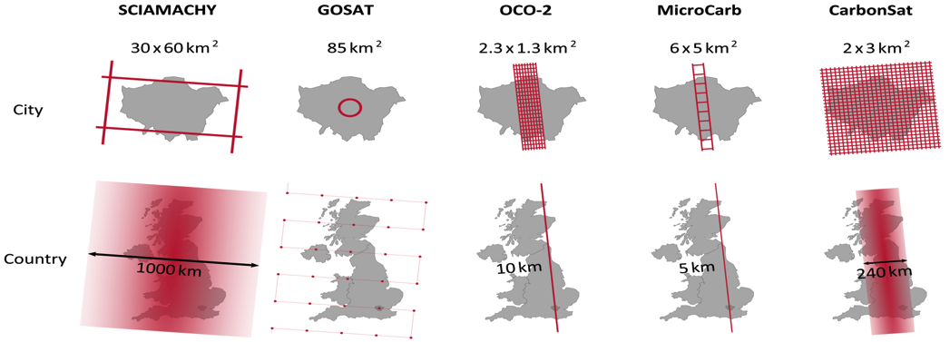
Future CO₂ Monitoring: Sentinel Expansion
Designed to measure anthropogenic CO₂ emissions
4 km² spatial sampling
Global coverage - revisit
time 2-3 days @40°N
XCO2 precision 0.5 – 0.7 ppm
Systematic bias < 0.5 ppm
CO₂M
2x2 km²
Notes:
To this effect, ESA is currently working with the EC on a CO2 monitoring capability as part of the Sentinel Expansion of Copernicus.
Auxiliary Data through NO2:
In addition, there will be use of NO2 plumes measurements as auxiliary data
These NO2 measurements of plume location, height will help to correct for inversion of wind field
This will yield more and better CO2 emission estimates
NO2 requirements:
Spatial sampling 4km2 (same as for CO2)
NO2 precision: 1-2.10^15 molecules / cm2
+ Multi-angle polarimeter for light path correction
+ Cloud imaging

Slide 10
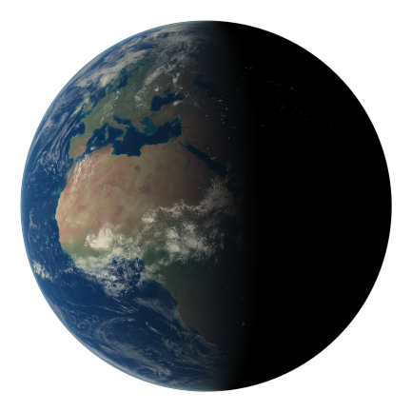
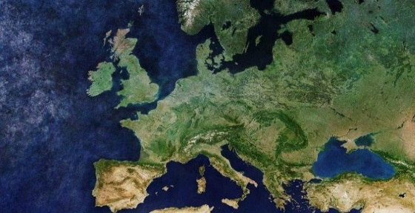
ESA’s Vision for Earth Observation
World-Class space missions for Earth Science
Outstanding Operational Planetary Monitoring and Weather
EO Europe
2040
Boost EO Capabilities
in Member States
EO for Societal Needs & European Innovation
Notes:
ESA’s Role:
By preparing, developing and exploiting the promising EO architectures, technologies & missions of tomorrow
By aligning user needs and a roadmap based upon structured dialogue with European EO stakeholders

Slide 11
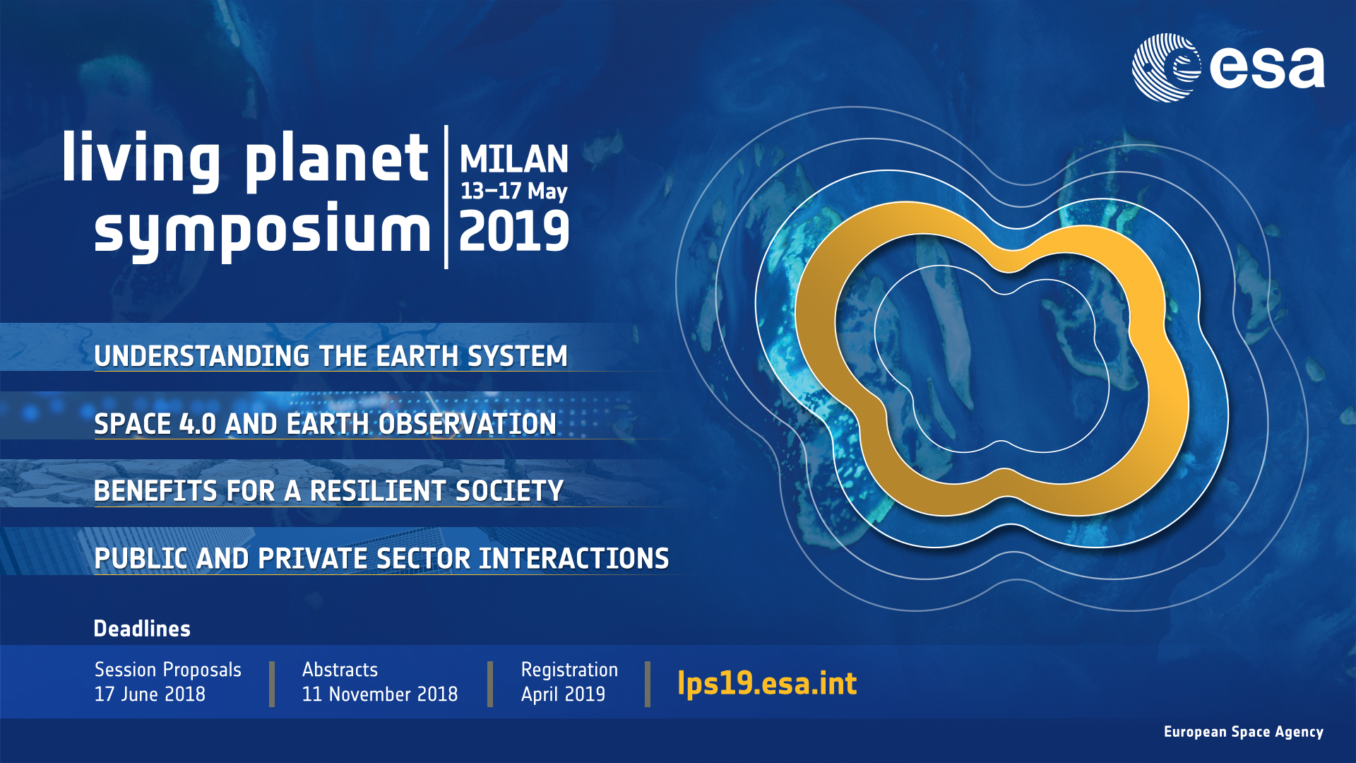

Slide 12
Thank you for your attention!
www.esa.int
@AschbacherJosef

