Slide 1

Agency Updates - DLR
K. Schmidt
Committee on Earth Observation Satellites
DLR, German Space Administration
CEOS Plenary 2018
Agenda Item 4.3
Brussels, Belgium
17 – 18 October 2018

Slide 2
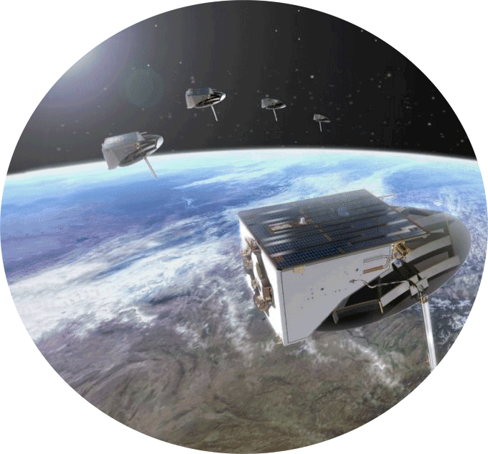

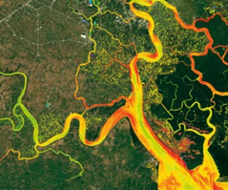
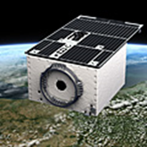
German EO Strategy
Roadmap to sustainable services
DLR.de • c hart 2
transfer into operational use and sustained user funding
set-up of partnerships
for service operations
best science & value-added products for applications in collaboration with users
mission development and operations based on sustained requirements and mature technologies

Slide 3


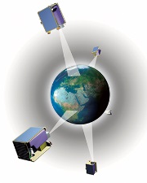



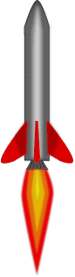
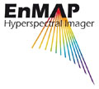


DLR.de • chart 3
German EO Missions
In Operation
RapidEye @ Planet
TET-1
BIROS
TerraSAR-X
TanDEM-X
DESIS@ISS
GRACE FO
2005
2010
2015
2020
2025
In Development
Planned
EnMAP
HRWS
METimage
MERLIN
Tandem-L

Slide 4
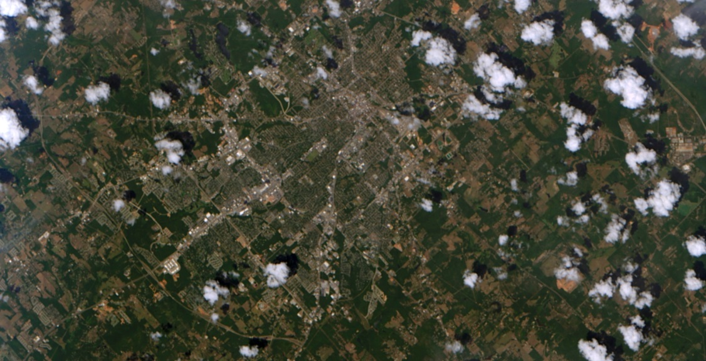
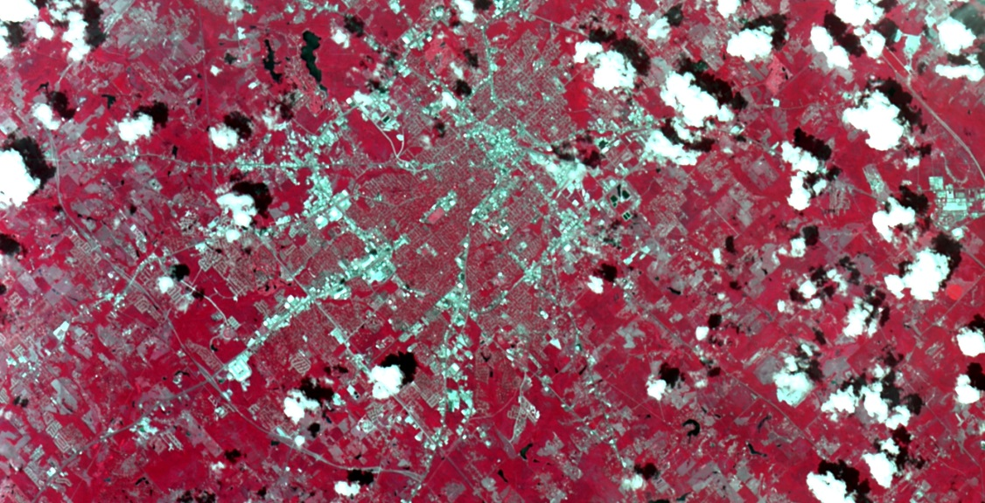
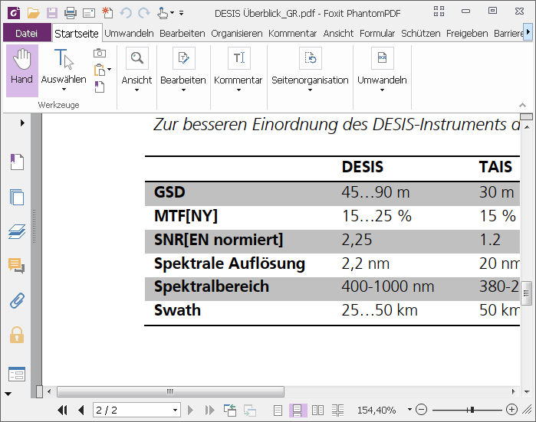
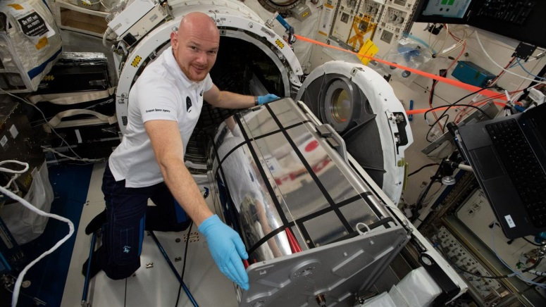
German Hyperspectral Instrument DESIS on ISS starts operations
https://www.dlr.de/dlr/en/desktopdefault.aspx/tabid-10081/151_read-30091/year-all/#/gallery/32211
DESIS: DLR Earth Sensing Imaging Spectrometer
Project by DLR Institute for Optical Sensor systems (OS) and Earth Observations Centers (EOC) with US-company Teledyne Brown Engineering
Development together with Fraunhofer Institute for Applied Optics and Precision Engineering Jena
Launch to ISS on 29.6.2018, Installation on MUSES platform on 27.8.2018
Scientific Data rights with DLR, commercial Data rights with Teledyne Brown Engineering.
ISS/DESIS:Tyler/Texas, 30.8.18, :upper photo typical RGB-channels,
lower: RGB channels with NIR-Band for amplification if vegetation
Alexander Gerst unwrapped DESIS and
prepared robotical installation on the
MUSES platform

Slide 5
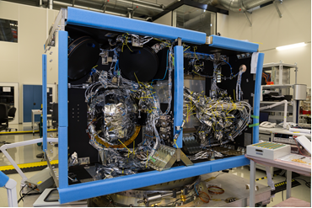
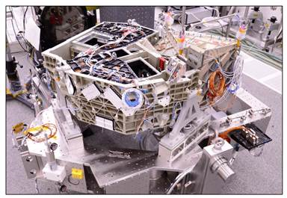
EnMAP – the German Hyperspectral Satellite
The Environmental Mapping and Analysis Program
  will provide accurate, quantitative information of the state and
  evolution of ecosystems
  is an imaging pushbroom hyperspectral sensor with a GSD of 30 m
  and 228 channels covering the spectral range from 420 to 2450 nm
EnMAP Status
  Phase D
  EnMAP Platform is in final integration
  Hyperspectral Instrument:
    Teleskop finished
    VNIR und SWIR Spektrometer: finished
    VNIR und SWIR Kamera: good progress
    Environmental test campaign early 2019
  Launch planned for end of 2020
  http://www.enmap.org/index.html
EnMAP Platform during electr. Integration
Integration status of EnMAP Instrument

Slide 6
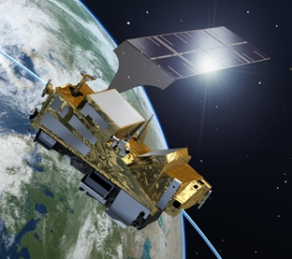
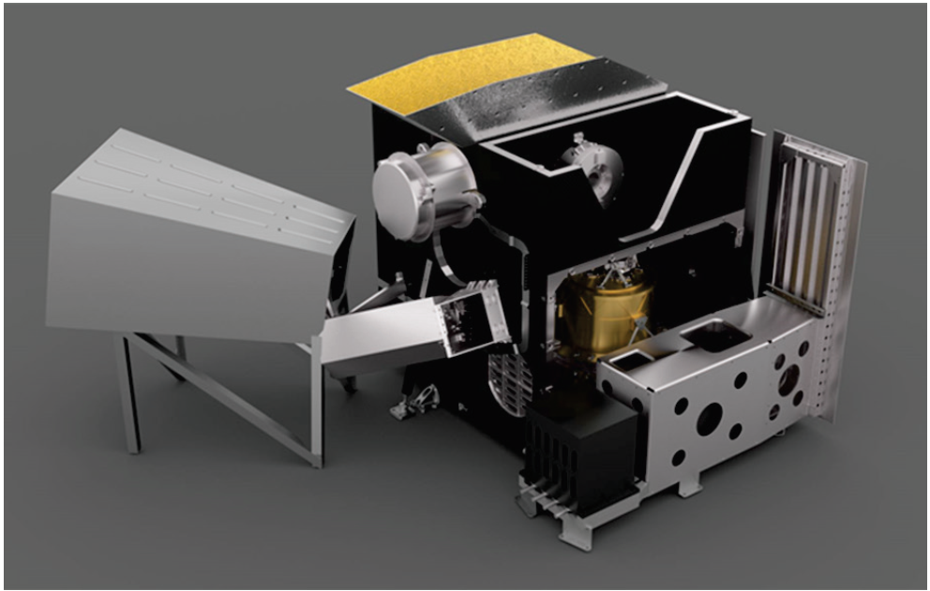

The METimage Mission
METimage is the Visible/Infrared Imaging (VII) Mission of the
European Polar System – 2nd Generation (EPS-SG)
    METimage is a cross-purpose, medium resolution, multi-spectral
    optical imaging radiometer for meteorological applications
    METimage is a customer furnished item (CFI)
    Accomodation on the MetOp-SG-A Satellites
    Development in cooperation with EUMETSAT
METimage Status
  Phase C
  Instrument development shows overall good progress
  Due to delays in several subsystems, a re-baselining was necessary
Launch currently planned for end 2022
https://www.dlr.de/rd/en/desktopdefault.aspx/tabid-2440/3586_read-10140

Slide 7
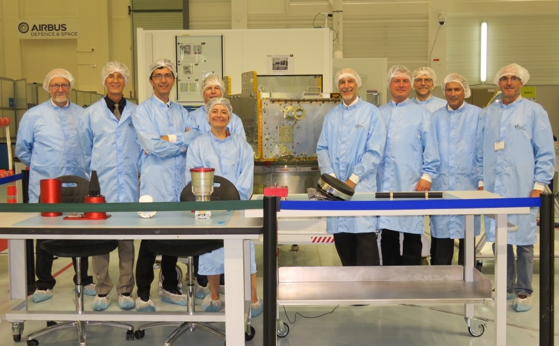

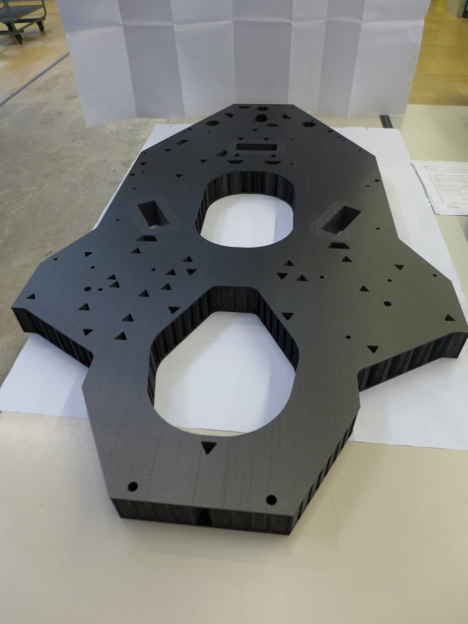
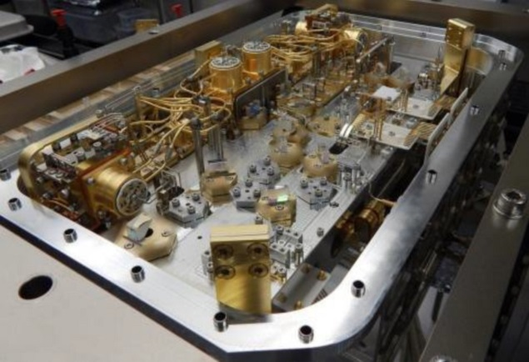

MERLIN Instrument (DLR)
  Phase C proceeds without major technical issues
  Significant delays occured in the development of the LASER
  Re-planning of the MERLIN schedule was necessary
MERLIN Platform (CNES)
  Very good progress
  Flight model of satellite platform is in clean room
Bodensegment (joint DLR/CNES responsibility)
  Joint test and validation campaign was sucessfully
  completed in 2018 (airborne and ground instrumens)
Launch date: mid 2024
MERLIN Platform in cleanroom at Airbus in Toulouse
FULAS Laser
https://www.dlr.de/rd/desktopdefault.aspx/tabid-2440/3586_read-31672/
MERLIN optical bench

Slide 8
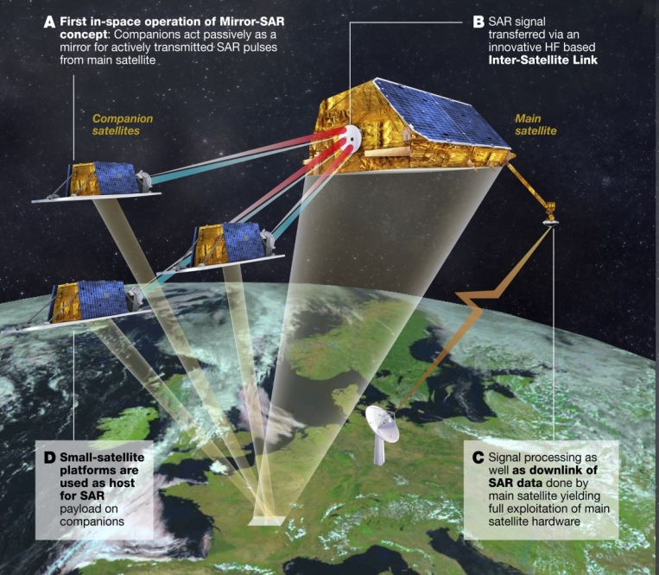
DLR.de • Chart 8
Next national X-Band SAR Mission
New X-Band SAR mission for data continuity of the successful
German TerraSAR-X and TanDEM-X missions
Multi-Static High Resolution Wide Swath (HRWS) Mission
  Broad range of user needs and applications
  Very agile monostatic mission with up to 25 cm resolution,
  scene sizes up to 500 km x 500 km and full polarimetry
  Multi-static mission for on demand digital elevation models
  and height change maps
Phase A successfully completed in July 2018
Start of phase B planned for 2019
Launch: 2024 – 2025

Slide 9

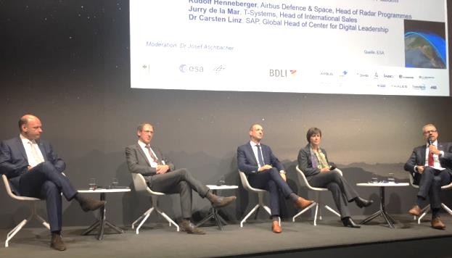
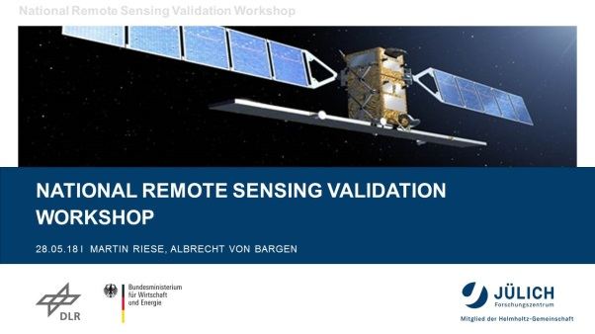

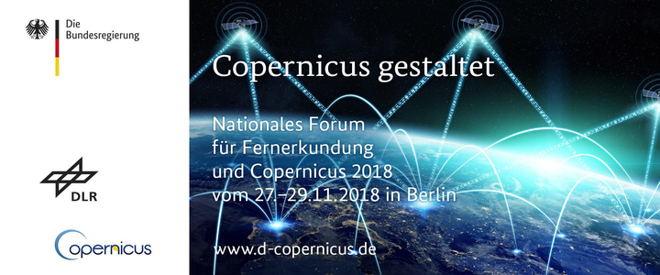
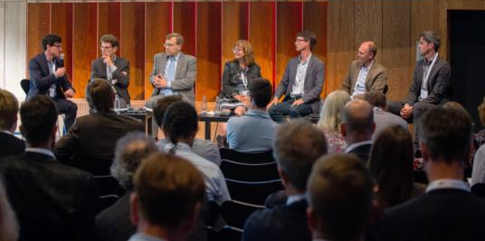
Key EO-Events in Germany 2018
25 - 29 April ILA Berlin EO-panel „Earth Observation for the digital economy“
28 - 30 May National Cal/Val Workshop, Bonn (co-organized with Research Centre Jülich
11 - 15 June 7th EarthCare Science and 1st EarthCare Validation Workshop, Bonn
(co-organized with ESA and JAXA)
25 – 27 June EO Symposium – „New perspectives in Earth Observation“, Cologne
1 - 5 October International Astronautical Congress, Bremen
27 - 29 November

Slide 10
Working Group on Calibration and Validation
DLR supports the implementation of CEOS and WGCV work plan items by
  Continuous serving in sub-groups & exchanging Cal/Val know-how WGCV level
  Contributing to the overall action plan
  Serving as link to Joint CEOS/CGMS WGClimate and for GHG actions
DLR / Research Centre Jülich: National Validation Workshop in Bonn (May 2018)
  To derive the „Opportunities, Needs & Gaps, Future perspectives“
  Based on a comprehensive survey about German validation means
  (to be published as brochure in 2019)
  Inclusion of representatives from CEOS WGCV (Chair et al.)
Remote Sensing from space
Validation Infrastructure

Slide 11


Joint Working Group on Climate
ECV Inventory
Gap Analysis & Recs.
Action Plan
DLR supports the implementation of
“The Architecture of Climate Monitoring from Space” by
  Participating in the verification of the ECV inventory
  Conducting in cooperation the gap analysis
  Supporting the formulation of the action plan
DLR is included in the review of the update of the GCOS implementation plan (GCOS-200)
DLR serves as link to CEOS / WGCV and vice versa
Notes:
DLR unterstützt die wesentlichen Aktivitäten der WGClimate beim „Kerngeschäft“, nämlich dem zyklischen Aufbau (und Update) des ECV Inventories durch den ersten Schritt der Inhaltsverifikation (aufgeteilt auf verschiedene Mitglieder der WG bzw. weitere Freiwillige angesprochend ruch die Raumfahrtagenturen; hier. DLR selbst); beteiligt sich dann an der Gap Analysis (hier GHGs u.a.) zusammen mit anderen WGClimate Mitgliedern und Volunteers; Diskussion des „Action plan“ in der WGClimate (das sind wir aber nicht im Lead sondern der Chair)
In der vergangen „Periode“ wurde gemeinsam die Antowrt von CEOS auf den GCOS Implementation Plan (Update) Entwurf formuliert (naja, DLR wird da dreimal angefragt: CEOS, GCOS, nationales GCOS)
Im Moment bedient DLR aufgrund der personellen Konstitution den Link zwischen WGClimete und WGCV für beide WGs.

Slide 12


DLR Contributions to WGCapD Workplan 2018-2020
Global activities (CB- 19, 21, 28, 29, 30, 31)
  DLR Grant to SAREDU/EO-College Portal infrastructure to provide EO Training
  material (SAR & Hyperspectral) and to support development and implementation
  of MOOCS in cooperation with ESA and other Agencies:
    MOOCs on Radar Backscatter (DLR / FSU Jena), Q1 2019
    MOOC on SAR Applications: Echoes in Space (ESA / CSA / FSU Jena), Q1 2019
    MOOC on Land applications (tbc, ESA Tender),
    MOOC targeting SDG 2 (Zero Hunger) and 13 (Climate Actions), funding applied for via
    Copernicus Framework Partnership Framework Project (2019-2020)
    Support to Webinar series on multiple topics, e.g. GEOGLAM and disasters (2019-2020, tbc)
    Portal-based access to CB and training resources via Installation of Calender API at EO –College (2019)
  Support to establish E-Learning Best practices and guidelines
  DLR Grant to development of free SAR operation system
Regional activities – training in GEO regions (CB 26)
  DLR to support AfriGEOSS training activities in 2019 and 2020 via SAREDU/EO-College Grant

Slide 13


GFOI and GEOGLAM @ DLR
Support with data
  Providing TerraSAR-X and TanDEM-X data for GFOI and GEOGLAM (JECAM, AsiaRice) R&D sites/teams
  Engaging in CEOS SDCG for GFOI from the start
Funding R&D
  Funding German research teams contributing to GFOI R&D and JECAM programmes.
Linking to users/donors
  Working with German Development Agency (GIZ) and relevant German Ministries BMZ/BMEL
    BMEL now funding GEOGLAM Programme Office
    BMZ considering to join GFOI Leads group and provide funding
    GIZ collaborating in various GFOI components at technical level

Slide 14
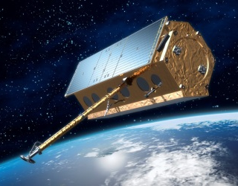
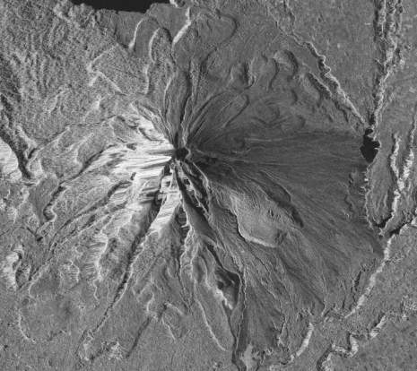
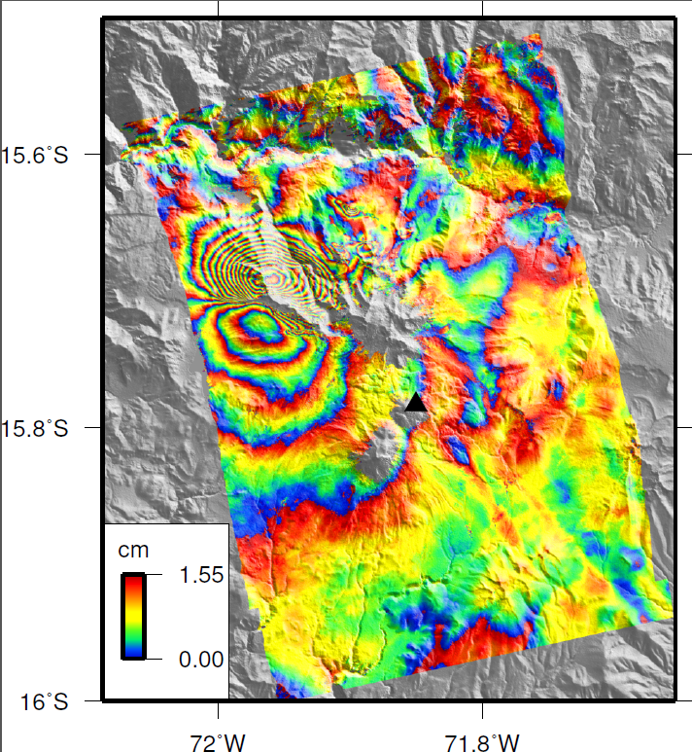
DLR Contributions to WG Disasters
DLR supports research and scientific demonstration of EO-based applications
Data contributions to Geohazard Supersites and CEOS demonstrators (TerraSAR-X, TanDEM-X)
  TSX order contingents for PIs of Geohazard Supersites (GEO GSNL)
    Icelandic Volcanoes, seismic hotspot Marmara/Turkey, and several more
    > 1000 SAR scenes p.a.
  CEOS Volcano Demonstrator (Latin America, Africa, SE-Asia)
    Support with data
    Background mission coverage of selected volcanoes
  Coverage of Haitian Recovery Observatory study area
  and more…(e.g. regular update to the CEOS MIM Database)

Slide 15
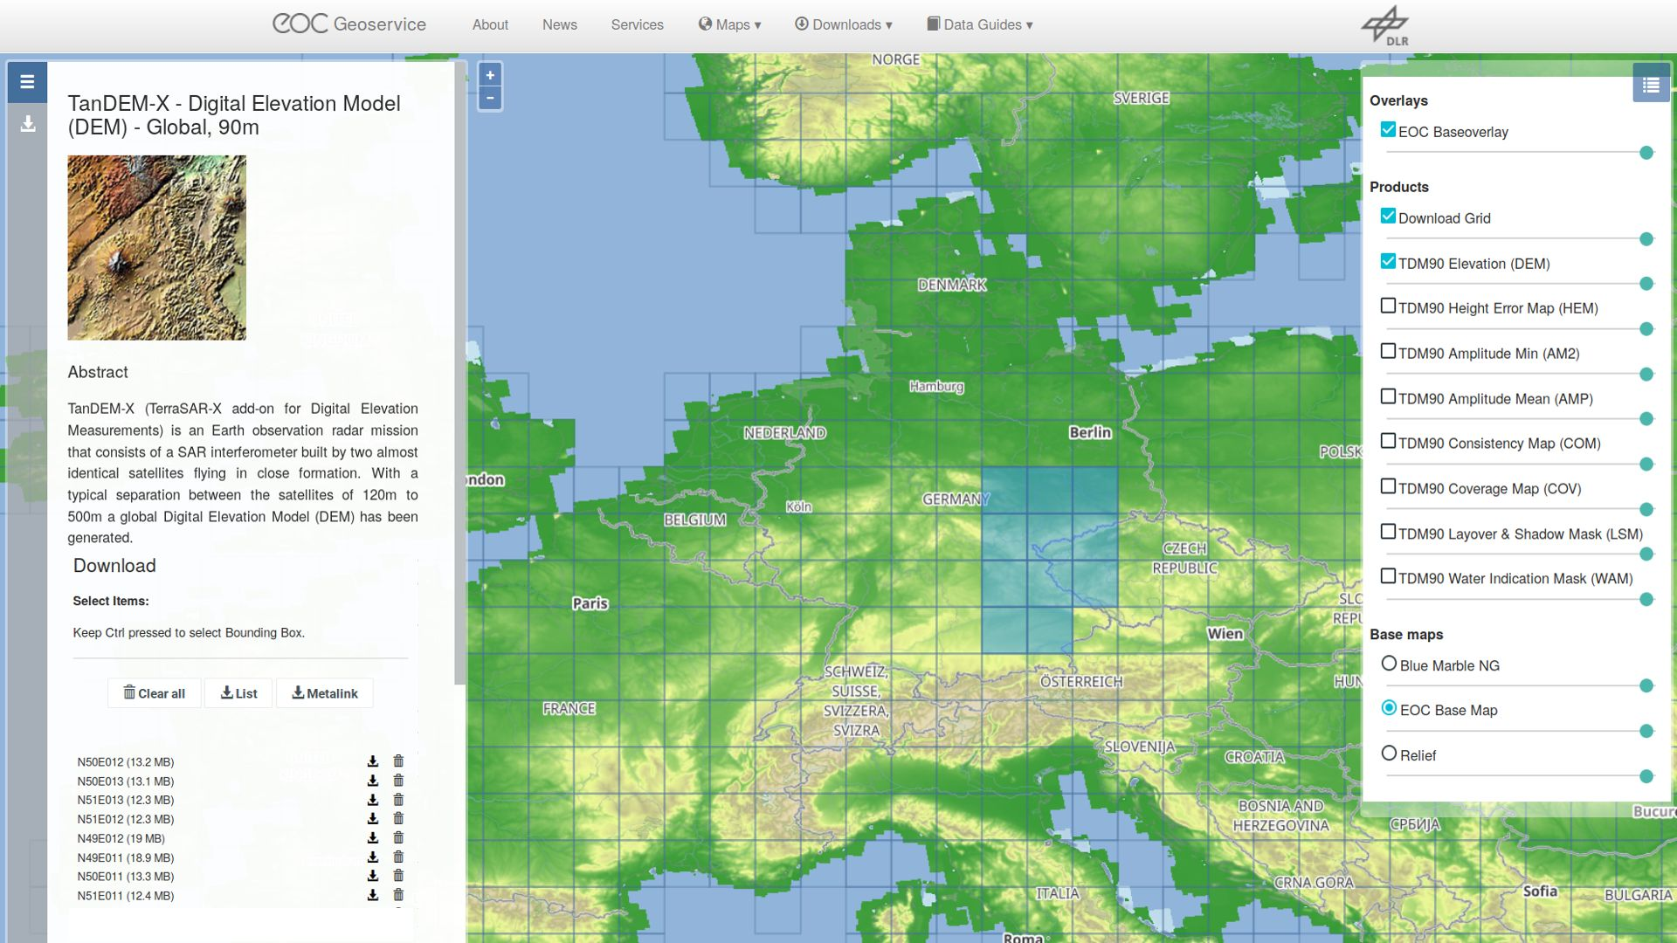
  just recently, free public access to all 90m TanDEM-X Data has been granted:
  https://www.dlr.de/eoc/en/desktopdefault.aspx/tabid-12632/22039_read-53088
download is free of charge and possible after registration.
Terms of use: https://geoservice.dlr.de/resources/licenses/tdm90/License_for_the_Utilization_of_90m_DEM_for_Scientific_Use.pdf
Download Portal: https://download.geoservice.dlr.de/TDM90/#details

