Slide 1
Netherlands activities in EO
Committee on Earth Observation Satellites
Organization
CEOS Plenary 2018
Agenda Item 4.3
Brussels, Belgium
17 – 18 October 2018

Slide 2
NSO EO strategy
Primary goal and means: engage users, and/or their reps in value chain, to express user needs
Strengthen commercial position of Space Sector
Increase awareness of role space in policy
G4AW: development aid for food security
Climate/environment
Instrument Cluster: engage all instrument core competences in joint technology activities
Bottom up technology process, to be validated by user need studies
Higher TRL (project realisation): paid by or on behalf of users (scientific, institutional, commercial)

Slide 3
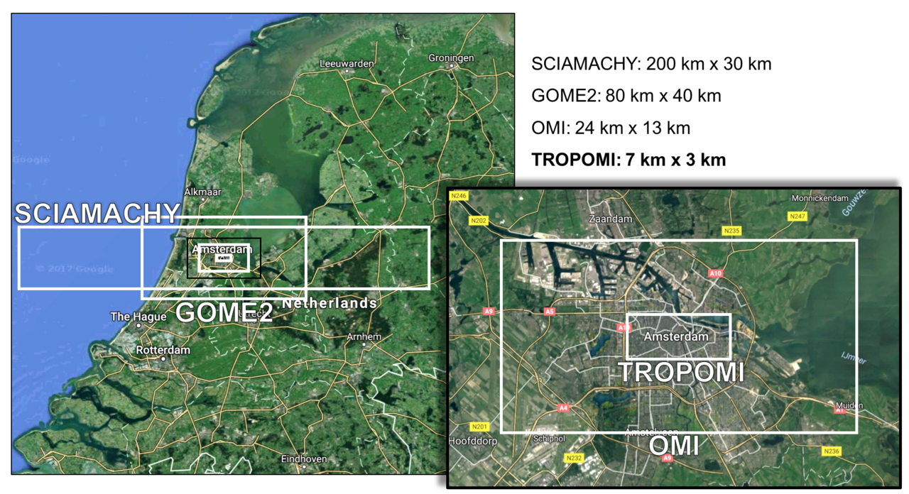
Achievements with partners (and advancement of technology)

Slide 4
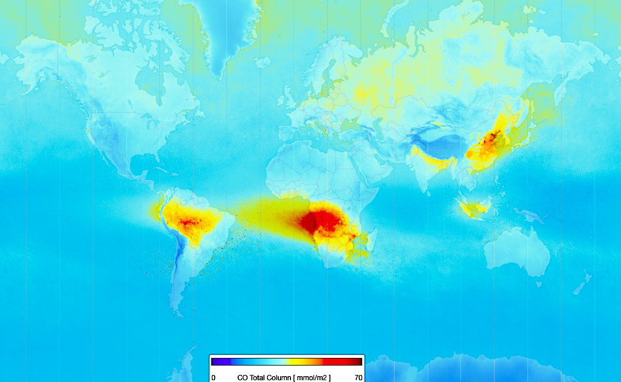
Achievements with partners

Slide 5
NSO priorities
Exploitation of OMI and TROPOMI
Overlap TBD
NSO finances operations, validation and in-orbit calibration
Contribute to institutional/scientific climate/AQ research
SPEXOne
Tropolite
Broaden the use of space in Earth Sciences
Flagship?
Explore the possibilities for small instruments (commercial/institutional)
Air quality
Water Quality/Water Management
Agriculture
Spectrometers, Hyperspectral imagers, spectropolarimeters

Slide 6
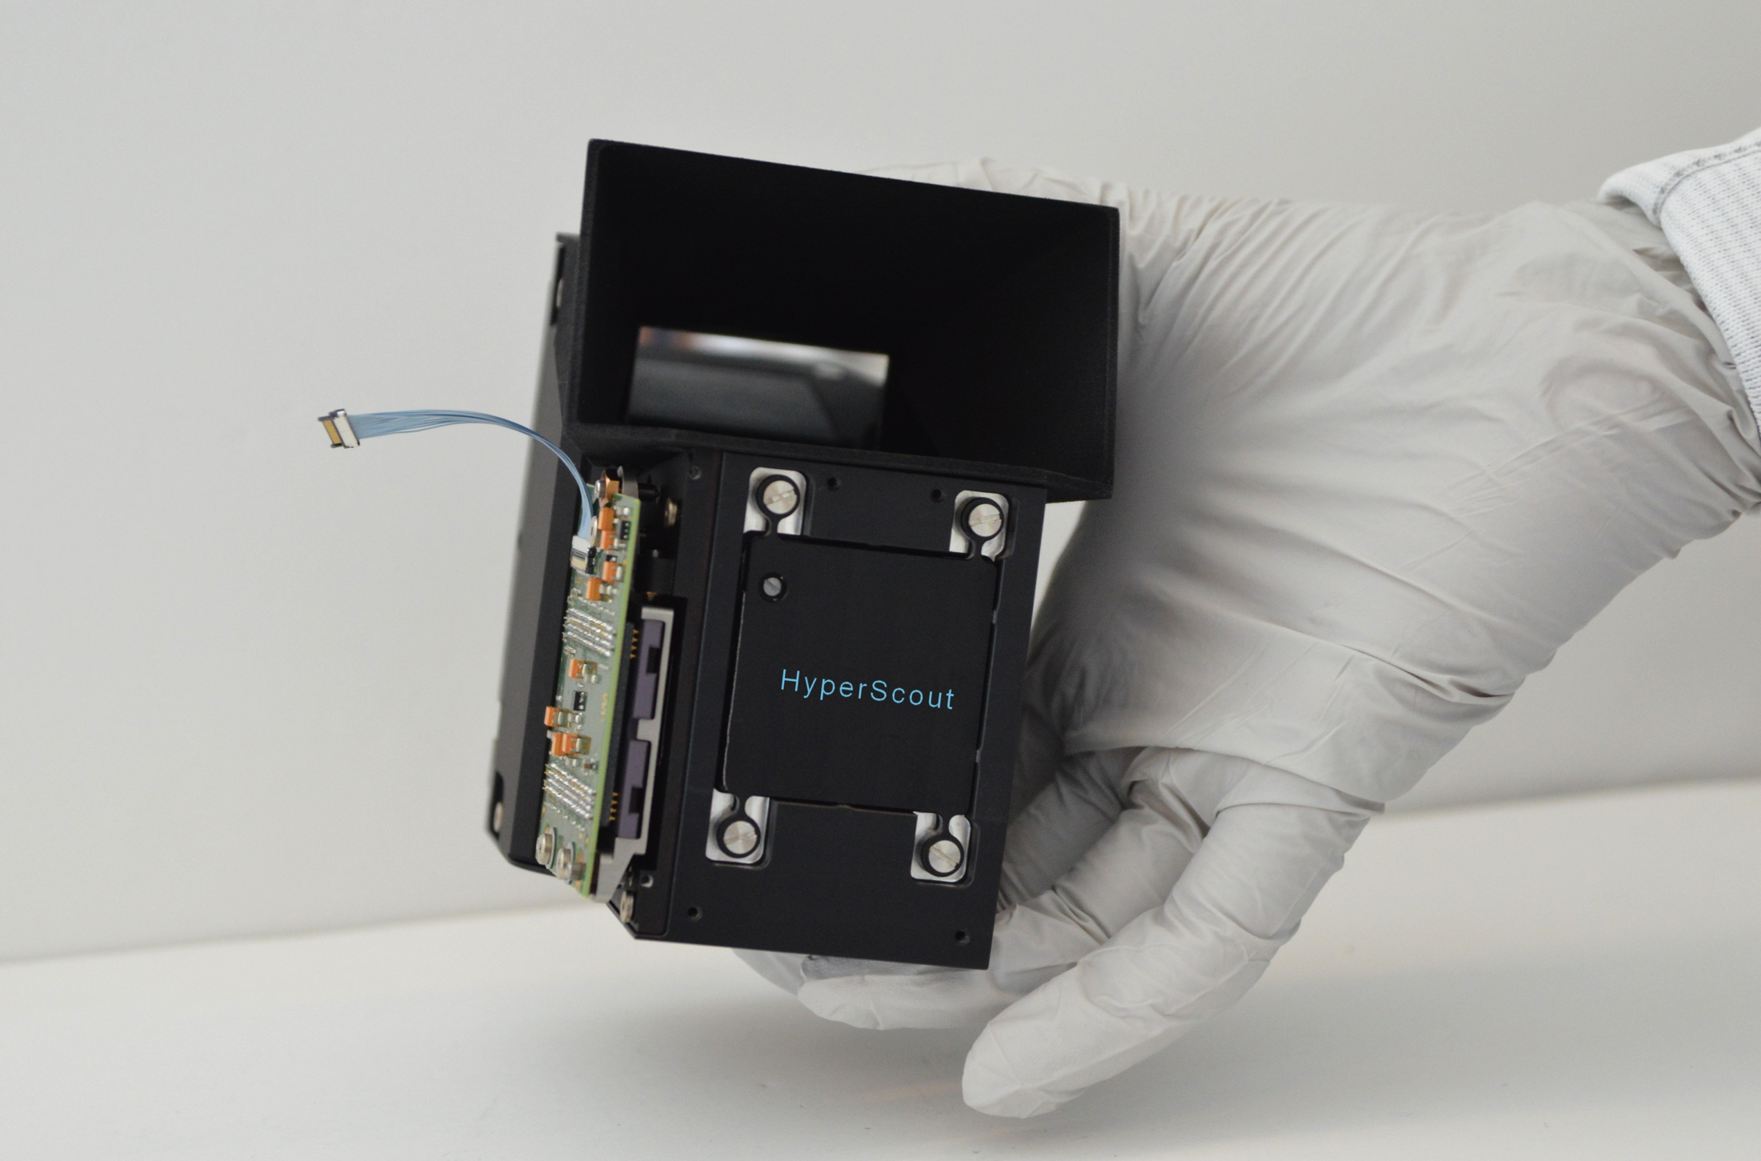
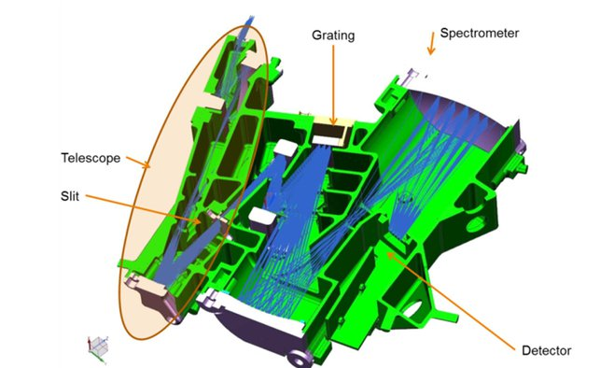
Options
Spectropolarimeters, Hyperspectral imagers
Spectrometers

Slide 7
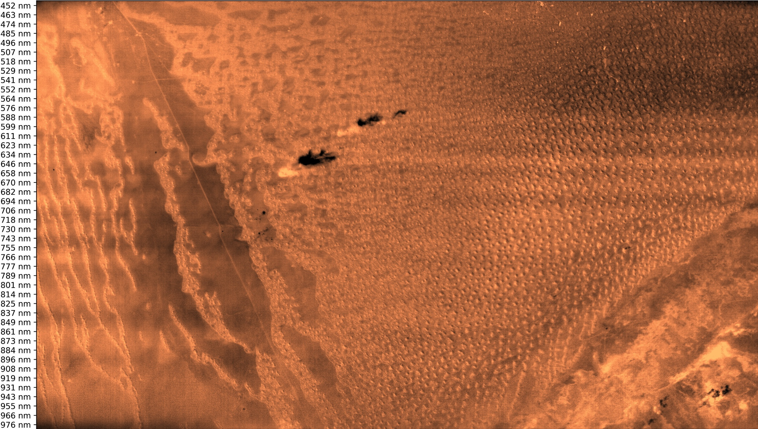
Hyperscout results

Slide 8
G4AW
Geodata for Agriculture and Water (G4AW) improves food security in developing countries by using satellite data.
Netherlands Space Office (NSO) managesthis programme, commissioned by the Dutch Ministry of Foreign Affairs.
3 Calls
60 mio €
2014-2021
23 projects
14 countries

Slide 9
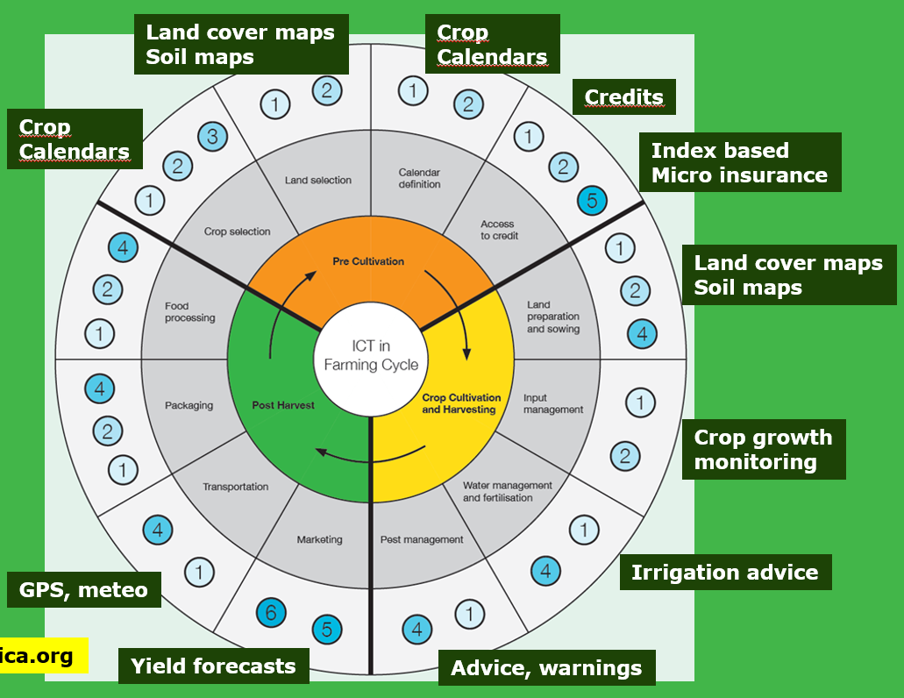
G4AW Services
Examples of services in G4AW
More localized weather forecasts
Yield forecasts / growth stages
Pest & disease warnings
Drought and flood warnings
Micro insurance
Risk profiling supporting insurance and credits

Slide 10
Role CEOS
the policy, scientific, and societal challenges driving the strategy and requirements of their agency for the next 10 to 15 years and the degree to which CEOS' thematic foci support these plans;
Linking space capabilities/results with policy is a challenge
how CEOS as an organisation is supporting and prioritising engagement around the agency’s requirements;
Priorities and requirements will be validated (im- or explicitly) by CEOS priorities
how CEOS activities related to standardisation (metadata and interoperability), quality control (cal/val), and data dissemination influence implementations in their agency.
NSO works in cooperation with larger agencies
Ground segment plans will take CEOS activities into account

