Slide 1
GEO update to the CEOS Plenary
Gilberto Câmara
GEO Secretariat Director

Slide 2
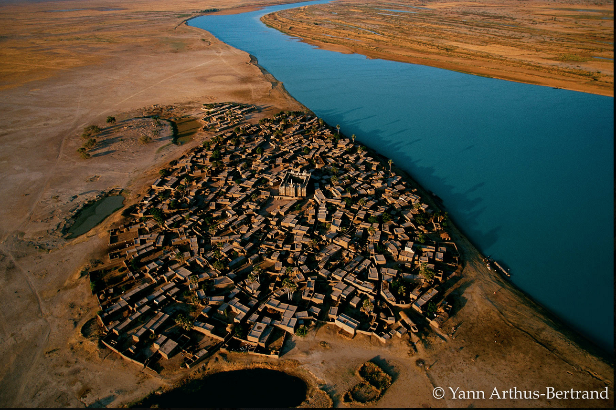
The fundamental challenge for our time
Can we provide food, water, and energy for 9,4 billion people, avoid dangerous climate change, and protect our planet’s biodiversity?

Slide 3
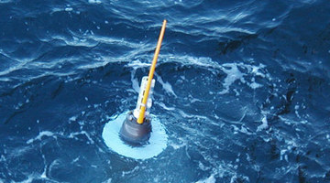
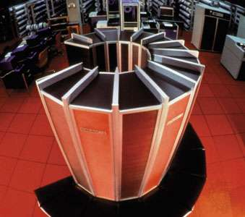
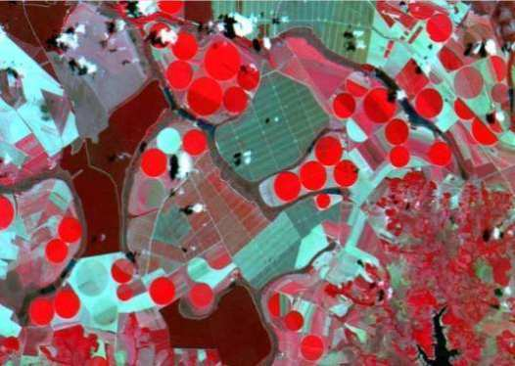
How does GEO work?
data
agreements
community
analysis

Slide 4
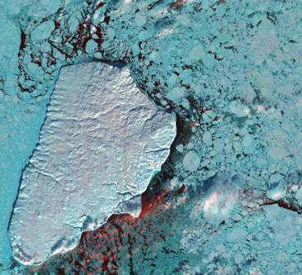
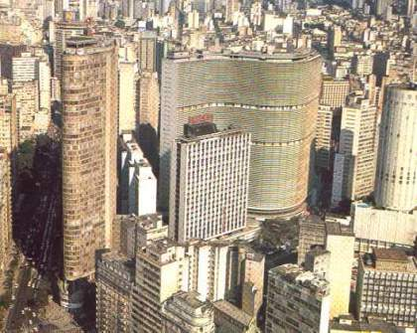
Knowledge and action for sustainable development
Knowledge: informs us about the limits of our planet
Action: societies decide how to use our planet’s resources

Slide 5
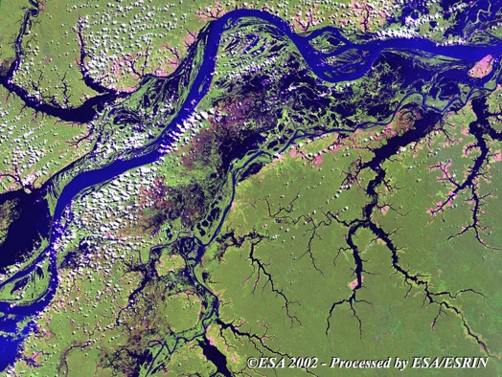
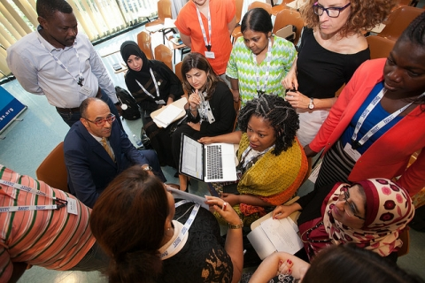
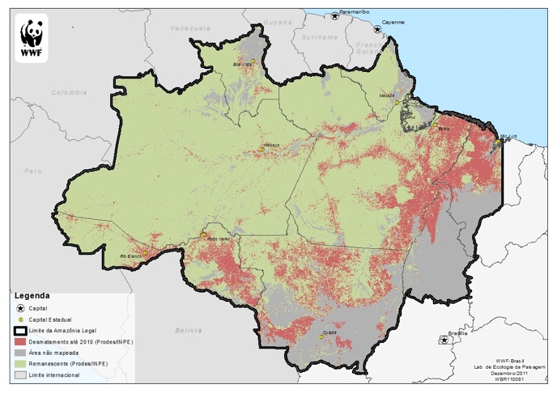
Building institutions for sustainabilty
Earth observation data
co-design & co-production
socially robust results
Trust is the key!

Slide 6
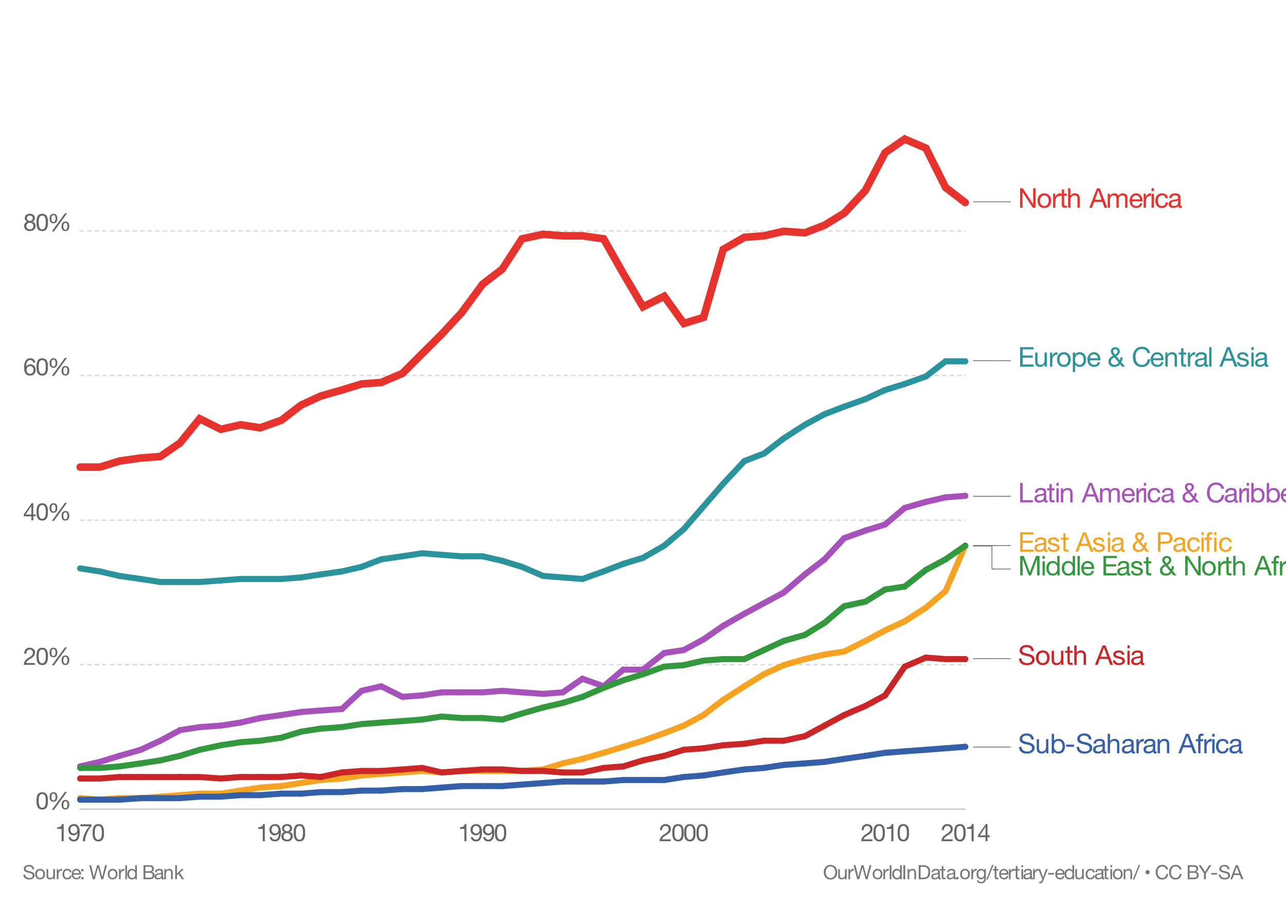
The world is becoming more educated:
enrolment rate in tertiary education
source: World Bank

Slide 7
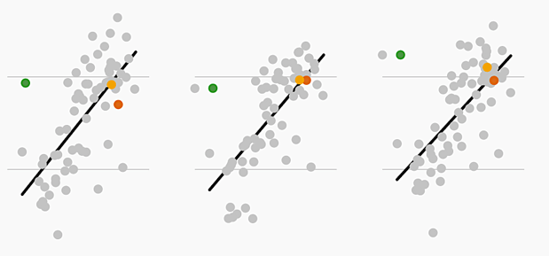
Vietnam, UK, and US students compared
Math
Reading
Science
PISA test score
GDP per capita
source: Dang and Glewwe (2018)
GDP per cap

Slide 8
The new digital economy
Low access cost
big data
public APIs
massive use
Google, Twitter, Facebook, Spotify, Netflix,…
images: shutterstock

Slide 9
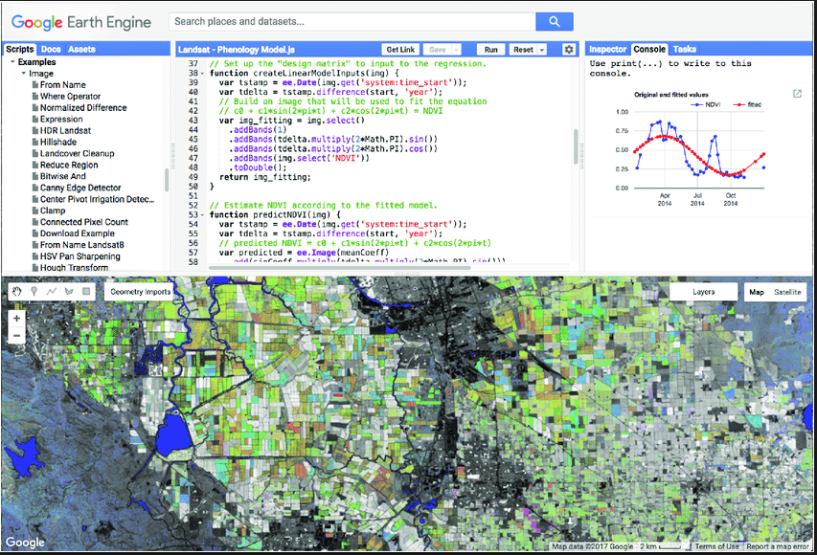
Who’s afraid of Google Earth Engine?
Global enabler (2.000+ papers): low entry cost to big Earth observation data analysis
but...no public decision on data, no long term guarantee

Slide 10
The digital economy effect
The Global South will only use EO information which is free at the point of access. How to pay for it?
The Global South will only use EO information which is free at the point of access. Who will pay for it?
Image: Rede Globo (Brazil)

Slide 11
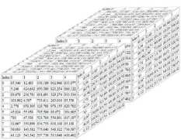
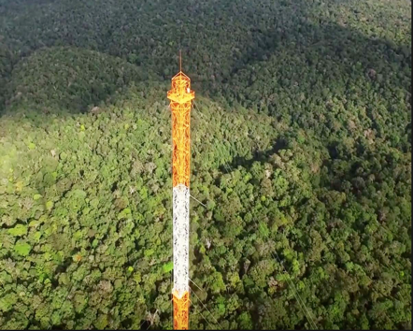
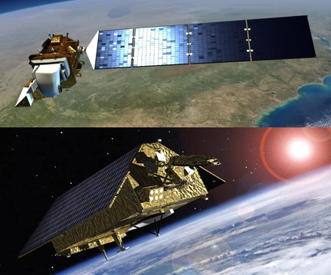
What the global EO community needs
Empowered global experts
Reusable, shared knowledge
Cloud architectures
APIs
APIs
In-situ observations
Multi-satellite data

Slide 12
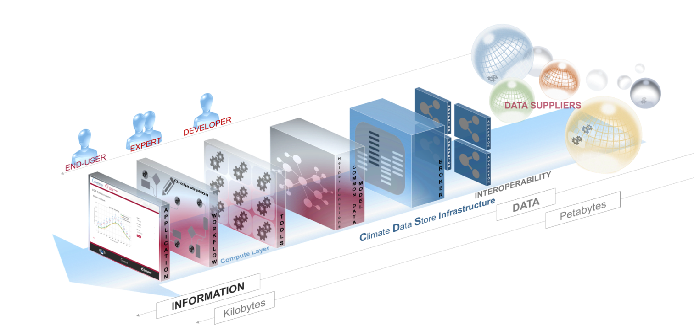
image: ECMWF
Climate data store: a well built open EO cloud

Slide 13
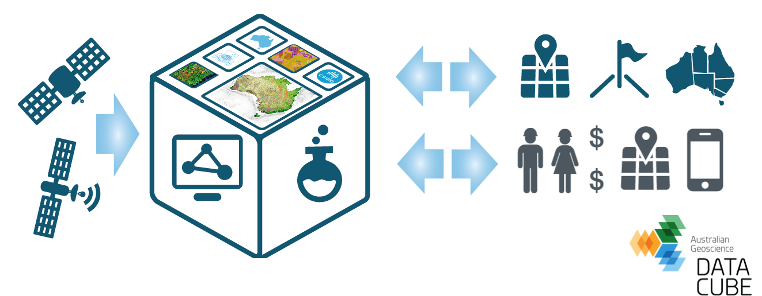
Open data cube: CEOS initiative
Collective effort: build an application library of data analysis methods

Slide 14
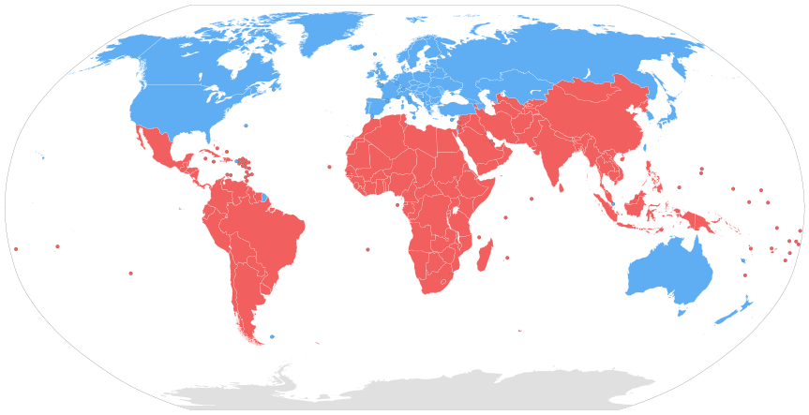
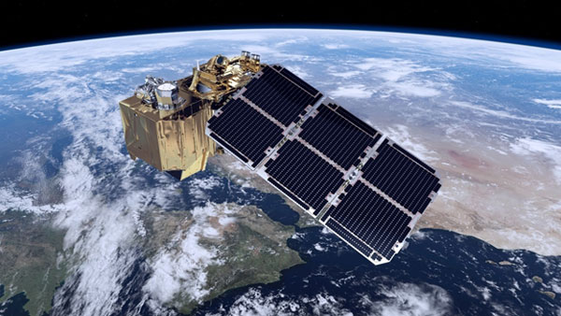
GEO contribution to open EO clouds
US$ 1,5 M
GEOSEC to support Global South to use Sentinel-2 ARD

Slide 15
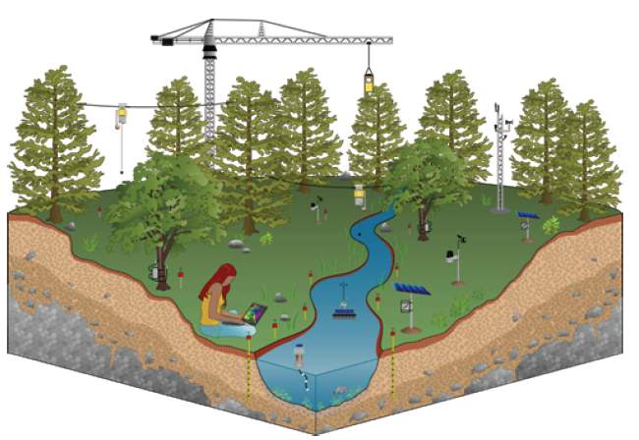
An in-situ EO data repository for GEO
Image: Deborah Estrin (UCSB)
GEO in-situ data cloud
APIs

Slide 16
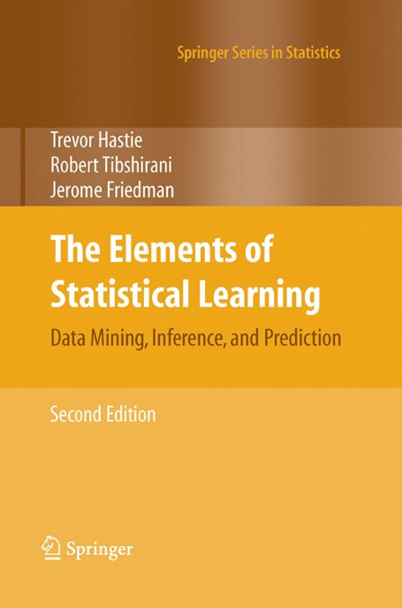
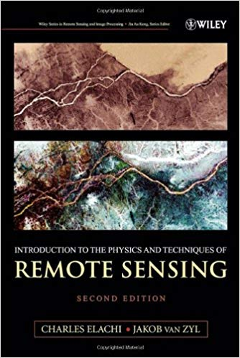
Earth observation data analysis: no secrets!
Open knowledge: books, papers, software

Slide 17
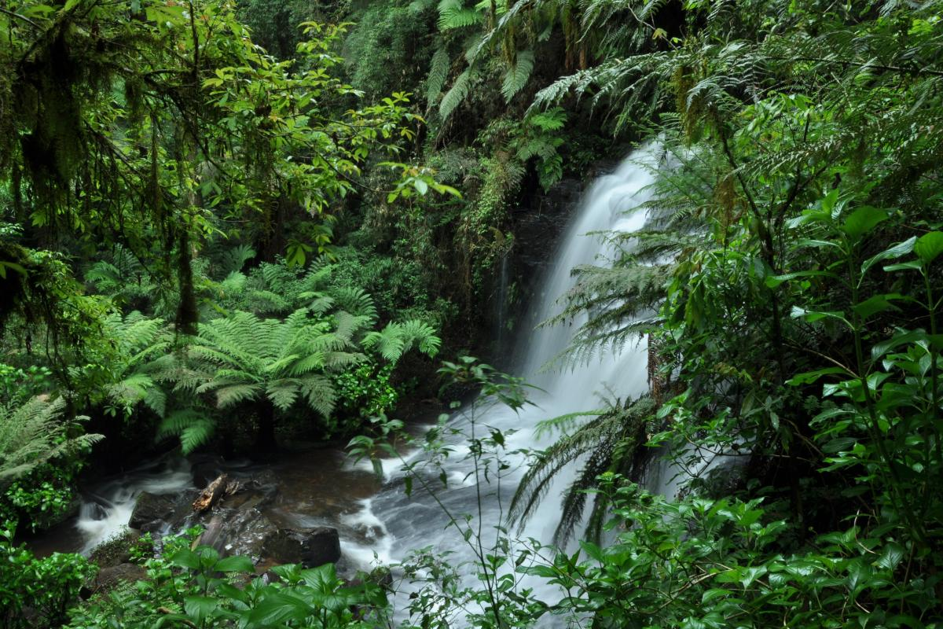
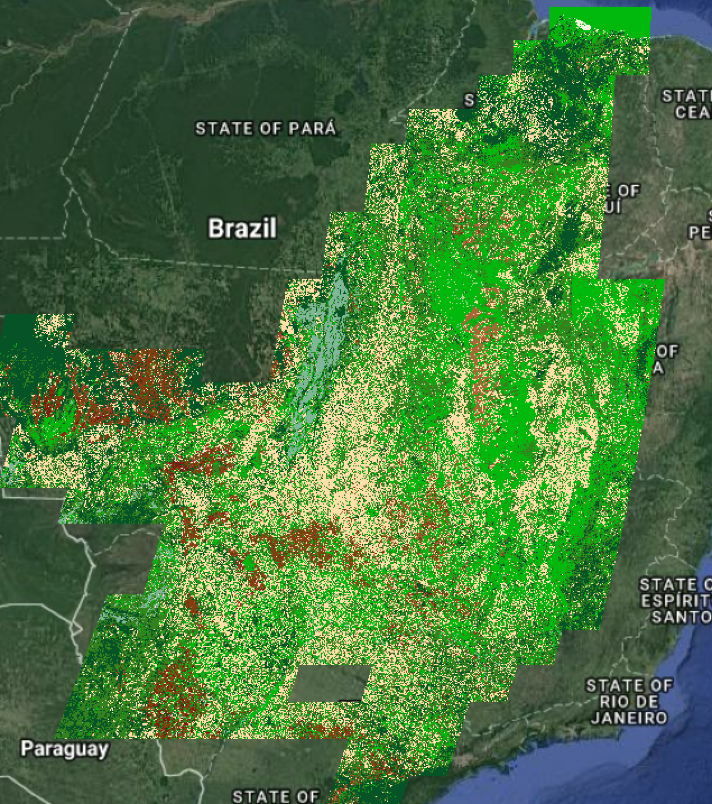
Ecology’s revenge on machine learning!
“forest” ?
Brazilian Cerrado: 2.5 million km², 65.000 samples!

Slide 18
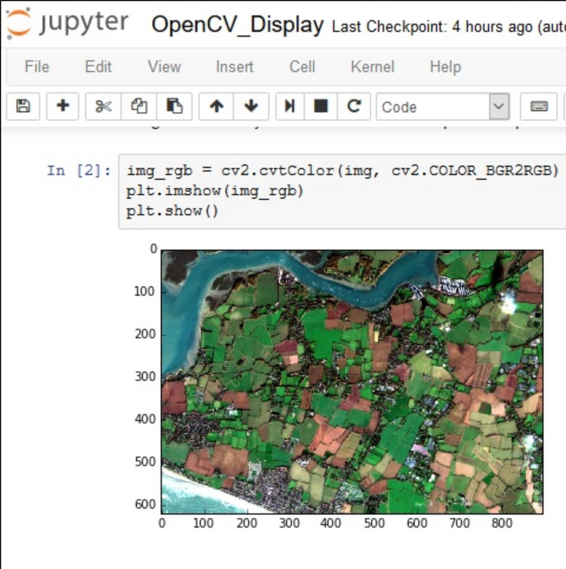
Sharing reusable science
GEO database of reusable reports and papers

Slide 19
Where GEOSS is going
metadata hub
Trusted, reproducible, and robust guidance on best use of Earth observation data for decision-making
knowledge hub

Slide 20
Let’s build and share knowledge for a sustainable planet!

Slide 23
Connecting GEO initiatives with GEOSS
Reusable and socially robust knowledge!

Slide 24
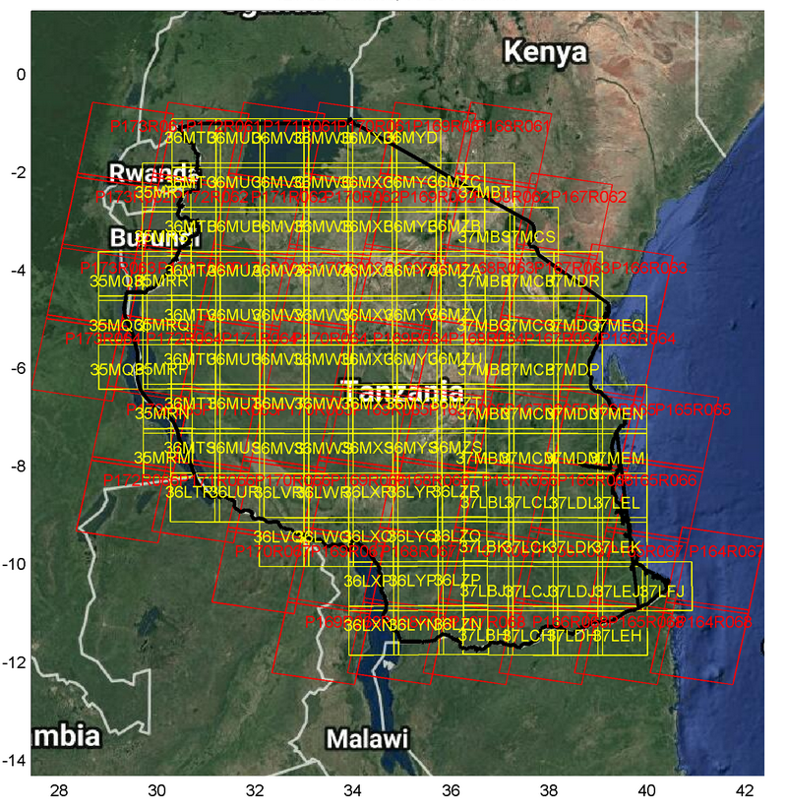
Combining L8 and S2 in Tanzania
figure: NASA

Slide 25
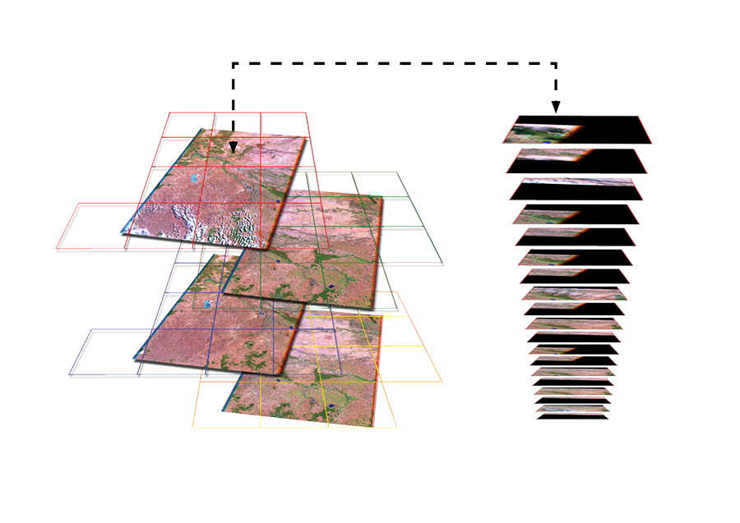
GEO community needs free and open multi-satellite data
Joint effort by CEOS agencies?

