Slide 1

GFOI and SDCG
Update & CEOS Next Steps
Committee on Earth Observation Satellites
Osamu Ochiai, CEOS Lead for GFOI
Frank Martin Seifert, SDCG Co-chair
Joanne Nightingale, SDCG Co-chair
Stephen Ward, CEOS Alternate Lead &
Data Component Manager
2018 CEOS Plenary
Agenda Item 3.5
Brussels, Belgium
16 – 18 October 2018

Slide 2
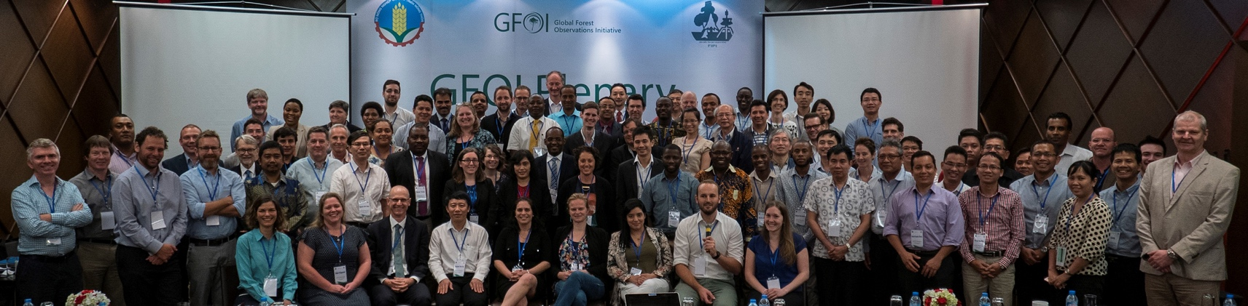




GFOI (Phase 2) Overview
GFOI coordinates international support on forest monitoring and
GHG accounting for REDD+ and related forums
Founded under Group on Earth Observations (GEO) in 2010 at GEO-VII
GFOI is a GEO Flagship since 2014
Phase 2 transition has been approved in Bogota Plenary (new donor funding)
Lead partners: currently Australia, CEOS, ESA, FAO, Norway, UK, USA, & the World Bank
Many other contributors including Countries, UNFCCC, IPCC, GFOC-GOLD, universities, technical and policy experts
@GFOI_FOREST
GFOI1
GFOI.ORG

Slide 3
GFOI Goals
Provide REDD+ countries with a larger and more targeted package of support than any one international partner can provide alone
Enable consistency or complementarity in support
Ensure support is targeted at country needs to help accelerate progress towards reporting and action
Foster a network of experts to help address challenges and bottlenecks to progress
Facilitate exchanges resources, comparative advantages, south-south collaboration and enable learning between partners
Avoid overlaps and duplication of effort by developing countries and international partners

Slide 4
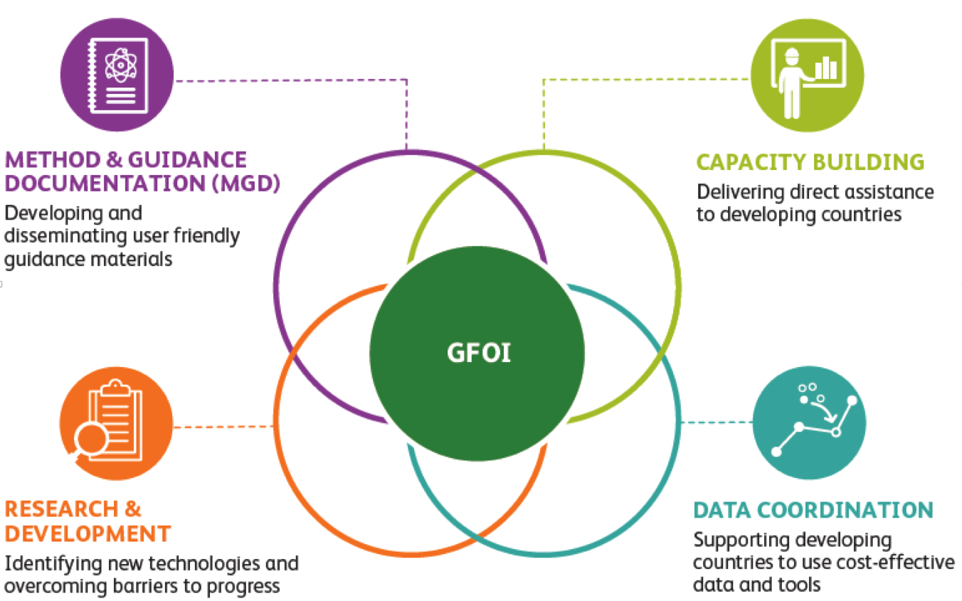
Four GFOI Components

Slide 5




















CEOS outcomes for GFOI Phase 1
Founding partner and instrumental in design and operation of the GEO Flagship (2010-2017)
Execution of the Space Data Strategy for GFOI
  Global baseline coverage for all nations UNFCCC reporting (2017 milestone)
  Observation strategy adjustments to L-8, S-1, S-2
  Data for R&D (and funding for coordination)
National archive characterisation for many GFOI countries
Key pilot (Colombia) – evolving to operational NFMS
GFOI brings CEOS closer to users than ever before – in a managed way and with substantial CB support (FAO, World Bank ...)
Data Driven
5

Slide 6
SDCG Actions
CARB04: CEOS Delivery of Coordinated Land Surface Observations for GFOI Countries
  Global achieved from 2017. Ongoing
CARB05: Updated Global Baseline Data Acquisition Strategy for GFOI and Strategy for Satellite Data in Support of GFOI R&D
  Adapts to new data streams. Includes commercial and PPP missions
Notes:
both ended nominally Q2 / 2018

Slide 7
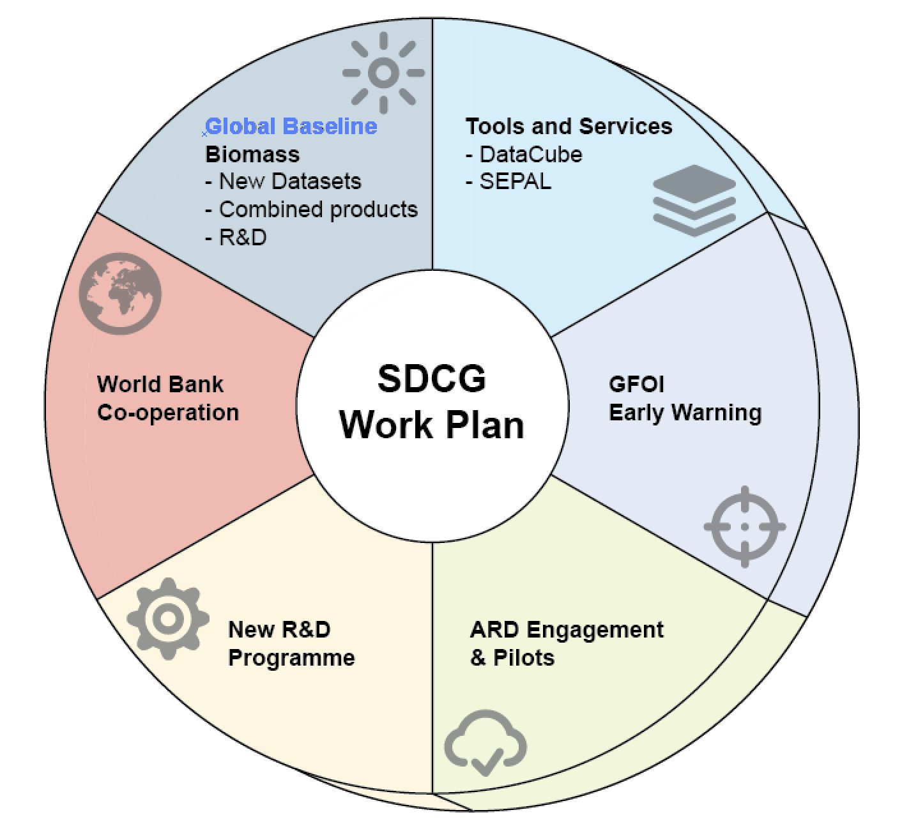
Phase 2 - SDCG Work Plan
Biomass – accelerating policy relevance of new data streams
World Bank cooperation
New Early Warning module
Tools and services emphasis
ARD engagement
New donor-driven R&D programme
User Driven

Slide 8

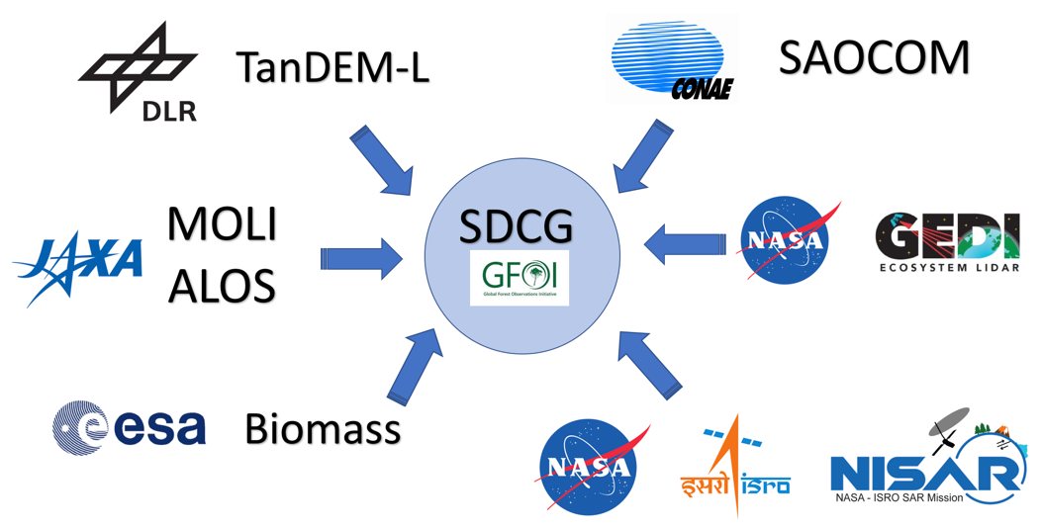

Phase 2 Opportunities for CEOS
L-band SAR constellation
Biomass mission and application team engagement – new constituency for an SDCG
Closer integration of CEOS’s GFOI
work with the relevant mission and application teams in these agencies – more effective framework for cooperation
  WGCV/LPV coordination

Slide 9
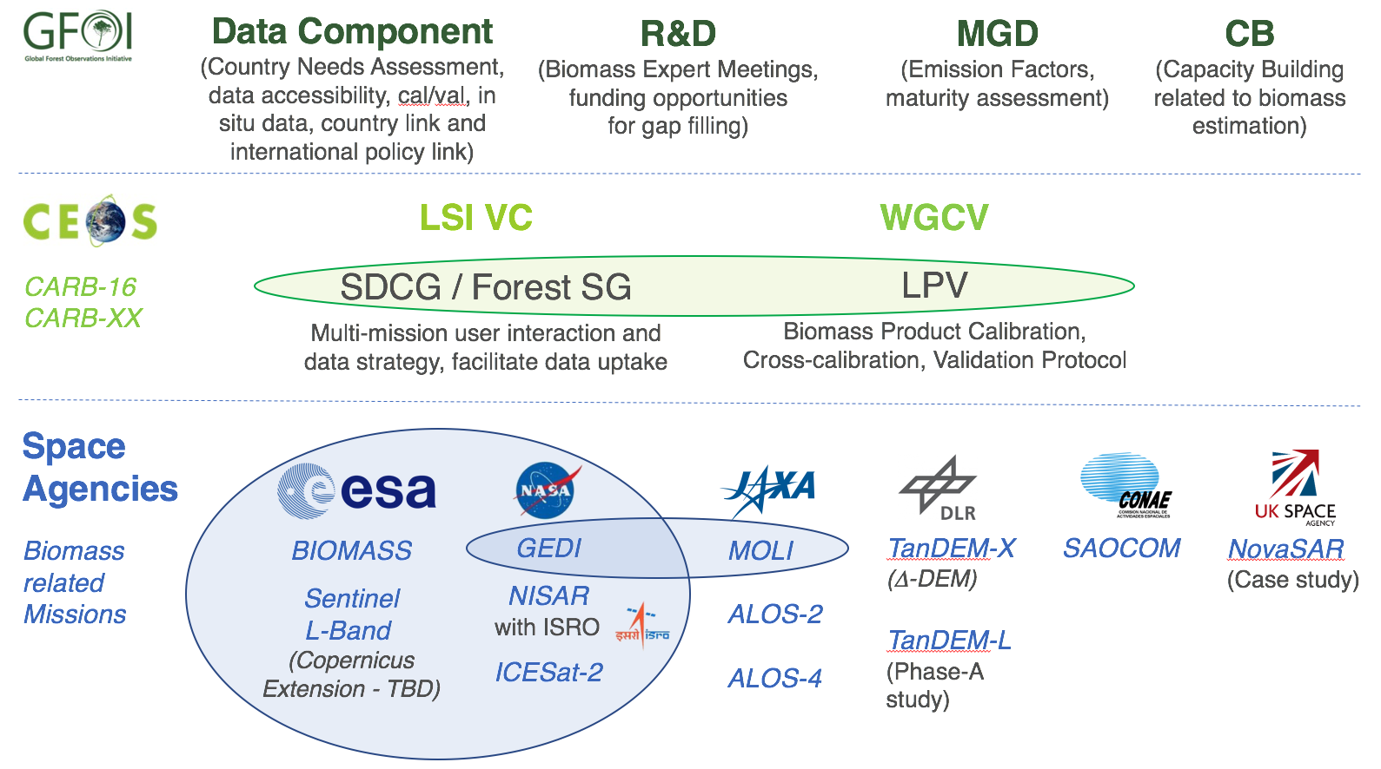
Future Biomass Framework
Notes:
CARB-XX is the new proposed task on “GFOI Data Uptake” or we have another year CARB-04

Slide 10
Phase 2 Engagement
Recently improved outlook for several challenges facing SDCG
  Possible return of a USGS rep and perhaps Co-Chair
  Multiple agencies volunteering SEC funding for operating capacity
    ESA, NASA, USGS, JAXA, NOAA
  Participation in new GFOI Data Component still needs attention
  Refreshing agency engagement & coordination around the biomass theme
The way forward for the CEOS engagement with GFOI depends on whether a critical mass of agencies exists to continue a stand-alone group (such as SDCG or some evolution of it); as well as the provision of capacity for the management of that group and for the execution of the Work Plan targets.
Recommendation from Sep Joint meetings with LSI-VC and GEOGLAM to further continue the merger with LSI-VC and establish SDCG as a Forestry Sub-Group within LSI
  Operations otherwise unchanged
  By CEOS Plenary 2019

Slide 11
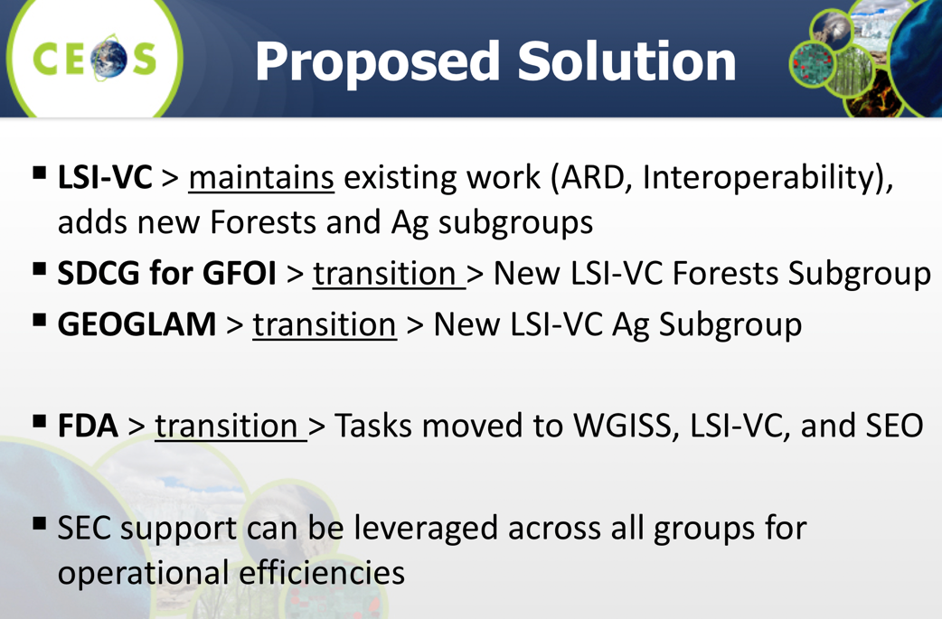
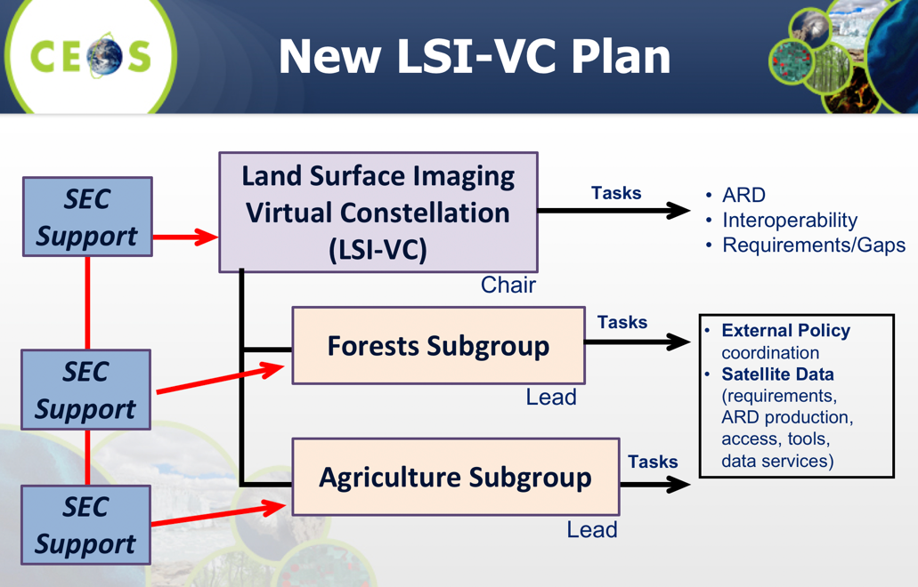
SDCG Ad Hoc Team Renewal
SDCG asks for a final year of operation from CEOS Plenary
Proposed further merger with LSI-VC per the Varese joint meeting recommendation – pending Plenary direction

Slide 12
Proposed CEOS position on GFOI and GEO
Limited interaction between GEOSEC and GFOI since GFOI Office moved from Geneva to FAO in 2015
Mutually beneficial for GFOI to continue to be recognised as a GEO initiative and flagship
CEOS support for GFOI is in part due to its GEO origins – CEOS can be instrumental in ensuring continued effective cooperation
CEOS and GEO both benefit from the donor funding GFOI is attracting
Reporting and branding overheads can presumably be minimal and managed

Slide 13
Plenary Discussion
Endorsement of SDCG as Ad-hoc for next year
Reflect on opportunity for pan-CEOS coordination on biomass issues and GFOI interface (SDCG & WGCV/LPV)
    ensuring participation from relevant agencies and mission programmes, and
    appropriate CEOS WP items
CEOS position on GFOI and GEO

