Slide 1
GCOS CEOS-32 Plenary 17-18 October 2018, Brussels
Stephen Briggs
Chairman, GCOS Steering Committee
Carolin Richter
GCOS Secretariat, WMO

Slide 2
Strategy
The new GCOS Strategy is being considered by the partners before its final adoption.

Slide 3
Strategy: Advocate – Coordinate - Communicate
Vision
a world where users have free access to the climate-related information they need
Aim
to ensure the availability and quality of observations necessary to monitor, understand and predict the global climate system so that communities and nations can live successfully with climate variability and change
What is needed?
ECV Requirements Implementation Plans, Principles and Guidelines (1)
Support to observations
implementation plans, Regional workshops and plans, capacity development, (2)
Observations
NMHSs, Space Agencies, Other networks and research organisations
Where are we now?
adequacy of ECV observations and evaluation of improvements
(1)
Networks contributing to global climate observations should be:
Free and Open
Transparent
Accurate
Useful
Timely
Use best available science
Advocate (3) Coordinate (4) and Communicate (5)
GCOS Sponsors:

Slide 4
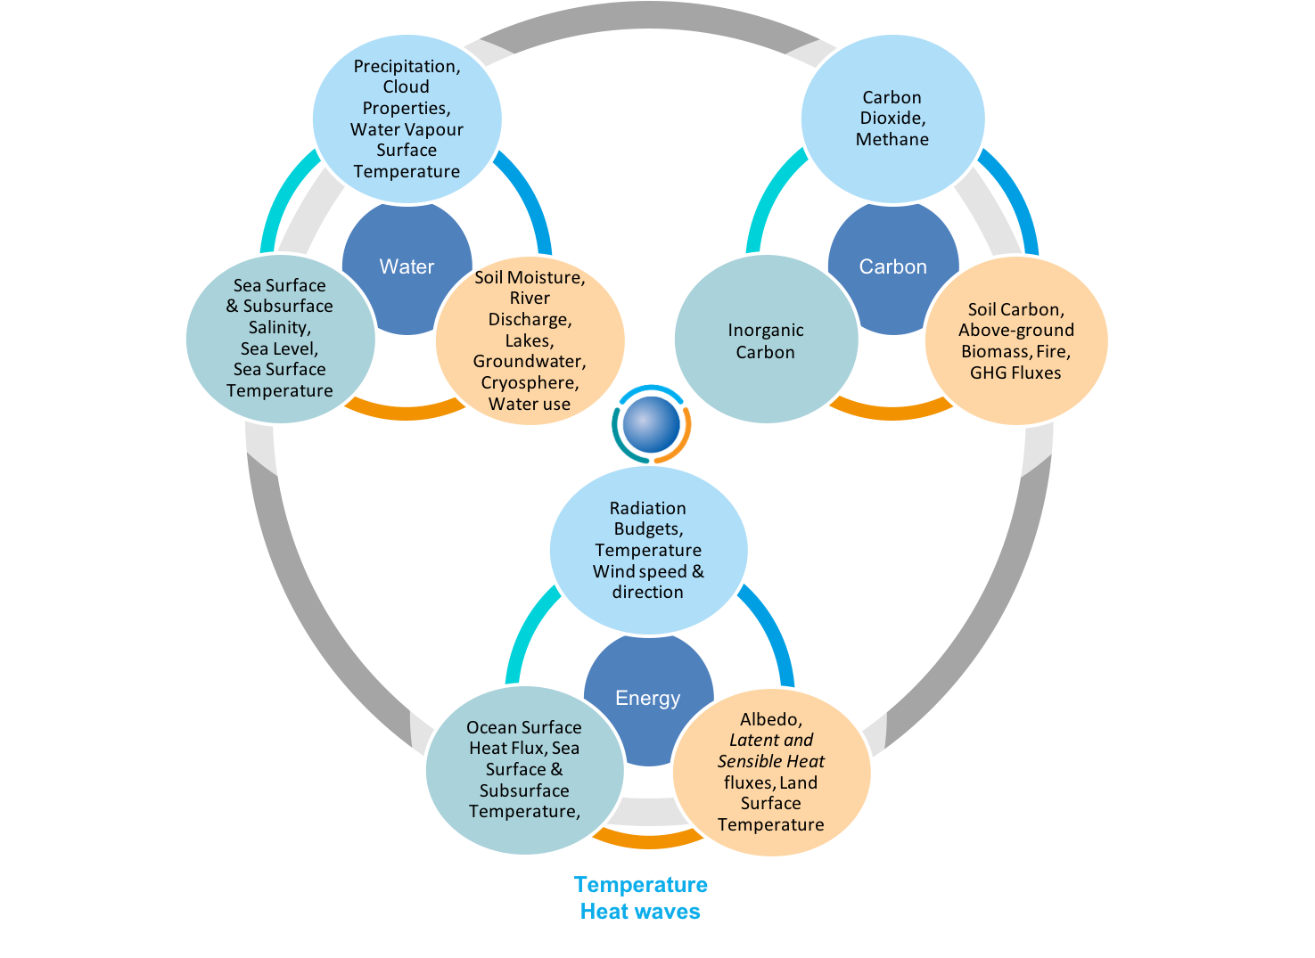
The GCOS implementation plan has an aim to improve the monitoring of the 3 climate cycles
For carbon the target is to quantify
fluxes of Carbon related gases to ± 10%
Changes in stocks of carbon to ± 10% on decadal scales on land and in the oceans
Changes in atmospheric annually carbon stocks to ± 2.5%
GCOS has many ECV related to the carbon cycle, the main ones are:
Ocean Inorganic Carbon
Atmospheric composition of CO₂ and CH₄
Greenhouse Gas Fluxes
Soil Carbon, Aboveground biomass, Permafrost

Slide 5
Paris Agreement
A major driver for climate observation needs. Adaptation, a significant element of the new GCOS Implementation Plan is an extremely important aim of the Paris Agreement.
GCOS will submit to COP24/SBSTA49 a paper on “Systematic Observations and the Paris Agreement” (to be approved by GCOS SC-26, 22-26 October 2018)

Slide 6
GCOS is assuring the availability of systematic climate observations, in partnership with WCRP, underlying the needs of the Parties to the UNFCCC and the IPCC:
Research
Assessment
WG I:
Physical Science Basis
WG II:
Impacts, Adaptation and Vulnerability
Observations
WG III:
Mitigation of Climate Change

Slide 7
The UNFCCC reality…
UNFCCC
Global Carbon Budget
Sea Level Rise, etc
Adaptation and Mitigation Workstreams
NAPs, NDCs
Loss & Damage
…
Observe
WMO-IGOS
GCOS
CGMS-CEOS
Research
WCRP
IAMC
Future Earth
PROVIA
Assess Knowledge
IPCC
AR6,
SR1.5, SROCC,
SRCCL, SCFR
SBSTA
Research
Systematic Observations
COP/CMA Global Stocktake
Assess collective progress on implementation of Paris Agreement
Assess adequacy of agreed warming limit
Climate Services
GFCS
WCSP
Global Average Temperature Other Services
ECV Inventory, Indicators, IG³IS
GCOS Implementation Plan
Regional Workshops
WMO State of the Environment
Feedback on needs and adequacy of information

Slide 8
From “observations and science informs policy” to “policy directs scientific focus”
Observations
Research
Assessment

Slide 9
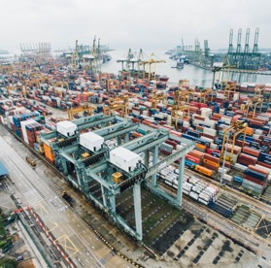
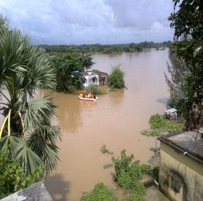
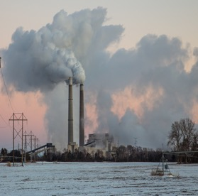
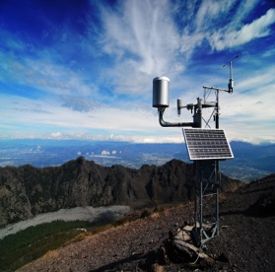
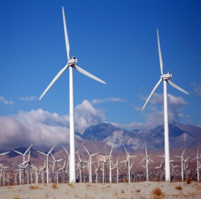
Systematic Climate Observations
Monitoring for planning adaption to climate change: projections and risk estimation
Monitoring of implementation of adaption (urban change, infrastructure, agriculture, …)
Paris Agreement and its Global Stocktake
Financial Support
Provision of Capacity Building
Technology Transfer
Monitoring of Land categories and forests: Mitigation, Adaptation, …
Monitoring for Emergency Warning systems, projections and risk assessments
Mitigation
Adaptation
Monitoring anthropogenic fluxes of GHGs, natural sources and sinks, & carbon cycle
Monitoring global temperature
Transparency framework: reporting
Measuring progress towards goal
Overall impact of NDCs: state of the climate, global water cycle and energy fluxes
Monitoring to support renewable energy, winds, water etc.
Capacity Building
Provision of financial support

Slide 10
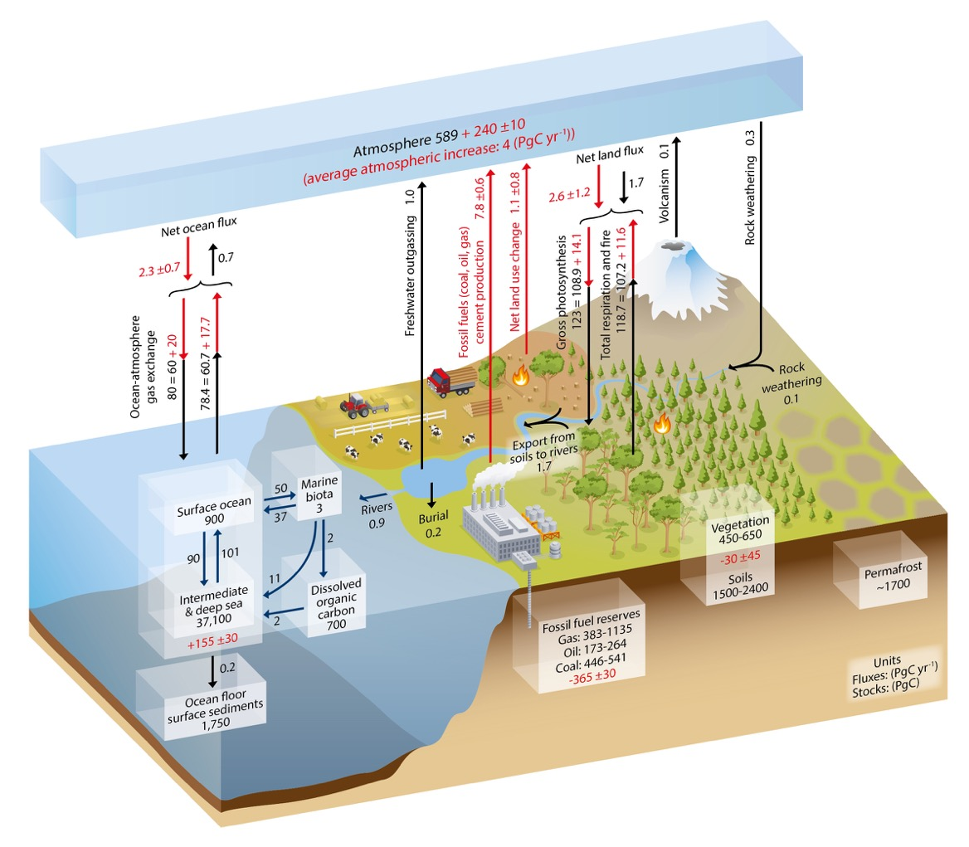
Improving observations of the Global Carbon Cycle
Atmospheric concentrations
Fire
Biosphere
Land Use Change
Ocean Carbonate System
Anthropogenic Emissions
Permafrost
SOURCE: IPCC AR5, IPCC 2013
Coastal Areas
River Discharge
Soil Carbon

Slide 11
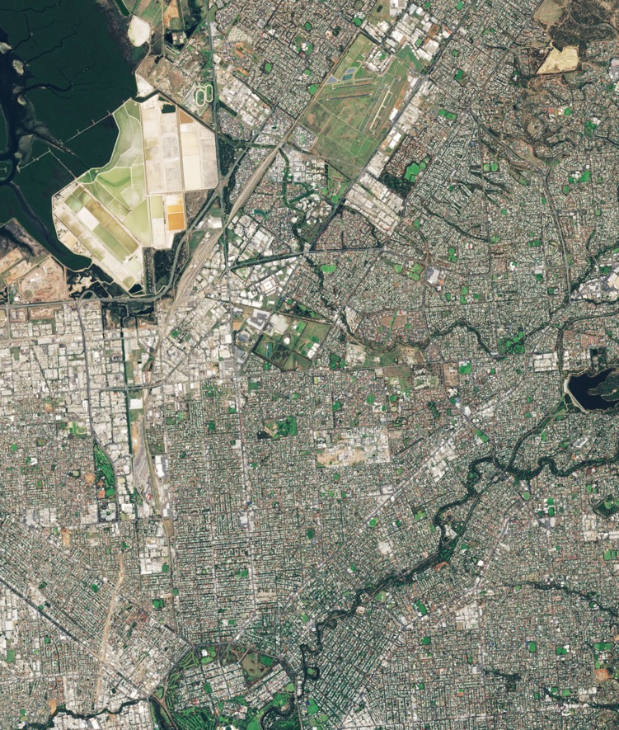
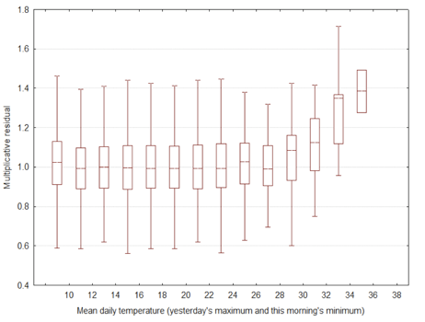
Example of potential remote sensing of implementation of adaption actions
Expected Mortality leads to Actions to cool Cities
Overall impact of these actions can be monitored remotely
Adelaide. SOURCE: modified Copernicus Sentinel data (2017), processed by ESA, CC BY-SA 3.0 IGO
GCOS Task Team on Adaptation, Terrestrial Observation Panel for Climate, Nigel Tapper, 2018.

Slide 12
Indicators
Part of the Communication Strategy.
For describing the rate and range of climate changes, and also becoming an input into the UNFCCC

Slide 13
Climate Indicators
Global Indicators
Indicators under development
Temperature and Energy
Atmospheric Composition
Ocean
Cryosphere
Biosphere
Supplementary Indicators
Surface Temperature
Atmospheric CO₂
Ocean Acidification
Glacier Mass Balance
Ocean Heat
Sea Level
Arctic and Antarctic Sea Ice
Water
Heat Waves
Heavy Precipitation
Ecosystem change
Droughts
Methane
Top of atmosphere energy balance
N₂O
Snow extent
Halocarbon GHG

Slide 14
Mean Temperature
Ocean Acidity
Atmospheric CO₂
Glacier Mass
Balance
Global mean temperature anomalies, with respect to the 1850–1900 baseline, for the five global datasets (Source: UK Met Office Hadley Centre)
Trends in surface (< 50 m) ocean carbonate chemistry calculated from observations obtained at the Hawaii Ocean Timeseries (HOT) Program in the North Pacific over
1988–2015. Seawater pH (black points, primary y-axis) and carbonate ion concentration (green points, secondary y-axis). Ocean chemistry data were obtained from the Hawaii Ocean Timeseries Data Organization & Graphical System (HOT-DOGS). (Source: US National Oceanic and Atmospheric Administration (NOAA), Jewett and Romanou, 2017)
Globally averaged mole fraction (measure of concentration), from1984 to 2016, of CO2 in
parts per million (left), CH4 in parts per billion (middle) and N2O in parts per billion (right). The red line is the monthly mean mole fraction with the seasonal variations removed; the blue dots and line depict the monthly averages. (Source: WMO Global Atmosphere Watch)
Mean cumulative mass balance of all reported glaciers (blue line) and the reference glaciers (red line). SOURCE: world glacier monitoring service http://wgms.ch/
Ocean Heat Content
Sea Ice Extent
Sea Level
Change
Arctic
Antarctic
Global ocean heat content change (x 1022 J) for the 0–700 metre layer: three-monthly means (red), and annual (black) and 5-year (blue) running means, from the US National Oceanic and Atmospheric Administration (NOAA) dataset. (Source: prepared by WMO using data from NOAA National Centers for Environmental Information)
Global mean sea-level time series (with seasonal cycle removed), January 1993–January 2018, from satellite altimetry multi-missions. Data from AVISO
(Source: Collecte- Localisation-Satellite (CLS) – Laboratoire d’Etudes en Géophysique et Océanographie Spatiales (LEGOS))
September sea-ice extent for the Arctic, and (right) September sea-ice extent for the Antarctic. Percentage of long-term average of the reference period 1981–2010 (Source: prepared by WMO using data from the US National Snow and Ice Data Center)

Slide 15
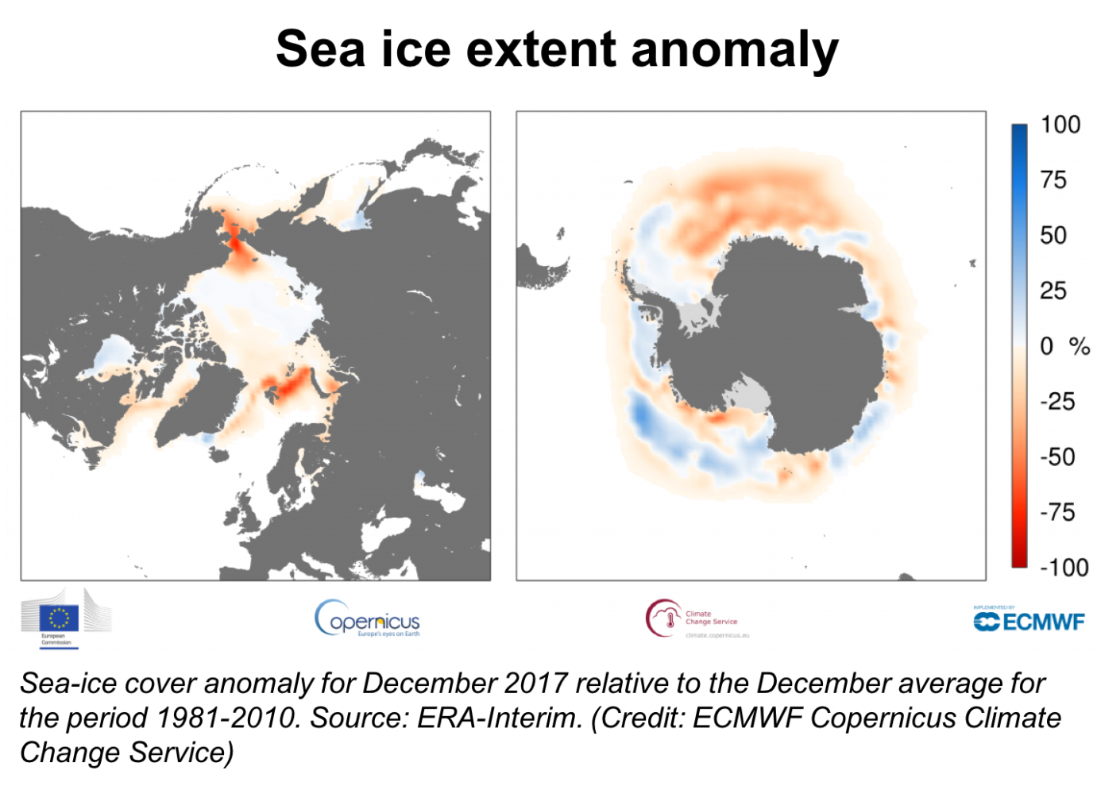
Global Climate Indicator – Sea-ice

Slide 16
Global Climate Indicator - Composition
Net global annual fluxes of CO₂ , CH₄ and N₂O into the atmosphere are estimated by the Copernicus Atmosphere Monitoring Service flux atmospheric inversion systems.
Data source: CAMS greenhouse gas flux data, Credit: Copernicus Atmosphere Monitoring Service/ECMWF
The figure on the left shows the CO₂ atmospheric content at the end of the last ice age, and the figure on the right shows recent atmospheric CO₂ content. Credit: WMO Global Atmosphere Watch (GAW) Program.

Slide 17
Requirements for Anthropogenic Greenhouse Gas Fluxes
Products | Resolution | Required measurement uncertainty | Standards/ References
Emissions from fossil fuel use, industry, agriculture and waste sectors | By country and sector | Globally 5% Nationally 10% | IPCC (2006) IPCC (2013)
Emissions/ removals by IPCC land categories (Forestry and Land Use Change)
Estimated fluxes by inversions of observed atmospheric composition - continental | 1 000–10 000 km | 10%
Estimated fluxes by inversions of observed atmospheric composition - national | 100–1 000 km | 30%
High-resolution CO₂ column concentrations to monitor point sources | 1 km | 1ppm
Source: GCOS-200, Annex A.
These should be regarded as aims – they cannot all be achieved now

Slide 18
Time Plan
2023 Global Stocktake
 | 2017 |  |  |  | 2018 |  |  |  | 2019 |  |  |  | 2020 |  |  |  | 2021 |  |  |  | 2022
 | Q1 | Q2 | Q3 | Q4 | Q1 | Q2 | Q3 | Q4 | Q1 | Q2 | Q3 | Q4 | Q1 | Q2 | Q3 | Q4 | Q1 | Q2 | Q3 | Q4 | Q1 | Q2 | Q3 | Q4
Adaptation Workshops (users&coastal)
Hold Regional Workshops |  |  |  | Pac |  |  | Afr |  |  |  | TBD |  |  | TBD |  |  |  | TBD
Strategy & Comm. Plan |  |  |  |  |  | EC |  |  |  | Cg
Indicators
Science Conference
Revise 2015 Status Report |  |  |  |  |  |  |  |  |  |  |  |  |  |  |  |  |  | AR6 WG I | AR6 WG III | AR6 WG II
Revise IP-2016
Review of ECV rqmts, Review of adequacy of ECV observations, Monitor progress on IP actions
.

Slide 19
The new GCOS Strategy is being considered by the partners before its final adoption. The Paris Agreement is a major driver for climate observation needs. Adaptation is a significant element of the new GCOS Implementation Plan. It is an extremely important aim of the Paris Agreement. GCOS will submit to COP24/SBSTA49 a paper on “Systematic Observations and the Paris Agreement” (to be approved by GCOS SC-26, 22-26 October 2018)
Indicators are describing the rate and range of climate changes, and also becoming an input into the UNFCCC.
GCOS Workshop: Use of space-based ECVs for climate adaptation, 6-7 February 2019, WMO, Geneva, preceded by TOPC TT Adaptation meeting, 4-5 February 2019.
@gcos_un
gcos.wmo.int

