Slide 1

Space Climate Observatory
Committee on Earth Observation Satellites
Selma Cherchali, SCO programme director, CNES
CEOS Plenary 2018
Agenda Item 2.2
Brussels, Belgium
17 – 18 October 2018

Slide 2



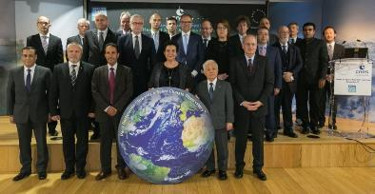
Space Climate Observatory
International framework
…
Illustration by David Parkins
Nature 514, 30–31, Oct. 2014
One Planet Summit – Paris, December 11th, 2017

Slide 3



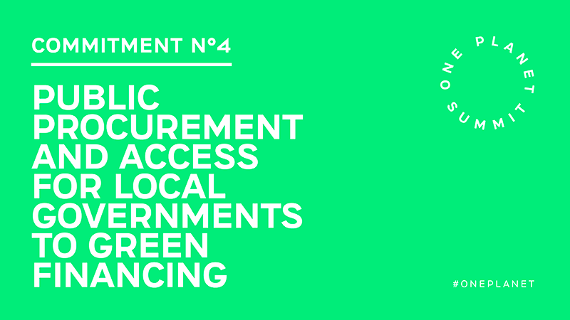
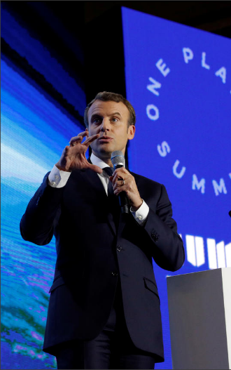








Space Climate Observatory
French Government Identifies 12 key One Planet Commitments
Creation of a Space Climate Observatory
Instigated by the French Space Agency, a Space Climate Observatory has been created in order to provide States and the scientific community with all the space data necessary for monitoring the health of our planet. This initiative is supported by all European space agencies, as well as other States including China, India, Russia, Mexico, Morocco and the United Arab Emirates. Access to interoperable space-based earth observation data will be a significant step forward in the earth monitoring system.

Slide 4
Space Climate Observatory
Scope
“Space Climate Observatory”
A world observatory of
the climate change and its impacts
from Earth Observation data
  Satellite data
      Earth observations at global, national and territories level
  Climate change and its impacts
      Humankind, both as anthropogenic causes and as the victims of their impacts (temperature increase, sea level rise and hazards,..)
  a joint Observatory
      A World Heritage system
      A country, an agency, an institution… could not make it for all the world/Planet
  http://spaceclimateobservatory.org

Slide 5
Space Climate Observatory
Scope
Monitoring climate change
Tracking the impacts of climate change
Environmental impacts
Mitigating and Adapting to climate change
Resources: land use, agricultural practices, relocation, water use…
Population: Migration of people, food security…
Atmospheric CO₂ concentration,
Sea level rise, Droughts and floods…
Global temperature, Clouds and Precipitation change,
Economical costs
Social and human impacts
Biodiversity reduction
Socio-economic development paths

Slide 6
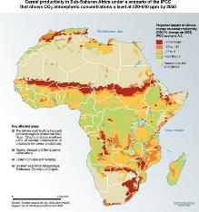
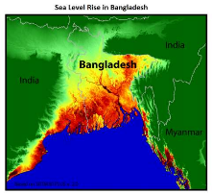
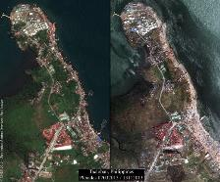
Space Climate Observatory
Country, sub-national / Territorial Stakes
  Climate change impacts are worldwide but there are also specific impacts at national, sub-national and territory levels
  Public access to data, tools and knowledge products
    Countries and territories level involvement
    A need for indicators to monitor the impacts at the right scale : specific needs (Paris Agreement, article 7) and elaborate scenarios of projections
  Need to implement attenuation and adaptation policies
    Decision Making
    Meaningful stakeholder involvement
  Need to marshal our forces through collaboration, partnerships, knowledge networks
    Co-construction (bilateral and / or multilateral cooperation)
Continental scale
Climate Change Impacts
Country scale
Territorial scale

Slide 7



Space Climate Observatory
Objectives
Feedback
Satellite data
2
1
3
Information, Outreach
Communication, Learn
Products & Services
ECV
Improve data access
(unified web interface)
Quality Control and Validation
In-situ data
Indicators, maps, scenarios
(past, present & future)
Research
&
Education
Government
&
Society
Traditional
&
New Medias
Toolkits and computing capacities
Socio-economic data

Slide 8
Space Climate Observatory
3 – Products & Services
Earth Observation Data
Spatial Products & ECV
(e.g. Data: Landsat images, SWH, ASTER, Radarsat, Copernicus data, etc.)
(e.g. Global or Local Products:
land cover, sea level rise, soil moisture, ice thickness, atmospheric concentration, gridded precipitation, etc.)
Products
&
Services
Co-construction
  Communities of development
  Make available to others, freely
  Exchange of use, best practice
Model outputs
National, Regional and
Local datasets
(e.g. Research: physics,
statistics, economics, socials, etc.)
(e.g. In-Situ measurements: weather, discharge, crop production, etc.)
(e.g. Statistical information: administrative areas, environmental, social and economic indicators)

Slide 9















Space Climate Observatory
Access
National SCO
Data Center
Space Agencies
International
Organization
National SCO
Products & Services
…
…
SCO – HUB
Data access, Information, Products & associated Services
but always
but always
End Users

Slide 10








Space Climate Observatory
SCO architecture – Global vs. National
National
Cognitive
Science
AI
Human, Social and Economic Sciences
« IR Système Terre »
International
Climate Change
&
Impacts
France
Big data
Socio-Economic
Data
DINAMIS

Slide 11
Space Climate Observatory
In summary -> An international and ambitious Program
  At level of populations
    Metrics and social indicators to measure the appropriation and acceptance by stakeholders
  Co-construction
    Communities of practice, enhance contribution and cooperation, sharing expertise
    Adapt the methodology/models/chains to country level needs – capacity building
  Open to all
    Inclusive international dimension
    A country, an agency, an institution… could not make it for all the world/Planet
    Transverse to Climate, Land, Ocean, Coastal… communities but also to social and economic science and communities

Slide 12

Space Climate Observatory
Schedule
Paris Declaration “Towards a space Climate Observatory”
Space Agencies
11 Dec. 2017
One Planet Summit “Creation of a Space Climate Observatory”
French Government – Commitments N°5
12 Dec. 2017
Nomination of a Head of SCO Program and Project Manager
CNES
2 Feb
2018
Definition of international dimension of SCO
Space Agencies, Organizations
May 2018
Toulouse Space Show (TSS) - Public demonstration, use cases
CNES, CNSA, CRTS... (open to international partners) Signature of an Agreement with CNSA
Jun. 2018
Phase 1
2nd meeting of One Planet Summit, New York, September 26
Until Nov.
Sep 2018
First International meeting, January 2019
Signature of an international charter / agreement, Nairobi
Dec. 2018
Mar 2019
…

