Slide 1
CEOS Work Plan Progress Report & Update
Committee on Earth Observation Satellites
Steven Hosford
CEOS Executive Officer
CEOS Plenary 2018
Agenda Item 1.2
Brussels, Belgium
17 – 18 October 2018

Slide 2
Its not rocket science!

Slide 3
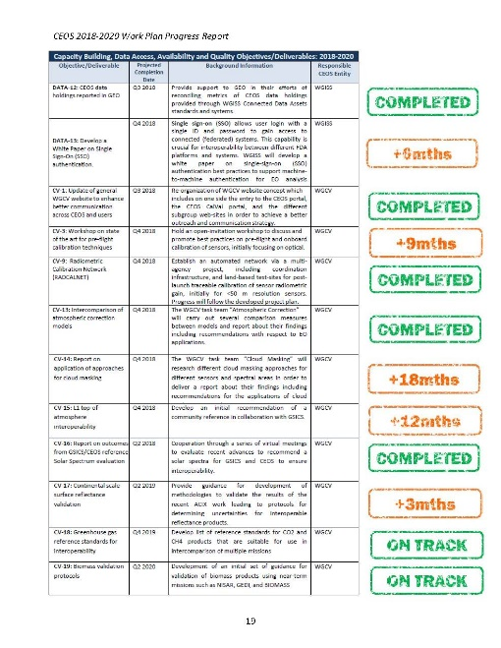
Overview
Progress against CEOS 2018-2020 Work Plan
Overview
Issues
CEOS 2019-2021 Work Plan Development
Proposed changes to WP
Schedule

Slide 4
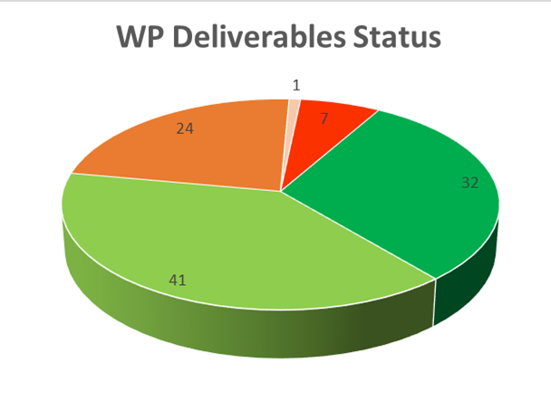
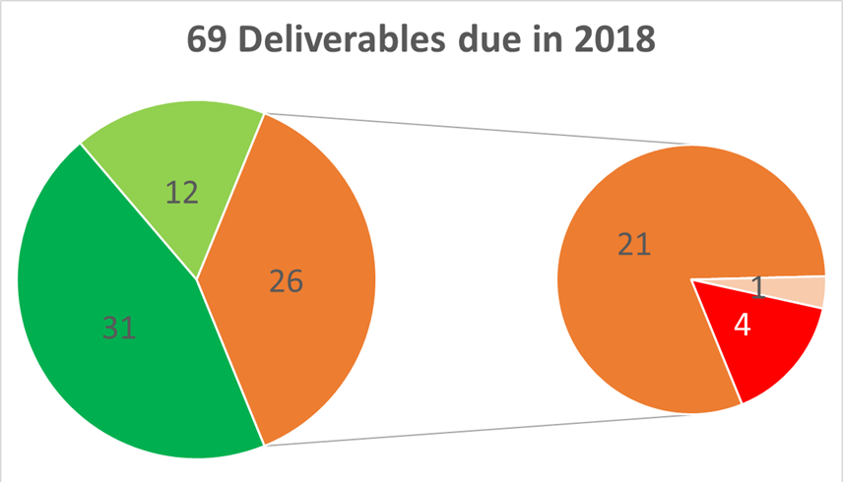
Progress against 2018-2020 WP
Good progress made! (see detailed WP Progress report)
Updated information provided on 93% of deliverables
All WP: 69% Completed/On track, 23% delay + new due dates
Due 2018: 62% Completed/On track, 30% delay + new due dates
Need to stay on track!

Slide 5
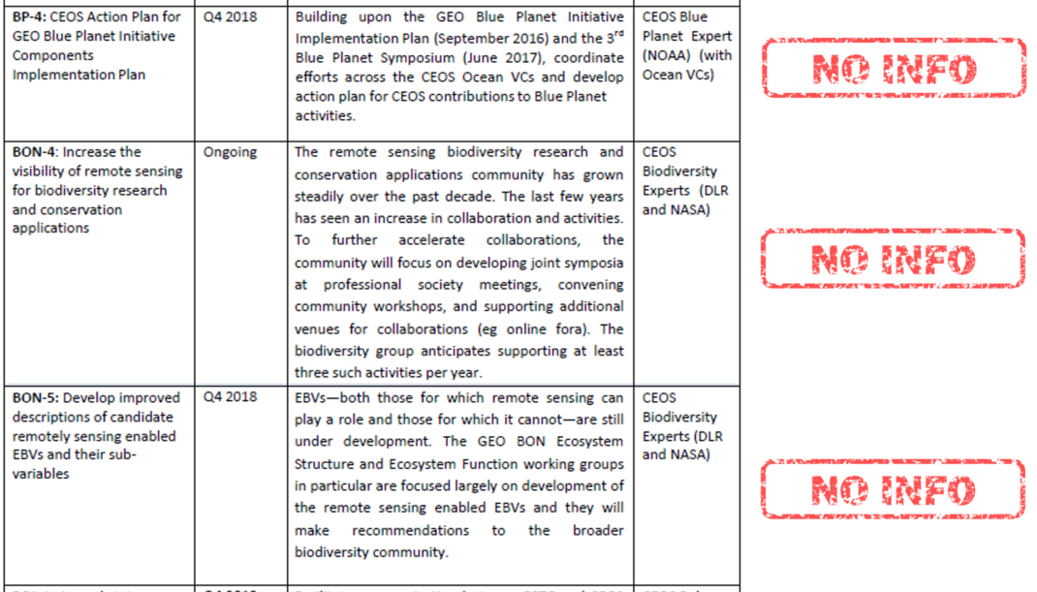
Naming and shaming
Information provided since 30th September

Slide 6
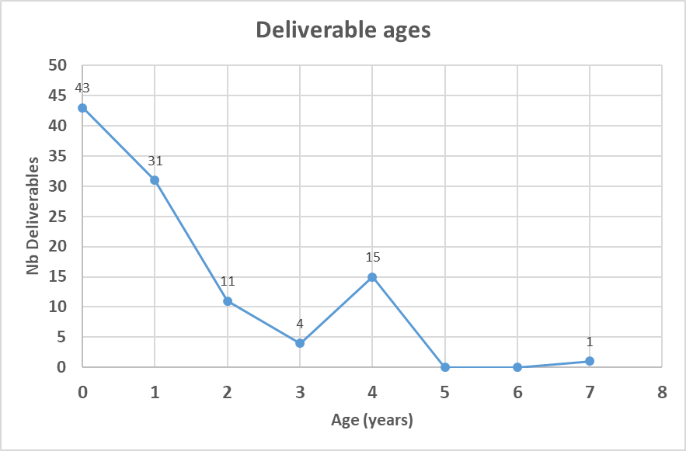
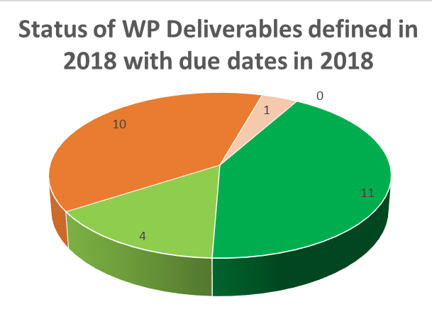
Progress against CEOS 2018-2020 Work Plan
end
2017
No Deliverables, when defined, are anticipated as >3years old whereas some live to 7years!
40% of our deliverables to be completed within the year 2018 are delayed
Need to improve due date estimates!

Slide 7
Work Plan Issues
Collectively, we
ALWAYS define short-term deliverables (initially always within 3 years) … despite the fact that a third of these are likely to continue longer
Take a longer term less “optimistic” view?
OFTEN get deliverable due dates wrong … even when the due date is within the same year
Improve estimation of due dates
NEVER modify due dates to outside the time period covered by the Work Plan (coming 3 years) … even when there is a significant chance that some deliverables will be completed later
Allow due dates longer than the period covered by the Work Plan
Provide more detailed deliverable descriptions including milestones and resource estimates

Slide 8
2019-2021 WP Development
- Proposed changes
Using the WP to improve work traceability
Better define WP deliverables
Who: CEOS entity (+ nominative), Contributing agencies (+nominative), Resource estimates
What: More detailed deliverable descriptions and breakdown into milestones (where relevant)
When: Temporal information on milestones/resources
… gradual implementation/upgrading of deliverable tracking tools.
Links from CEOS WP deliverables to GEO Work Programme elements
As the Space Arm of GEO, we need to know where our work is supporting the implementation of the GEOSS.

Slide 9
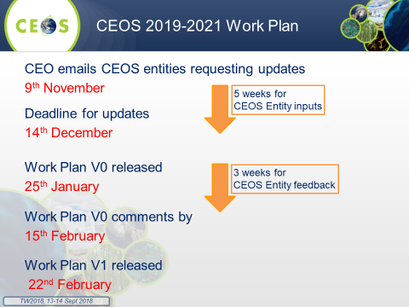
24th CEOS Plenary (2010), Agenda Item 9
2019-2021 WP Development
- Proposed changes
Proposed changes
Link to GEO WP

Slide 11
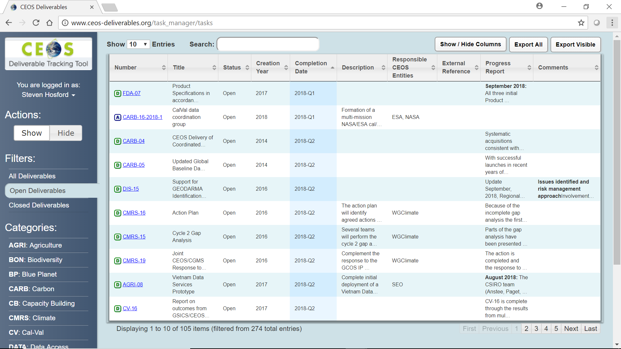
2019-2021 WP Development
- Proposed changes
Agency-driven top-down requests
During WP development - open call to CEOS agencies to propose new CEOS deliverables
Requirement for deliverable to be carried by a CEOS entity
Need for consultation with responsible CEOS entity prior to submission to WP
Modify the ceos-deliverables.org deliverable tracking tool to record
Cumulative number of months due date has been set back for every deliverable
Nb of times due date has been set back

Slide 12
CEOS 2019-2021 Work Plan
CEO emails CEOS entities requesting updates
9th November
Deadline for updates
14th December
Work Plan V0 released
25th January
Work Plan V0 comments by
15th February
Work Plan V1 released
22nd February
5 weeks for
CEOS Entity inputs
3 weeks for
CEOS Entity feedback

Slide 13
Conclusions
Good progress made against deliverables due in 2018
Need to remain vigilant to complete “On Track” deliverables
Renewed emphasis from CEOS leadership means CEOS entities using WP more and more as a tool to define and monitor their work
Several improvements to be implemented in coming year including:
Standard reporting
Nominative deliverable ownership (in addition to CEOS entity)
Improve deliverable descriptions and due date estimates
Improve online deliverable tracking tool
Define links into GEO

