Slide 1
Membership proposal for CEOS
Committee on Earth Observation Satellites
National Institute of Environmental Research
CEOS Plenary 2018
Agenda Item #1.2
Brussels, Belgium
17 – 18 October 2018

Slide 2
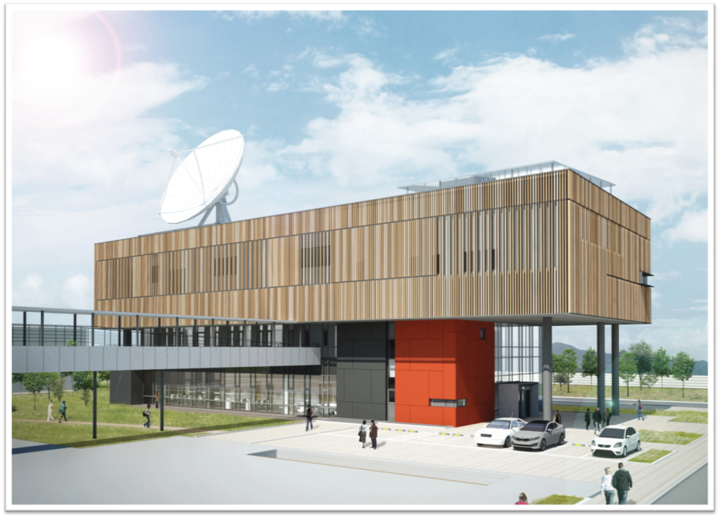
Introduction of NIER
NEPI established(1978)
*National Environmental Protection Institute
NEPI expanded as the NIER(2005) *National Institute of Environmental Research
NIER conducts research - environmental health - climate & air quality - resources and energy - water, soil, …
GEMS will be launched(2019~2020) and operated for 10 years
GEMS mission start(2009~)
ESC established(2018)
*Environmental Satellite Center

Slide 3
The Roadmap for Satellite Missions
NIER will continue to pursue satellite missions to monitor air quality and climate change
Present
Future plans
GEMS* (GEO)
Greenhouse
gas
Satellite
(LEO)
GEMS-II
(GEO)
2029 Launch(TBD)
2025 Launch(TBD)
2029~2039
2019.10 Launch
2025~2030
2019~2029

Slide 4
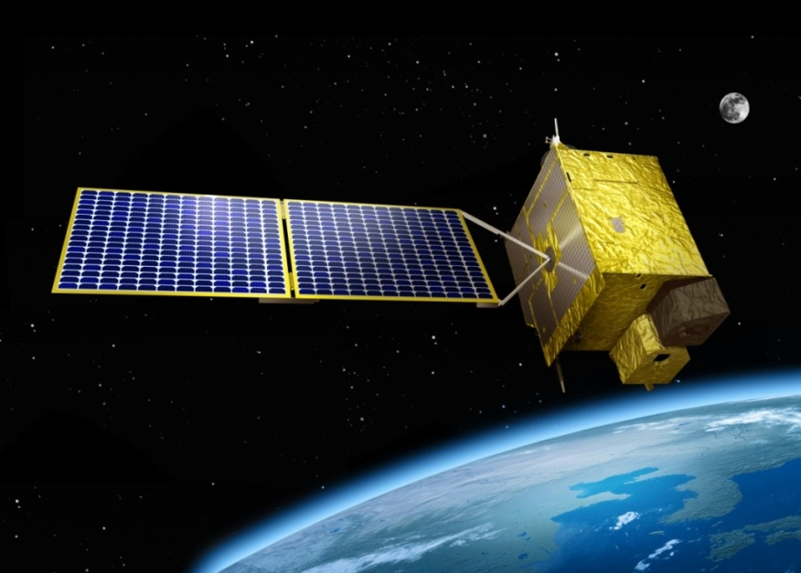
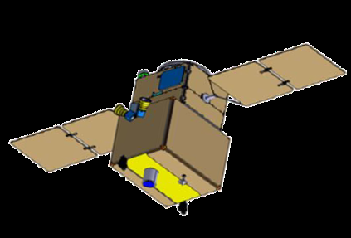
Ongoing NIER’s Satellite Missions
MISSION | GEMS | Compact Advanced Satellite
FOCUS | Short lived species in troposphere | Long lived species in troposphere and stratosphere
ORBIT | Geostationary | Low Earth Orbit
COVERED AREA | Hourly over East Asia | Daily global
AIR QUALITY | NO₂, O₃, Aerosol, HCHO, SO₂
CLIMATE | Aerosol, O₃ | O₂, CO₂
STATUS | Assembly completion (Payload, Bus), Launch: Oct.,2019 ~ Mar.,2020 | In planning

Slide 5
The Role of NIER ESC in GEMS mission
GK-2 Prog. Office (MSIT)
GEMS Program Office (NIER ESC, Ministry of Environment)
Instrument
AQ Model
Cal/Test
L0-1b Dev., Proc.
L1b data
CTM
AQ forecast
Ground Station
L0-3 Proc.
Retrieved data
Data service
Algorithm
Post Cal. Dev.
L1b-2 Dev.
KARI, BATC
NIER AQF center
Science team
NIER ESC
Data Assim.
CAL/VAL
The Satellite Operations Center(SOC) will be operated by Korean Aerospace Research Institute(KARI).

Slide 6
NIER’s effort to achieve in CEOS
Improving satellite data quality through collaboration in instrument calibration and algorithm development.
Maximizing the efficiency in service improvement, utilization expansion, and policy contribution by data release and feedback.
Improving the accessibility of satellite data through the standardization of data and its format
Maximizing the mutual synergy of data utilization with CEOS members.

Slide 7
NIER’s contribution to CEOS
Reflecting the global atmospheric environment issues discussed in CEOS meetings on the next mission plan.
Share experience of the development process, such as retrieval algorithm, validation results, application field.
Supporting researches regarding air pollution and climate change from formation-flying with other satellites.
Supporting the international user community on observation activities.
Collaborating to resolve the issues on global atmospheric environment and strengthen the inter-complementarity and compatibility between global satellites

Slide 8
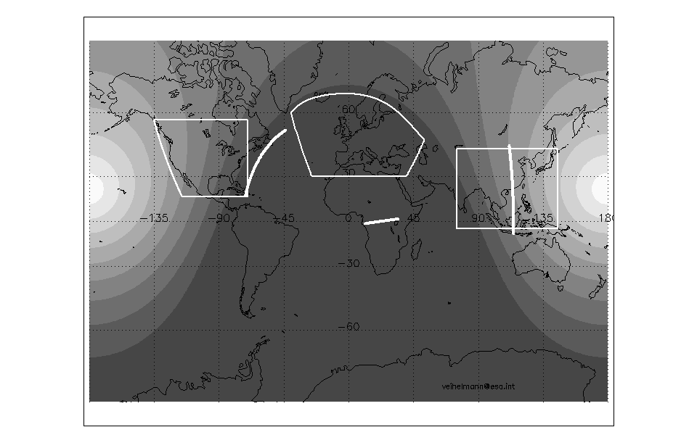
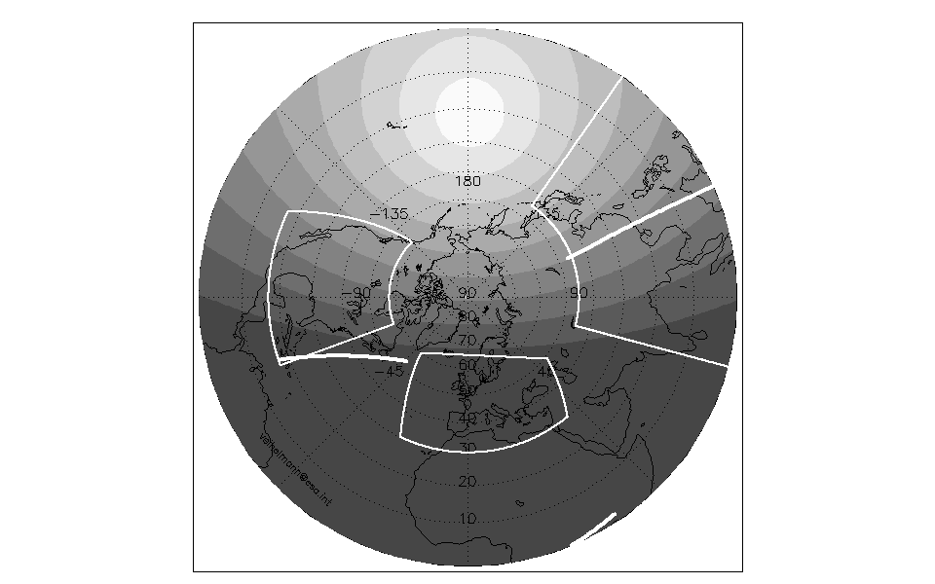
Plan for Formation-flying in CEOS ACVC
Sentinel-5P
TEMPO
Sentinel-4
GEMS
GEMS
TEMPO
Sentinel-5P
Sentinel-4
Constellation synergy on improving spatial and temporal coverage to monitor globalized pollutants & SLCF
Sharing basic requirements on data products and instrument to maintain data quality
Consolidating socio-economic benefit analysis
Supporting QA and CAL/VAL

Slide 9
Summary
National Institute of Environmental Research(NIER) desires to become a member of CEOS.
NIER has developed the Geostationary Environment Monitoring Spectrometer (GEMS) to improve capabilities to monitor and forecast climate change and air quality in East Asia.
After GEMS launch(Oct.2019-mar.2020), the NIER will process received data into useful forms and serve consistently and indiscriminately to the public.
Since the 12th CEOS AC-VC meeting in Seoul, South Korea in 2015, NIER has been participating in the annual AC-VC meeting.
Now, NIER would like to extend its participation in CEOS with contribution to CEOS and achievement of reasonable efforts.

Slide 10
Ending
Thank you for your attention

Slide 11
Presenter Guidance
Presenters should name their files using the following convention:
AgendaItemNumber_LastName_Subject_Version.pptx (e.g., 1.5_Holloway_Communications_v2.pptx)
Reporting to support discussion or decision is encouraged, but historical context and detailed reporting should be provided as pre-meeting reading material or in background slides.
Materials should explicitly highlight the decisions, endorsements, outcomes, or actions you are seeking at Plenary. The more explicit you are with the required actions, the better. i.e., do feel free to propose draft action text for consideration – it may be revised, but will help with the efficient preparation of the Plenary actions record.
Materials should be sent to matthew@symbioscomms.com and Luc@plusci.be
Documents for endorsement: no later than Wednesday October 3rd
Presentations: no later than Wednesday October 10th

