Slide 1
CEOS Membership Issues
Committee on Earth Observation Satellites
Steven Hosford
CEOS Executive Officer
CEOS Plenary 2018
Agenda Item 1.2
Brussels, Belgium
17 – 18 October 2018

Slide 2
Summary
CEOS context & reminders
Current status
Rights and Obligations
Application procedure
Applications for CEOS Member Status
National Institute of Environmental Research, Korea
United Arab Emirates Space Agency

Slide 3
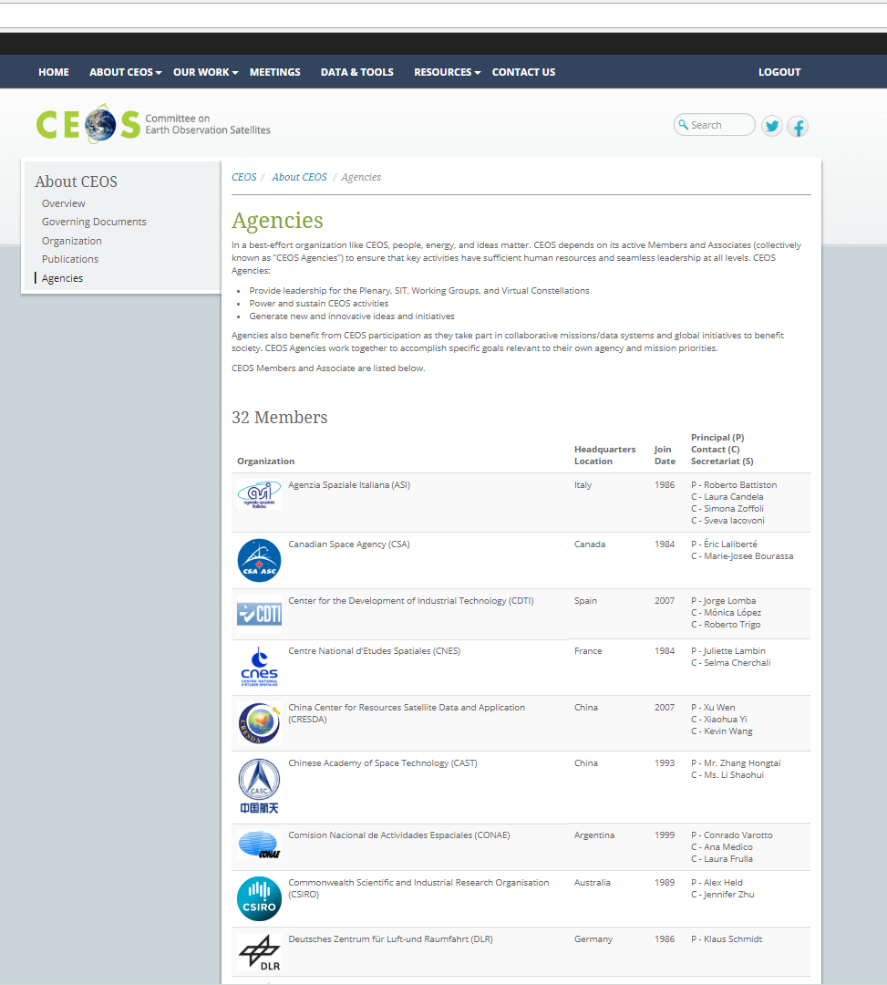
CEOS Context & Reminders
CEOS is
32 Members
Governmental Organisations that are responsible for a civil space-based EO programme
28 Associate Members
Governmental Organisations that have a less mature EO programme or significant ground segment role or satellite coordination groups/ international scientific or governmental bodies
Some “Rights and Obligations” …
Full participation in exchange of technical information on a voluntary basis though WGs/VCs/AHTs (as participant or chair)
Full sharing, CEOS publication and coordination of future programme plans and opportunities
CEOS must be informed promptly of any change in a member’s status with regard to eligibility
Proposed Action: CEO to review CEOS membership by
contacting all CEOS members

Slide 4
CEOS Context & Reminders
Candidates (member/associate member) contact the CEOS Executive Officer
Candidates supply a letter motivating their membership request
Letters are reviewed by CEOS Secretariat
Candidates are invited to present their membership request at CEOS Plenary
Candidates leave the room during Plenary deliberations
Candidates return to room and are informed of Plenary’s decision

Slide 5
Applications for CEOS Member status
Applications for CEOS Member Status
National Institute of Environmental Research, Korea
United Arab Emirates Space Agency

