Slide 1
CEOS Analysis Ready Data (CARD4L) CEOS Analysis Ready Data for Land (CARD4L) are satellite data that have been processed to a minimum set of requirements and organised into a form that allows immediate analysis with a minimum of user effort, and interoperability both through time and with other datasets
Committee on Earth Observation Satellites
Plenary
Session 8: Item 8.3
Rapid City, USA
Wednesday 20 October 2017

Slide 2
The correct slide template is needed!

Slide 3
LSI-VC Membership changes
Bianca Hoersch (ESA co-chair) has moved to a new role in ESA.
ESA have identified Susan Mecklenburg as a follow-on co-chair.
Daniel Wicks has joined LSI-VC from UK Satellite Applications Catapult.
Andreia Siqueira has joined LSI-VC from Geoscience Australia, with a focus on supporting the implementation of the CARD4L framework.

Slide 4
LSI-VC and CARD4L
The Land Surface Imaging Virtual Constellation (LSI-VC) was tasked (Nov 2015) to “Define intercomparable Analysis-Ready Data (ARD) products within the context of land surface imaging”.
CEOS Analysis Ready Data for Land (CARD4L), are satellite data that have been processed to a minimum set of requirements and organized into a form that allows immediate analysis with a minimum of additional user effort, and, interoperability both through time and with other datasets
Framework for establishing ‘minimum requirements’ for products that:
Are ready for ‘immediate analysis’
Require minimal additional user effort to prepare
Interoperable with other CARD4L datasets
Intended to lower barriers and engage new communities of users

Slide 5
CARD4L Status (1 of n)
CEOS Analysis Ready Data for Land (CARD4L)
CARD4L Specification framework presented at SIT-32, in Paris. The framework includes:
The CARD4L Definition - complete
Product Family Specifications (PFS)
PFS are in the implementation phase. PFS provide the detail for analysis ready data land products of various types.
Product Alignment Assessments (PAA)
PAAs are yet to be developed. PAAs will allow data providers to assess how well their products align with the CARD4L specifications, and,
As a basis for independent assessments of alignment.

Slide 6
CARD4L Framework
Data that have been processed to a minimum set of requirements and organised into a form that allows immediate analysis with a minimum of user effort and interoperability both through time and with other datasets.
Product family specifications indicate the threshold and target requirements

Slide 7
CARD4L Status (2 of n)
Product Family Specifications (PFS) have been developed for:
Radar backscatter
Surface Reflectance
Land Surface Temperature
Other PFS will probably emerge, e.g., Radar phase data
Detailed input to the draft CARD4L specifications was received from multiple sources June-Sept 2017, improving the documents and raising awareness of CEOS’ leadership in this area.
A further round of technical teleconferences will happen in 2017 convened by Geoscience Australia (Andreia Siqueira).
Very strong support for CARD4L is indicated by a range of experiences and activities. (UK, ESA, USA-USGS & NASA, Canada, Australia, CNES, etc.).
A proposed special issue of the Journal of Remote Sensing on Analysis Ready Landsat Data indicates the scientific relevance.

Slide 8
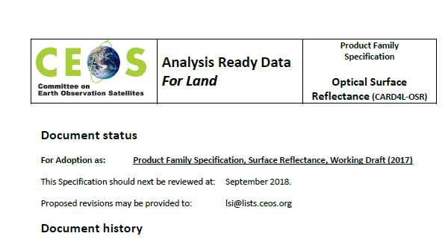
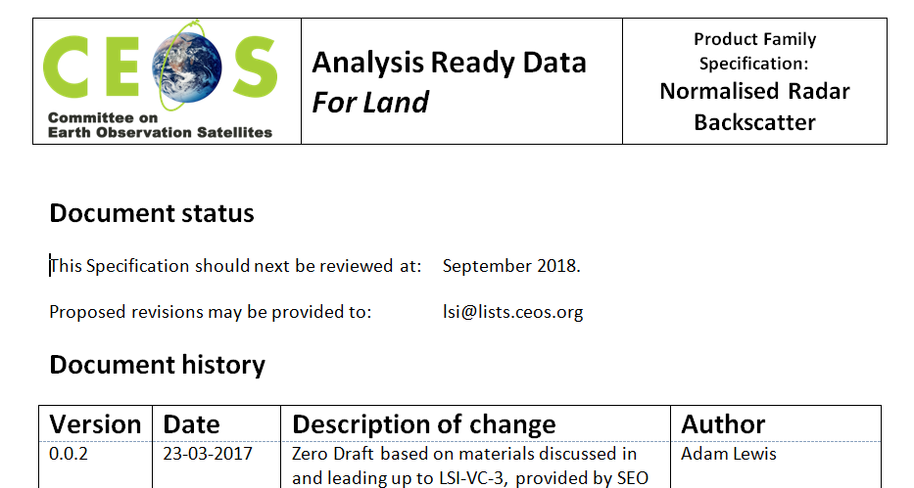
CARD4L PFS documents
Product Family Specifications are technical documents….

Slide 9
CARD4L Status (3 of n)
The importance of CARD4L is also indicated by :
The Moderate Resolution Interoperability (MRI) initiative hosted by LSI-VC and supported by USGS during2017
Analysis ready data is a first step for interoperability
The Future Data Architectures ad-hoc Team (FDA-AHT) recommending :
A broader strategy for CEOS analysis ready data
this was discussed at the SIT Workshop
LSI-VC promote the benefits of CARD4L to providers

Slide 10
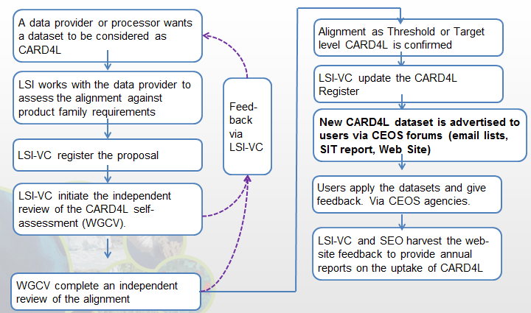
CARD4L Status (4 of n)
LSI-VC will now move into an implementation phase which will have multiple objectives, viz:
‘road-test’ the Product Family Specifications, including through further technical teleconferences.
Develop the process for datasets to be assessed as CARD4L
Identify data products that are on-track to become CARD4L
Monitor and communicate progress of individual products toward CARD4L
Implementation processes are under discussion

Slide 11
CARD4L Status (5 of n)
LSI-VC will also:
Engage with user communities, e.g., through GFOI and GeoGLAM, to capture and communicate user experiences of Analysis Ready Data / MRI
Take steps to promote the CARD4L framework to data providers. These include using the CEOS web site to communicate progress toward CARD4L products.
We expect that data providers will need to be:
Aware of the Benefits of ARD production
Supported to use and ‘own’ the CARD4L framework
Recognised for achievements in production of CARD4L

Slide 12
CARD4L Status – pause for questions?

Slide 13
Analysis Ready Data
Communicating CARD4L to data providers
Actions that LSI-VC / SEO will progress to better engage data providers in CARD4L: | Capture the Benefit | Support the implementation | Recognise the contributions
1. Complete the Framework, including independent assessment, continuous development of the guidance material, and review processes to refine / add / remove product family specifications - publish on the CEOS web site including progress toward Product Family Specifications |  | ✔
2. Develop an on-line list of CARD4L datasets, including the level of maturity (planned; algorithm development; test production; local production; systematic production; continuous improvement) |  | ✔ | ✔
3. Showcase certain CARD4L products – ALOS Global Mosaics; USGS-Landsat Surface Reflectance, and others, including their uses and benefits, on the web site. | ✔ | ✔ | ✔
4. Maintain an open and inclusive team (LSI / FDA ..), seeking welcoming contributions from new players to continue to support the development and maintenance of the Product Family Specifications. |  | ✔
5. Promote CARD4L (ARD) workshops or special sessions alongside conferences and SIT meetings. | ✔ | ✔ | ✔

Slide 14
CARD4L, MRI, and FDA Relationship
Full exploitation of EO data requires CARD4L, MRI, and FDA along with critical user feedback informing future directions
MRI
- Addresses how to combine data / scientific methods to maximize interoperability
CARD4L is the first step to MRI
- MRI provides feedback to CARD4L
FDA
MRI and CARD4L are vital components of FDAs
CARD4L-compliant products feed FDAs
CARD4L
Is the step to get the data ‘ready for’ FDAs and interoperability

Slide 15
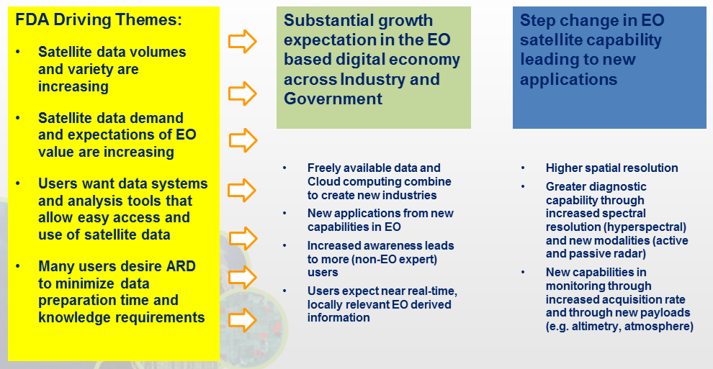
A Broader ARD Strategy?
Background
The FDA-AHT recommended that LSI-VC consider a broader strategy for ARD, i.e., beyond Land (CARD4L). The rationale is that analysis ready data are necessary ..

Slide 16
A Broader ARD Strategy?

Slide 17
A Broader ARD Strategy?
Background
At the SIT Workshop a meeting of the VC’s considered this question
VC meeting outcomes
The meeting noted that, in practice, oceanographic and atmospheric approaches that provide grids of variables such as sea surface temperature (which in turn underlie products such as NOAA coral bleaching warning product) are exemplars of and have provided the guidance for CARD4L
Nonetheless, the CARD4L framework offers a general formalisation of the that may be of value to other VC communities
LSI-VC agreed to provide the other VC’s with the CARD4L framework for their consideration.
FDA-AHT recommendation (to consider a strategy) was retained.

Slide 18
A Broader ARD Strategy?
Considerations
The action from LSI-VC to share the CARD4L framework is and gather feedback is still in train.
A broader CEOS strategy for analysis read data would be beyond the scope of the Land Surface Imaging VC. Other discipline VCs would need to have a stake in the work.
The first step would be for FRD-AHT to clarify the outcomes desired of this task (what benefit is sought?), and to capture the scope.

