Slide 1

FDA Objectives and Implementation Planning
Committee on Earth Observation Satellites
FDA AHT Co-Leads
    Steve Labahn, USGS
    Nick Hanowski, ESA
    Alex Held, CSIRO
2017 SIT Tech Workshop – Agenda Item #3
ESA/ESRIN – Frascati, Italy
13th-14th September 2017

Slide 2
FDA Team
Co-Leads
  Steve Labahn, USGS
  Nick Hanowski, ESA
  Alex Held, CSIRO
Team Members
  Darren Janzen, CCMEO
  Steven Hosford, CNES
  Richard Moreno, CNES
  Rob Woodcock, CSIRO
  Martin Ditter, COM
  Peter Strobl, COM
  Mirko Albani, ESA
  Pier Bargellini, ESA
  Bianca Hoersch, ESA
  Michael Schick, EUMETSAT
  Adam Lewis, GA
  Jonathon Ross, GA
  Gary Geller, GEO Secretariat
  Osamu Ochiai, GEO Secretariat
  Debjyoti Dhar, ISRO
  Koji Akiyama, JAXA
  Andy Mitchell, NASA
  Brian Killough, NASA
  Anne Kennerley, NOAA
  Clement Adjorlolo, SANSA
  Paida Mangara, SANSA
  Willard Mapurisa, SANSA
  Nale Mudau, SANSA
  George Dyke, Symbios
  Matt Steventon, Symbios
  Stephen Ward, Symbios
  Beth Greenaway, UKSA
  Chris Hall, UKSA
  Chris McQuire, UKSA
  Brian Sauer, USGS
  Eric Wood, USGS

Slide 3
Significant Change…
Significant Opportunities
  FDA Driving Themes:
  Satellite data volumes and variety are increasing
  Satellite data demand and expectations of EO value are increasing
  Users want data systems and analysis tools that allow easy access and use of satellite data
  Many users desire ARD to minimize data preparation time and knowledge requirements
  Substantial growth expectation in the EO based digital economy across Industry and Government
  Step change in EO satellite capability leading to new applications
  Freely available data and Cloud computing combine to create new industries
  New applications from new capabilities in EO
  Increased awareness leads to more (non-EO expert) users
  Users expect near real-time, locally relevant EO derived information
  Higher spatial resolution
  Greater diagnostic capability through increased spectral resolution (hyperspectral) and new modalities (active and passive radar)
  New capabilities in monitoring through increased acquisition rate and through new payloads (e.g. altimetry, atmosphere)

Slide 4
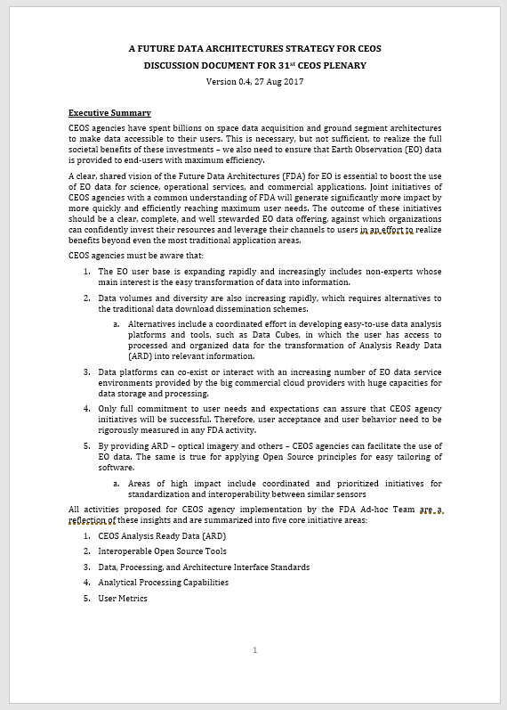
FDA Strategy Document

Slide 5
FDA Themes and Outcomes
CEOS Analysis Ready Data (ARD)
  Implement and provision CEOS Analysis Ready Data for Land (CARD4L)-compliant products
  Advance ARD for marine and atmosphere domains
Interoperable Open Source Tools
  Continue supporting the CEOS Data Cube (CDC) initiative
  Demonstrate new technologies through ongoing support of ‘pilot projects’ and consideration of alternate candidate architectures
Data, Processing, and Architecture Interface Standards
  Develop standards for pixel-level data discovery, access, and common analytical processing requests (e.g., cloud free mosaics of ARD) exploiting EO satellite data among various CEOS exploitation platforms
Analytical Processing Capabilities
  Prototype portable web-based analytical processing APIs/Web Services that work across CEOS exploitation platforms in full computing environments for time series and other analysis
User Metrics
  Develop a data use metrics framework through which agencies can contribute to how EO data is being used, rather than just downloaded data quantities

Slide 6
How Can CEOS Agencies Contribute?
CEOS Analysis Ready Data (ARD) (through LSI-VC):
  Produce ARD data and/or provide ARD production tools
  Expand CEOS ARD to include the ocean and atmosphere domains
  Participate in standard setting and review processes (including user feedback loops for evolution)
  Engage through WGCV to define QA protocols and cross-validation projects across ARD products
  Reach out to commercial providers to encourage their participation in ARD (at their cost)
  Promote and enable discoverability of ARD datasets
Interoperable Open Source Tools (through SEO):
  Promote the use of interoperable open source tools, such as Open Data Cube (ODC), and application algorithms to enhance the use and impact of CEOS satellite data
  Continue to support the CEOS Data Cube (CDC) initiative and progress the development of core components, supporting documentation, and training materials
  Support the initial deployment of the CDC architecture by providing training and capacity building to interested international users
  Contribute application algorithms to the ODC repository along with documentation and case studies

Slide 7
How Can CEOS Agencies Contribute?
Data, Processing, and Architecture Interface Standards (through WGISS):
  Identify key data and metadata standards experts to join WGISS
  Support WGISS in the development of standards that ensure interoperability among one or more FDA platforms
  Support prototype testing of data and application standards to ensure successful implementation
  Identify specialists to join WGISS with expertise in their data holdings to provide guidance on how their holdings are changing to accommodate pixel level access
  Identify key System Engineers, Applications Liaisons, and Communication/Outreach Liaisons to engage with WGCapD in developing strategies to promote FDA paradigms and systems
Analytical Processing Capabilities (through WGISS):
  Identify Data Analysts, System Engineers, and System Architects to join WGISS
  Provide agency computing resources for prototype testing of application algorithms to take advantage of locally stored data or to utilize web-based protocols (e.g., WCS, APIs) for data interaction
  Engage CEOS agencies who have implemented authentication systems to provide their lessons learned and best practices
User Metrics (through WGISS):
  Engage CEOS representatives familiar with user needs analysis and metric reporting
  Support development of universal metric capturing
  Participate in open venues for discussion of abstract CEOS projects (webinars, conferences, etc.)

Slide 8
31st CEOS Plenary
Endorsements
  FDA Strategy for CEOS
Decisions
  Continuation of FDA AHT into 2018 centered around the 5 FDA themes:
    CEOS Analysis Ready Data (ARD)
    Interoperable Open Source Tools
    Data, Processing, and Architecture Interface Standards
    Analytical Processing Capabilities
    User Metrics
  With CEOS Plenary endorsement, FDA AHT plans to continue its work to integrate and oversee the FDA-related activities of several key entities within the CEOS structure – specifically LSI-VC, SEO, WGISS, and WGCapD – and to keep the momentum that has been built

Slide 9
Backup

Slide 10
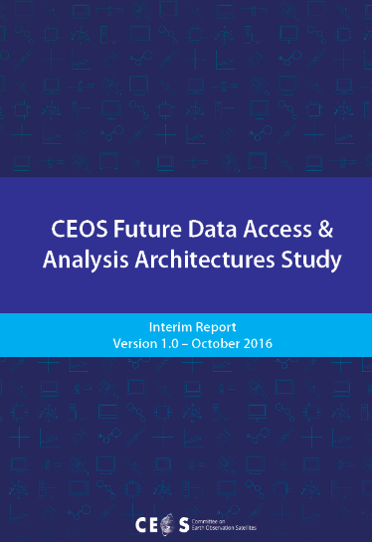
FDA AHT Objectives
CEOS FDA AHT was initiated at the 2015 CEOS Plenary meeting and was tasked with developing a report on the current status of data supply, access, processing, and delivery to provide guidance to CEOS on the potential that new high-performance, cloud-computing technologies can provide.
2016 FDA AHT assessed the potential of new technologies and approaches to bridge the gap between the enormous volumes of Earth Observation (EO) data and the users developing applications to tackle key environmental, economic, and social challenges.
2017 FDA AHT continuing the excellent work from 2016 by pursuing pilot architectures, obtaining end user feedback / best practices / lessons learned, generating CARD4L products, and addressing strategic questions:
  What should CEOS agencies do together?
  When should CEOS focus on supporting agencies to do their own things better (e.g., best practices)?
  What should be ‘outside scope’?

