Slide 1

Overview of Ongoing Efforts in the Water/Ocean Space
Committee on Earth Observation Satellites
Kerry Ann Sawyer
National Oceanic and Atmospheric Administration (NOAA)
CEOS Plenary 2017
Agenda Item # 7.1
Rapid City, South Dakota, USA
19 – 20 October 2017

Slide 2
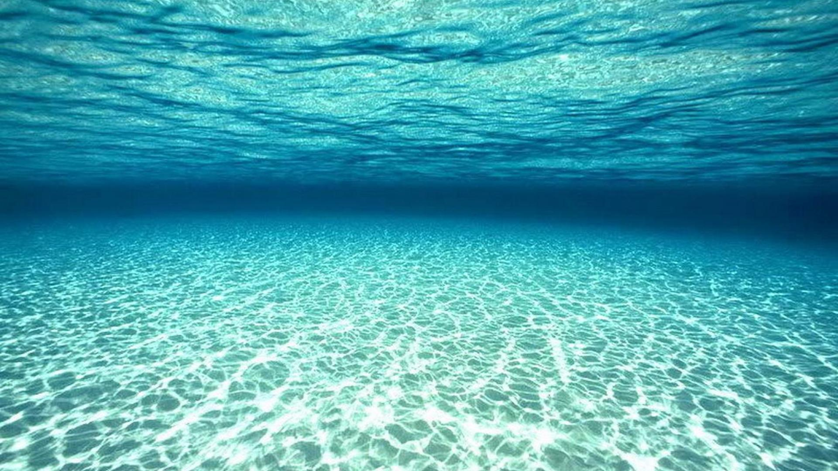
First…Thank you!
Paul DiGiacomo, Selma Cherchali, Brad Doorn, Angelica Gutierrez, Rick Lawford, Vanessa Aellen, Emily Smail, Jorge Vazquez,Vardis Santos, Eric Lindstrom, Nagaraja Rao Harshadeep, Christine Bognar

Slide 3
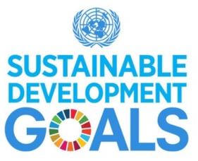
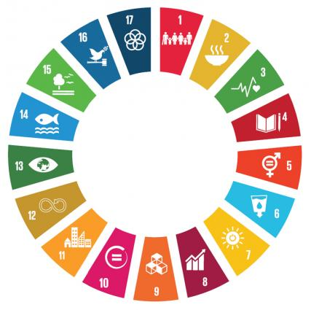





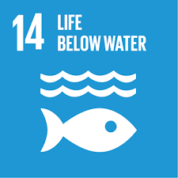





Water is of Interest to Many

Slide 4
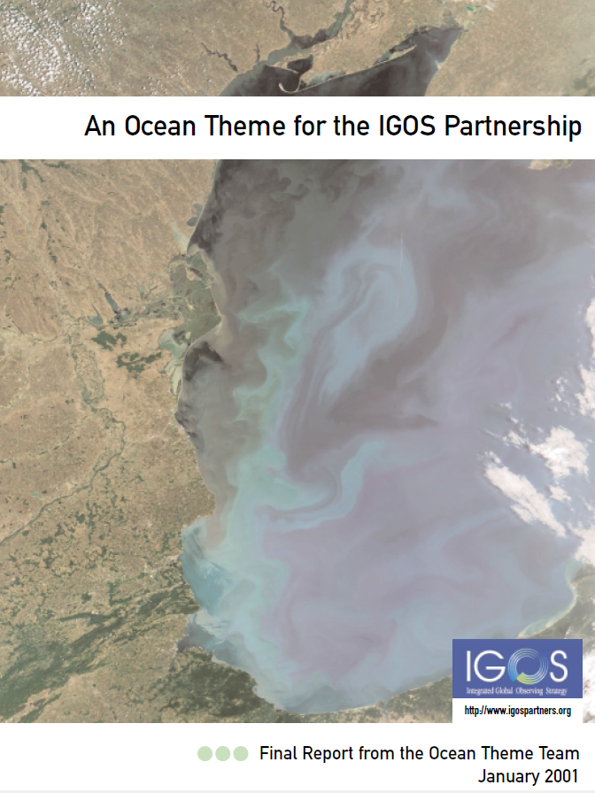
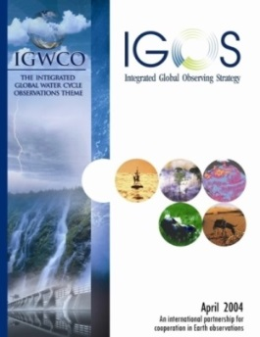
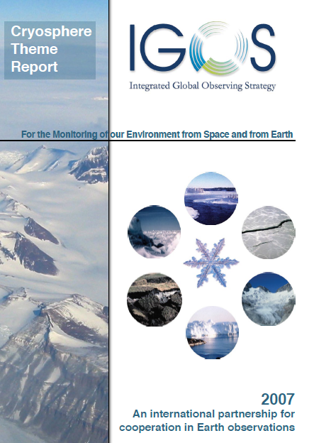
IGOS Water Theme Reports
In the beginning, there were the IGOS Theme Reports….
Ocean Theme Report, 2001
Water Theme Report, 2004
Coastal Theme Report, 2006
Cryosphere Report, 2007

Slide 5

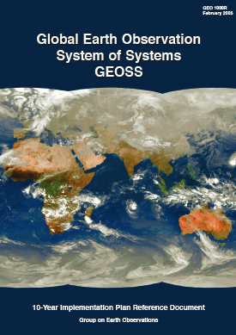
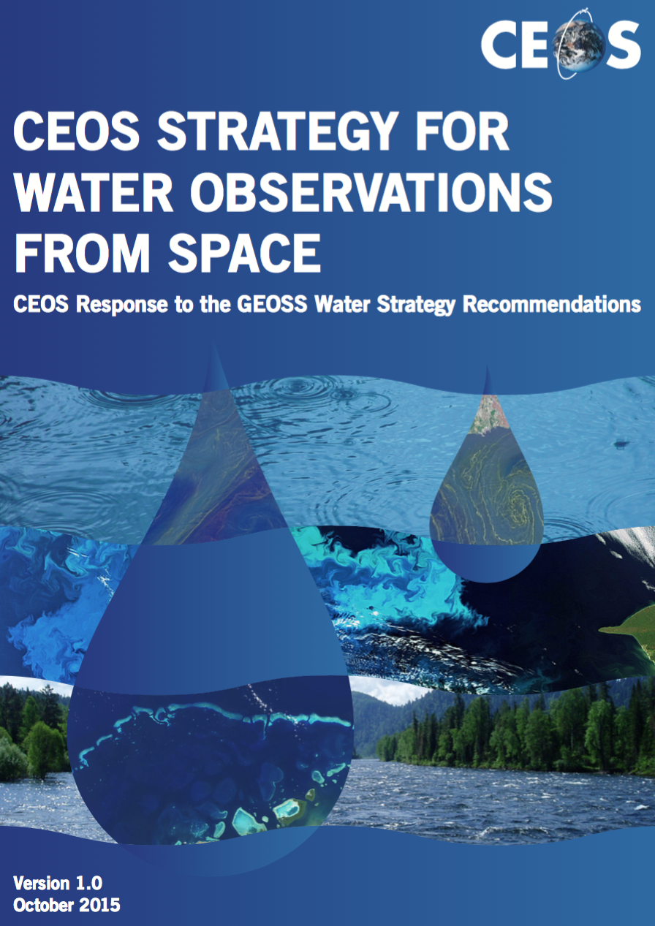
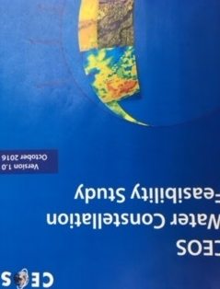
GEOSS and CEOS Water Strategies and Studies
The GEOSS Water Strategy renews the observational component of the community’s efforts to communicate the needs of the Water community within the framework of GEOSS.
CEOS Water Strategy Implementation Study Team (WSIST) prepared the CEOS Water Strategy to the GEOSS Water strategy recommendations.
CEOS also executed Feasibility Study on Satellite Missions/Instruments Focused on Water Quality Measurements (next presentation)
GEO Water Strategy
CEOS Response
IGOS Water Theme report
2004
GEOSS 10 Year
Implementation Plan
2005
GEOSS Water Strategy
2014
CEOS Water Strategy
2015
CEOS Water Constellation
FS,
2016

Slide 6



GEO Water-related Initiatives
CEOS providing critical Earth observations, and in several
instances active support and leadership, for a number of
GEO Water-related Initiatives (details on following slides….)
Led by NASA, NOAA, USGS
CEOS Rep. on Steering Committee (P. DiGiacomo)
Co-Chairs: Arnold Dekker, P. DiGiacomo & Steve Greb
Leads include NOAA (P. DiGiacomo) & CSIRO (Andy Steven)
CEOS Rep to Advisory Board (SIT Vice Chair)
CEOS Blue Planet Expert (P. DiGiacomo)

Slide 7
GEOGLOWS Mission and
Components
To connect the demand for sound and timely environmental information to the supply of data and information about the Earth’s water system and to explore the science needed to achieve the goals outlined in the initiative.
To advocate for broad, open data policies and for the realization of the right to access information
To help ensure that the data collected through national, regional and global observing systems is both made available in the public domain and applied to decision-making.
1. Enhancing Global Water Sustainability Sustainable Development Goals Water Scarcity and Access Climate Change Cold Regions | 2. Minimizing Basin and Regional Risk Integrated Water Prediction (IWP) Floods Droughts Transboundary Issues (IWRM) Water-Energy-Food-Environment-Health Nexus Climate Change Adaptation | 3. Essential Water Variable (EWV) Understanding Water Quality Water Use Water Cycle Variables (Precipitation, Soil Moisture, Groundwater, Evapotranspiration, Stream Flow, Surface Water Storage (Includes Snow Pack))
4. Earth Observations, Integrated Data Products and Applications, and Tool Development 5. Data Sharing, Dissemination of Data, Information, Products, and Knowledge User Engagement, Capacity Building and AmeriGEOSS
These efforts include the satellite aspects of water observations through CEOS and space agencies

Slide 8
GEOGLOWS List of Connection with CEOS
Enhance the added value of Earth Observations to provide the right information for
water resource management.
Provide feedback to CEOS and CEOS agencies on requirements for space-based Earth Observations and facilitate the collaboration across all the agencies in addressing those requirements.
Collaborate with CEOS in developing the tools and environment needed to expand the use of satellite data
With Working groups (WGCapD, WGClimate, WGCV, WGDisasters, WGISS)
With CEOS Virtual Constellations (AC-VC, LSI-VC, OCR-VC, OST-VC, OSVW-VC, P-VC, SST-VC)
  Proposing a SAR-VC (Synthetic Aperture Radar) which would support GEOGLOWS as well as AquaWatch and Blue Planet for (CEOS) Water Activities
With CEOS Ad Hoc Teams (Ad Hoc Team on Sustainable Development Goals, Ad Hoc Team on Future Data Architectures, Ad Hoc Working Group on the Group on Earth Observations (GEO) Global Agricultural Monitoring (GEOGLAM) Initiative,
GEOSS Water Strategy: On going opportunity to collaborate on new area after further discussion with Aquawatch Blue Planet

Slide 9


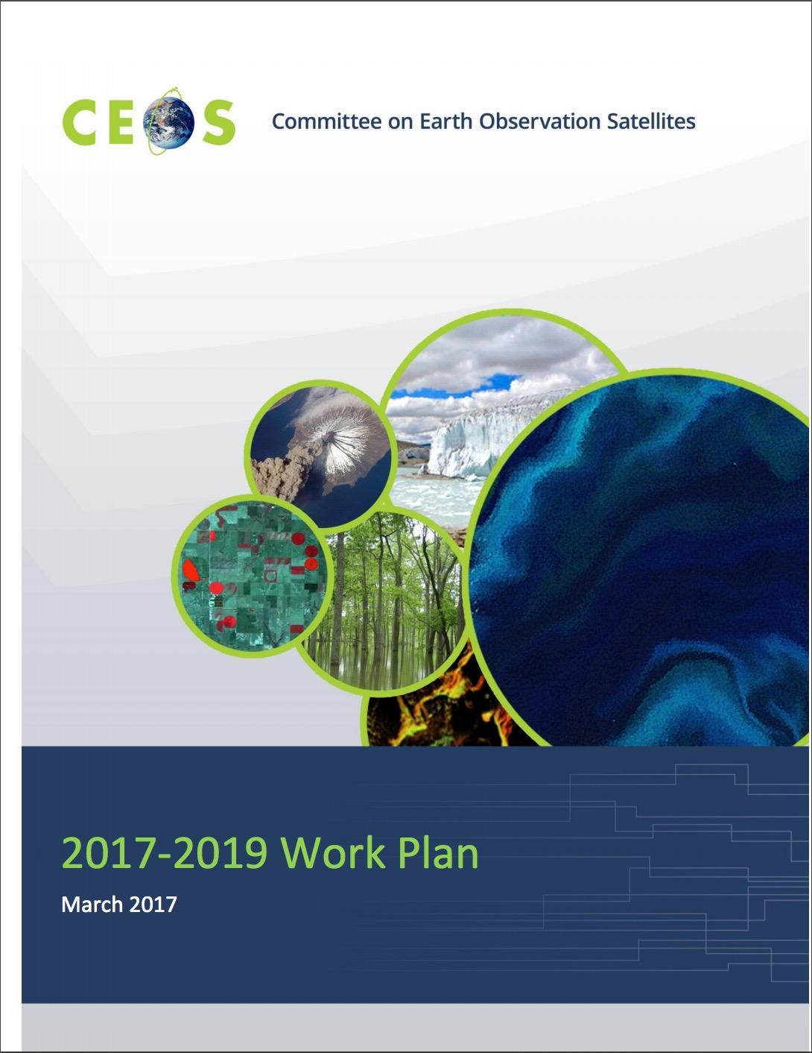








GEOGLOWS – CEOS Possible Synergies
GEOGLOWS Cross-walk to
CEOS 2017-2019 Work Plan
Science, applications
product development
Data dissemination, portals & capacity building
Policy Linkages
EWV
3.1. Climate Monitoring, Research, and Services
3.2 Carbon Observations, Including Forested Regions
3.3 Observations for Agriculture
3.4 Observations for Disaster
3.5 Observations for Water
3.6. Capacity Building, Data Access, Availability and Quality
3.7. Advancement of the CEOS Virtual Constellations
3.8. Support to Other Key Stakeholder Initiatives
3.9. Outreach to Key Stakeholders

Slide 10
GEO AquaWatch Initiative
The AquaWatch Mission
To improve the coordination, delivery and utilization of water quality information for the benefit of society.
The AquaWatch Goal
To develop and build the global capacity and utility of Earth Observation-derived water quality data, products and information to support integrated water quality management and decision making.
AquaWatch recently completed an informational booklet on water quality monitoring
  The booklet is available on the AquaWatch website www.geoaquawatch.org
  Printed copies now available!

Slide 11
GEO AquaWatch Initiative
Current Activities
AquaWatch is currently developing a product suite for NTU turbidity, Secchi disk depth product, diffuse attenuation coefficients, and surface reflectance
This product suite is a first step in a long term project to develop a global water quality monitoring service
Future 2017 – 2019 Activities
Continue to build on the water quality information service
Support and collaborate with other GEO groups on water quality project needs (GEOGLOWS, EO4SDGS, GEO Blue Planet, GEO Wetlands, GEO BON, Regional GEO groups)
Populate formal Steering Committee and build Working Group activities
Work to increase engagement and collaboration with other GEO groups
Begin capacity building activities

Slide 12
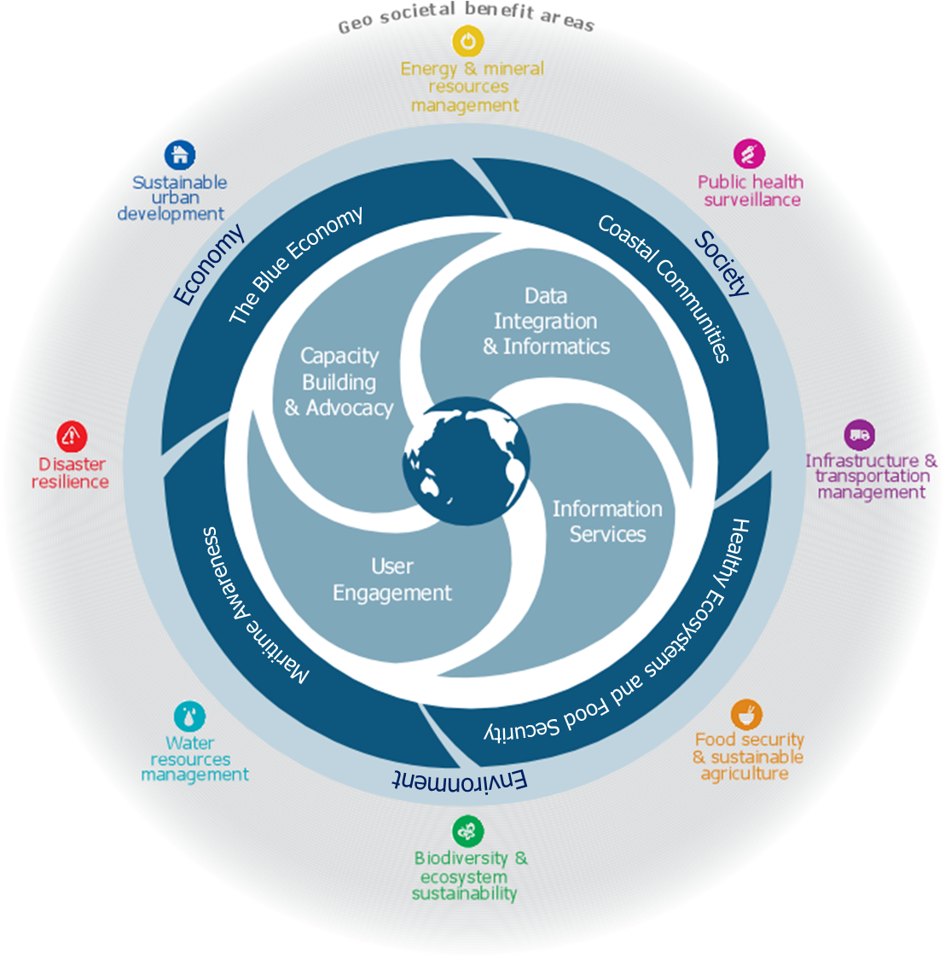
GEO Blue Planet Initiative
Blue Planet Mission
advance and exploit synergies among ocean and coastal observational programmes
increased integration of and access to in situ and remote sensing ocean observation data
improve engagement with a variety of users for enhancing the timeliness, quality and range of services
raise awareness of the societal benefits of ocean observations at the public and policy levels

Slide 13

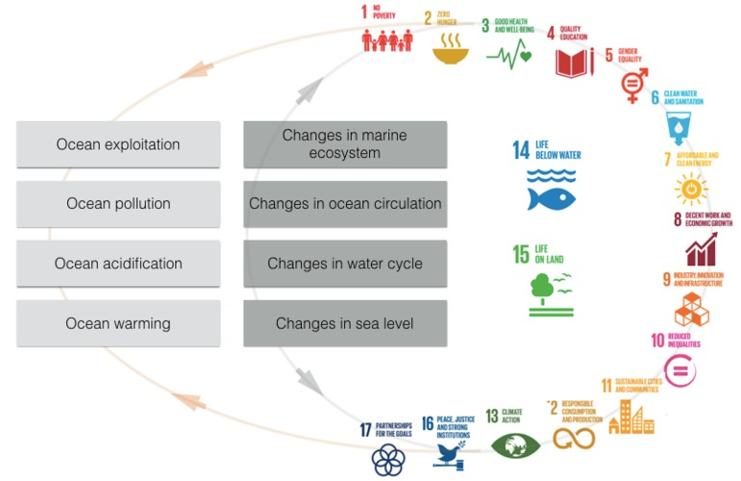
GEO Blue Planet Initiative
Current Activities
Blue Planet is organizing a supplemental issue in the Journal of Operational Oceanography on Ocean Observing for Societal Benefit
  The supplemental issue will Issue will focus on end-to-end case studies of ocean observations being used to benefit various sectors of society
Blue Planet is leading the organization of a workshop titled “Implementing and Monitoring the Sustainable Development Goals in the Caribbean: The Role of the Ocean”
  The workshop will take place from January 17 – 19, 2018 in St. Vincent and the Grenadines

Slide 14
CEOS Virtual Constellations
Water Relevant CEOS Virtual Constellations
Precipitation (P-VC)
Land Surface Imaging (LSI-VC)
Ocean Colour Radiometry (OCR-VC)
Ocean Surface Topography (OST-VC)
Ocean Surface Vector Wind (OSVW-VC)
Sea Surface Temperature (SST-VC)
>
CEOS
COVERAGE
Initiative

Slide 15
The COVERAGE Initiative
CEOS endorsed COVERAGE initiative at SIT-32 (April 2017, Paris) as a 3 year pilot project
Collaborative effort within CEOS with the 4 Ocean Virtual Constellations (SST, OST, OCR, OSVW) and GEO projects (MBON, Blue Planet) to enable more widespread use of ocean satellite data in support of applications
Provides a coherent, cross-cutting, focal activity (not a new VC or WG) aligning with and promoting the advancement of CEOS programmatic objectives, including FDA efforts
COVERAGE is informed by and a response to known needs of the ocean community for improved, more integrated data access for societal benefit in support also of SDGS relating to marine biodiversity & ecosystem management
COVERAGE aims to develop a data rich platform for more seamless delivery of analysis ready ocean data to demonstrate the value added of multivariate ocean data integration in support of science, applications, and public engagement
Tech. Platform for improved, integrated ocean data access utilizing emerging data management and cloud capabilities: “fusion environment” for multi-parameter observations, available in near-real-time, collocated to a common grid, thematically organized and available via value-added data services (data discovery, visualization, subsetting)
Stakeholder Beneficiaries:
Internal: Ocean VCs, WGISS External: GEO-Blue Planet, GEO-MBON, UN/IOC GOOS

Slide 16
COVERAGE Activities and Status
Advisory Board developed with cross-agency and stakeholder representation
  Participants include: NASA, NOAA, CNES, EUMETSAT, Copernicus, Australian Bureau Meteorology, Integrated Marine Ocean Observing System, Sargasso Sea Commission, CEOS Ocean VCs, and WGISS
Stakeholder Engagement & Presentations since SIT-32 (April 2017)
  BP symposium, GHRSSTXVII, IMOS, EOSDIS, CNES, NOAA, IOOS, MBON, SSC, CMEMS, UNDP-4M
Project Initiation – October 2017
  COVERAGE Phase A project with NASA support
  Project core team assembled & Project infrastructure in place
  Workshop series proposal in process in collaboration with Sargasso Sea Commission
COVERAGE has a 4-part development concept
  Phase: A. Scoping (6mo). B. Prototype Development/Evaluation (1yr). C: Full system development (1yr). D: Testing/Evaluation & transition to operations (6mo)
  Reflected in COVERAGE inputs to CEOS 2017-19 Work Plan
Phase A work plan key elements (next 6 months)
  Detailed technical scoping, use case gathering & requirements analysis
  Inventory of target datasets, providers, interfaces
  COVERAGE system technical architecture, including CEOS and data provider interoperability considerations
  Collaborative arrangements & ongoing stakeholder engagement

Slide 17
Integration and coordination
across water activities
COVERAGE

Slide 18

Challenges and Current Issues
Collaboration, not exploitation
Overlap, not redundancy
Good intentions but confusing to external partners
We need to explain why each water-related initiative is important and if not unique, then we need to determine how to combine into a holistic project
Workshop?

Slide 19
Back-up Slides

Slide 20
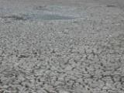
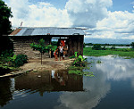

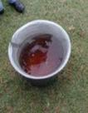
Why GEOGLOWS?
Water sustainability is a critical issue in sustainable development and for the achievement of the SDGs.
Decision-making in water resources planning and management can be supported with the improved use of earth observation data and associated analytical tools and services.
Poor awareness and use of the available and evolving data (incl. from earth observation) and analytical services especially in the developing world.
Strong need to improve open, public-domain access to critical data and analytical services
Need for improved partnerships to improve quality of supply of services and connect to demand of end-users.
GEOGLOWS can contribute to modernized management of water resources to improve productivity and better manage climate risks
The amount of satellite based measurements are at any time, greater than any other measurement. We need to effectively use these data to contribute to water management.

Slide 21
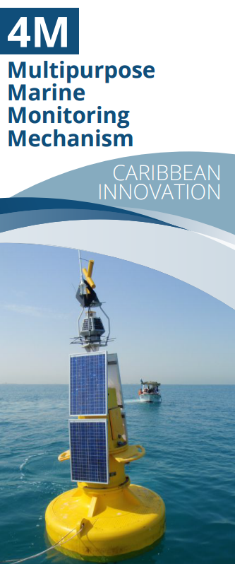
GEO Blue Planet Initiative
Current Activities
Blue Planet is continuing to support to 4M project with UNDP Barbados and the OECS and IOCARIBE-GOOS
  The initial focus of the 4M project will be:
    Service for detection and monitoring of pollution occurrences at sea &
    Service for detection, monitoring and forecasting of sargassum
Blue Planet is continuing engagement with symposium participants on potential projects
Blue Planet is working to develop a communications and engagement strategy
Notes:
OECS is the Organisation of Eastern Caribbean States

Slide 22

GEO Blue Planet Initiative
Future 2017 – 2019 Activities
Build the user engagement working group and inventory previous and current user engagement activities in the ocean and coastal observation community
Build additional working groups on data integration and informatics, capacity building and advocacy and information services
Secure funding for implementation of 4M
Secure funding for additional SDG workshops in other regions
Identify
Identify and begin work on additional prototype/pilot projects
Advocate for sustained ocean and coastal observations

