Slide 1

JAXA Earth Observation Programs
Committee on Earth Observation Satellites
Akiko Suzuki
Japan Aerospace Exploration Agency (JAXA)
CEOS Plenary 2017
Agenda Item 4.17
Rapid City, South Dakota, USA
19 – 20 October 2017

Slide 2
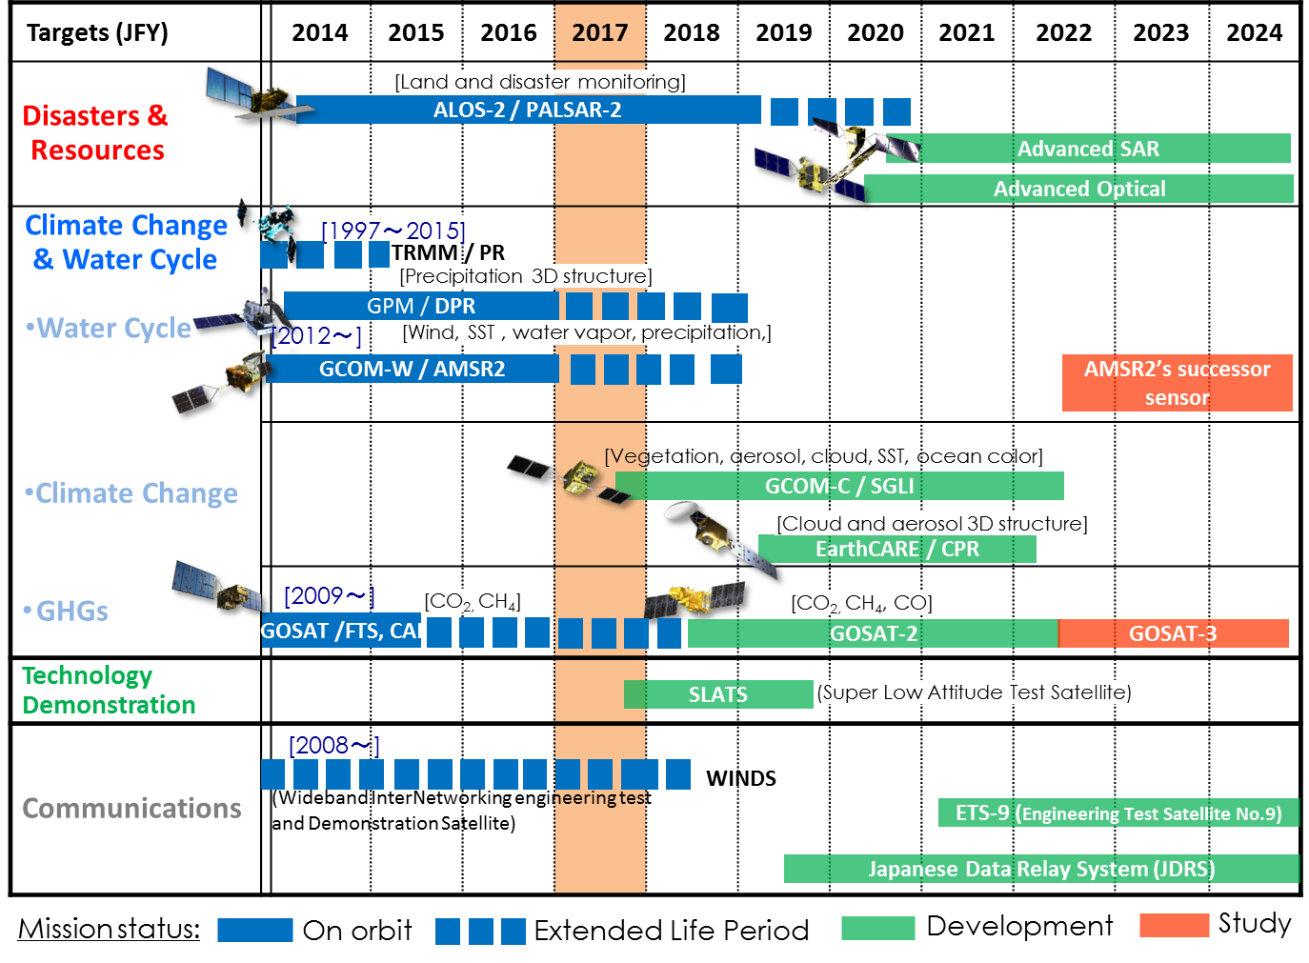
Schedule of JAXA Satellites

Slide 3
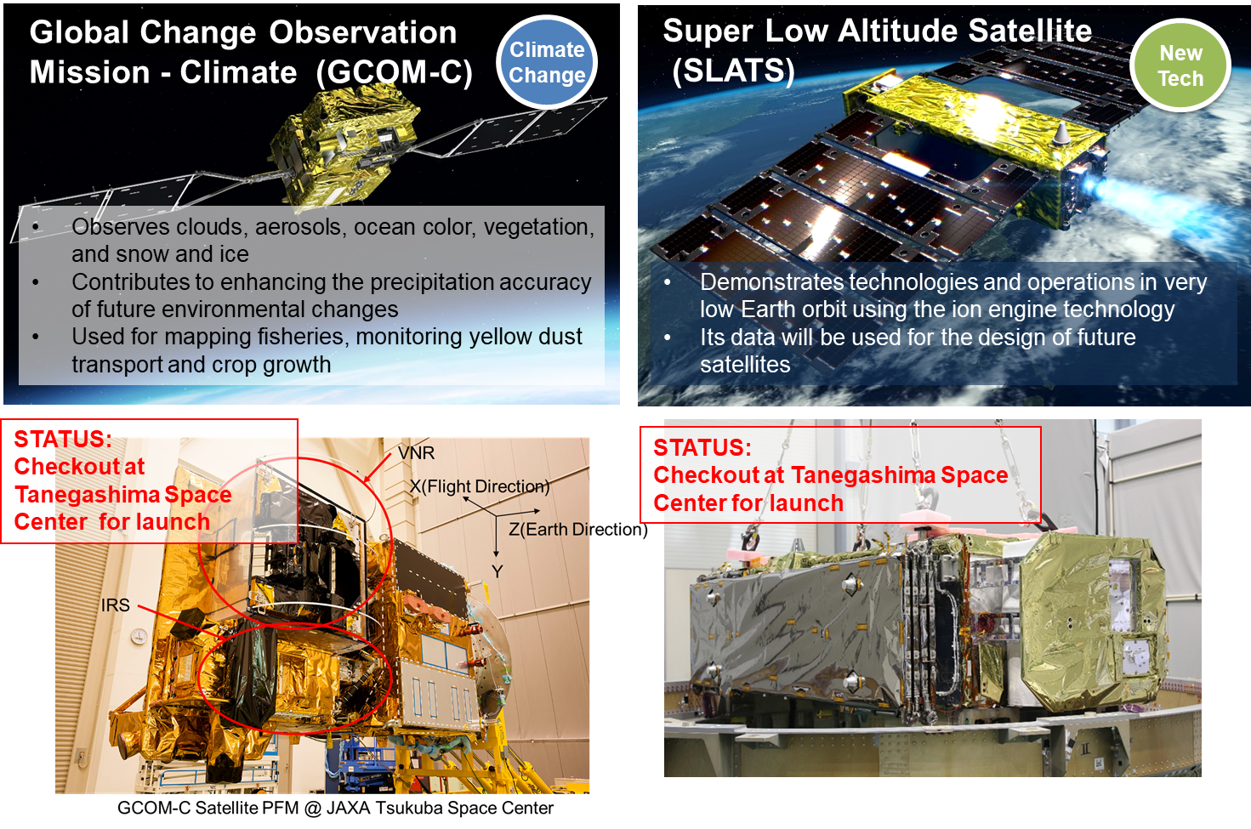
Upcoming Satellites
Scheduled for launch in JFY2017

Slide 4
Current Status and Future
GCOM Mission
Nominal Operation Period of GCOM-W was successfully completed in May 2017.
GCOM-W’s condition is extremely well. Extended Operation was determined.
GCOM-C will be launched in latter half of JFY 2017.
Approved budget for research on the hosted payload capability of AMSR2’s successor sensor onboard GOSAT-3 for JFY2017.
Included budget for research of AMSR2’s successor sensor in the governmental budgetary request for JFY 2018.

Slide 5
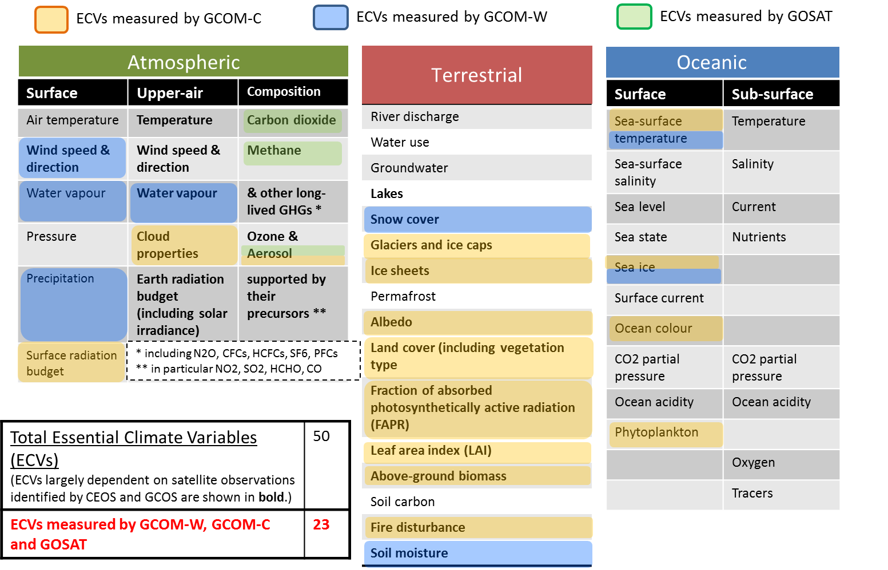
Essential Climate Variables (ECV)
measured by GCOM-C & W, GOSAT

Slide 6
JAXA’s New EO Data Distribution Plan
Promote Open and Free
Available Spatial resolution
  10 meter resolution or Coarser
Enhance provision of available products on the internet
  To be open upon processed
ALOS/AVNIR-2 Global → ALOS-2 ScanSAR → ALOS PALSAR Global
  G-Portal（GCOM-W/C, GPM, etc.）
  JJ-FAST, JASMES, JASMIN（for GFOI, GEOGLAM）

Slide 7
JAXA’s Open and Free Data
Satellite/ Sensor |  | Before | NOW
MOS/JERS/ADEOS/ADEOS-2/ AMSR-E/TRMM |  | ○ | ○
GOSAT |  | ○ | ○
GCOM-W and GCOM-C |  | ○ | ○
GPM |  | ○ | ○
ALOS | AVNIR-2 | ー | ○
 | PALSAR(10m) | ー | ○
 | DSM (30m) | ○ | ○
 | Forest map / mosaic (25m) | ○ | ○
ALOS-2 | ScanSAR (100m) | ー | ○
 | Fine mode (10m) | ー | ー

Slide 8
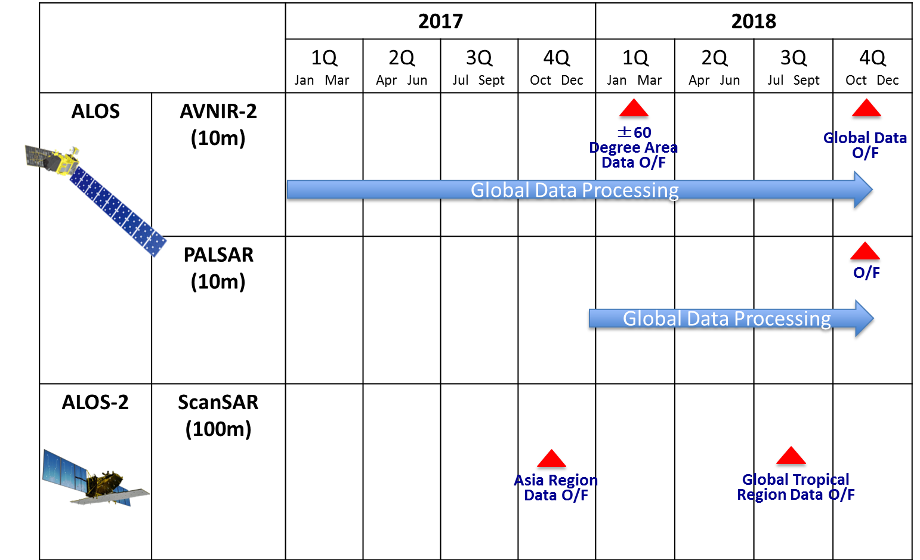
Schedule of Data Processing
and O/F Access

Slide 9
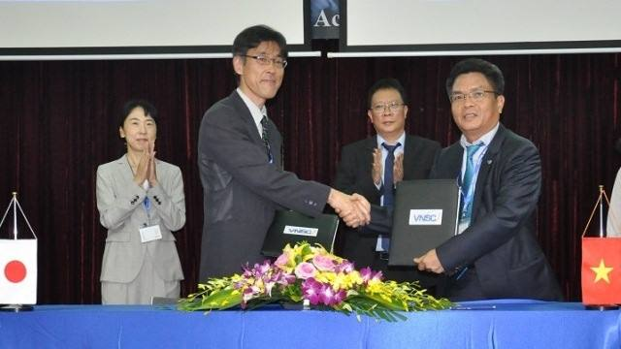
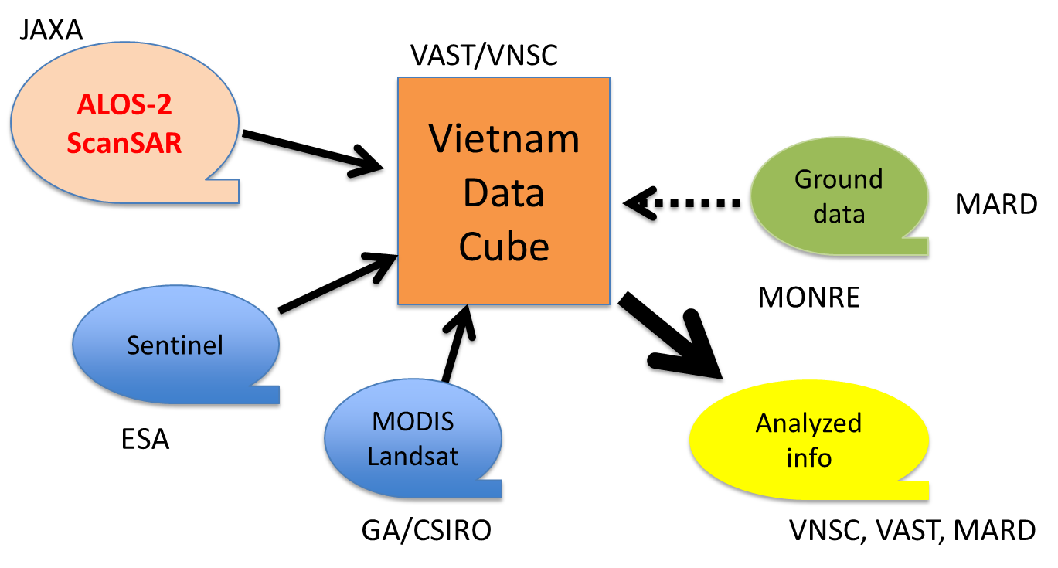
Representatives from VNSC and JAXA
sign an agreement on satellite data exchange
Hanoi, September 18 (Credit: VNSC)
To support the DataCube Programme in Vietnam - a large data platform programme of the Earth’s observation satellites in order to develop related applications, such as rice, forest and water quality monitoring, in addition to promoting the use of satellite data in the field of Earth observation.

