Slide 1
ESA EO Status Report
31th CEOS Plenary, 18-20 October 2017

Slide 2
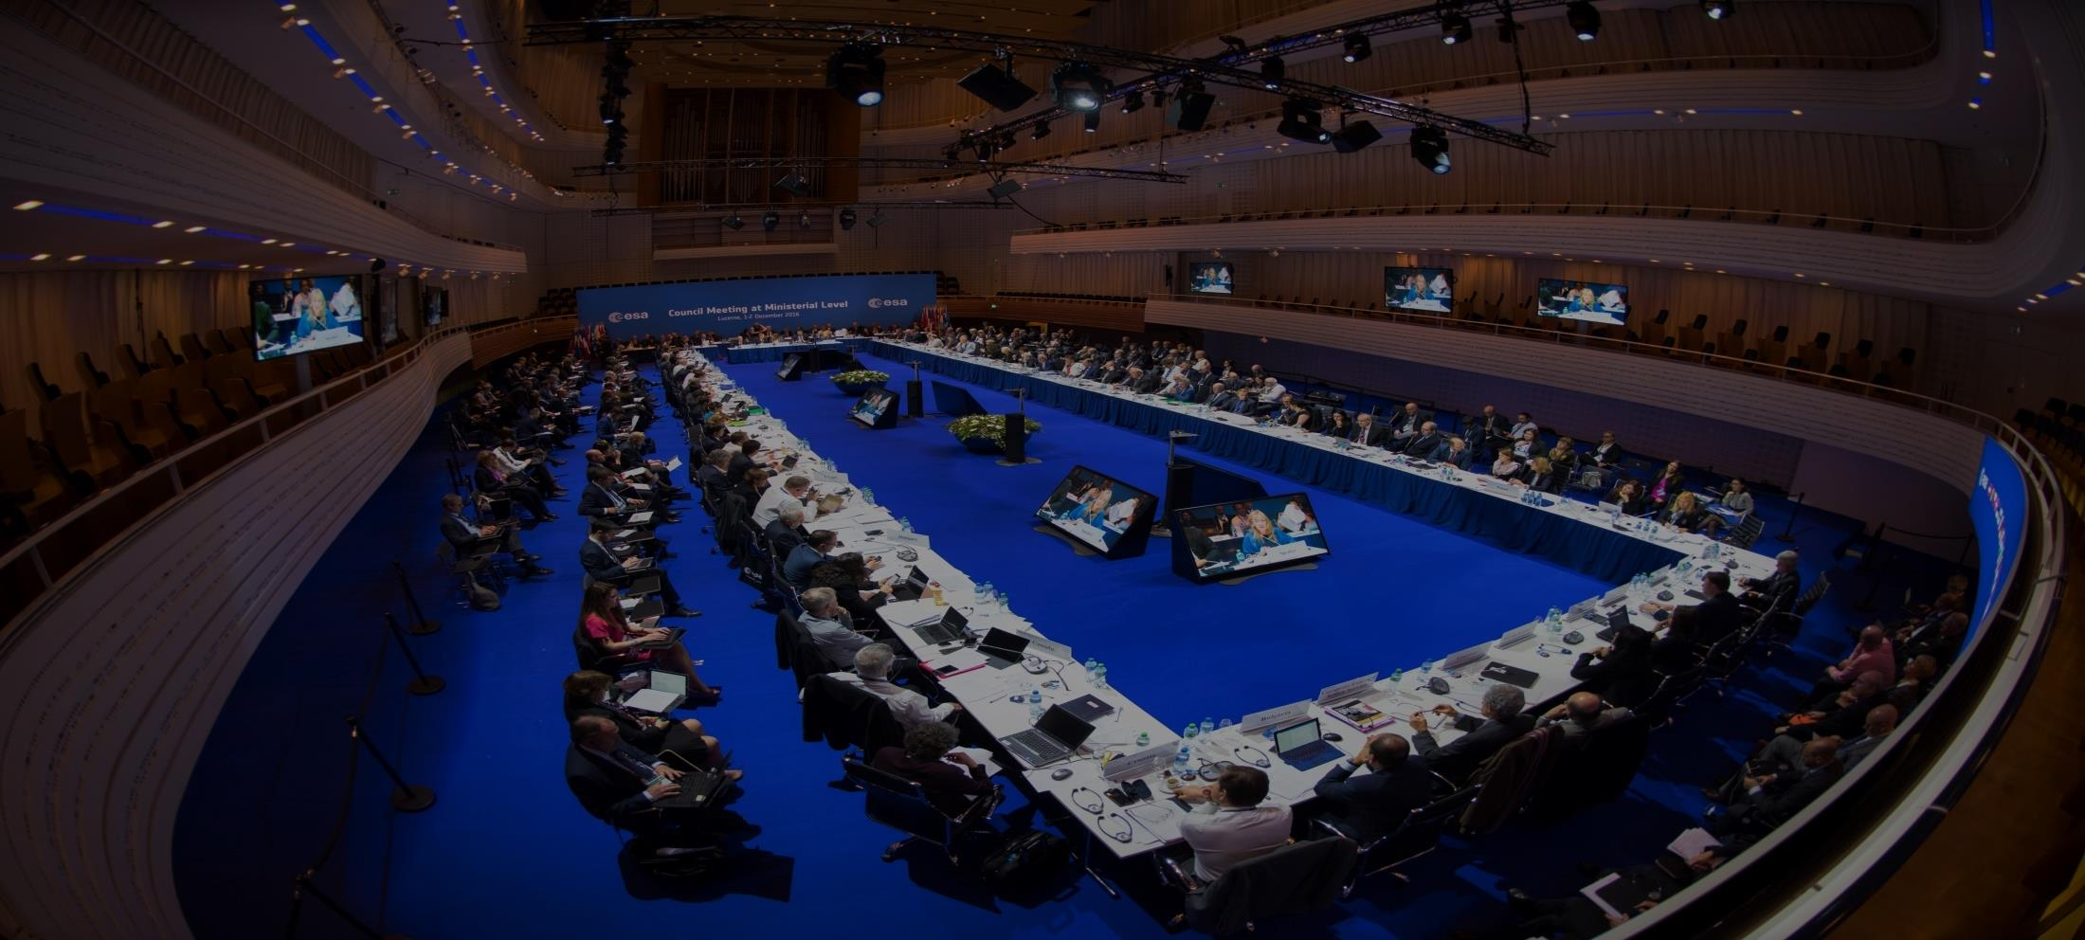
Ministerial Council, 1-2 Dec 2016: Results
ESA Member-State commitment exceeds €10 billion
Earth Observation receives
€ 1.55 billion consisting of:
  EOEP-5:1.158 M€
  GMECV:83 M€
  InCubed: 35 M€
  Altius: 95 M€
  Seosat: 50 M€
  Earthnet and LTDP (Basic Activities): 130 M€
Notes:
In addition to the numbers above, as part of the mandatory level of resources, LTDP and Earthnet will receive approx. 26 M€ per year.
ESA today concluded a two-day Council meeting at ministerial level in Lucerne, Switzerland. Ministers in charge for space matters from ESA’s 22 member states plus Slovenia and Canada allocated €10.3 billion for space activities and programmes based on the vision of a United Space in Europe in the era of Space 4.0.
The high level of subscriptions demonstrates once more that ESA’s Member States consider space as a strategic and attractive investment with a particularly high socio-economic value.
It also underlines that ESA is THE European Space Agency capable of channeling their investment to respond effectively to regional, national and European needs by covering all elements of space: science, human spaceflight, exploration, launchers, telecommunications, navigation, Earth observation, applications (combining space, airborne and terrestrial technology), operations and technologies; as well as responding to the needs and challenges of Europe and the Member States by bringing together all stakeholders.
Ministers confirmed the confidence that ESA can conceptualize, shape and organize the change in the European space sector and in ESA itself. While also acting as a global player, broker and mediator at the centre of international cooperation in space activities, in areas ranging from the far away in exploration (with the concept of a Moon Village for instance) to supporting closer to home the international global climate research effort following the Paris Agreement of 2015.
At this summit, Ministers in charge of space matters have declared support for ESA’s Director General’s vision for Europe in space and the role and development of ESA: now the Space 4.0i era can start with ESA committing to inform, innovate,interact and inspire. And, building on commercialization, participation, digitalization, jobs and growth, the concept of “United Space in Europe” will soon become a reality.

Slide 3
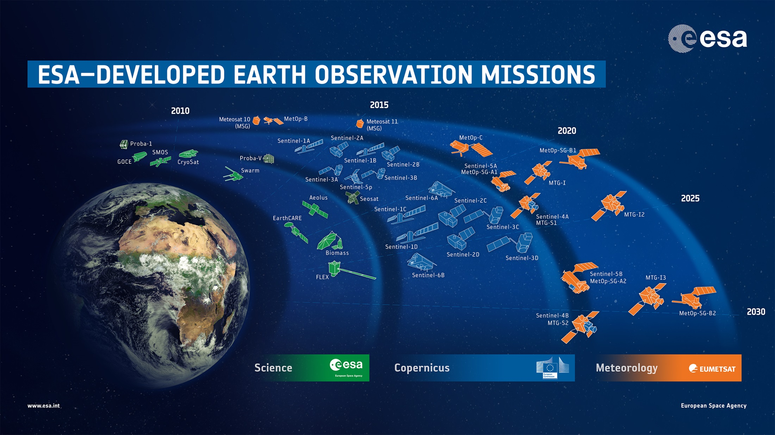
27 satellites in development, 12 in operations

Slide 4
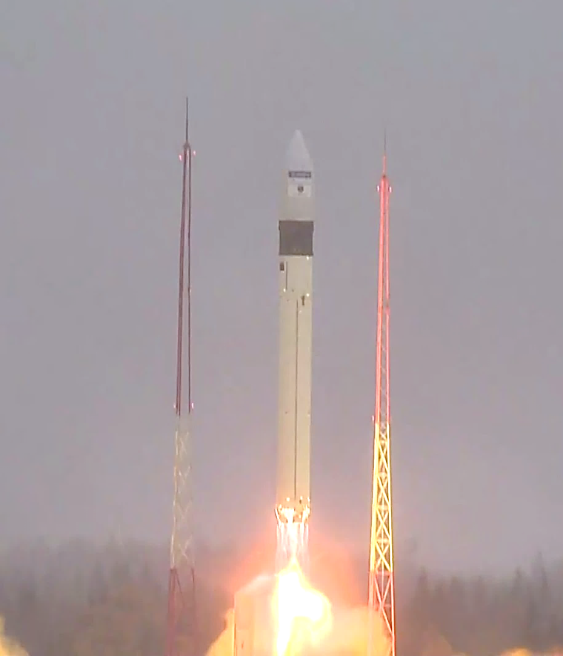
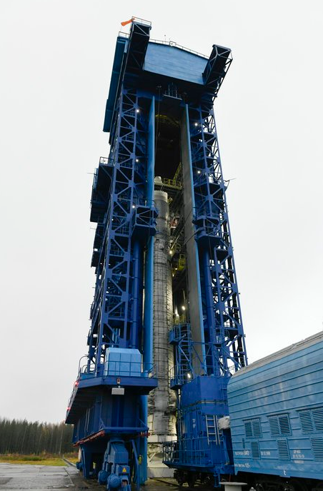
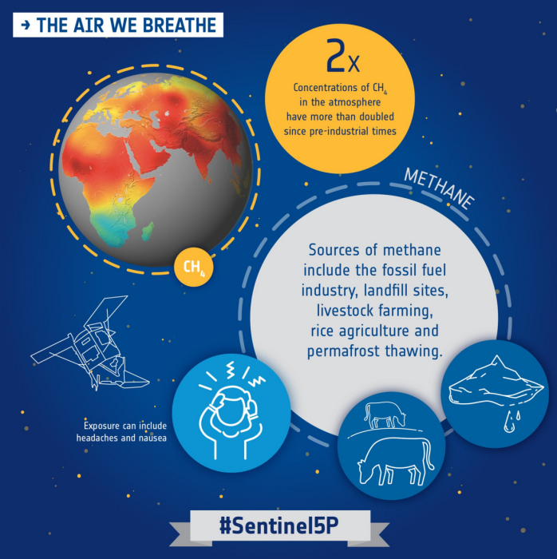
Successful Launch Sentinel-5P
13 October 2017 - 11:27 CEST
Rokot Launcher, Plesetsk Cosmodrome

Slide 5
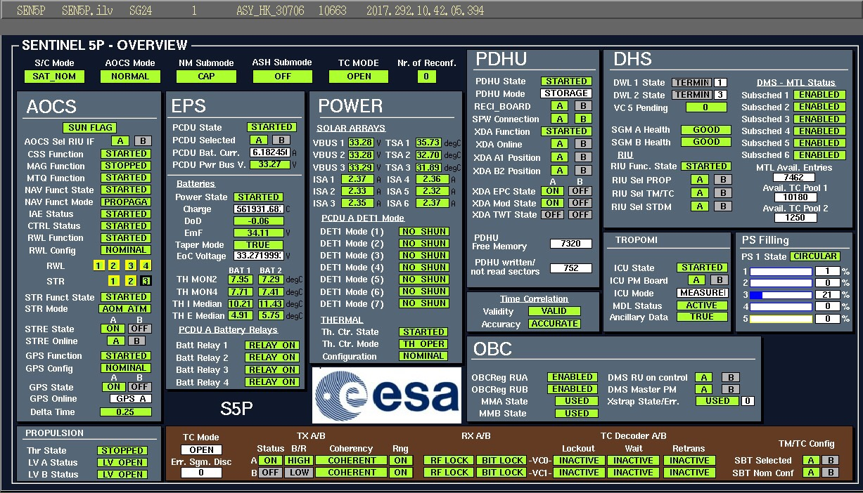
Sentinel-5P - LEOP All green !

Slide 6
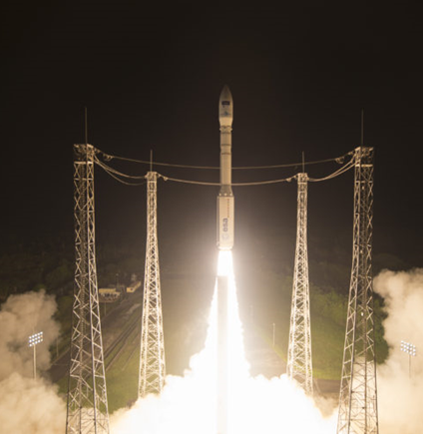
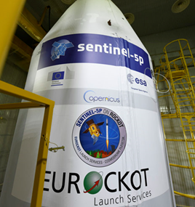
Sentinel Launches
Sentinel-2B
Launched
7 March 2017
SENTINEL | DATE | LAUNCHER
Sentinel-1A | Launched 3 April 2014 | Soyuz ST
Sentinel-2A | Launched 22 June 2015 | Vega
Sentinel-3A | Launched 16 Feb 2016 | Rockot
Sentinel-1B | Launched 25 April 2016 | Soyuz ST
Sentinel-2B | Launched 7 March 2017 | Vega
Sentinel-5P | Launched 13 October 2017 | Rockot
Sentinel-3B | Early 2018 | TBD
Sentinel-6A (*) | July 2020 | TBD
Sentinel-5P
Launch Planned
13 October 2017
^{(*) = FAR}
Notes:
To introduce the 3 next launches to come and launch swap

Slide 7
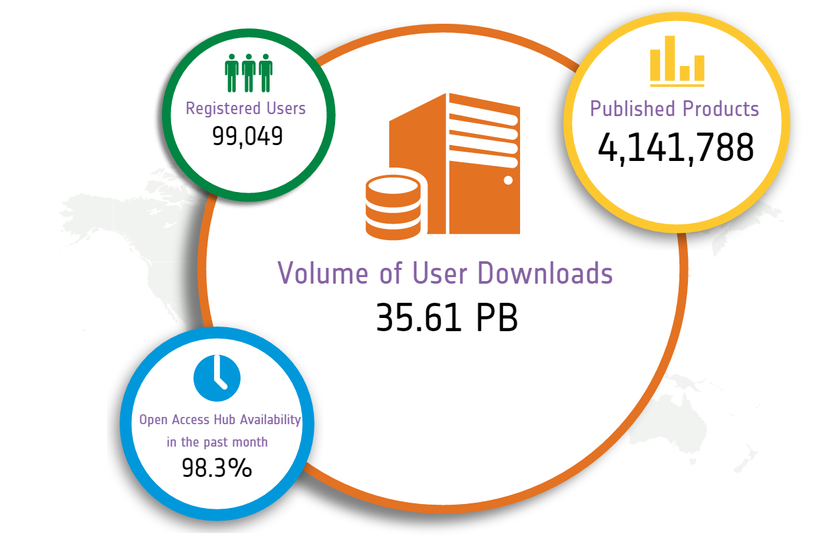
Source: Open Access Data Hub (9 Oct. 2017)
Sentinels: Data Access Statistics

Slide 8
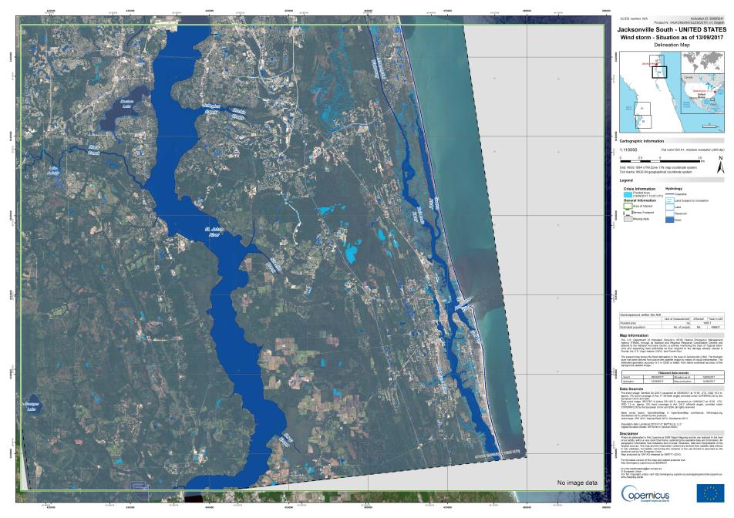

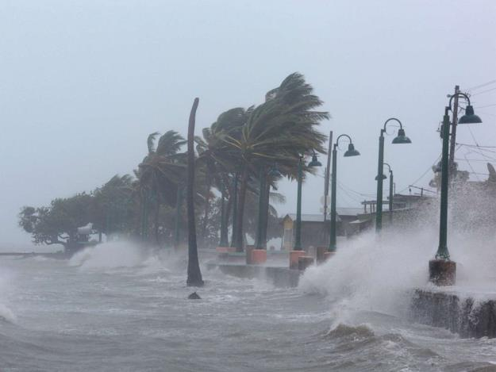
Copernicus: Hurricane Irma (Florida)
Notes:
September 2017
Hurricane Irma made landfall in southwest Florida as a Category 4 storm, bringing gusts of up to 130 mph in some areas. The US death toll has risen to 10, and millions have been left without power as a result of the storm's extraordinary power.
This is a Delineation Map produced by the Copernicus Emergency Management Service.

Slide 9
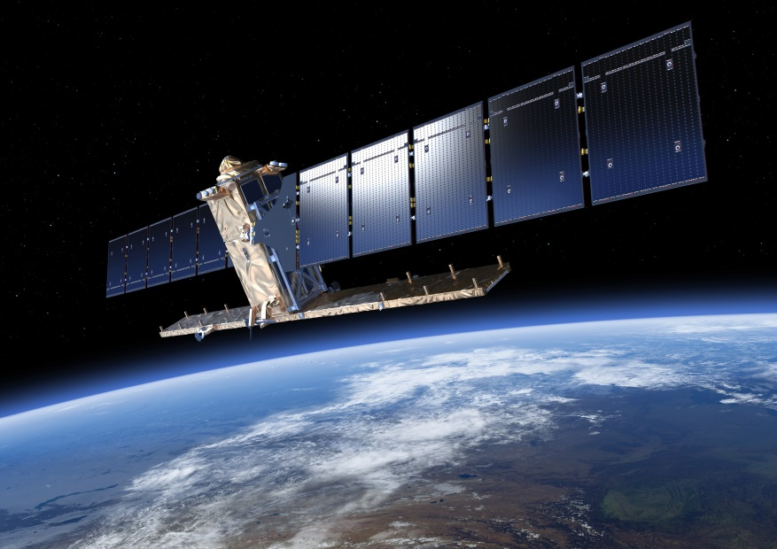
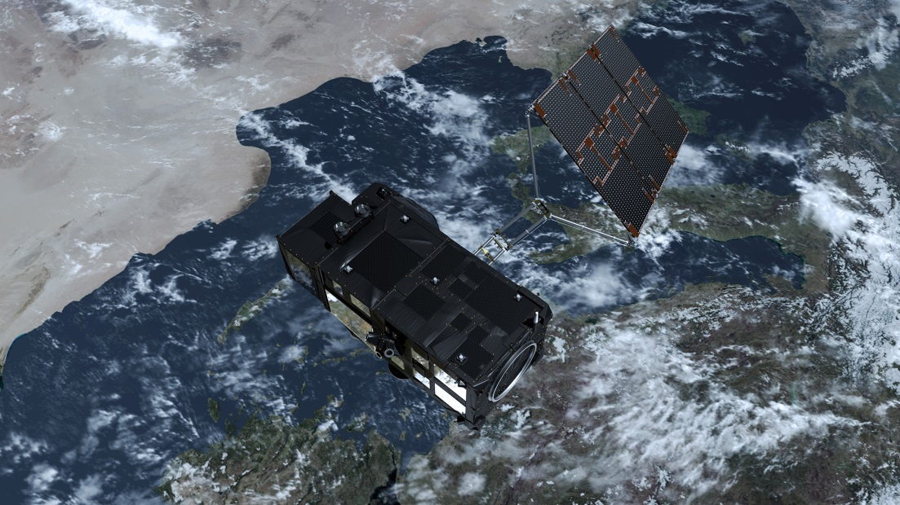
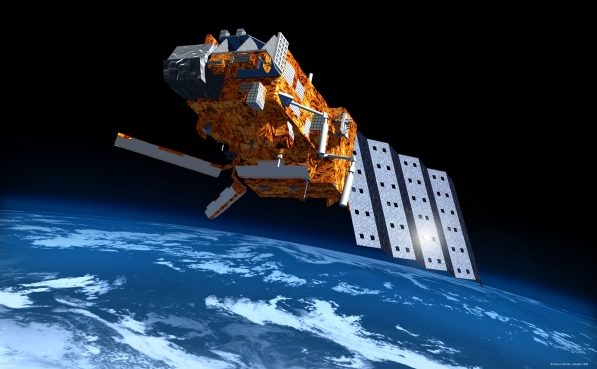
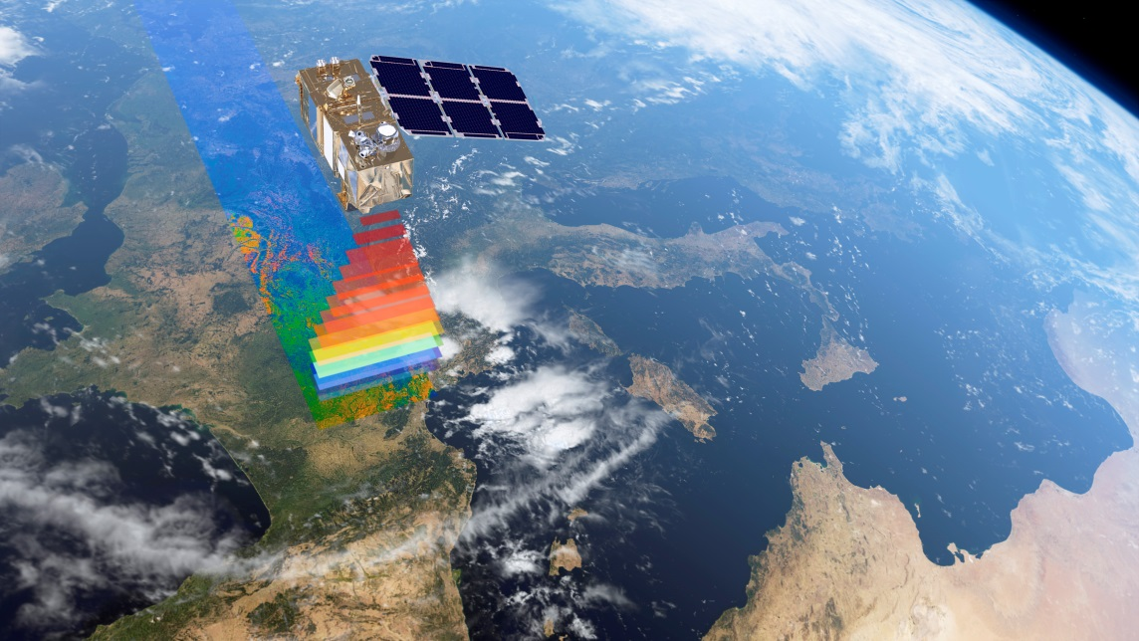
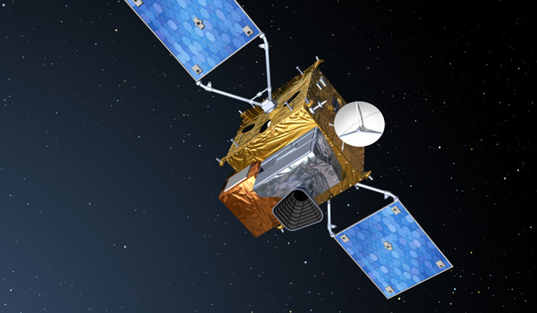
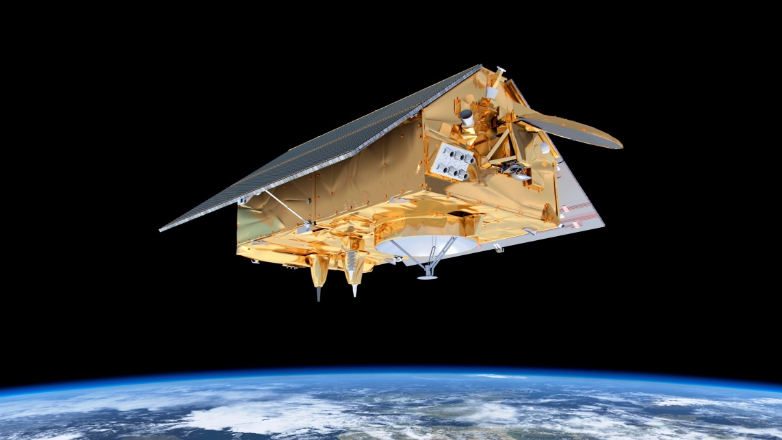
Constellation First Generation Sentinels
1
3
5
2
4
6
Notes:
To introduce the 3 next launches to come and launch swap

Slide 10
Copernicus Space Component Evolution
Preparing funding decisions at CM19 and MFF2021+
Both, current and expansion missions, are replaced by NG missions
2014
Current Sentinel constellation
Sentinel Next Generation
Sentinel Expansion
Copernicus for Security

Slide 11
Expansion Missions (Sentinel 7, 8, 9, …)
Phase A/B1 studies of Potential New Sentinels - responding to EU policy and user priorities:
  Anthropogenic CO2 Monitoring
  Agriculture/Urban – Thermal Infrared
  Polar Ice and Snow – Topographic mission
  Polar floating sea ice - Passive Microwave Imaging
  Agriculture/Mining – HyperSpectral
  Agriculture/Polar – L-Band SAR
Notes:
The procurements cover preparatory activities for potential future Sentinel missions that respond to new observation needs and priorities identified by the users.

Slide 12

Earth Explorer 9 & 10 Call
9
260 M€ CaC, launch by 2025
13 full Proposals received by June 2017
PB-EO decision for EE-9 Phase A
in November 2017
10
Call for ideas published in September
Letters of Intent due in December
Proposals for mission ideas due March 2018
Launch foreseen 2027/28
CaC ≤ 400 M€ (2017 e.c.)
Notes:
Targetted overall cost EE9:
260 M€ (150 sat; 25 Ground Segment; 25 launcher; 40 ESA cost; 20 margin)

Slide 13


Thank you for your attention

