Slide 1
ESA EO Status Report
31th CEOS Plenary, 18-20 October 2017

Slide 2
27 satellites in development, 12 in operations

Slide 3
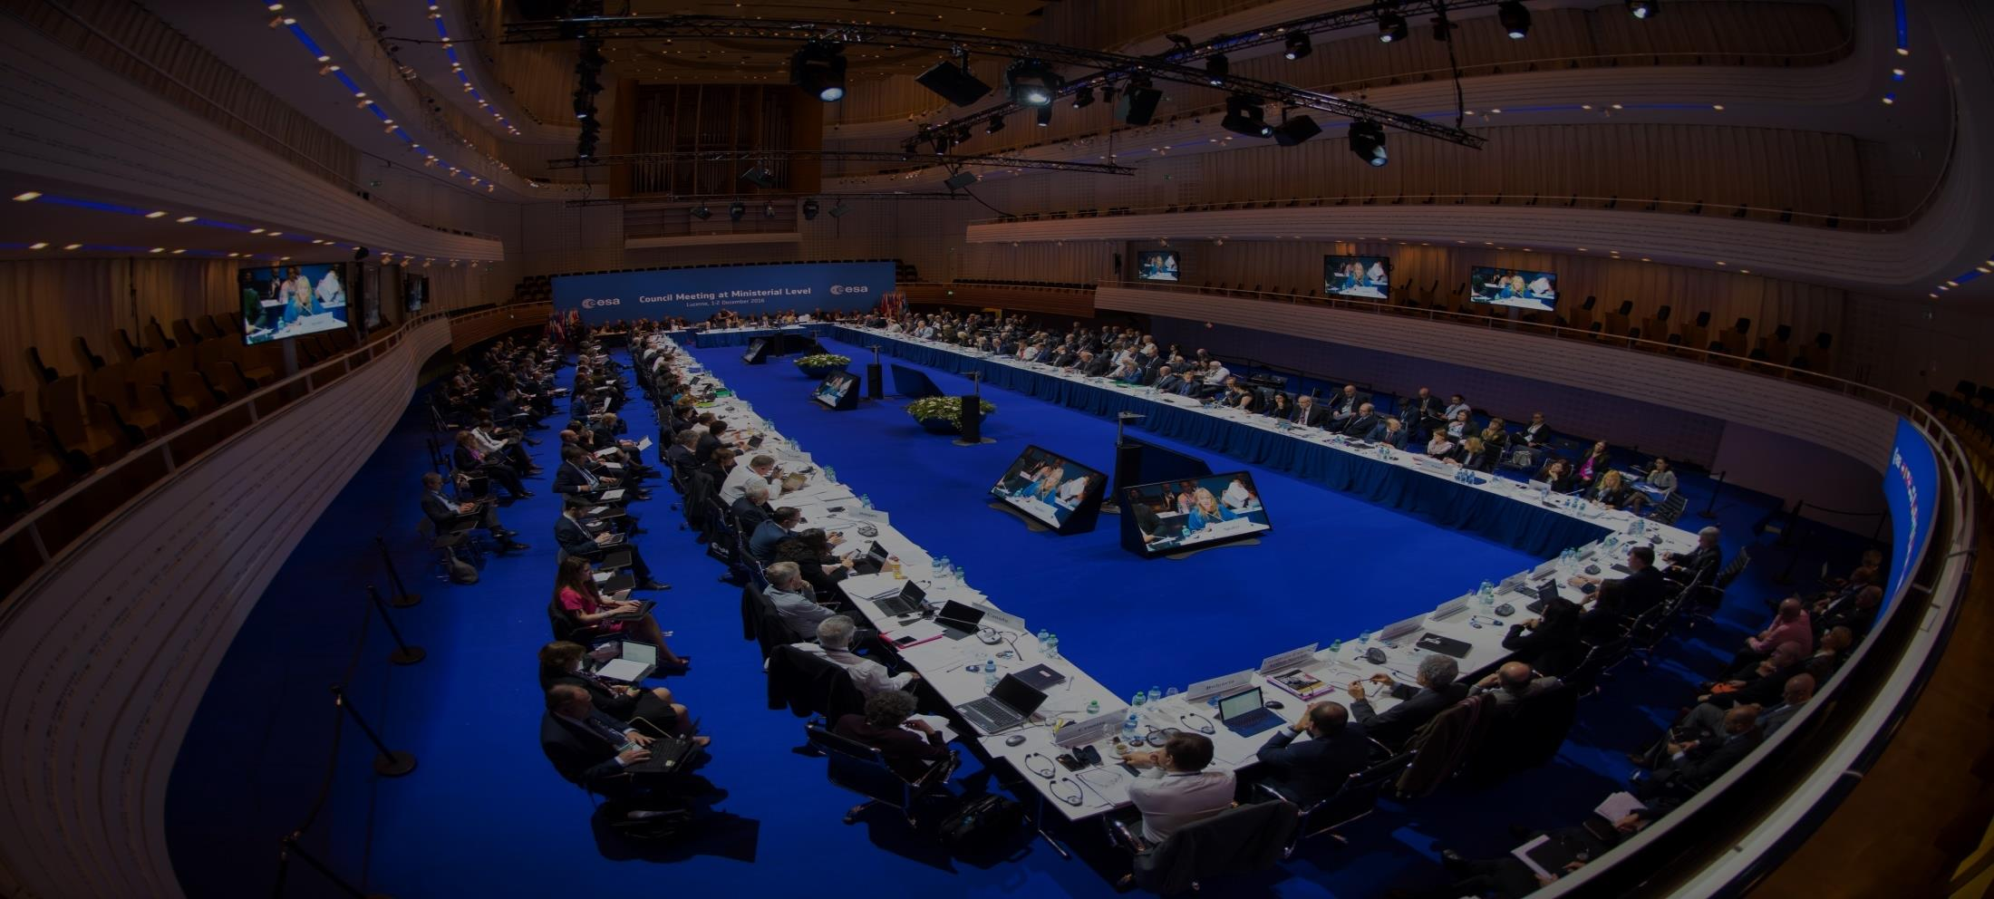
Ministerial Council, 1-2 Dec 2016: Results
ESA Member-State commitment exceeds €10 billion
Earth Observation receives € 1.55 billion consisting of:
EOEP-5:1.158 M€
GMECV:83 M€
InCubed: 35 M€
Altius: 95 M€
Seosat: 50 M€
Earthnet and LTDP (Basic Activities): 130 M€
Notes:
In addition to the numbers above, as part of the mandatory level of resources, LTDP and Earthnet will receive approx. 26 M€ per year.
ESA today concluded a two-day Council meeting at ministerial level in Lucerne, Switzerland. Ministers in charge for space matters from ESA’s 22 member states plus Slovenia and Canada allocated €10.3 billion for space activities and programmes based on the vision of a United Space in Europe in the era of Space 4.0.
The high level of subscriptions demonstrates once more that ESA’s Member States consider space as a strategic and attractive investment with a particularly high socio-economic value.
It also underlines that ESA is THE European Space Agency capable of channeling their investment to respond effectively to regional, national and European needs by covering all elements of space: science, human spaceflight, exploration, launchers, telecommunications, navigation, Earth observation, applications (combining space, airborne and terrestrial technology), operations and technologies; as well as responding to the needs and challenges of Europe and the Member States by bringing together all stakeholders.
Ministers confirmed the confidence that ESA can conceptualize, shape and organize the change in the European space sector and in ESA itself. While also acting as a global player, broker and mediator at the centre of international cooperation in space activities, in areas ranging from the far away in exploration (with the concept of a Moon Village for instance) to supporting closer to home the international global climate research effort following the Paris Agreement of 2015.
At this summit, Ministers in charge of space matters have declared support for ESA’s Director General’s vision for Europe in space and the role and development of ESA: now the Space 4.0i era can start with ESA committing to inform, innovate,interact and inspire. And, building on commercialization, participation, digitalization, jobs and growth, the concept of “United Space in Europe” will soon become a reality.

Slide 4
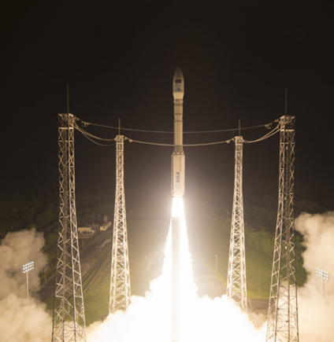
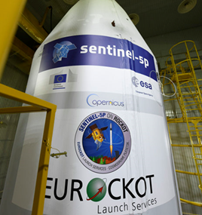
Sentinel Launches
Sentinel-2B
Launched
7 March 2017
SENTINEL | DATE | LAUNCHER
Sentinel-1A | Launched 3 April 2014 | Soyuz ST
Sentinel-2A | Launched 22 June 2015 | Vega
Sentinel-3A | Launched 16 Feb 2016 | Rockot
Sentinel-1B | Launched 25 April 2016 | Soyuz ST
Sentinel-2B | Launched 7 March 2017 | Vega
Sentinel-5P | 13 October 2017 | Rockot
Sentinel-3B | Early 2018 | TBD
Sentinel-6A (*) | July 2020 | TBD
Sentinel-5P
Launch Planned
13 October 2017
^{(*) = FAR}
Notes:
To introduce the 3 next launches to come and launch swap

Slide 5
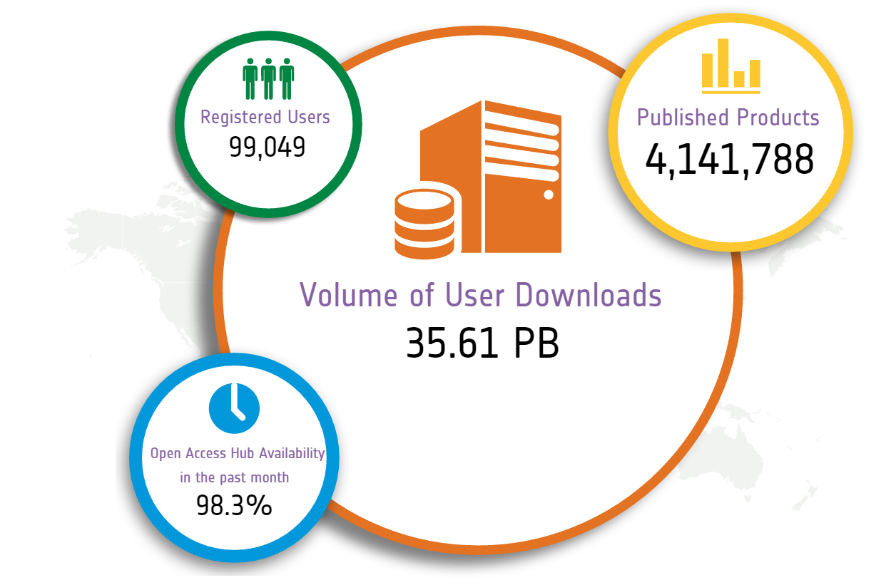
Source: Open Access Data Hub (9 Oct. 2017)
Sentinels: Data Access Statistics

Slide 6
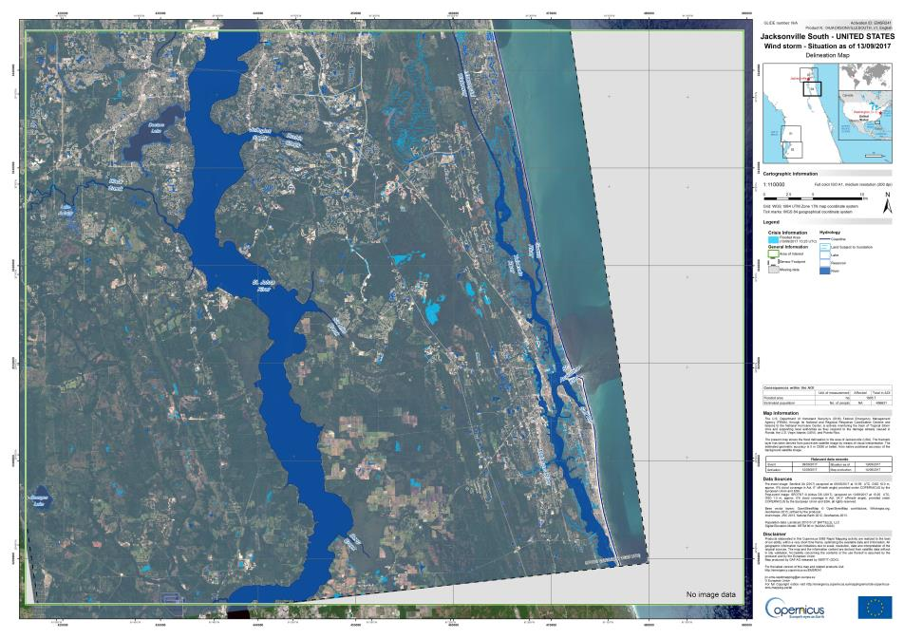
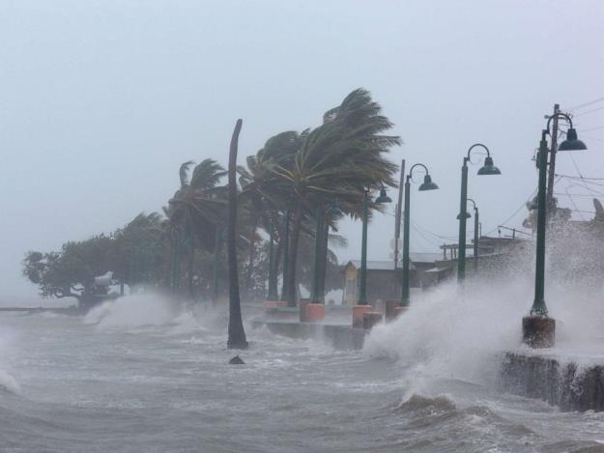
Copernicus: Hurricane Irma (Florida)
Notes:
September 2017
Hurricane Irma made landfall in southwest Florida as a Category 4 storm, bringing gusts of up to 130 mph in some areas. The US death toll has risen to 10, and millions have been left without power as a result of the storm's extraordinary power.
This is a Delineation Map produced by the Copernicus Emergency Management Service.

Slide 7
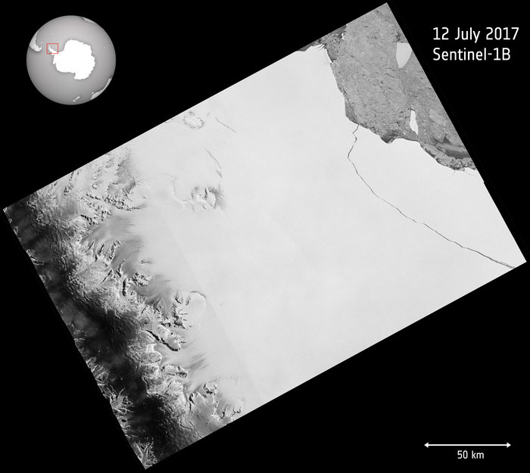
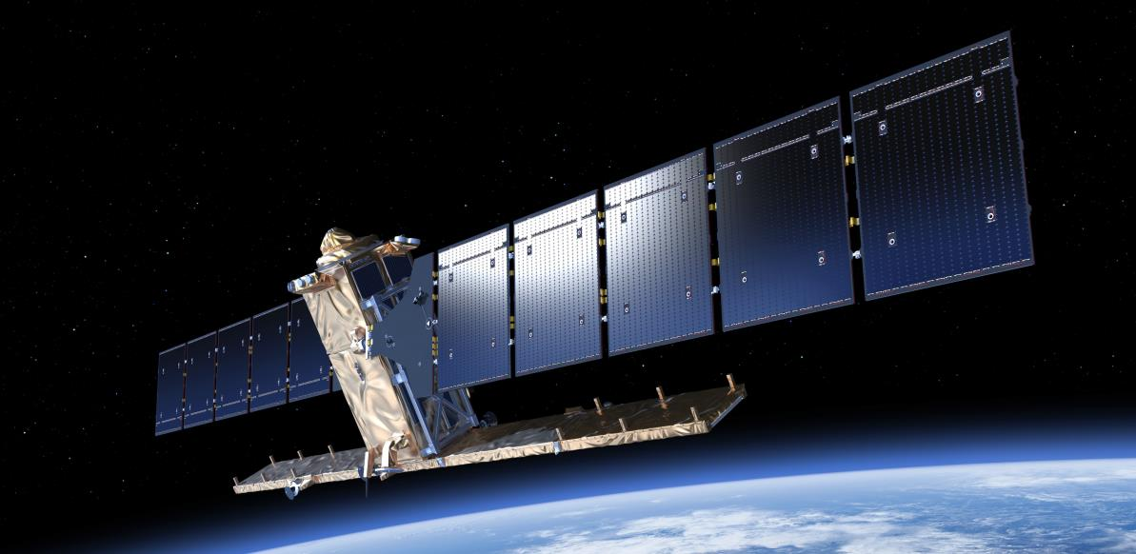
Copernicus: Antarctica's Larsen-C
contains modified Copernicus Sentinel data (2017), processed by ESA, CC BY-SA 3.0 IGO
Notes:
Witnessed by the Copernicus Sentinel-1 mission on 12 July 2017, a lump of ice more than twice the size of Luxembourg has broken off the Larsen-C ice shelf, spawning one of the largest icebergs on record and changing the outline of the Antarctic Peninsula forever. The iceberg weighs more than a million million tonnes and contains almost as much water as Lake Ontario in North America. Since the ice shelf is already floating, this giant iceberg will not affect sea level. However, because ice shelves are connected to the glaciers and ice streams on the mainland and so play an important role in ‘buttressing’ the ice as it creeps seaward, effectively slowing the flow. If large portions of an ice shelf are removed by calving, the inflow of glaciers can speed up and contribute to sea-level rise. About 10% of the Larsen C shelf has now gone.

Slide 8
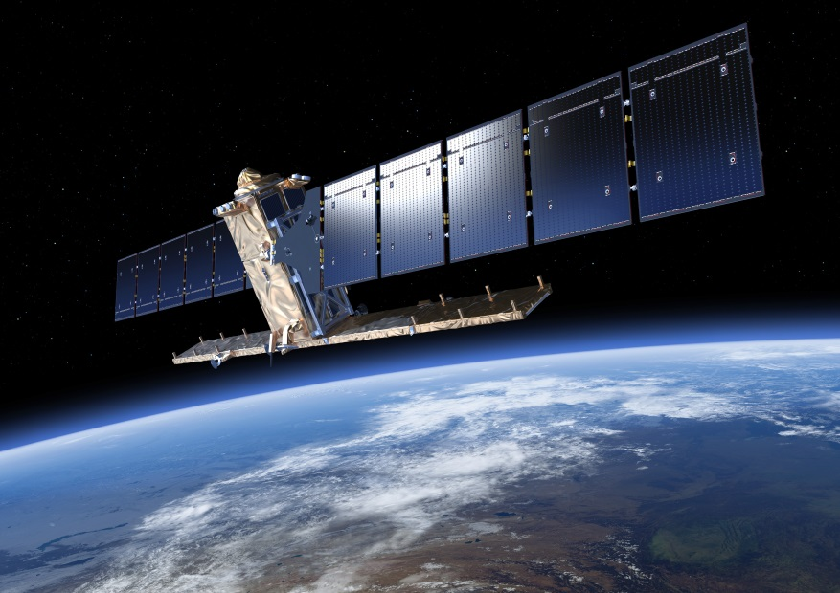
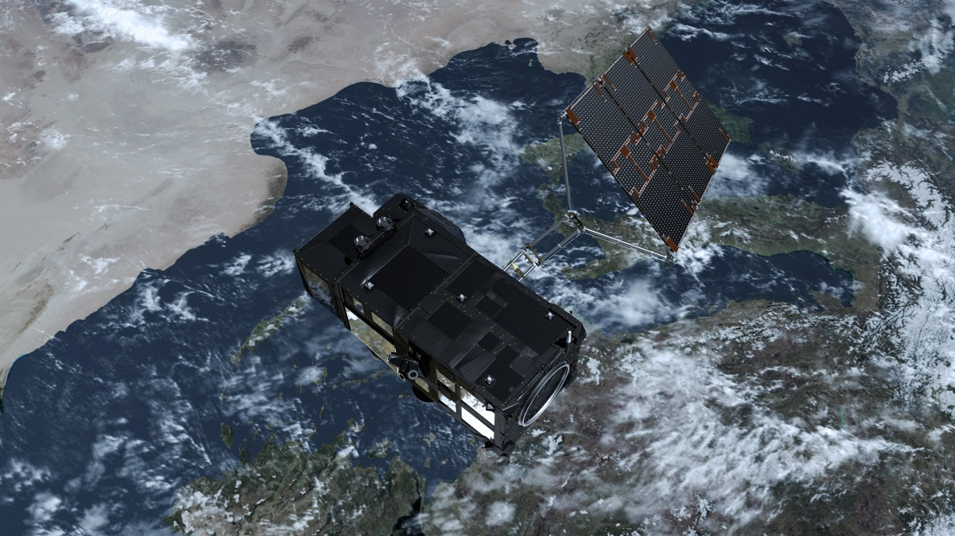
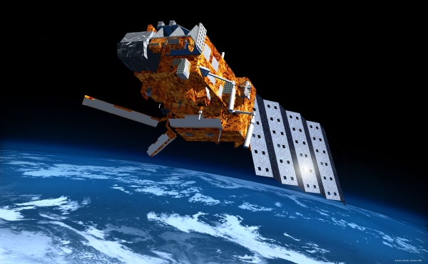
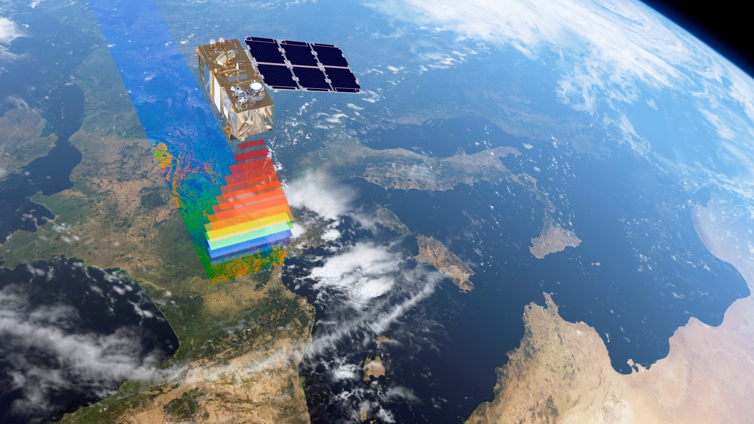
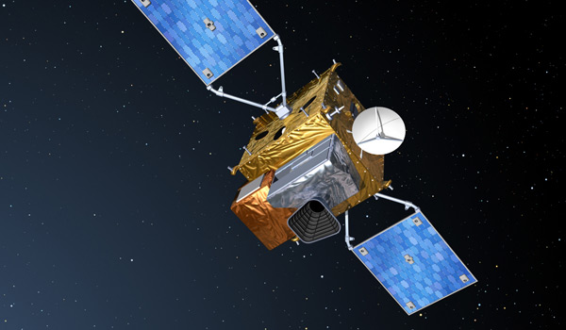
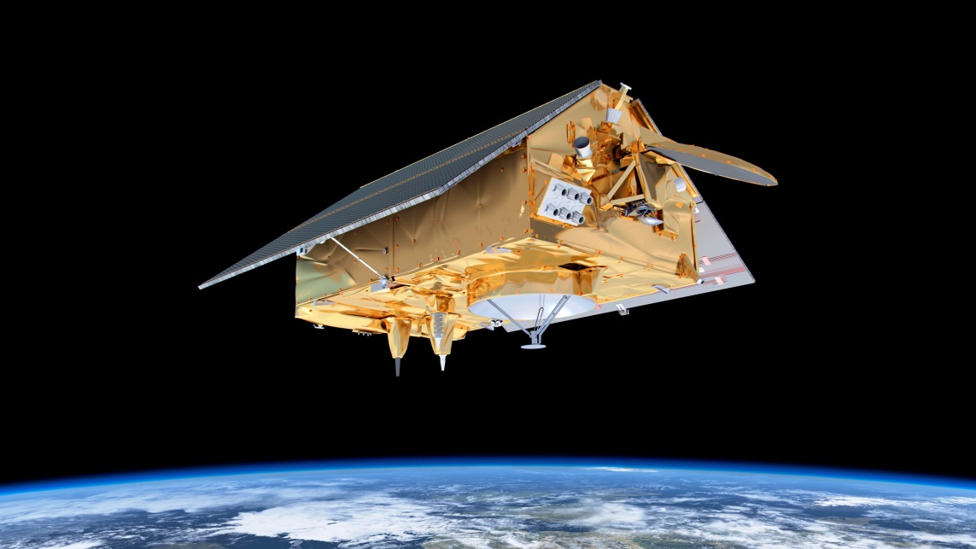
Constellation First Generation Sentinels
1
3
5
2
4
6
Notes:
To introduce the 3 next launches to come and launch swap

Slide 9
Sentinel Evolution
2028/2029
2014
Next Generation
Current missions
Expansion
In the long run, Sentinels current and expansion missions will be replaced by Sentinels Next Generation missions.

Slide 10
New Observation Priorities
Conclusions on major gaps
CO2 measurements to estimate anthropogenic emissions
High-Resolution Thermal observations
Monitoring of sea ice and ice sheets in the polar region (various measurements and instruments)
Hyper-spectral measurements
SAR L-band observations
Ancillary measurements of gravity field
Notes:
From 14 Sep WS Slides :
Observation requirements for a future Copernicus Space Component
PRELIMINARY ANALYSIS OF OBSERVATION REQUIREMENTS
1. CO2 Monitoring Task Force
2. Arctic/Polar Task Force
3. Thermal imaging-based high spatial resolution land surface temperature measurements Expert Group
4. Hyperspectral imaging-based Expert Group

Slide 11
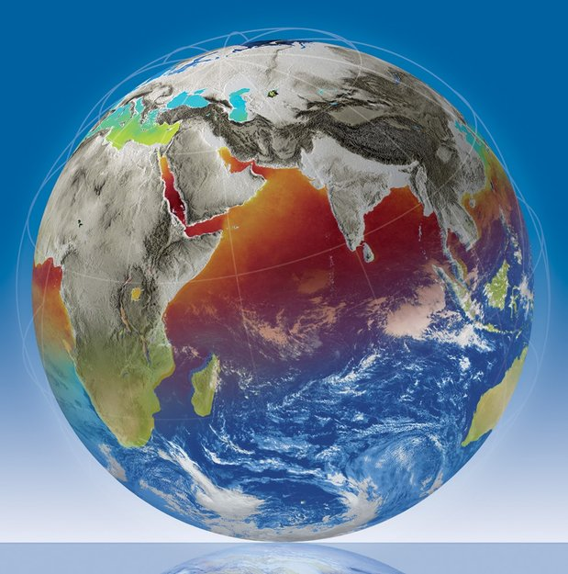
Earth Explorer 9 & 10 Call
9
260 M€ CaC, launch by 2025
13 full Proposals received by June 2017
PB-EO decision for EE-9 Phase A in November 2017
10
Call for ideas published in September
Letters of Intent due in December
Proposals for mission ideas due March 2018
Launch foreseen 2027/28
CaC ≤ 400 M€ (2017 e.c.)
Notes:
Targetted overall cost EE9:
260 M€ (150 sat; 25 Ground Segment; 25 launcher; 40 ESA cost; 20 margin)

Slide 12
Thank you for your attention

