Slide 1

Virtual Constellation Issues, Discussions, Decisions
Committee on Earth Observation Satellites
J.-L. Fellous, SIT Chair Team
CEOS Plenary 2017
Agenda Item 10.4
Rapid City, South Dakota, USA
19 – 20 October 2017

Slide 2
Introduction
Seven Virtual Constellations are currently active
  One about the atmosphere: the AC-VC
  One about land: the LSI-VC
  Four about the ocean surface: the SST-, OST-, OSVW- and OCR-VC
  One about the water cycle: the P-VC
All VCs but one took part in tag up teleconferences with the SIT Chair Team in February and July, contributed to SIT-32 in April and to the VC-WG Day and SIT Technical Workshop in September
Overall the VCs are in good shape, and fulfill the purpose for which they have been established: help improve international coordination and measurement coverage, anticipate and remedy to potential gaps, reduce redundancy, favor intercomparison, etc.
There are a few minor issues not dealt with here and a couple of more important questions that are discussed hereafter

Slide 3
CEOS Work Plan VC Action Status
Number | Title | Completion Date | Status | Notes
VC-02 | AC-VC: Total ozone dataset validation and harmonization | 2017-Q4 | Completed | Action can be considered closed for Level 1 and 2 products. Work on higher-level products is required and is ongoing.
VC-03 | AC-VC: Air quality constellation coordination | 2017-Q2 | Substantial Delay | Through VC-03 AC-VC will prepare a document on "Geophysical Validation Needs for the AQ Constellation". Draft anticipated Q3 2017 and final document Q2 2018. Issue: data access
VC-09 | OCR-VC: Implementation of the International Network for Sensor InTercomparison and Uncertainty Assessment for Ocean Colour Radiometry (INSITU-OCR) | 2019-Q4 | On track | INSITU-OCR is moving forward nicely, following a modular approach, several agencies are offering resources. The IOCCG is providing a coordinating officer.
VC-14 | OSVW-VC: Vision for an OSVW Constellation | 2017-Q4 | Substantial Delay | No document prepared for CEOS Plenary. Issue: Case for OSVW-VC
VC-15 | OSVW-VC Standards and Metrics | 2018-Q4 | Not started | Many issues not well understood
VC-17 | P-VC: Support to ECV precipitation parameters | 2017-Q4 | On track | The GPM satellite constellation has been stable in its observational capabilities. The GPM Core Observatory completed the NASA End of Prime Mission (EOPM).

Slide 4
Work Plan VC Action Status (cont’d)
Number | Title | Completion Date | Status | Notes
VC-18 | P-VC: Programs for improvement of global precipitation products | 2017-Q4 | On track | A substantial suite of activities is improving global precipitation products.
VC-19 | SST-VC: Documented plan for the SST Virtual Constellation | 2017-Q2 | Substantial Delay | Delayed earlier in 2017 but activity has restarted. Issue: PMW continuity
VC-26 | LSI-VC: Pilot approaches to conducting integrated assessments of gaps/opportunities in asset usage | 2017-Q4 | Completed | LSI-VC has examined how the process used by GEOGLAM can be adapted to other purposes. Use of tools such as COVE to automate/streamline the process has been considered. Though such tools will help, significant expert analysis still required.
VC-27 | LSI-VC: Develop a roadmap for the routine production of intercomparable ARD | 2018-Q4 | On track | ARD has been a major focus of the group. Ratification of Product Family Specifications is a key next step (under way). A number of agencies have presented their initial plans for production of ARD.
VC-29 | LSI-VC: Framework for moderate resolution land sensor interoperability | 2018-Q2 | On track | This Chair initiative will be presented at Plenary.

Slide 5
VC Issues and difficulties
OSVW-VC (P. Chang, R. Sharma and S. Linow)
  Building a strong case for operation continuity
    Ref.: CEOS-WP: Section 3.8, VC-14
AC-VC (J. Al-saadi/B. Veihelman and D. Crisp)
  AQ/GHG constellation coordination; Unmet measurement goals; Data access policies
    Ref.: CEOS-WP: Section 3.8, VC-2, VC-3
SST-VC (A. O’Carroll and K. Casey)
  Passive Microwave Radiometer Continuity
Leadership issues
  OST-VC – resolution underway

Slide 6
OSVW-VC (P. Chang, R. Sharma and S. Linow)
Building a strong case for operation continuity

Slide 7
OSVW-VC Status and Health
ASCAT (METOP-A & B)
  Open and near real-time data access
  ASCAT available through EPS-SG (SCA)
  METOP-C scheduled for a October 2018 launch
SCA (ASCAT Follow-On, EPS-SG) ~2022/23
ScatSat, September 2017 (Injected into ~9:45 am local crossing time and drifting to ~8:45 am)
  Open and near real-time data access (April 24, 2017)
OSCAT follow-on (OceanSat-3 & 3A) ~2018/2019
CMA will be providing OSVW measurements starting with their FY-3E launch
CEOS Plenary 2017, 19-20 October

Slide 8
CEOS Ocean Vector Surface Winds Virtual Constellation (OSVW-VC) Current Status and Outlook
Launch
10
11
12
13
14
15
16
17
18
19
20
21
22
23
24
10/06
METOP-A Europe
METOP-C Europe
C-band
METOP-B Europe
Post EPS Europe
06/99
Oceansat-3A India
QSCAT USA
03/14
Oceansat-2 India
Oceansat-3 India
ScatSat India
HY-2A China
HY-2B China
CFOSAT China/France
Ku-band
RapidSCAT USA
HY-2C China
Meteor-M N3 Russia
Meteor-MP 3 Russia
FY-3E China
Combined C- and Ku-band
FY-3G China
Advanced Scat series India?
Design Life
Extended Life
Design Life
Extended Life
Proposed
Operating
Approved
Note: Near real-time and open data access not assured for all missions listed
CEOS Plenary 2017, 19-20 October

Slide 9
Optimum (minimum) OSVW-VC
2015 IOVWST meeting recommendation
At least 3 scatterometers in orbits designed to roughly meet WMO requirements (observations every 6 hours)
One instrument in a non-sun-synchronous orbit for sampling the diurnal cycle, better mid-latitude sampling and provide inter-calibration
A white paper describing and justifying the oceanography and climate requirements for the optimum OSVW constellation is being developed through the IOVWST.
CEOS Plenary 2017, 19-20 October

Slide 10
The OSVW Constellation Future?
Questions posed at the 2017 OSVW-VC meeting
  Is the “business” case for satellite OSVW strong enough?
  Satellite SSH, SST(IR), rain/TPW, visible/IR imagery, and microwave soundings appear to be considered core measurement capabilities, but is this the case for satellite OSVW?
  What needs to be done to improve the chances of realizing the optimum (minimum) satellite OSVW constellation?
CEOS Plenary 2017, 19-20 October

Slide 11
SST-VC (K. Casey and A. O’Carroll)
Passive Microwave Radiometer Continuity

Slide 12
Background
There continues to be a risk to the current and continued PMW constellation for SST and a need for a redundant capability of PMW with ~7 GHz. These concerns are heightened with no confirmed continuity of plans for an AMSR-2 follow-on available.
Past PMW presentations:
  SIT TWS, September 2016: Importance of PMW constellation for SST and impacts.
  SIT-31, April 2016 & CGMS-44, June 2016: Passive Microwave Radiometer constellation for Sea Surface Temperature
  SIT-32, April 2017 and SIT Technical Workshop, September 1917: Passive Microwave Radiometer Continuity, a continuing issue

Slide 13

Passive Microwave Radiometers for SST
11
12
13
14
15
16
17
18
19
20
21
22
23
24
25
~7 GHz channel(s) available enabling global retrievals:
GCOM-W1 (AMSR-2)
AMSR-2 follow-on
HY-2A (MWI)
HY-2B, C (MWI)
HY-2D, E, F
WindSat
Coriolis (WindSat)
Potential new mission concepts e.g.
AMSRE
ESA Microwat
No ~7 GHz channel(s) so retrievals only available at low to mid latitudes:
GPM-Core (GMI)
TRMM (TMI)
FY-3A, B, C (MWRI)
FY-3D (MWRI)
FY3-F, G, R (MWRI)
In orbit
Approved
Planned/Pending approval
(in extended mission phase)

Slide 14
PMW constellation status in the last year
For Global retrievals including high latitudes:
AMSR-2 follow-on is not approved at the moment.
HY-2 series continuing, but operational access and GHRSST data specification not yet established. GHRSST discussions continued with NSOAS in 2017.
Coriolis continuing but entering extended mission.
For low / mid-latitude retrievals:
FY-3 series continuing. CMA welcomed as new members of SST-VC. Working towards GHRSST specification. Discussions begun at the GHRSST science team meeting, June 2017.
GPM-Core continuing but entering extended mission.

Slide 15
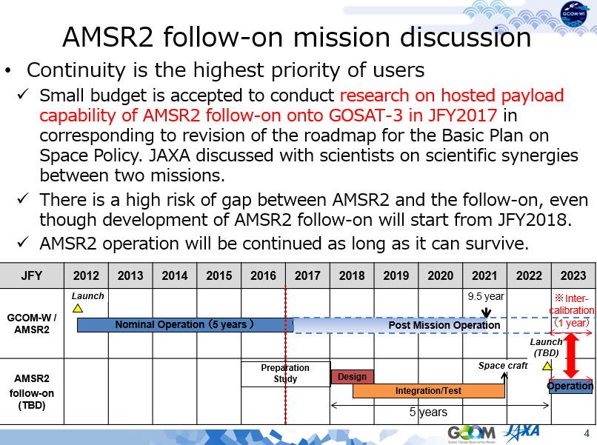
Update from JAXA

Slide 16
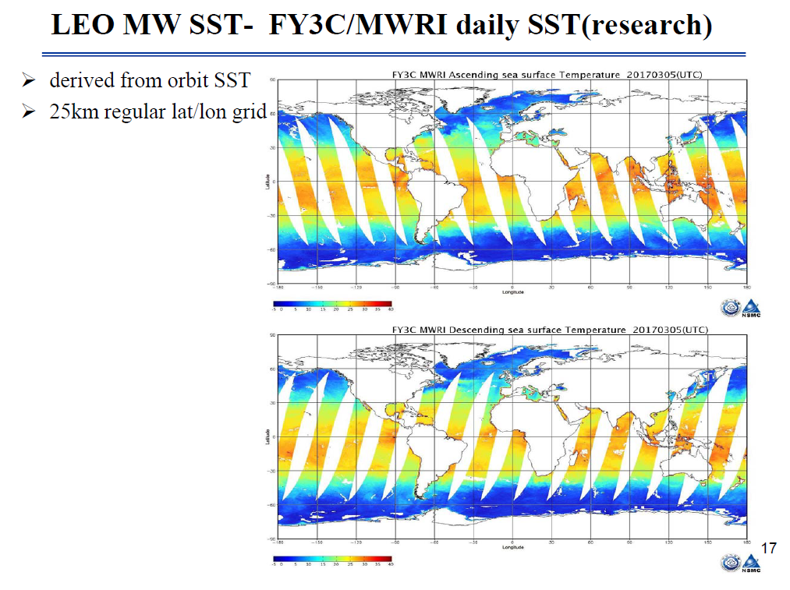
Update from CMA
Improvements needed on accuracy of FY-SST from PMW
CMA and GHRSST establishing more cooperation in SST operational product validation and data blending

Slide 17
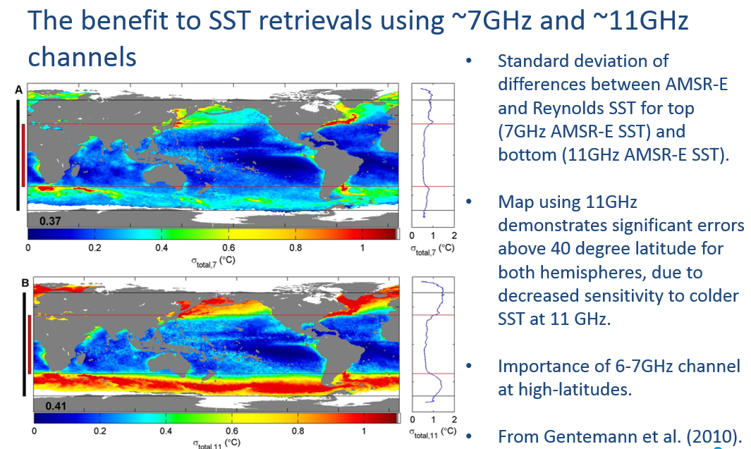
Importance of PMW to SST - example

Slide 18
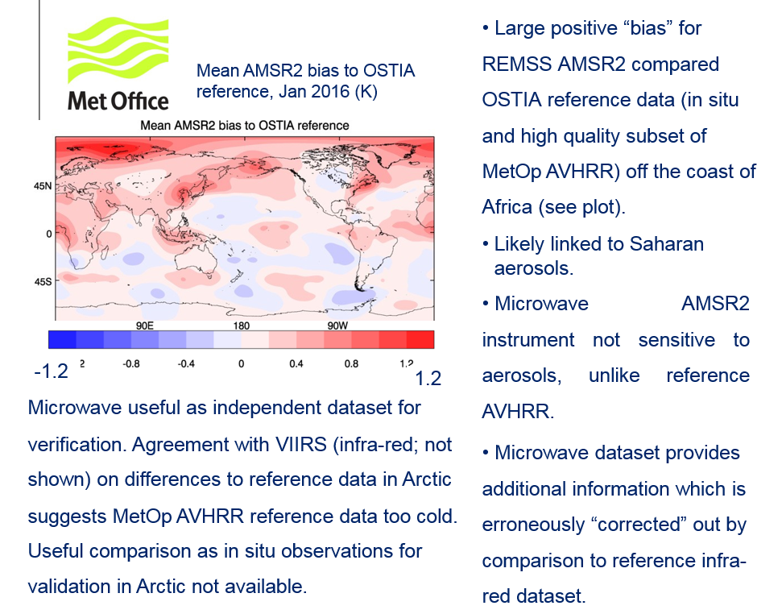
Impacts of PMW on SST - example
Significant impact of PMW at high latitudes, aerosol regions, and persistent cloudy regions where IR SST not possible / deficient

Slide 19
Summary of use of PMW for SST
Use of Passive Microwave Radiometers (PMW) for SST retrievals is an essential component of global constellation of SST sensors.
Provides temperature of ocean under clouds, not possible from infrared sensors, albeit with poorer spatial resolution. Important in high-latitude regions and in areas of extensive and persistent cloud cover or in case of a large volcanic event.
Impact studies of SST analyses / ocean forecasts show PMW also needed for:
  Verification of SST analyses (and inter-comparisons) at the poles.
  Aerosol regions (robust to IR sensitivity displayed in these regions).
  Improves feature definition (e.g. fronts) esp. where persistent cloud.
  Impact studies show improvement in RMSD (e.g. 0.02K global to 0.05K regional). Particularly important at high latitudes.
  In addition retrievals of Ocean Surface Salinity Measurements give better performance when using SST analyses including PMW data (e.g. Meissner et al, TGRS-2016-00278)
Workshops planned/proposed:
  In Europe (December, 2017) on PMW use
  In North America (Spring, 2018) on PMW continuity

Slide 20
Summary to CEOS
Currently there are still risks and gaps identified in constellation, therefore continuity and redundancy of PMW for SST continues to be sought.
Given the current risk to the current and continued PMW constellation for SST and the need for a redundant capability of PMW with ~7 GHz, CEOS is requested to continue to coordinate and encourage its agencies to ensure the continuation of the existing capability and to facilitate the coordination of agencies to ensure continuity and redundancy of PMW for SST.
Forthcoming workshops in Europe and North America should be supported and will provide an opportunity for this coordination
These data are particularly important for SST analyses and ocean models at high latitudes, aerosol regions, persistent cloudy regions, feature definition and overall contribute to an improvement in ocean forecast skill.
AMSR-2 follow-on is not yet approved, but study on possible payload to the GOSAT-3 satellite is being conducted in JFY 2017. The SST-VC note that approval of this mission would give the greatest opportunity for continuation of PMW for SST applications.
Significant progress is being made with CMA on cooperation with SST, together with the SST-VC and GHRSST

Slide 21
AC-VC issues (J. Al-saadi, B. Veihelman and D. Crisp)
Data access
Unmet measurements goals
Joint AQ/GHG constellation

Slide 22
AC-VC Issue: Data Access Policies
Enabling the Air Quality (AQ) Constellation objectives for open data exchange now relies on data access policies for the Asian missions to be established by their organizations
  CEOS-endorsed AQ constellation position paper (2011) recommended “establishing protocols for mutual open and timely data distribution” to collaboratively enhance the quality of data products from all missions, thereby extending a global focus to the observations
  Initial missions include Europe’s S4 and S5P, USA’s TEMPO, Korea’s GEMS, and potentially China’s Gaofen-5
  NASA and the EU now have open data policies including L-1b and L-2
Request CEOS actively engage (or continue) conversations with appropriate agencies in Republic of Korea and China to facilitate open sharing of satellite data between all partner space agencies
Notes:
This slide expresses known near-term AC-VC needs. Looking to future developments, including GHG constellations, it would be helpful to also consider India in this conversation.

Slide 23
AC-VC Recommendation:
Unmet Air Quality Measurement Goals
Though the emergent AQ constellation is a success story, two measurement goals remain unmet: extending hourly AQ observations to the rest of the world and providing hourly CO vertical profile measurements with near-surface sensitivity
  The emergent AQ constellation includes hourly geostationary (GEO) observations over Europe, East Asia, and North America
  Requisite CO measurements are not currently planned anywhere; MTG IRS (Europe) and GeoCARB (US) will provide limited capability
  Air quality in the developing world is a growing societal challenge (increasing industrialization and population) with global impact
  Extending GEO observational capability to the southern hemisphere and tropics will leverage experience and capabilities from the emergent missions to be an effective capacity-building activity
Encourage agencies to identify strategies to meet remaining AQ measurement goals, possibly including innovative funding and partnership approaches to build capacity in the developing world
Notes:
The emergent AQ constellation will measure trace gases relevant to ozone pollution (O3, NO2, HCHO) and aerosol pollution. The goal to provide hourly CO measurements that can distinguish between free-tropospheric and near-surface abundances is currently unmet worldwide. Multispectral measurements of CO, as provided approximately daily from low Earth orbit by MOPITT and potentially being continued into the future by e.g. combined retrievals from CrIS and TROPOMI, provide vertical profile information with near-surface sensitivity. The near-surface sensitivity is critical for distinguishing between locally-produced and externally-transported pollution. None of the emergent geostationary missions have this capability to distinguish between free-tropospheric and near-surface CO. The IRS on MTG will resolve the free troposphere at hourly repeat cycle over Europe, albeit with limited sensitivity to near surface concentrations. GeoCARB will resolve the free troposphere at up to 3 times per day over North America.

Slide 24
AC-VC Recommendation:
Enable Joint AQ/GHG Constellations
Constellations for observing air quality (AQ) and greenhouse gases (GHG) have developed separately but are highly interdependent
  Similar emission sources (i.e., combustion) control AQ and GHG
  AQ affects natural carbon cycles, modulating net GHG abundances
  Simultaneous AQ and GHG observations provide better constraints on emission fluxes and transformation, critical for policy strategies
Atmospheric composition Observing System Simulation Experiment (OSSE) capability has matured rapidly
  AC-VC is fostering AQ and GHG OSSE development with involvement of ECMWF, ESA, Copernicus, NASA, JAXA, NIER, and others
  International objectives for both AQ and GHG observations could be achieved more effectively through coordinated planning
Agencies should be encouraged to coordinate existing AQ and GHG OSSE capabilities to efficiently enable joint AQ/GHG satellite constellation studies

Slide 25
A few more words from a CEOS veteran

Slide 26
Thirty-three years with CEOS
My first CEOS meeting was held in the UK in 1984, following the G7 decision to establish a coordinating body
  I remember having worked with Lisa Shaffer, later known as “the CEOS goddess”, and Ichtiaque Rasool at defining data sharing policy basics, using the idea of a “data pool” proposed by Gérard Brachet
In 1997, I replaced Gérard as CEOS Chair for CNES. The Plenary in Toulouse was (to our surprise) attended by G.O.P Obasi, the then Secretary General of WMO. Among other initiatives, the concept of “troika” was proposed and approved.
In 1999-2001, I was successively SIT Vice-Chair (assisting Bob Winokur), then Chair. At the Kyoto Plenary in 2001, I said “Good bye, CEOS!”
In 2005, back from Ifremer to CNES/ESA, I was tasked to work as the ocean expert on the CEOS Response to GCOS-IP. In 2206, I became the first CEOS Executive Officer. In 2007, I retired from CNES/ESA and at the Hawaii Plenary, I said “Good bye, CEOS!”

Slide 27
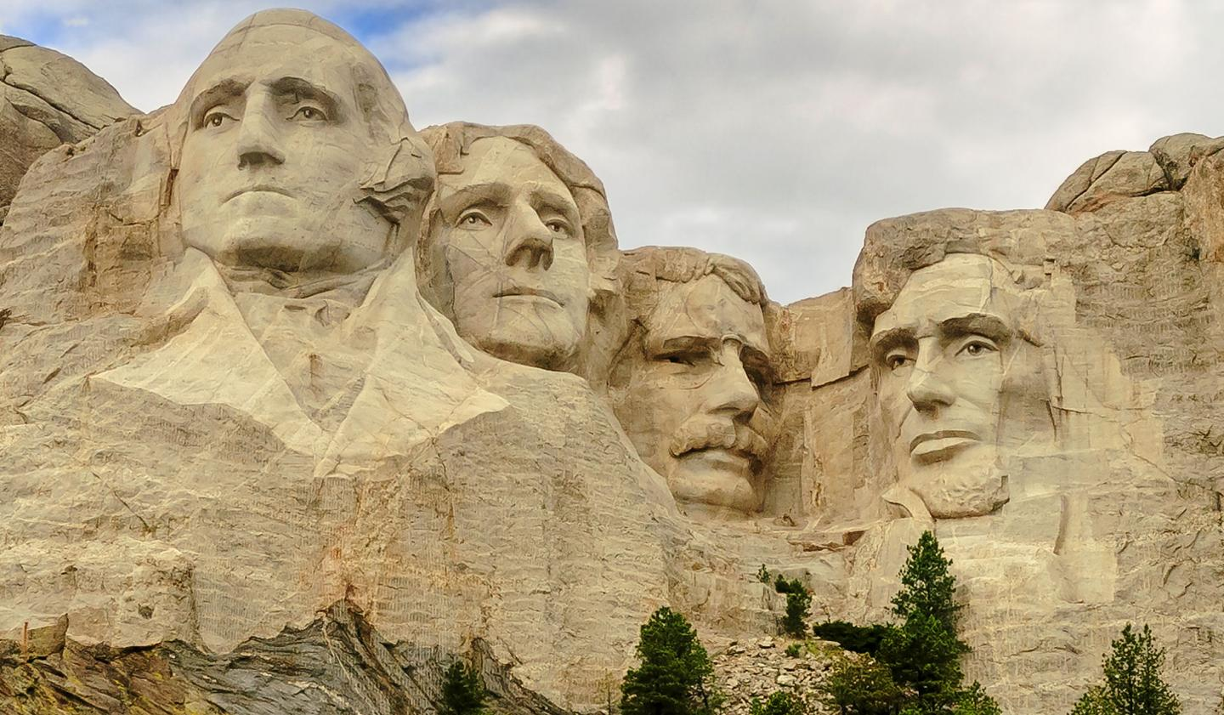
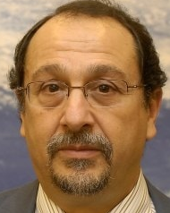
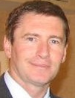
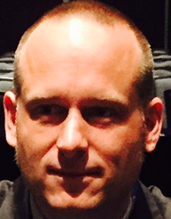
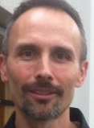

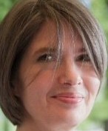
The CEO Dynasty (2007-2017)

Slide 28
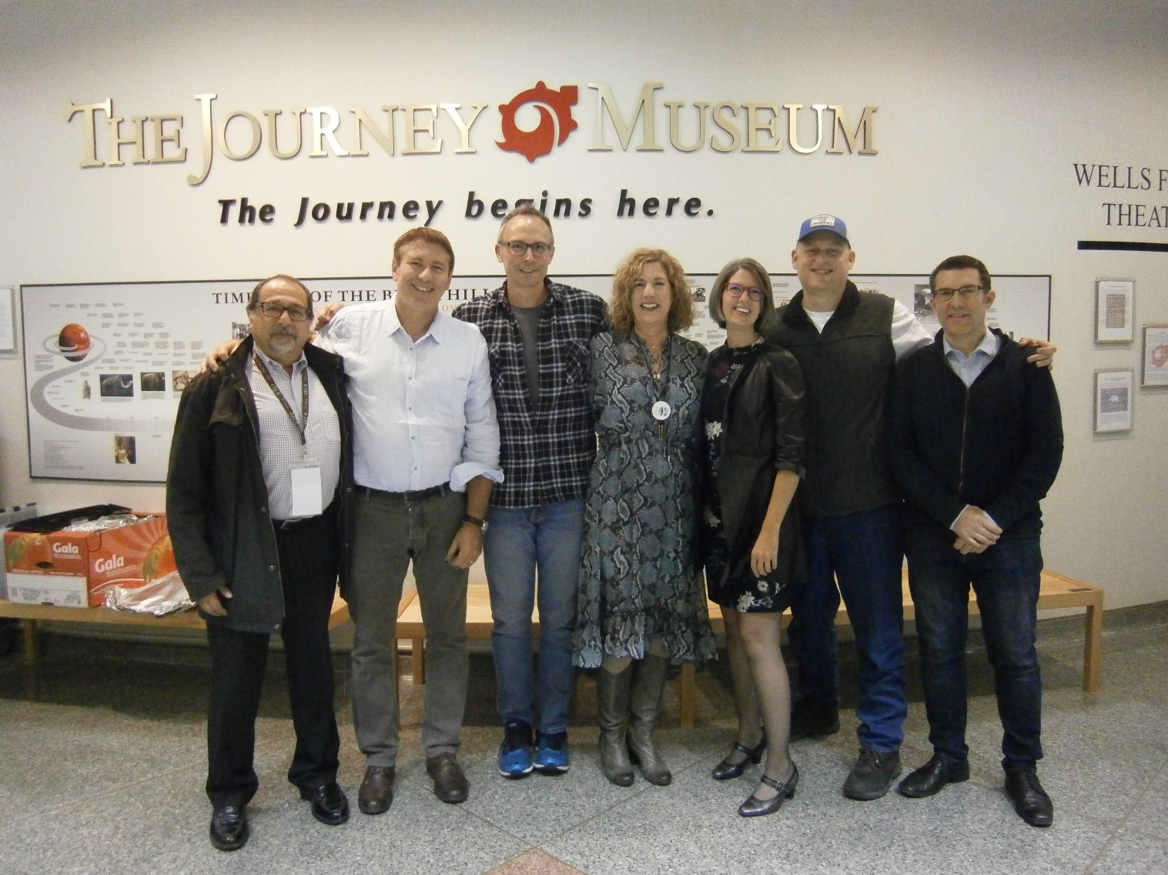
… and beyond !

Slide 29
A few remarks
I am indebted to many colleagues for their support and mentorship over the years, e.g., Brachet, Embleton, Winokur, Asrar, Gibson, Shaffer, Ishida, Smith, among others, and to the WG and VC leads
Any organization has its highs and lows. Since several years, space agencies and some individuals have “made CEOS great again”
  The formation of GEO and redirection of CEOS as “the space arm” for GEO and GEOSS have been seminal in this renewal
  Seizing the opportunity of a new GCOS Implementation Plan, Barbara Ryan and Stephen Briggs have triggered in 2007 the production of a first CEOS Response to the GCOS-IP
  The joint CEOS-CGMS WGClimate (thanks, Alain!) is a great step
  Reviving the WGs and VCs through the redefinition of their ToRs and the establishment of a structured CEOS Work Plan, with the successive SIT leadership of Michael Freilich, Pascale Ultré-Guérard and Stephen Briggs have streamlined and energized CEOS
  I am confident their successors will carry CEOS further ahead. Long life to CEOS! YES, YOU CAN!

Slide 30

My third and last “good bye!”
You have known me with various hats
  CNES (->1994)
  Medias-France (->98)
  CNES again (->2001)
  ESA (->2005)
  Orange Bleue Conseil, supporting CNES and ESA (2013-2017)
  COSPAR (since 2008)
You’ll remember me as this guy with a strange black hat, fading away from Rapid City, South Dakota…

