Slide 1

WGISS - Working Group for Information Systems and Services
Committee on Earth Observation Satellites
Andrew Mitchell-NASA
CEOS Plenary 2017
Agenda Item # 10.1
Rapid City, South Dakota, USA
19 – 20 October 2017

Slide 2

Outline
Interoperability Interest Group
Technology Exploration Interest Group
Data Stewardship Interest Group
GEO Interactions
Vice Chair Nomination – For Endorsement
CEOS 2017 – 2019 Work Plan Action Items

Slide 3



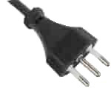

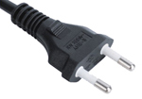










Interoperability Interest Group
Architecture
  CWIC
  FedEO
  IDN
Connected Data Assets
System Level Team
Carbon Strategy

Slide 4
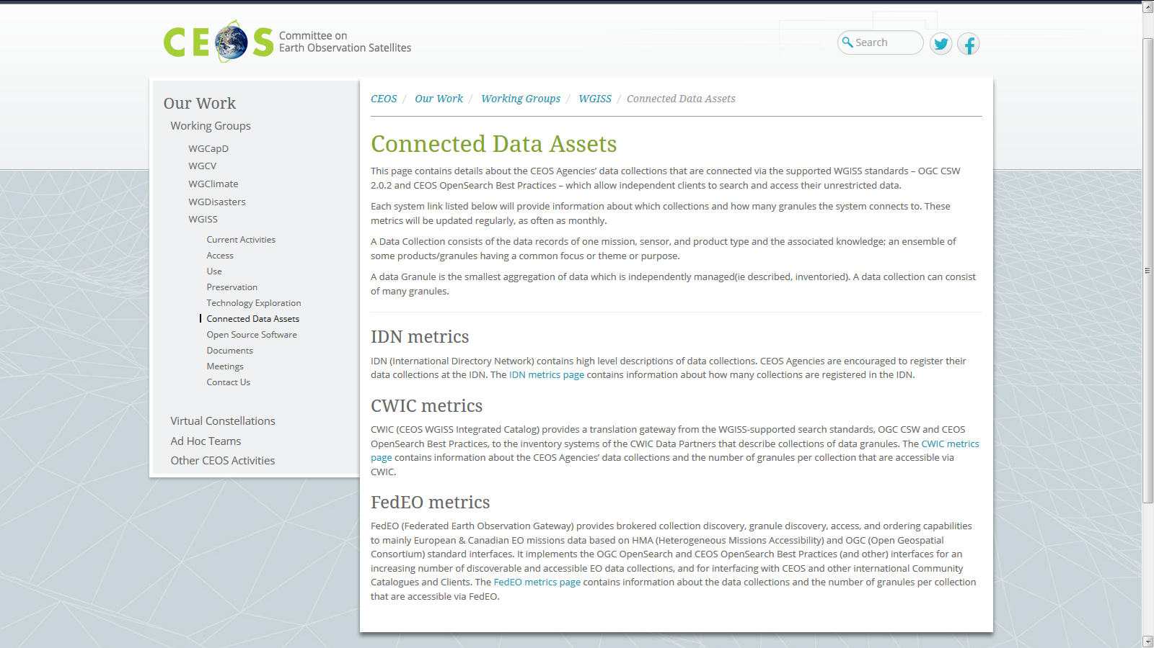
What Data is Accessible?
WGISS webpage has current list of the data collections accessible from IDN, FedEO, and CWIC
Over 32,000 collections searchable in the IDN
Over 5000 collections accessible with associated granules
Over 300+ million granules accessible (granule search)
Additional data collections/granules continuously being added from heritage and current EO missions
Additional data partners can be added to FedEO and CWIC federations
Independent data partners who support the WGISS standards can be added to the WGISS Connected Data Assets

Slide 5
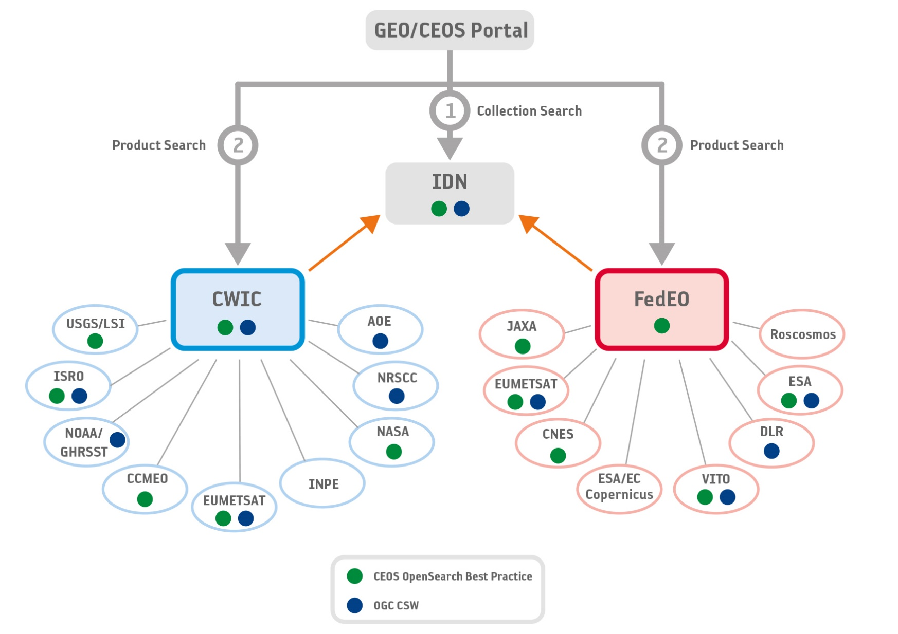
WGISS Data Assets
Architecture
DATA-8: Improve WGISS Interoperability Standards Architecture

Slide 6
Connected Data Assets
Success Stories
Clients accessing data via WGISS Connected Data Assets
  GEOSS Evolve – Data Access Broker (DAB)
  GEO Portal
  AMERIGEOSS Data and Services Portal
  ESA FedEO Portal
  Cove (MDA – Radarsat and INPE CBRS2)
  …

Slide 7
ECVs/CDRs Discovery and Access through WGISS Systems
Objective: facilitate discoverability and accessibility of ECV Products and space-born CDRs relevant for the CEOS Carbon Action via WGISS Interoperability Systems & Standards (FedEO/CWIC/IDN, OpenSearch).
Approach: start from results of WGClimate Questionnaire for ECV Inventory population; tailoring for Carbon Action and gaps identification wrt data records already discoverable/accessible through WGISS systems.
Additional Resources: support from WGClimate and experts for priorities setting; activities at data providers’ side to be carried out by relevant entities.
DATA-9: ECVs/CDRs Discovery and Access through WGISS Systems
Notes:
Carbon Portal prototype

Slide 8
WGISS Carbon Portal
CARB-15: Carbon Data Portal
Objective: Implement a carbon data portal to facilitate the discoverability and accessibility of ECV products and space-borne CDRs. The portal will seamlessly access data both in CWIC and FedEO to provide necessary data and services to the carbon science community of both CEOS and GEOSS.
Approach: Working with Mark Dowell (CEOS Carbon lead) and Stephen Plummer (WG Climate), WGISS will begin defining a preliminary set of “requirements” for a future Carbon Portal. WGISS will start with the initial list of ECVs that are key for Carbon and start putting together a list of relevant data collections from identified data providers.
Additional Resources: requirements definition and development resources provided by NOAA; support from WGClimate and experts for requirements definition.
Notes:
Carbon Portal prototype

Slide 9
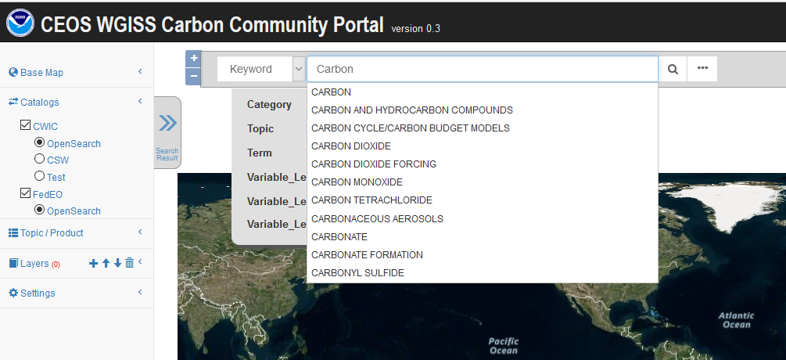
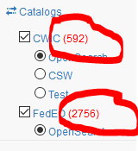
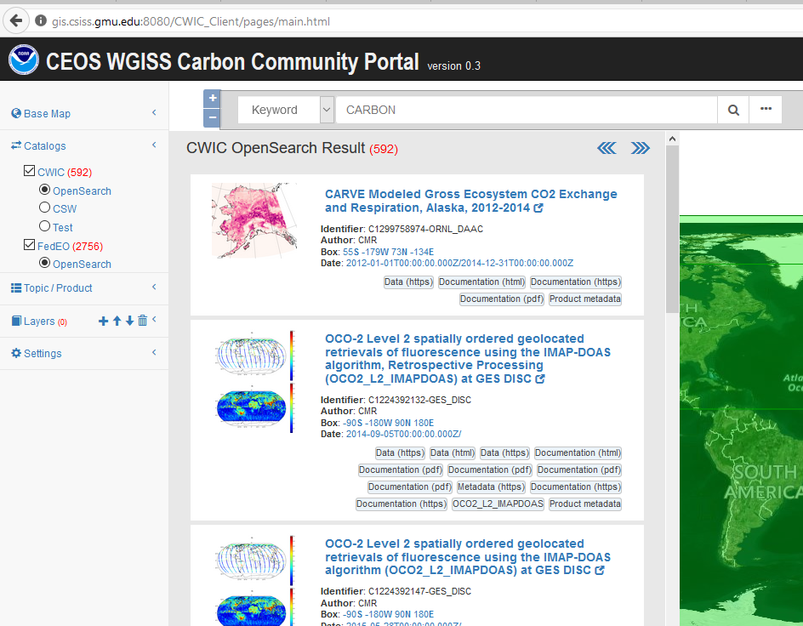
Carbon Collection & Granule Search
Keywords (auto-completion with IDN Science Keywords)
Return records from both CWIC and FedEO

Slide 10
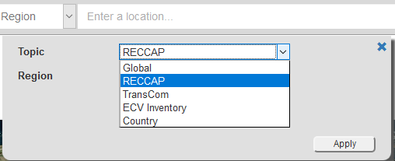
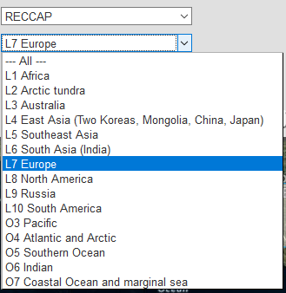
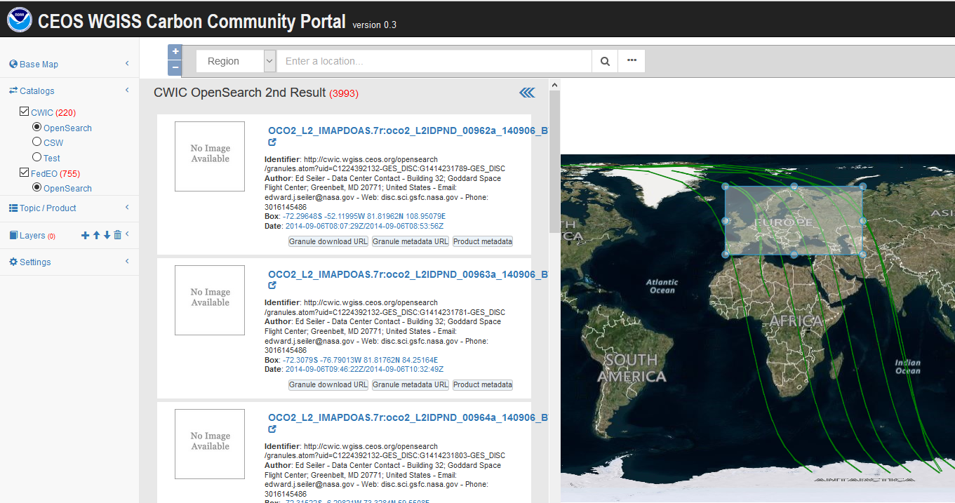
Carbon Regions of Interest
Special regions
  Global
  RECCAP
  TransCom

Slide 11
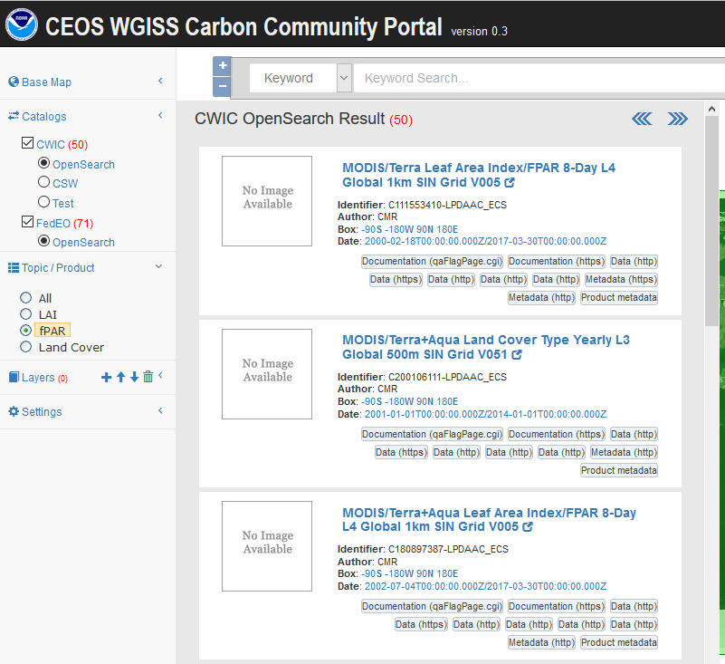
Carbon Topics
Special topics or interest area for carbon community
  Predefined, topic-filtered search
  The example: Special topic: fPAR (Fraction of Photosynthetically Active Radiation)

Slide 12
Technology Exploration
Interest Group
Purpose: to serve as a forum for exchange of technical information and lessons-learned experience about current and trending software technologies, services and other WWW / Internet related software technologies.

Slide 13

2017 Technology Webinars
DATA-11: Technology Exploration webinars and workshops
Relevancy Ranking of Data Search Results
  14th of March 2017
    Stefano Nativi (GEOSS EVOLVE)
    Chris Lynnes and James Norton (NASA)
Data Cubes for Large Scale Data Analytics
  19th of June 2017
    Rob Woodcock (CSIRO)
    Brian Killough (CEOS SEO)
Burgeoning Role of Python for Earth Observation Data Analysis
  22nd of August 2017
    Syed Rizvi (Open Data Cube)
    Rich Signell (USGS)
    Alber Sanchez (INPE)
Joint webinars and advertising with:
  WGCapD
  NextGEOSS
  GEOSS Evolve
  Federation of Earth Science Information Partners (ESIP)
http://ceos.org/ourwork/workinggroups/wgiss/technology-exploration/
Image Source: http://www.readingconnections.org/newsletters/june2010newsletter.htm

Slide 14

FDA Themes supported via WGISS
Data, Processing, and Architecture Interface Standards
  Develop standards for pixel-level data discovery, access, and common analytical processing requests (e.g., cloud free mosaics of ARD) exploiting EO satellite data among various CEOS exploitation platforms
Analytical Processing Capabilities
  Prototype portable web-based analytical processing APIs/Web Services that work across CEOS exploitation platforms in full computing environments for time series and other analysis
User Metrics
  Develop a data use metrics framework through which agencies can contribute to how EO data is being used, rather than just downloaded data quantities
FDA-6: Technical best practices relating to future data architectures opportunities
Image Source: http://www.cfphc.info/get-involved/

Slide 15
Data Stewardship Interest Group
WGISS accomplishes its Data Preservation and Curation efforts through the Data Stewardship Interest Group (DSIG)

Slide 16
Data Stewardship Interest Group
Data Purge Alert Procedure & White Paper
  Data Purge Alert – “USGS National Aerial Photography Program (NAPP) Black-and-White from Color Infrared Film Collection “
a
WGISS EO Data Stewardship Maturity Matrix
  In review
  Being submitted to GEOSS Evolve Data Management Principle group
DATA-10: Reference Model for Data Stewardship

Slide 17



Data Stewardship Best Practices
Document Tree
Policy Documents
Individual organizations'
policies (stewardship, access, ...)
EO Data Stewardship
Cooperative Framework
Applied to
CEOS EO Space Data Sets
Data Purge Alert Procedure & White Paper
High level framework documents
Applied to
Technical Documents
Preservation Workflow
Glossary of Acronyms and Terms
General guidelines and best practices
Support
Guidelines and best practices on specific topics
Persistent Identifiers Best Practice
EO Data Preservation Guidelines
Preserved Data
Set Content
Associated Knowledge Preservation
CEOS Maturity Matrix
Reference Model for Data Stewardship
EO Data Set Consolidation Process
…
Technical implementation procedures
Image Source: https://fcstesting.files.wordpress.com/2013/09/futurent-consulting-project-completed.png
Image Source: http://eastenders.wikia.com/wiki/File:Under-construction.png

Slide 18
GEO Interactions
GEOSS Evolve
AmeriGEOSS
NextGEOSS
GEOSS / WGISS Workshop – April 2017 (WGISS-43)
WGISS presented during the GEO Data Provider’s Workshop in April 2017 on GEO/GCI Success stories
  “How WGISS has made over 300 million CEOS data resources accessible to GEO”

Slide 19

GEOSS EVOLVE
In the 2017-2019 GEO Workplan, the GEO Foundational Task GD-07 is transitioned to a GEO Initiative titled ‘GEOSS EVOLVE’.
WGISS, as a data provider of GEOSS, provided comments to GEOSEC on where WGISS is supporting (and can support) GEOSS EVOLVE work packages (WPs)
WGISS now has representation in:
  WP 1: Evolving GEOSS Architecture,
  WP 2: Functionality Testing
  WP 3: Data Management Principles
  WP 5: Demonstrations Projects (Lead OGC)
  WP 6: Community Portals
DATA-12: CEOS data holdings reported in GEO

Slide 20
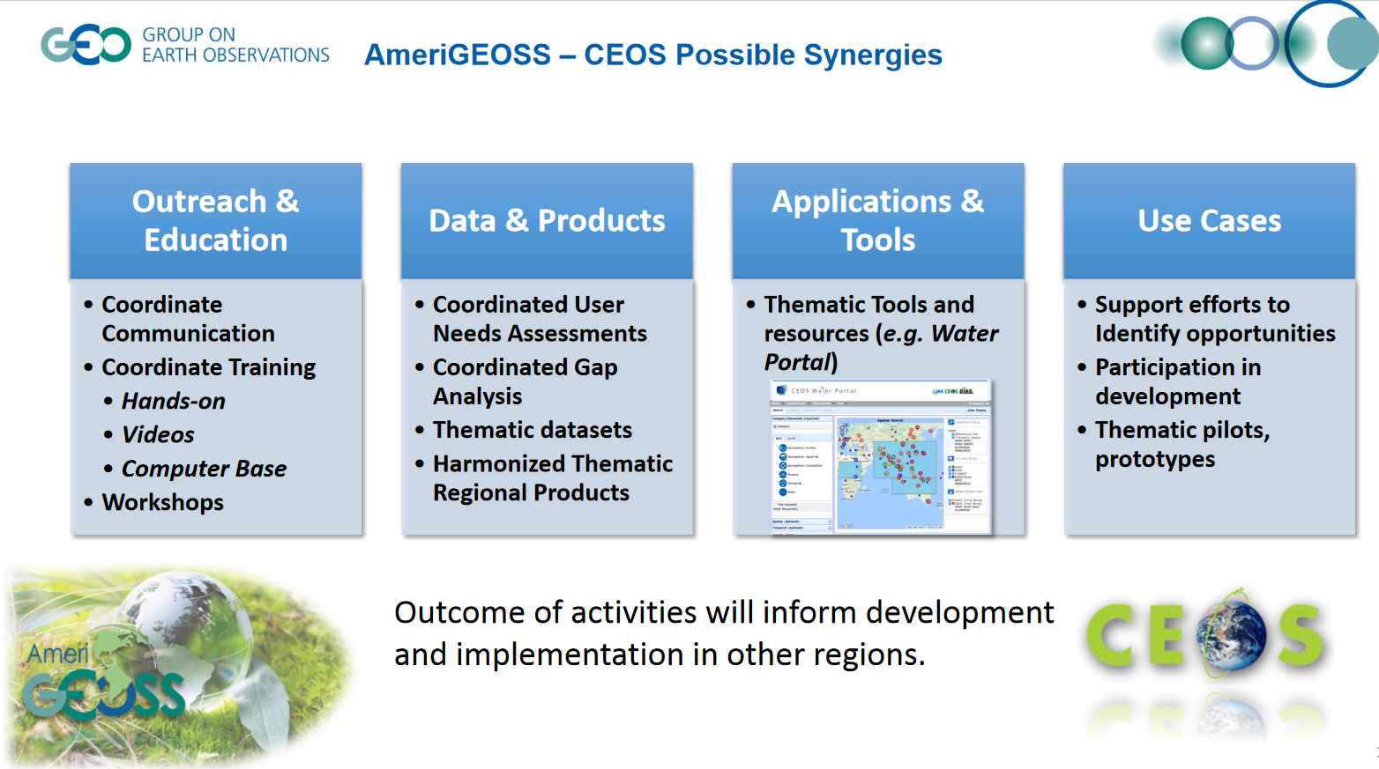
AmeriGEOSS

Slide 21
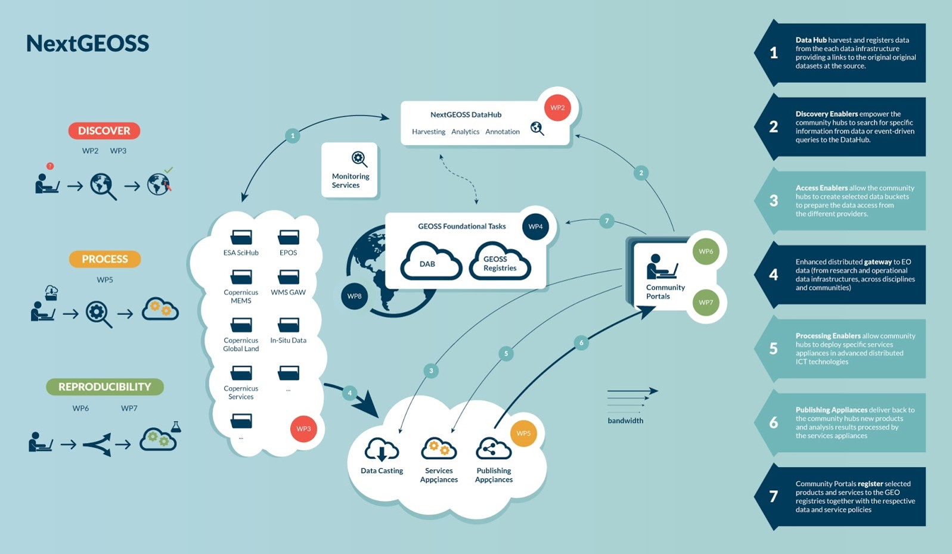
NextGEOSS
WGISS is now represented on the NextGEOSS Advisory Board
Working with NextGEOSS on federated authentication technology solutions

Slide 22

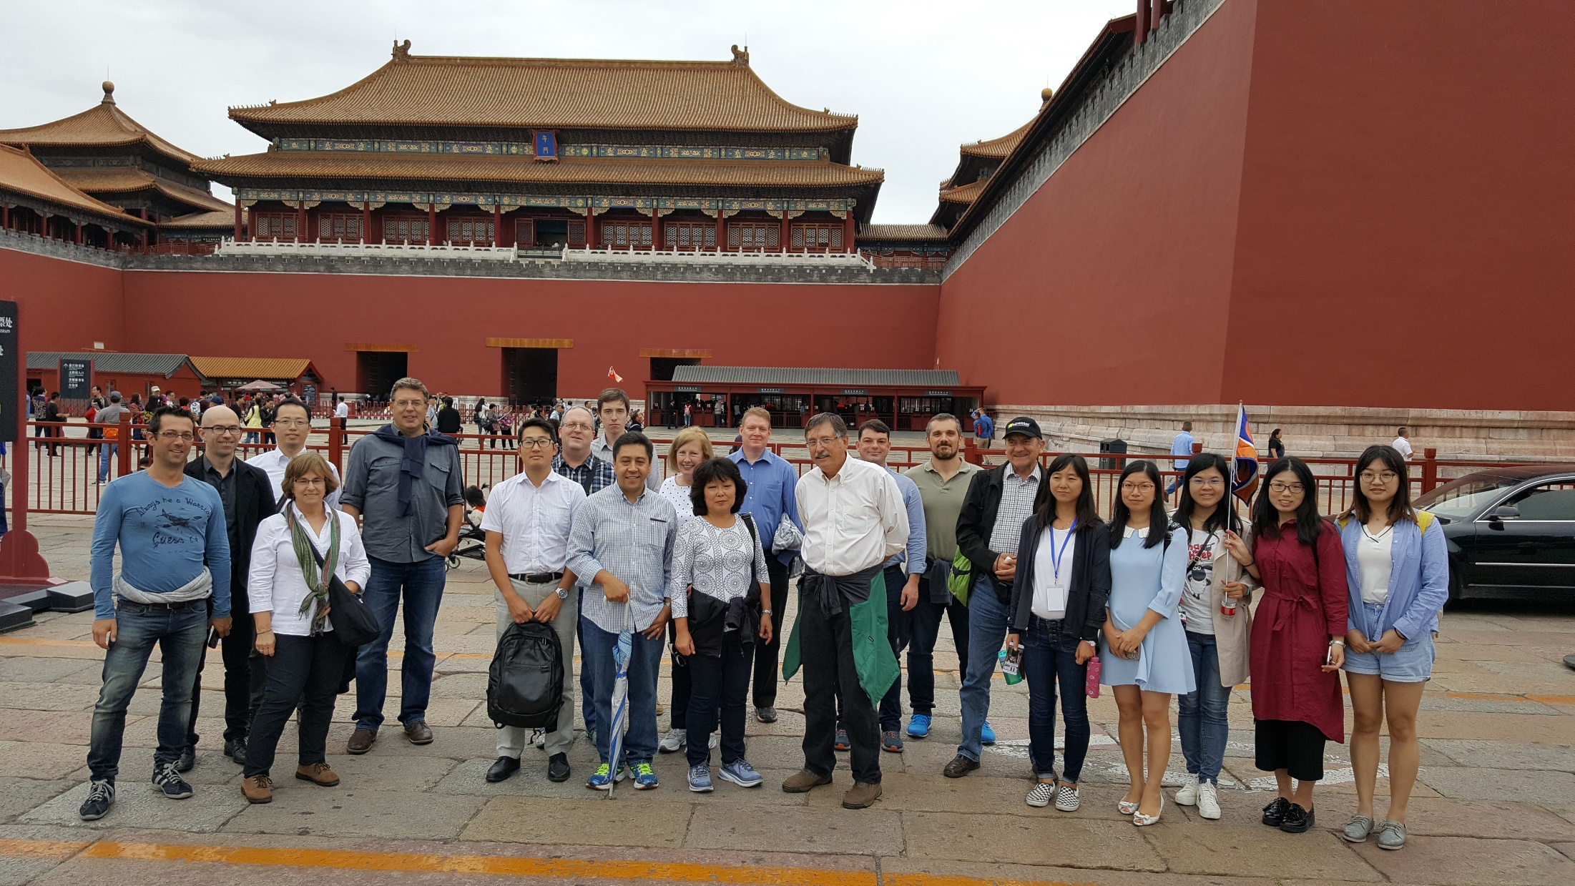
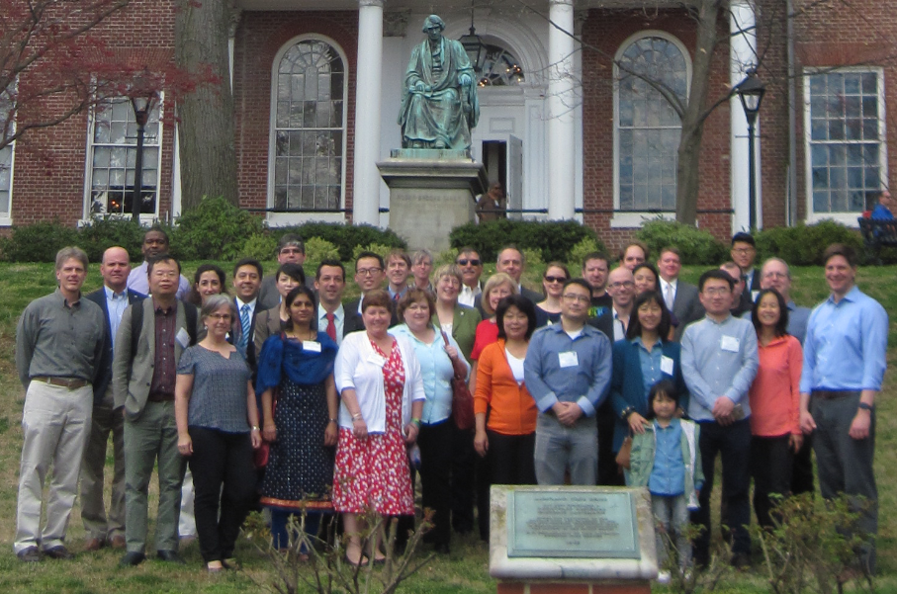
Upcoming Meetings
2017 Conference on Big Data from Space (BiDS'17) hosted by ESA - Toulouse, France (November 2018)
Virtual WGISS Plenary – February 2018
WGISS 45 hosted by INPE - Sao Paulo, Brazil (April 2018)
  DIAS – Cloud Computing/Big Data Workshop
WGISS 46 – September 2017
WGISS 44 – Beijing, China
WGISS 43 – Annapolis, Maryland
Image Source: http://www.accidentalcreative.com/teams/guide-to-insanely-productive-meetings/

Slide 23

Endorsement Vice Chair Nomination
Working Group Vice Chair Nomination
Current Chair term terminates with CEOS plenary 31
Candidate: Dr. Robert Woodcock - Commonwealth Scientific and Industrial Research Organisation (CSIRO)
Dr. Robert Woodcock is the Research Group Leader for Geoscience Analytical Platforms in the CSIRO Minerals Resources Flagship and Deputy Director of the CSIRO Earth Observation Informatics Future Science Platform. His research interests lie in the application of Earth observation informatics to national scale problems and the publication and use of open data as well as the effective use of high performance computing by Earth observation users in research, government and industry environments.
CEOS WGISS recommends the nomination of Dr. Robert Woodcock
Request for endorsement of Dr. Robert Woodcock as incoming Vice-Chair 2017

Slide 24
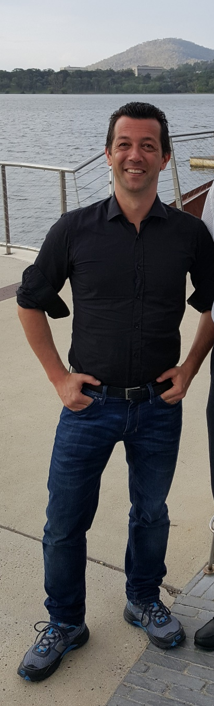

WGISS Chair Handover
New WGISS Chair
Mirko Albani –
Long Term Data Preservation (LTDP) Programme Manager
EO Ground Segment Department,
European Space Agency (ESRIN, Frascati)
Image Source: https://game-solver.com/guess-up-emoji-answers/guess-up-emoji-applause/

Slide 25


