Slide 1

Ad Hoc Team on Sustainable Development Goals
(AHT SDG)
Committee on Earth Observation Satellites
Co-leads (CSIRO, ESA, USGS)
CEOS Plenary 2017
Agenda Item #9
Rapid City, South Dakota, USA
19 – 20 October 2017

Slide 2
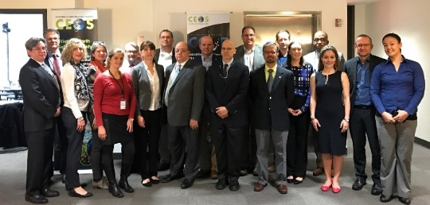
CEOS AHT SDG
Background
First name | Name | Organisation | Status | Role
Marie-Josee | Bourassa | CSA | Member
Paul | Briand | CSA | Member | Acting
Alex | Held | CSIRO | Co-Lead | PoC, coordinator
Flora | Kerblat | CSIRO | Member | Direct support for co-leads, coordination
Michael | Nyenhuis | DLR | Member | Member (observer)
Klaus | Schmidt | DLR | Member
Mark | Dowell | EC | Member
Astrid-Christina | Koch | EC | Member
Maurice | Borgeaud | ESA | Member | Observer
Marc | Paganini | ESA | Co-Lead | PoC, coordinator
Ivan | Petiteville | ESA | Member
Jono | Ross | GA | Member
Tapan | Misra | ISRO | Member
Chu | Ishida | JAXA | Member
Takanori | Miyoshi | JAXA | Member
Yuko | Nakamura | JAXA | Member
Kim | Holloway | NASA | Member | CEOS SEO, communication
Argie | Kavvada | NASA | Member | NASA PoC
Brian | Killough | NASA | Member | CEOS SEO, data cube
Paul | Di Giacomo | NOAA | Member
Satya | Kalluri | NOAA | Member
Kerry | Sawyer | NOAA | Member
Paida | Mangara | SANSA | Member
Nale | Mudau | SANSA | Member | Observer
Imraan | Salooji | SANSA | Member | Observer
George | Dyke | Symbios | Member
Matt | Steventon | Symbios | Member
Stephen | Ward | Symbios | Member
Fernando | Echavarria | USDOS | Member
Eric | Wood | USGS | Co-Lead | PoC, coordinator
CEOS 30th Plenary (Brisbane, 2016) decided the creation of an Ad Hoc Team on SDGs (AHT SDG) until next plenary (CEOS 31st Plenary, Oct 2017)
3 current co-leads : CSIRO (A. Held), ESA (M. Paganini), USGS (E. Wood)
Today ~30 members (mailing list) : if you wish to nominate someone else or add other names, please let us know!

Slide 3

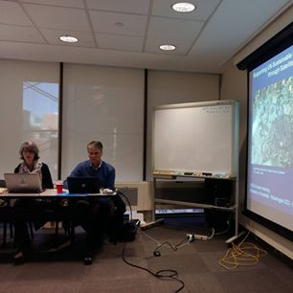
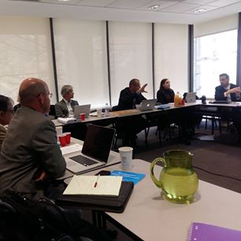
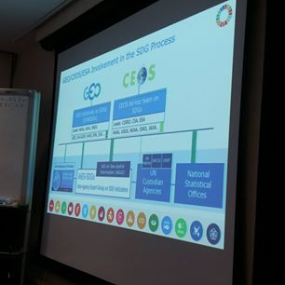
CEOS AHT SDG
Background
AHT SDG face-to-face meetings in 2017:
Strategic meeting in Washington DC, Embassy of Australia,
March 2017 (incl. GEO & external stakeholders, ~25 people)
Side-meeting in Paris, CEOS SIT-32, April 2017
Side-meeting in Frascati, CEOS 2017 TW, Sept 2017
Side-meeting in Rapid City, CEOS 31st Plenary, Oct 2017
AHT SDG main outputs in 2017:
  AHT SDG Terms of Reference produced for noting at SIT-32 (Paris, April 2017)
  AHT SDG Implementation Plan (incl. ToR) produced for information at CEOS 31st Plenary
  Stock of CEOS activities on SDGs (CEOS Engagement Compendium):
  online survey, direct emailing, results compiling (in progress)

Slide 4

CEOS AHT SDG
Terms of Reference (ToR)
In the global, complex and continuously evolving SDG environment, the AHT SDG aims to:
take stock of the UN processes in place for the SDG implementation and of the existing SDG stakeholders;
focus its activities around the unique role that CEOS should play as a coordination body of the Space community efforts to support the integration of satellite EO in support to the full realisation of the SDGs.
The AHT SDG can’t progress alone: it relies on a network and mainly:
aligns its engagement in the context of
(Programme Board, Engagement Strategy, and its EO4SDGs initiative)
builds on established relationships the CEOS Agencies have with UN agencies (custodians), individual countries (incl. national statistics), and other SDG stakeholders (eg. foundations, universities, development banks).

Slide 5
CEOS AHT SDG:
Terms of Reference (ToR)
The AHT SDG will assess, showcase and promote EO contribution
to SDG Targets and Indicators
CEOS AHT SDG – ToRs (summary):
Coordinate the efforts of CEOS agencies and channel CEOS support to the UN process on SDGs through GEO (showcases, promotion, etc.).
Provide a forum for sharing/communicating EO best practices in support to the SDGs in collaboration with GEO.
Analyse new opportunities for satellite-based EO to support SDG Targets and Indicators (methods, data, indicators), in part via enhanced engagement of CEOS agencies within the GEO initiatives and flagships.
Engage with relevant authoritative SDG stakeholders inside (eg. IAEG-SDGs/UNSD, UN GGIM, WGGI, Custodian agencies) and outside the UN system (eg. GPSDD, IISD, WBG, Foundations).
Use CEOS assets and bodies (WGCapD, AHT FDA, etc.) to build and strengthen EO capacities at all levels of the UN SDGs implementation.

Slide 6
AHT SDG Implementation Plan
Key elements
Compile & maintain a compendium of CEOS Agencies’ engagement on SDGs
Define a coherent, flexible and adaptive CEOS engagement plan on SDGs
Coordinate CEOS support to GEO-led SDG activities
Review and assess the contribution of EO to the SDG Targets and Indicators
Demonstrate, showcase and foster the added-value of EO in the SDG monitoring & reporting process
Facilitate uptake of EO by SDG stakeholders (eg. National Statistics)
Develop impactful Communication & Outreach activities on EO for SDGs

Slide 7

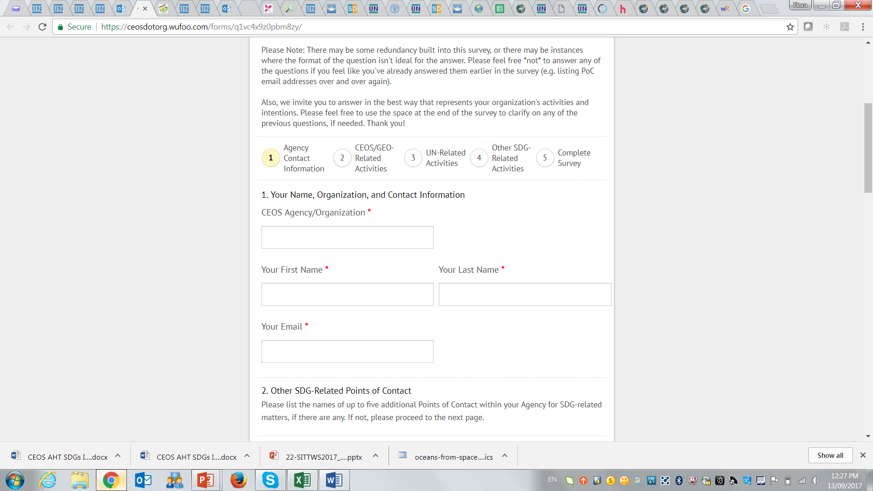
AHT SDG Implementation Plan
1. Compendium of Agencies’ engagement
Objective: Collect and centralize information across CEOS Agencies on their SDG engagement and related activities, through online surveys and other consultation channels.
Why? For CEOS internal use, to get Agencies’ points of contact, identify strengths and weaknesses in CEOS collective engagement, and better coordinate / align / optimize CEOS agencies' activities on SDGs.
2018+ activities:
Maintain a CEOS Engagement Compendium on SDGs as a living database (Excel document to be available on CEOS Document Management), with up-to-date information on Agencies’ engagement, for consultation by all CEOS Agencies
2017 activities:
An online survey was designed and circulated to get basic information on Agencies engagement: PoCs, GEO/CEOS activities on SDGs, UN system, international/regional initiatives, National Statistical Offices, internal projects related to SDGs, global/regional datasets.
      Only a few responses: we hope to get effective and constructive responses from CEOS Agencies in the coming months through a simplified approach.
  Engagement Compendium will be completed following CEOS 31 Plenary

Slide 8
AHT SDG Implementation Plan
1. Compendium of Agencies’ engagement
Summary of Responses received so far … (Compendium) living database (Excel sheet), for consultation by all CEOS Agencies (to be uploaded soon to CEOS Management System)
 | 1. Agency SDG Point of Contact (POC) | 2. CEOS Entities, GEO Flagships, Initiatives, and/or other SDG-related activities the Agency is part of (or willing to be a part of) | 3. Global / national partnerships related to EO & the SDGs | 4. SDG Targets or Indicators (specifically promoted in the Agency) | 5. Global / Regional Datasets: [primary datasets to help achieve the SDGs]"
CSIRO | X | X | X | X | X
DLR | X | X | X | X
EC | X
ESA | X | X | X | X | X
JAXA | X | X | X | X | X
NASA | X
NOAA | X | X | X | X | X
USGS | X | X | X
More to add? New thoughts? Please send us (Kim/Flora) more information so we stay up-to-date, and able to provide inputs when needed (conferences, workshops, articles, …)

Slide 9

AHT SDG Implementation Plan
2. CEOS engagement on SDGs
With GEO
Objective: Develop a consistent and coherent CEOS engagement strategy on SDGs.
Why? To identify, maximize CEOS efforts and available resources on SDGs for a higher impact (on the use of EO in SDGs) and tangible benefits for CEOS agencies.
2018+ activities:
Detailed analysis of CEOS Agencies’ engagement on SDG Targets and Indicators with identification of strengths and gaps.
Define an effective engagement strategy with:
  GEO (EO4SDGs initiative, GEO Program Board, GEO activities)
  UN system & custodian agecies/International organizations: UNSD, IAEG-SDG WGGI, UN-GGIM, GPSDD, S&T Innovation Forum, Custodian Agencies, IFIs, Foundations…)
  (* participation of CEOS associate members to be better encouraged & strengthened)
  Countries: National Statistical Offices (NSOs) and line ministries.
2017 activities:
Attained a firm grasp on the SDGs landscape and identified key SDG stakeholders.
Analysis of CEOS Agencies’ engagement on SDGs (output of IP 1 – just started).

Slide 10
AHT SDG Implementation Plan
3. CEOS support to GEO-led SDG activities
With GEO
Objective: Coordinate CEOS support to GEO-led SDG activities, through the 3 GEO complementary channels (Program Board, EO4SDG and GEO initiatives/flagships)
Why? To optimize the development and maximize use of EO solutions (methods, tools and products) in GEO SDG-related activities, and their uptake by SDG stakeholders.
2018+ activities:
Strategic : support CEOS representative to the GEO Programme Board (SDG subgroup) to ensure GEO's Work Program aligns with stated SDG priorities, identifying gaps and proposing additions/modifications to the GEO Work Program.
Tactical : coordinate the CEOS agencies’ contribution to the GEO EO4SDG Initiative
Implementation : strengthen CEOS agencies’ involvement in GEO community activities, initiatives and flagships (with EO relevance for SDGs), promoting an adaptation/tailoring of existing EO methods/products/tools to SDG Targets and Indicators.
2017 activities:
Reviewed the GEO work program and identified key EO-related activities missing in the program or where CEOS Agencies should be more actively involved.
Participated in GEO EO4SDG conference calls, and international events to showcase the value of EO for SDGs (e.g. ISRSE-37, GEO/CEOS side event on SDGs at GEO XIV plenary)

Slide 11
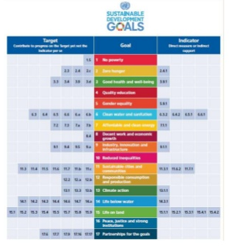
AHT SDG Implementation Plan
4. EO contribution to SDG targets and indicators
With GEO
Objective: Assess the current and potential contribution of EO to the SDG Targets and Indicators (through the lenses of space-based EO) and identify areas of better EO uptake.
Why? To increase the effective use of space-based EO in the overall SDGs process (targets achievement and indicators’ monitoring) and by all key players (global, national, local levels)
2018+ activities:
Conduct an in-depth analysis of the use of EO in the IAEG-SDGs Metadata Repository (SDG Indicators) and as a source of information for countries to better achieve their targets.
Communicate the result (lobbying) – in cooperation with the GEO EO4SDG initiative - to the IAEG-SDGs Working Group on Geospatial Information (WGGI).
Contribute to IAEG-SDGs WGGI work.
2017 activities:
Analyzed and reviewed the global Indicators framework (consolidated tables have been circulated)
Initiated an ESA-funded project on EO4SDGs that includes a thorough study of the current and potential contribution of EO to the SDG Targets and Indicators (Call in August, start of activity in 2018).

Slide 12
AHT SDG Implementation Plan
5. Showcase unique added-value of EO to other SDG stakeholders
With GEO
Objective: To demonstrate the value of EO for achieving the SDG targets and for reporting on indicators, through coordination with UN Custodian Agencies and selected pilots, that can lead to wider adoption by SDG stakeholders.
Why? To increase the use of Earth Observations in the overall SDGs landscape (targets and indicators) and by all actors (from global to local levels)
2017 activities:
Initiated SDG pilot projects in partnership with GEO (e.g. CEOS/GEO SELIS proposal to the GPSDD-WB Call on “collaborative data innovation for SD” on the use of data cube technology for SDGs).
2018+ activities:
Compile EO best case practices for SDGs starting with the 5 SDGs where GEO is the most actively involved: Zero Hunger (SDG 2), Water and sanitation (SDG 6), Sustainable urbanization (SDG 11), Life below water (SDG 14), Life on land (SDG 15).
Launch one or two national/regional large-scale SDGs pilot projects (in partnership with GEO EO4SDG and relevant GEO activities), starting from the methodological guidelines provided by the custodian agencies and engaging with key players (incl NSOs).
Develop EO capacity building/training in countries: online courses and webinars on the integration of EO in the SDGs monitoring (in partnership with GEO, custodians and NSOs).

Slide 13
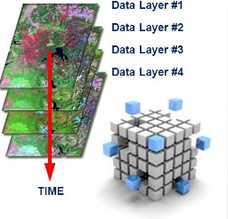
AHT SDG Implementation Plan
6. Facilitate uptake of EO by SDG stakeholders
With FDA and SEO
With GEO
Objective: Review the availability and demonstrate the utility of Big Data tools and infrastructures to facilitate the uptake of satellite-based EO data by SDG stakeholders.
Why? Facilitate awareness on technological solutions to discover, access,
process and analyse EO data and information by all SDG actors
2017 activities:
Initiated, in partnership with GEO, a number of national demonstrations
on the utility of the CEOS data cubes for SDG monitoring and reporting
(e.g. Colombia, Balkans)
2018+ activities:
Analyze the existing and ‘under-development tools’ capacity (online platforms, toolboxes and Big Data analytics tools): how can it serve the SDG stakeholders, using EO-based data, addressing both global and national needs.
Conduct a number of pilot country cases to demonstrate the value of big data analytics tools (e.g. CEOS Datacube) with a particular focus to the developing countries (leaving no one behind).
Demonstrate the up-scale opportunities of EO approaches for SDG monitoring and reporting.

Slide 14

AHT SDG Implementation Plan
7. Communication & Outreach activities
With GEO
Objective: Promote the value of EO for SDGs at international, regional and national levels
Why? Raise awareness of the value of EO amongst the SDG community and showcase benefits.
2018+ activities:
Finalize the CEOS Handbook on SDGs for distribution at UNSC-49 (March 2018), 7th IAEG-SDGs meeting (March 2018), HLF (July 2018) and UN GGIM Plenary (August 2018)
Participate in the SDG-related events (in partnership with GEO) to continue raise awareness and inform SDG stakeholders on the value of EO for the SDGs.
Contribute to the development of a GEO Portal on SDGs (EO4SDG website) as a Knowledge Hub with the provision of EO best case practices, demonstration products, global/regional data sets, EO data processing and analytics Toolboxes.
Develop primers/flyers on the importance of EO for SDGs (with GEO)
2017 activities:
Contributed to the production of a GEO-CEOS joint report on “EO in service of the 2030 agenda for Sustainable Development” (distributed at UNSC-48).
Initiated a number of Primers on EO for SDGs (general, and SDG 2)
Started the production of a CEOS Handbook on SDGs

Slide 15
CEOS AHT SDG
Way forward & key recommendations
CEOS 30th Plenary, Brisbane, 2016:
“In 2017, the team will develop recommendations for CEOS Principals on how CEOS should organise itself beyond 2017 to support CEOS engagement on the SDG agenda, including its relationship with GEO”
The AHT SDG co-leads invite CEOS Principals to:
Welcome the Implementation Plan of the AHT SDG for the year to come.
Support the work of the AHT SDG by:
  Designating their principal Points Of Contacts (POC) on SDGs.
  (for each CEOS Agency willing to participate to the AHT SDG)
  Encouraging CEOS Agencies to respond positively to future requests from the AHT SDG when collecting information on and promoting the value of EO in the SDG process.
  improving the AHT SDG workforces (time/efforts).
Ensure a favorable framework for CEOS agencies and GEO partners to continue collaborating on SDGs.
Renew the AHT SDG for one year with the objective to have a permanent CEOS working group on SDGs (to be decided at CEOS Plenary 32 in October 2018).

Slide 16

Thanks
for your attention
We look forward to working closely (and sustainably!) with you next year!
Feel free to contact us:
Eric Wood (USGS, co-lead of the AHT SDG) woodec@usgs.gov
Marc Paganini (ESA, co-lead of the AHT SDG) marc.paganini@esa.int
Alex Held (CSIRO, CEOS Chair 2016 & co-lead of the AHT SDG) alex.held@csiro.au
Flora Kerblat (CSIRO, AHT SDG team) flora.kerblat@csiro.au
Kim Holloway (NASA/SEO, Communication) kim.e.Holloway@nasa.gov
CEOS web pages on SDGs:
http://ceos.org/ourwork/ad-hoc-teams/sustainable-development-goals/

