Slide 1

CEOS Analysis Ready Data for Land (CARD4L) and Broader CEOS ARD Strategy
Committee on Earth Observation Satellites
Adam Lewis, LSI-VC
CEOS Plenary 2017
Agenda Item 8.3
Rapid City, South Dakota, USA
19 – 20 October 2017

Slide 2
LSI-VC Membership changes
Bianca Hoersch (ESA co-chair) has moved to a new role in ESA.
ESA have identified Susanne Mecklenburg as a follow-on co-chair. Susanne the ESA SMOS and Sentinel-3 mission manager.
Daniel Wicks has joined LSI-VC from UK Satellite Applications Catapult.
Andreia Siqueira has joined LSI-VC from Geoscience Australia, with a focus on supporting the implementation of the CARD4L framework.

Slide 3
LSI-VC and CARD4L
CEOS Analysis Ready Data for Land (CARD4L), are
satellite data that have been processed to a minimum set of requirements and organized into a form that allows immediate analysis with a minimum of additional user effort, and, interoperability both through time and with other datasets
CARD4L is a framework for establishing ‘minimum requirements’ for products that:
    Are ready for ‘immediate analysis’
    Require minimal additional user effort to prepare
    Interoperable with other CARD4L datasets
This work relates to CEOS Activity ID FDA-07 ☺
Notes:
The Land Surface Imaging Virtual Constellation (LSI-VC) was tasked (Nov 2015) to “Define intercomparable Analysis-Ready Data (ARD) products within the context of land surface imaging”.
Intended to lower barriers and engage new communities of users

Slide 4
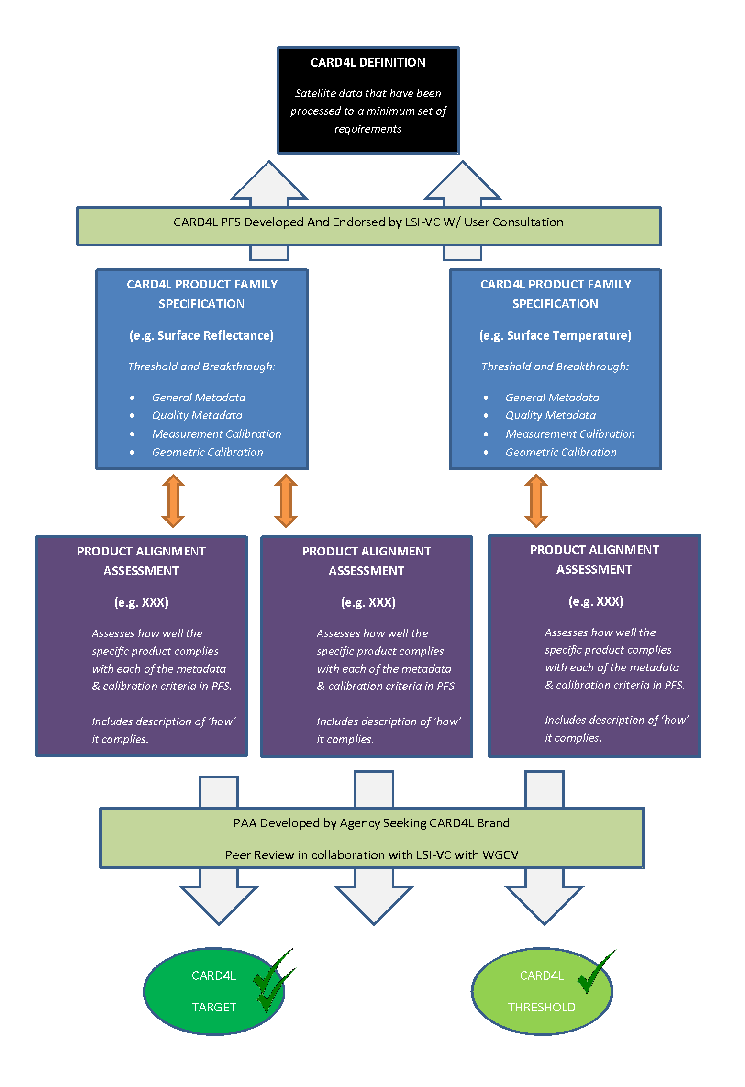
LSI-VC and CARD4L
CARD4L Framework
Notes:
The Land Surface Imaging Virtual Constellation (LSI-VC) was tasked (Nov 2015) to “Define intercomparable Analysis-Ready Data (ARD) products within the context of land surface imaging”.
Intended to lower barriers and engage new communities of users
CARD4L Specification framework presented at SIT-32, in Paris. The framework includes:
The CARD4L Definition - complete
Product Family Specifications (PFS)
PFS are in the implementation phase. PFS provide the detail for analysis ready data land products of various types.
Product Alignment Assessments (PAA). PAAs are yet to be developed. PAAs will:
Allow data providers to assess how well their products align with the CARD4L specifications, and,
Provide a basis for independent assessments of alignment.

Slide 5
CARD4L Status
Product Family Specifications (PFS) have been developed for:
  Surface Reflectance
  Radar backscatter
  Land Surface Temperature
Detailed input to the draft CARD4L specifications was received from multiple sources June-Sept 2017, improving the documents and raising awareness of CEOS’ leadership in this area.
More input is needed. A further round of technical teleconferences will happen in 2017 convened by Geoscience Australia (Andreia Siqueira)
Other PFS will probably emerge, e.g., Radar phase data, water leaving radiance
Very strong support for CARD4L is indicated by a range of experiences and activities (UK, ESA, USGS, NASA, Canada, GA, CNES, etc.).
The journal Remote Sensing has recently announced a special issue, anticipated for mid 2018, on Analysis Ready Landsat Data

Slide 6
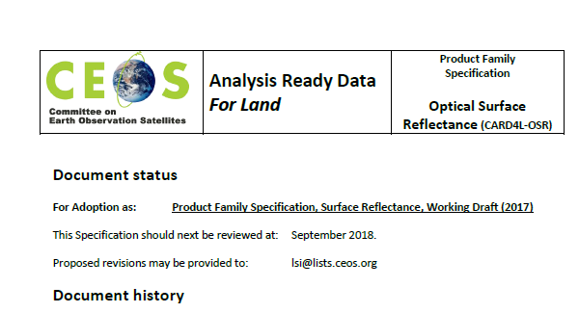
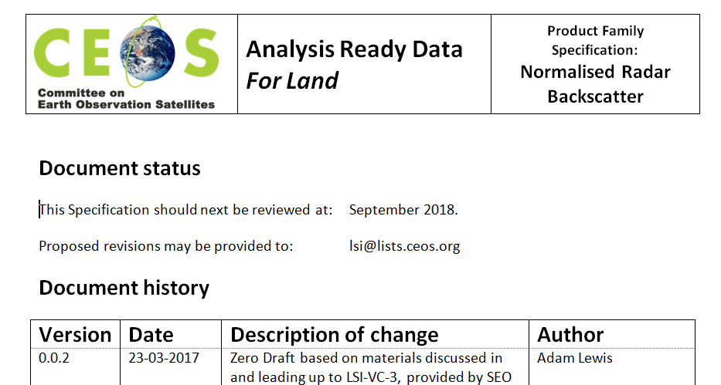
CARD4L Status
Product Family Specifications are technical documents

Slide 7
CARD4L Status
The importance of CARD4L is also indicated by :
The Moderate Resolution Interoperability (MRI) initiative hosted by LSI-VC and supported by USGS during2017
  Analysis ready data is a first step for interoperability
The Future Data Architectures ad-hoc Team (FDA-AHT) recommending :
  That LSI-VC promote the benefits of CARD4L to providers
  [this is agreed and has been taken on-board by LSI-VC]
  A broader strategy for CEOS analysis ready data
    (discussed at the SIT Workshop) [this is for discussion]

Slide 8
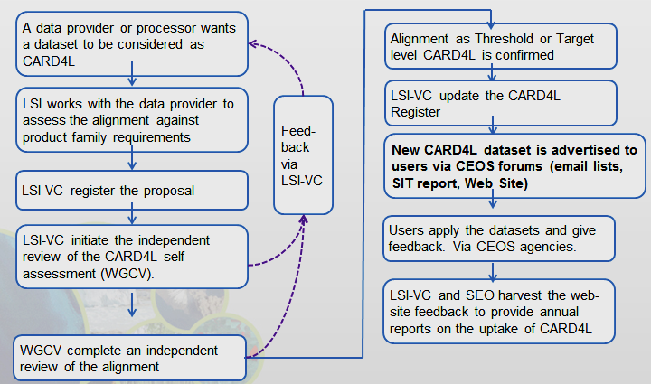
CARD4L Status
LSI-VC will now move into an implementation phase with several objectives:
‘road-test’ the Product Family Specifications, including through further technical teleconferences
Develop the process for datasets to be assessed as CARD4L
Identify data products that are on-track to become CARD4L
Monitor and communicate progress of individual products toward CARD4L
The Product Family Specifications will continue to evolve as the LSI-VC gathers feedback in the Alignment Assessments
Implementation processes are under discussion

Slide 9
CARD4L Status
In order to communicate CARD4L the LSI-VC will:
Engage with user communities, e.g., through GFOI and GeoGLAM, to capture and communicate user experiences of Analysis Ready Data / MRI
Take steps to promote the CARD4L framework to data providers. These include using the CEOS web site to communicate progress toward CARD4L products
We expect that data providers will need to be:
  Aware of the Benefits of ARD production
  Supported to use and ‘own’ the CARD4L framework
  Recognised for achievements in production of CARD4L

Slide 10
Communicating CARD4L to providers
Actions that LSI-VC / SEO will progress to better engage data providers in CARD4L: | Capture the Benefit | Support the implementation | Recognise the contributions
1. Complete the Framework, including independent assessment, continuous development of the guidance material, and review processes to refine / add / remove product family specifications - publish on the CEOS web site including progress toward Product Family Specifications |  | ✔
2. Develop an on-line list of CARD4L datasets, including the level of maturity (planned; algorithm development; test production; local production; systematic production; continuous improvement) |  | ✔ | ✔
3. Showcase certain CARD4L products – ALOS Global Mosaics; USGS-Landsat Surface Reflectance, and others, including their uses and benefits, on the web site | ✔ | ✔ | ✔
4. Maintain an open and inclusive team (LSI / FDA ..), welcoming contributions from new players to continue to support the development and maintenance of the Product Family Specifications |  | ✔
5. Promote CARD4L (ARD) workshops or special sessions alongside conferences and SIT meetings (or in Journal special editions!) | ✔ | ✔ | ✔

Slide 11
CARD4L Status – pause for questions?

Slide 12
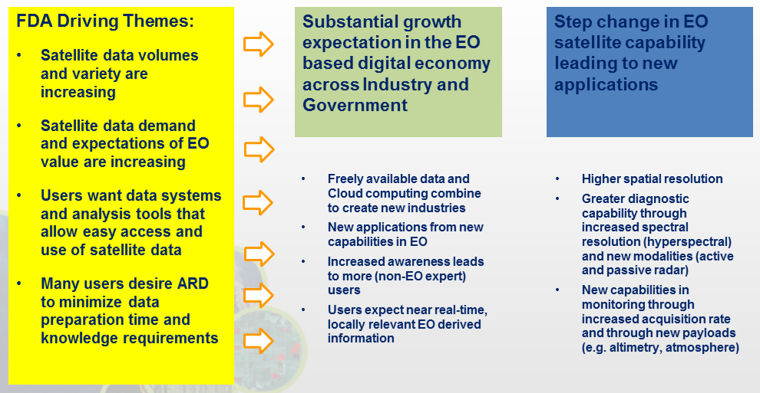
A Broader ARD Strategy?
Background
The FDA-AHT recommended that LSI-VC consider a broader strategy for ARD, i.e., beyond Land (CARD4L).
The rationale is that analysis ready data is necessary as an input to future data architectures

Slide 13
A Broader ARD Strategy?
Background
Discussed by VCs during the SIT Workshop
Outcomes from the meeting of VCs:
The meeting noted that oceanographic and atmospheric approaches, that provide grids of variables such as sea surface temperature (which in turn enable products such as NOAA Coral Reef Watch Alert System) are exemplars and have provided guidance for CARD4L
Nonetheless, the CARD4L framework offers a general formalisation that might be of value to other VC communities
LSI-VC to provide the VC’s with a package for them to:
  Provide feedback on the framework to LSI-VC
  Consider the applicability of the CARD4L framework to Oceans and Atmosphere

Slide 14
A Broader ARD Strategy?
Considerations
A broader CEOS strategy for analysis ready data would be beyond the scope of the Land Surface Imaging VC. Other discipline VCs would need to have a stake in the work.
Proposed approach
LSI-VC share the CARD4L framework with the VCs for feedback as planned.
CEOS (FDA/LSI-VC) use the feedback from the VCs to inform its response to the recommendation of the FDA-AHT regarding a broader ARD strategy.

Slide 16
CARD4L, MRI, and FDA Relationship
Full exploitation of EO data requires CARD4L, MRI, and FDA along with critical user feedback informing future directions
MRI
- Addresses how to combine data / scientific methods to maximize interoperability
    CARD4L is the first step to MRI
    - MRI provides feedback to CARD4L
FDA
MRI and CARD4L are vital components of FDAs
CARD4L-compliant products feed FDAs
CARD4L
Is the step to get the data ‘ready for’ FDAs and interoperability

Slide 17
CARD4L Status
CARD4L Specification framework presented at SIT-32, in Paris. The framework includes:
The CARD4L Definition - complete
Product Family Specifications (PFS)
  PFS are in the implementation phase. PFS provide the detail for analysis ready data land products of various types.
Product Alignment Assessments (PAA). PAAs are yet to be developed. PAAs will:
  Allow data providers to assess how well their products align with the CARD4L specifications, and,
  Provide a basis for independent assessments of alignment.

