Slide 1

CEOS Data Cube (CDC) and FDA Pilot Outcomes
Committee on Earth Observation Satellites
Brian Killough
NASA, CEOS Systems Engineering Office
CEOS Plenary 2017
Agenda Item 8.2
Rapid City, South Dakota, USA
19-20 October 2017

Slide 2
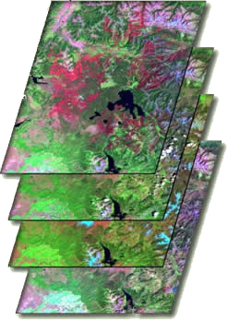

What are Data Cubes?
Data Cube = Time-series multi-dimensional (space, time, data type) stack of spatially aligned pixels ready for analysis
Proven concept by Australia with plans for global implementation
Analysis Ready Data (ARD) ... Dependent on pre-processed products to reduce the burden on users
Open source software approach allows free access, promotes expanded contributions, and increases data usage.
Unique features: exploits time series, increases data interoperability, and supports many new applications.
TIME
Data Cubes are a popular topic … “The Data Cube Manifesto” (Peter Baumann, EU) and “The Six Faces of the Data Cube” (Peter Strobl, EC)

Slide 3
Benefits of Data Cubes
Expanded use of CEOS satellite data … expanded user base
Reduced processing burden .. dependency on ARD
Enhanced interoperability ... improved by MRI
Efficient time series analyses
Free and open access
Flexible deployment (local or cloud)
Use of a common architecture
Community development and sharing … via GitHub
Our goal is NOT to sell a product or distribute a tool. Our goal is to provide a SOLUTION that has VALUE and increases the IMPACT of satellite data.

Slide 4

Open vs. CEOS Data Cubes
The ODC initiative is larger than CEOS.
The Open Data Cube (ODC) initiative was established by CEOS, with a goal to create and foster an open “community” of contributors.
The ODC uses a common architecture among the various implementations so that all users can share tools and applications.
The CEOS Data Cube (CDC) is one “implementation” of the ODC. Similarly, Digital Earth Australia (DEA) and USGS Land Change Monitoring, Assessment, and Projection (LCMAP) are implementations.
The CDC goal is to focus on building global capacity to utilise satellite data and contribute to global initiatives (e.g. UN-SDG, GFOI, GEOGLAM) through the use of Data Cubes.

Slide 5

CEOS Data Cube Vision
A solution supporting CEOS objectives …
  Build capability of users to apply CEOS satellite data
  Supporting priority CEOS/GEO agendas and SDGs
CEOS Agencies wanting to participate …
  Through provision of CEOS Analysis Ready Data (ARD) products
  Contributing to development and uptake of solutions
Customer focused …
  Training materials and easy installation/maintenance
  A brand that people know and trust
  An active community of users
Scalable solution …
  Operational Data Cubes in 20 countries by 2022
  Key partners (e.g. GEO, World Bank) supporting data cube projects

Slide 6
The “Road to 20” Operational Data Cubes by 2020
Colombia has an operational Data Cube since Dec 2016 with over 25,000 historic Landsat images. They continue to expand the user base, applications and datasets. The Colombia Data Cube won the National Environmental Award of Colombian Society of Engineers in May 2017 and has been approved by the Colombia Government into 2018.
Switzerland has an operational Data Cube since July 2017 with over 4,000 historic Landsat images. They have received Swiss government approval and developed a new website (swissdatacube.org). Their future plans include expanded datasets (Sentinel) and increased applications with both government and university involvement. They are also planning capacity building in Georgia and Moldova.
Vietnam is slowly making progress by establishing pilot cubes in several regions using a new high performance computing system. Their focus is on forests, rice, and water applications. VNSC is hosting an internal Data Cube Workshop on Sept 17.
Operational
Under Development
Under Review or Expressed Interest
3 operational, 4 under development, 22 under review = 29 total

Slide 7
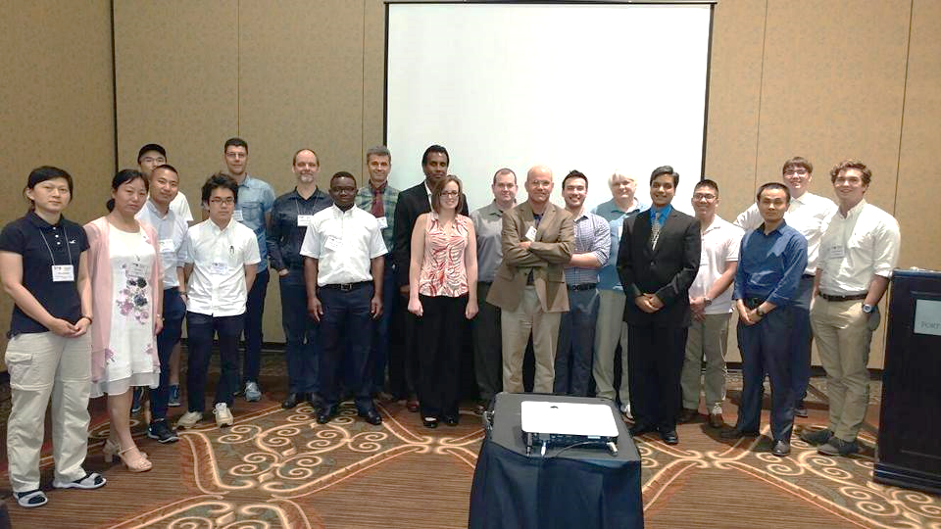

ODC Progress
We have established an “ODC Partners” group which includes representatives from NASA-SEO, GA, CSIRO, USGS, and UK-Catapult.
We have established an “ODC Steering” group which include technical representatives from NASA-SEO, GA, CSIRO, and USGS.
We have established a new website https://opendatacube.org
We have developed “white papers” for the ODC and CDC that describe the goals of each initiative and an ODC governance document.
We conducted the first ODC Workshop
at the 2017 IGARSS conference
in Fort Worth, Texas, USA.

Slide 8
Technical Progress
The CDC has established detailed content to support Data Cube deployments
  Installation – system requirements, installation guide
  Data Preparation – ARD guidance, data acquisition guidance
  Data Cube Creation – ingestors for all popular datasets
  Applications – AWS demo, Python notebooks, growing list of algorithms
  User Forum – discussion groups for user support
Data Cube ingestion has demonstrated significant reduction in data storage requirements when comparing the ingested Data Cubes to the original data.
  Landsat = 3x to 7x reduction (varies with data parameter selections).
  Sentinel-1 GRD = 6x reduction (based on 30m grid, VV and VH only)

Slide 9
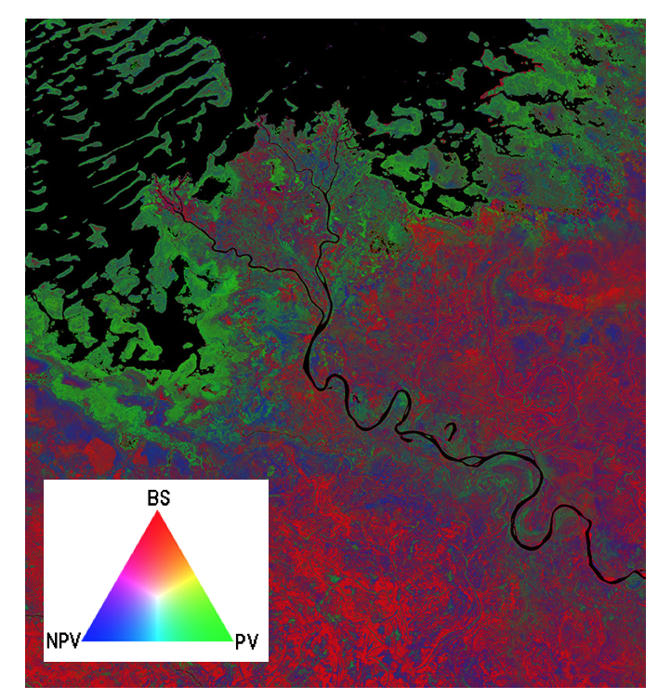
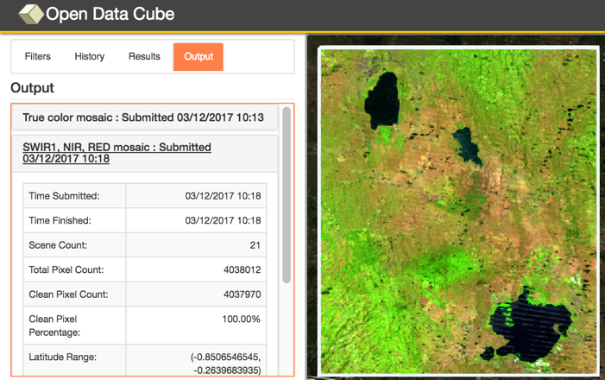
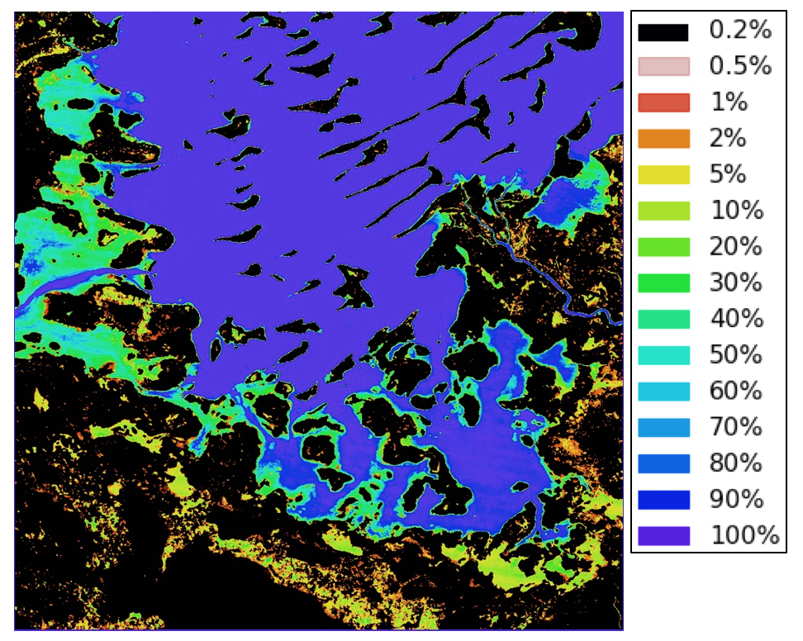
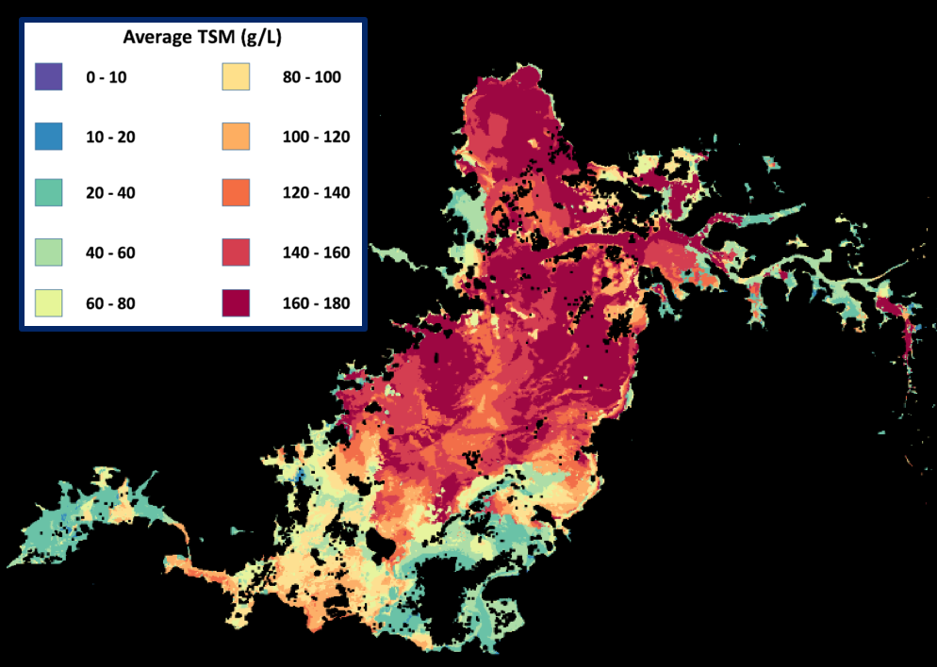
Amazon (AWS) Demo Portal
Data Cubes
16 cubes with 10+ years each.
Kenya, Cameroon (Lake Chad), Togo (coastal Africa), Ghana, Colombia, Tonga (Pacific Island), Vietnam, Australia (Menindee Lakes), Bangladesh.
User Interface Features
9 applications: cloud coverage maps, custom cloud-free mosaics, fractional cover, NDVI anomaly, water detection, water quality, landslides, coastal change and urbanization.
Outputs in GeoTIFF and GIF animation.
New features added in Sept 2017: data visualization tools, ingestion “on demand” for new cubes or subsetting, and indices.
This is the first “hands-on” global demo of the Data Cube to show its potential for rapid time series analysis and diverse applications
http://tinyurl.com/datacubeui
Free and Open!

Slide 10
FDA Deliverables
FDA-02: Collaborative Development of CEOS Data Cube (Q4 2019)
The core Data Cube team (NASA-SEO, GA, CSIRO, USGS, UKSA) is making excellent progress … Governance Plan (Partners Forum, Steering Council), website, prototype development, dataset ingestion, applications, execution.
FDA-03: CEOS Data Cube Governance (Q2 2017) - COMPLETE
The new Open Data Cube Governance Plan was completed and published on the ODC website in July 2017. The plan addresses the Partners Forum, Steering Council, participation and licensing.
FDA-04: CEOS Data Cube Pilots (Q4 2017) – COMPLETE
The CEOS implementation of the Open Data Cube (called the CEOS Data Cube) has established new operational pilots in Colombia and Switzerland and nearing completion in Vietnam and Taiwan. The group will add more country targets in 2018 and continue to capture “lessons learned”.
FDA-05: Promote Awareness of the CEOS Data Cube (Q4 2017) - COMPLETE
Awareness of the CEOS Data Cube has increased significantly from: the new website (www.opendatacube.org), IGARSS and GEO exhibitions, Pecora-20,
and 4 separate GEO side events (next week).

Slide 11

FDA Lessons Learned
Through our initial country interactions, we have learned a number of lessons …
Users should have Python programming skills
We must clearly understand country needs to guide users
toward the needed satellite data and application tools
We must maintain consistent customer communication
(both face-to-face and remote) to sustain deployment
progress and build trust
We must utilise relationships with investment banks (e.g. World Bank) and GEO to increase access to country contacts and facilitate deployment and testing
The ODC community needs to continue to grow and expand to build confidence towards desired outcomes and to build the supply of open source tools and applications

Slide 12
Other CEOS Deliverables
AGRI-08: Vietnam Data Services Prototype (Q2 2018)
Completed several visits and workshops since Dec 2016. With the use of a new computing system they will have an operational Data Cube in place in early 2018 focused on forestry, water quality and rice applications.
AGRI-09: RAPP Data Cube Demo and Application Testing (Q4 2018)
The CSIRO Fractional Cover algorithm has been implemented in the Data Cube and tested. The SEO is working with Kenya and Colombia to develop plans for using a Data Cube at the RAPP test sites.
CARB-18: Colombia Data Cube Prototype (Q4 2018)
Progressing with IDEAM and the Univ. of Andes to add new data connections and applications to their operational system. Focused on forest mapping, change detection, new datasets, cloud filtering and mosaics.

Slide 13
Plans for 2018
2nd Annual ODC Technical Meeting in Canberra, Australia on Feb 14-16, 2018.
2nd Training Workshop and 1st Open Data Cube session at the IGARSS Conference in Valencia, Spain in July 2018.
Complete operational country deployments in Vietnam, Taiwan, United Kingdom, Uganda and Uruguay.
Improved documentation, new iPython Notebook demos, improved cloud computing deployment and execution, added “Data Cube On-Demand” feature, new User Interface features (pixel plotting, transect plots, clustering).
Develop a new QGIS tool plugin with a web-based connection to a Data Cube.
Develop and test new Data Cube applications: PyCCD land change detection
(both optical and radar datasets), Water Quality algorithm based on a Look-Up-Table approach for Chlorophyll-A, CDOM and TSS outputs, and the Random Forest clustering algorithm for land classification.
Test new Analysis Ready Data (ARD) ingestion and applications: Sentinel-1 SLC (with phase data), Sentinel-2 (Level-2 surface reflectance), SPOT-5, and ALOS-PALSAR.

