Slide 1

Feasibility Study on Satellite Missions/Instruments Focused on Water Quality Measurements (For Information)
CEOS-WP: Section 3.5, Obj/Del: WAT-3
Committee on Earth Observation Satellites
CEOS Plenary 2017
Agenda Item 7.2
Rapid City, South Dakota, USA
19 – 20 October 2017

Slide 2

Status of the Feasibility Study
Report is in Final Draft thanks to the considerable efforts of the writing team:
              Arnold Dekker: Honorary Science Fellow - CSIRO
              Peter Gege - DLR
              Nicole Pinnel - DLR
              Xavier Briottet - France
              Steef W,M, Peters - Netherlands
              Sindy Sterckx - Belgium
              Kevin Turpie - NASA
              Claudia Giardino - Italy
              Elizabeth Botha - CSIRO
              Maycira Costa - Canada
              Martin Bergeron - CSA
              Nima Pahlevan - NASA
              Thomas Heege - Germany
              Andy Court - Netherlands
              Vittorio E. Brando - Italy

Slide 3
Scope of the Feasibility Study
Imaging Spectrometer for Aquatic Ecosystems
Three activities defined in this feasibility study:
An assessment of the benefits and technological difficulties of designing a global satellite mission focused on inland, estuarine, deltaic and near coastal waters - as well as mapping macrophytes, macro-algae, seagrasses and coral reefs and shallow water bathymetry- at significantly higher spatial resolution than 250m.
To examine threshold and baseline observation requirements for sensors suitable for aquatic ecosystems to inform CEOS Agencies
That the GEO Water community define inland and near-coastal water quality and benthic habitat essential variables, including an assessment of relative priority, linked to defined economic, social and environmental benefits. This information would be of great value in informing investment decisions.

Slide 4
Feasibiliy Study Content
Background
Science and Applications Driving Sensor Specifications
  - Inland waters, wetlands, transition zones, shallow coastal ecosystems, shallow water bathymetry, air-water interface
Platform Requirements and Mission Design
  - considerations, instrument characteristics, cal/val
Aquatic Ecosystem Earth Observations Enabling Activities
  - Atmospheric and air-water interface corrections, estimation of aquatic variables from water leaving radiance, in-situ measurements for algorithm parameterization, Instrumentation protocols and data collection strategies
Summary of Recommendations
Appendices
  Science Traceability Matrix
  Sensitivity Analysis

Slide 5
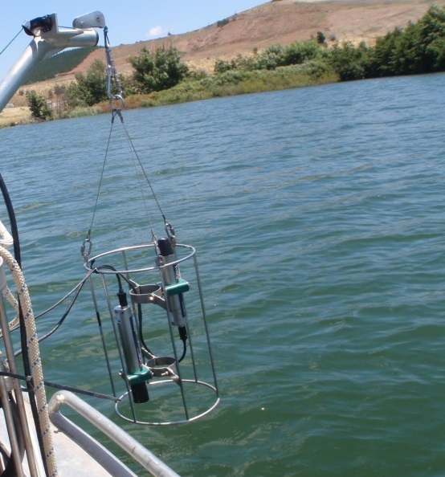
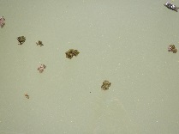

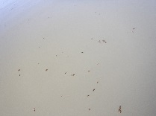
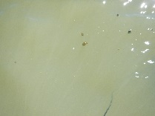
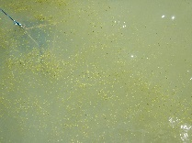
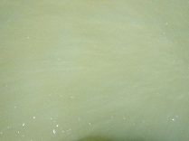
Inland waters: not so simple: land-water boundaries; lakes at -140 to 4500 m altitude
Reflectance

Slide 6
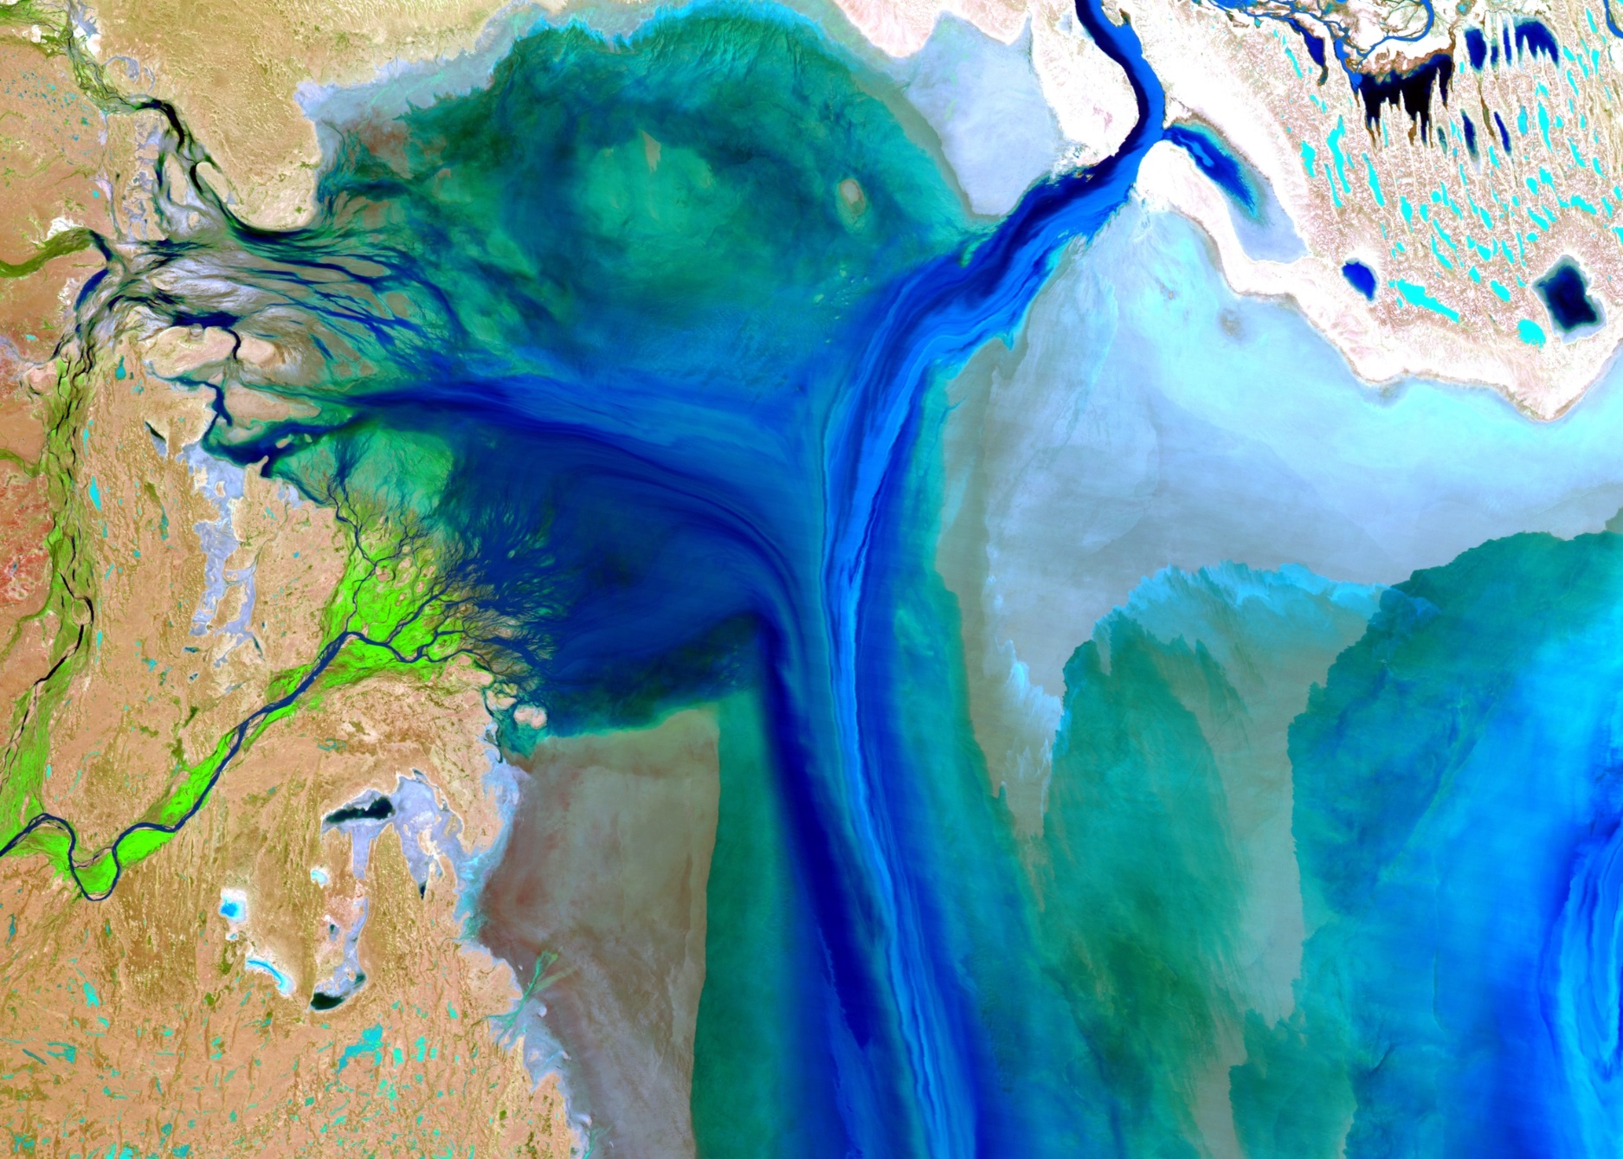
Salt lakes- not so simple
(Lake Eyre- Australia after floods)

Slide 7
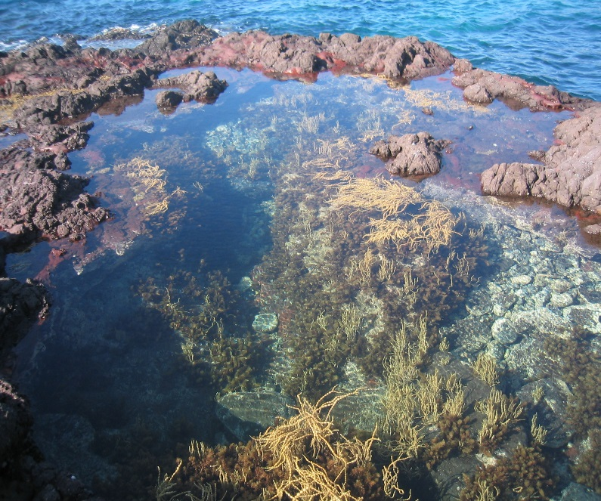
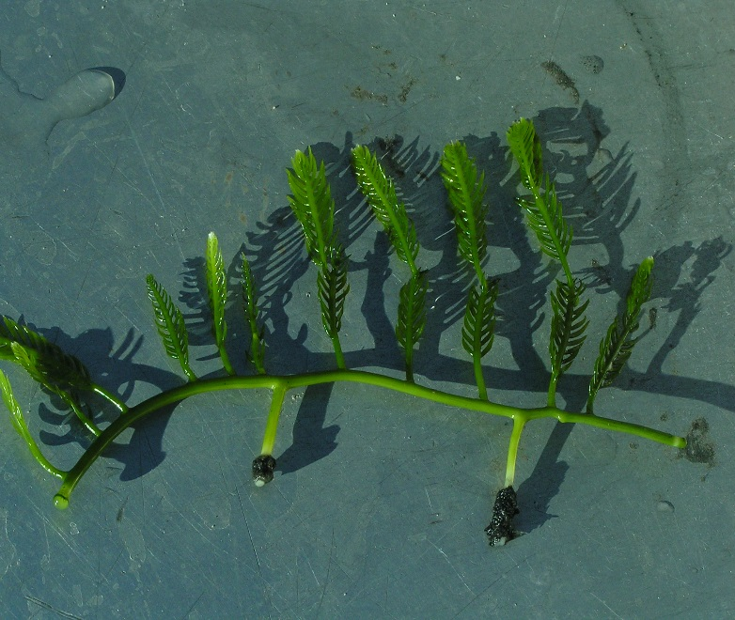
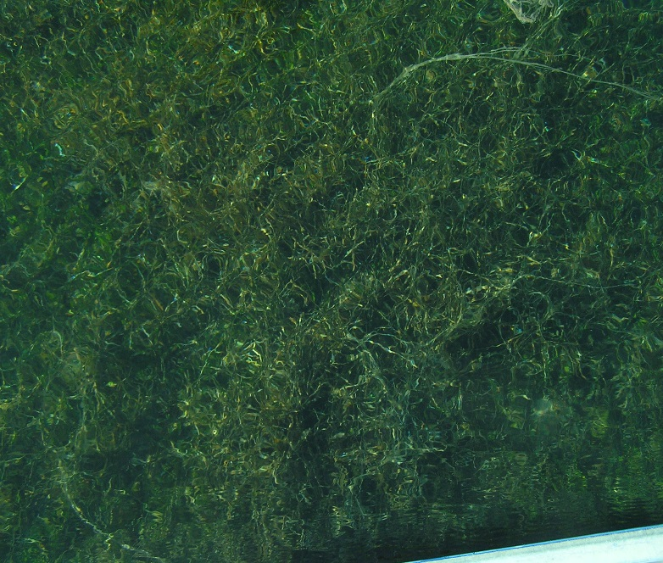
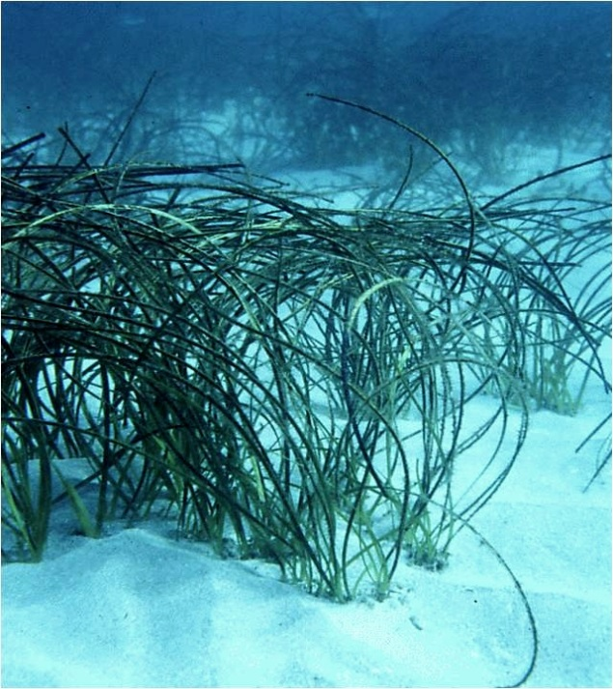
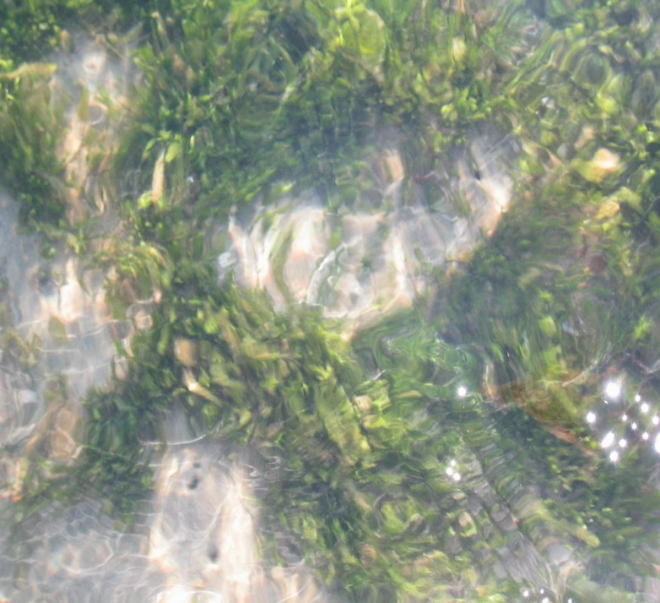
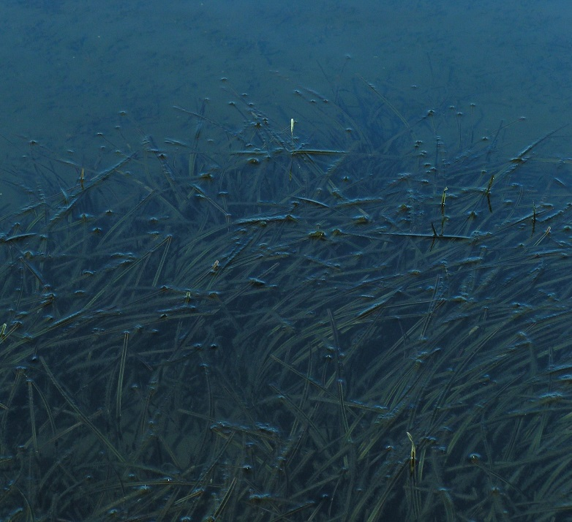
Seagrass and intertidal: not so simple:

Slide 8
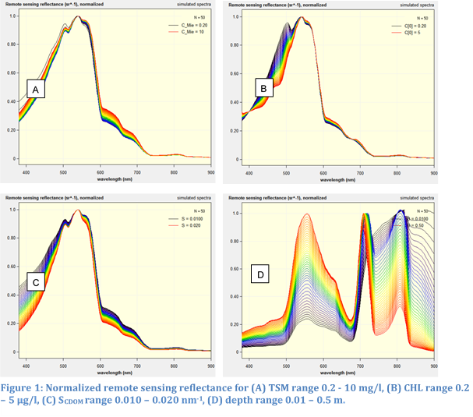
Simulation results Rrs (normalized) for a range of inland to coastal water types

Slide 9
Spectral resolution (in 2.5 nm steps) required to resolve change at low to high variable concentration
(standard OAC scenario-optically shallow water)

Slide 10
Trade-off between spatial, spectral and radiometric resolution
The priority in specifications for an aquatic ecosystem imaging spectrometer (or many multi-bands sensor is from 1 to 4:
Spatial resolution (as not getting a pure aquatic pixel avoids any measurement at all)
Spectral resolution (to discriminate between all the variables)
Radiometric resolution: should be as high as possible given priorities 1 and 2
Temporal resolution (varies from once a season to hourly intervals) can be solved by LEO+GEO and /or constellations of LEO’s

Slide 11
Summary spectral bands & resolution from:
(i) multiple types of simulations, (2) spectral pigment features ( from phytoplankton, macrophytes and other benthos), and algorithm requirements
center | FWHM | Water Quality and Benthic Characterisation Related Application
[nm] | [nm]
+/-380 | 15 | CDOM ; NAP; PFT | 1
+/-412 | 5 to 8 | CDOM ; PFT | 2
+/-425 | 5 to 8 | CDOM ; Blue Chl-a absorption reference band ; NAP; PFT | 3
+/-440 | 5 to 8 | CDOM ; Blue Chl-a absorption maximum; PFT | 4
467 | 5 to 8 | Pheaocystis/ diatoms ; Blue Chl-a ; Accessory pigments | 5
+/-475 | 5 to 8 | Accessory pigments ; Blue Chl-a absorption band reference; PFT, NAP; | 6
+/-490 | 5 to 8 | Blue Chl band-ratio algorithm; PFT;Accessory pigments | 7
+/-510 | 5 to 8 | Blue Chl band-ratio algorithm ; NAP ; | 8
+/-532 | 5 to 8 | PFT & carotenoids; NAP | 9
+/-542 | 5 to 8 | NAP | 10
555 | 5 to 8 | NAP; Cyanophycoerythrin reference band; PFT | 11
565 | 5 to 8 | CPE in vivo absorption maximum and possibly fluorescence | 12
+/-583 | 5 to 8 | CPE and CPC reference band; chlorophylls a,b and c; CPE fluorescence | 13
+/-594 | 5 to 8 | PFT | 14
+/-615 | 5 to 8 | CPC in vivo absorption maximum -avoiding chlorophyll- c | 15
624 | 5 to 8 | CPC in vivo absorption maximum, suspended sediment, PFT; chlorophyll c | 16
631 | 5 to 8 | PFT | 17
+/-640 | 5 to 8 | NAP, CPC reference band | 18
649 | 5 to 8 | Chl-b in vivo absorption maximum | 19
665 | 5 to 8 | FLH baseline | 20
676 | 5 to 8 | Red Chl-a in vivo absorption maximum | 21
683 | 5 | Chlorophyll fluorescence (FLH) band | 22
+/-700 | 5 to 8 | HABs detection; NAP; reference band for 2 or 3 band Chl-a algorithms | 23
+/-710 | 5 to 8 | FLH baseline; HABs detection; NAP; reference band Chl-a algorithms | 24
+/-748 | 15 | NAP in highly turbid water | 25
+/- 775 | 15 | NAP in highly turbid water | 26
Note that for the algal pigment absorption maxima we have included reference bands for the 3 band pigment absorption and fluorescence line height approaches. Physics based spectral inversion methods do not need these pigment reference bands. When the band center has a +/- sign it means that the wavelength center is not critical and may vary by about 5 nm.

Slide 12
Recommended spectral bands for atmospheric correction purposes as well as Non Algal Particulate matter concentration estimation.
+/- 730 | Sun and sky glint/NAP/atmospheric correction
+/- 740 | Sun and sky glint/NAP/atmospheric correction
+/- 750 | Sun and sky glint/NAP/atmospheric correction
+/- 770 | Sun and sky glint/NAP/atmospheric correction
+/- 865 | Atmospheric correction
1240 or 1238 | Atmospheric correction (MODIS or VIIRS)
1640 or 1600 | Atmospheric correction(MODIS or VIIRS)
2130 or 2257 | Atmospheric correction (MODIS or VIIRS)

Slide 13
Spatial & spectral resolution requirements
The minimum spatial resolution requirement for inland water bodies can be categorized for large lakes and for smaller water bodies:
A GSD of 300 m can observe the majority of the world’s lake surface area (but is a small fraction of the total number of lakes)
The Sentinel-3 series of satellites has 22 spectral bands, high SNR and a GSD of 300m and is thus adequate for large lakes.
A sensor with a minimum GSD of 15-17 m would enable observations for ~25% of global river reaches and 90 to 100% of lakes 0.2 ha or larger.
The focus should be around 5 to 8 nm spectral intervals and a GSD of about 17 m, whilst a GSD of 30 m could be a compromise between costs and S:N (= close to experimental sensor ENMAP Specs)

Slide 14
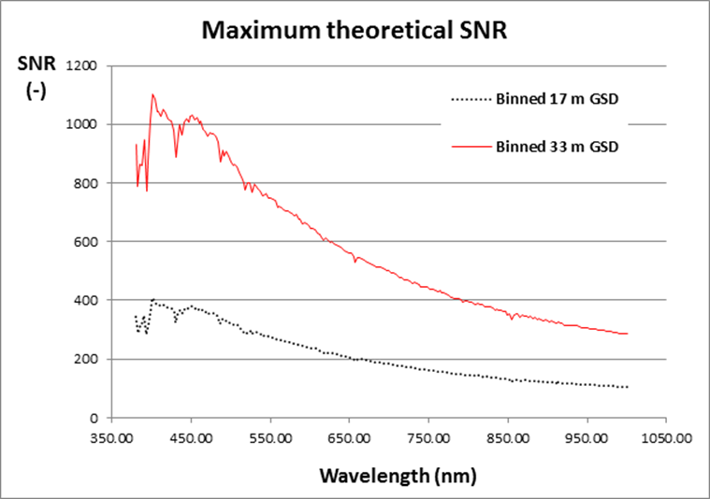
A simulation of achievable radiometric resolution within constraints of spectral and spatial resolution in terms of SNR ( By M. Bergeron CSA)
Raw Ground Sampling Area of 5.66 and 11 m binned (3 bins) to 17 and 33 m;
- Raw Spectral Sensing Interval of 2.66 nm binned (3 bins) to 8 nm;
- Assumes typical TOA radiance at 42 degrees SZA from Zia Ahmad (2012);
- a 30 cm aperture for the fore optics.

Slide 15
CEOS Report
“Feasibility Study Imaging Spectrometer”:
Society needs detection, assessment and monitoring of aquatic ecosystems :
UN SDG’s 6, 14 and 15 contain aquatic ecosystem variables specifically.
Coral reefs, seagrasses, macro-algae, macrophytes (freshwater) could all possibly be measured with a fixed set of multispectral bands for each separate application
However…..
When measuring optically active water constituents over large ranges (optically deep water case) and needing to measure the substratum/benthic spectra through a water column (optical shallow water case), there is not one specific multispectral band set that will be able to do it all- strong indication imaging spectrometry will be required.
On the other hand …..
By augmenting planned land sensors spectrally or ocean sensors spatially, cost-effective solutions for observing aquatic ecosystems could be achieved.

Slide 16
For CEOS Consideration
CEOS acknowledges that this report has properly defined essential inland and near-coastal and benthic habitat variables including an assessment of relative priority, linked to defined economic, social and environmental benefits.
CEOS acknowledges there has been a gap till now in designing EO systems for land and oceans – the gap being the non-oceanic aquatic ecosystems from freshwater to coral reefs. That current and planned global missions (land and ocean) are not adequate for these (non-oceanic) aquatic ecosystems (with the exception of aquatic ecosystem optically deep water bodies larger than a few square kilometers as they can be observed using the new generation of coastal ocean colour sensors).
CEOS agrees that dedicated sensors for this important societal and environmental benefit area should be considered in future land and ocean sensor design specifications and that these (non-ocean) aquatic ecosystems requirements be considered when proposing or designing new sensors.

Slide 17
CEOS Considerations (Cont.)
This dedicated satellite sensor designed for (non-oceanic) aquatic ecosystems can provide significant added value in comparison to other existing and planned satellite systems, and serve relevant requirements, including benefits to the society and social impacts and benefits to relevant science questions.
The required public funded investments of such a mission need to be in balance with the expected socio-economic and environmental outcomes. The system shall not conflict with actual or foreseeable commercial investments into comparable satellite systems. It shall support the self-sustainable and demand driven market development of value added Earth observations (EO) services, and investments in complementary commercial systems and services, by closing data gaps. Therefore, a collaboration and alignment with related investment activities of the private sector needs to be considered.
CEOS notes that funding for dedicated missions, or for enhancing or adapting mission designs, is a decision for individual agencies and governments.

Slide 18
Proposed Timeline
Report Final Draft Published – Oct 2017
Report Distributed throughout CEOS for reference and review (Oct 2017 – Feb 2018):
1. To identify any issues or items of concern
2. To provide feedback on how they may feed the report into their future activities (particularly OCR-VC and LSI-VC)
3. To help inform missions in the planning stage .
Reconciliation of CEOS Comments and Finalize Report (mid-March 2018)
Decisional action for SIT-33 for endorsement of report (as a CEOS Report)

Slide 19
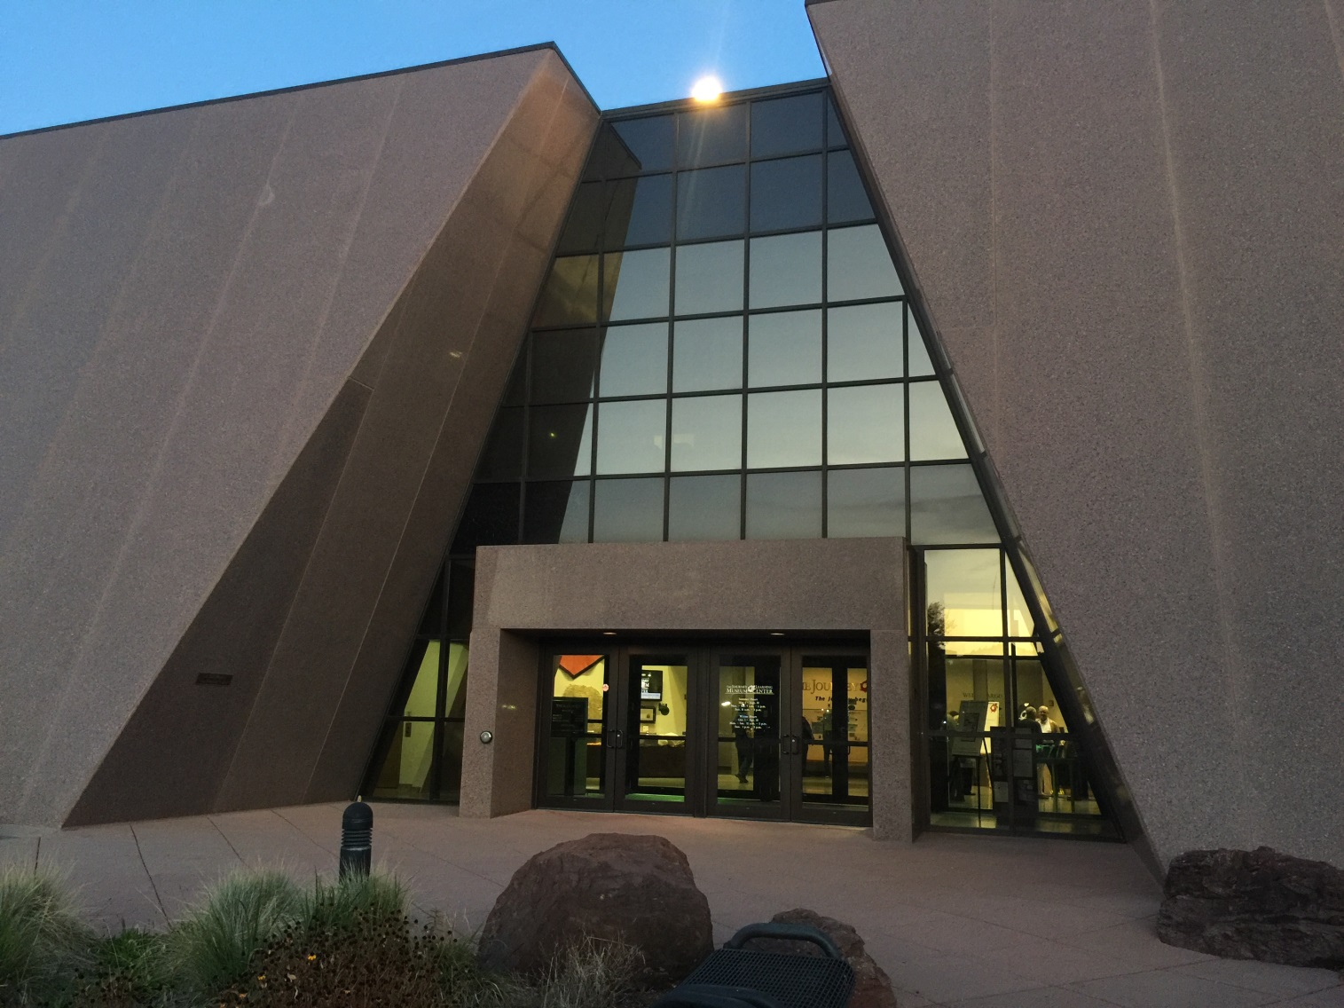
Questions

