Slide 1

Overview of Ongoing Efforts in the Water/Ocean Space
Committee on Earth Observation Satellites
Kerry Ann Sawyer
National Oceanic and Atmospheric Administration (NOAA)
CEOS Plenary 2017
Agenda Item # 7.1
Rapid City, South Dakota, USA
19 – 20 October 2017

Slide 2
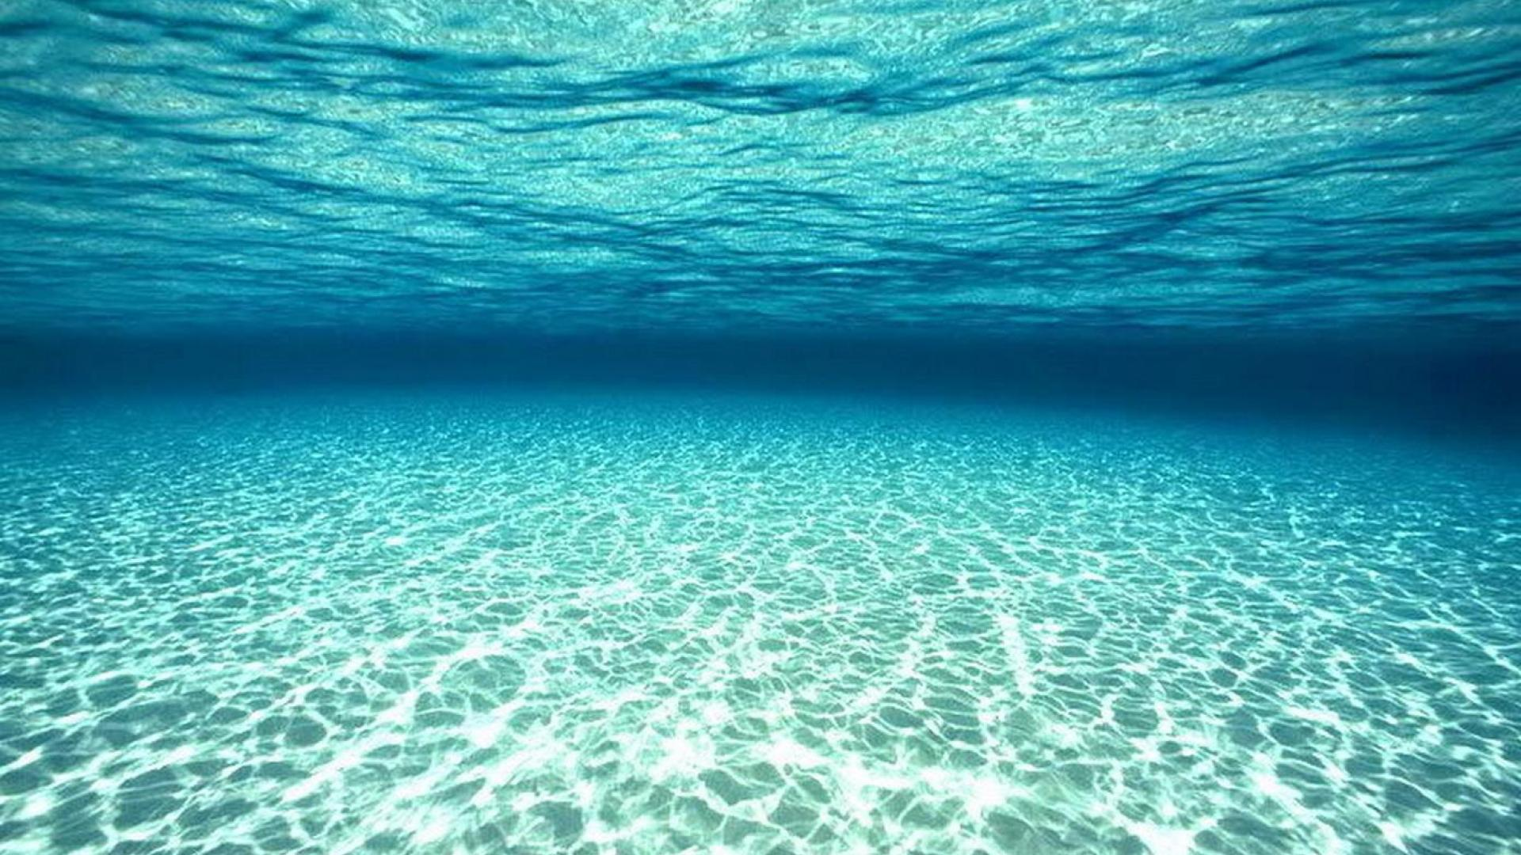
First…Thank you!
Paul DiGiacomo, Selma Cherchali, Brad Doorn, Angelica Gutierrez, Rick Lawford, Vanessa Aellen, Emily Smail, Jorge Vazquez,Vardis Santos, Eric Lindstrom, Nagaraja Rao Harshadeep, Christine Bognar
Notes:
First, I would like to thank the following representatives from the GEOGLOWS, AquaWatch, Blue Planet, and COVERAGE communities for their input to this presentation. Now…quiet blue water…followed by a bit of chaos.

Slide 3
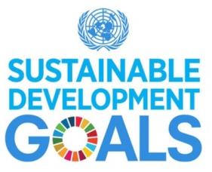
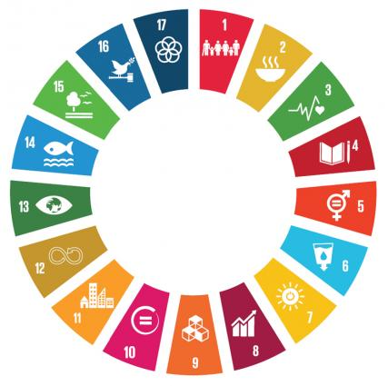

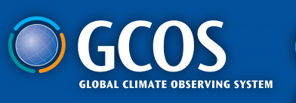

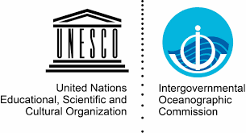
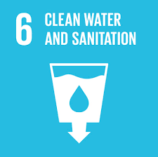
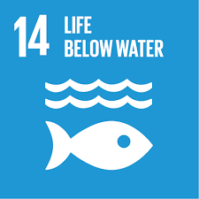





Water is of Interest to Many
Notes:
There are many interested parties in water. This slide attempts to show the breadth of these parties – water for climate, water quality, water quantity – too much/too little, precipitation, ground water, coastal water, broad open ocean water, inland waterways, agriculture. I know this slide does not even capture half the interest in water.

Slide 4
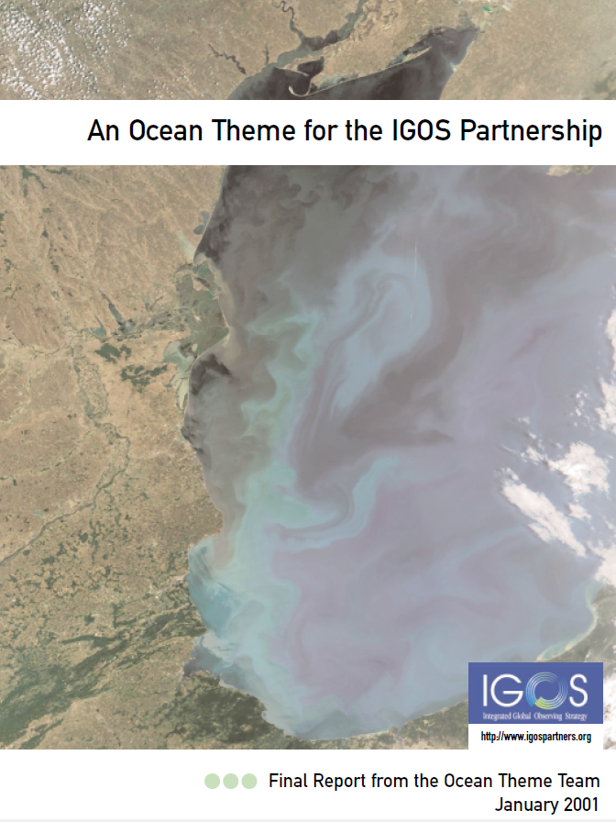
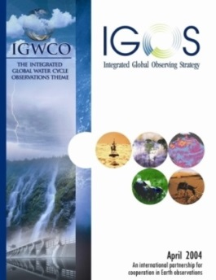
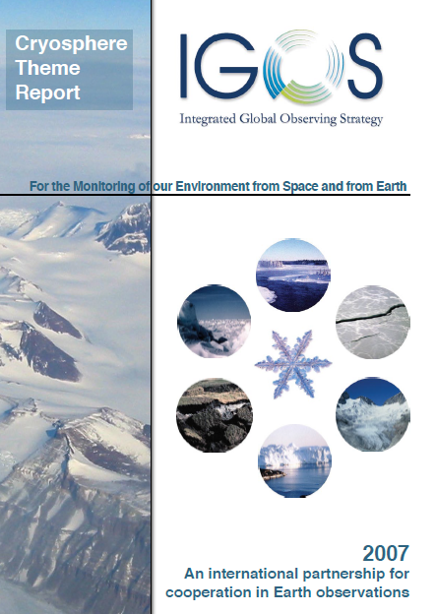
IGOS Water Theme Reports
In the beginning, there were the IGOS Theme Reports….
Ocean Theme Report, 2001
Water Theme Report, 2004
Coastal Theme Report, 2006
Cryosphere Report, 2007
Notes:
This slide shows a bit of history of Water, predating GEO. A little more background – the Integrated Global Water Cycle Observations (IGWCO) Community of Practice (CoP) theme was first introduced to IGOS-P (P as in partnership) in 2000 and a full proposal was accepted in 2001 with final approval in 2004. In October 2007, IGWCO transitioned from an IGOS-P theme to an element of GEO through an exchange of letters between the Secretariats of the IGWCO and GEO. It became a GEO Community of Practice in 2008 when it merged with a fledgling Global Water Cycle CoP within the User Interface Committee. This CoP provides the leads of the various GEO water subtasks with an opportunity to discuss their progress and plans.

Slide 5
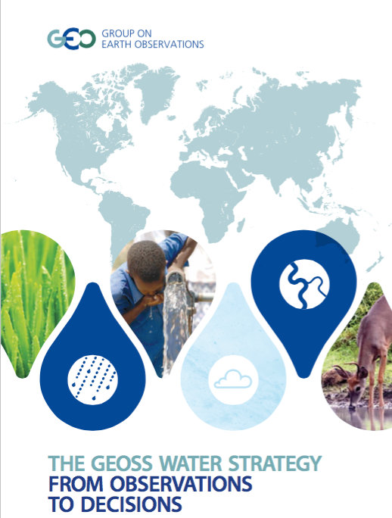
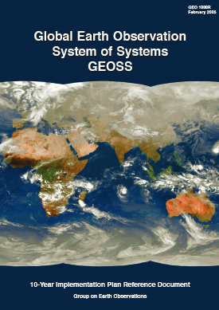
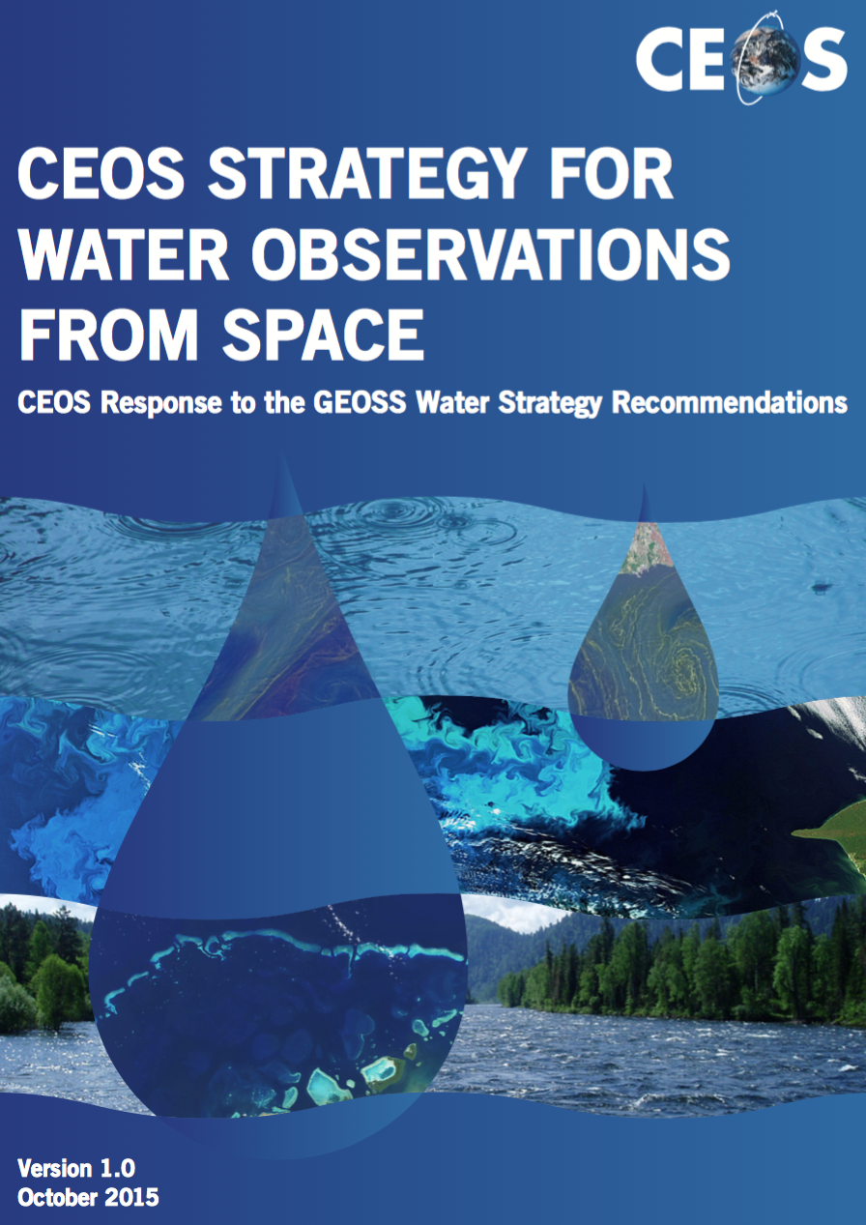
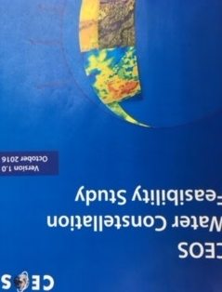
GEOSS and CEOS Water Strategies and Studies
The GEOSS Water Strategy renews the observational component of the community’s efforts to communicate the needs of the Water community within the framework of GEOSS.
CEOS Water Strategy Implementation Study Team (WSIST) prepared the CEOS Water Strategy to the GEOSS Water strategy recommendations.
CEOS also executed Feasibility Study on Satellite Missions/Instruments Focused on Water Quality Measurements (next presentation)
GEO Water Strategy
CEOS Response
IGOS Water Theme report
2004
GEOSS 10 Year
Implementation Plan
2005
GEOSS Water Strategy
2014
CEOS Water Strategy
2015
CEOS Water Constellation
FS,
2016
Notes:
From IGOS to GEO and GEOSS. The GEOSS Water Strategy Report was released in February 2014 with a request to CEOS to identify recommendations that we, CEOS, would be willing to help address (22 actions, with 10 where CEOS had direct role – “Advancing satellite data acquisition theme” and 12 other actions requiring assessment by CEOS Agencies). The GEOSS Water Strategy renewed the observational component of the community’s efforts to communicate the needs of the Water community within the framework of GEOSS. The Integrated Water Cycle Observations (IGWCO) Community of Practice was shepherding the GEOSS Water Strategy and was tasked with preparing a Water Implementation Plan after receiving Agency/Entity responses.
We prepared our CEOS Water Strategy in response to the GEOSS Water Strategy Report (many thanks to JAXA for their leadership of CEOS Water Strategy Implementation Study Team (WSIST) within CEOS) in 2015 expecting that it would be used as reference to help develop the Water Implementation Plan but alas, the IGWCO never moved forward with developing the Water Implementation Plan and instead, a separate community (led by the U.S. – NOAA, NASA, and USGS) proposed a new GEO activity called GEOGLOWS – GEO Global Water Sustainability – as a GEO Initiative in the 2015 GEO Work Programme. More on GEOGLOWS in a bit but essentially, GEOGLOWS overtook the GEOSS Water Strategy Report and Water Implementation Plan.
CEOS also executed Feasibility Study on Satellite Missions/Instruments Focused on Water Quality Measurements in 2016 (next presentation).

Slide 6

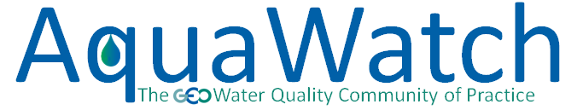

GEO Water-related Initiatives
CEOS providing critical Earth observations, and in several
instances active support and leadership, for a number of
GEO Water-related Initiatives (details on following slides….)
Led by NASA, NOAA, USGS
CEOS Rep. on Steering Committee (P. DiGiacomo)
Co-Chairs: Arnold Dekker, P. DiGiacomo & Steve Greb
Leads include NOAA (P. DiGiacomo) & CSIRO (Andy Steven)
CEOS Rep to Advisory Board (SIT Vice Chair)
CEOS Blue Planet Expert (P. DiGiacomo)
Notes:
GEOGLOWS: Provides a framework for EO to contribute to mitigating water challenges; freshwater
focused per GEO SBA.
AquaWatch: Improve water quality in coastal and inland waters [WAT-5].
GEO Oceans and Society: Blue Planet: Observational programs devoted to ocean and coastal
waters [WP section 3.9].

Slide 7
GEOGLOWS Mission and
Components
To connect the demand for sound and timely environmental information to the supply of data and information about the Earth’s water system and to explore the science needed to achieve the goals outlined in the initiative.
To advocate for broad, open data policies and for the realization of the right to access information
To help ensure that the data collected through national, regional and global observing systems is both made available in the public domain and applied to decision-making.
1. Enhancing Global Water Sustainability Sustainable Development Goals Water Scarcity and Access Climate Change Cold Regions | 2. Minimizing Basin and Regional Risk Integrated Water Prediction (IWP) Floods Droughts Transboundary Issues (IWRM) Water-Energy-Food-Environment-Health Nexus Climate Change Adaptation | 3. Essential Water Variable (EWV) Understanding Water Quality Water Use Water Cycle Variables (Precipitation, Soil Moisture, Groundwater, Evapotranspiration, Stream Flow, Surface Water Storage (Includes Snow Pack))
4. Earth Observations, Integrated Data Products and Applications, and Tool Development 5. Data Sharing, Dissemination of Data, Information, Products, and Knowledge User Engagement, Capacity Building and AmeriGEOSS
These efforts include the satellite aspects of water observations through CEOS and space agencies
Notes:
GEOGLOWS – GEO Global Water Sustainability – is a key element of the Water Resource Management SBA. GEOGLOWS addresses five of the six priority areas from the GEOSS Water Strategy with its strategies and on-going activities, and provides a framework for enabling GEO Members to address many of the Water Strategy’s 58 recommendations. Interesting note – IGWCO actively tracks the actions of the GEOSS Water Strategy (but is not preparing the Water Implementation Plan which now is overcome by events with the inception of GEOGLOWS – as I understand – PERSONAL COMMENTARY).
GEOGLOWS, when mature, could provide a coordination framework for all water initiatives under the GEO programme. GEOGLOWS addresses water quantity and water quality and has six components, as identified on the chart.

Slide 8
GEOGLOWS List of Connection with CEOS
Enhance the added value of Earth Observations to provide the right information for
water resource management.
Provide feedback to CEOS and CEOS agencies on requirements for space-based Earth Observations and facilitate the collaboration across all the agencies in addressing those requirements.
Collaborate with CEOS in developing the tools and environment needed to expand the use of satellite data
With Working groups (WGCapD, WGClimate, WGCV, WGDisasters, WGISS)
With CEOS Virtual Constellations (AC-VC, LSI-VC, OCR-VC, OST-VC, OSVW-VC, P-VC, SST-VC)
  Proposing a SAR-VC (Synthetic Aperture Radar) which would support GEOGLOWS as well as AquaWatch and Blue Planet for (CEOS) Water Activities
With CEOS Ad Hoc Teams (Ad Hoc Team on Sustainable Development Goals, Ad Hoc Team on Future Data Architectures, Ad Hoc Working Group on the Group on Earth Observations (GEO) Global Agricultural Monitoring (GEOGLAM) Initiative,
GEOSS Water Strategy: On going opportunity to collaborate on new area after further discussion with Aquawatch Blue Planet
Notes:
This slide was presented by Selma at the SIT Technical Workshop just a mere month ago. It highlights the expected/realized connection with the various CEOS entities. Note connections to essentially all VCs, WGs, and AHTs, with emphasis on Precipitation and Land Surface Imaging VCs and almost all WGs and the SDG AHT.
I would like to draw attention to the sub-bullet that seems to have gotten overlooked at the SIT Technical Workshop – Proposing a SAR-VC (Synthetic Aperture Radar) which would support GEOGLOWS as well as AquaWatch and Blue Planet for (CEOS) Water Activities.

Slide 9


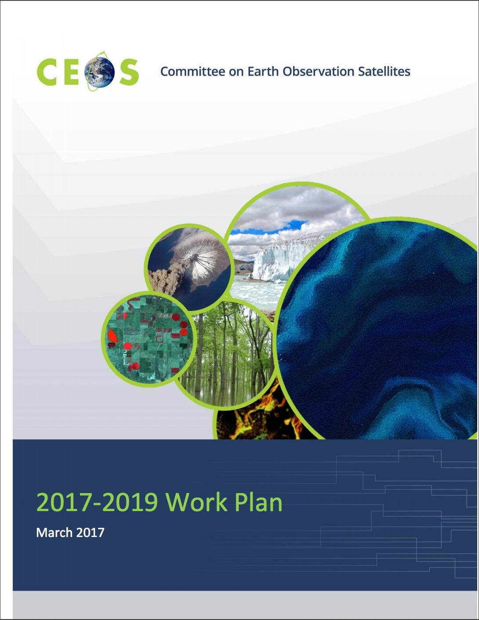








GEOGLOWS – CEOS Possible Synergies
GEOGLOWS Cross-walk to
CEOS 2017-2019 Work Plan
Science, applications
product development
Data dissemination, portals & capacity building
Policy Linkages
EWV
3.1. Climate Monitoring, Research, and Services
3.2 Carbon Observations, Including Forested Regions
3.3 Observations for Agriculture
3.4 Observations for Disaster
3.5 Observations for Water
3.6. Capacity Building, Data Access, Availability and Quality
3.7. Advancement of the CEOS Virtual Constellations
3.8. Support to Other Key Stakeholder Initiatives
3.9. Outreach to Key Stakeholders
Notes:
Identified synergies between CEOS work plan and GEOGLOWS efforts. This is an incredibly helpful slide and perhaps should be accomplished for AquaWatch (Blue Planet already has deliverables in the CEOS Work Plan so easy to map those).

Slide 10
GEO AquaWatch Initiative
The AquaWatch Mission
To improve the coordination, delivery and utilization of water quality information for the benefit of society.
The AquaWatch Goal
To develop and build the global capacity and utility of Earth Observation-derived water quality data, products and information to support integrated water quality management and decision making.
AquaWatch recently completed an informational booklet on water quality monitoring
  The booklet is available on the AquaWatch website www.geoaquawatch.org
  Printed copies now available!
Notes:
AquaWatch’s mission is to improve the coordination, delivery and utilization of water quality information for the benefit of society in coastal and inland waters (no ocean). AquaWatch has a heritage – previously referred to as the GEO Water Quality Community of Practice or GEO Inland and Near-Coastal Water Quality Working Group. It was created as response to the need for a global operational (i.e., routine and sustained) water quality information system.
AquaWatch is an independent activity (i.e., complements but not subsumed by GEOGLOWS, Blue Planet, or other GEO initiatives) that collaborates and coordinates with these and other activities but is a stand-alone effort with a distinct and discrete focus: to develop an operational water quality monitoring and forecasting service for coastal and inland waters.
For more information on AquaWatch, please download the informational booklet on Advanced Techniques for Monitoring Water Quality using Earth Observations from the AquaWatch website.

Slide 11
GEO AquaWatch Initiative
Current Activities
AquaWatch is currently developing a product suite for NTU turbidity, Secchi disk depth product, diffuse attenuation coefficients, and surface reflectance
This product suite is a first step in a long term project to develop a global water quality monitoring service
Future 2017 – 2019 Activities
Continue to build on the water quality information service
Support and collaborate with other GEO groups on water quality project needs (GEOGLOWS, EO4SDGS, GEO Blue Planet, GEO Wetlands, GEO BON, Regional GEO groups)
Populate formal Steering Committee and build Working Group activities
Work to increase engagement and collaboration with other GEO groups
Begin capacity building activities
Notes:
This slide just highlights some of the current and planned activities for AquaWatch.

Slide 12
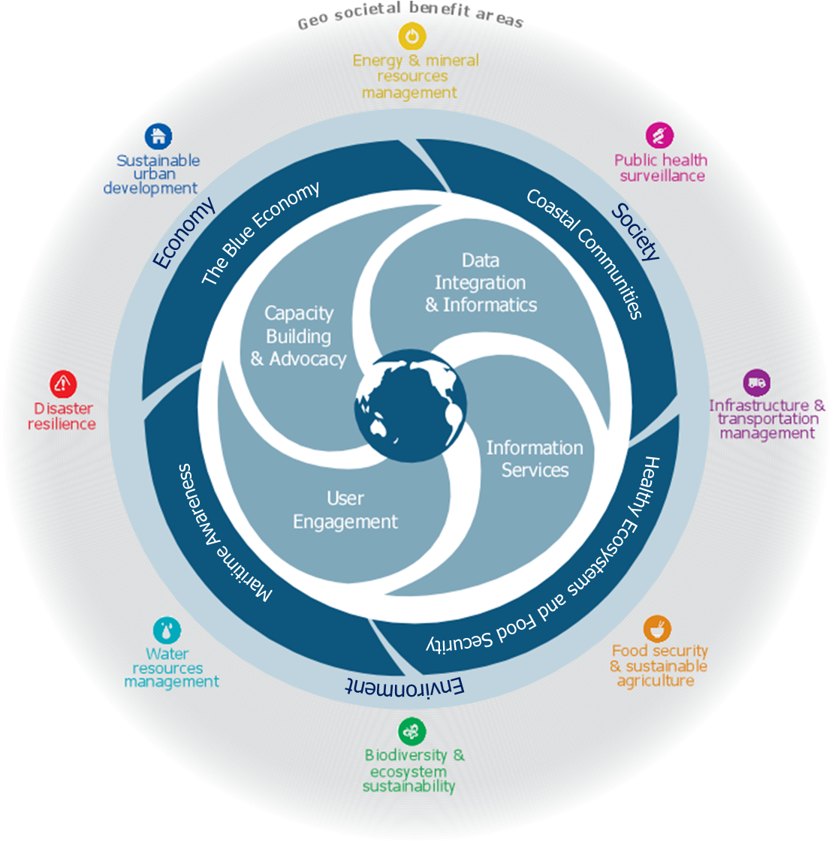
GEO Blue Planet Initiative
Blue Planet Mission
advance and exploit synergies among ocean and coastal observational programmes
increased integration of and access to in situ and remote sensing ocean observation data
improve engagement with a variety of users for enhancing the timeliness, quality and range of services
raise awareness of the societal benefits of ocean observations at the public and policy levels
Notes:
First symposium was in 2010. This initiative has been through many restructures since that very first symposium, one key element being the now sole focus on oceans and coastal waters. PERSONAL COMMENTARY – I remember quite a bit of discussion on Blue Planet addressing all blue on the planet, which included lakes, rivers, reservoirs, even large ponds but things changed.
Blue Planet has four objectives, four components aligned with the four objectives, and four themes on which the components will be focused. And these themes aim to address the three pillars of sustainable development – environmental protection, societal development, and economic development.
Blue Planet brings together ocean data providers (especially CEOS agencies) and end users in support of societal benefits, addressing crucial issues such as fisheries management, inundation and sea level rise, ocean acidification, water quality (here is that term once again, all three GEOGLOWS, AquaWatch, and Blue Planet have a water quality component).

Slide 13

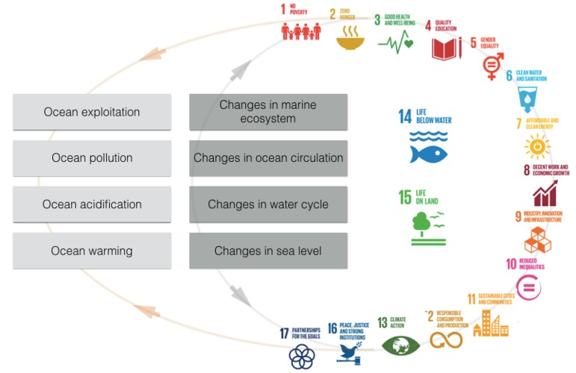
GEO Blue Planet Initiative
Current Activities
Blue Planet is organizing a supplemental issue in the Journal of Operational Oceanography on Ocean Observing for Societal Benefit
  The supplemental issue will Issue will focus on end-to-end case studies of ocean observations being used to benefit various sectors of society
Blue Planet is leading the organization of a workshop titled “Implementing and Monitoring the Sustainable Development Goals in the Caribbean: The Role of the Ocean”
  The workshop will take place from January 17 – 19, 2018 in St. Vincent and the Grenadines
Notes:
This slide just highlights current activities, including a workshop in January that aims to facilitate a dialogue between the governments and people of the Caribbean Small Island States about their efforts to implement and monitor the SDGs and, by monitoring this dialogue, to extract knowledge needs, which then can be related to data needs.

Slide 14
CEOS Virtual Constellations
Water Relevant CEOS Virtual Constellations
Precipitation (P-VC)
Land Surface Imaging (LSI-VC)
Ocean Colour Radiometry (OCR-VC)
Ocean Surface Topography (OST-VC)
Ocean Surface Vector Wind (OSVW-VC)
Sea Surface Temperature (SST-VC)
>
CEOS
COVERAGE
Initiative
Notes:
All seven VCs have a water component, even LSI (and we will hear more about that from Tom Cecere in just a moment). The focus of this slide is on the ocean-related VCs and how they intersect with the CEOS Ocean Variables Enabling Research and Applications for GEO (COVERAGE) Initiative.

Slide 15
The COVERAGE Initiative
CEOS endorsed COVERAGE initiative at SIT-32 (April 2017, Paris) as a 3 year pilot project
Collaborative effort within CEOS with the 4 Ocean Virtual Constellations (SST, OST, OCR, OSVW) and GEO projects (MBON, Blue Planet) to enable more widespread use of ocean satellite data in support of applications
Provides a coherent, cross-cutting, focal activity (not a new VC or WG) aligning with and promoting the advancement of CEOS programmatic objectives, including FDA efforts
COVERAGE is informed by and a response to known needs of the ocean community for improved, more integrated data access for societal benefit in support also of SDGS relating to marine biodiversity & ecosystem management
COVERAGE aims to develop a data rich platform for more seamless delivery of analysis ready ocean data to demonstrate the value added of multivariate ocean data integration in support of science, applications, and public engagement
Tech. Platform for improved, integrated ocean data access utilizing emerging data management and cloud capabilities: “fusion environment” for multi-parameter observations, available in near-real-time, collocated to a common grid, thematically organized and available via value-added data services (data discovery, visualization, subsetting)
Stakeholder Beneficiaries:
Internal: Ocean VCs, WGISS External: GEO-Blue Planet, GEO-MBON, UN/IOC GOOS
Notes:
Please refer to these slides separately to understand fully the context and background of COVERAGE. I would like to take the opportunity, however, to highlight that COVERAGE is essentially a coherent set of data products from the four oceans VCs; a collaborative and cross-cutting effort that was undertaken in response to identified needs of the ocean community. COVERAGE expects to engage with user communities/stakeholders and determine what type of functionality and datasets the community needs/desires; there is a strong user interaction component to this project.
Also connects with GEO MBON group and Integrated Marine Observing System (IMOS) and GOOS.

Slide 16
COVERAGE Activities and Status
Advisory Board developed with cross-agency and stakeholder representation
  Participants include: NASA, NOAA, CNES, EUMETSAT, Copernicus, Australian Bureau Meteorology, Integrated Marine Ocean Observing System, Sargasso Sea Commission, CEOS Ocean VCs, and WGISS
Stakeholder Engagement & Presentations since SIT-32 (April 2017)
  BP symposium, GHRSSTXVII, IMOS, EOSDIS, CNES, NOAA, IOOS, MBON, SSC, CMEMS, UNDP-4M
Project Initiation – October 2017
  COVERAGE Phase A project with NASA support
  Project core team assembled & Project infrastructure in place
  Workshop series proposal in process in collaboration with Sargasso Sea Commission
COVERAGE has a 4-part development concept
  Phase: A. Scoping (6mo). B. Prototype Development/Evaluation (1yr). C: Full system development (1yr). D: Testing/Evaluation & transition to operations (6mo)
  Reflected in COVERAGE inputs to CEOS 2017-19 Work Plan
Phase A work plan key elements (next 6 months)
  Detailed technical scoping, use case gathering & requirements analysis
  Inventory of target datasets, providers, interfaces
  COVERAGE system technical architecture, including CEOS and data provider interoperability considerations
  Collaborative arrangements & ongoing stakeholder engagement
Notes:
COVERAGE has four-part development concept and is currently in Phase A – for next six months. COVERAGE is already in the CEOS Work Plan, which means, we are actively supporting this activity.

Slide 17
Integration and coordination
across water activities
COVERAGE
Notes:
This slide focuses on sorting out the ambiguities and overlaps between the GEO initiatives while noting that oceans, presented by COVERAGE, are well-coordinated within CEOS as it exists and has been endorsed explicitly as a CEOS initiative (added post-presentation for clarity).
The common theme among all these activities is a water quality component and unfortunately, this is a challenge for the community which makes a challenge for us. When we look at this chart, it seems easy to identify the intersections, synergies and overlaps. Expectation is that GEOGLOWS is freshwater only but in actuality, ultimately, GEOGLOWS would like to provide a coordination framework for all water initiatives under the GEO programme. Blue Planet should just focus on oceans and coastal waters, increasing integration of and access to in situ and remote sensing ocean observation data, promoting and facilitating the development of end-to-end ocean information services, improve connections between producers and providers of ocean observation data, products, and information to end users. AquaWatch should be the nexus between GEOGLOWS and Blue Planet, focusing on water quality of coastal and inland waters. And COVERAGE is here, as a coordination body of the ocean-related VCs.
This chart as it stands, shows the thematic interpretation of these efforts.
In actuality, the situation is a bit more programmatic, with all efforts working as stand-alone entities with one common denominator being water quality.

Slide 18
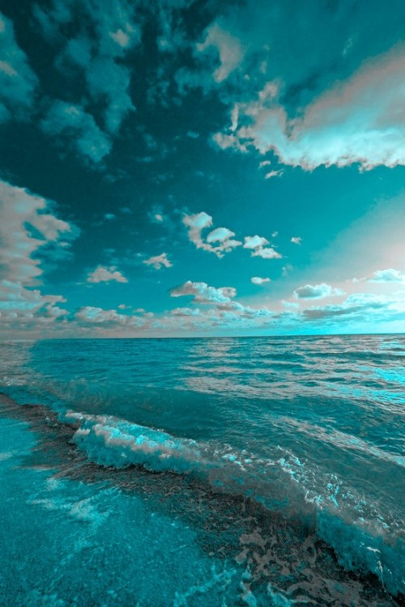
Challenges and Current Issues
Collaboration, not exploitation
Overlap, not redundancy
Good intentions but confusing to external partners
We need to explain why each water-related initiative is important and if not unique, then we need to determine how to combine into a holistic project
Workshop?

Slide 19
Back-up Slides

Slide 20
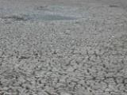
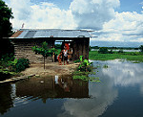

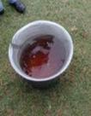
Why GEOGLOWS?
Water sustainability is a critical issue in sustainable development and for the achievement of the SDGs.
Decision-making in water resources planning and management can be supported with the improved use of earth observation data and associated analytical tools and services.
Poor awareness and use of the available and evolving data (incl. from earth observation) and analytical services especially in the developing world.
Strong need to improve open, public-domain access to critical data and analytical services
Need for improved partnerships to improve quality of supply of services and connect to demand of end-users.
GEOGLOWS can contribute to modernized management of water resources to improve productivity and better manage climate risks
The amount of satellite based measurements are at any time, greater than any other measurement. We need to effectively use these data to contribute to water management.

Slide 21
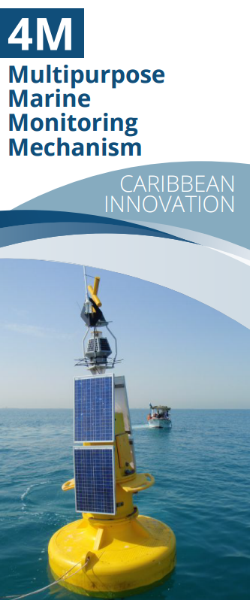
GEO Blue Planet Initiative
Current Activities
Blue Planet is continuing to support to 4M project with UNDP Barbados and the OECS and IOCARIBE-GOOS
  The initial focus of the 4M project will be:
    Service for detection and monitoring of pollution occurrences at sea &
    Service for detection, monitoring and forecasting of sargassum
Blue Planet is continuing engagement with symposium participants on potential projects
Blue Planet is working to develop a communications and engagement strategy
Notes:
OECS is the Organisation of Eastern Caribbean States

Slide 22

GEO Blue Planet Initiative
Future 2017 – 2019 Activities
Build the user engagement working group and inventory previous and current user engagement activities in the ocean and coastal observation community
Build additional working groups on data integration and informatics, capacity building and advocacy and information services
Secure funding for implementation of 4M
Secure funding for additional SDG workshops in other regions
Identify
Identify and begin work on additional prototype/pilot projects
Advocate for sustained ocean and coastal observations

