Slide 1
GEO-DARMA (DIS-15): Status
Committee on Earth Observation Satellites
Ivan Petiteville, ESA
CEOS Plenary 2017
Agenda Item # 6.2
Rapid City, South Dakota, USA
19 – 20 October 2017

Slide 2
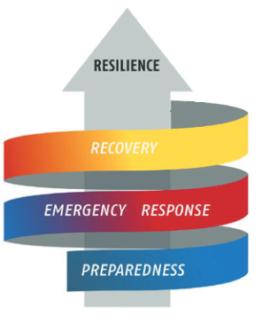
Why GEO-DARMA ?
Satellite data still largely under exploited
Until recently, mostly used in response phase.
Huge volume of free of charge EO data
e.g. 10 TB/day from European Sentinel-1 and 2
(optical and radar images;
more than Facebook !!!!).
GEO-DARMA goal:
Demonstrate that combined use of all sources of EO data improves the response to most critical DRR-related issues, in all phases.
- several national / local pilot projects,

Slide 3
Billy The Kid

Slide 4
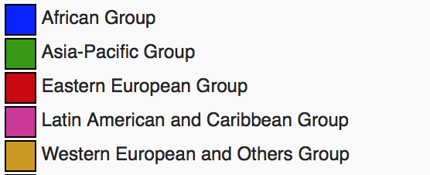
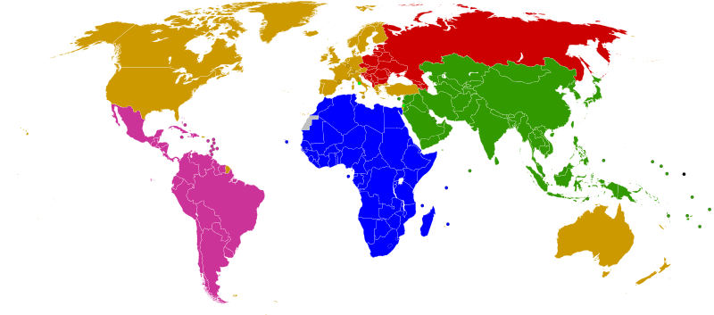
GEO-DARMA Partnership Approach
.
ASEAN
ADPC
ADRC
SDMC (SAARC)
UNESCAP
APEC
Asia-Pacific
Africa
Latin America
Caribbean
SADC
ECOWAS
IGAD
RCMRD
AUC
CDEMA
CEPRELAC
INDM (OAS)
CAPRADE
ECLAC
Legend:
Blue (e.g. ASEAN) is prospective Regional Institution partner
Red (e.g. UNESCAP) is identified Regional Institution partner
Regional programmes of global partners (e.g. World Bank, GFDRR, UNDP, UNEP, UNESCO, UNISDR) to be considered across all regions)

Slide 5
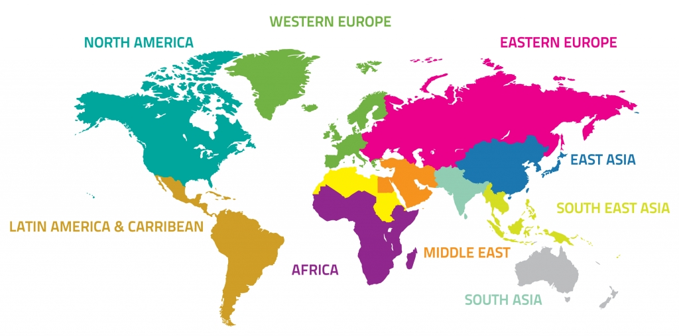
GEO-DARMA Approach
Identification of users needs and DRR priorities per region
For each region:
Types of hazards,
DRR Issues to be solved,
Initial countries

Slide 6
GEO-DARMA Approach (2)
(project dots only an illustration)
Prototype projects – progressive extension to neighbouring countries

Slide 7
Main Activities in 2017
KO Workshop (@ASI, March 14, 2017).
Regional missions to Southeast Asia (May 2017) and Latin America/Caribbean (September 2017)
1st Steering Committee meeting and Concept workshop (2017 UN Global Platform for DRR, Cancun, 25 May 2017)
Introduced Steering Committee (SC) Members to GEO-DARMA Concept and forge collective approach on way forward
Reviewed role and schedule for SC
Reviewed high-level GEO-DARMA approach and refined schedule and timeline as function of objectives
Discussed Sendai Framework priorities and SDGs, and how EO contributes to their indicators
Initiated discussion on regional priorities
Presentation to “Americas Summit for DRR” (September 2017)

Slide 8
GEO-DARMA Steering Committee
Tiziana Bonapace, Director ICT and DRR, UNESCAP
Francis Ghesquiere, Head, World Bank / Global Facility for DRR (GFDRR)
Ronald Jackson, Executive Director, Caribbean Disaster and Emergency Management Agency (CDEMA)
Michael Szoenyi, Group Head of Flood Resilience, Zurich Insurance Group
Mohammed Ibrahim, Principal Programme Officer, ECOWAS Commission
Faisal Djalal, Chairperson, Asia-Pacific Alliance for Disaster Management
Hans Guttman, Executive Director, Asian Disaster Preparedness Center (ADPC)
John Bosco Kayla Kiema, Director Technical Services, Regional Centre for Mapping of Resources for Development (RCMRD)
Godfrey Bahigwa, Director, Rural Economy and Agriculture, African Union Commission (Invited)
Rohan Richards, Co-chair, UN-GGIM WG-Disasters
Mayra Valle Torres, CEPREDENAC, Coordinator, Training and Education (Invited)
Ivan Petiteville, GEO-DARMA PoC, CEOS / ESA
One or two more members from Latin America to join
Notes:
One or two more members from Latin America to join

Slide 9
Current Status and Next Steps
As reflected in CEOS Work Plan (DIS-15):
Regional Assessment Template agreed by Steering Committee (SC) and distributed to Regional Organisations.
Regional Organizations to develop short report on their vision for regional priorities (on-going)
Review of regional assessments by SC (Q1 2018)
Conclusion of Concept phase and initiation of 1st projects for prototyping phase (Q2 2018).

Slide 10
Suggestions from 1st regional mission – Southeast Asia
Identify specific SDG and Sendai indicators and demonstrate how EO can be used operationally to track progress – suggested area Central Asia or ASEAN countries.
Identify existing projects (e.g. SERVIR Mekong) that could benefit from integration of much broader suite of satellite EO resources and demonstrate added benefit.
Select a small (four to five) group of coastal megacities in SE Asia that show rapid growth (e.g. Manila, Jakarta, Bangkok…) and use EO as a tool to monitor key parameters of risk and resilience in a multi-hazard perspective over a five year period.
Consider balance of smaller, easier to achieve projects (in Pacific island context for example) and broader more ambitious projects (in transboundary flooding in a major river basin).

Slide 11
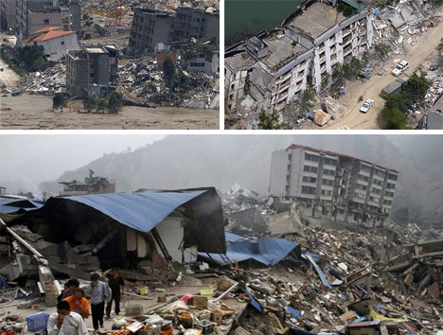
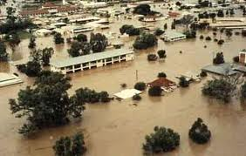
THANK YOU …..

