Slide 1
Report from the WG Disasters
Committee on Earth Observation Satellites
Stéphane Chalifoux, CSA
Chair, Working Group on Disasters
CEOS Plenary 2017
Agenda Item # 6.1
Rapid City, South Dakota, USA
19 – 20 October 2017

Slide 2
Overview of the Presentation
GEO Geohazard Supersites and National Laboratories (GSNL) (DIS-10)
Recovery Observatory (DIS-12)
Floods, Seismic Hazards, Volcanoes Pilots and Landslide Pilot (DIS-13)
GEO-DARMA (DIS-15) (following presentation)
Meetings and Conferences
Communication and Outreach
CEOS-WP: Section 3.4, Obj/Del: DIS-10/12/13/15

Slide 3
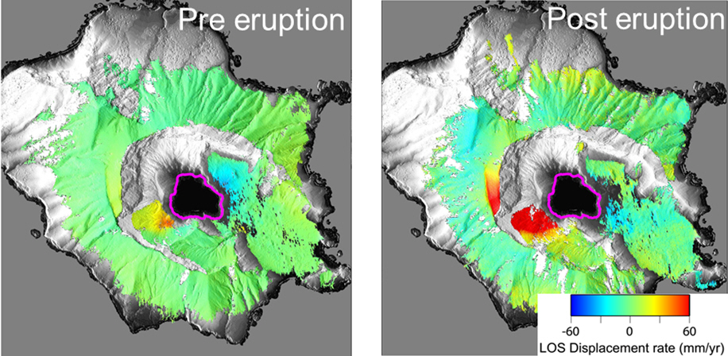
GEO Geohazard Supersites and Natural Laboratories (GSNL) (DIS-10)
Supersite Periodic Review Process: Biennial report
New Zealand Volcano and Ecuadorian Volcanoes supersites
New Zealand Supersite
TerraSAR-X spotlight data revealed a number of previously unrecognized deforming areas.
Quick facts:
Outreach: 6 peer reviewed journal articles and
6 conference presentations/proceedings in 2015-16
Dara used: ENVISAT, Sentinel, TerraSAR-X, Cosmo-SkyMed, RADARSAT, ALOS

Slide 4
Supersite Periodic Review Process
Positive evaluations from Agencies with comments and remarks to Supersite coordinators: examples of data utilization, preliminary results and science team.
Approve New Zealand Supersite Report (Permanent Supersite)
Approve Ecuadorian Volcanoes Supersite Report (Permanent Supersite)

Slide 5
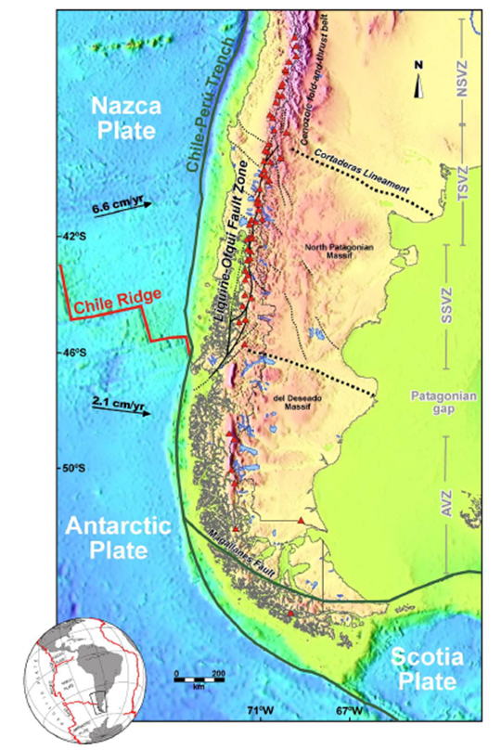
Southern Andes Supersite Proposal
New Supersite
The Southern Andes are a young and active mountain belt where volcanism and tectonic processes pose a significant threat to the growing communities nearby. In fact, only recent eruptions caused evacuations of 250-3500 people each as managed the Chilean Civil Protection agency.
The region of interest extends over 220 km along the arc in a swath of 50 km in width in Chile and Argentina.

Slide 6
CEOS support to the Southern Andes Supersite
Indicative data resources committed
CEOS intends to support this Supersite with the following resources:
CSA | 120 products for a period of 2 years | RADARSAT-2
CNES | Initial quota of 10.000km2 which is roughly equivalent to 3.500km2 of tri-stereo acquisitions | Pleiades, SPOT-5
DLR | Positive about the proposal. No confirmation of data support yet | TerraSAR-X
ASI | no quota defined, new and archive products, for a period of 2 years (2018-19) | COSMO-SkyMed
USGS | no quota as the data is freely accessible | Landsat
ESA | no quota as the data is freely accessible | Sentinel-1, -2, -3
Approve Southern Andes Supersite Proposal

Slide 7
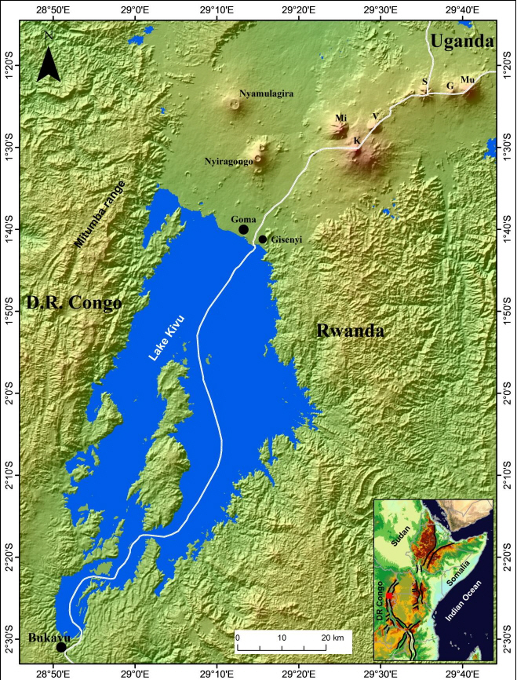
Virunga Volcanoes Supersite Proposal
New Supersite
Fifteen years after the Nyiragongo 2002 destructive eruption, the Goma Volcano
Observatory remains under-equipped and with few qualified scientists. Only a seismic network really contributes to the monitoring of Nyiragongo and Nyamulagira
volcanoes.
All studies which will contribute to improved assessment and the understanding of Geohazards in the Virunga and Lake Kivu basin are critical for Disaster Risk Reduction in this highly populated region of very vulnerable population.

Slide 8
CEOS support to the Virunga Volcanoes Supersite
Indicative data resources committed
CEOS intends to support this Supersite with the following resources:
CNES | 9 tri-stereo images per year | Pleiades, SPOT-5
ASI | Archive data, 100 new acquisitions per year for a period of 2 years | COSMO-SkyMed
USGS | no quota as the data is freely accessible | Landsat
ESA | no quota as the data is freely accessible | Sentinel-1, -2, -3
Approve Virunga Volcanoes Supersite Proposal

Slide 9
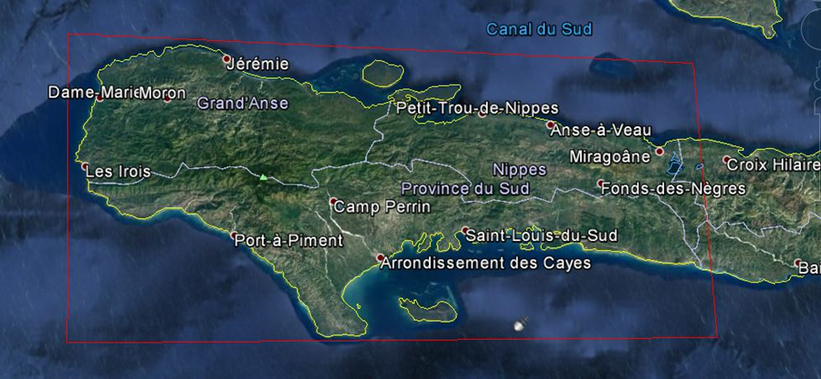
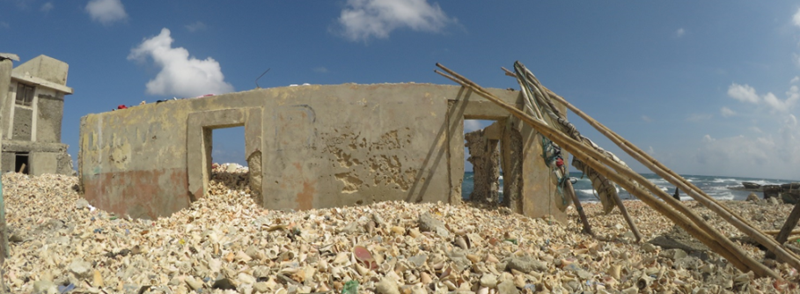
Recovery Observatory (RO) (DIS-12)
The RO aims to offer free and open access to data and information useful in planning and monitoring recovery, but also to serve as a forum of exchange and collaboration on recovery related issues to foster resilience at the community level.
Quick facts:
• Create an easy to access, interactive forum for recovery users to access data and information products, exchange on results and objectives, and generally better understand how EO can support long-term recovery planning and monitoring
• Serve as a focal point for satellite image experts and local specialists to better serve the region and answer local needs effectively
• Offer a source of shared value to foster the development of tailor-made information
• Serve as a link to mobilize public institutions and stakeholders around recovery goals
House full of seashells brought by the sea
Credit Flore Guiffault
Haiti Area of Interest for the Recovery Observatory
Credit USGS Landsat and ADS/CNES SPOT-6 data

Slide 10
Recovery Observatory
CEOS Agencies:
• ASI: CSK archived and newly acquired data; ASI researchers will also provide terrain displacement products; support to Italian providers of value-added products.
• China/AOE/CAS: scientific research on RO area of interest and possible data contribution (not confirmed).
• CNES: archived and newly acquired Pleiades and SPOT data; IT infrastructure; project management support; ROOT secretariat and general coordination support; value adding support to French industry.
• ESA: Sentinel-1, 2 and 3 data and technical advice; tools and services for terrain motion mapping, landslide hazard mapping and possibly other relevant geohazard types to support the exploitation of different EO data sources.
• NASA: NASA landslide monitoring product; MODIS flood monitoring; EO-1 historical data; support in accessing CEOS flood pilot data and products produced over the area in the past.
• USGS: Landsat-8 data.
• NOAA: support from previous flood pilot work in the area; coordination with meteorological community and flash flood warning; coastal zone monitoring for reef health; vector-borne disease research using algorithms developed for other regions.
• CSA: possible contribution of RADARSAT imagery.
• DLR: contribution of TSX imagery – complete imaging of RO area in successive coverages (two acquired so far, several more planned) to support change detection.
Approve Recovery Observatory Operational Plan

Slide 11
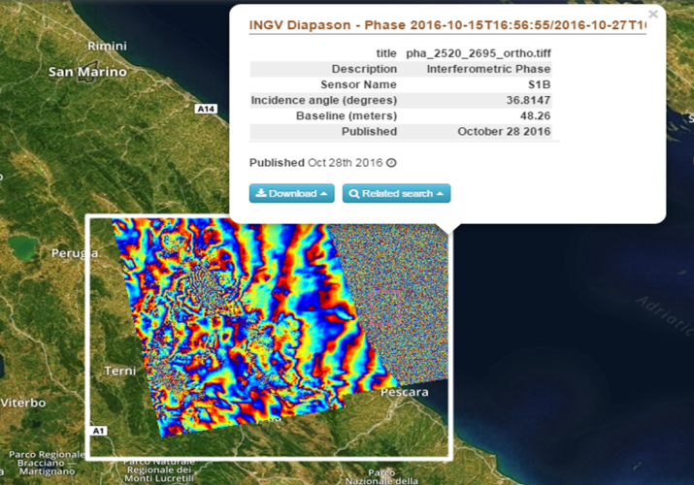
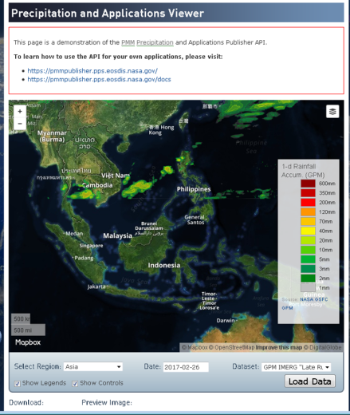
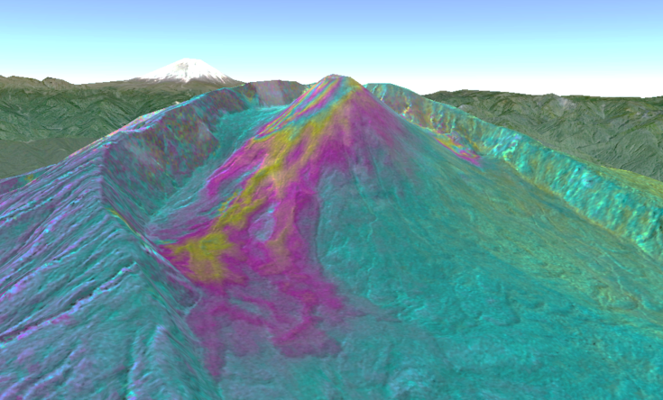
Floods, Seismic Hazards, Volcanoes Pilots and Landslide Pilot (DIS-13)
Floods, Seismic Hazards, Volcanoes Pilots: Approve Final reports
Three thematic pilots (Floods, Seismic Hazards and Volcanoes) completed with success.
Objectives reviewed against delivery and were met in almost all cases. For the Flood Pilot, the feasibility of the global flood dashboard was demonstrated, but no permanent home identified due to lack of funding. For the Volcano Pilot, Objective C, the intensive monitoring of a single major event was not implemented as no such event occurred during the pilot period.
Sustainability strategies involving implementation beyond CEOS identified for each pilot, as pilots move to demonstrator phase.

Slide 12
From a Pilot to a Demonstrator
Demonstrators aim to take successful elements of pilots and broaden their application to new users in new geographic areas, or to consolidate applications with existing users and seek long-term sustainability through new funding relationships.
Demonstrators continue to explore new scientific applications and do not offer operational capabilities.
Demonstrators aim to set up operational services in long-term at end of demonstrator phase.
Demonstrators can only begin if pilot is successfully concluded and objectives of pilot have been met.
Each demonstrator proposed is preparing an Implementation Plan for review by SIT-33; when possible, demonstrators are linking to existing activities such as GEO-DARMA.

Slide 13
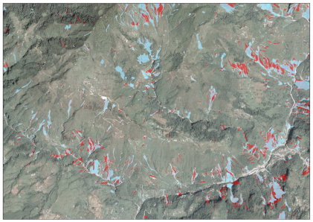
Landslide Pilot Update
Achievements
Confirmed data request plans, submitted licensing agreements and submitted data requests for relevant sensors over the two main study regions: Nepal and the Pacific Northwest, U.S.
Conducted one in person meeting at EGU in April, 2017 and have had numerous virtual meetings to ensure alignment of data requests between regions
The POCs of this pilot are engaging with the Geohazards Exploitation Platform to determine how the pilot could leverage this capability.
Activities
Coordination of activities in Nepal and the Pacific Northwest remained a main focus of the efforts for this period. Summarized several of the existing efforts and presented them at the CEOS WG on Disasters Meeting as well as shared them with the Landslide pilot team.

Slide 14
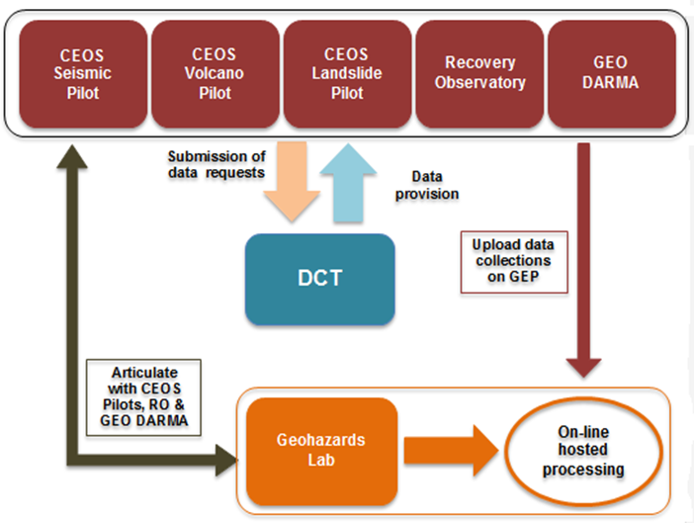
Geohazards Lab Implementation Plan
A platform with federated resources to access, process and publish satellite EO data and derived products
Goal: Provide data access and a processing and e-collaboration environment to exploit EO data to assess geohazards and their impact
Aims to address priorities of the Sendai Framework for Disaster Risk Reduction 2015-2030 using satellite EO (focus: better understanding hazards & risks)
Supports and complements the CEOS WG Disasters activities (on-going pilots, follow-on activities and the RO), the GSNL and GEO-DARMA.

Slide 15
Geohazards Lab Implementation Plan
CEOS Agencies:
ESA: Access to ESA missions data: ERS SAR and ENVISAT ASAR data; Access to Sentinel-1A & 1B and Sentinel-2A data in line with the Copernicus Data Policy; Access to the Geohazards Exploitation Platform (GEP) including in particular: data storage and ICT resources.
DLR: Providing higher level science products to the user community derived not only from Sentinel-1 but also from TerraSAR-X data, exploiting its resolution and high geometric quality; Providing further access to the automated Sentinel-1 interferometric chain (GEP, run by ESA) for international users; Supporting and participating in discussions on future product generation standards and interoperability between missions.
ASI: Facilitating access to COSMO-SkyMed data collections through the GEP for CEOS and GSNL activities; Testing & demonstrating hosted processing services available in the GEP to analyse COSMO-SkyMed and Sentinel-1 SAR data; Participating to the Geohazards Lab activity about methodologies for product generation, standards and interoperability between EO missions and EO based processing chains.
CNES: Processing services developed by the French Solid Earth community including systematic InSAR processing, DEM processing and optical image correlation. Potential contribution to a pool of specific human resources dedicated to the Geohazards Lab initiative.
Approve Geohazards Lab Implementation Plan

Slide 16
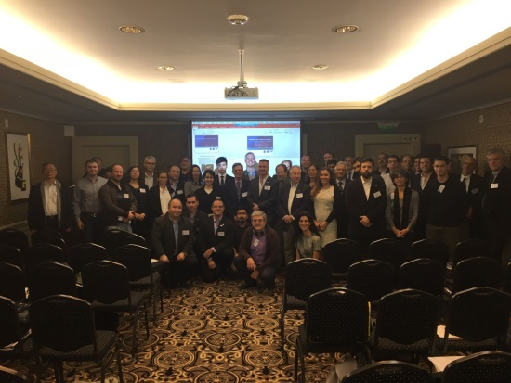
Meetings and Conferences
Meetings
The 7th CEOS WG Disasters meeting, hosted by the Italian Space Agency (ASI), was held in Rome, Italy, from March 14 to 16, 2017.
GEO-DARMA Steering Committee first meeting and Concept Workshop was held in Cancún, Mexico, May 25th, 2017.
The 8th CEOS WG Disasters meeting, hosted by CONAE and NASA, was held in Buenos Aires, Argentina, from September 4 to 8, 2017.
Conferences
Global Platform for Disaster Risk Reduction, May 2017, Mexico, organized by The United Nations Office for Disaster Risk Reduction.
Disaster Risk Reduction Across the Americas Summit in Buenos Aires, Argentina, from September 3 to 8, 2017.

Slide 17
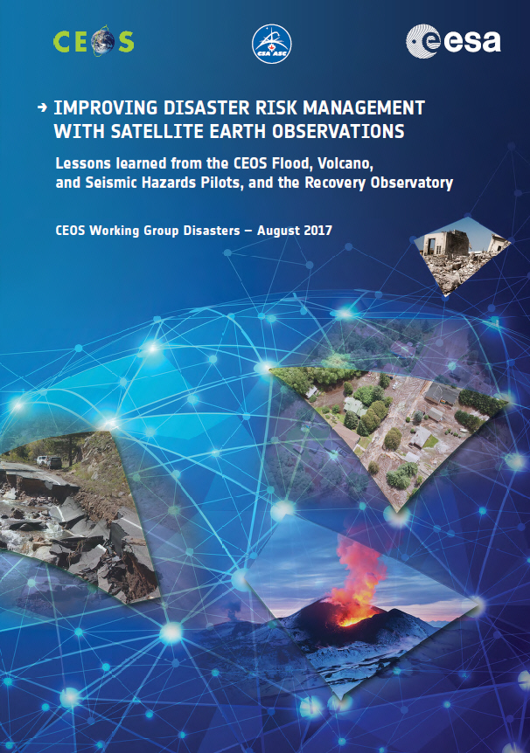
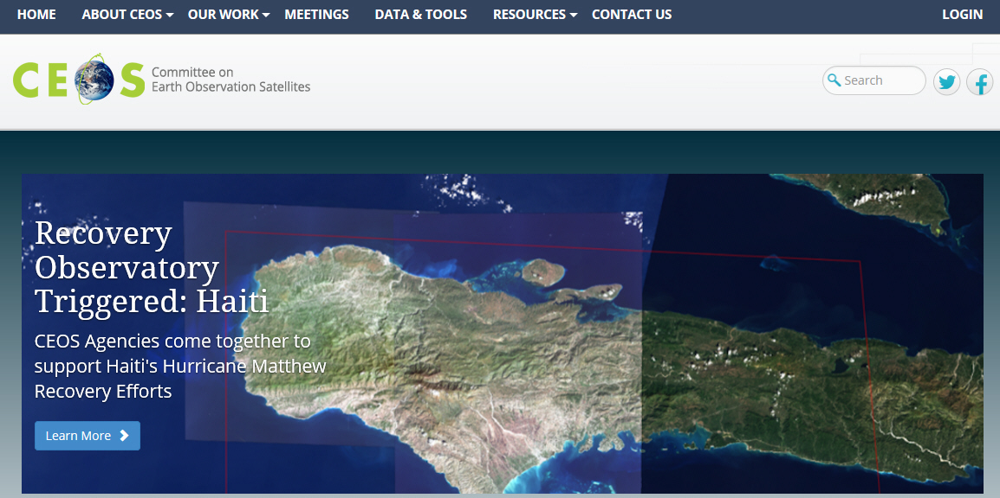
Communication and Outreach
CEOS Website Story
- Volcano Pilot
- Recovery Observatory
CEOS Disasters Brochure
@ Disaster Risk Reduction Across the Americas Summit
@ GEO-XIV Plenary CEOS Exhibition Booth

Slide 18
CEOS Work Plan
WG Disasters Activities will be updated in 2018!
DIS-10: Implementation of Data Acquisition Plan in support to DRM pilots and data coordination for GSNL supersites Will be amended to only keep GSNL
DIS-12: Report on survey of donors for post-2017 operation of a Recovery Observatory (commences 9 months after Recovery Observatory triggering? Delayed: This will start in Spring 2018
DIS-13: Report on follow-on actions to DRM Pilots Will include Landslide Pilot activities
DIS-15: Support for GEO-DARMA identification of major hazards and DRR issues for each selected region

Slide 19
Decision @ Plenary 2017
Items for Decision
DIS-10 - GEO GSNL Proposals (Southern Andes and Virunga Volcanoes Supersites) and Biennial Reports (Ecuador and New-Zealand Supersites).
DIS-12 - Recovery Observatory Operational Plan.
DIS-13 - Disaster Risk Management pilot initiative final reports that includes follow-on actions for Volcano and Seismic Hazards Pilots.
DIS-13 - Geohazards Lab Implementation Plan.
Approve New Vice-Chair/Chair: NASA.

Slide 20
Reporting @ Plenary 2017
Items for Reference
DIS-12 - Recovery Observatory Malawi and Nepal demonstrators final reports.
DIS-12 - Recovery Observatory status update.
DIS-13 - Landslide Pilot status update.
DIS-15 - GEO-DARMA concept phase summary.

Slide 21
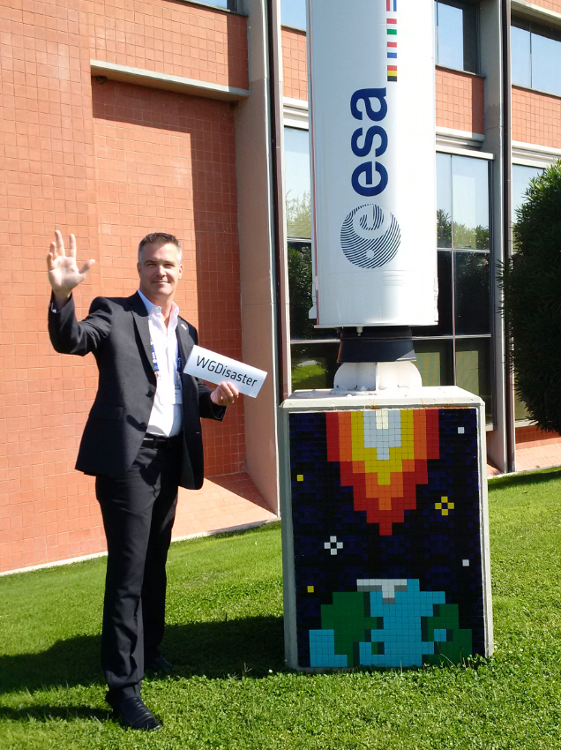
Goodbye !!!!
Many thanks to all CEOS members, specifically participants of the WG on Disasters.
A special thank to CSA who gave me the privilege and opportunity to be part of CEOS, an amazing EO community.
Now it’s time for me to say “Thanks for the Memories” and the trust you gave me!!
Cheers!!

