Slide 1

Update on EUMETSAT
Committee on Earth Observation Satellites
CEOS Plenary 2017
Agenda Item # 4.9
Rapid City, South Dakota, USA
19 – 20 October 2017

Slide 2
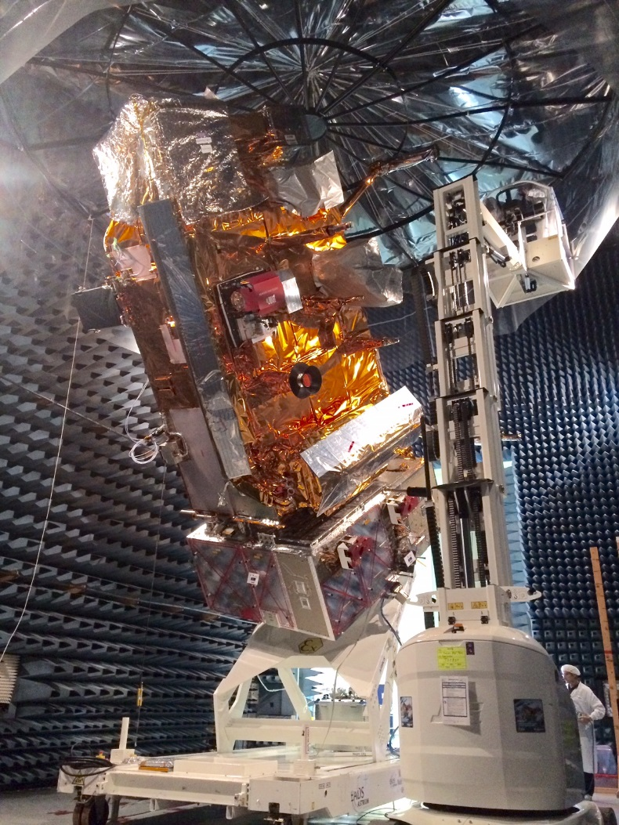
Preparing for Metop-C launch
in cooperation with ESA, CNES, NOAA
Satellite tests ongoing
MHS & GOME-2 instruments to be reintegrated after repair/re-calibration
Virtualised ground segment configuration qualified for three-Metop operations
System validation tests and operations preparation ongoing
Target launch date advanced to 20 September 2018
Three-Metop constellation from 2019 to 2022

Slide 3
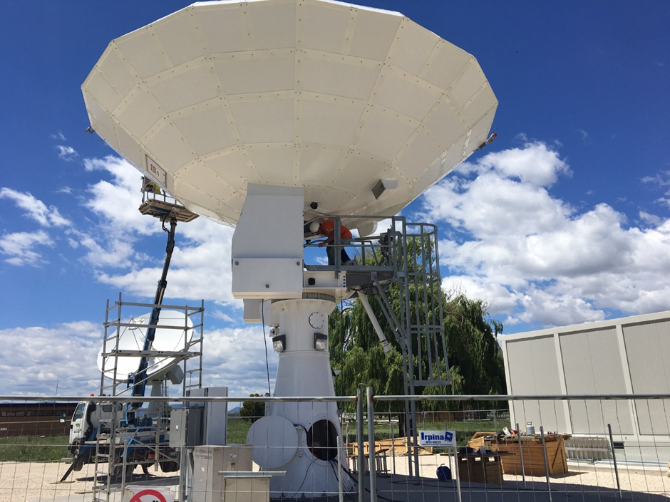
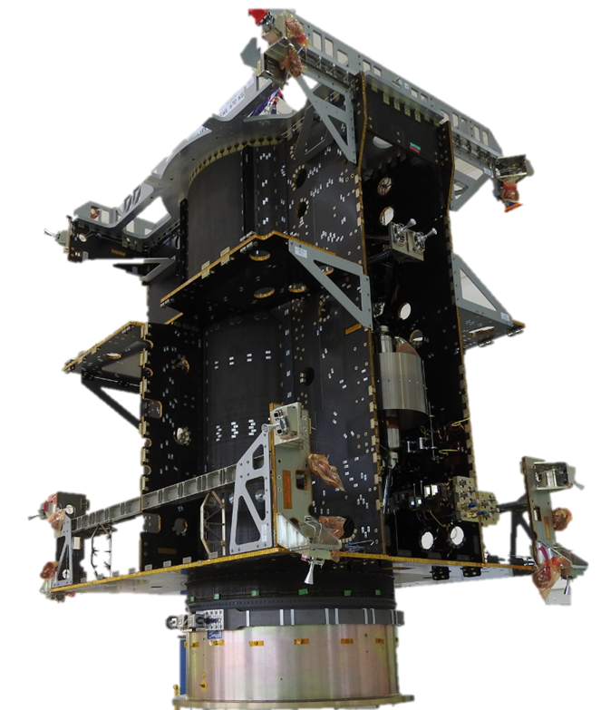
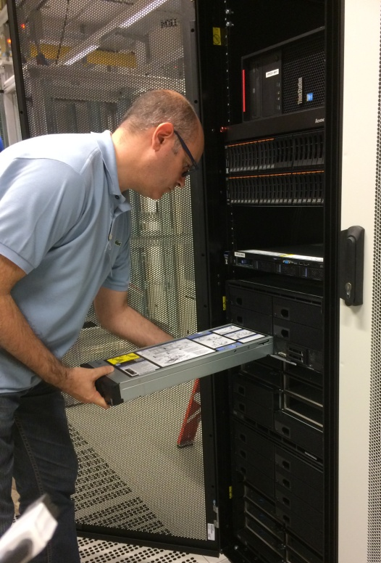
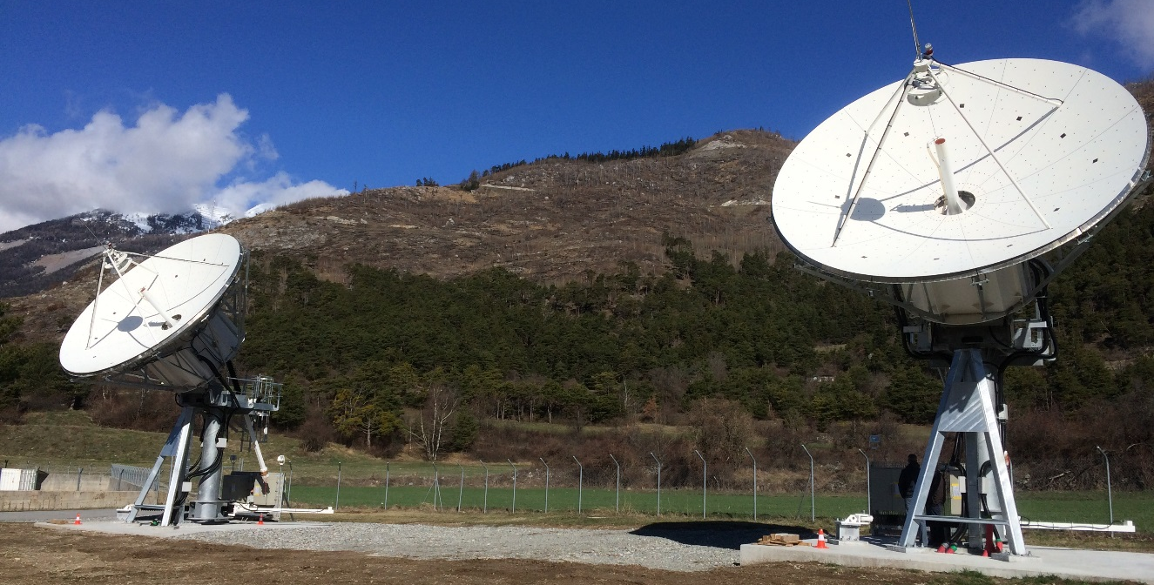
MTG development in cooperation with ESA
Mission control chain deployed
1st System Validation Test performed
Launch: 2021 for MTG-I1, 2023 for MTG-S1

Slide 4
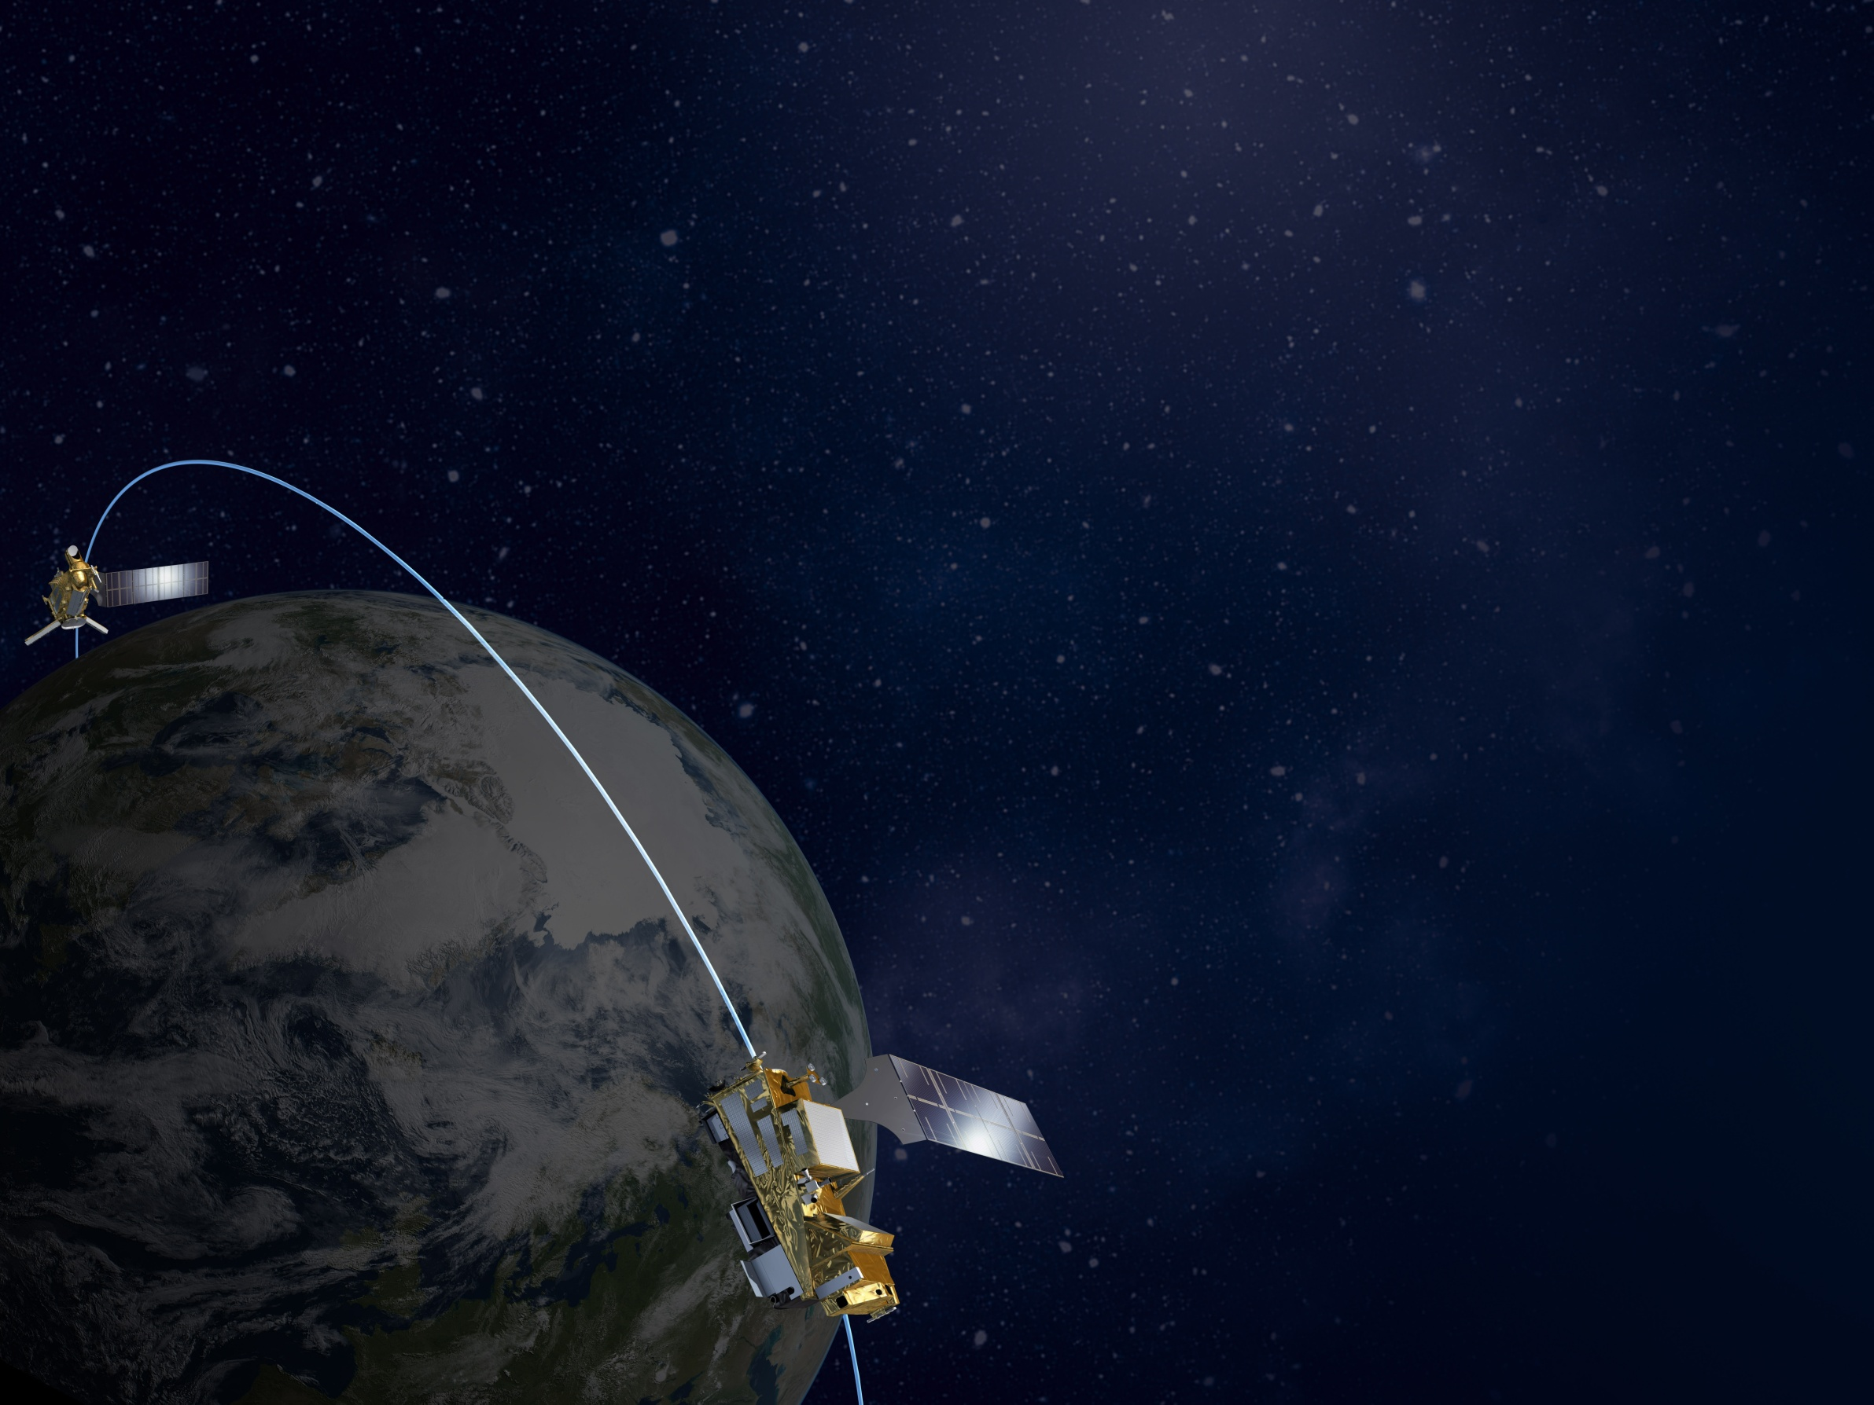
EUMETSAT Polar System – SG development
In cooperation with ESA, CNEs, DLR, NOAA
ESA space segment development progressing towards satellites CDR
System development in phase C
Ground segment development
  All contracts running
  Sub-segments passed PDR
Contracts for launch and LEOP services in place
Target launch dates:
  Metop-SG A1: end 2021
  Metop-SG B1: end 2022

Slide 5
Data access:
EUMETCast & “big data” Pathfinder projects
Format Conversion (PF IV)
NRT (Push) Dissemination
Thematic processing
Hosted Processing (PF V)
EUMETCast Terrestrial (PF II)
ICSI
EUMETSAT Ground Segment
Including SAFs
WebMapServices(PF III)
Pull Data Access
Online Data Access(PF I)
Long Term Archivee

Slide 6

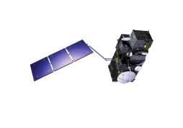



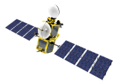
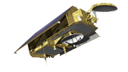



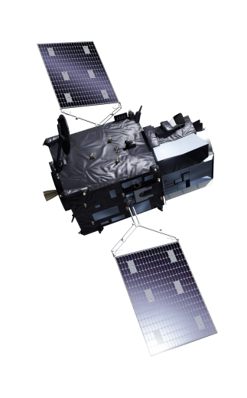
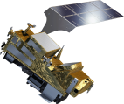
Sentinel-3 Marine mission
Jason-3 and Sentinel-6/Jason-CS cooperative missions
Sentinel-4 as part of MTG(-S) system
Sentinel-5 as part of EPS-SG system
Data access
Sentinel-3A: routine operations since 16 October
Sentinel-3B: launch in 2018

Slide 7
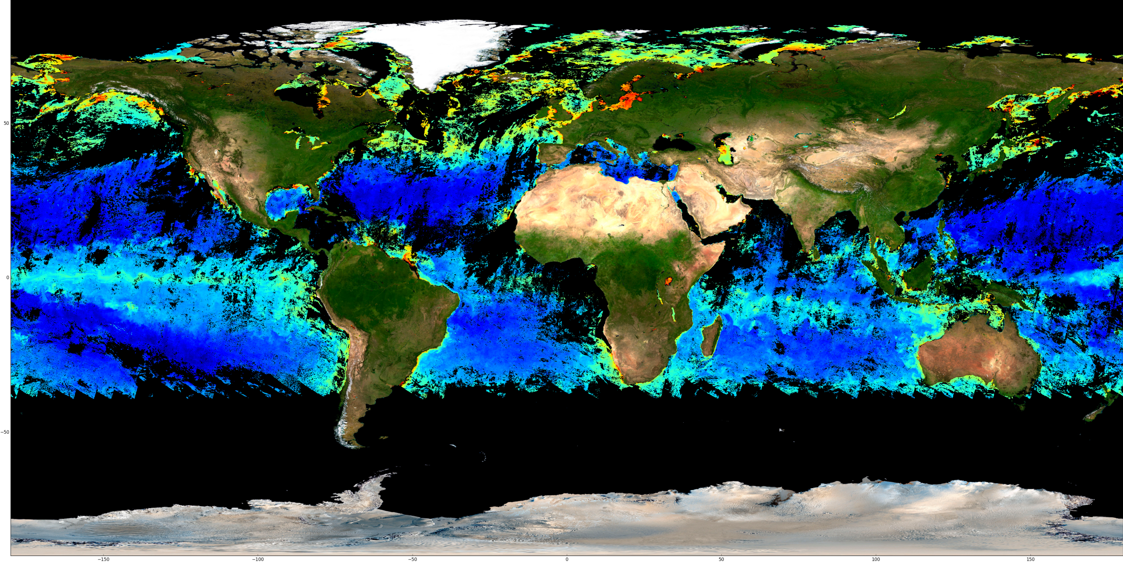

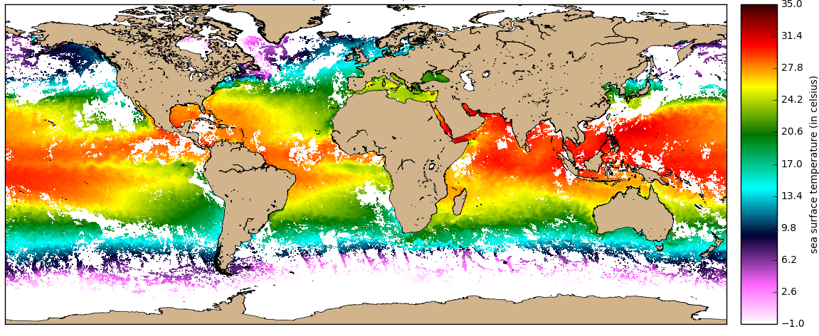
Ocean products from Sentinel-3

Slide 8


One Copernicus DIAS Platform
(with ECMWF and Mercator-Ocean)
Grd
segment
distribution
Prod.
distribution
DIAS management
DaaS
Elastic cloud
Resources
Storage / computing
SaaS
distribution
PaaS
Prod.
IaaS
distribution
distribution
Prod.
Prod.
OTHER

Slide 9

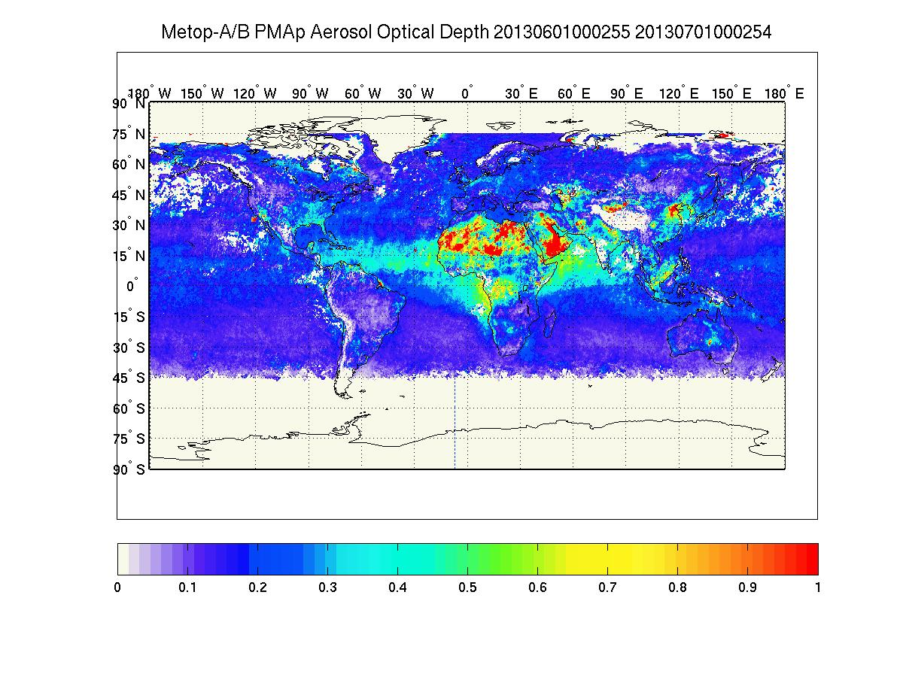
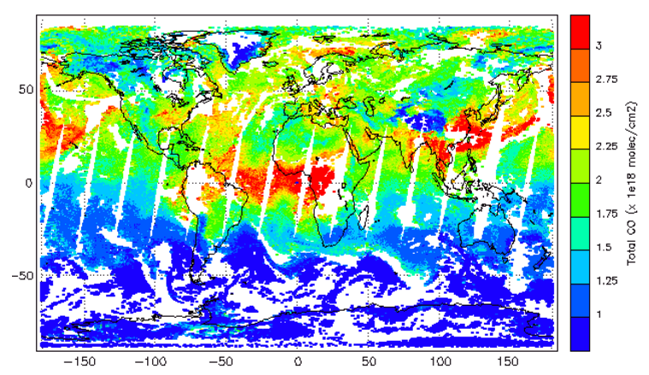
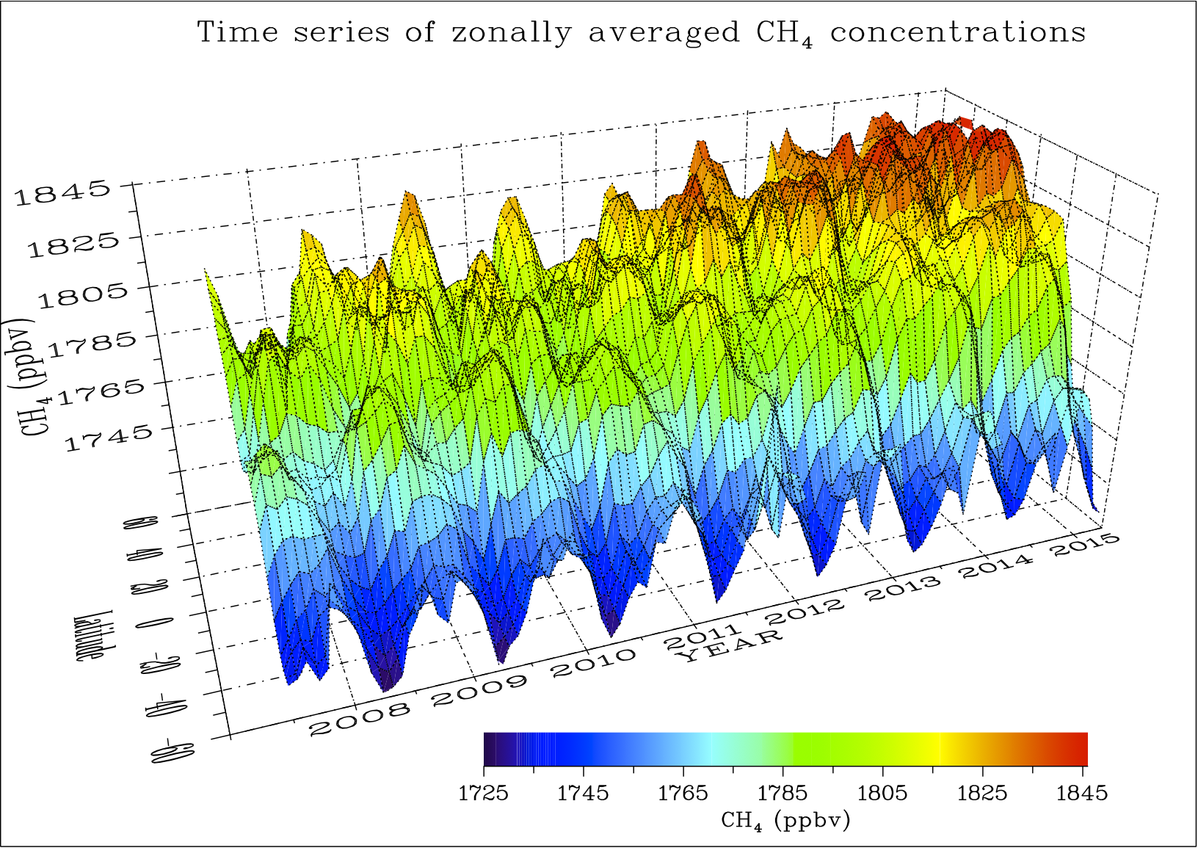
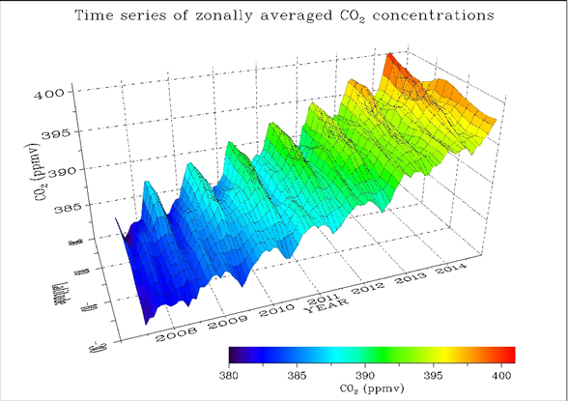

Greenhouse gases:
preparing for Sentinel-7
CH₄ (ppb)
Notes:
seasonal variations and inter-annual trend for these two green-house gases.

