Slide 1

NASA Overview
Committee on Earth Observation Satellites
NASA Earth Science Division
CEOS Plenary 2017
Agenda Item 4.8
Rapid City, South Dakota, USA
19 – 20 October 2017

Slide 2
NASA Agency Overview
NASA leads or co-leads 47 of the 87 total CEOS Objectives/Deliverables
  All NASA-involved tasks have updated progress/status in the CEOS Work Plan database
NASA continues free and open provision of all EO data products – policy since 1994
  Metadata, processing codes, model outputs as well as data products
  >17.5 petabytes total holdings (as of 2016)
  > 17 petabytes distributed to date
Recent Launches: CYGNSS (12/2016), SAGE-III (2/2017), LIS (2/2017), RAVAN (CS- 11/2016), ICECube (CS- 4/2017), MiRaTA (CS- 11/2017)
Near-Term Upcoming Launches: TSIS-1 (11/2017-2/2018), GRACE-FO (3/2018), ICESat-2 (9/2018), >6 CubeSats before 6/2018
Recent Mission Terminations: EO-1, GRACE; Jason-2, Cloudsat orbit changes
Budget Status:
  Funded at (high) 2016 level through 8 December 2017
  President’s FY18 budget proposal includes 8.9% overall cut, 5 mission terminations, initiates new missions
    DSCOVR-EPIC/NISTAR, RBI, PACE, CLARREO-PF, OCO-3 proposed terminated
    Continues all other missions in development and operation
    TROPICS, GeoCarb initiated (among others)
  Congressional appropriation informed by – but not necessarily identical to – President’s proposal
Decadal Survey expected 12/2017

Slide 3
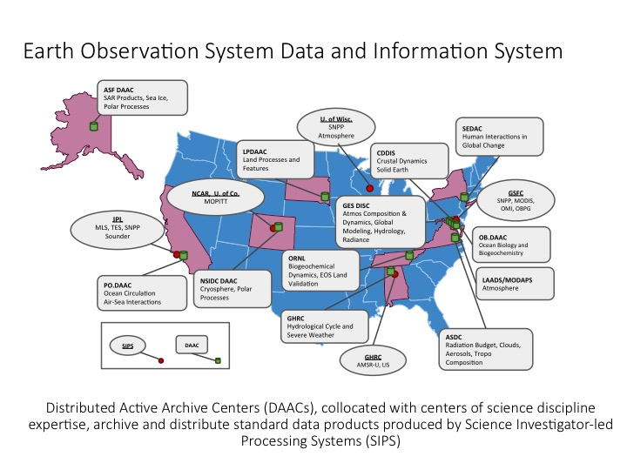
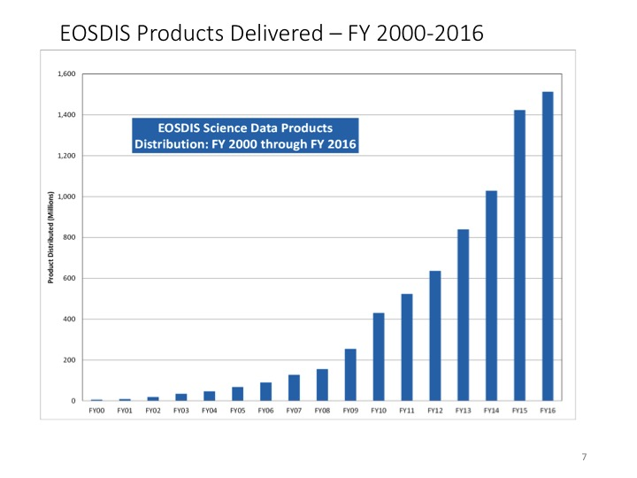
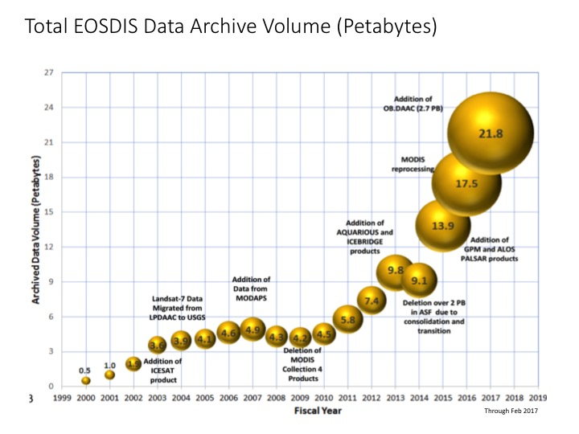
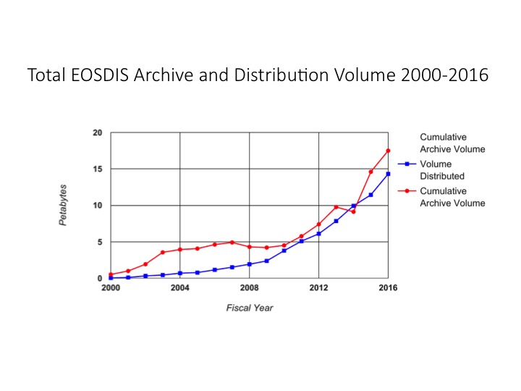
NASA Earth Science Data Systems

Slide 4
NASA Agency Overview
NASA leads or co-leads 47 of the 87 total CEOS Objectives/Deliverables
  All NASA-involved tasks have updated progress/status in the CEOS Work Plan database
NASA continues free and open provision of all EO data products – policy since 1994
  Metadata, processing codes, model outputs as well as data products
  >17.5 petabytes total holdings (as of 2016)
  > 17 petabytes distributed to date
Recent Launches: CYGNSS (12/2016), SAGE-III (2/2017), LIS (2/2017), RAVAN (CS- 11/2016), ICECube (CS- 4/2017), MiRaTA (CS- 11/2017)
Near-Term Upcoming Launches: TSIS-1 (11/2017-2/2018), GRACE-FO (3/2018), ICESat-2 (9/2018), >6 CubeSats before 6/2018
Recent Mission Terminations: EO-1, GRACE; Jason-2, Cloudsat orbit changes
Budget Status:
  Funded at (high) 2016 level through 8 December 2017
  President’s FY18 budget proposal includes 8.9% overall cut, 5 mission terminations, initiates new missions
    DSCOVR-EPIC/NISTAR, RBI, PACE, CLARREO-PF, OCO-3 proposed terminated
    Continues all other missions in development and operation
    TROPICS, GeoCarb initiated (among others)
  Congressional appropriation informed by – but not necessarily identical to – President’s proposal
Decadal Survey expected 12/2017

Slide 5


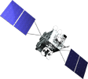


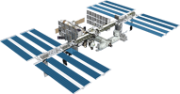

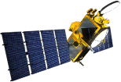

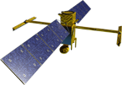
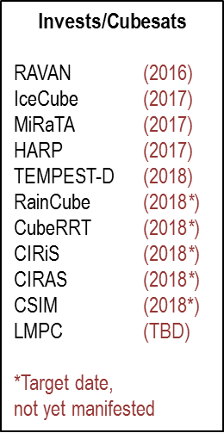



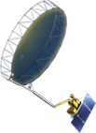




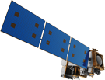


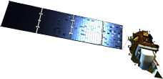

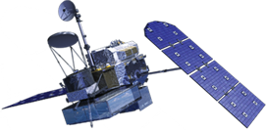

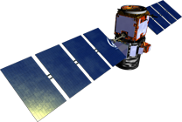

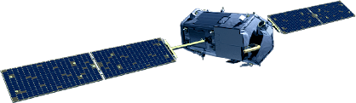
Earth Science Missions
FY17 Program of Record
Landsat 9 (2020)
PACE (2022)
GeoCARB (~2021)
ISS Instruments
CATS (2020), LIS (2020), SAGE III (2020)
TSIS-1 (2018), OCO-3 (2018), ECOSTRESS (2017), GEDI (2018)
CLARREO-PF (2020)
TROPICS (12) (~2021)
MAIA (~2021)
Sentinel-6A/B (2020, 2025)
NI-SAR (2021)
JPSS-2 Instruments
RBI (2018), OMPS-Limb (2018)
SWOT (2021)
TEMPO (2018)
GRACE-FO (2) (2018)
Formulation
ICESat-2 (2018)
NISTAR, EPIC
(DSCOVR / NOAA)
(2019)
Implementation
CYGNSS (8) (2019)
Primary Ops
Extended Ops
SMAP (>2022)
Landsat 7
(USGS) (~2022)
QuikSCAT (2017)
SORCE,
TCTE (NOAA) (2017)
Suomi NPP (NOAA) (>2022)
Terra (>2021)
Landsat 8
(USGS) (>2022)
Aqua (>2022)
CloudSat (~2018)
CALIPSO (>2022)
GPM (>2022)
Aura (>2022)
GRACE (2) (2018)
OSTM/Jason-2
(NOAA) (>2022)
OCO-2 (>2022)
06.26.17
Notes:
MISSIONS w/ years and cube sats; FY17
06/26: GPM status from primary to extended
5/23: removed TSIS-2
Fleet - Earth Science Division - Missions (with color key; Gemtone version; editable)
Current at of April 18, 2017
Credit: NASA/J. Mottar
------------------------------
SLIDE INFO
April 18, 2017 – Changed LIS and SAGE III to green, Removed EO-1
January 24, 2017 – Removed Rapidscat, changed CYGNSS to green
August 25 – Ianson approved, Denning change on NISAR, changed yellow to orange implementation given KCP-C
July 22 – Denning change per Ianson: move TROPICS (12) with MAIA and EVM-2 and delete separate icon and name
July 21 - Denning changes per Freilich/Ianson:
Fixed misspelling of e in Sentinel and corrected it to not be all caps
Separated each ISS mission on its own line
Put MAIA and EVM-2 on own as new, taking MAIA off PACE
Change RBI to Orange
July 13-14 Mottar added TROPICS icon and name. Denning made the following changes (had discussed w Freilich to do when these passed KCP-B and into implementation) changed yellow to orange for:
OCO-3, SWOT, TSIS-1, GEDI
April 29 per Freilich, Denning made these changes:
-Put MAIA with PACE
April 26 per Ianson information on 4/22, Denning made these changes:
TSIS-1 orange changed to yellow as still in formulation (until if successful KDP-C June 8)
GEDI orange changed to yellow as still in formulation (until if successful KDP-C June 9
changed order put ECOSTRESS before TSIS-1
April 22 Changed JPSS-2 (NOAA) to yellow for Formulation (confirmed w Carolyn Mercer and Ariel Pavlick (OCE embed with master tables)) as it had been in orange Implementation. Chart sent to Ianson and Neeck for check.
CORRECTION DENNING PER RIVERA Feb 18, 2016
Changed misspelling of “Sentinal” to “Sentinel”
UPDATE DENNING PER FREILICH DECISIONS FEB 12, 2016
Changed OCO-3 to Formulation color and moved lower in list
Changed RBI to Formulation color
Changed GEDI to Implementation color and moved to line above it
Added TSIS-2 in Formulation color
UPDATE DENNING PER FREILICH DECISIONS FEB 4, 2016
Changed “Altimetry FO (Formulation in FY16) to “Sentinal-6A/B”
On Landsat 9, removed comma and TIRFF
Change I was going to make – “NISTAR, EPIC (NOAA’s DSCOVR) to green primary ops was already corrected
Dec. 15, 2015 – Updated: TEMPO changed to Implementation phase; NISTAR, EPIC changed to Primary Ops phase; ; OCO-3 and ECOSTRESS changed to Implementation phase; Aquarius removed; slide now fully editable. JMottar
May 18, 2015 – Added to SMD Multimedia Library.
May 18, 2015 – Updated the outdated 2014 version: TRMM was removed; NISTAR, EPIC (NOAA's DSCOVR) were added; SMAP icon was updated; moon at top left was removed; color key moved to top left.-JMottar
ID: I-EA-15-0040 (image)
ID: SL-EA-15-0068 (slide)

Slide 6
Earth Science Missions
President’s Budget Request (May 2017)
Landsat 9 (2020)
GeoCARB (~2021)
ISS Instruments
CATS (2020), LIS (2020), SAGE III (2020)
TSIS-1 (2018), ECOSTRESS (2017), GEDI (2018)
TROPICS (12) (~2021)
MAIA (~2021)
Sentinel-6A/B (2020, 2025)
NI-SAR (2021)
JPSS-2 Instruments
OMPS-Limb (2018)
SWOT (2021)
TEMPO (2018)
GRACE-FO (2) (2018)
Formulation
ICESat-2 (2018)
Implementation
CYGNSS (8) (2019)
Primary Ops
Extended Ops
SMAP (>2022)
Landsat 7
(USGS) (~2022)
QuikSCAT (2017)
SORCE,
TCTE (NOAA) (2017)
Suomi NPP (NOAA) (>2022)
Terra (>2021)
Landsat 8
(USGS) (>2022)
Aqua (>2022)
CloudSat (~2018)
CALIPSO (>2022)
GPM (>2022)
Aura (>2022)
GRACE (2) (2018)
OSTM/Jason-2
(NOAA) (>2022)
OCO-2 (>2022)
06.26.17
Notes:
MISSIONS w/ years and cube sats; FY17
06/26: GPM status from primary to extended
5/23: reflecting proposed budget, X’d RBI; removed TSIS-2
Fleet - Earth Science Division - Missions (with color key; Gemtone version; editable)
Current at of April 18, 2017
Credit: NASA/J. Mottar
------------------------------
SLIDE INFO
April 18, 2017 – Changed LIS and SAGE III to green, Removed EO-1
January 24, 2017 – Removed Rapidscat, changed CYGNSS to green
August 25 – Ianson approved, Denning change on NISAR, changed yellow to orange implementation given KCP-C
July 22 – Denning change per Ianson: move TROPICS (12) with MAIA and EVM-2 and delete separate icon and name
July 21 - Denning changes per Freilich/Ianson:
Fixed misspelling of e in Sentinel and corrected it to not be all caps
Separated each ISS mission on its own line
Put MAIA and EVM-2 on own as new, taking MAIA off PACE
Change RBI to Orange
July 13-14 Mottar added TROPICS icon and name. Denning made the following changes (had discussed w Freilich to do when these passed KCP-B and into implementation) changed yellow to orange for:
OCO-3, SWOT, TSIS-1, GEDI
April 29 per Freilich, Denning made these changes:
-Put MAIA with PACE
April 26 per Ianson information on 4/22, Denning made these changes:
TSIS-1 orange changed to yellow as still in formulation (until if successful KDP-C June 8)
GEDI orange changed to yellow as still in formulation (until if successful KDP-C June 9
changed order put ECOSTRESS before TSIS-1
April 22 Changed JPSS-2 (NOAA) to yellow for Formulation (confirmed w Carolyn Mercer and Ariel Pavlick (OCE embed with master tables)) as it had been in orange Implementation. Chart sent to Ianson and Neeck for check.
CORRECTION DENNING PER RIVERA Feb 18, 2016
Changed misspelling of “Sentinal” to “Sentinel”
UPDATE DENNING PER FREILICH DECISIONS FEB 12, 2016
Changed OCO-3 to Formulation color and moved lower in list
Changed RBI to Formulation color
Changed GEDI to Implementation color and moved to line above it
Added TSIS-2 in Formulation color
UPDATE DENNING PER FREILICH DECISIONS FEB 4, 2016
Changed “Altimetry FO (Formulation in FY16) to “Sentinal-6A/B”
On Landsat 9, removed comma and TIRFF
Change I was going to make – “NISTAR, EPIC (NOAA’s DSCOVR) to green primary ops was already corrected
Dec. 15, 2015 – Updated: TEMPO changed to Implementation phase; NISTAR, EPIC changed to Primary Ops phase; ; OCO-3 and ECOSTRESS changed to Implementation phase; Aquarius removed; slide now fully editable. JMottar
May 18, 2015 – Added to SMD Multimedia Library.
May 18, 2015 – Updated the outdated 2014 version: TRMM was removed; NISTAR, EPIC (NOAA's DSCOVR) were added; SMAP icon was updated; moon at top left was removed; color key moved to top left.-JMottar
ID: I-EA-15-0040 (image)
ID: SL-EA-15-0068 (slide)

Slide 7
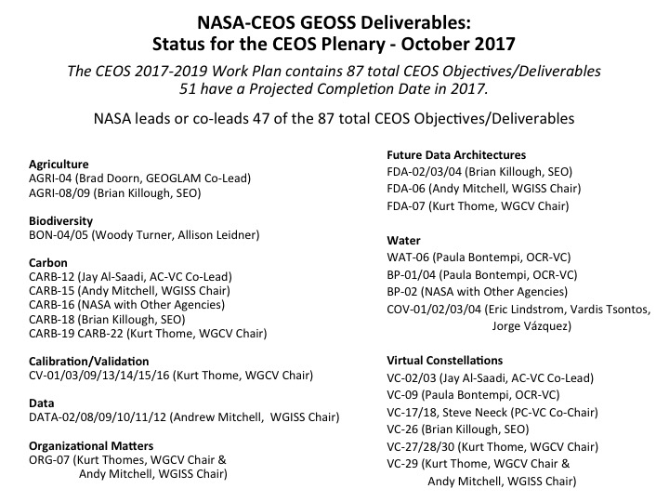
NASA Earth Science Data Systems

Slide 8
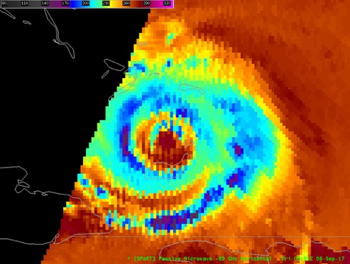
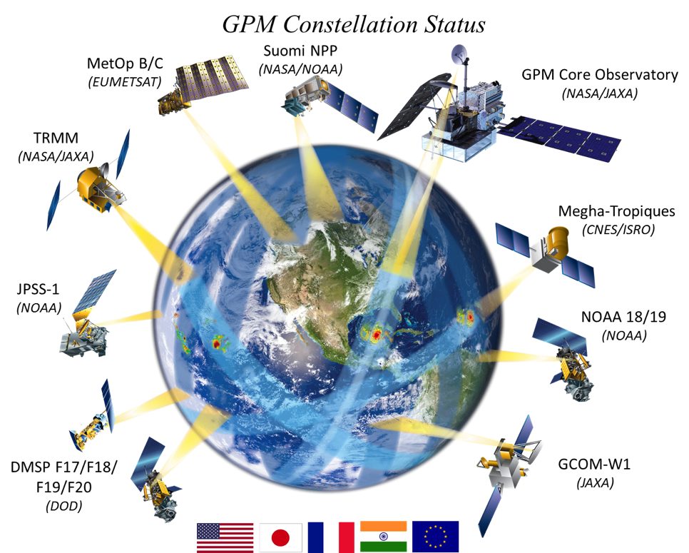
GPM Measurements Influence Hurricane Forecasts
GPM Constellation
Suomi NPP
(NASA/NOAA)
MetOp B/C
(EUMETSAT)
GPM Core Observatory
(NASA/JAXA)
Megha-Tropiques
(CNES/ISRO)
JPSS-1
(NOAA)
NOAA 18/19
(NOAA)
DMSP F17/F18
F19/F20
(DoD)
GCOM-W1
(JAXA)

Slide 9
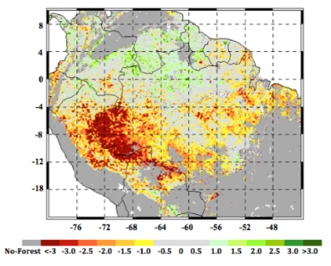
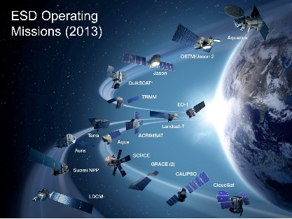
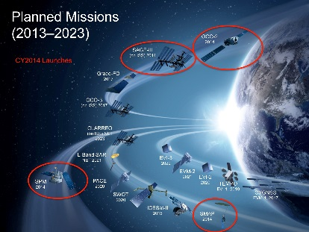
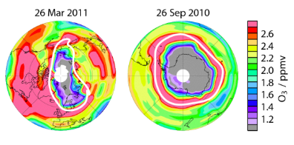
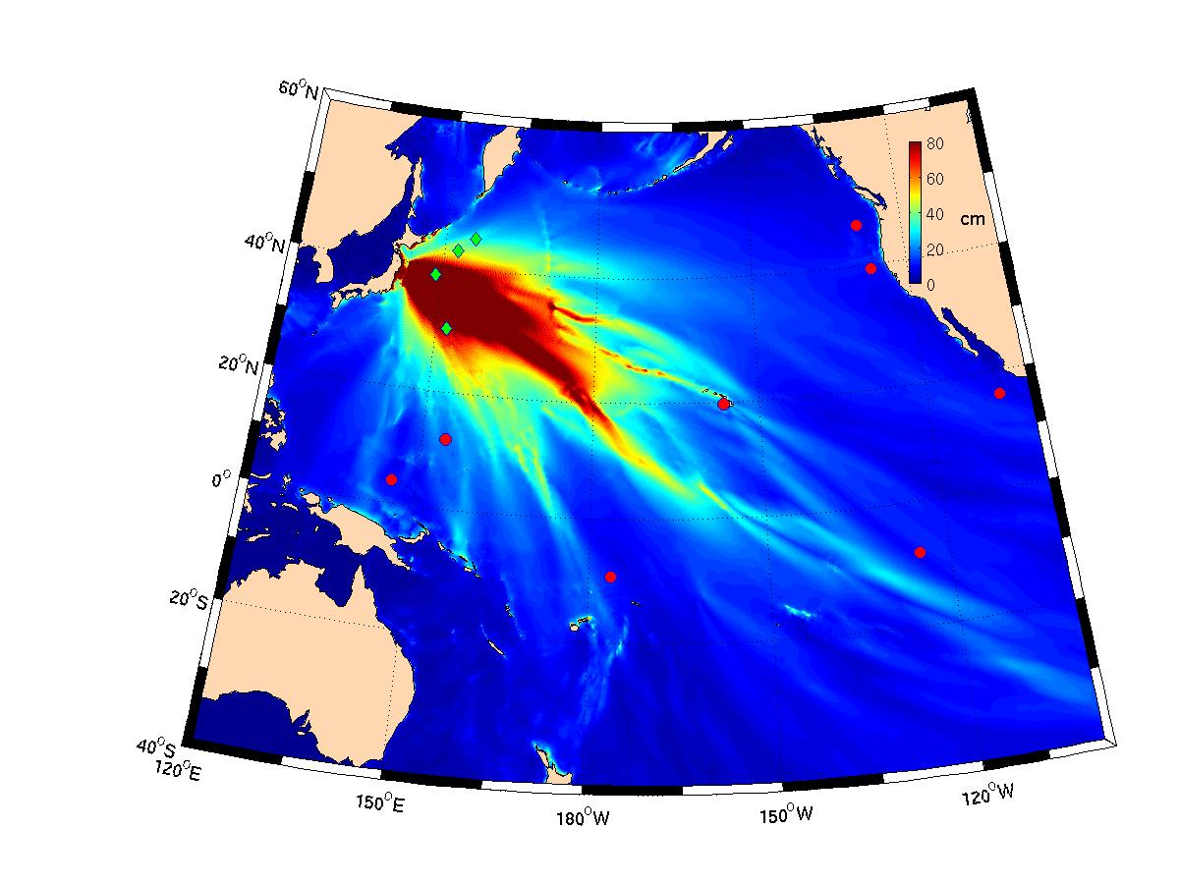
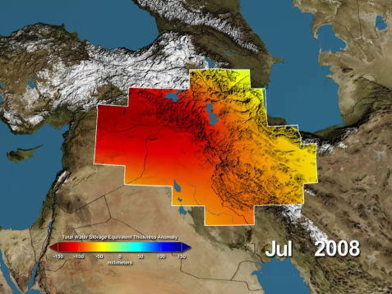
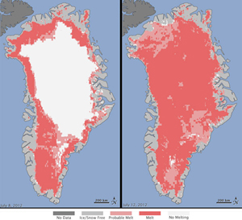
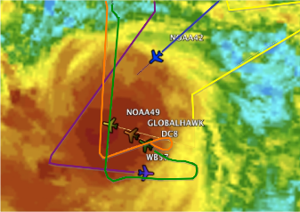
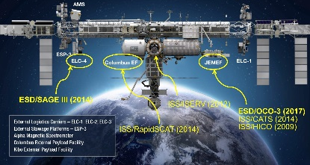

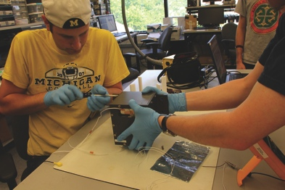
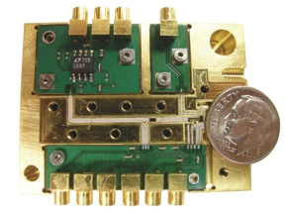
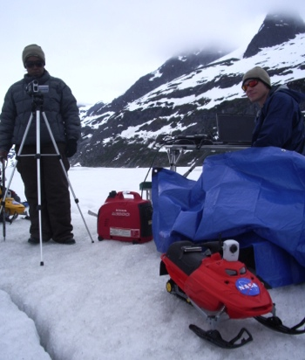

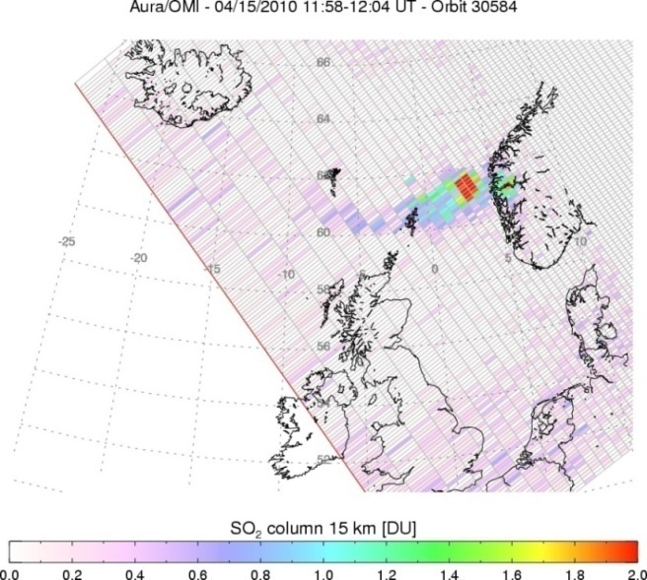
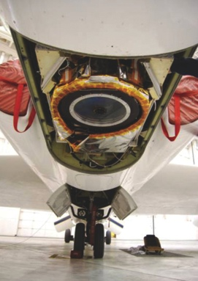
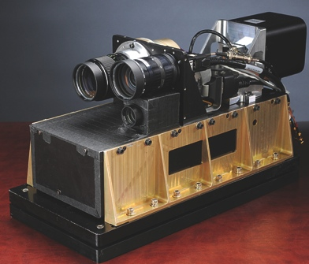



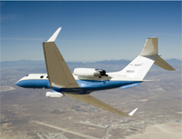
NASA’s Earth Science Division
Research
Flight
Applied Sciences
Technology
Notes:
9

