Slide 1

NOAA Agency Update
Committee on Earth Observation Satellites
Steve Volz, SIT Vice Chair
National Oceanic and Atmospheric Administration (NOAA)
CEOS Plenary 2017
Agenda Item # 4.7
Rapid City, South Dakota, USA
19 – 20 October 2017
Notes:
NOAA is a science-based services agency.
NESDIS’ mission is provide secure and timely access to global environmental data and information from satellites and other sources to both promote and protect the Nation’s environment, security, economy and quality of life.
Our vision is to expand understanding of our dynamic planet as the trusted source of environmental data.
The satellites provide data that informs decisions affecting:
Weather forecasting
Resilient coastal communities
and healthy oceans.
NOAA’s Top Four Priorities:
To provide information and services to make communities more resilient
To evolve the National Weather Service
To invest in observational infrastructure
To achieve organizational excellence

Slide 2
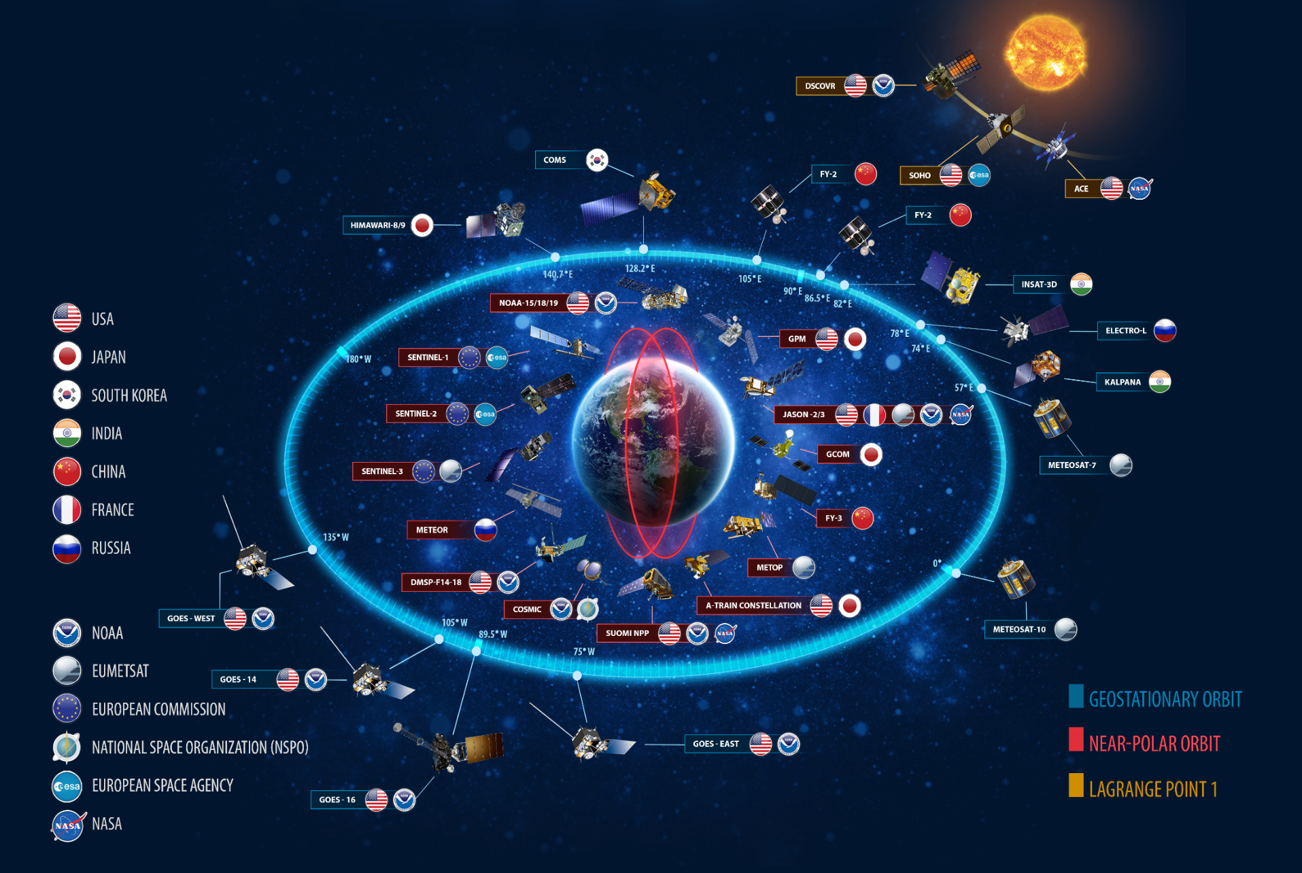
Partnerships for Integrated System
Existing Partnership
Potential Partnership
NOAA Mission
Notes:
Image: This graphic includes the current space-based portion of the World Meteorological Organization's Global Observing System, plus additional space weather and environmental satellites.
We operate in an environment where there is a international constellation of Earth observing satellites and we are moving towards a greater utilization of this vast network.
While NOAA operates many satellites, no one organization or nation can afford alone to effectively monitor the entire planet alone.
The American public has long depended on the NOAA weather satellites. But as all of us here know, our satellites alone could never provide us with the depth of knowledge that we need in order to serve our public.
NOAA partners with the international community to leverage data from satellites around the world, providing a more complete understanding of our ever changing plan
We are co-dependent on the data of our partners. Collectively, our assets represent a powerful global constellation of Earth Observation satellites.

Slide 3
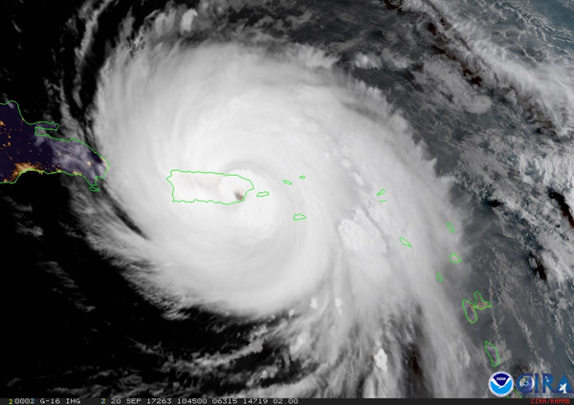
GOES-16 geocolor image of Hurricane Maria over Puerto Rico as it made landfall on September 20, 2017. Credit: CIRA
Notes:
Although not yet operational, data from NOAA’s GOES-16 satellite proved vital in forecasting operations for Hurricane Maria as it neared Puerto Rico on September 20, 2017. Radar in San Juan went out at 5:50 a.m. EDT, just before Maria made landfall on the island. Land-based radar is used during storms to provide detailed information on hurricane wind fields, rain intensity, and storm position and movement. With this critical technology disabled and a major hurricane approaching, forecasters were able to utilize data from NOAA’s latest geostationary satellite, GOES-16, to track the storm in real-time.
GOES-16 is able to scan a targeted area of severe weather as often as every 30 seconds, a capability not available with current GOES. This rapid scanning rate is allowing forecasters to analyze cloud patterns and track Maria in real time. GOES-16 also has three times more channels than the current GOES imager, providing better estimates of the structure of tropical cyclones and their environments. The four-fold improvement in resolution from GOES-16 provides greater accuracy of feature attributes, allowing for better characterization of the eyes of hurricanes.

Slide 4
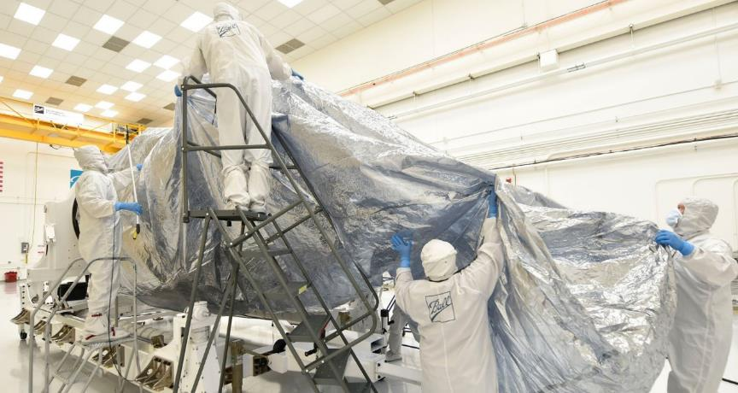
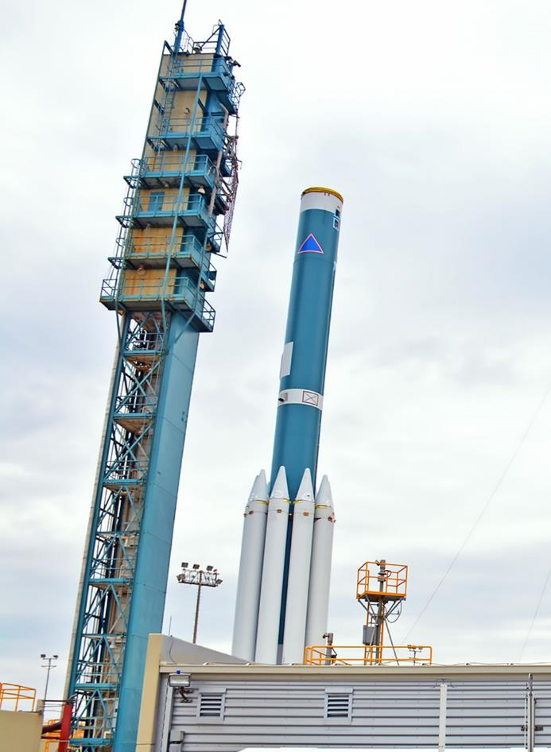
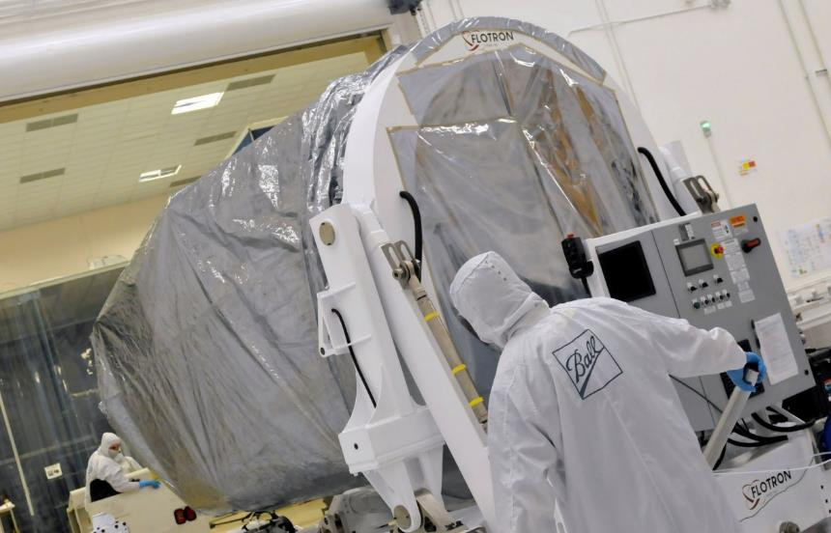
Preparing for Launch JPSS-1

Slide 5
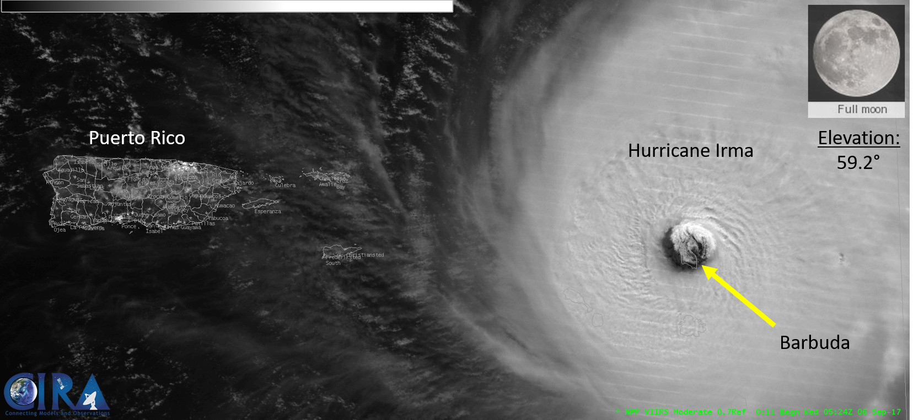
VIIRS Imagery of Hurricane Irma

Slide 6
Realizing the CEOS Work Plan
NOAA Actions By Due Date
NOAA Open Actions = 7
Full Disclosure – Difficult to get final reporting on two actions but finally
provided to Jono on Monday

Slide 7
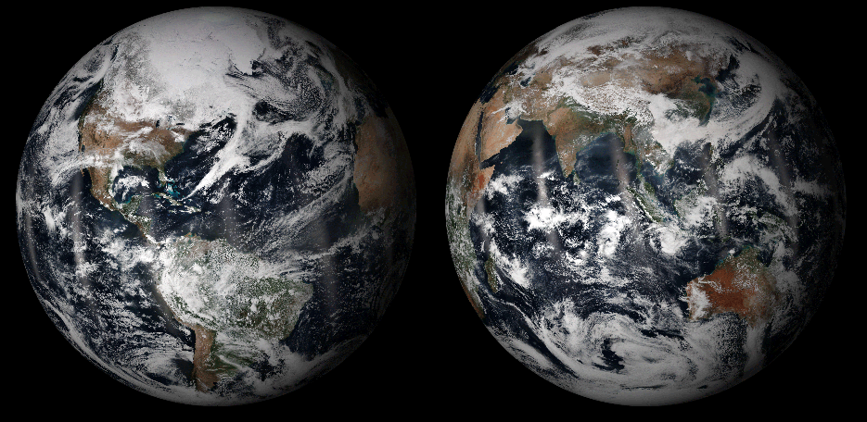
Thank You
Notes:
Image: Each image is assembled by processing 15 orbits of the Suomi NPP satellite over a 24 hour period, and uses techniques to blend the edges of each orbit.

