Slide 1
International Financing Institutions (IFI) Engagement
Committee on Earth Observation Satellites
S Briggs, ESA
CEOS Plenary 2017
Agenda Item #4.5
Rapid City, South Dakota, USA
19 – 20 October 2017

Slide 2
Background (1)
SIT Chair Team Theme
Maintain and improve effectiveness of our strategic partnerships, including with UN agencies, Development Banks, international programmes and agencies; the effective functioning of GEO, and CEOS within it, is a high priority
Key Partnership Trends
UN agencies …
Internet giants …
Development finance (from IFIs and national Aid agencies) sustainable and structured alignment of resources which do not finance space programs directly, but support through their own financing, activities, and competencies (e.g. capacity-building activities) in areas where EO already, or should, play a major role

Slide 3
Background (2)
GEO: Status of involvement with IFIs
GEO has recognised IFIs as critical partner, with special panel at upcoming GEO Plenary to discuss
Need to ensure coherent approach between CEOS and GEO in dealing with IFIs
Key mechanisms
IFIs and National Development Agencies support majority of geospatial activities in developing countries
Different modalities: how can IFIs:
Improve what is already being implemented?
Improve proposed delivery of planned projects?
Inform possibilities of innovative new policy decisions based on better knowledge of new technologies

Slide 4
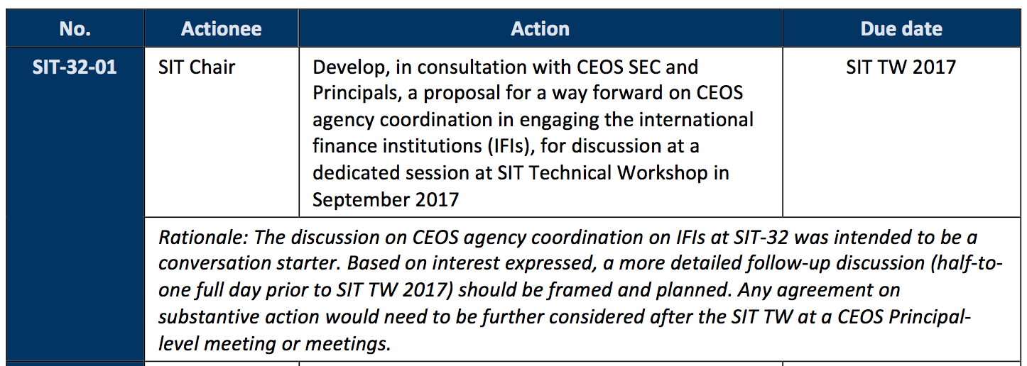
SIT-32 Discussion and Actions
Main discussion points from SIT-32 (Apr 2017)
Partners and Partnerships:
Follow-up at the SIT Technical Workshop on the potential for space agencies to collectively engage with development finance institutions was agreed.
SIT-32-01

Slide 5
SIT TWS IFI Session Main Conclusions
Principle objective: to develop a coherent, consistent, and compelling set of materials to promote the ‘mainstreaming’ of EO for ODA
Need to address the Banks at three separate levels:
Improving ongoing implementation
Defining improved new implementation, further
New strategic policy opportunities afforded by EO information
Accessible data is not sufficient – certified methodology that produces transparent results is also required
Start with support to Bank policies, rather than capabilities
Translate the value of EO into language that the Banks can understand and incorporate into their decision making processes

Slide 6
SIT TWS IFI Session Outcomes – Next Steps for Discussion
Two Outputs Proposed
A Statement (one page) of the CEOS commitment to support the expanded use of EO in Development, highlighting the role and benefits that EO can deliver, and
A supporting document (10-12 pages) consisting of key summary information (based on the White Paper, 3-4 pages) to substantiate the Statement, followed by examples (8-10 pages) that illustrate the benefits and use of EO drawn from across the CEOS agencies.

Slide 7
Statement Overview
Background
ODA is complex and rapidly changing
SDGs are likely to drive ODA priorities over the next few decades
Significant developments making EO an operational source of environmental information
Increase efficiencies, improve future operations, extend capabilities
Promote transparency, responsibility and accountability
Way Forward
Develop coherent strategy and approach to expand use of EO for ODA
Interface with GEO
Address
Awareness of what EO can deliver through
Acceptance methodologies & best-practice guidelines
Use availability of operational data sets, tools, and capacity-building

Slide 8
For Plenary Consideration
Plenary to:
consider endorsement of Statement on EO and ODA
discuss and agree approach to IFIs
Engage at the highest levels of IFIs using materials
Timing good as IFIs formulate new approaches – CEOS statement is important and could make a difference
Plan to make the most of GEO Plenary opportunity – Panels, and DC location with IFIs present: CEOS as the ‘space arm’ of GEO
Supporting document to be developed by end of 2017
discuss and agree action, call for volunteers
Informally, NASA, JAXA, ESA, GEOSEC all indicated early interest in contributing to the proposed materials

