Slide 1

GEO Update
Barbara Ryan, GEO Secretariat
CEOS Plenary 2017
Agenda Item 4.1
Rapid City, South Dakota, USA
19 October 2017

Slide 2
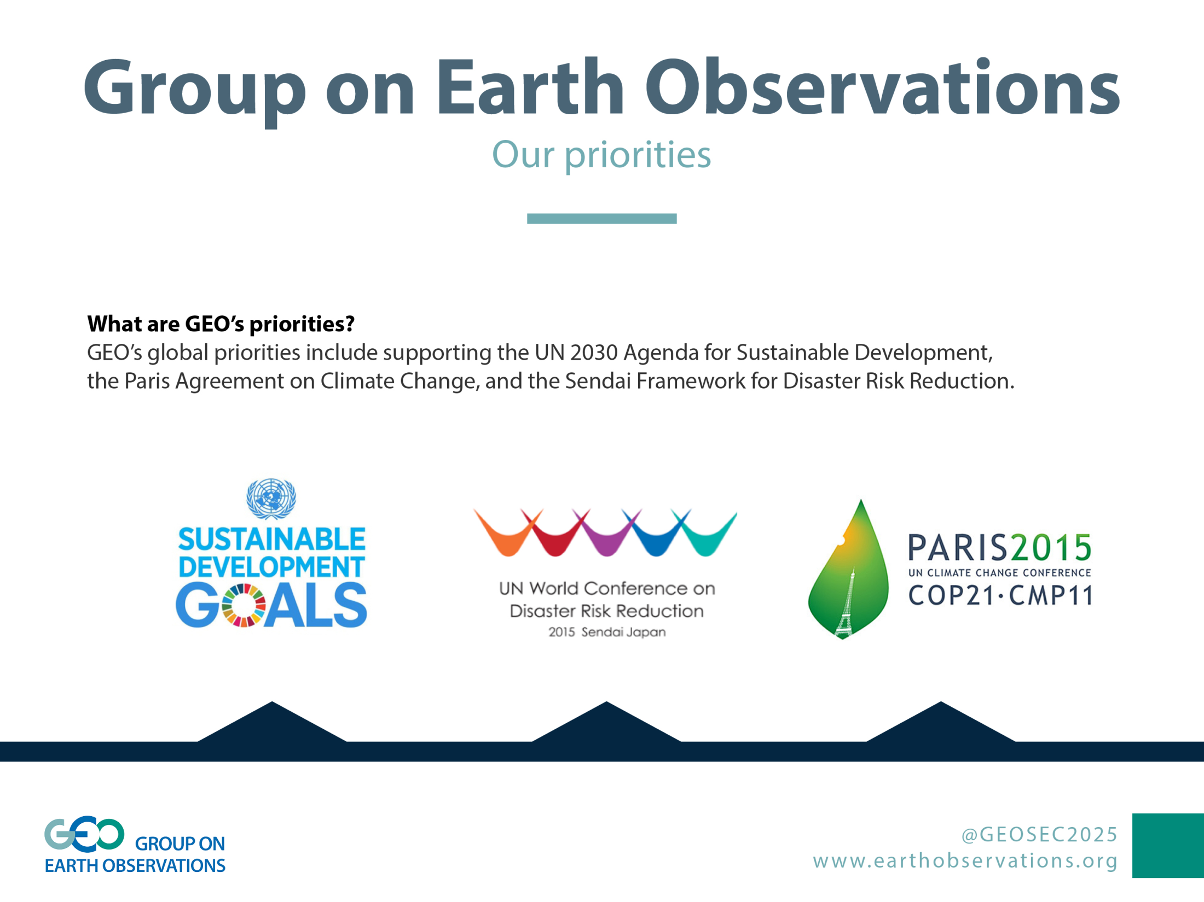


Slide 3
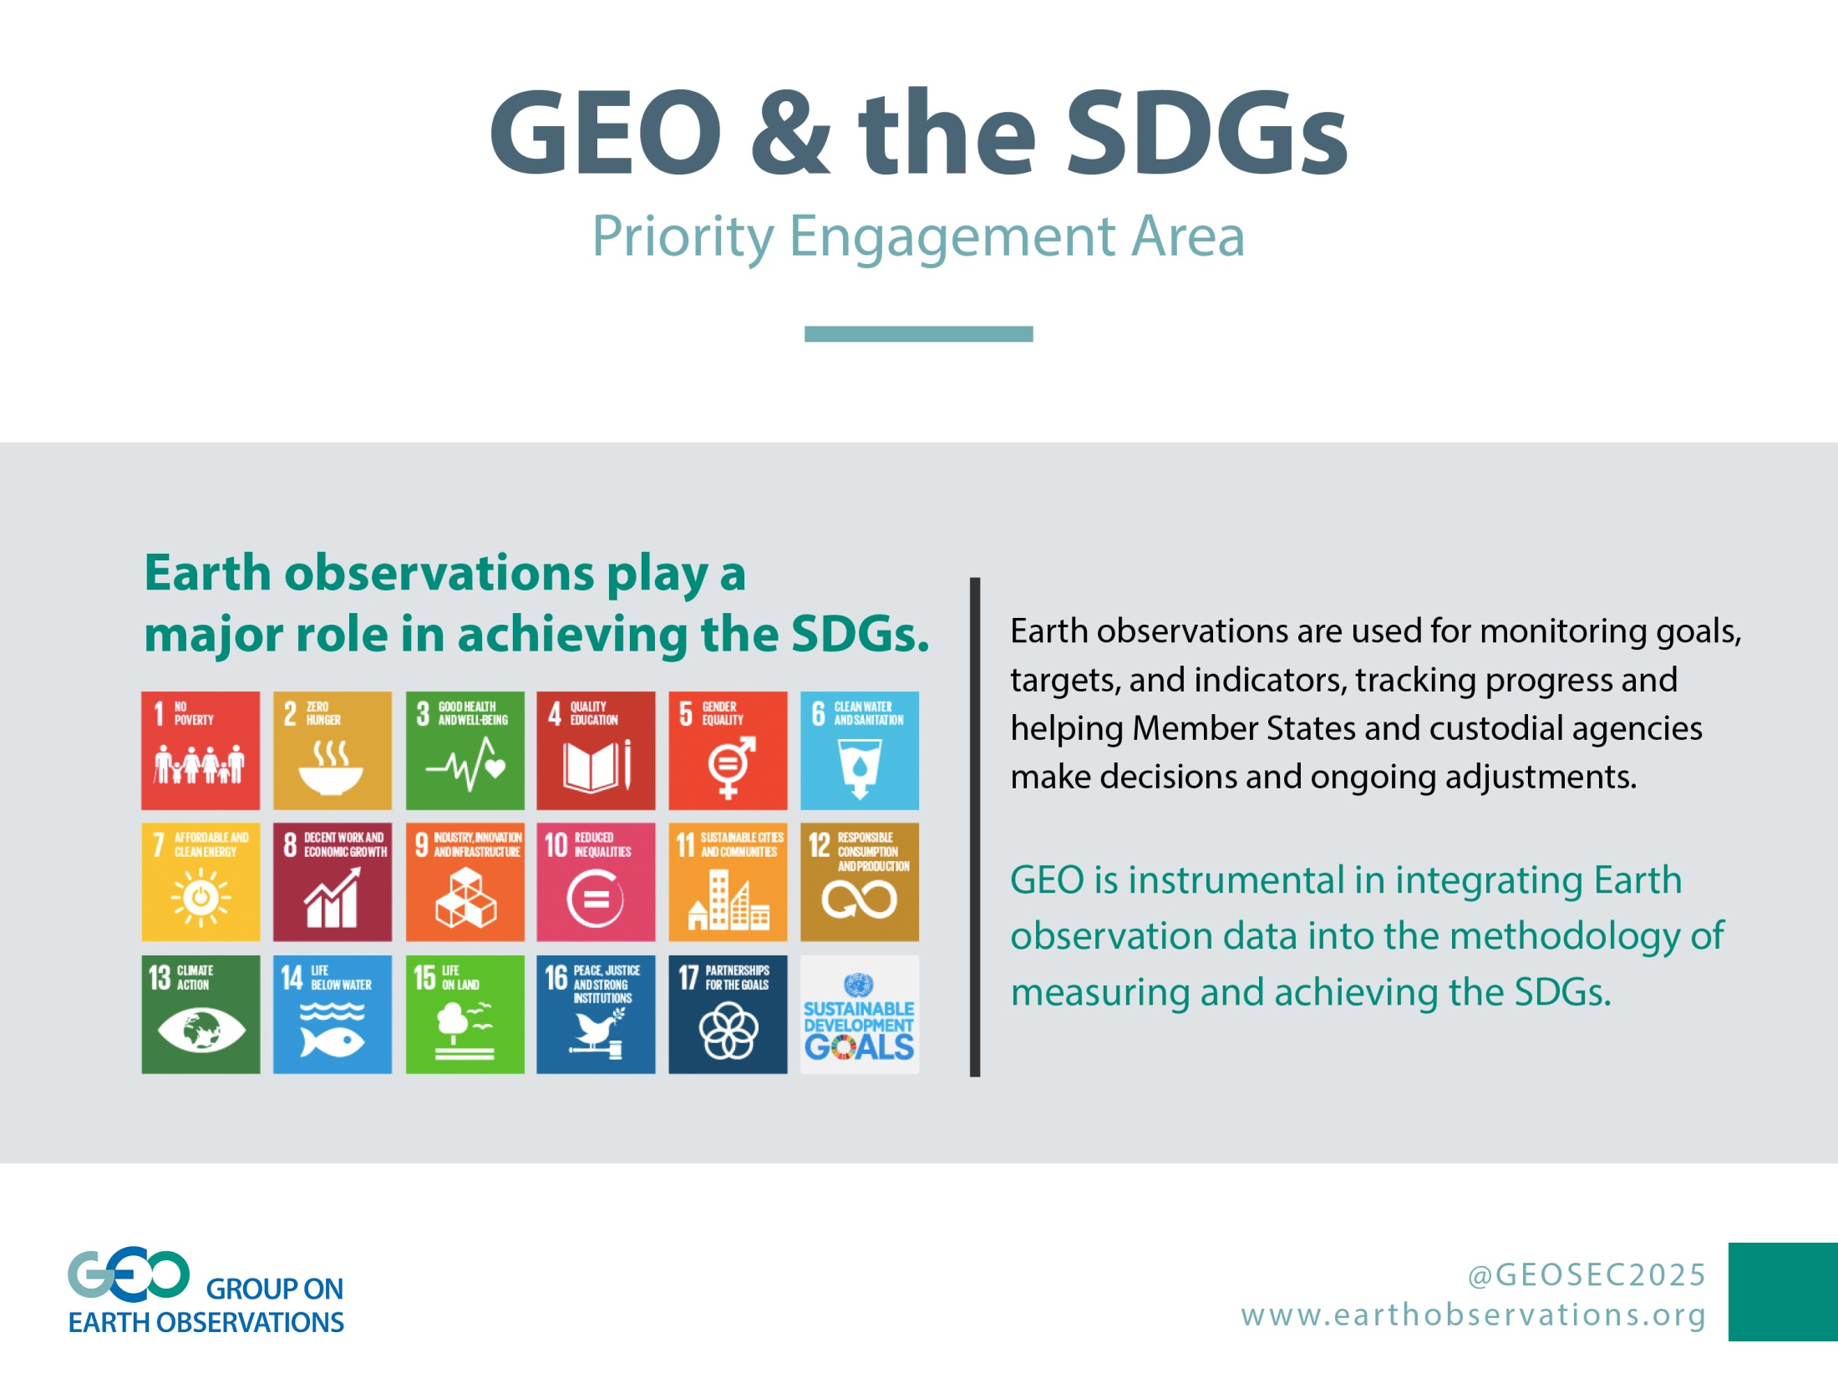

Slide 4

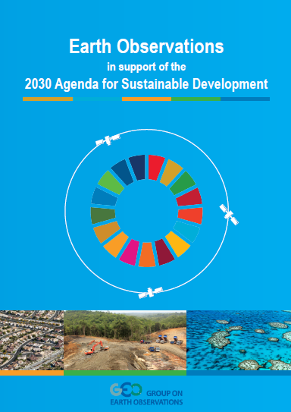
Agenda 2030
EO Case Studies
GEO is instrumental in integrating Earth observation data into the methodology of measuring, monitoring and achieving the SDG Indicators.
Brochure gives graphic illustrations of EO data allowing decision-makers to help identify the status of conditions they need to report, as well as visualize solutions.
https://www.earthobservations.org/documents/publications/201703_geo_eo_for_2030_agenda.pdf

Slide 5
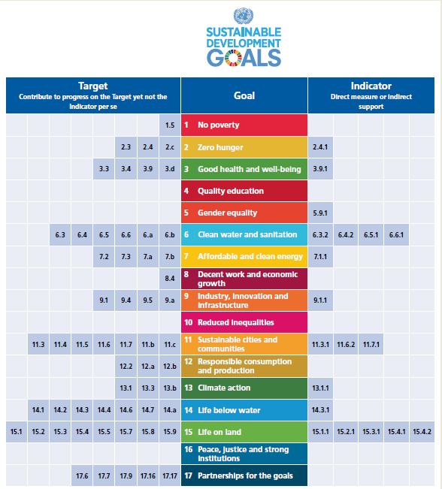
EO4SDG
GEO Initiative

Slide 6

In-Country activities
6.6.1 Extent of water-related ecosystems
GEO and NASA are coordinating with UN Environment through the EO4SDG Initiative to measure spatial extent of open water bodies in 8 countries (starting with Peru, Senegal and Jamaica), generate maps and analysis, and also test the use of very high resolution remote sensing in 3 of 8 countries.
The NASA team will provide maps & estimates of vegetated wetlands extent across a select group of the 8 countries.
For water quality, the NASA team will be using Landsat and Sentinel-2 to produce concentrations of Total suspended solids (TSS) and Chlorophyll-a (Chl) products.
All National EO analysis will be packaged by NASA and provided to countries by UN Environment (around October 2017). Training sessions will follow dissemination of these EO data analyses.

Slide 7


Developing methodologies
15.3.1 Proportion of degraded land over total land area
GEO representatives have again been extensively involved with UNCCD and FAO in their efforts to develop methodologies for monitoring degraded land through use of EO techniques.
GEO has been asked to provide advice and expertise in the UN process of elevating Goal 15 indicators to higher classification based on development and translation of EO techniques into robust methods that can be supported by the global statistical community.

Slide 8
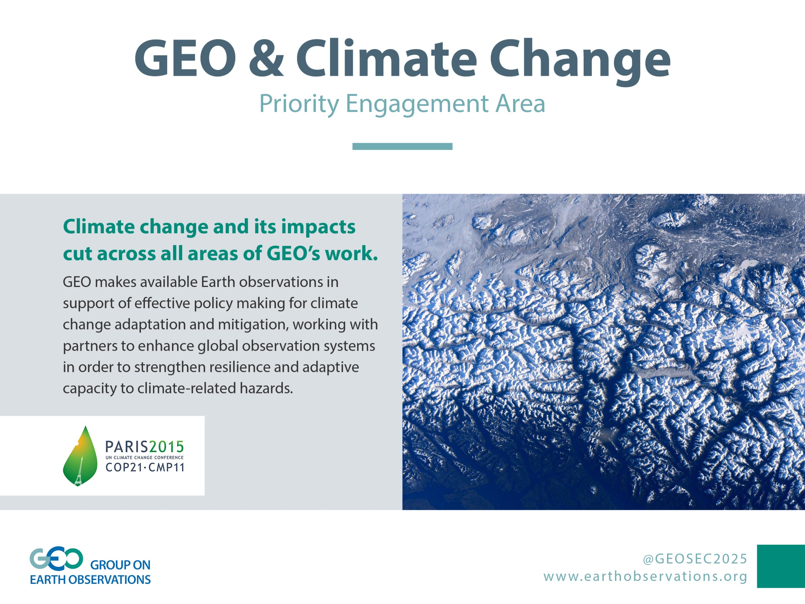

Slide 9

Climate Change
Responding to the Paris Agreement
Article 4 and Article 13 – National Reporting
Reported five-yearly by parties, successive reductions in emissions
Using existing methods and guidance; not validation
Article 5 Mitigation
Knowledge of evolution of sinks and sources
Article 7 Adaptation
(7.6) Strengthening cooperation,
(7.7c) Research, systematic observation
Article 10 Technology Transfer
& Article 11 Capacity Development
Article 14 Global stocktaking
in the light of equity and the best available science: 2023, 2028…
Article 15 Compliance
GEO PB Action (Aug 2017):
Organise a workshop on the EO response to the Paris Agreement

Slide 10

GCOS/GEO Side Event -- COP-23
Current status
UNFCCC (Sep 2016) endorsed GEO to have independent eligibility to apply for Side Events and Exhibits at future UNFCCC sessions
GEO and GCOS Secretariats developed a joint Side Event concept
  Topic: Integrated observations for mitigation and adaptation & Practical support to Parties
Side Event scheduled for 13h15 on Wednesday, 8 November
GEO Exhibition booth both weeks – open for Lightening Talks

Slide 11

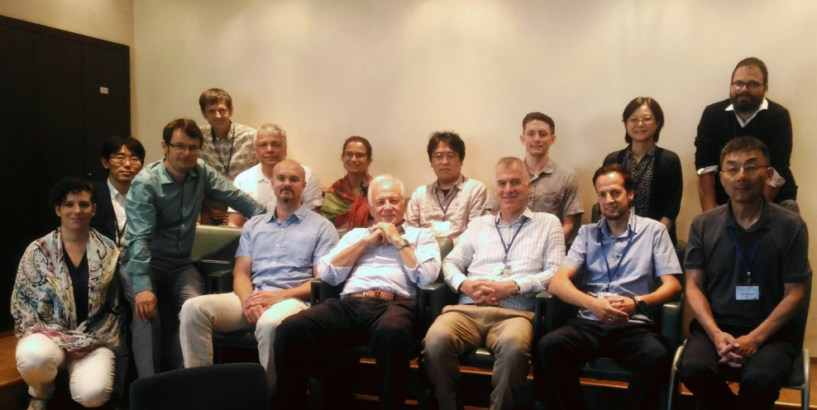
GEO Carbon and GHG Initiative
Path forward
Kick-Off Meeting, 6-7 July 2017, Rome
Outcomes (Outgrowths)
Set up a Steering and Advisory Board to ensure senior-level leadership
Establish a Secretariat to coordinate technical implementation
Draft a White Paper to get the broad buy-in
Develop Showcases to demonstrate added value

Slide 12
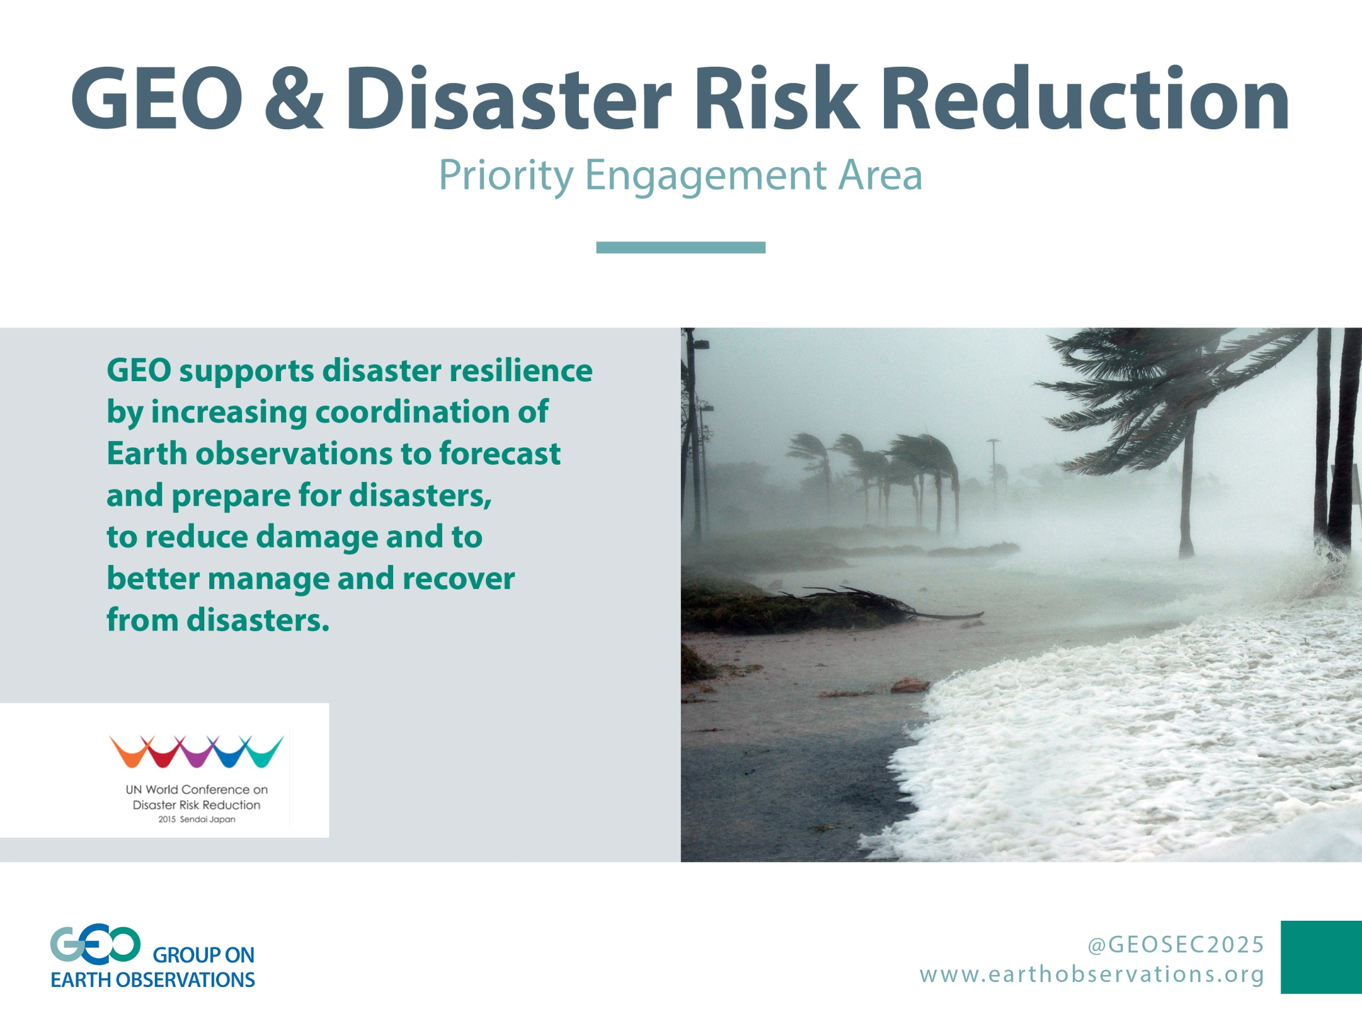

Slide 13
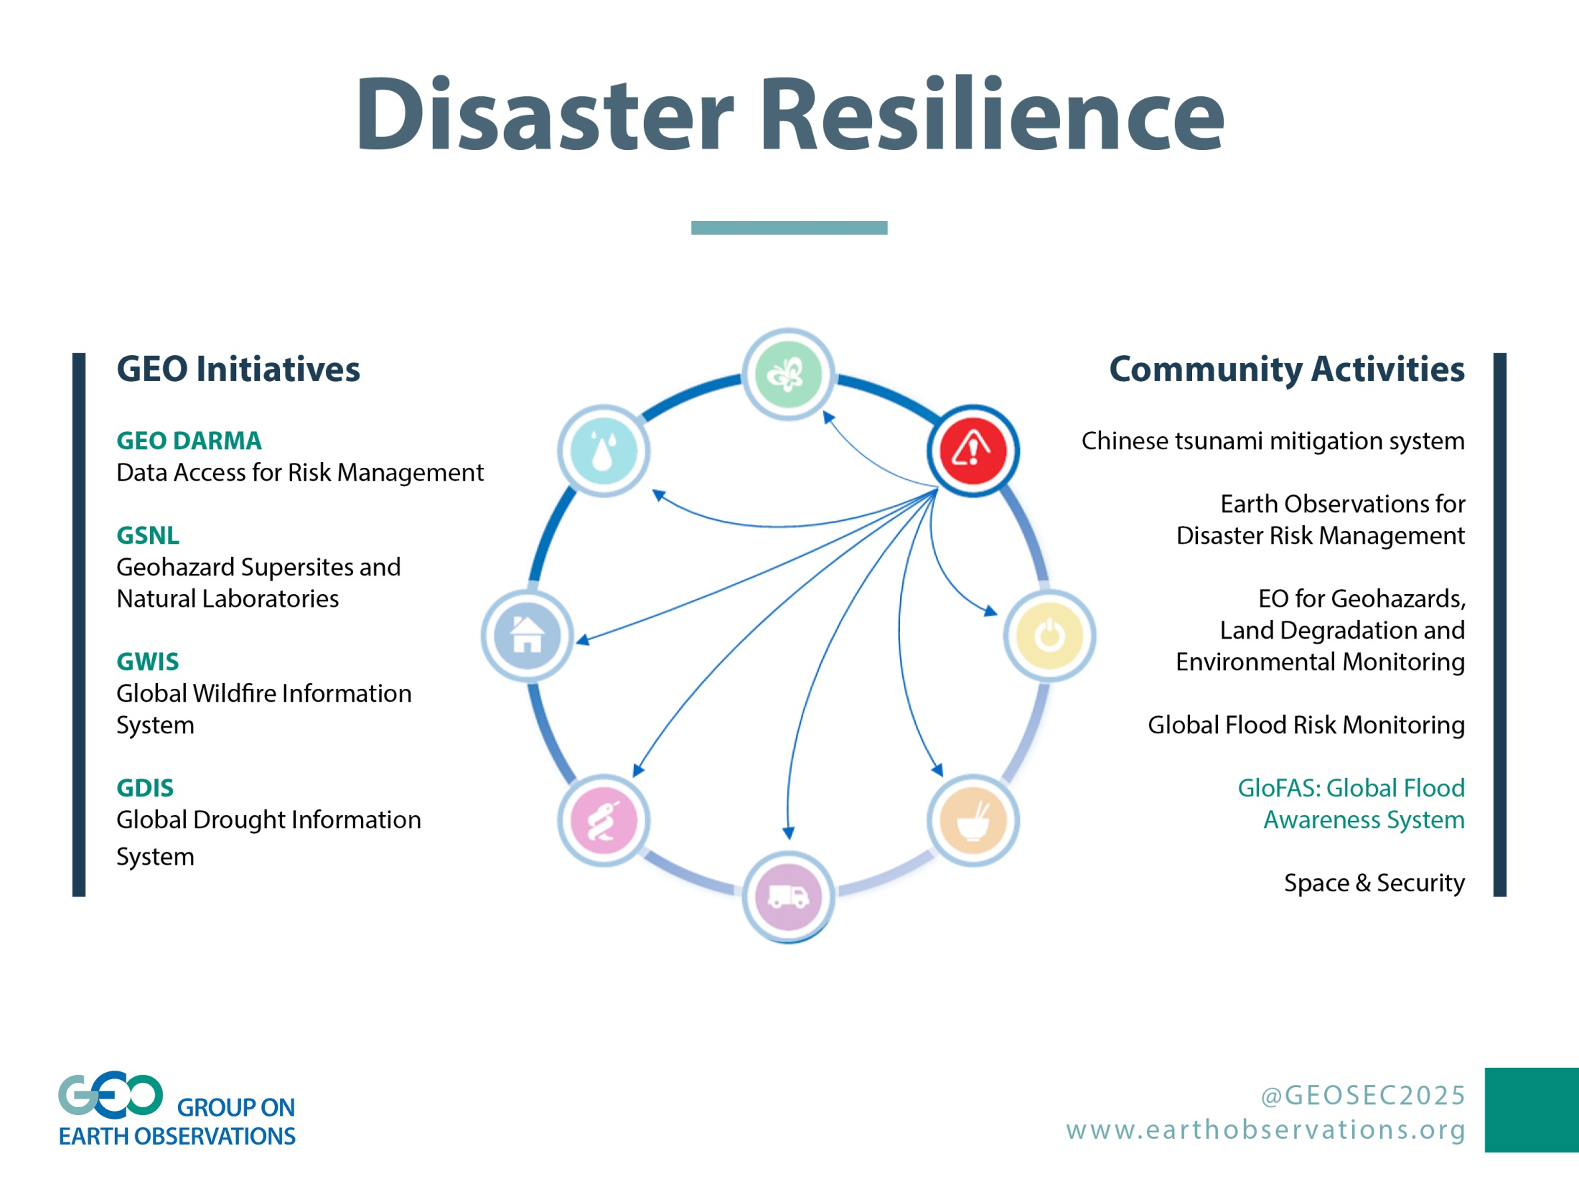

Slide 14
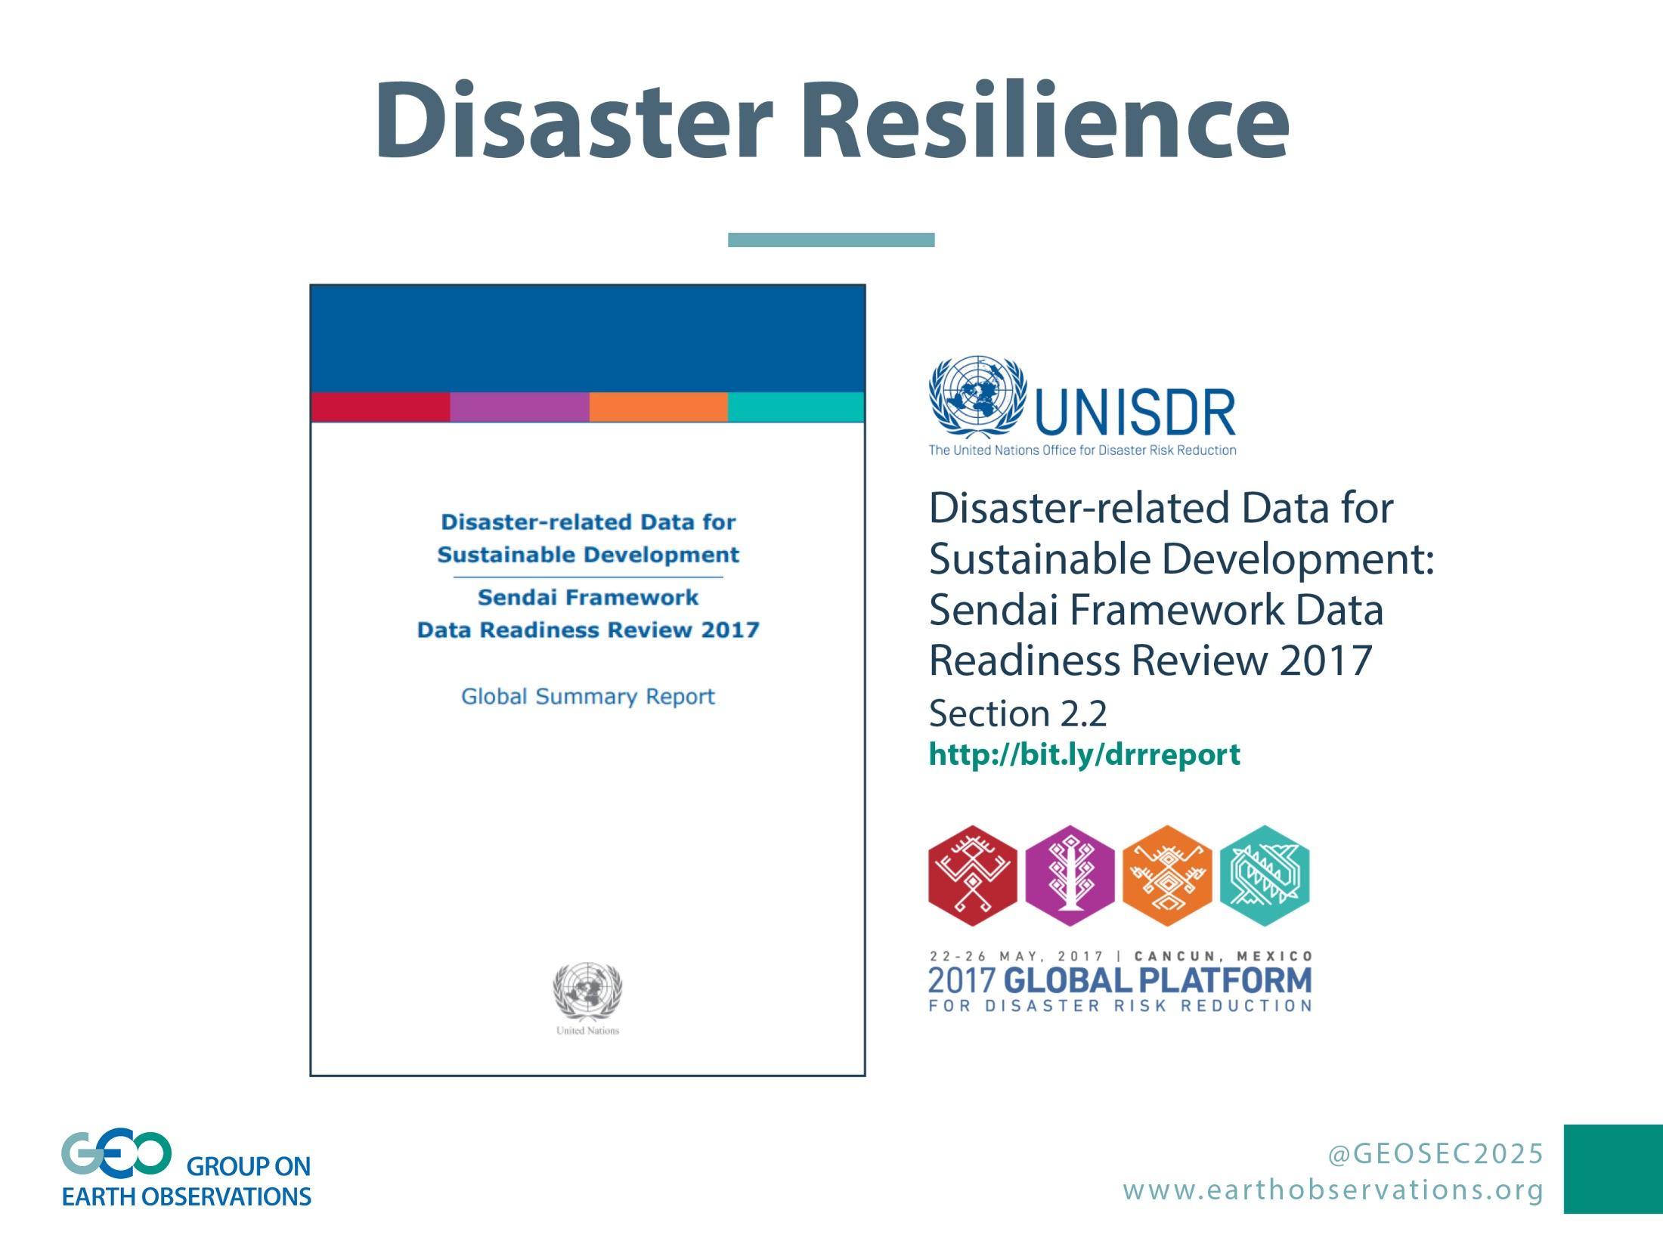

Slide 15
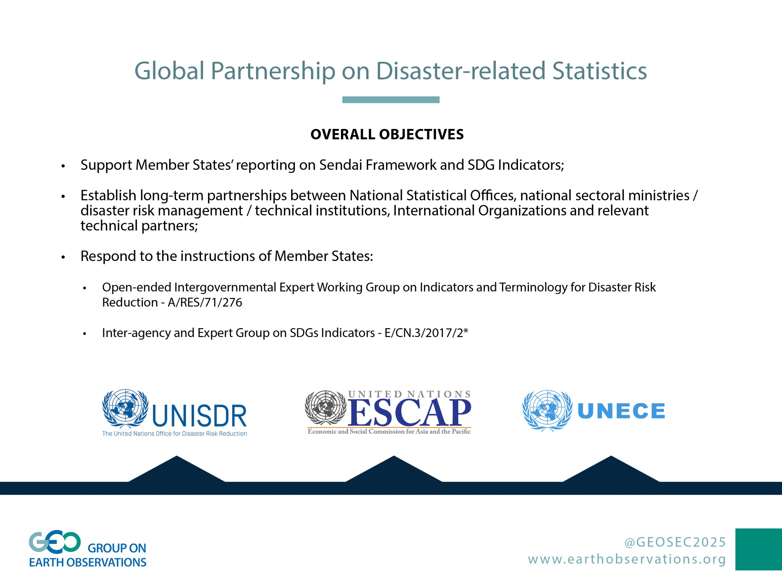

Slide 16


Slide 17

