Slide 1



Russian Remote Sensing System:
Current STATus and prospects of development

Slide 2
Priorities of Remote sensing constellation development
In Russia, the Earth remote sensing constitutes one of the priority lines of space activities which regulation is the responsibility of the ROSCOSMOS State Space Corporation
The Russian Federal Space Program for 2016–2025 envisages more than double increase in data resource of the Russian satellite constellation group and productivity of remote sensing ground infrastructure.

Slide 3








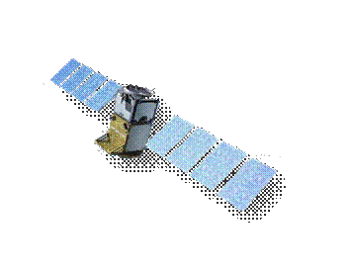

Hydrometeorology
Natural Resources
THE Russian remote sensing
constellation
Meteor-M1
Meteor-M2
Meteor-M2.1
Meteor-M2.2
Meteor-M2.3
Meteor-M2.4
Meteor-M2.5
Meteor-MP
hygrometeorologyn
Arktika-M1
Arktika-M2
Arktika-M3
Meteor-M3
Arktika-M4
Arktika-M4
Elektro-L1
Elektro-L2
Elektro-L3
Elektro-L4
Elektro-L5
Elektro-L5
2016
2017
2018
2019
2020
2021
2022
2023
2024
2025
Resurs-P1
Resurs-P 2
Resurs-P 3
Resurs-P 4
Resurs-P 5
Resurs-PM1
Resurs-PM 2
Resurs-PM 3
Resurs-PM 4
natural resources
Kanopus-V1
Kanopus-V-IK
Kanopus-V 5
Obzor-O1
Obzor-O2
Kanopus-V 3
Kanopus-V 6
Kanopus-V 4
Kondor-FKA1
Kondor-FKA2
Obzor-R1
Obzor-R2
Obzor-R3
Всего
7
8
12
16
17
21
22
22
21
22
22
Multispectral imaging (VIS and IR)
Radar imaging

Slide 4
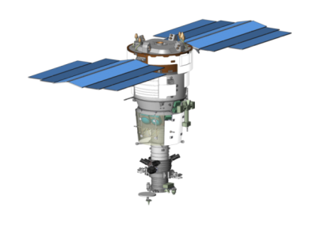
Resurs-P satellite
MISSION PURPOSE
Acquisition of VIS and NIR highly-detailed remote sensing data in real time for ecological monitoring, natural resources inventory, mineral exploration, and large-scale mapping
Sensor Complement
Very High Resolution Optoelectronic Sensor [Geoton]
  PAN resolution (0.60–0.72µm) – 0.9m
  MS resolution (5 bands: 0.45–0.90µm) – 3m
  Swath width – 38km
Wide-Swath Multispectral High Resolution Sensor [ShMSA-VR]
  PAN resolution
  (0.58-0.80µm) – 12m
  MS resolution
  (bands: 0.43–0.90µm) – 23.8m
  Swath width – 97km
Wide-Swath Multispectral Medium Resolution Sensor [ShMSA-SR]
  PAN resolution (0.58–0.80µm) – 60m
  MS resolution (5 bands: 0.43–0.90µm) – 120m
  Swath width – 441km
  Hyperspectral Sensor [GSA]
  Resolution (96-255 bands, 0.4-1.1µmкм) – 30m
  Swath width – 25km
  Launch date – June 25, 2013 (Resurs-P1)
  December 26, 2014 (Resurs-P2)
  March 13, 2016 (Resurs-P3)
  Current Tasks
Maps creation and update (scale >1:10,000)
Environmental monitoring
Operational disaster monitoring
Respond to agriculture and forestry challenges
Socio-economic infrastructure monitoring

Slide 5
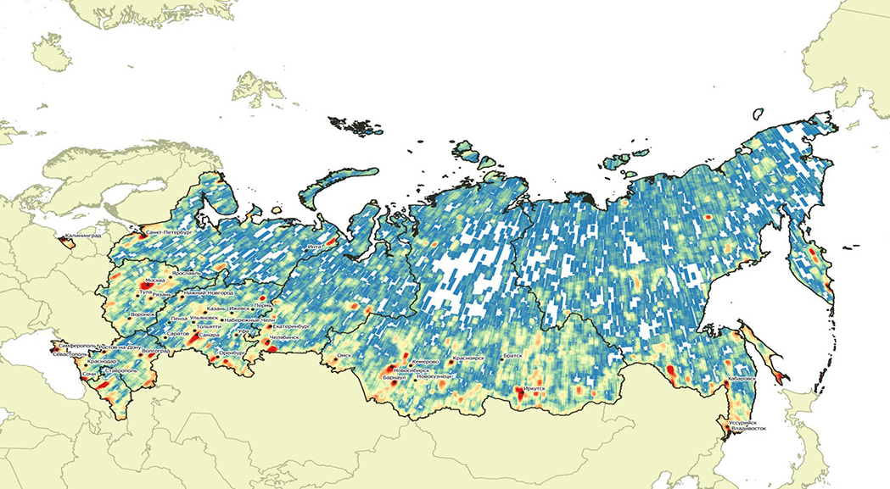
Coverage of Russia with Resurs-P data
The area of the Russian territory coverage with the Resurs-P No.1 and No.2 data
(PAN and MS data) is more than 30 million sq. km since 2013

Slide 6
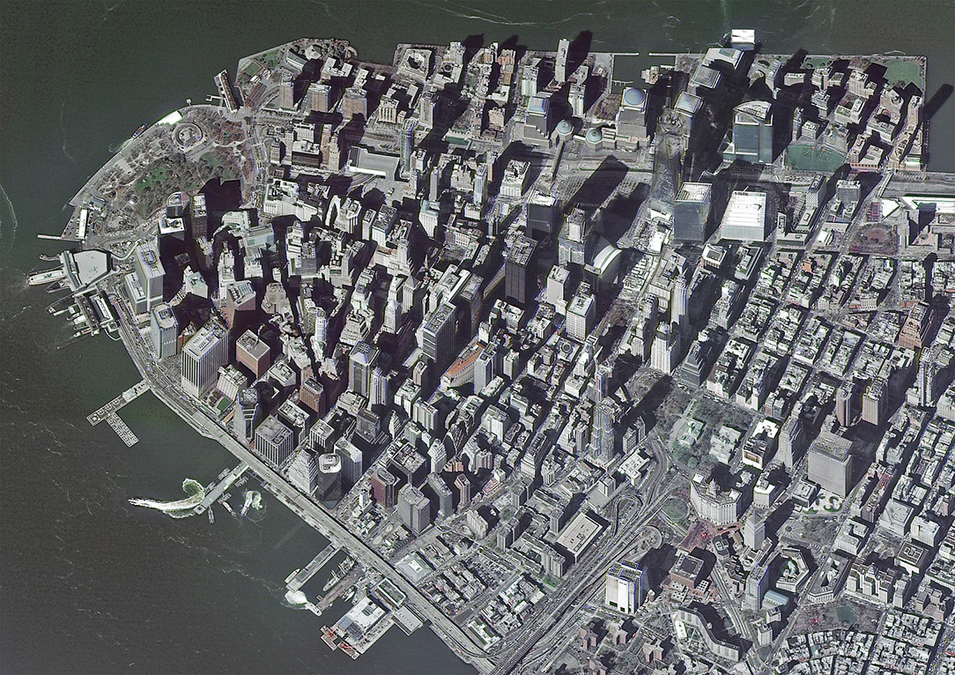
Resurs-P image
New-York, USA

Slide 7
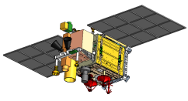
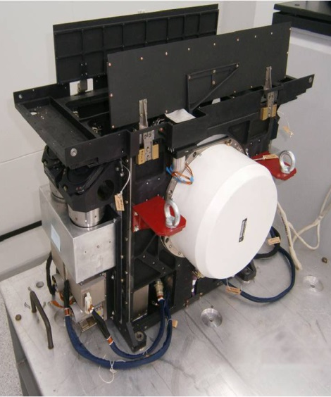
KANOPUS-V satellite
Mission Purpose
Acquisition of remote sensing high resolution VIS and NIR data for ecological monitoring, natural resources inventory, mineral exploration, and large-scale mapping
  Launch date – July 22, 2012 (Kanopus-V1)
  July 14, 2017 (Kanopus-V-IK)
Sensor complement
PAN Imaging System [PSS]
  Resolution (0.54–0.86µm) – 2.1m
Swath width – 23km
MS Imaging System [MSS]
  Resolution (4 bands: 0.46–0.84µm) – 12m
Swath width – 20km
Multispectral IR Scanner Unit [MSU-IK-SRM] – Kanopus-V-IK
  Resolution
  (2 bands: 3.5–4.5, 8.4–9.4µm) – 200m
Swath width – 2000km
Noise Equivalent Temperature at 300K – 0.1-0.2 К
Minimal area of fire seat detected – 5×5m
  Next launch – December 2017
  Current Tasks
Maps creation and update (scale >1:25,000)
Ecological monitoring
Disasters monitoring
Respond to agriculture and forestry challenges
Socio-economic infrastructure monitoring
МСУ-ИК-СРМ

Slide 8
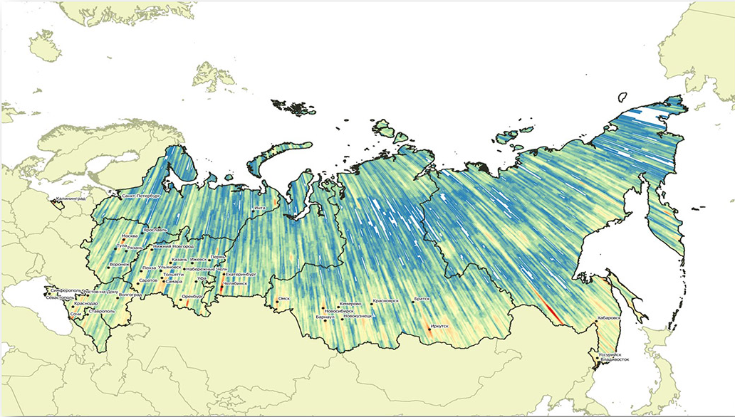
Coverage of Russia with kanopus-V data
The area of the Russian territory coverage with the Kanopus-V data (PAN and MS data) is more
than 50 million sq. km since 2013

Slide 9
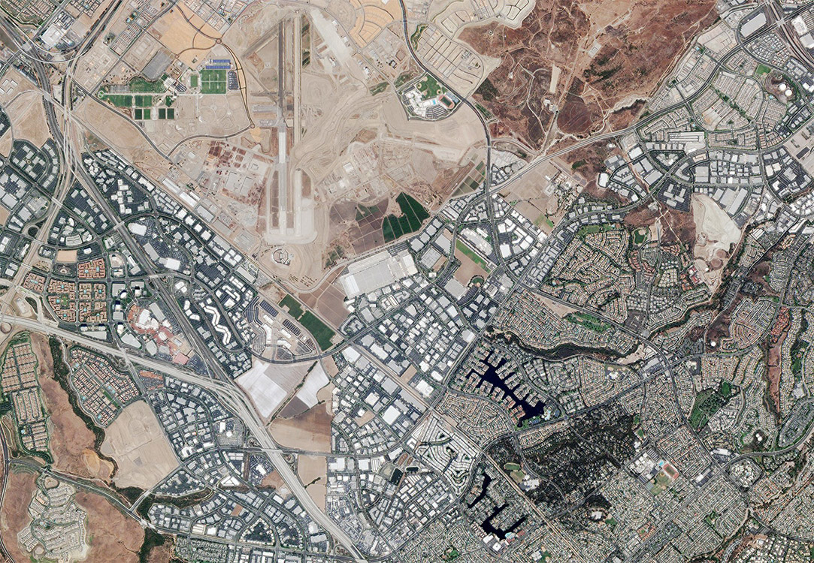
Kanopus-V image
Irvine, California, USA

Slide 10
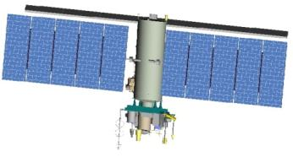
Meteor-M satellite
Mission Purpose
Operational acquisition of data on cloudiness and the Earth’s underlying surface, hydrometeorological data collection, heliogeophysical research, and ecological monitoring
Sensor complement
  Multispectral Scanning Imaging System [KMSS]
Multispectral scanning instrument [MSU-100]
  MS resolution
  (3 bands:
  0.53–0.57, 0.63–0.68, 0.76–0.90µm) – 60m
  Swath width – 900km
Multispectral scanning instrument [MSU-50]
  MS resolution
  (3 bands: 0.37-0.45, 0.45-0.51,
  0.58-0.69µm) – 120m
  Swath width – 900km
  Low-resolution multispectral scanning instrument [MSU MR]
  MS resolution
  (6 bands: 0.5–0.7, 0.7–1.1, 1.6–1.8, 3.5–4.1,
  10.5–11.5, 11.5–12.5µm) – 1000m
  Swath width – 2800km
  Heliogeophysical Instrument Complex [GGAK]
  Launch date – 17 September 2009 (Meteor-M1)
  8 July 2014 (Meteor-M2)
  Current tasks
Environmental monitoring
Ice conditions monitoring
Operational emergency monitoring
Radiation and heliophysical condition monitoring in near space

Slide 11
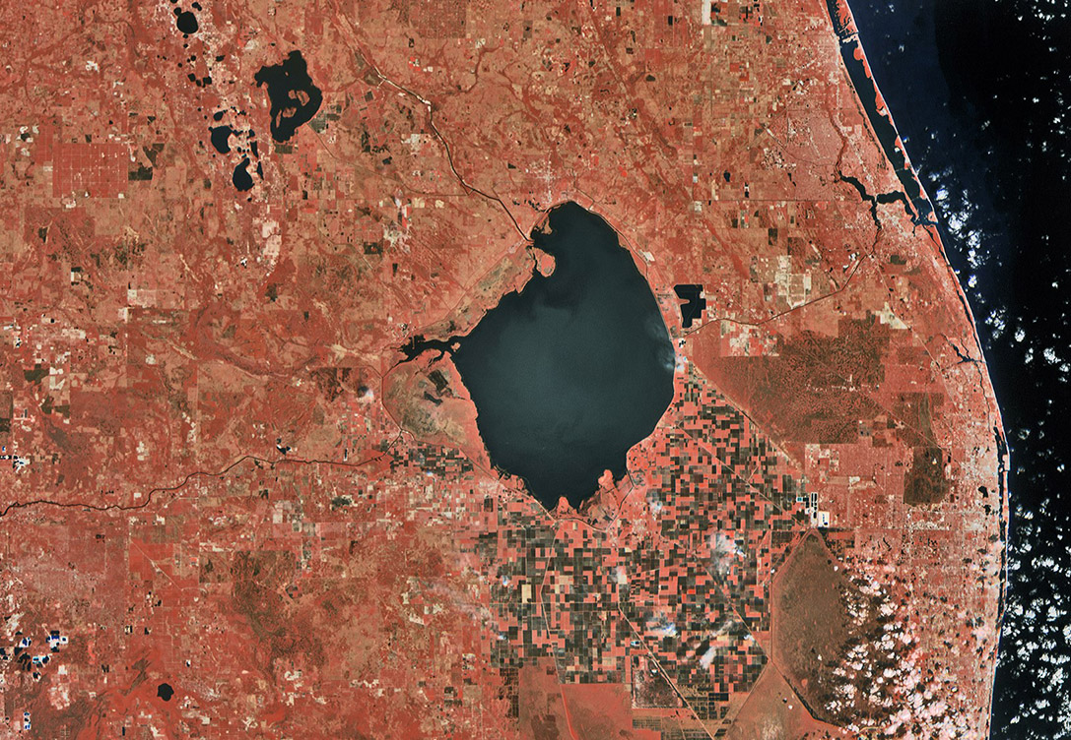
Meteor-M image
Lake Okeechobee, USA

Slide 12
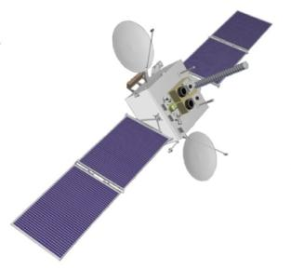
Elektro-L SATTELITE
Mission Purpose
Operational acquisition of data on cloudiness and the Earth’s underlying surface, hydrometeorological data collection, and heliogeophysical measurements
Sensor complement
  Multispectral scanner [MSU-GS]
  Coverage area – visible disk of the Earth
  VIS resolution
  (3 bands:
  0.46–0.65, 0.65–0.80, 0.80–0.90µm) – 1000m
  NIR resolution
  (7 bands:
  3.5–4.1, 5.7–7.0, 7.5–8.5, 8.2–9.2,
  9.2–10.2, 10.2–11.2, 11.2–12.5µm) – 4000m
  Swath width – 900km
  Revisit period – 30 min (as scheduled)
  – 15 min (by request)
  Heliogeophysical instrument complex [GGAK]
  Launch date – January 20, 2011 (Elektro-L1)
  currently located at 76°E
  10 December 2015 (Elektro-L2)
  currently located at 77.8° E
  Current tasks
Operational imagery of the earth’s underlying surface
Ocean monitoring
Global monitoring of emergencies

Slide 13
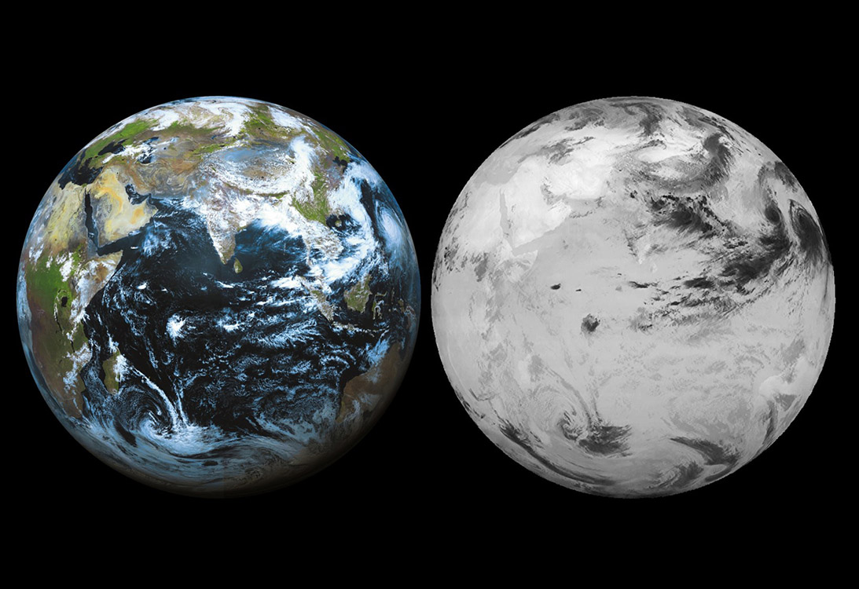
ELEKTRO-L
Visible range (RGB)
IR band (10.2-11.2nm)

Slide 14
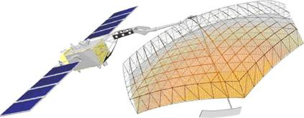
Kondor-FKA
Mission objectives
Operational all-weather 24-hour monitoring of the Earth over the latitude range between 90N and 90S
Onboard Instrument SAR (S-band)
Imaging modes | Resolution (m) | Swath width (km) | Frame size (km) | Polarization
Spotlight | 1-2 | 2×500 | 10×10 | HH VV
Fine | 1-3 |  | 10×500
Standard | 6–12 |  | (20–100)× 500
  Planned launches
  – 2019 (Kondor-FKA1)
  – 2020 (Kondor-FKA2)
  Data applications
Operational disaster monitoring
Topographic mapping, DEM, DTM
Environmental monitoring
Agriculture and forestry monitoring
Socio-economic infrastructure monitoring
Shipping navigation

Slide 15
Obzor-R
Mission objectives
Operational all-weather 24-hour monitoring of the Earth over the latitude range between 90N and 90S
Onboard Instrument SAR (X-band)
Imaging modes | Resolution (m) | Swath width (km) | Frame size (km) | Polarization
Very high resolution | 1 | 2×470 | 10×(15–20) | HH VV HV VH
High resolution | 3–5 | 2×600 | 50×50 | HH VV HV VH V(V+H) H(V+H)
Stripmap | 2 5 | 2×470 2×600 | 10×4000 30×4000
Stripmap wide | 20 40 | 2×600 | 90×4000 220×4000
Wide swath | 200 300 500 | 2×600 2×600 2×750 | 400×4000 600×4000 750×4000
  Planned launches – 2021 (Obzor-R1)
  – 2023 (Obzor-R2)
  Data applications
Operational disaster monitoring
Topographic mapping, DEM, DTM
Environmental monitoring
Agriculture and forestry monitoring
Socio-economic infrastructure monitoring
Shipping navigation

Slide 16
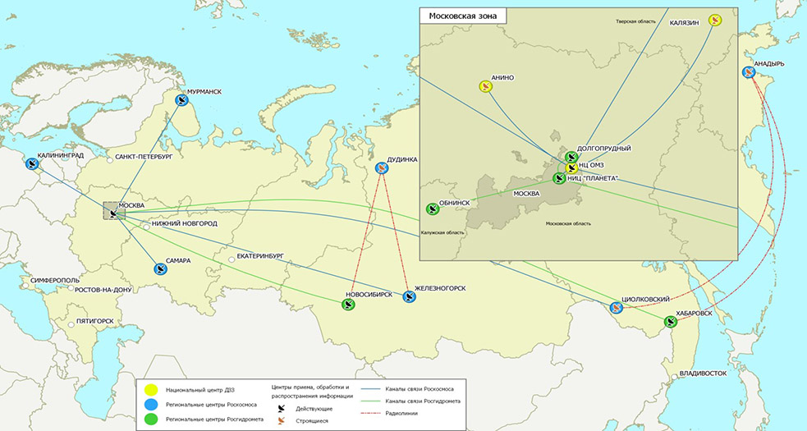
INTEGRATED GEOGRAPHICALLY DISTRIBUTED INFORMATION SYSTEM OF EARTH REMOTE SENSING
The ground-based space remote sensing infrastructure basic components providing the guaranteed target use of the Russian in-orbit remote sensing satellite constellation were constructed in 2016:
Integrated Geographically Distributed Information System of Remote Sensing (6 Roscosmos centers,
5 Roshydromet centers, new centers in Murmansk and Kaliningrad will be commissioned in 2016);
Bank of basic remote sensing data products of interagency use;
Ground-truth observation validation system;
Remote sensing data certification center

Slide 17
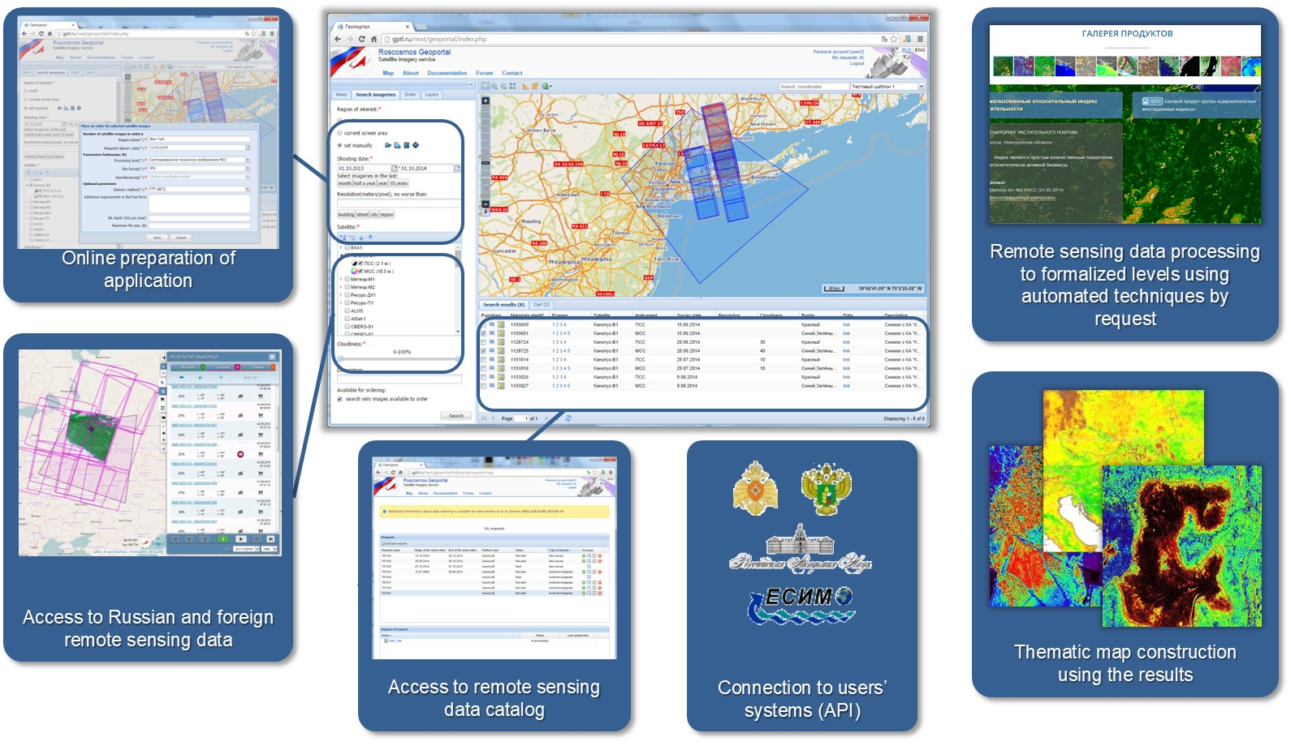
INTEGRATED SOLUTIONS OF OPERATOR OF REMOTE SENSING SPACE SYSTEMS

Slide 18
PRIORITIES of THE Russian remote sensing system development
Developing hydrometeorological facilities including practical use of modern target equipment and scientific instruments (microwave radiometers, Fourier spectrometers etc.);
Constructing all-weather radar observing facilities, especially in S- and Х-band;
Establishing the National Remote Sensing Center in order to provide a one-man management of target use of in-orbit satellite constellation and ground-based space infrastructure of Earth remote sensing to secure an optimal distribution of data flows with extended functional of scientific research and experimental operation of prospective remote sensing facilities including with regard to solving thematic tasks by governmental and commercial customers;
Creating an end-to-end quality control of the target equipment at all stages of satellite lifetime, data and data products validation;
Creating a system of automatic (flow) generation of key socioeconomic products and geoservices in real time.

Slide 19
ROSCOSMOS Participation in CEOS
ROSCOSMOS is a member WGCV, WGISS and Working Group on Disasters
ROSCOSMOS provides the latest information on Russian satellites to update the CEOS MIM Database
ROSCOSMOS implements a set of activities aimed at opening up access to some Russian remote sensing data (Open Data Portal establishing and the ROSCOSMOS’s geoinformation services catalogs connection to the CWIC)
ROSCOSMOS organized and hosted the 13th GEO Plenary in November 2016 and in October 2017, ROSCOSMOS holds the 8th Asia/Oceania Meteorological Satellite Users’ Conference (Vladivostok city).

Slide 20
Thank you!

