Slide 1
CNES Earth Observation Program Update
Committee on Earth Observation Satellites
Juliette Lambin
Centre National d’Etudes Spatiales
CEOS Plenary 2017
Agenda Item 4.19
Rapid City, South Dakota, USA
19 – 20 October 2017

Slide 2
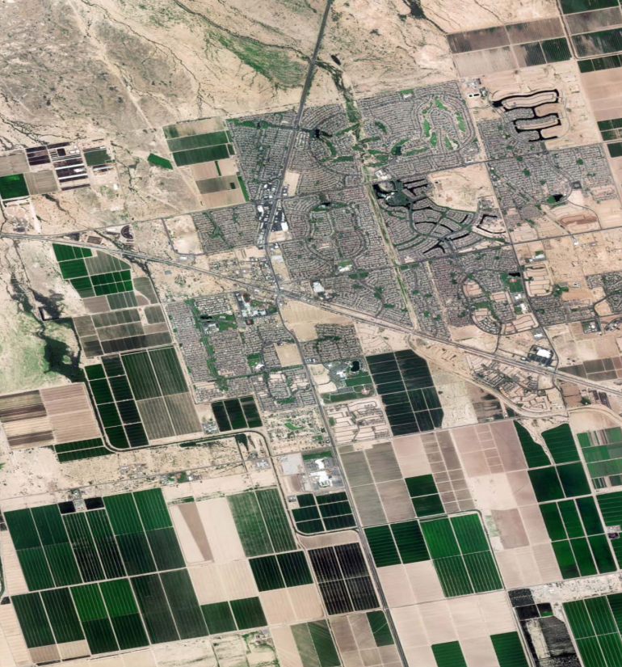
CNES programmes recent highlights
2017 CEOS Plenary – RAPID CITY 19-20 oct 2017
Venµs launch: August 1st 2017
Cooperation with ISA
Microcarb phase C/D decision
Targeted launch date: end 2020
CFOSAT : satellite under completion
delivery of SWIM instrument to CNSA (China)
Launch expected summer 2018

Slide 3
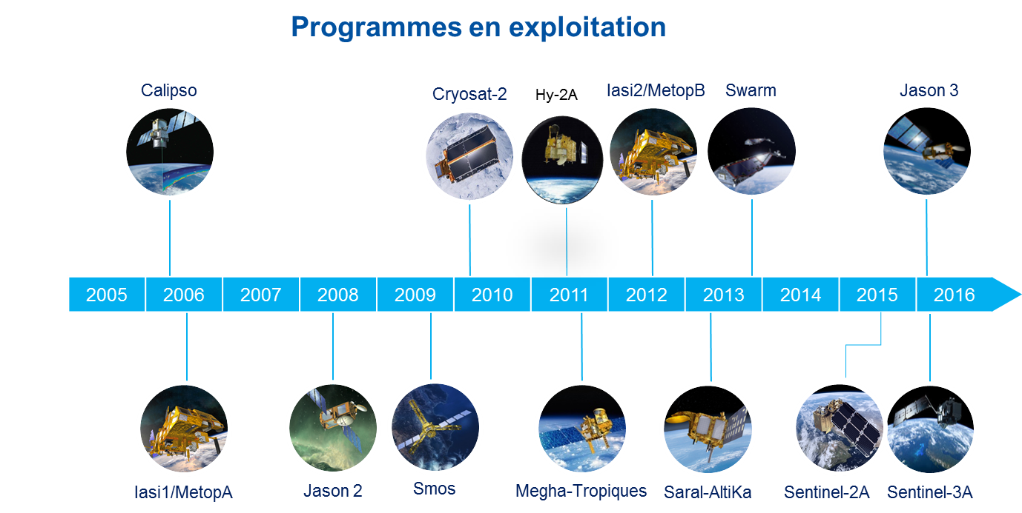
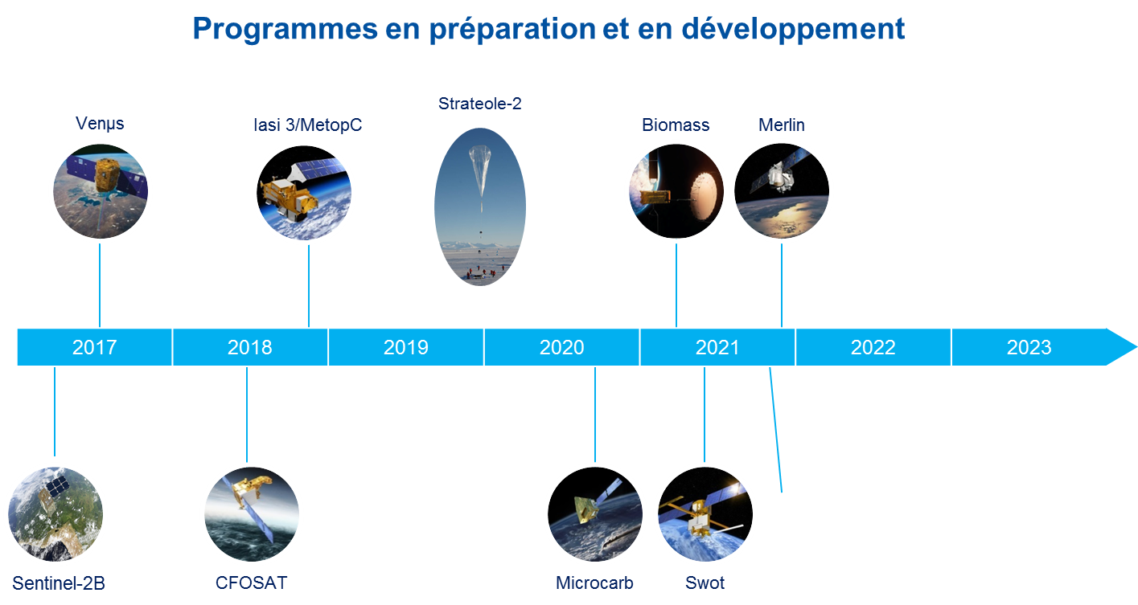
Overview
2017 CEOS Plenary – RAPID CITY 19-20 oct 2017
In operation….
…in development
NASA
EUMETSAT
ESA
ISRO
CNSA
UKSA
DLR
ISA
CSA
JAXA

Slide 4
CNES and Climate
2017 CEOS Plenary – RAPID CITY 19-20 oct 2017
Upcoming:
Climate Summit on Dec 12h in Paris =>
Space agencies dinner on Dec 11th
Address the 3 topics of previous declarations
Round tables to discuss progress, remaining challenges
Work on a Paris Declaration
Draft to be circulated soon (before COP-23)
Bonn Nov 22nd HoSA dinner as an occasion to review the declaration.
Common communication tool initiative
Support to COP 21 – Paris
Microcarb decisions
Space agencies common declarations
2015 Mexico : Climate change & Disaster management
2016 New Delhi : GHG monitoring
2016 Marrakesh: Water
Paris Air show diner
June 18th, 2017
Contributions from: AEM, ASI, UAE, CONIDA, ESA, KARI, LAPAN, Swiss Space office…
Feedback, inputs, help from CEOS greatly appreciated!

Slide 5
Thank you for your attention
Juliette Lambin

